Slide 1
Bankers team (Receipt bank problem)
Valentin Zmiycharov (valentin.zmiycharov@gmail.com)
Plamen Hristov (hristov.reading@gmail.com)
Nikolay Marinov (nikolay.marinov@sciant.com)

Slide 2
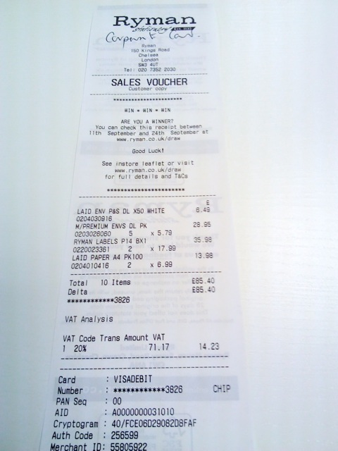
The tasks
What is the currency?
What is the total price?
Who is the supplier?

Slide 3
Total amount approach
Extract all the prices in each receipt
Extract some features for each price
TF-IDF on surrounding text
Count of digits on the price line
Order by occurrence in the receipt
Order by value in the receipt
Can be sum of other prices
Train binary classifier -> Is total price or not?
Calculate probability for each price in the receipt
Select the one with the highest probability

Slide 4
Achieved results for total price
TOP 1 Accuracy: 0.544
TOP 2 Accuracy: 0.607

Slide 5
Achieved results or supplier detection
CountVectorizer, TfidfTransformer, MLPClassifier - 71%
CountVectorizer, TfidfTransformer, LinearSVC - 71.44%
NER + DBScan clustering - untested

Slide 6
Supplier classification using CNN for images
Due to significant variance and group size two suppliers were chosen Taxi Receipts and LE Paint Quotidien.
Taxi Receipt 689/689 [==============================] - 63s - loss: 0.3625 - acc: 0.9086 - val_loss: 0.4827 - val_acc: 0.9004
Le Pain Quotidien 687/687 [==============================] - 62s - loss: 0.4223 - acc: 0.9738 - val_loss: 0.3762 - val_acc: 0.9767

Slide 7
Thank you!
Q&A

