Slide 1

Key management system with HSM
Vítor Neto

Slide 2
Requirements
Secure storage;
Integrity assurances;
Accountability;
Secure cryptographic key generation;
Secure cryptographic operations;
Secure cryptographic key storage;

Slide 3
Hardware security modules
Secure hardware, tamper resistance;
Wide range cryptographic capabilities;
Generate, store, protect cryptographic keys;
High quality random number generation capabilities;
Compliance;
High performance;
Scalable;

Slide 4
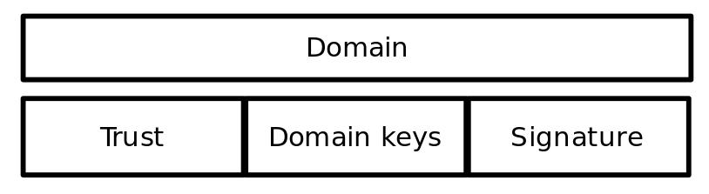
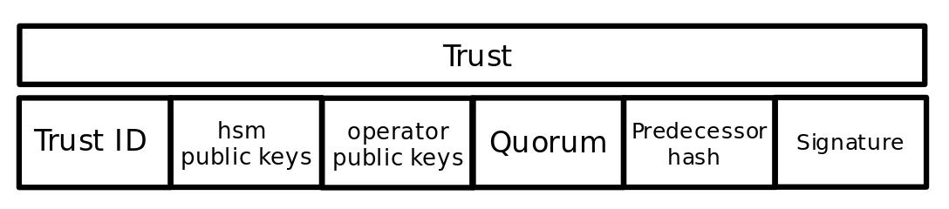
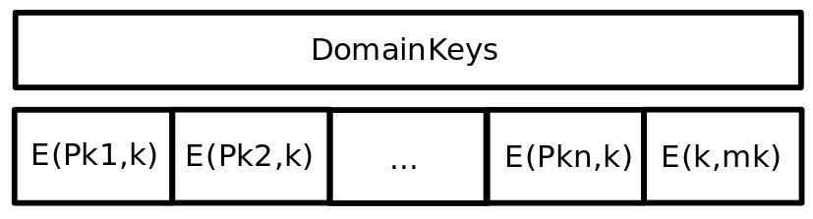
PoC – Data structures

Slide 5
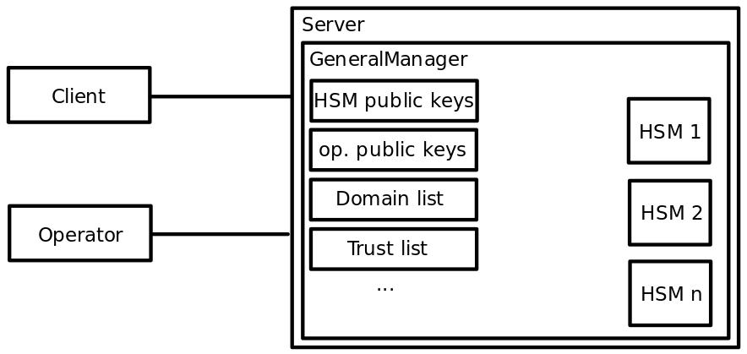
PoC – Architecture

