Slide 1

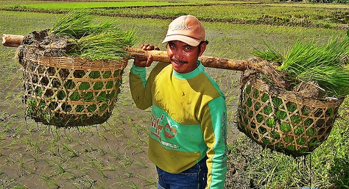

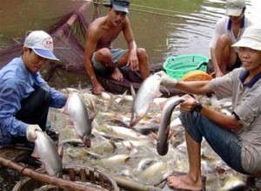
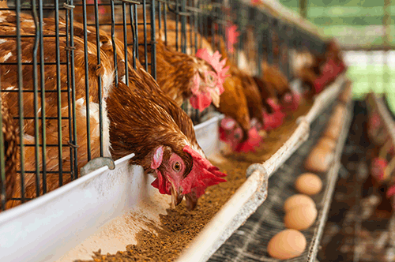

?
?
?
?
?
?
?
?
?

Slide 2
PROBLEM OCCURED
1. Don’t know where to produce their crops, vegetables or poultries within their nearby areas
2. LESS MARKETING STRATEGY
3. Lack of LOW TECHNOLOGY in the province

Slide 3
OVERVIEW & SOLUTIONS
1. Don’t know where to produce their crops, vegetables or poultries within their nearby areas
2. LESS MARKETING STRATEGY
3. Lack of LOW TECHNOLOGY in the province

Slide 4

Producers to Market Solutions for Agricultural Entrepreneurs

