Slide 1
VIRAM Stop for Shop
UNDER THE GUIDANCE OF: MUSKAAN GULRAJANI
Team Members:
Rahul Raushan
Mayuri Mandole
Vainaykee Gupta

Slide 2
VIRAM .
Online shopping system
A web based project which is made for remote shopping through the internet.
Through this user can purchase product
A seller can sell products
And admin can manage the whole application.

Slide 3
The proposed project has three users as follows:
Admin
Seller
Buyer: (Registered/Non-Registered )

Slide 4
Tools used:
Oracle 10g Database.
Eclipse Java EE for web Developers 2018.
Tomcat server 8.0
Spring MVC.
Hibernate.
HTML5, CSS3, JAVASCRIPT, BOOTSTRAP
GIT

Slide 5
AGILE METHODOLOGY
Continuous Iteration of development and testing throughout the software development lifecycle of the project.
Both development and testing activities are concurrent unlike the Waterfall model.
The agile software development emphasizes on four core values.
Individual and team interactions over processes and tools
Working software over comprehensive documentation
Customer collaboration over contract negotiation
Responding to change over following a plan

Slide 6
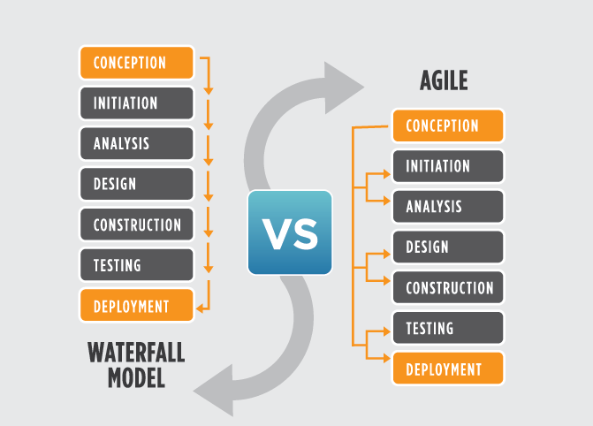
Why Agile?

Slide 7
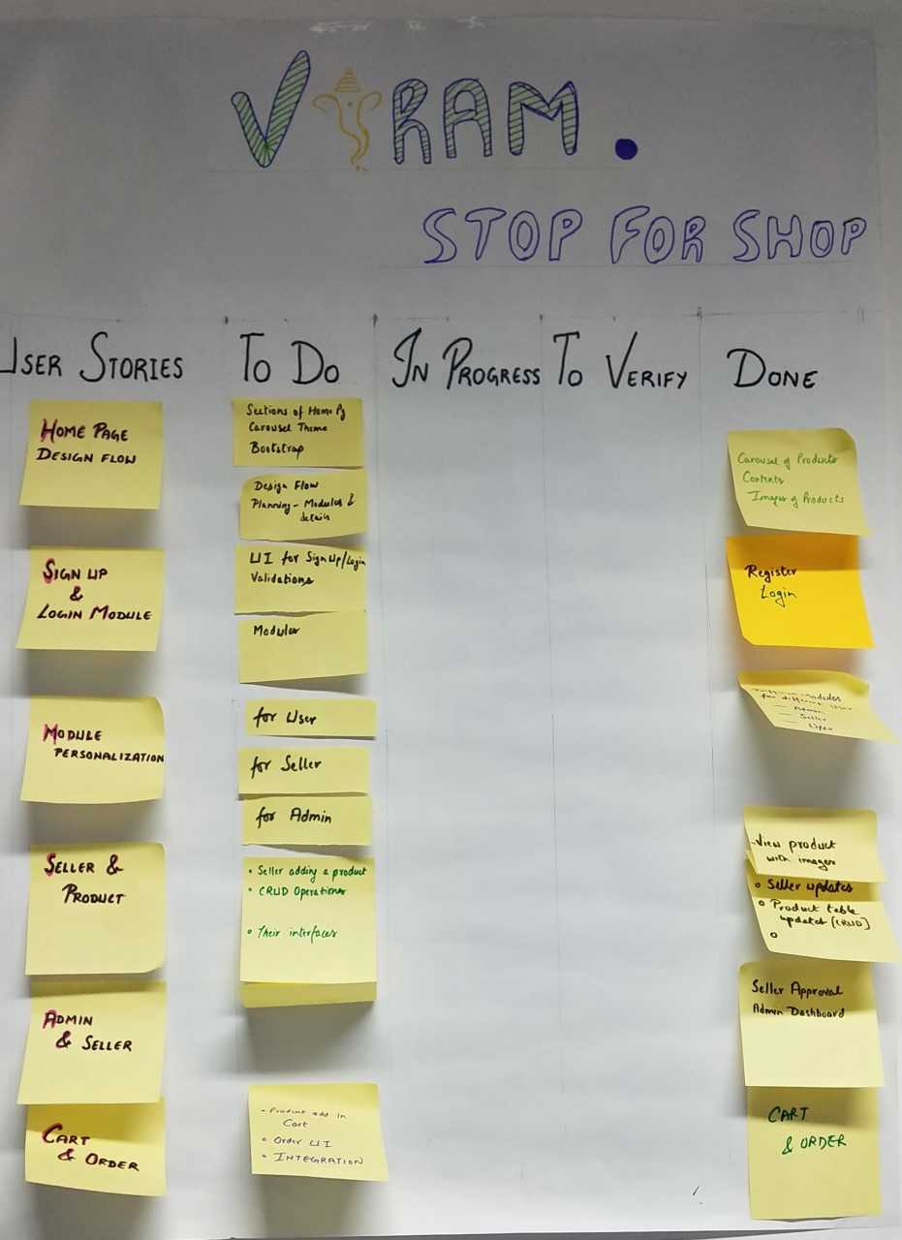
Scrum Chart

Slide 8
MODULES
User Module
Seller Module
Admin Module
Order Module

Slide 9
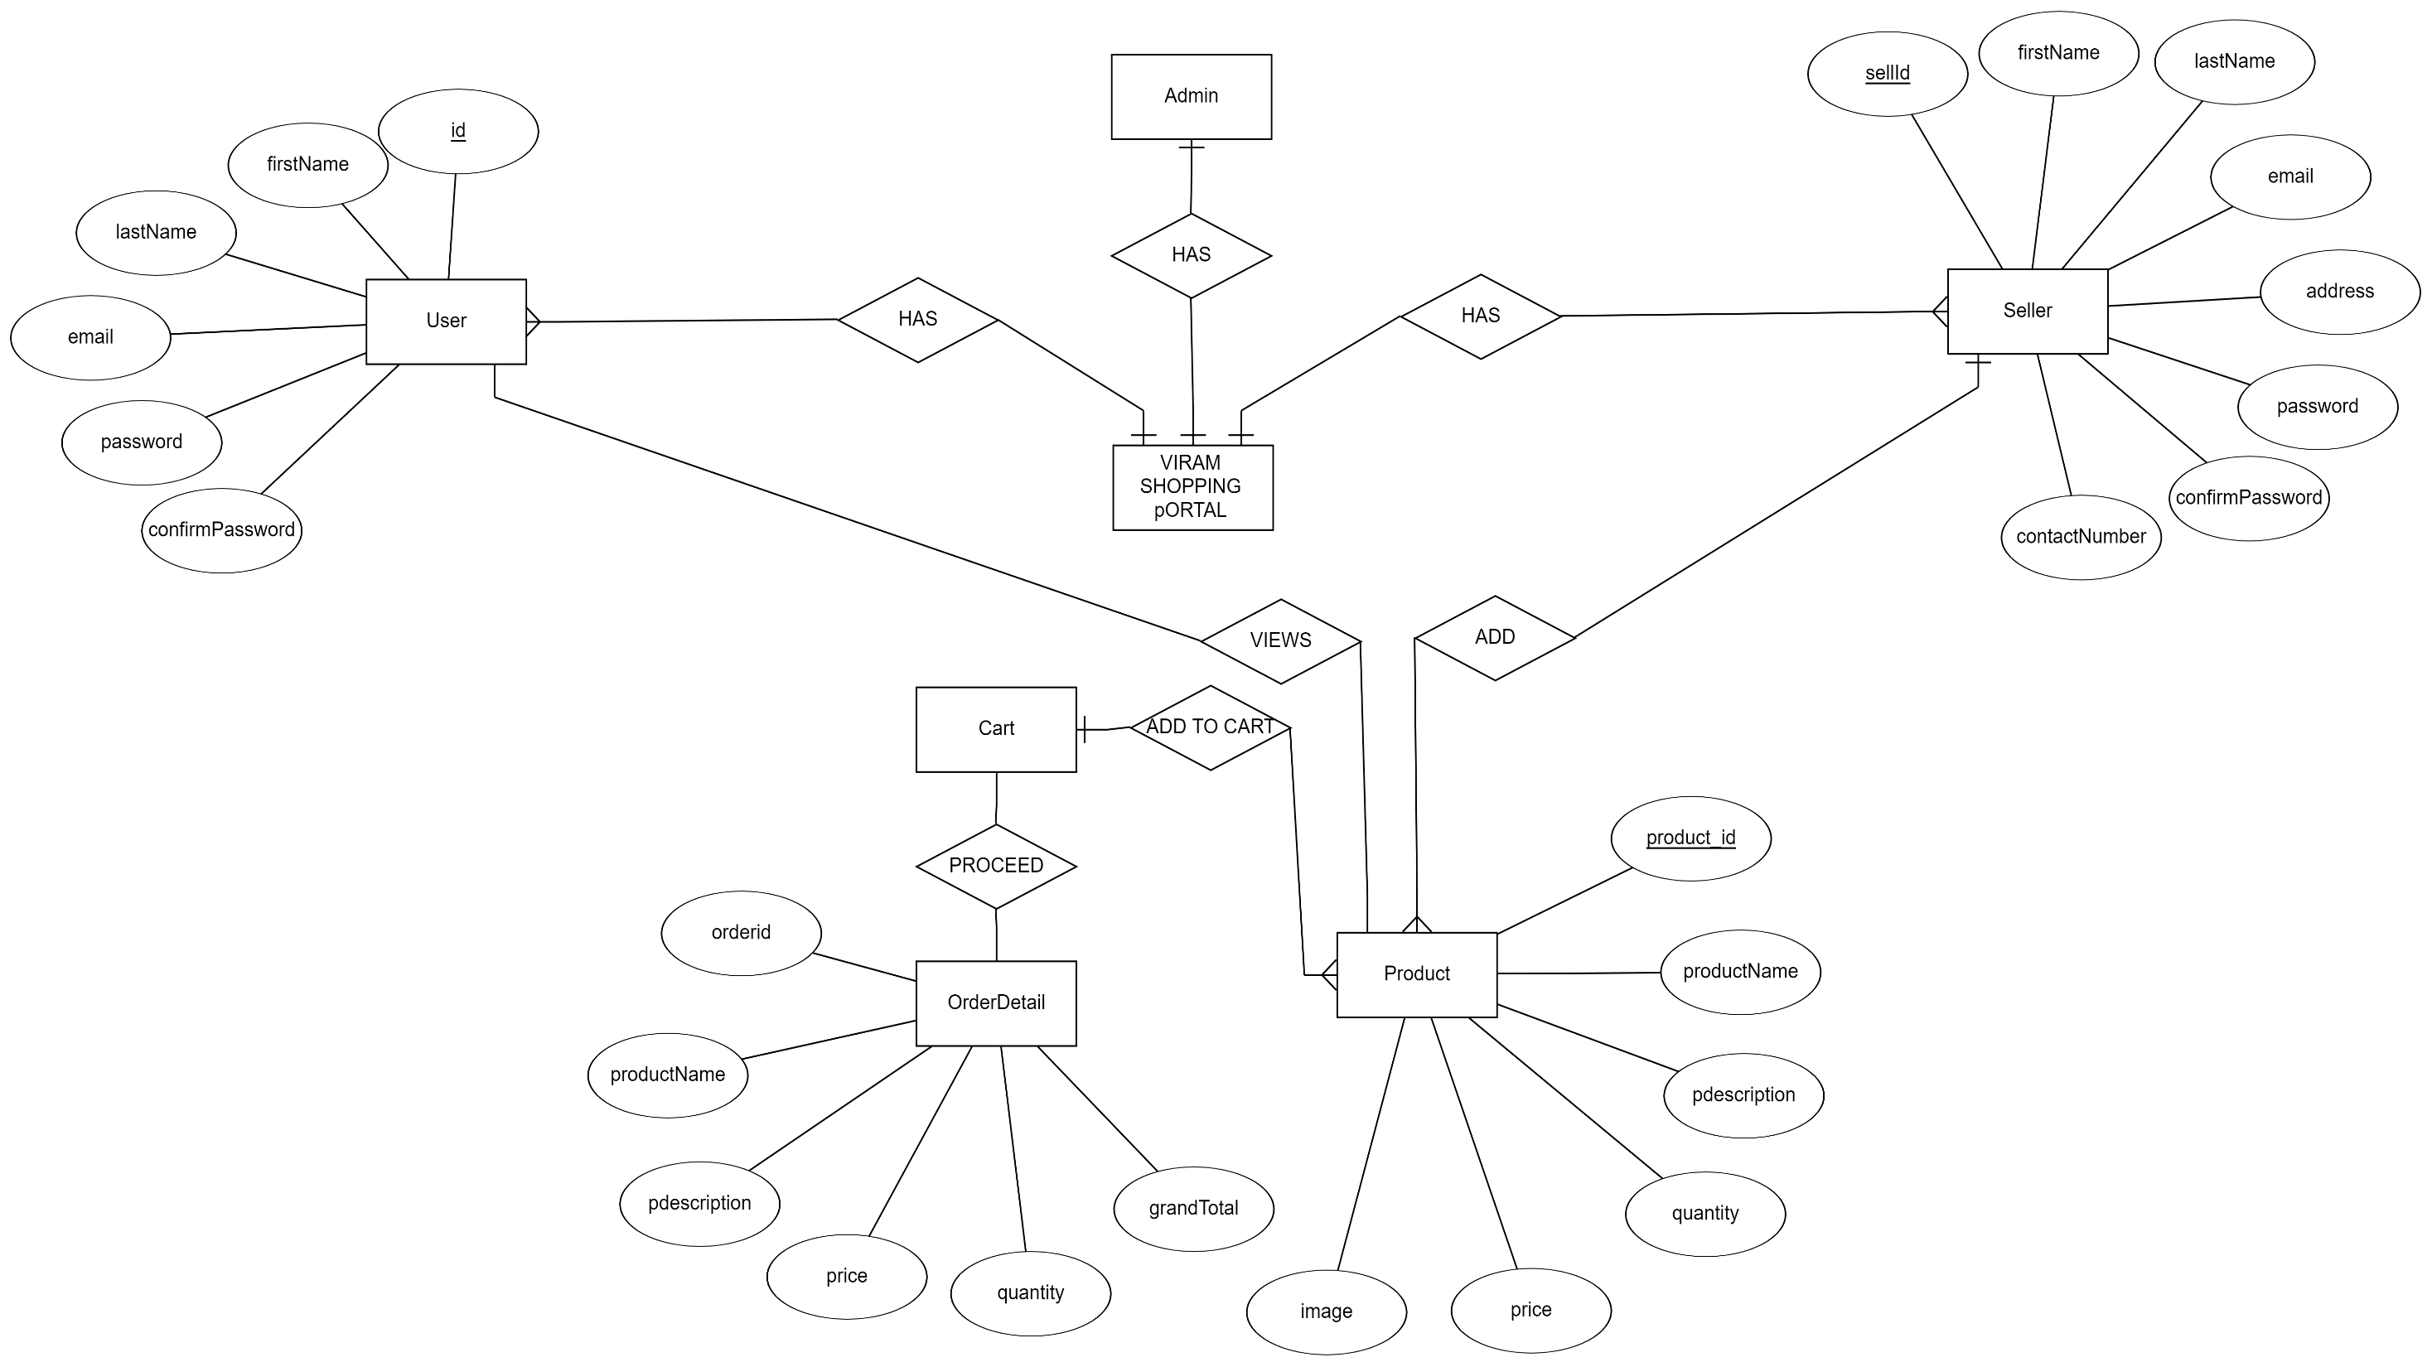
ER Diagram:

Slide 10
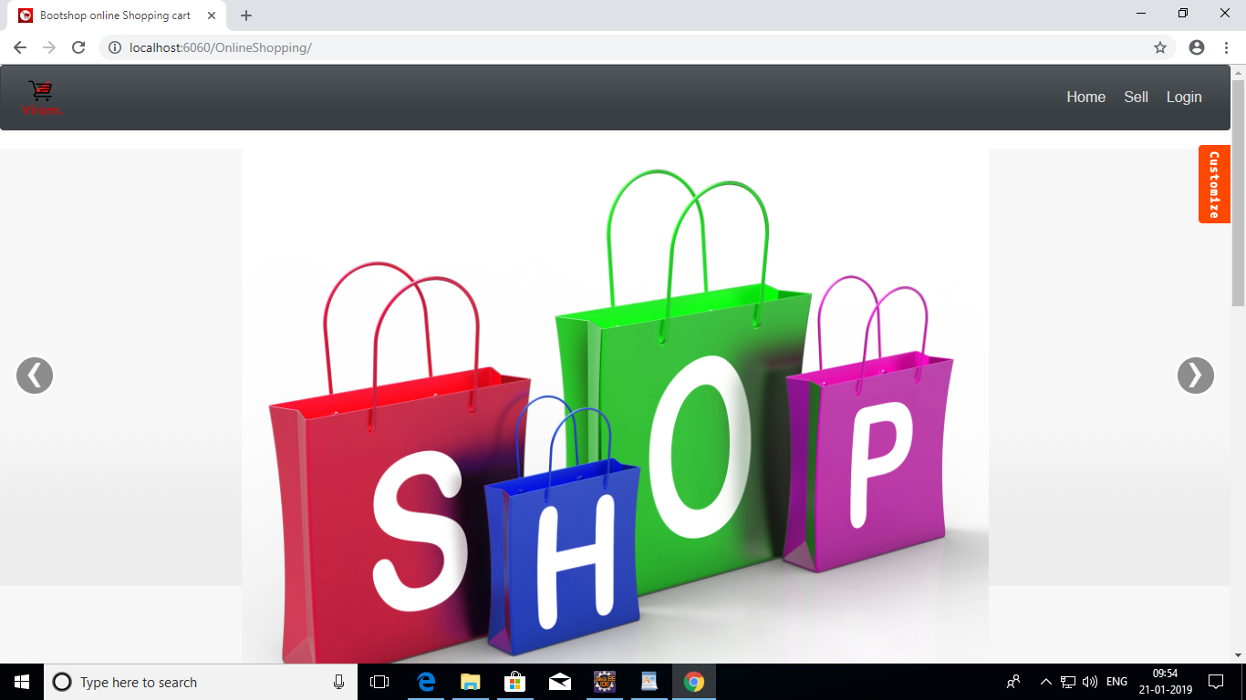
Home Screen

Slide 11
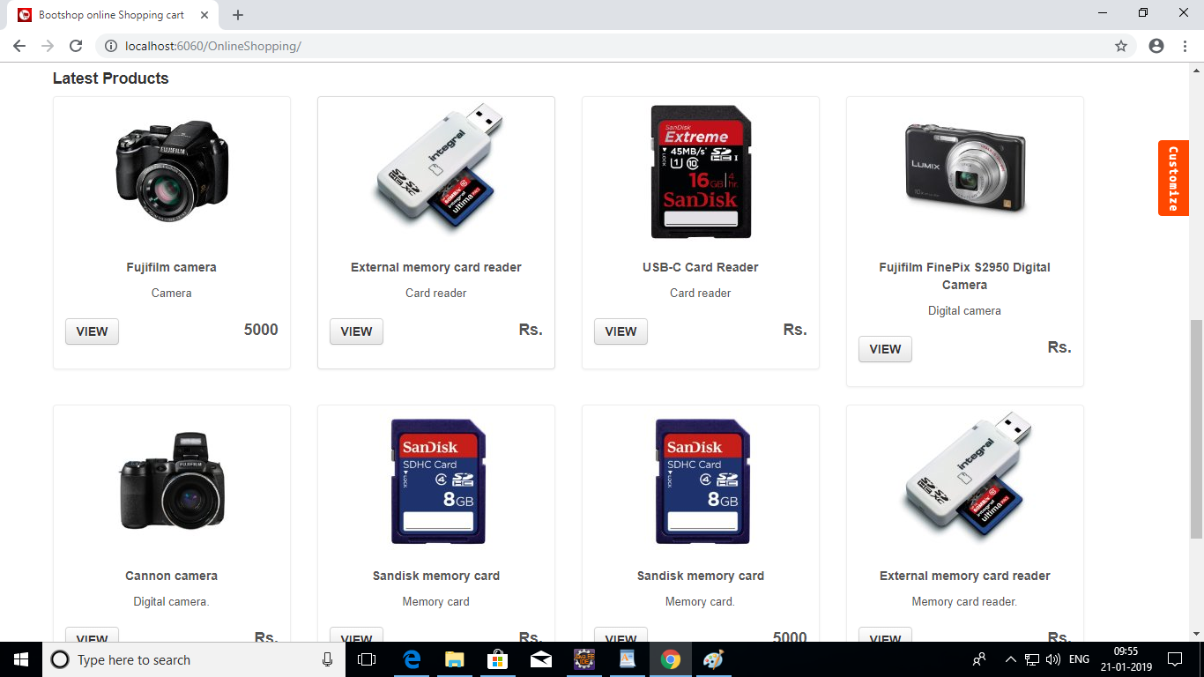

Slide 12
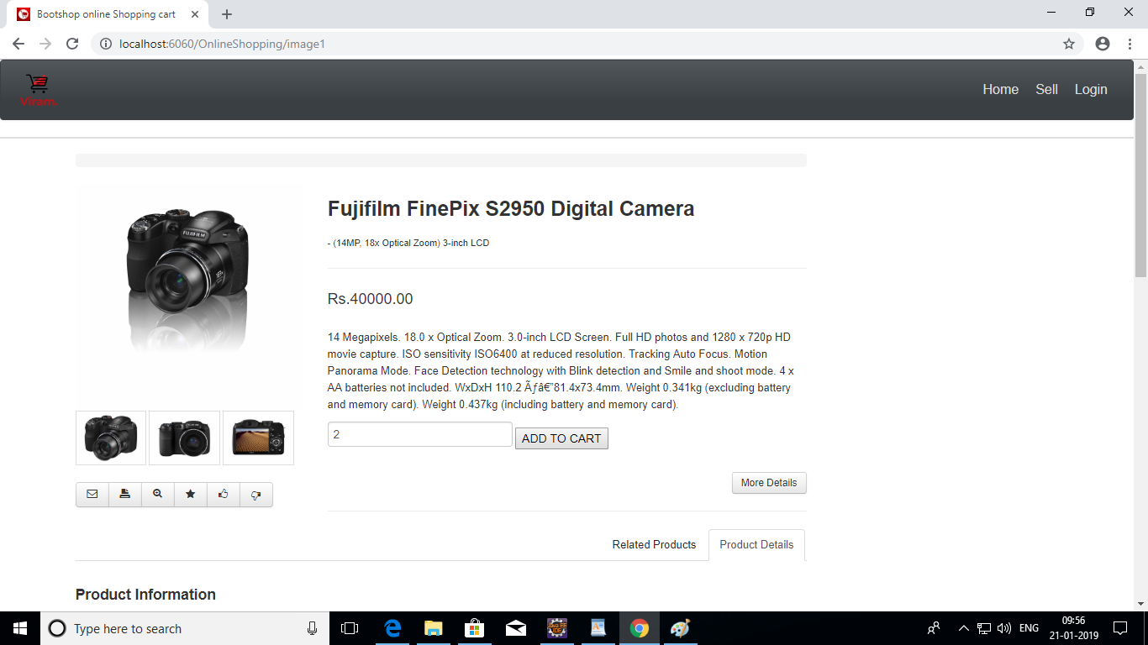

Slide 13
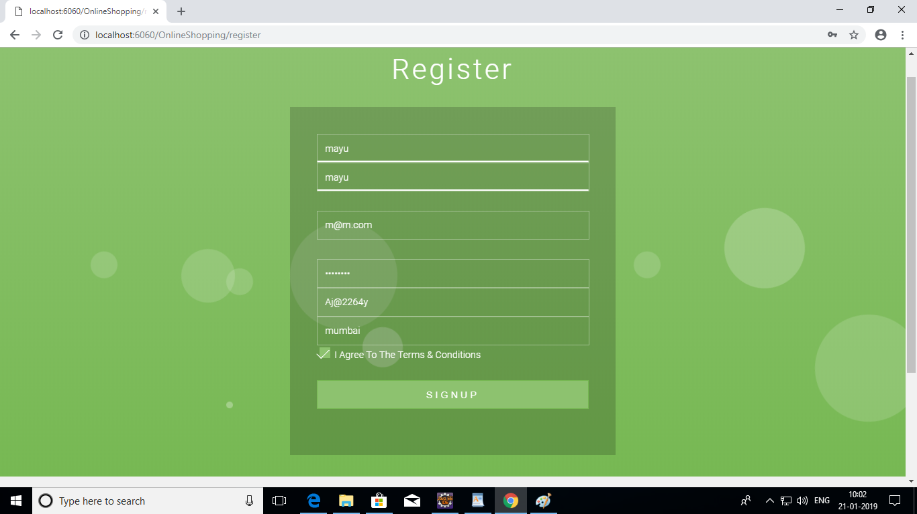

Slide 14
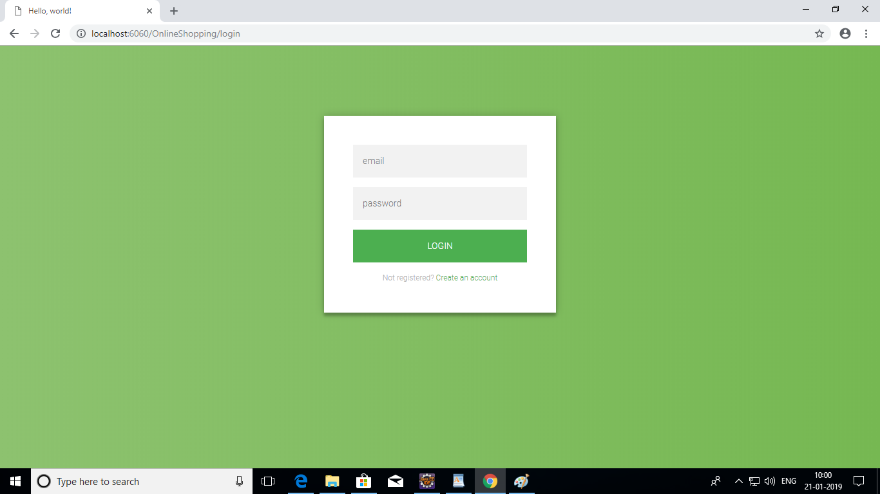

Slide 15
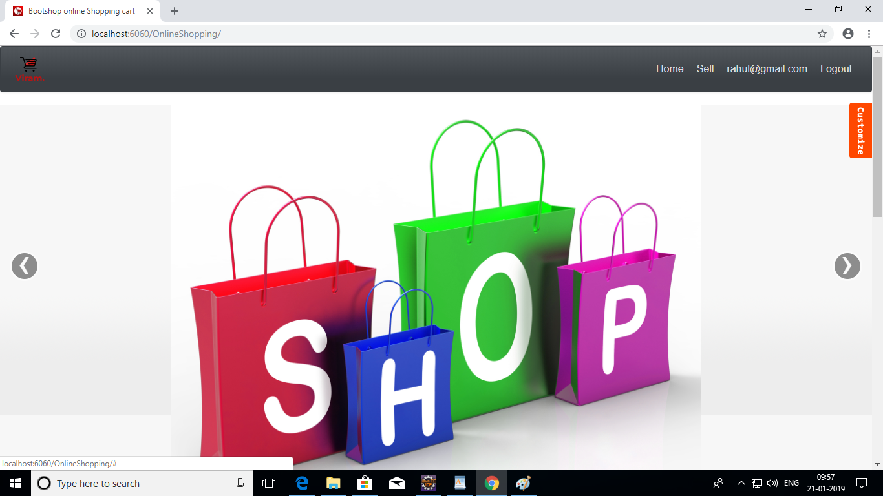

Slide 16
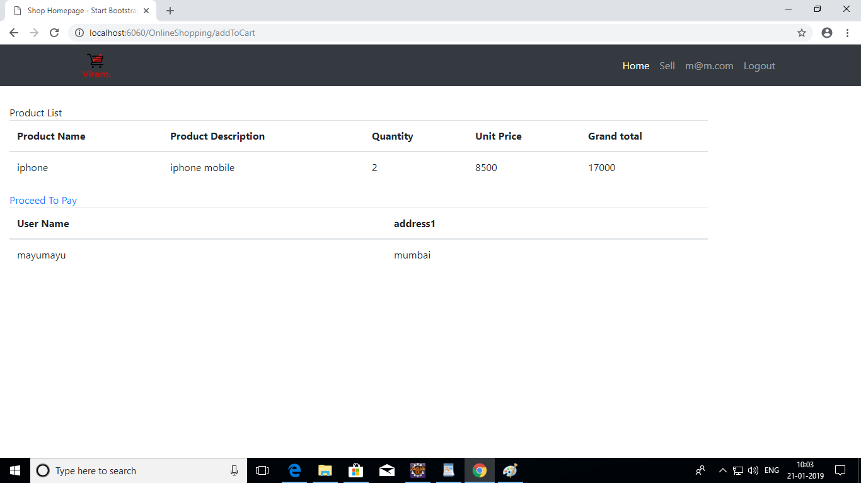

Slide 17
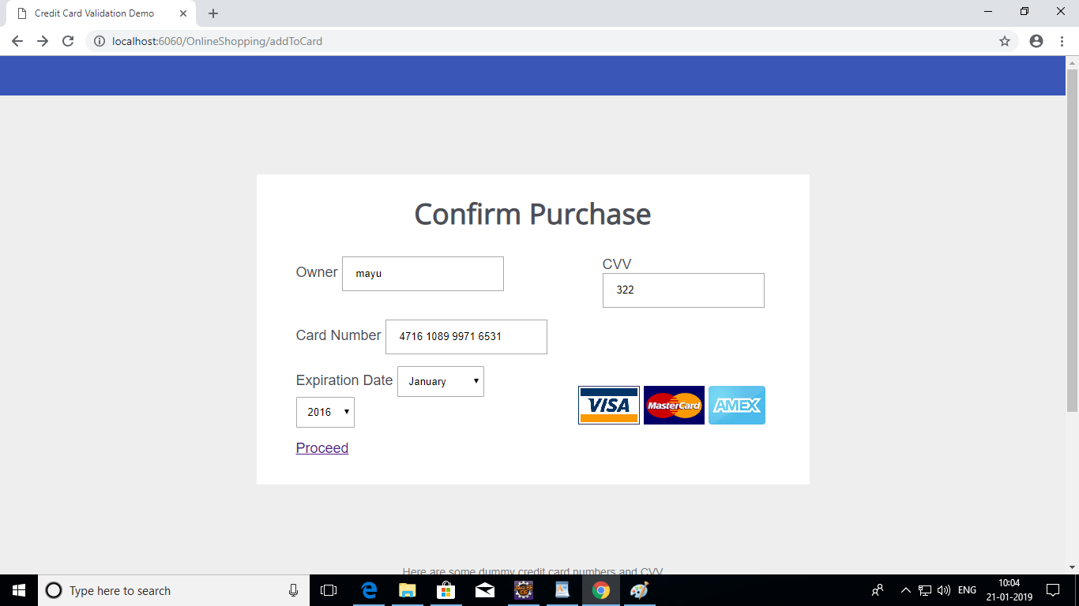

Slide 18
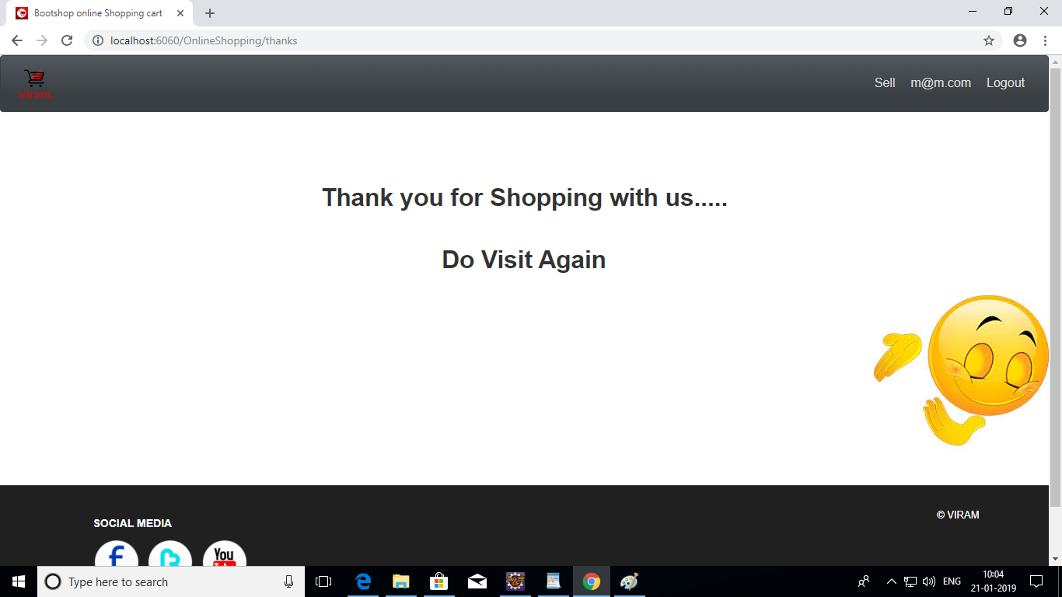

Slide 19
Seller Dashboard

Slide 20
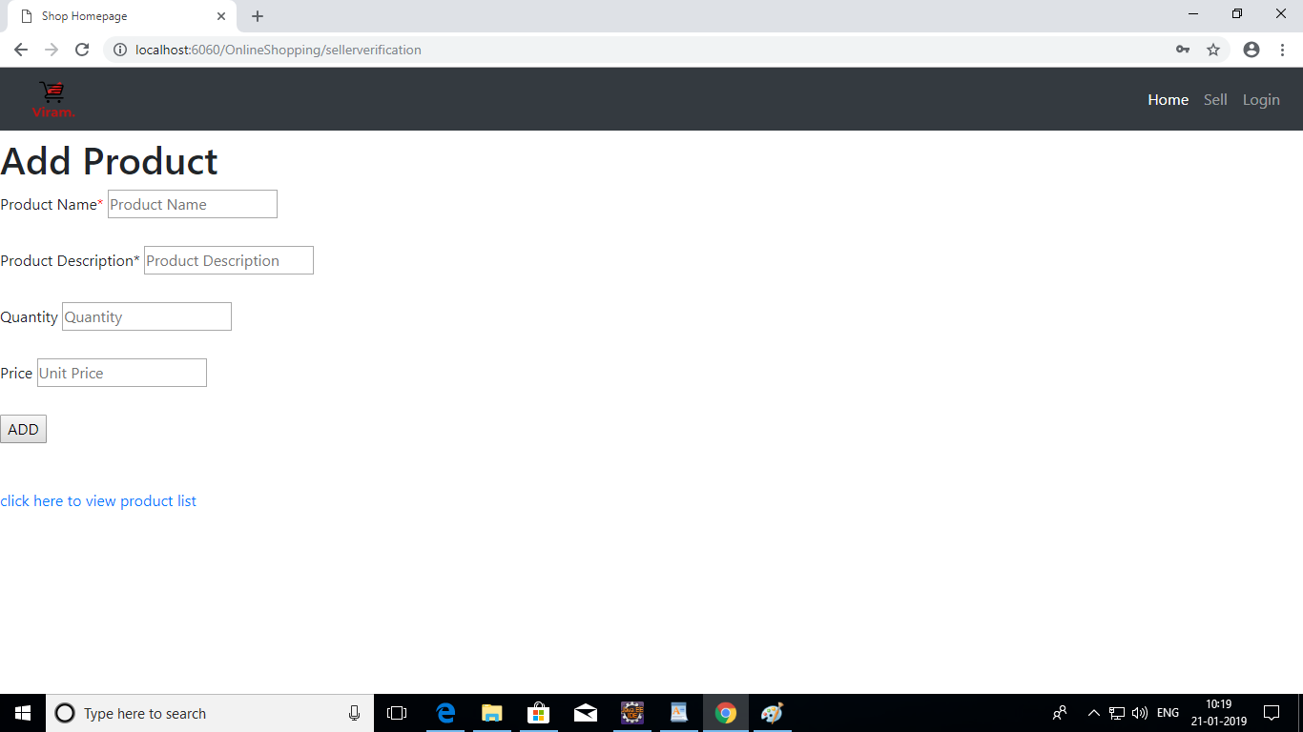

Slide 21
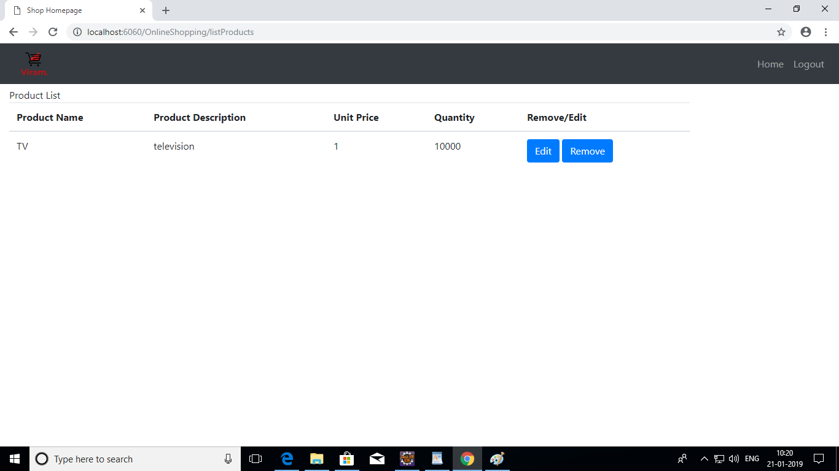

Slide 22
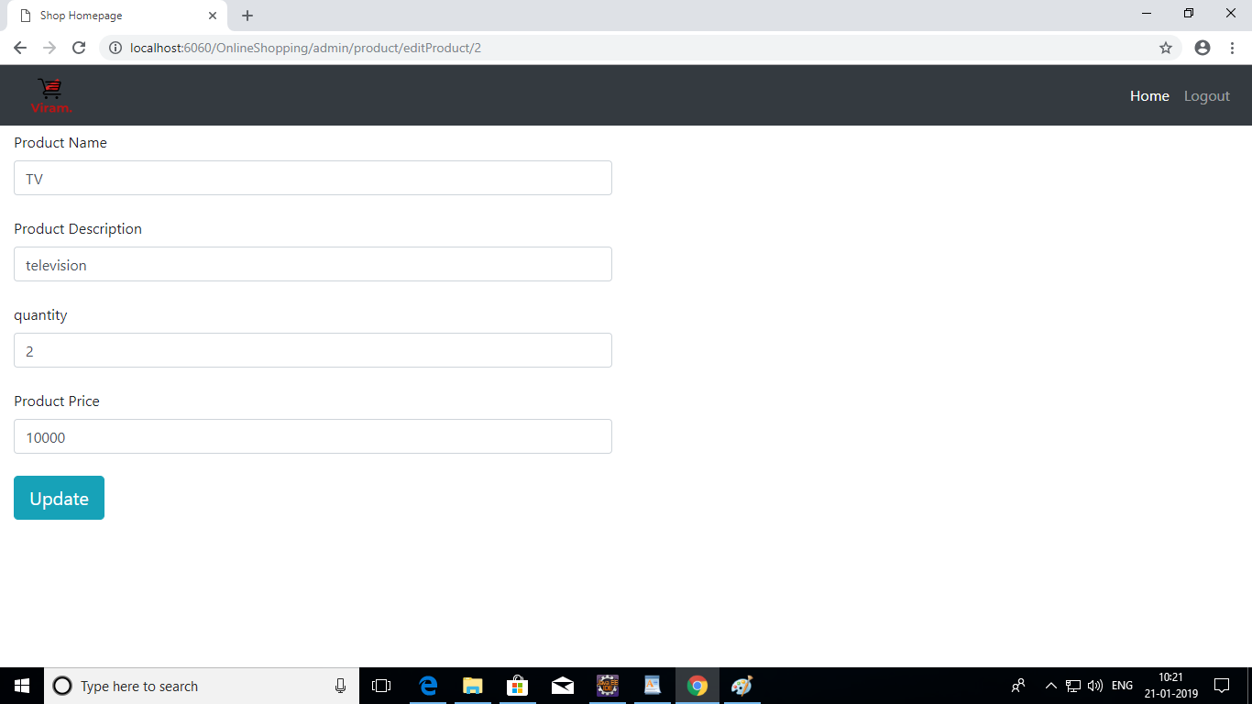

Slide 23
Admin Dashboard

Slide 24
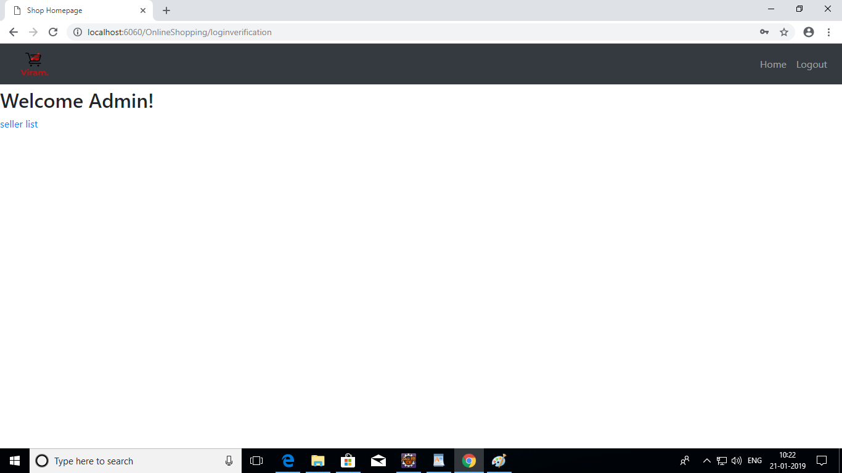

Slide 25


Slide 26
Future Scope
To provide user with more interactive user interface :
Compare Option
Payment Options

Slide 27
THANK YOU..!

