Slide 1

What’s Amazon trying to find out ?
Business Problem
Detect fake or manipulated reviews and prevent reputation crisis before they affect sales.
Identify common patterns of products with better acceptance.

Slide 2
Sentiment Reviews Analysis from Products of
amazon

Slide 3
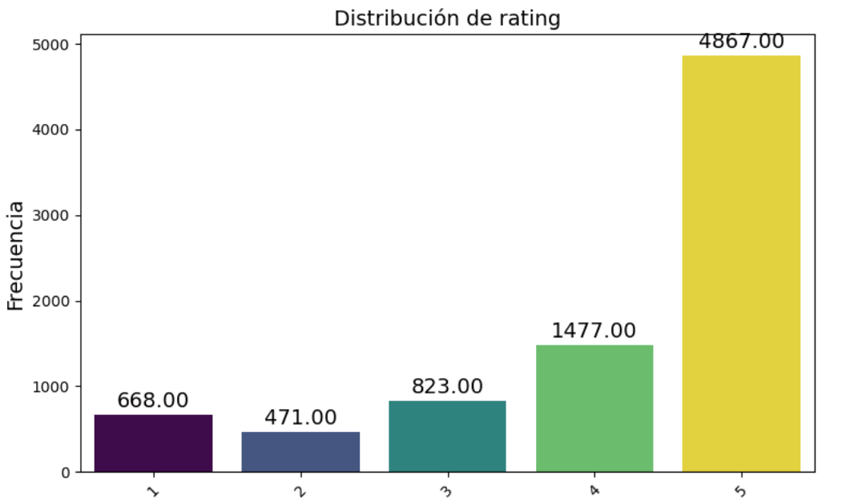
📌
Rating Distribution
Dataset and processing data
🔹 Source: McAuley Lab (2023) - Category All_Beauty
🔹 Preprocessing Steps:
✅ Nulls and duplicates elimination.
✅ Text normalization.
✅ Tokenization y stopwords elimination.
✅ Sentiment categorization (positive, neutral, negative).
✅ Training dataset balancing
📌

Slide 4
Basic models performed
NAIVE BAYES (w/ SMOTE)
LOGISTIC REGRESSION
SVM (linear kernel)
Naïve Bayes showed strong bias to class 5 and it’s inefficient for other classes.
Good model for class 5 and 1, balanced in recall and precision.
Mixed general performance.
Better performance but still deficient.

Slide 5

Optimized Models
NB (Grid Search)
SVM (Random Search)
Better general performance, more balanced and better captured minority classes. There’s still room to improvements.
Slower and with no clear advantages over LR
RL (Grid Search)
RL (Random Search)
WINNER MODEL
Good precision recall balance. Buen equilibrio de precision y recall.
L1 helped selecting features.
Similar performance to LR w/ Grid Search. Linear parameters + L2 worked well.

Slide 6
Advanced Modeling
RAMDOM FOREST
XGBOOST
Naïve Bayes shows a strong bias to class 5 and it’s inefficient for other classes.
Better performance than naive bayes but still with deficiencies.

Slide 7
Winner model
Good model in general but still ignores minorities classes.
F1 score
Class 5
Mejor
accuracy
Higher accuracy
RL with Grid
Search
RL con
Grid Search
L1
Low recall
class 2 y 3
L1

Slide 8
Conclusions
🔸Winner model 🏆 Optimized Logistic Regression
🔸Class performance
🔸Preprocessing importance
🔸Balanced Dataset.

Slide 9
Practical Applications
🎯 Automatic reviews filter
🎯 Early detection to avoid reputation crisis
🎯 Commercial decision support
🎯 Fake or manipulated reviews evaluation

Slide 10
Future actions
🚀 Dataset balance
🚀 Training with embeddings
🚀Enlarge sample dataset
🚀Interactive visualization tools integration

Slide 11
Thank you!

