Slide 1
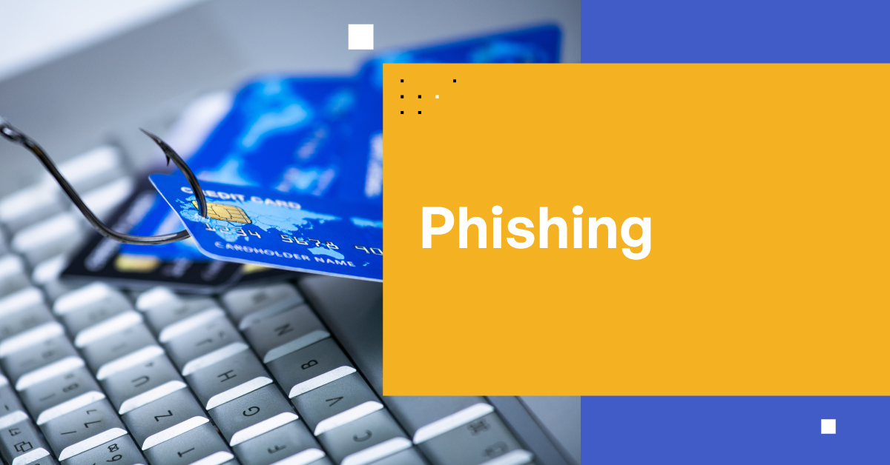
PHISHING
PHISHING

Slide 2
INDEX
What is phishing?
How Phishing is carried out?
Some common types of Phishing
How to recognize Phishing emails and fake websites?
Social Engineering tactics used in Phishing
How to stay protected from Phishing?
Real life examples of Phishing?

Slide 3
What is Phishing?
Phishing is a type of cybersecurity attack where attackers trick users into revealing sensitive information like login credentials or financial details by posing as legitimate individuals or organizations. It's a form of social engineering that exploits human trust to bypass security measures.
Attackers impersonate trusted sources through email, text messages, phone calls, or websites.
They use psychological tactics to convince users to click malicious links, download attachments, or provide information.
The goal is to obtain login credentials, financial data, or other personal information.
Phishing relies on manipulating human behavior rather than exploiting technical vulnerabilities.

Slide 4
How Phishing is carried out?
Phishing attacks typically follow a series of steps. Here are the common stages involved:
Preparation: attackers gather information about their target, which may include email addresses, names, and other personal details. This can be done through social engineering or data breaches.
Crafting the message: the attacker creates a convincing email or message that appears to come from a legitimate source, such as a bank, online service, or a trusted colleague.
Distribution: the phishing message is sent to the target(s) via email, social media, or messaging apps. Attackers may use bulk email techniques to reach a large number of potential victims.
Deceptive links or attachments: the message typically contains a link to a fraudulent website or an attachment that may contain malware. The link often resembles a legitimate URL but may have slight variations.
Victim interaction: if the victim clicks the link, they are directed to a fake website that mimics a legitimate one. Here, they may be prompted to enter sensitive information, such as usernames, passwords, or credit card details.

Slide 5
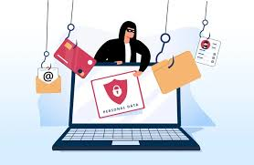
Data collection: once the victim submits their information, the attacker collects it for malicious purposes, such as identity theft, financial fraud, or unauthorized access to accounts.
Exploitation: the attacker uses the stolen information to carry out fraudulent activities, which may include accessing bank accounts, making unauthorized purchases, or selling the data on the dark web.
Cleanup and cover-up: in some cases, attackers may attempt to cover their tracks by deleting evidence of the phishing attack or using techniques to avoid detection.
Follow-up attacks: attackers may also use the information obtained to launch further attacks, such as spear phishing, where they target specific individuals with tailored messages.

Slide 6
Some common types of Phishing
Email Phishing: Generic emails sent to many users, often containing malicious links or attachments.
Spear Phishing: Targeted attacks aimed at specific individuals, often using personal information to appear legitimate.
Vishing: Voice phishing conducted over the phone, where attackers impersonate legitimate entities to extract sensitive information.
Smishing: Phishing via SMS, where attackers send text messages with malicious links.
Whaling: A type of spear phishing that targets high-profile individuals, such as executives, with highly personalized attacks.
Clone Phishing: A legitimate email is duplicated, but with malicious links or attachments added.
Angler Phishing: Attackers impersonate customer service accounts on social media to lure victims into providing personal information.

Slide 7
How to recognize Phishing emails and fake websites?
To recognize phishing emails, look for urgent calls to action, requests for sensitive information, and mismatched sender domains. For fake websites, check the URL for misspellings, ensure it starts with "https," and look for a padlock symbol in the address bar.
Recognizing phishing emails
1.Sender clues: -Check if the email is from a public domain (e.G., @Gmail.Com) while pretending to be from
a company.
-Look for slight misspellings in the domain (e.G., Amaz0n.Com).
-Compare the sender's email address with previous communications from that organization.
2.Content and tone: -Be wary of spelling or grammatical errors.
-Watch for urgent language urging immediate action (e.G., “Act now”).
-Assess if the tone is inconsistent with previous messages from the sender

Slide 8
3.Links and Attachments: -Verify if the link URL differs from the anchor text.
-Be cautious of unexpected attachments.
-Avoid vague call-to-action buttons (e.g., “Click here”).
4.Security Pressure: -Be suspicious if the email requests personal information or passwords.
-Look for requests to bypass company protocols.
-Note any threats of negative consequences for non-compliance.
Identifying fake websites
1.URL Inspection: -Always check the URL for misspellings or unusual characters.
-Ensure the website starts with "https" indicating a secure connection.
-Look for a padlock symbol in the address bar, which signifies a secure site.

Slide 9
2.Website design and functionality: -Compare the website's design with the legitimate site;
phishing sites often have poor design or functionality.
-Check for contact information and verify it through trusted sources.
3.Trust signals: -Look for customer reviews or ratings on independent sites.
-Be cautious of websites that pressure you to make quick decisions or provide sensitive
information.

Slide 10
Social engineering tactics used in phishing
Impersonation: Attackers pretend to be trusted entities, such as banks, government agencies, or tech companies, to build trust and authority.
Urgency: They create a sense of urgency by claiming a problem requires immediate action, encouraging the victim to act without verifying the message's authenticity.
Fear: Attackers use threats or warnings to install fear, prompting users to take action to avoid potential harm or consequences.
Authority: They may present themselves as having authority or expertise to gain the victim’s respect and compliance.
Scarcity: They claim limited opportunities or deals, creating a sense of urgency and prompting users to act quickly without proper consideration.

Slide 11
Baiting: they offer something desirable, like gift card or prize , to lure victims into clicking on malicious links or revealing information.
Pretexting: Attackers lie about their identity and purpose to gain the victim’s trust and then trick them into providing sensitive information.
Tailgating: In physical settings, attackers might follow someone into a restricted area by impersonating a legitimate employee or delivery person.
Business Email Compromise (BEC): Attackers impersonate executives to trick subordinates into making fraudulent wire transfers other financial transactions.
Social Proof: They might show a large number of users are taking a certain action, creating the impression that the action is safe or legitimate.

Slide 12
How to stay protected from phishing?
To effectively avoid phishing attacks, it's essential to adopt a combination of awareness, vigilance, and proactive measures. Here are some best practices to help protect yourself and your organization from phishing:
Authorized source: download software from authorized sources only where you have trust.
Confidentiality: never share your private details with unknown links and keep your data safe from hackers.
Check url: always check the url of websites to prevent any such attack. It will help you not get trapped in phishing attacks.
Avoid replying to suspicious things: if you receive an email from a known source but that email looks suspicious, then contact the source with a new email rather than using the reply option.
Phishing detection tool: use phishing-detecting tools to monitor the websites that are crafted and contain unauthentic content.

Slide 13
Try to avoid free wifi: avoid using free Wifi, it will lead to threats and phishing.
Keep your system updated: it's better to keep your system always updated to protect from different types of phishing attacks.
Keep the firewall of the system on: keeping on the firewalls helps you filter ambiguous and suspicious data and only authenticated data will reach you.
Two-factor authentication (2FA): enable 2FA on accounts whenever possible to add an extra layer of security.
Strong passwords: use complex passwords and change them regularly. Avoid using the same password across multiple accounts.
Account alerts: set up alerts for unusual account activity to catch potential breaches early.
Seek confirmation: if in doubt, contact the organization directly using verified contact information rather than responding to the email.

Slide 14
Real life examples of phishing
1. Google and Facebook phishing attack
Between 2013 and 2015, a phishing campaign caused Facebook and google losses of $100 million. The attackers took advantage of the fact that both companies had a Taiwanese supplier called quanta. The attackers sent a series of fake invoices, pretending to be from quanta, and the invoices were paid by Facebook and google.
Eventually, the fraud was discovered, and Facebook and google took legal action. The attackers were arrested in Lithuania and extradited to the U.S.. Facebook and google were able to recover $49.7 million of the $100 million stolen.
2. USPS phishing attack
In 2020, a smishing campaign used the united states post office (USPS) as a front for an attack. Cybercriminals sent SMS messages that told recipients they should click a link to view important information about an upcoming USPS delivery. The malicious link actually took victims to various web pages designed to steal their google account credentials.

