Slide 1
FIFA 2018 World Cup Challenge by Crystal Ballerz Team
Team Members:
Vijayanand Narayanan - UpGrad
Sonali Chhabra - UpGrad
Vishal Sharma – Non UpGrad

Slide 2
FIFA World Cup 2018 Challenge
Background
The most coveted tournament in football is the world cup that is conducted once every 4 years. 32 football playing nations will participate in the 2018 tournament held in Russia and one will emerge as the winner eventually.
Objectives
Carry out research, understand the teams, players, rankings and what it takes to win the tournament
Predict 4 semi-finalists
Predict 2 finalists
Predict winner of 2018 world cup

Slide 3
Data Selection
World Cup 2018 Matches – src: https://www.kaggle.com/agostontorok/soccer-world-cup-2018-winner/data
This dataset consists match fixtures of all teams along with information on previous titles, previous finalists, semi finalists and their rankings
Results - src: https://www.kaggle.com/agostontorok/soccer-world-cup-2018-winner/data
This dataset consists results of all football matches played between various countries from 1930 onwards
FIFA Rankings - src: https://www.kaggle.com/agostontorok/soccer-world-cup-2018-winner/data
Data contains rankings of teams from 1993 onwards
Elo Ratings - src : https://www.eloratings.net/
This data contains Elo ratings of football teams based on the Elo rating system, developed by Dr. Arpad Elo. This rating has been chosen as it works well for a Zero Sum game such as football

Slide 4
Problem Solving Methodology
Data Cleaning
Merge Data from all datasets
Create derived metrics and dummy for categorical variables
Exploratory Data Analysis
Choose sample from dataset
Choose model and train
Feature Engineering
Re-run model with selected features
Fine tune performance of model
Predict outcome of matches using test dataset

Slide 5
Data Cleaning
Following steps were taken to clean data,
Consistent team names. For example Portugal instead Porugal
Check for duplicate observations
Handle missing values
Replace incorrect values
Re-format date

Slide 6
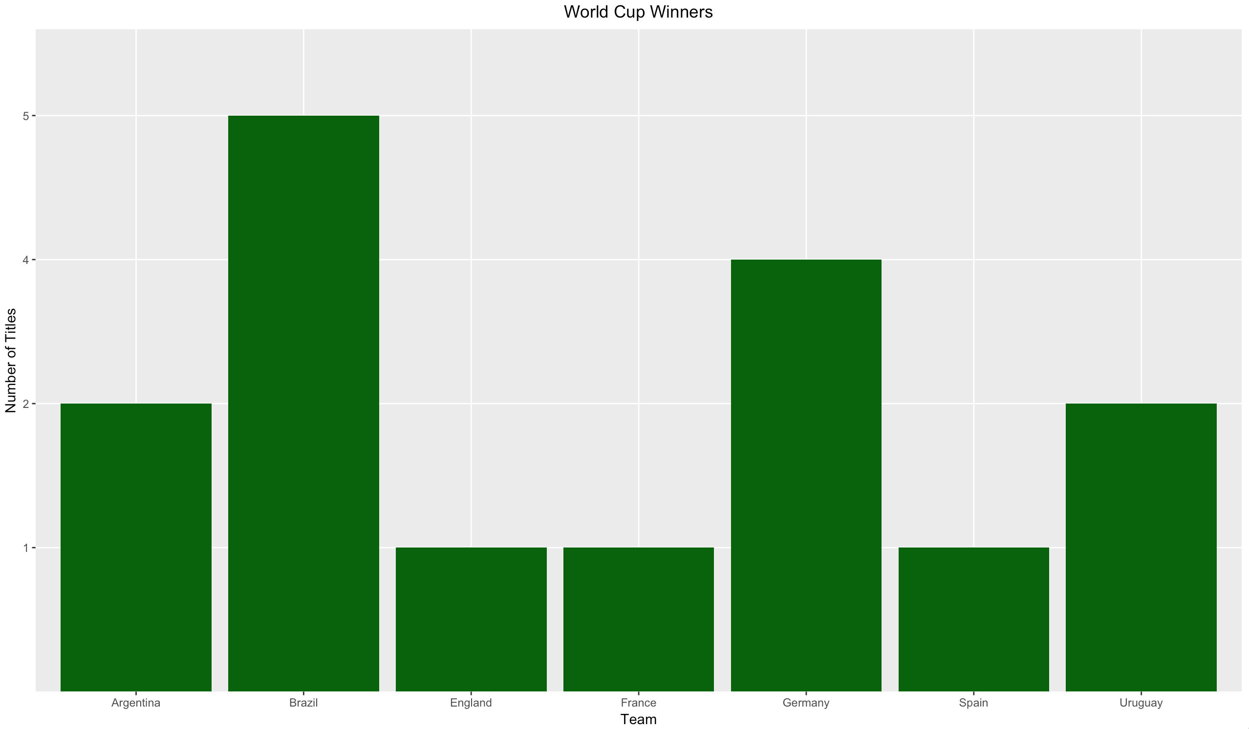
EDA – Previous World Cup Winners
Past World Cup winners have been
Brazil – 5 times
Germany – 4 times
Argentina and Uruguay – 2 times

Slide 7
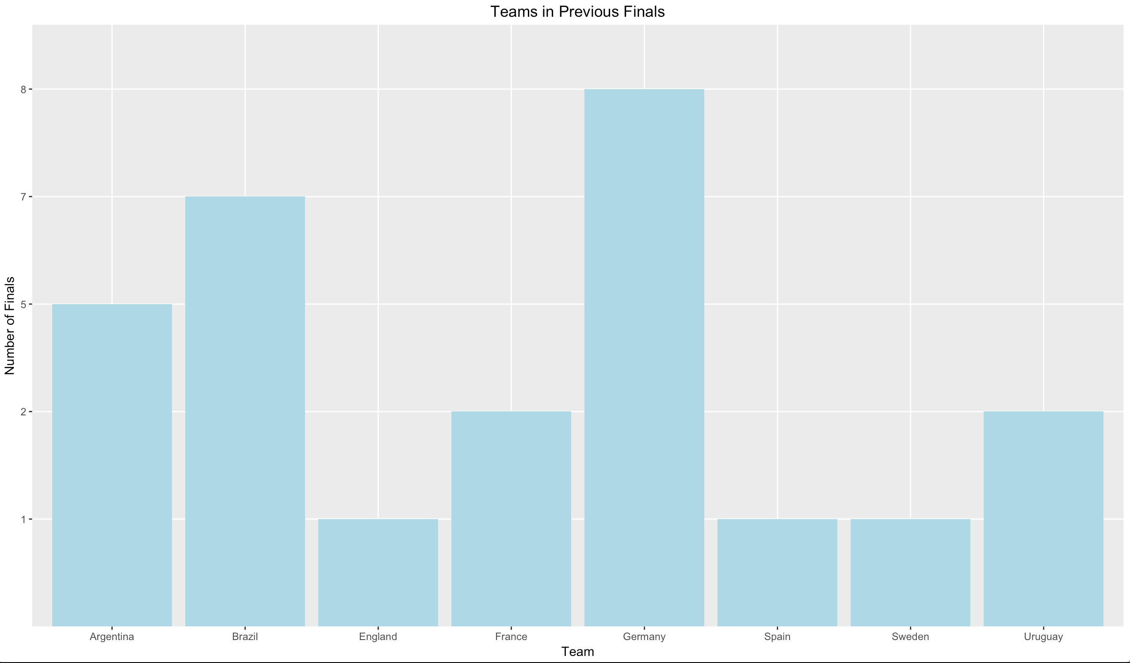
Teams in Previous World Cup Finals
Teams that have been in previous finals,
Germany– 8 times
Brazil – 7 times
Argentina – 5 times
France and Uruguay – 2 times

Slide 8
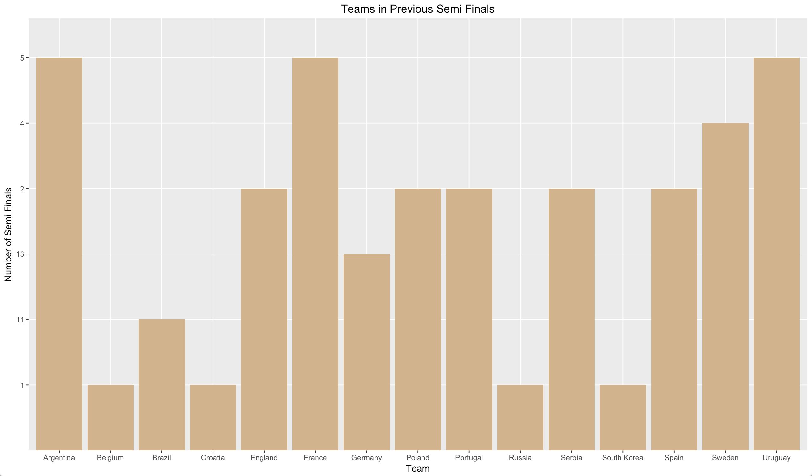
Teams in Previous World Cup Semi Finals
Teams that have been in previous semi finals,
Germany – 13 times
Brazil – 11 times
Argentina, France, Uruguay – 5 times

Slide 9
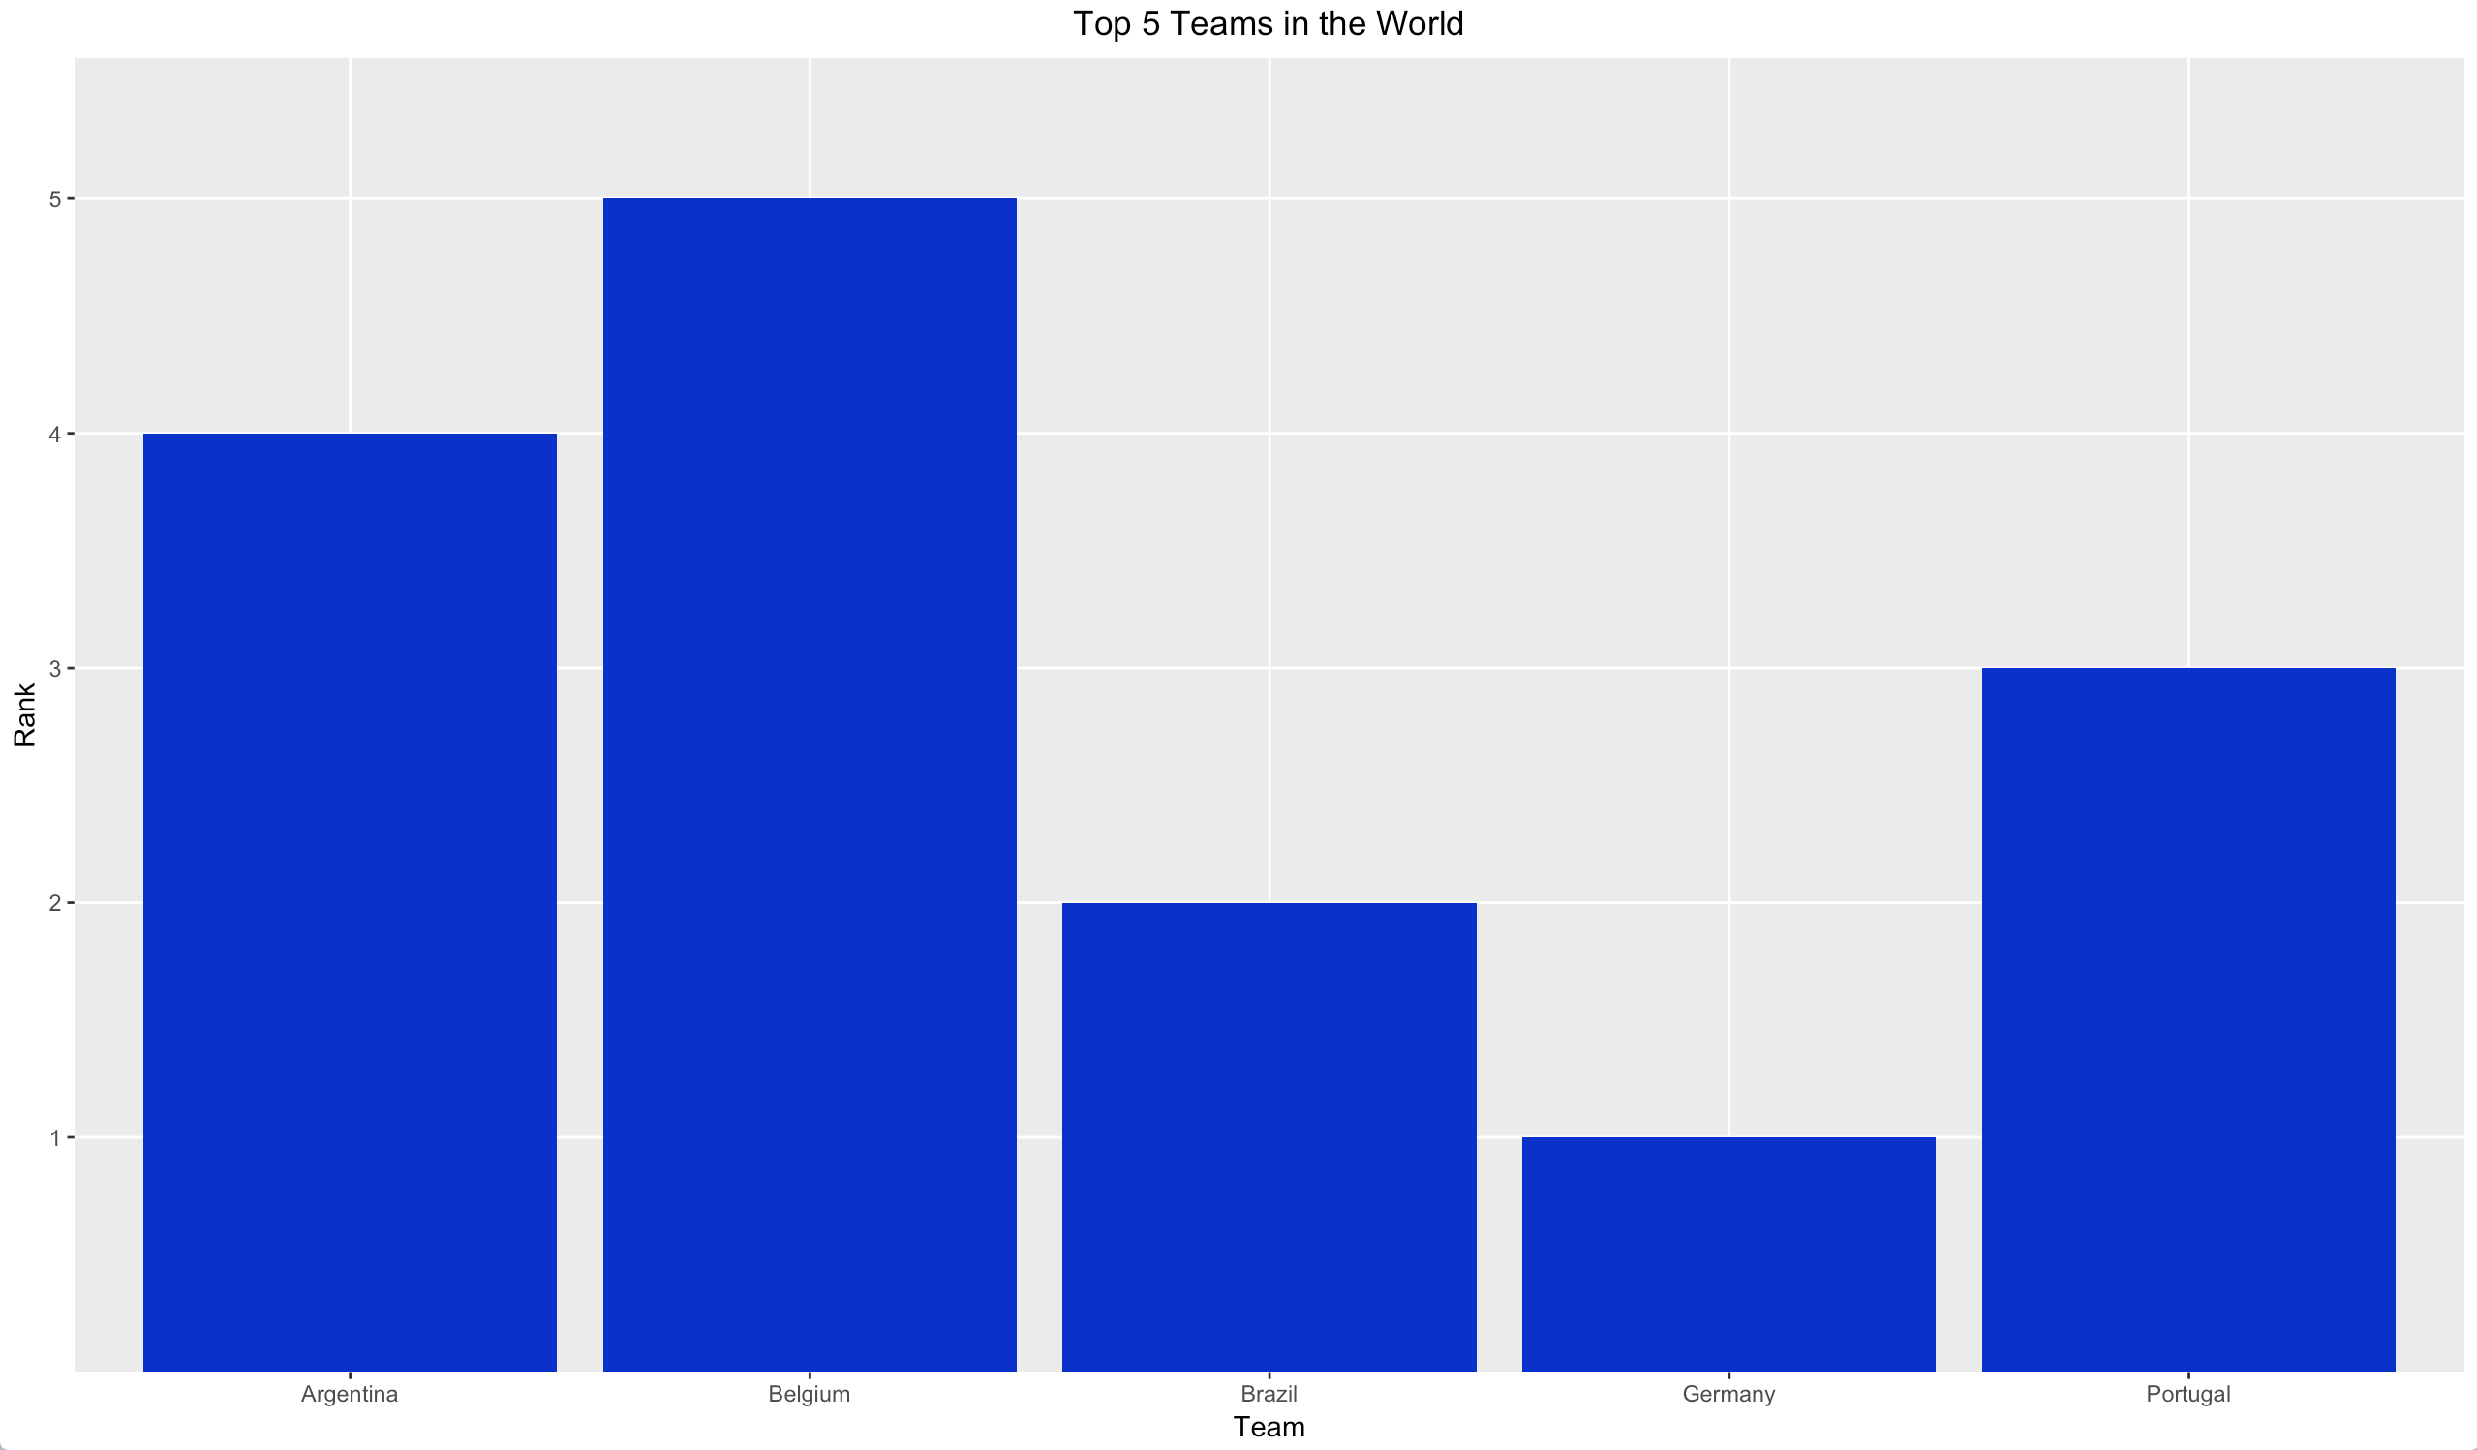
Top 5 Teams in the world

Slide 10
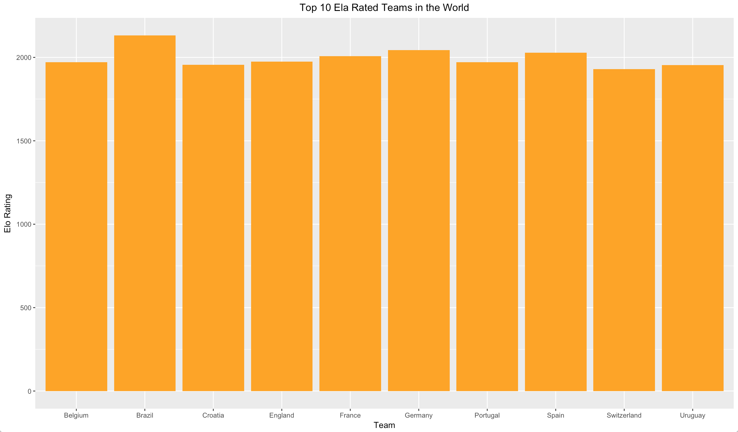
Top 10 Elo Rated Teams in the world

Slide 11
Combined Data
Considerations when combining data
Select records from dataset from year 1993 onwards. This is because FIFA rankings are available only from 1993
If a country has multiple rankings for a year in the dataset then select the most recent one
If Elo rating is missing for a team then replace with a default value of 1300 (recommended default value for a football team)
Remove columns such as City, Country, Match Year as they are irrelevant for the prediction

Slide 12
Target Variable
Target (dependent) variable for the prediction is:
Outcome
Target variable for a group match can have 3 values i.e 1-home team win, 0-home team loss or 0.5-draw
Target variable for knockout stage matches can only have 1-home team win or 0-home team loss

Slide 13
Model Selection – Random Forest
3 Models were tried out to make predictions,
Logistic Regression
SVM and
Random Forest
From the above, Random Forest was chosen to be the final model because of better accuracy, sensitivity and specificity values over the other models.

Slide 14
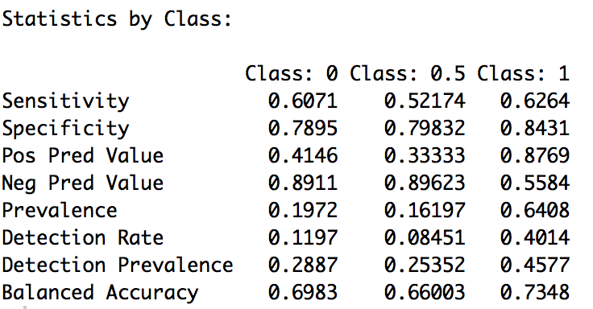
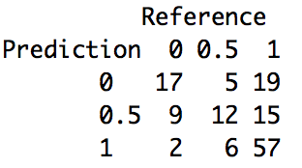
Random Forest With All Features
randomForestModel <- randomForest(outcome ~ ., train, ntree = 30000, mtry = 5, nodesize = 0.01 * nrow(train))
Confusion Matrix
Accuracy: 60.56%,

Slide 15
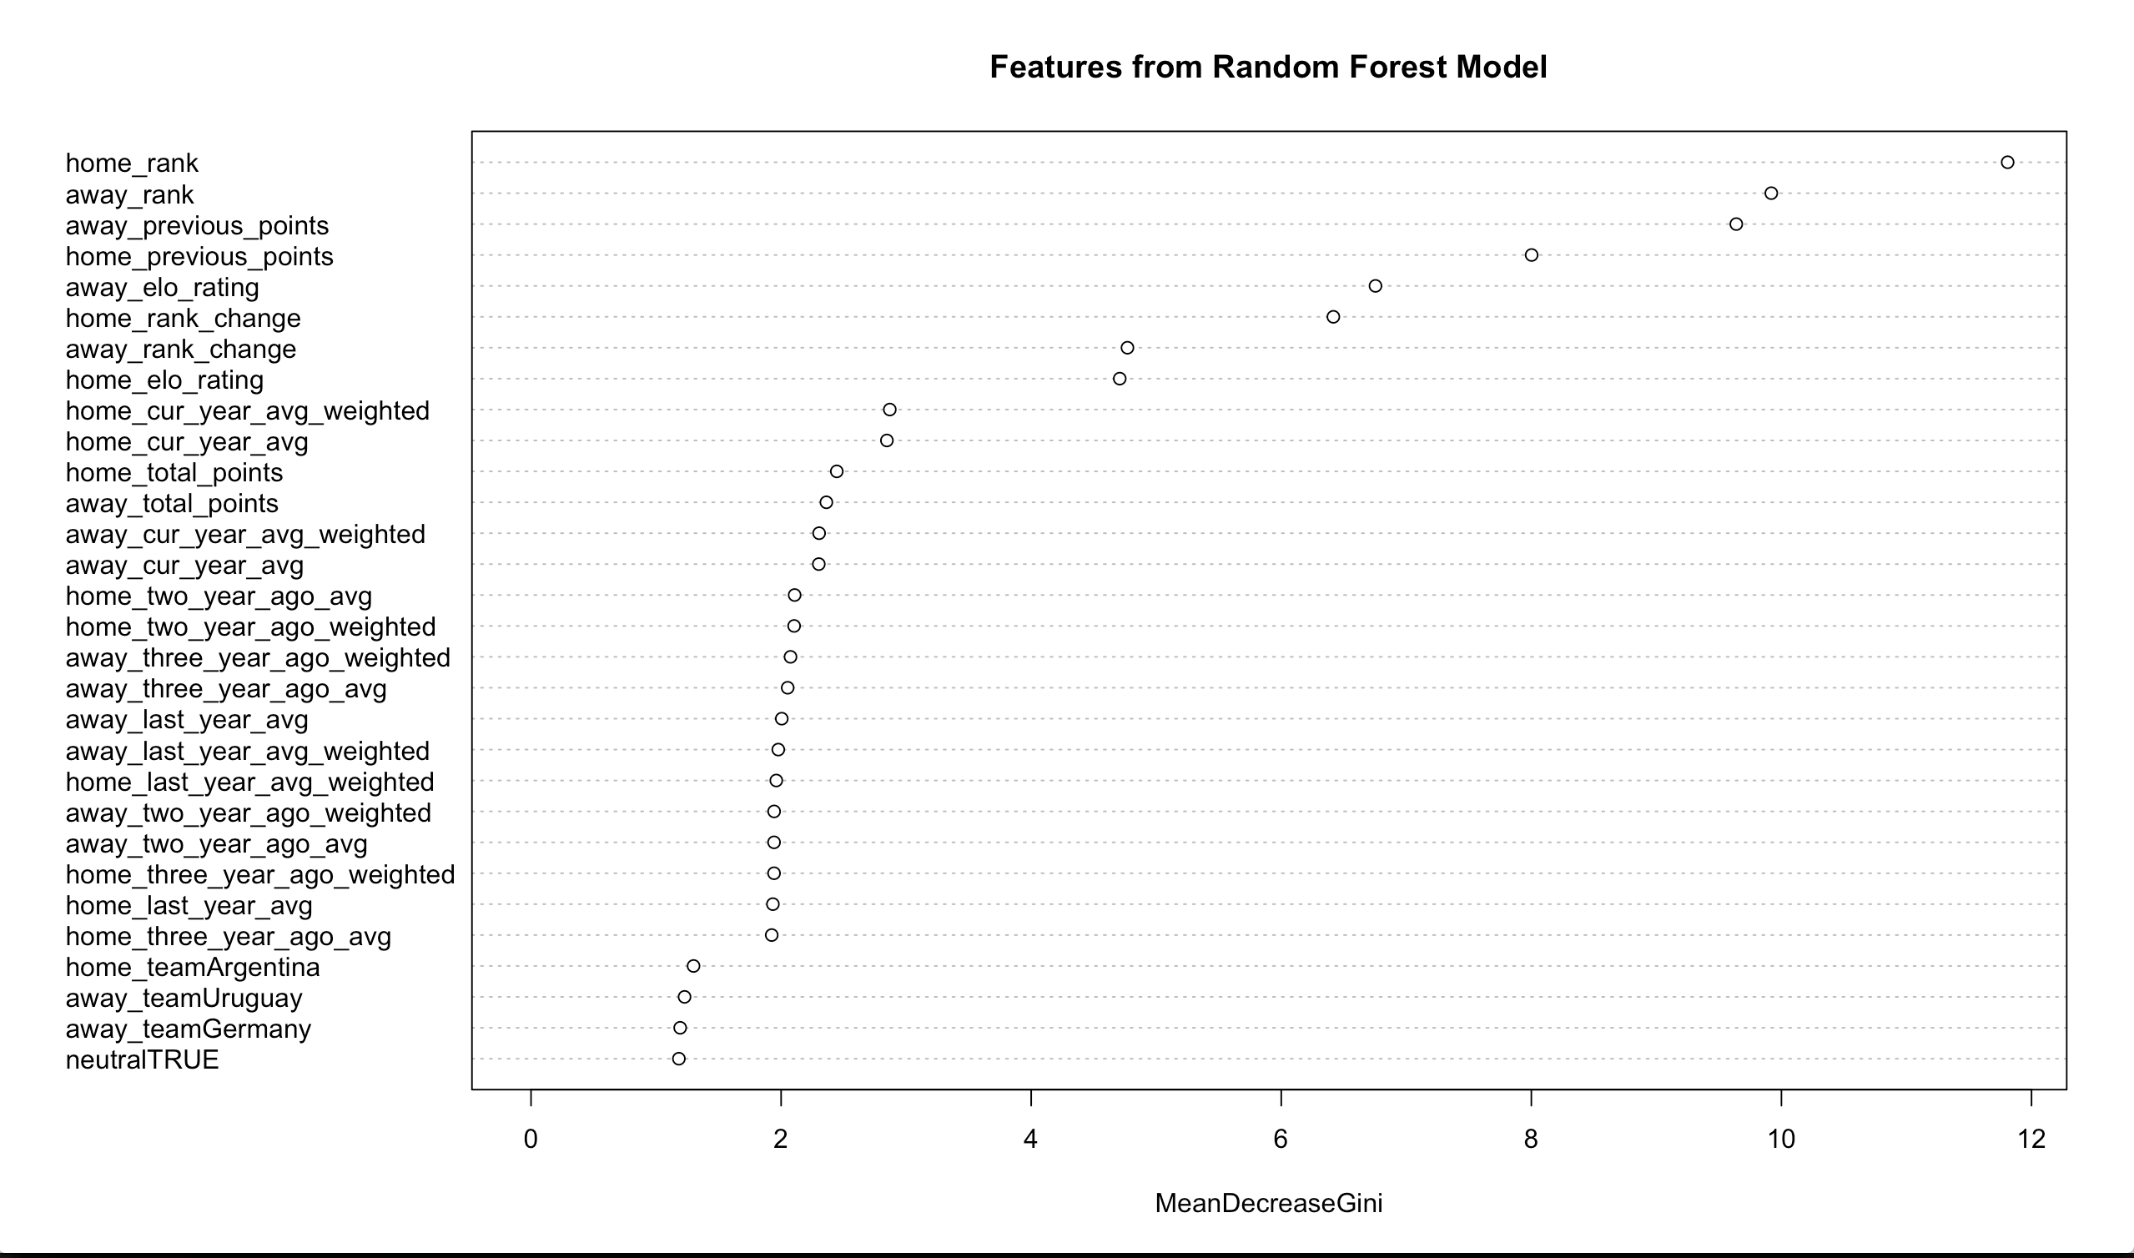
Feature Engineering

Slide 16
Important Features
Selected features,
outcome ~ home_rank + away_rank + home_previous_points + away_previous_points + home_rank_change + away_rank_change + home_cur_year_avg + home_cur_year_avg_weighted + home_two_year_ago_avg + home_two_year_ago_weighted +away_cur_year_avg + away_cur_year_avg_weighted + home_elo_rating + away_elo_rating

Slide 17
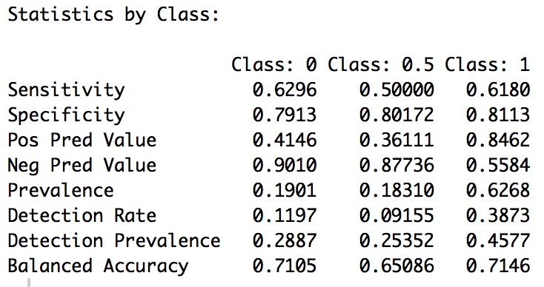
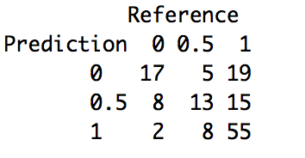
Random Forest With Selected Features
randomForestModel_1 <- randomForest(formula_1, train, ntree = 20000, mtry = 2, nodesize = 0.01 * nrow(train))
Confusion Matrix
Accuracy: 60%

Slide 18
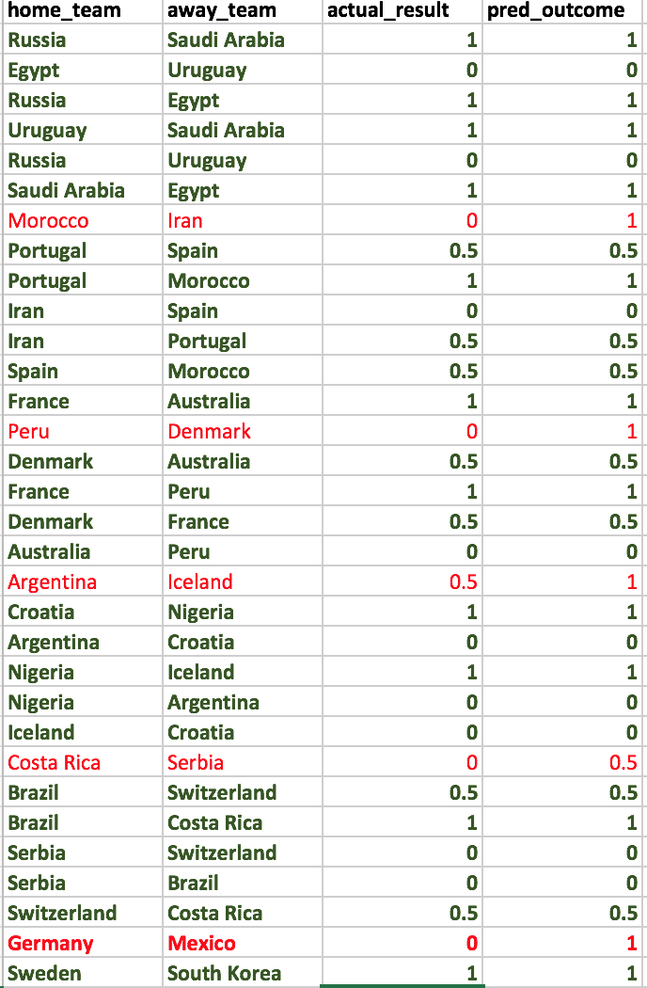
Group Stage Predictions
A sample of the group stage predictions is shown
40 out out 48 group matches were predicted correctly (shown in green)
8 out of the 48 matches were predicted incorrectly (shown in red)
83% accuracy

Slide 19
Round 16
At the time of writing this report the final group standings for all groups A to H were already out. So, the fixtures for round 16 are,
Team A |  | Team B
Uruguay | vs | Portugal
France | vs | Argentina
Brazil | vs | Mexico
Belgium | vs | Japan
Spain | vs | Russia
Croatia | vs | Denmark
Sweden | vs | Switzerland
Colombia | vs | England

Slide 20
Round 16 Predictions
As there cannot be a draw in the knockout phase, probabilities of a team getting 0 or 1 was calculated to make a decision
Team A |  | Team B | Predicted Winner
Uruguay | vs | Portugal | Portugal
France | vs | Argentina | France
Brazil | vs | Mexico | Brazil
Belgium | vs | Japan | Belgium
Spain | vs | Russia | Spain
Denmark | vs | Croatia | Croatia
Sweden | vs | Switzerland | Switzerland
Colombia | vs | England | England

Slide 21
Quarter-final Predictions
Team A |  | Team B | Predicted Winner
France | vs | Portugal | Portugal
Brazil | vs | Belgium | Brazil
Croatia | vs | Spain | Croatia
England | vs | Switzerland | Switzerland

Slide 22
Semi-final Predictions
Team A |  | Team B | Predicted Winner
Portugal | vs | Brazil | Brazil
Croatia | vs | Switzerland | Switzerland

Slide 23
World Cup 2018 Final
Final
Runner-up : Switzerland
Winner: Brazil
Team A |  | Team B | Predicted Winner
Brazil | vs | Switzerland | Brazil

