Slide 1

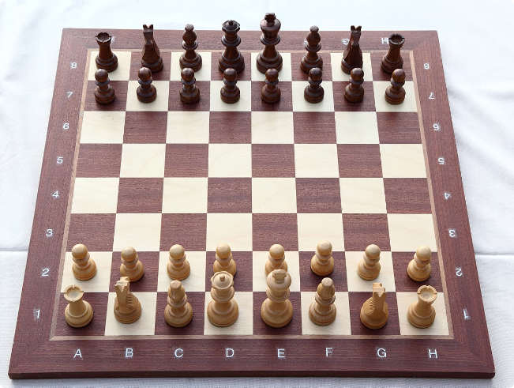
Vipin Kumar
12220492 N-Queen Visualizer

Slide 2
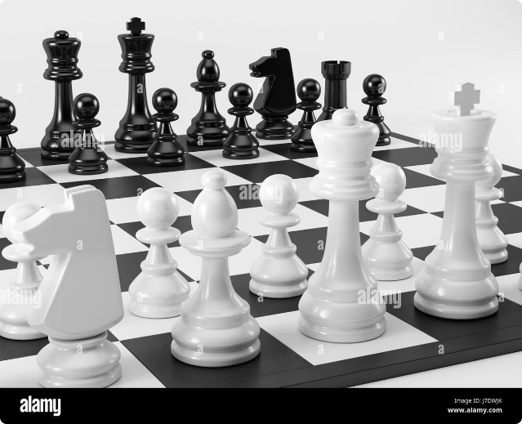
N-Queens Visualizer
This presentation will introduce the N-Queens problem, a classic algorithmic challenge, and showcase a custom-built visualizer that demonstrates the backtracking algorithm used to solve it. Through interactive visual demonstrations, users can gain a deeper understanding of this problem and the power of backtracking techniques.

Slide 3

The N-Queens Problem
1
What is the N-Queens Problem?
The N-Queens problem involves placing N queens on an N×N chessboard such that no two queens threaten each other.
2
Historical Background
The problem was first proposed by Max Bezzel in 1848, making it a time-honored challenge in computer science and mathematics.
3
Significance
Solving the N-Queens problem requires the use of advanced algorithmic techniques, making it an important exercise in problem-solving and computational thinking.

Slide 4
Project Objectives
Key Features
Algorithmic Approach
Educational Value
The N-Queens Visualizer allows users to specify the board size, visualize the step-by-step placement of queens, view multiple solutions, and adjust the speed of the visualization.
The visualizer employs a backtracking algorithm to find solutions to the N-Queens problem, demonstrating the power of this technique in solving complex, constrained-search problems.
By providing an interactive and visually engaging tool, the N-Queens Visualizer aims to help students and professionals better understand the problem and the underlying algorithm.

Slide 5

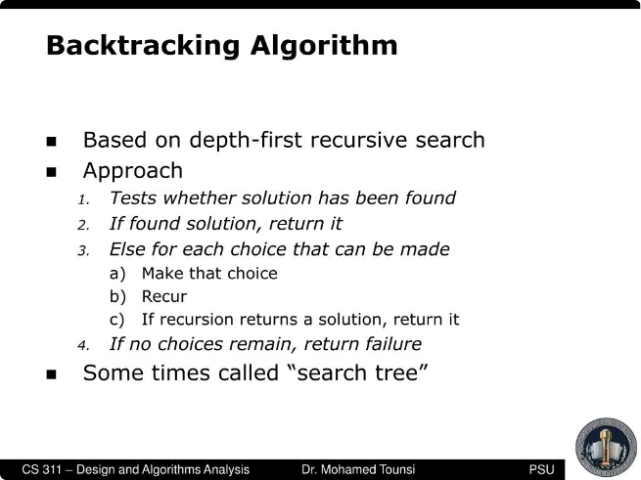
The Backtracking Algorithm
1
Start in the Leftmost Column
The algorithm begins by placing a queen in the leftmost column of the chessboard.
2
Place Queens One Column at a Time
The algorithm then proceeds to place queens in each subsequent column, moving from left to right.
3
Backtrack if Conflicts Arise
If a queen cannot be placed in a column without threatening existing queens, the algorithm backtracks to the previous column and tries a different position.

Slide 6


The User Interface
Main Frame
The main frame of the application displays the chessboard and the visualization of the backtracking algorithm.
Grid Panel
The grid panel represents the chessboard, with visual cues to indicate the placement and removal of queens.
Control Panel
The control panel provides users with the ability to start and stop the visualization, move to the next solution, and adjust the speed of the animation.
User Controls
Users can interact with the application using buttons to control the visualization and explore different solutions to the N-Queens problem.

Slide 7

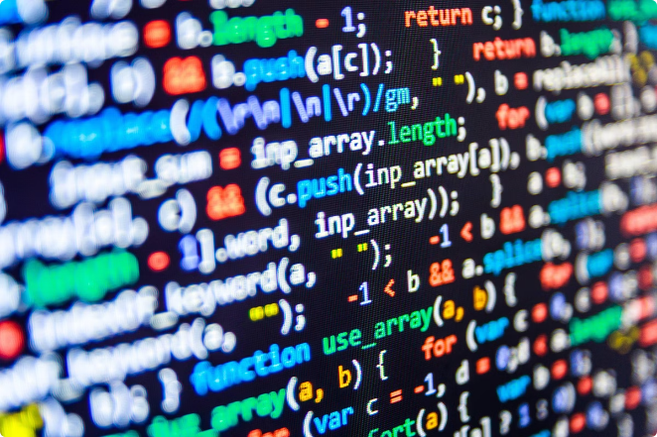
Implementation Details
1
Key Methods
The visualizer's implementation includes methods like solveNQueens(), isSafe(), updateGUI(), and delay() to handle the backtracking algorithm and the graphical user interface.
2
Graphical Representation
The application uses Java Swing to create a graphical representation of the chessboard, with text fields for the cells and visual updates to show the placement and removal of queens.
3
Visualization Techniques
The visualizer employs various techniques, such as color changes and animated transitions, to provide a clear and engaging representation of the backtracking process.

Slide 8
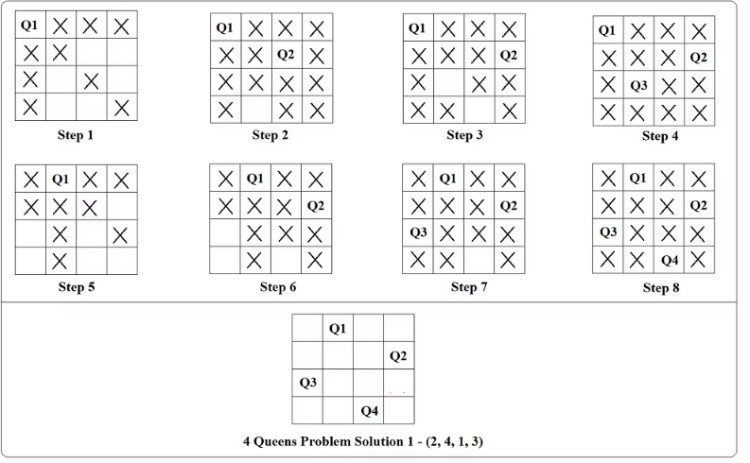
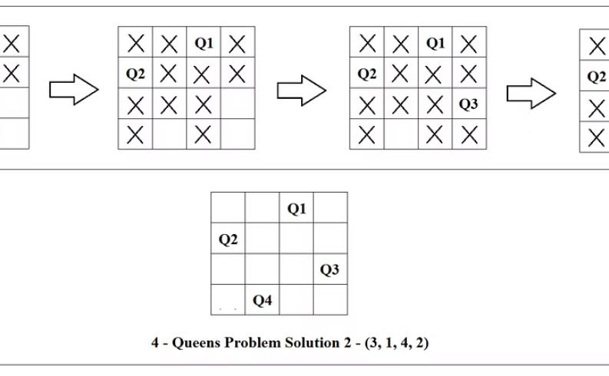
Demonstration and Results
Solution 1 (N=4)
Solution 2 (N=4)
One of the possible solutions for the N-Queens problem with N=4 is shown, with the queens placed on the chessboard.
Another valid solution for the N-Queens problem with N=4 is demonstrated, illustrating the application's ability to find and display multiple solutions.

Slide 9
Educational Value and Future Enhancements
Educational Value
Demonstrating Backtracking
Future Enhancements
The N-Queens Visualizer serves as an effective educational tool, helping students and professionals understand the N-Queens problem and the backtracking algorithm used to solve it.
Potential future enhancements include incorporating more advanced algorithms, optimizing the existing algorithm for better performance, and expanding the visualizer's capabilities to handle larger board sizes.
The step-by-step visualization of the backtracking process provides valuable insights into the inner workings of this powerful algorithmic technique.

Slide 10

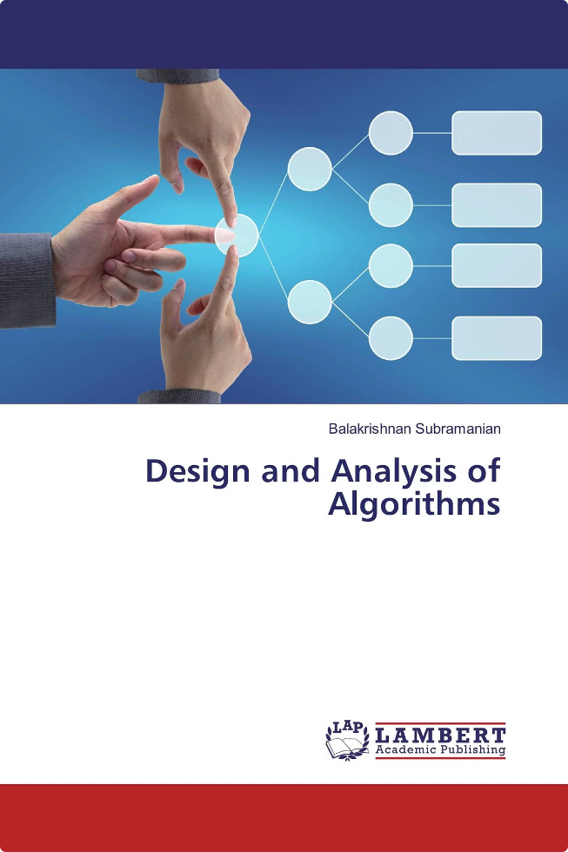



References and Resources
Wikipedia
N-Queens Problem
GeeksforGeeks
N-Queens Problem
Introduction to Algorithms
by Cormen, Leiserson, Rivest, and Stein

