Slide 1
Cloud Computing

Slide 2
Course plan
Learning session 2-3
Core Services

Slide 3
Disclaimer
Most Clouds completely abstract real infrastructure
End-users deal with services on top of real infrastructure

Slide 4
“Core Services” lecture plan
Compute
Storage
Network
Databases
Events and Messaging
Notes:
What is “XXX resources”?
Types of XXX resources
How to choose?

Slide 5
Compute
Compute is …
infrastructure capable to run your workload/application
CPU + memory

Slide 6
Compute
Compute could be based on:
raw Virtual Machines (VM)
Functions (Function as a Service)
Containers
Mixed/Hybrid

Slide 7
Compute
Virtual Machine
Configurable CPU, RAM, size/type of storage, network bandwidth
Control OS components and configuration
Create snapshots/images
Virtual Machines / EC2 / Compute Engine

Slide 8
Compute
Functions
Run code in response to event (http or from other services)
No VMs to manage
Faster scale-out
(often) Pay only for running time (ms)
Azure Function / AWS Lambda / Cloud Function

Slide 9
Compute
Containers
Run single container without orchestrator
No VMs to manage
Azure Container Instance / AWS Fargate / Cloud Run

Slide 10
Compute
Kubernetes:
Run multiple containers on (partially) cloud-managed Kubernetes
Integrated with other cloud services
(mostly) based on VMs
AKS / EKS / GKE
Notes:
Azure Kubernetes Service / Elastic Kubernetes Service / Google Kubernetes Engine
Google offers A LOT on top of GKE
- Create workloads (cluster creation is included)
- Create apps from marketplace
- Modify workloads through portal:
- Add public endpoints and load balancers
- Scale and autoscale
- Rolling updates configuration

Slide 11
Compute
Application-optimized:
VM optimized for concrete app
Pre-installed applications/services
Often includes other cloud services (monitoring, dns, and others)
Cloud-provider offers marketplace
App Service / Lightsail or Elastic Beanstalk / App Engine
Notes:
Wordpress, LAMP stack, runtime optimized for golang, java, dotnet…

Slide 12
Compute
Batch:
VMs optimized for high performance computing
Azure Batch / AWS Batch / Preemptible Virtual Machines

Slide 13
Compute
Other:
Service Fabric: distributed systems platform (azure’s k8s)
???

Slide 14
Compute
How to choose compute service?
Azure
AWS
GCP compute

Slide 15
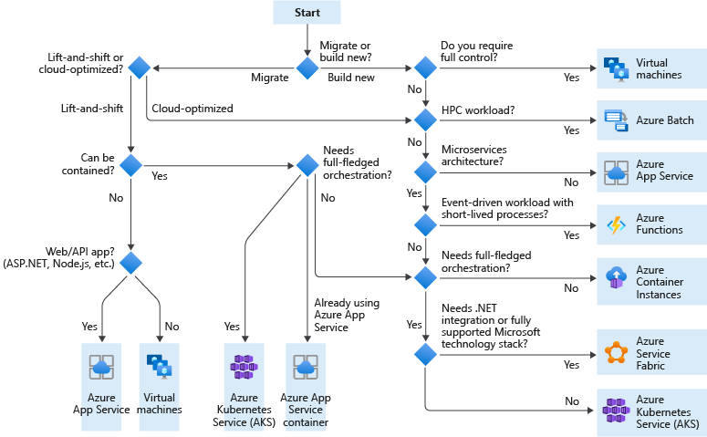

Slide 16
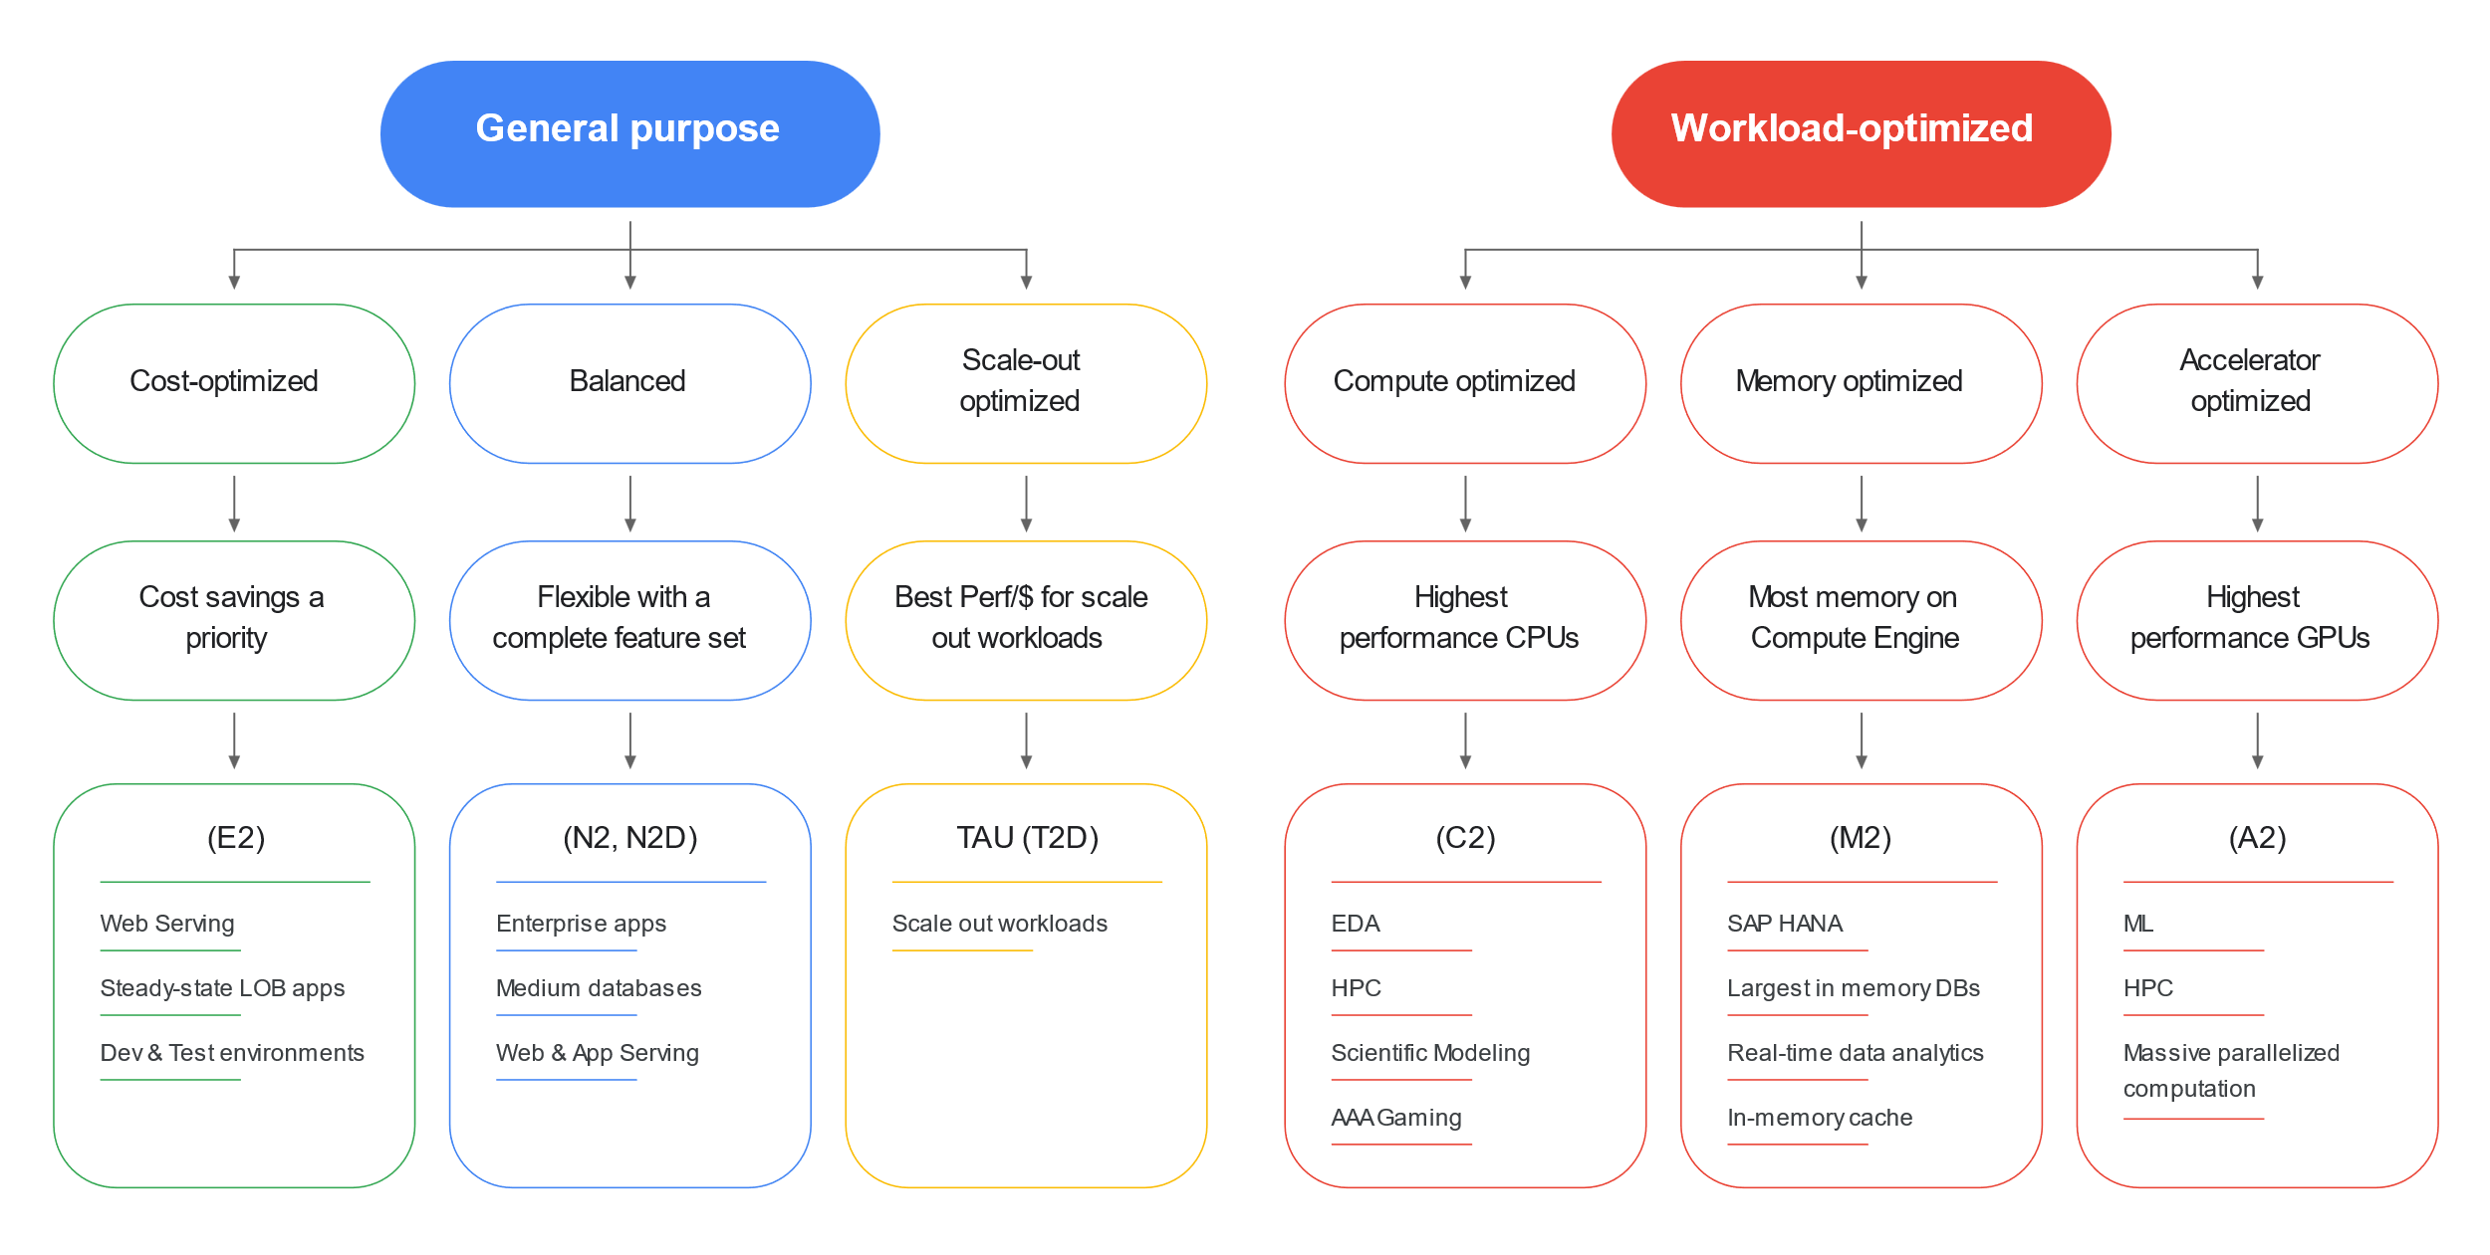

Slide 17
Compute
Demo

Slide 18
Compute Summary
Compute is an infrastructure capable to run workload/application
Main types:
VM
Function
Container

Slide 19
Storage
Storage is an infrastructure capable to store your data

Slide 20
Storage
Types of storage resources
Block
File system
Object

Slide 21
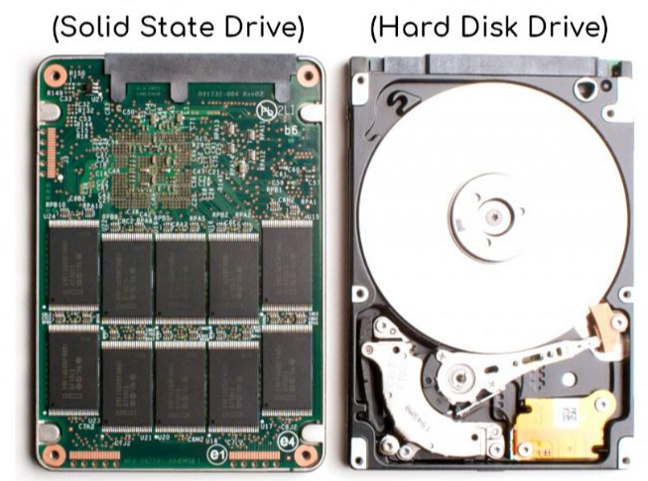
Storage
Block Storage:
Specific location on disks/memory
Network access to raw block devices
Each block could be referenced in different OS and partitioned independently
Notes:
There are SATA disks on the picture, while _modern_ computers runs NVMe SSD that operates over PCI Express bus.
SATA SSD still imitated HDD, while NVMe acts more like memory (that’s why NVM – non-volatile memory)

Slide 22
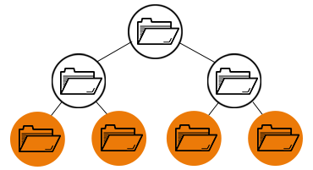
Storage
File Storage:
Shared filesystem
Folder structure
File path and name
Image credit: https://www.redhat.com/en/topics/data-storage/file-block-object-storage

Slide 23
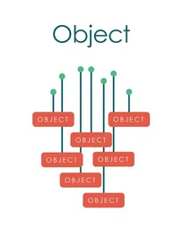
Storage
Object Storage:
Flat-structure like key-value store
Each object has associated metadata and Id
Immutable objects: written or replaced
Often accessed via (REST) API
Often allows aggregation into buckets/containers
Image credit: https://www.caringo.com/blog/scaling-your-data-storage-for-the-age-of-zettabytes

Slide 24
Storage
AWS offerings:
Block Storage: EBS (Elastic Block Storage)
File System: EFS (Elastic File System)
Object Storage: S3 (Simple Storage Service) with multiple replication types and access tiers (Storage Classes) including Glacier
Bonus: Snow Family
Notes:
S3 (Simple Storage Service)
Object storage: store each file as a separate entity
HA, security, performance
Charge for usage
File size: 0 byte - ~5 terabytes
Access controls
Access tiers: standard, intelligent, Standard-Infrequent, One-zone Infrequent, Glacier, Glacier Deep Archive
Elastic Block Storage (EBS)
Raw, unformatted block device attached to EC2
Attach multiple volumes to the same EC2
Use as FS or hard-drives
Dynamically change configs and size
Replicated in AZ
Can move between VMs, encrypt, do not delete when EC2 goes away
Different types

Slide 25
Storage
Azure offerings:
Block Storage: Azure Disk
File System: Azure File or One Drive
Object Storage: Storage Account, including Blob, Queue, Table, File Share (File System)
Has multiple access tiers and replication modes

Slide 26
Storage
GCP offerings:
Block Storage: Persistent Disk
File System: Filestore or Google Drive
Object Storage: Cloud Storage with multiple access tiers (Storage Classes) and redundancy options

Slide 27
Storage
How to choose:
Who uses the storage
Usage patterns and performance: access frequency, size of data, size of files
Pricing
Access control

Slide 28
Storage
Demo

Slide 29
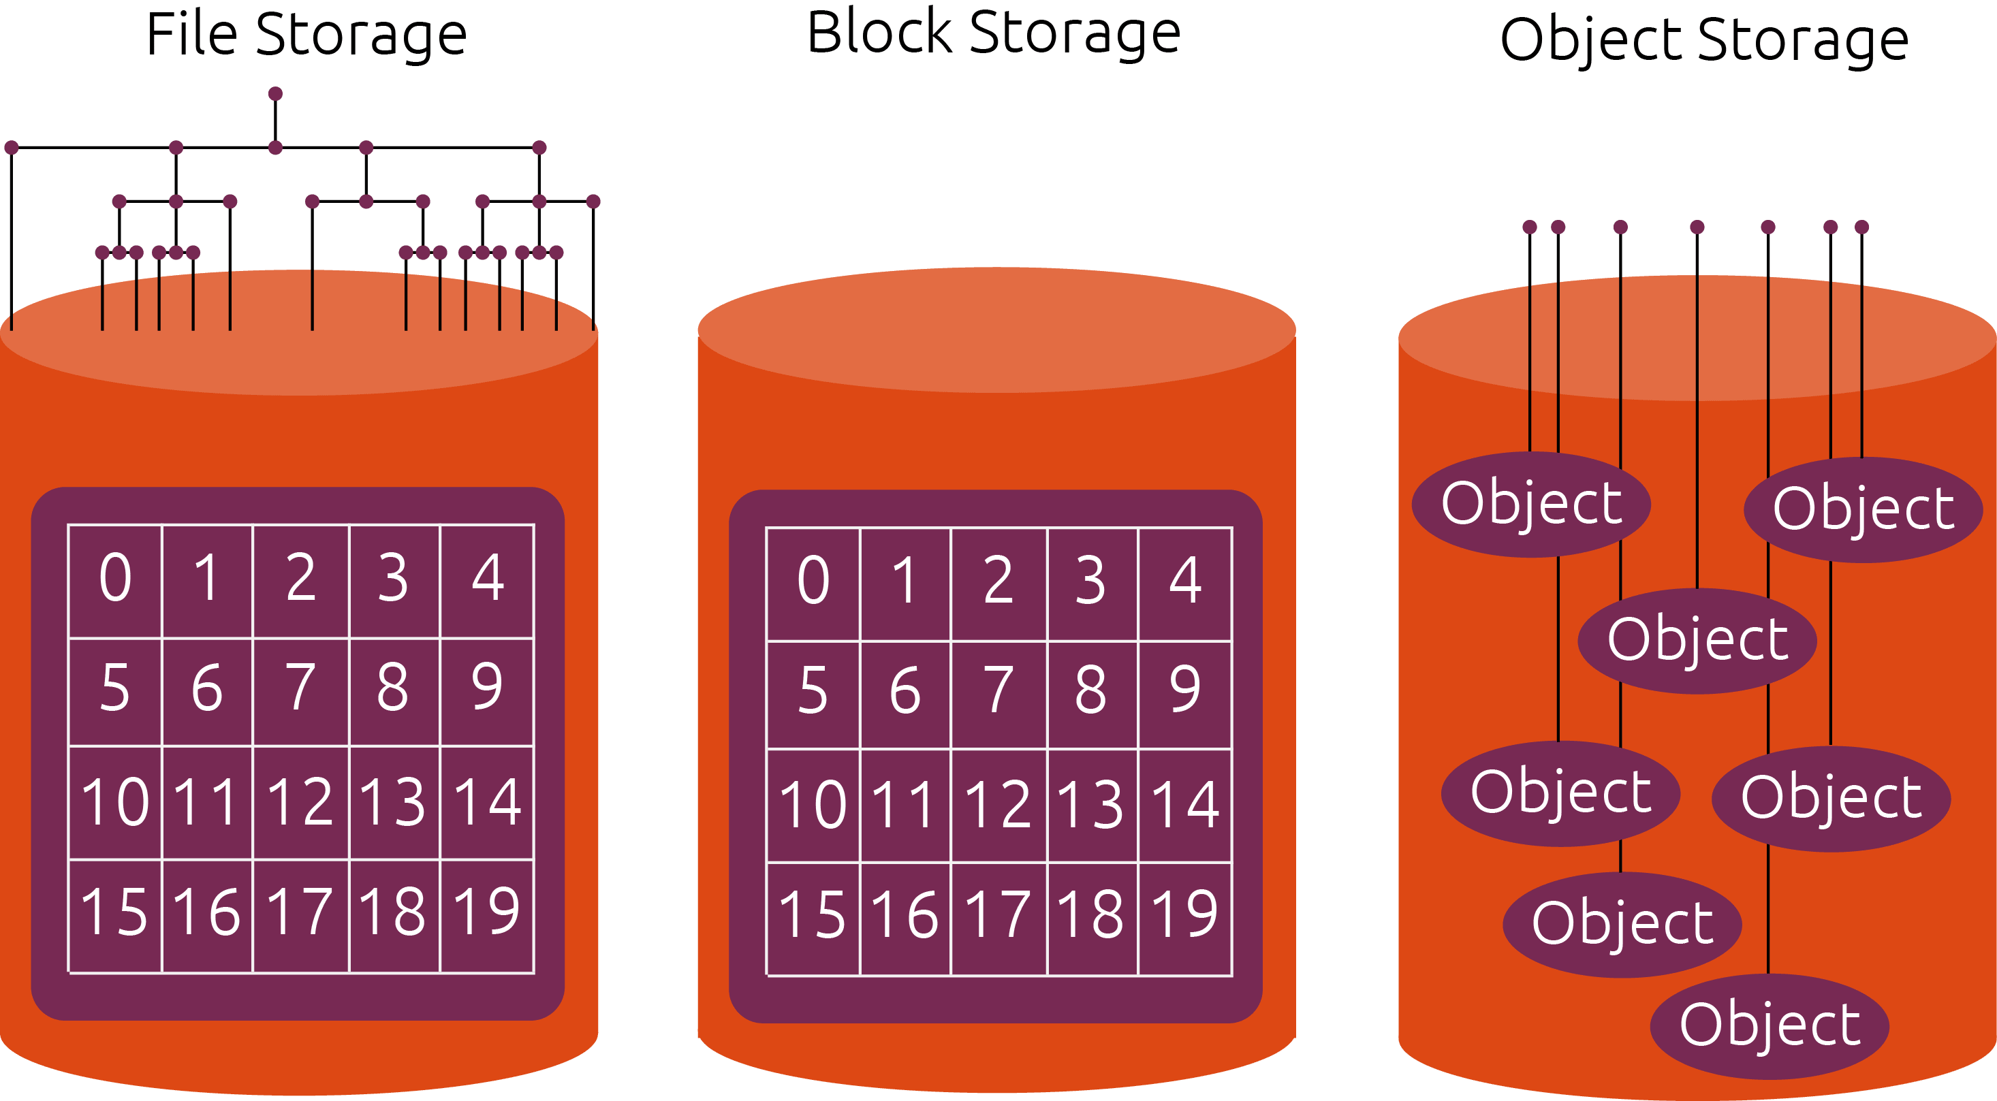
Storage Summary
Image credit: https://ubuntu.com/blog/what-are-the-different-types-of-storage-block-object-and-file

Slide 30
Storage
Examples
VM disk
DB Backup
A bunch of json files
Data Lake
Share files within a team

Slide 31

[Bonus] Storage

Slide 32
Network
Cloud does not offer a physical network, but it provides networking services
Networking services – are the ones that solve your connectivity and isolation problems
Software-defined network

Slide 33
Network
Classless Inter-Domain Routing (CIDR)
Used for IP-allocation and routing
It divides the space using 1-bit steps
Consists of two parts:
the most significant bit
network prefix

Slide 34
Network
CIDR notation | Bits | Range
10.0.0.0/8 | 00001010.00000000.00000000.00000000 | 10.0.0.0 – 10.255.255.255
10.1.0.0/16 | 00001010.00000001.00000000.00000000 | 10.1.0.0 – 10.1.255.255
10.2.0.0/16 | 00001010.00000010.00000000.00000000 | 10.2.0.0 – 10.2.255.255
10.3.0.0/31 | 00001010.00000011.00000000.00000000 | 10.3.0.0 – 10.3.0.1
10.3.0.2/32 | 00001010.00000011.00000000.00000010 | 10.3.0.2 – 10.3.0.2
CIDR Calculator example

Slide 35
Network
Private Network
a computer network that uses private IP address space
anyone may use these addresses without approval from regional or local Internet registries
private network devices communicate with public internet via Network Address Translation (NAT)
CIDR notation | IP range
10.0.0.0/8 | 10.0.0.0 – 10.255.255.255
172.16.0.0/12 | 172.16.0.0 – 172.31.255.255
192.168.0.0/16 | 192.168.0.0 – 192.168.255.255

Slide 36
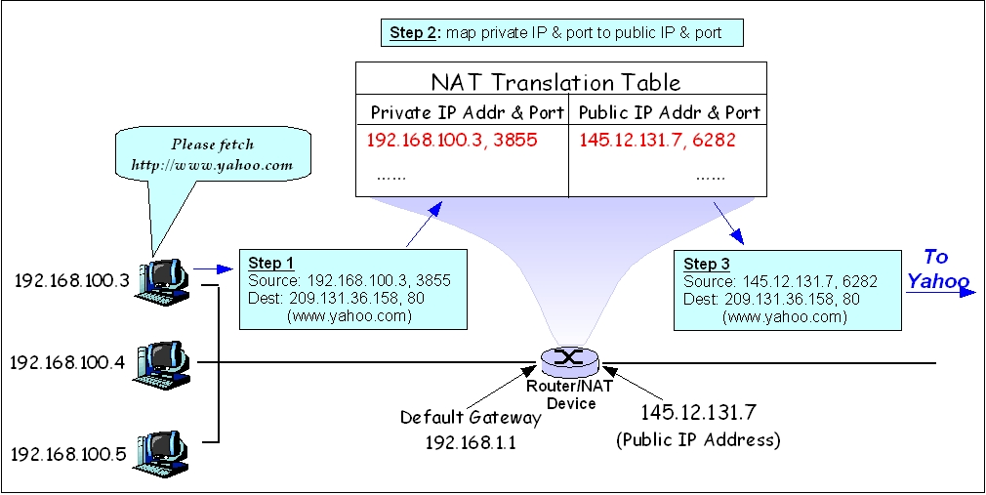
Network
Image credit: https://en.wikipedia.org/wiki/Network_address_translation#/media/File:Network_Address_Translation_(file2).jpg

Slide 37
Network
Virtual Network
Like traditional network but in cloud and dedicated only for you
Has address space specified as CIDR block
Has 1..N subnets (CIDR)
Can have Route table, security rules/groups, public/private endpoints
Could be peered with other Virtual and on-premise networks
Virtual Network / Virtual Private Cloud (VPC) / Virtual Private Cloud

Slide 38
Network
Load Balancer (LB)
distributes network traffic
could be exposed publicly or private-only
custom rules, auto-scaling, health-checks, and others
integrates with other cloud-services
Load Balancer / Elastic Load Balancer (ELB) / Cloud Load Balancer

Slide 39
Network
Domain Name System (DNS)
translates names to IP addresses
can work with cloud-internal resources …
… or with public domain-registrars
Azure DNS / Route 53 / Cloud DNS

Slide 40
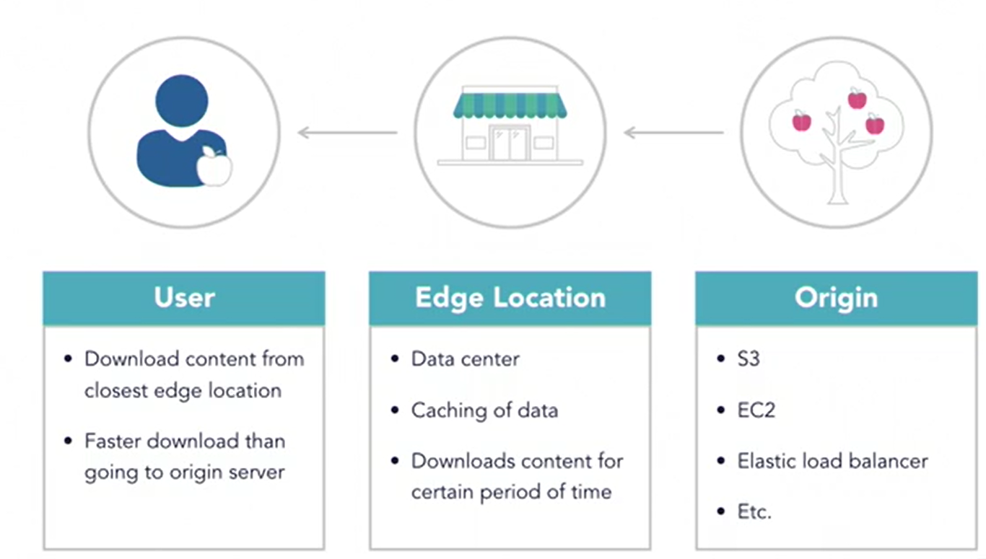
Network
Content Delivery Network (CDN)
Caches files on edge locations
Azure CDN / CloudFront / Cloud CDN
Image Credit https://awsnewbies.com/

Slide 41
Network
And a LOT of others, for example AWS Ground Station or Azure Orbital

Slide 42
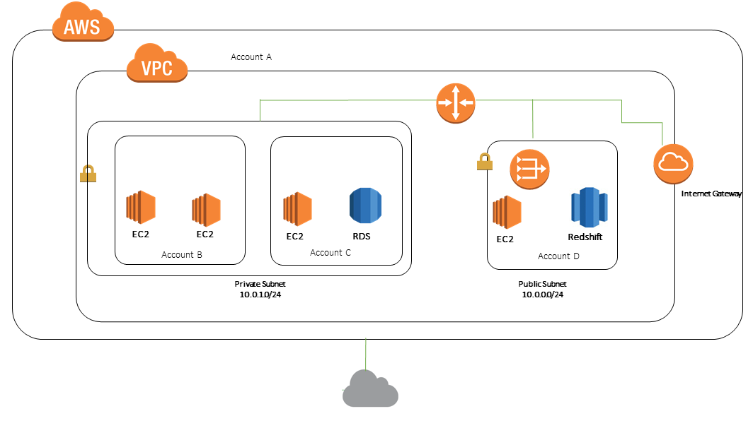
Network
Image credit: https://docs.aws.amazon.com/vpc/latest/userguide/example-vpc-share.html

Slide 43
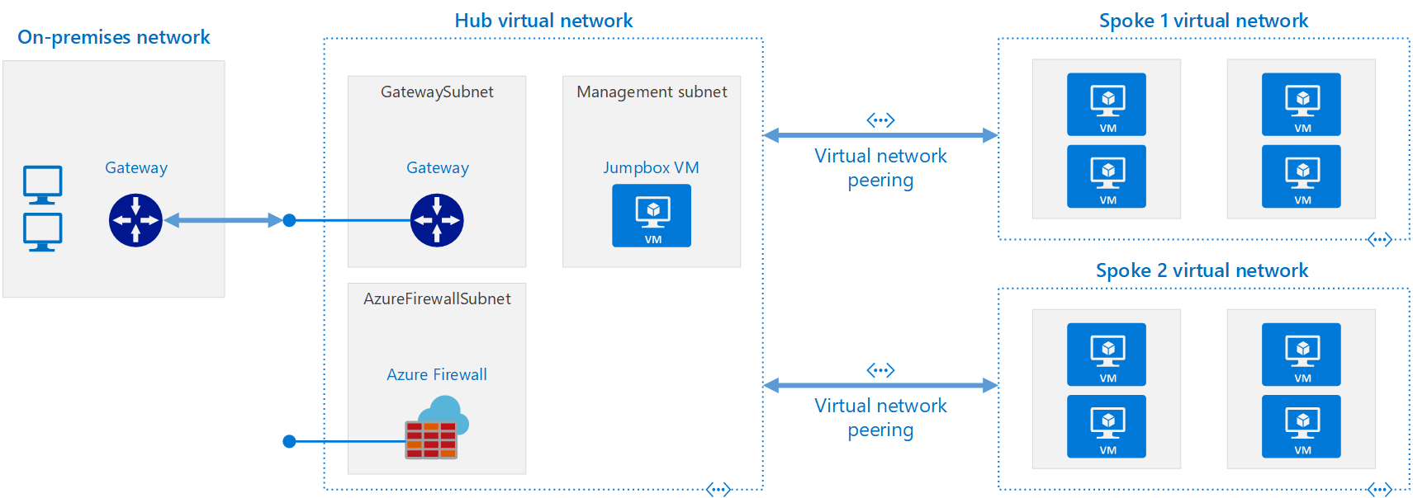
Network
From https://docs.microsoft.com/en-us/azure/architecture/reference-architectures/hybrid-networking/hub-spoke

Slide 44
Network Summary
Networking services solve your connectivity and isolation problems
Virtual Networks
CIDR notation for address space
Split on subnets
NAT
security rules/groups
Load Balancer
DNS
CDN

Slide 45
Databases
Cloud Database is …
Place where you store and query data
Managed by cloud provider

Slide 46
Databases
Cloud providers
might propose a custom database (CosmosDB, Aurora, DynamoDB, BigTable, Spanner)
have product, which is compatible with popular solutions: psql, mysql, mongo, cassandra, redis, etc
Compatible does not mean actual product behind. Thus, read the docs

Slide 47
Databases
Cloud Database groups
Relational
Non-relational
In-memory

Slide 48
Databases
Relational DBs in cloud
Azure:
Azure SQL (MS SQL)
Azure Database for MariaDB/MySQL/PostgreSQL
AWS:
Aurora
Relational Database Service [RDS] (Aurora, psql, mysql, mariadb, oracle, mssql)
GCP:
Cloud Spanner
Cloud SQL (MySQL, PostgreSQL, and SQL Server)

Slide 49
Databases
Non-relational DBs in cloud
Azure:
CosmosDB (with different APIs: mongo, cassandra, sql, gremlin)
Storage Account Table
AWS:
DynamoDB
DocumentDB (mongo), Keyspaces (cassandra), Neptune (graph)
GCP:
Cloud BigTable (more data)
Firestore (less data)

Slide 50
Databases
In-memory DBs in cloud
Azure:
Azure Cache for Redis
AWS:
Amazon ElastiCache for Memcached/Redis
GCP:
Memorystore (Redis/Memcached)
Notes:
… and each cloud provider has marketplace with more products

Slide 51
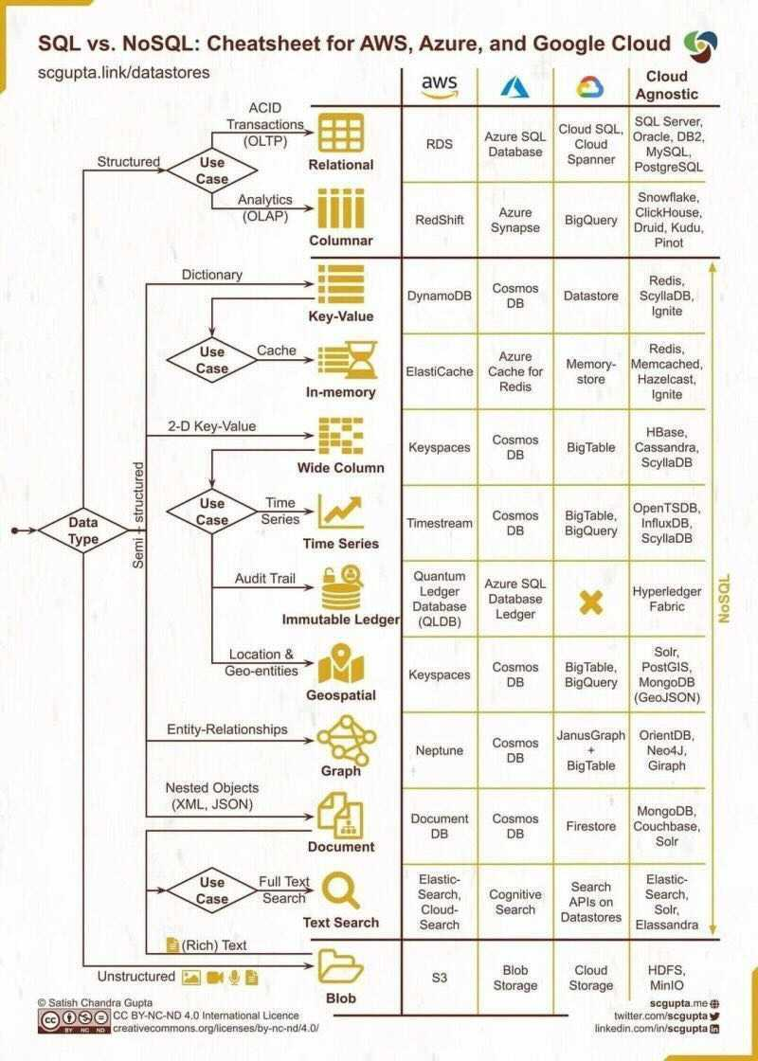

Slide 52
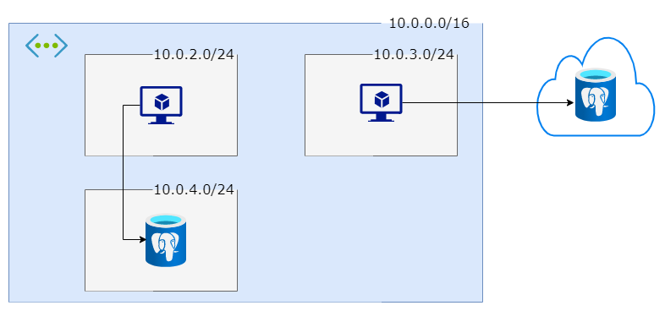
Demo
Connected devices

Slide 53
Events and Messaging
Event streams in cloud
Azure:
Event Hub (compatible with Kafka)
Stream Analytics
AWS:
Amazon Kinesis
Managed Streaming for Apache Kafka
GCP:
PubSub
Dataflow
Notes:
Event – an action or occurrence often originated asynchronously
Event log – persisted immutable sequence of events (append-only, sequential reads, often partitioned)

Slide 54
Events and Messaging
Messaging in cloud
Azure:
Service Bus
Storage Account Queue
AWS:
Simple Queue Service (SQS)
Amazon MQ (ActiveMQ and Rabbit)
GCP:
PubSub
Notes:
Message – event or command
Message could be processed or retries separately. Message is not necessary to process sequentially.

Slide 55
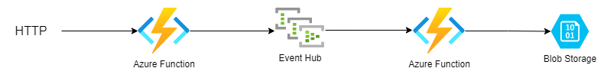
Demo

Slide 56
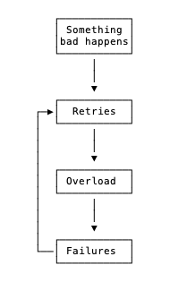
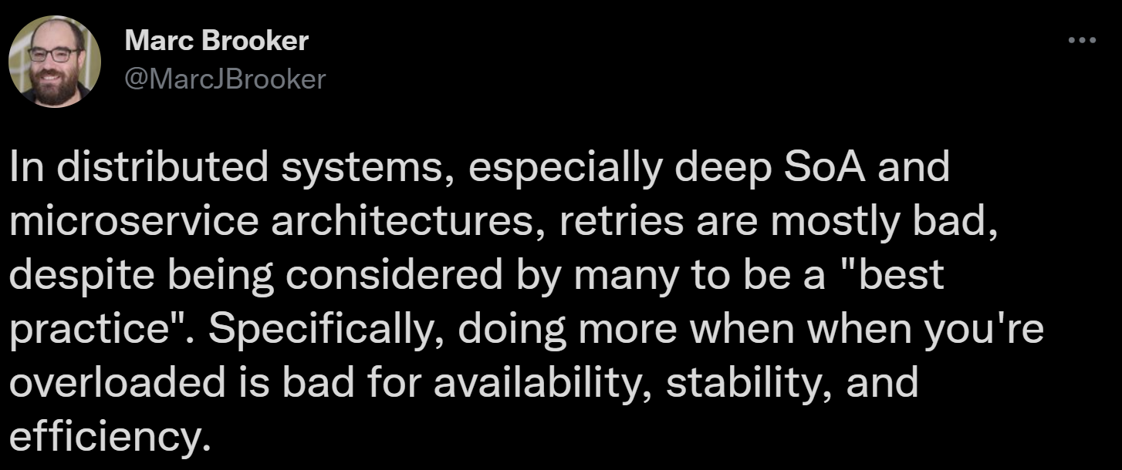
https://twitter.com/MarcJBrooker/status/1489651911640825858

Slide 57
Additional resources
(video) Safe Client Behavior
(comics) Networking basics by Julia Evans
(video) DynamoDB design-patterns (applies to most “nosql”)

Slide 58
Additional resources (optional)
(video) AWS Networking Fundamentals
(article) How DNS works
(article) What happens on DNS update
(article) What is CDN
(course) Google’s Introduction to Computer Networking

Slide 59
Additional resources (optional)
(article) Online Event Processing
(safe-client articles): bulkhead, circuit-breaker, poison-queue
(article) AWS Aurora inside
(article) DynamoDB internals (medium paywall)
(article) AWS in plain English

