Slide 1
Cloud Computing

Slide 2
Course plan
Learning session 4
Security
Identity and Access Management (IAM)

Slide 3
Security
It is easy to spin up a new perfectly configured resource in cloud
And it is the same easy to spin up a vulnerable

Slide 4
Security lesson plan
Breach scenarios
What is security in “cloud”
Security areas
Security levels: infrastructure, application, data, user
Case studies:
Public Key Infrastructure (PKI)
Secrets management
Configuration management
Disaster recovery
Custom policies
Expect security services to fail

Slide 5
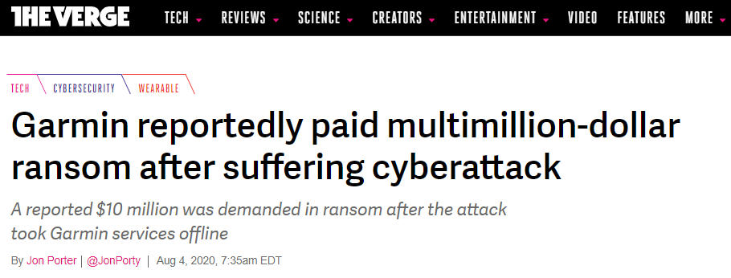
Breach scenarios
Ransomware: threat to publish data or blocks access
https://www.theverge.com/2020/8/4/21353842/garmin-ransomware-attack-wearables-wastedlocker-evil-corp
Notes:
There is even negotiation companies to get discounts

Slide 6
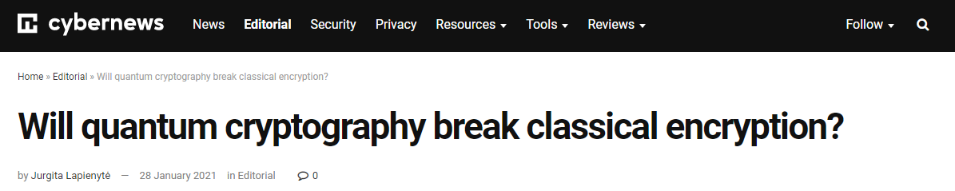
Breach scenarios
Encryption break: from weak encryption algorithms and weak key generators to server-side vulnerabilities and leaked keys

Slide 7
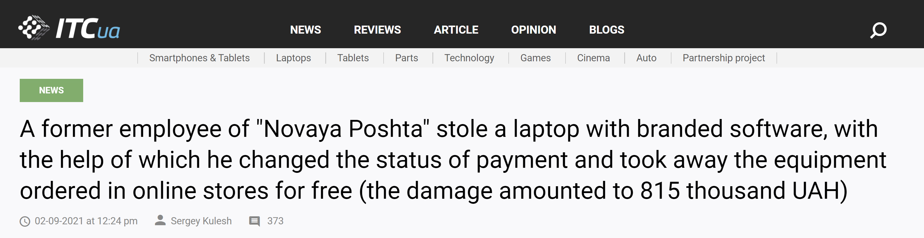
Breach scenarios
Physical theft: taking of another person's property or services
https://itc.ua/news/byvshij-sotrudnik-novoj-poshty-menyal...

Slide 8
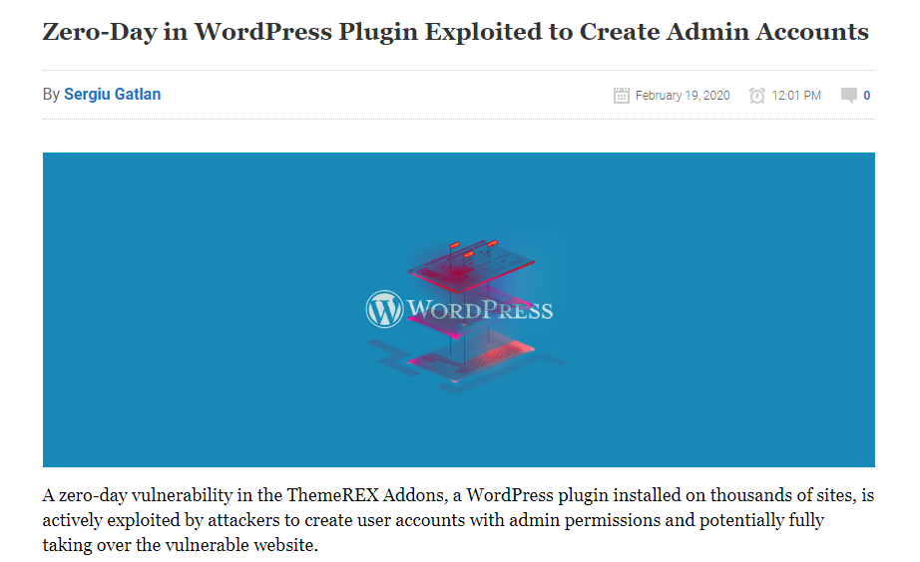
Breach scenarios
CVE exploitation
https://www.bleepingcomputer.com/news/security/zero-day-in-wordpress-plugin-exploited-to-create-admin-accounts/

Slide 9
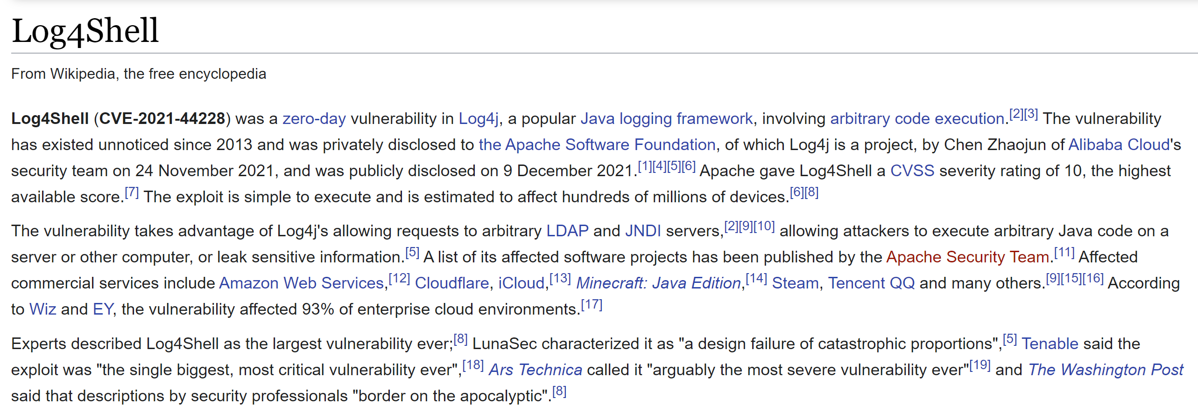
Breach scenarios
CVE exploitation
https://en.wikipedia.org/wiki/Log4Shell

Slide 10
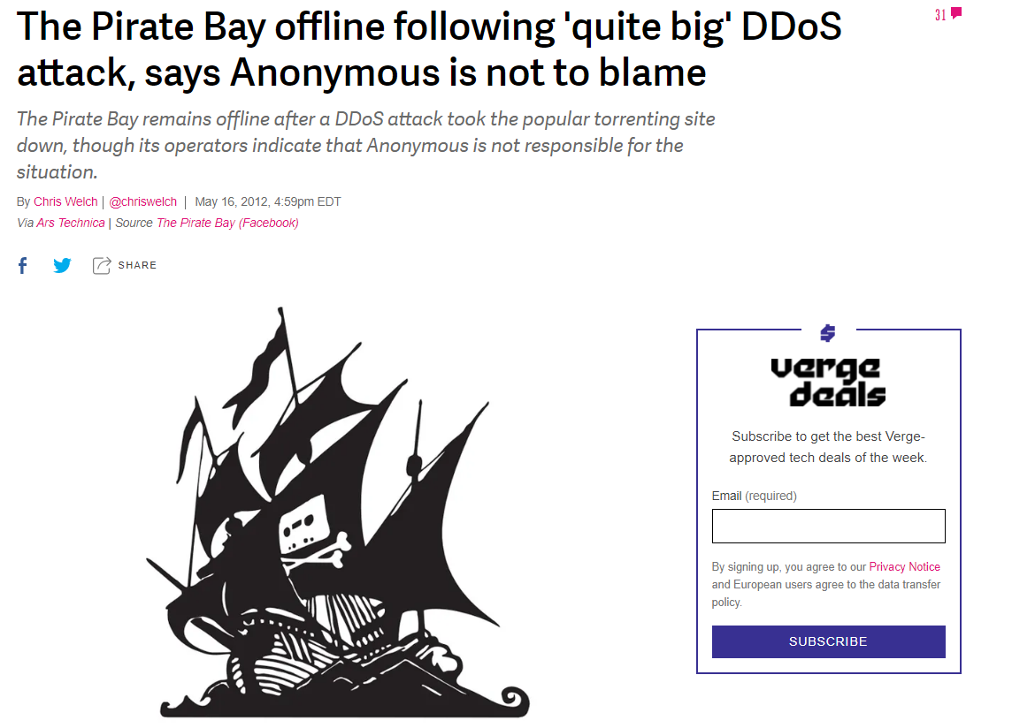
Breach scenarios
DDOS
https://www.theverge.com/2012/5/16/3024861/pirate-bay-offline-ddos-attack

Slide 11
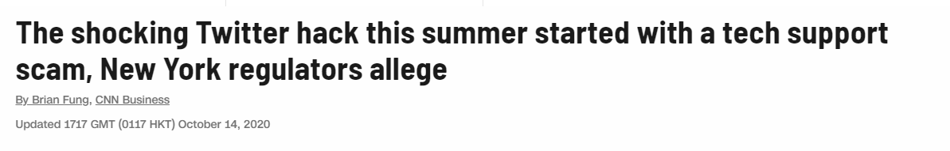
Breach scenarios
Employee data theft / Social engineering
https://edition.cnn.com/2020/10/14/tech/twitter-hack-tech-support-scam/index.html
Notes:
+ https://www.dfs.ny.gov/Twitter_Report
A lot comes from phishing…

Slide 12
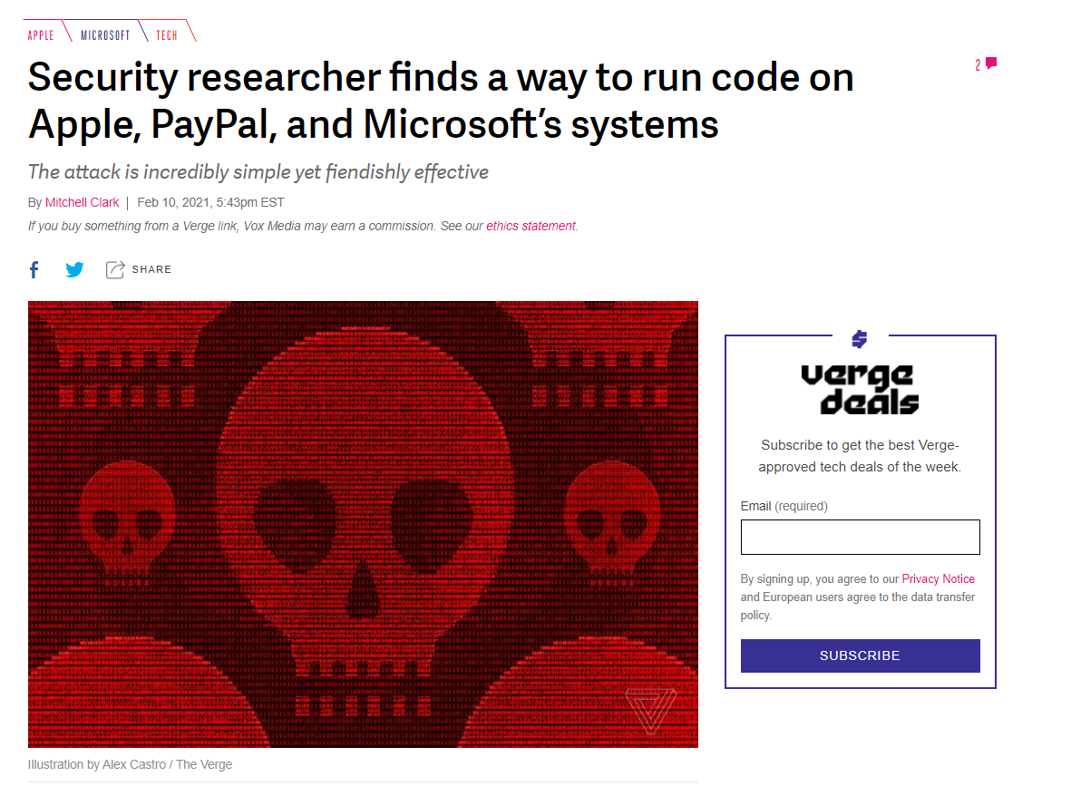
Breach scenarios
Supply Chain Attacks
https://www.theverge.com/2021/2/10/22276857/security-researcher-repository-exploit-apple-microsoft-vulnerability

Slide 13
Security
But Cloud Provider takes care about security…

Slide 14
Security
Cloud Provider is responsible for protecting your data from other tenants.
Protecting your data from intruders/hackers - is your task.

Slide 15
Security
Security is about dealing with Risk:
Accidental deletion
Theft
Privacy
Compliance

Slide 16
Security
Cloud Provider often gives tools to deal with security risks

Slide 17
Security
Security comes with a price:
increased cost and complexity
decreased maintainability

Slide 18
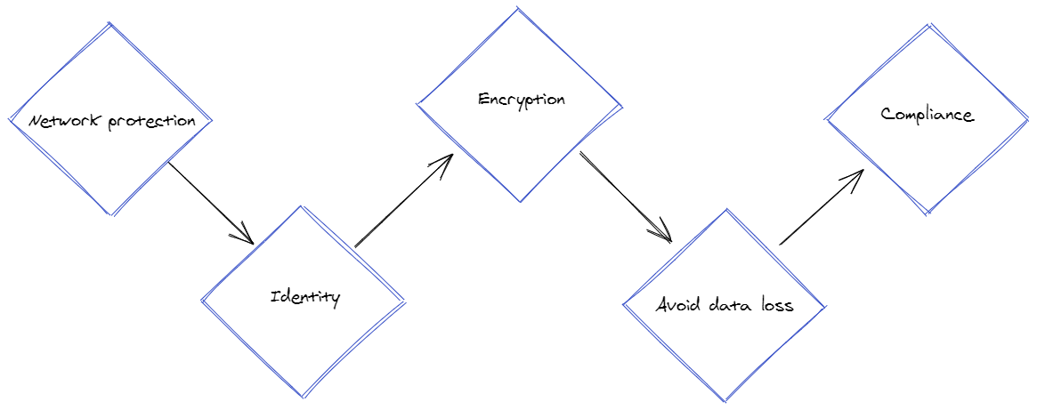
Security Areas

Slide 19
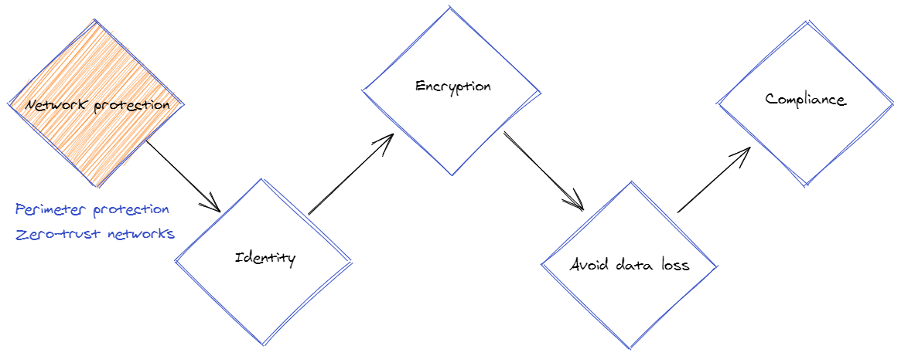
Security Areas
Notes:
Firewall, security-groups, DDoS protection, JIT-VM/Jumphost/Bastion-host/Shielded-VMs

Slide 20
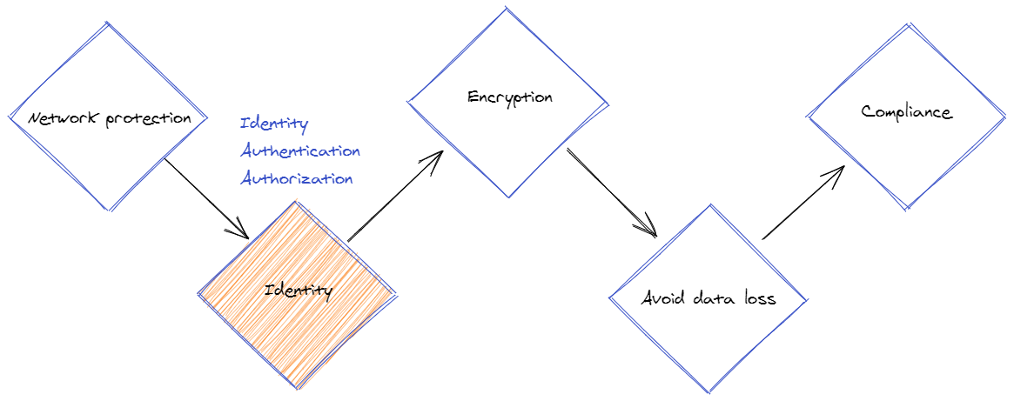
Security Areas
Notes:
Azure AD, AWS AIM, RBAC

Slide 21
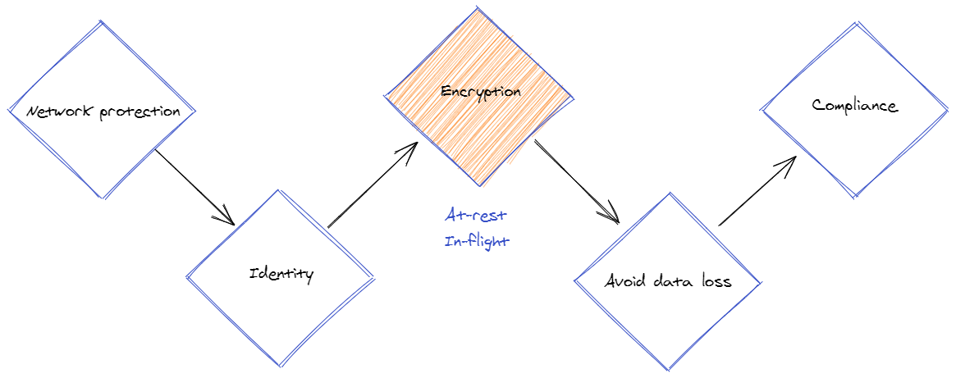
Security Areas

Slide 22
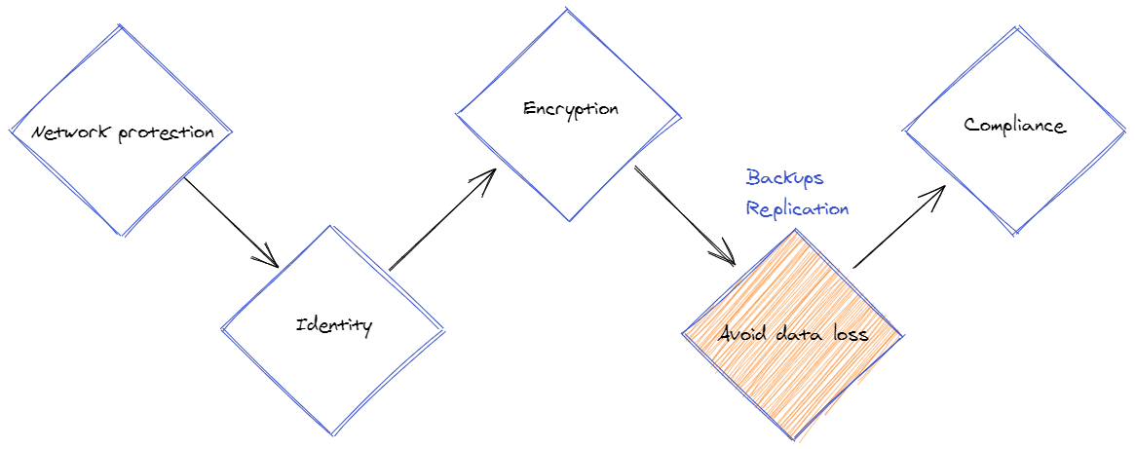
Security Areas

Slide 23
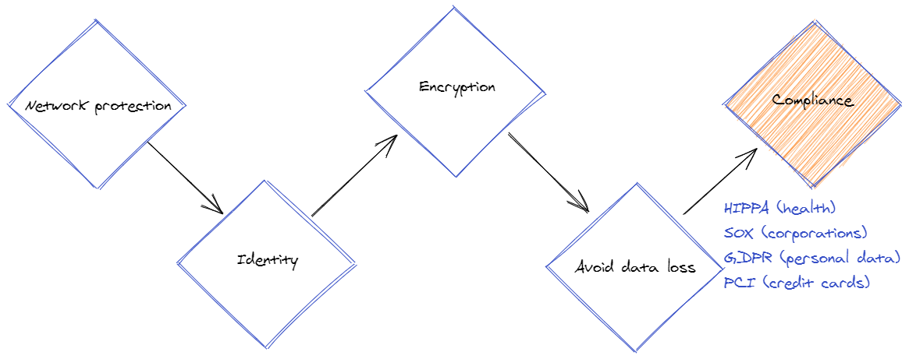
Security Areas
Notes:
Know in which domain you are, and which standard applies to it (mostly about data)

Slide 24
Security levels
Infrastructure-level security
Server-side data encryption
Network traffic protection (in-flight)
OS, firewalls
IAM/RBAC
Notes:
Encrypt data in database/storage
Add (s) to your protocol: HTTPs, sFTP, …
Strict firewall rules, OS hardening
Least-privilege identity

Slide 25
Security levels
HTTPs is needed even inside private network: How to contact google sre dropping a shell in cloud sql

Slide 26
Security levels
Application-level security
Client-side data encryption
Logs: infrastructure, access-logs, OS, db, api/app
Monitoring: metrics, notifications/alerts
Configuration Management: patches, versioning, trusted artifacts
Notes:
Encrypt data before sending it over the wire
Gather logs from all your resources and store them at least a few weeks
Expose metrics, watch them, alert
Patch your dependencies, use explicit (ideally immutable) versions, sign artifacts and verify your supply chain

Slide 27
Security levels
Data-level security
DB level
Table/object level
Record level
Field level (e.g. one column has more sensitive data than others)

Slide 28
Security levels
User-interface level
Least privilege
Do not use root
Strong passwords
MFA and PIM
Secrets rotation
Custom policies
Audit logging
Notes:
Human and machine identities should be allowed only a minimal needed set of permissions
Enforce strong passwords and multiple factors auth
Rotate (machine) secrets frequently and set expiration dates
Codify your system policies and enforce resources to follow them
Log who does what and when

Slide 29
Security levels
Password rotation is required for machines/apps/scripts, but not for humans: The Debate about Password Rotation Policies
Regular human-password rotation causes
weaker passwords
work disruptions
higher cost to maintain across the org
It’s better to use a static but strong password (and password manager)

Slide 30
Case studies
Public Key Infrastructure (PKI)
Notes:
Demo:
- Show certificate trusted by public authority

Slide 31
Case studies
Secrets management
Put expiration date on a secret
Scoped tokens instead of full-access keys
Keep secrets out of code
Notes:
Demo:
Storage account key vs SAS-token
Azure Key Vault

Slide 32
Case studies
Configuration management
Patch dependencies
Scan for CVE
Sign commits, container-images, assemblies
Immutable versions, build once
Notes:
Demo:
Scan with trivy
Build container, use it by sha

Slide 33
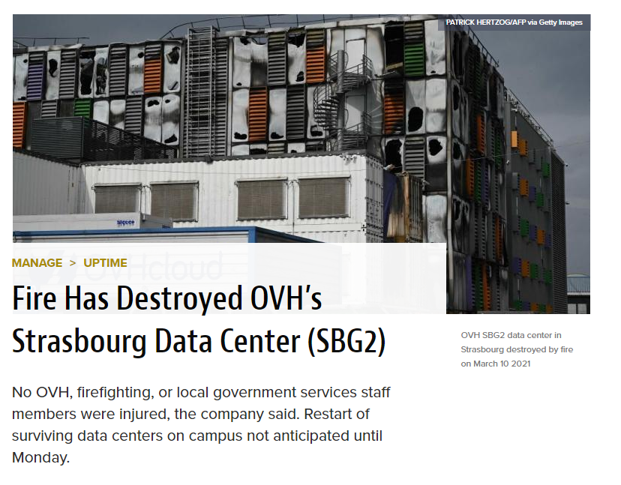
Case studies
Disaster recovery
Backup data
Document restore process
https://www.datacenterknowledge.com/uptime/fire-has-destroyed-ovh-s-strasbourg-data-center-sbg2

Slide 34
Case studies
Avoid circular dependencies and be careful with a single tool combined for unrelated use-cases
- Roblox was down for 73 hours partially because everything relied on a single Consul instance (including monitoring)
- Google wifi-password reset caused the whole company unable to use central password-manager
Notes:
Google Password manager in 2012
Google had an internal password manager created by a single team for internal usage but gradually because a company-wide solution even to distribute wifi-passwords
In 2012 wifi password change caused an enormous spike of requests to the app which caused a failure
As it was an internal app maintained in a best-efforts manner, there were no documents on how to deal with it, thus …
On-call engineer restarted the app without knowing that hard restart requires a hardware security module (HSM) smart-card.
These smart cards are stored in several offices in physical safes but not in the office where the on-call engineer was (New York)
The engineer called a colleague in Australia, but the Australian office cannot open the safe because…
The secret combination is stored in the password manager…
They called other offices and finally found a person who remembers the combination by heart and can open the safe
But when they inserted the smart-card it returned a cryptic error…
Meanwhile, the Australian office decided to use a power drill to open their safe, but their card gave the same error.
After an additional hour, someone understood that the green light on the smart card indicates nothing and it should be flipped.

Slide 35
Case studies
Custom policies
Codify rules
Verify adherence to rules at deployment time
Monitor/enforce rules at runtime

Slide 36
Case studies
Expect security services to fail
For example, Parler content was dumped because twilio integration faded away

Slide 37
Case studies
Note who uses your product
- Google is regularly under attack because of Gmail accounts (even in 2010)
- Strava leaked US army bases because of location tracking

Slide 38
Course plan
Learning session 4
Security
Identity and Access Management (IAM)

Slide 39
Identity Access Management Lesson Plan
Common Terminology:
Identities, Groups
Permissions, Roles
Scopes
Role-based Access Control (RBAC)
Access Control Lists (ACL)
Authentication
Authorization
OAuth, OpenID, SAML Protocols
Clouds: AWS/GCP IAM, AAD

Slide 40
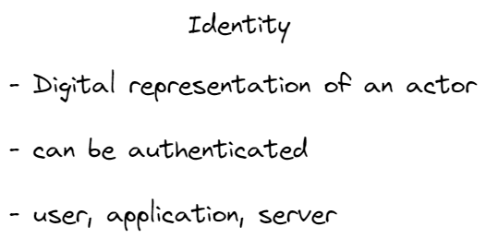

Slide 41
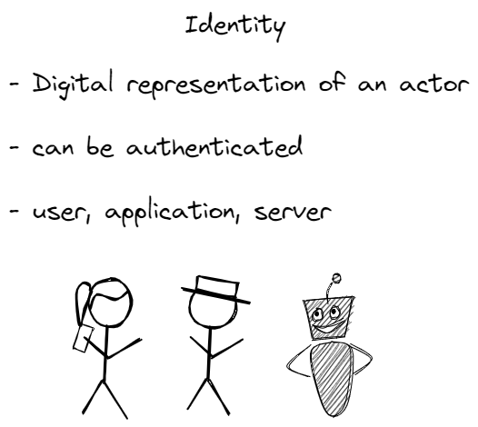

Slide 42
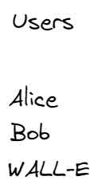

Slide 43
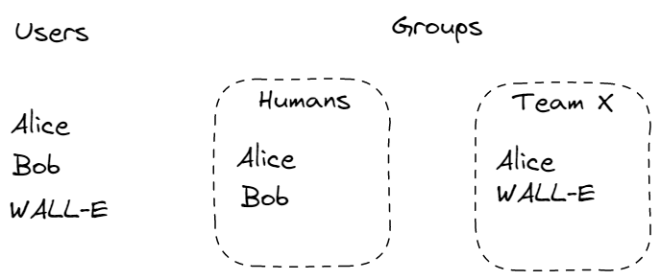

Slide 44
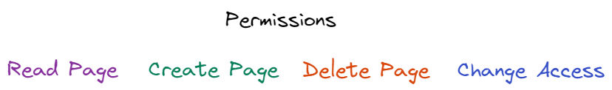

Slide 45
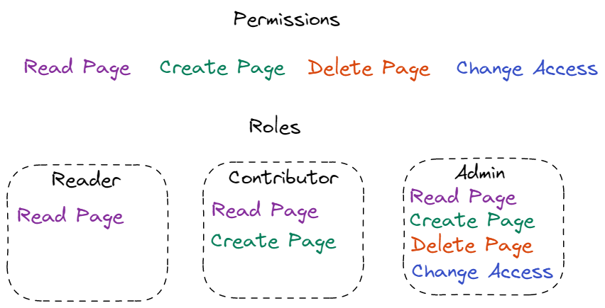

Slide 46
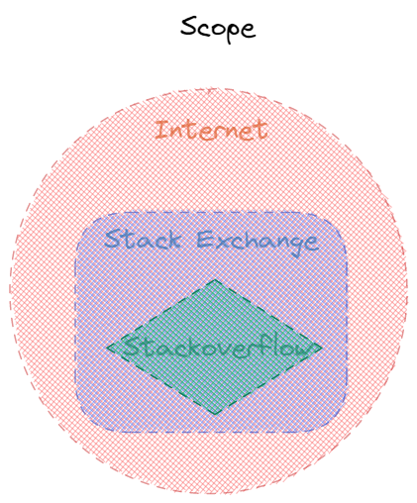

Slide 47
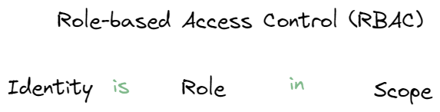

Slide 48
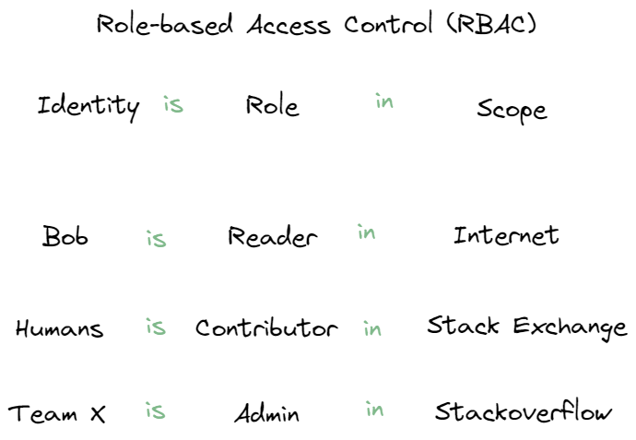

Slide 49
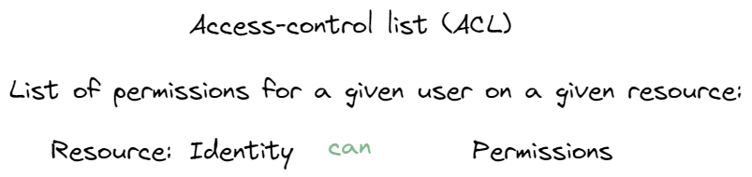

Slide 50
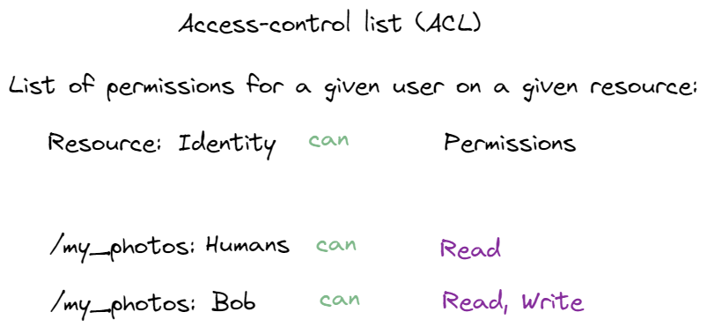

Slide 51
Identity Access Management
Azure RBAC explained

Slide 52
Identity Access Management
Authentication – verification that an identity is who/what they claims

Slide 53
Identity Access Management
Authentication could be based on
Password
Certificate
Token
Biometrics (fingerprint, face identification, etc)

Slide 54
Identity Access Management
Authorization – verify that exact identity is permitted to perform an operation

Slide 55
Identity Access Management
SAML
Open standard to exchange authentication and authorization data.
First published in 2001, SAML 2.0 in 2005
XML-based markup + protocol

Slide 56
Identity Access Management
OAuth
Open standard to delegate access [authorization]
First published in 2006
OAuth 2.0 published in 2012

Slide 57
Identity Access Management
OpenID – authentication protocol first published in 2006.
OpenID Connect (OIDC) – the third version of OpenID protocol, published in 2014

Slide 58
Identity Access Management
OAuth 2.0 is only for authorization
OpenID Connect (OIDC) is a layer on top of OAuth 2.0 and adds login and profile information about the person who is logged in
OIDC enables single-sign-on (SSO) and uses id-token (e.g. JWT)

Slide 59
Identity Access Management
An Illustrated Guide to OAuth and OpenID Connect

Slide 60
Identity Access Management
AWS IAM
GCP IAM
Azure Active Directory (AAD)

Slide 61
Identity Access Management
All of them covers authentication and authorization:
Verifies Identities
Manage Identities access to Resources via Permissions
Aggregate Identities into Groups
Aggregate Permissions into Roles

Slide 62
Identity Access Management
Plus
Identity management
Auditing – logs to answer the question “who did what, where and when?”
Policies – enforce rules

Slide 63
Identity Access Management
Demo
Kubernetes RBAC
Azure Active Directory

Slide 64
Identity Access Management
Demo
Review “security” aspect of FaaS template

Slide 65
Additional resources
(article) What is DDOS attack
(article) How to break encryption
(article) Public Key Infrastructure
(article) What is good Runbook
Password generator and common password approaches with negative impact

