Slide 1
Cloud Computing

Slide 2
Course plan
Learning session 5
Pricing
Monitoring and Observability

Slide 3
Pricing
Sometimes you pay not for what you use, but for what you forgot to turn off
There is no Garbage Collection

Slide 4
Pricing
Snowflake pricing
Pay-as-you-go vs pre-paid vs spot instances
Storage pricing
Traffic pricing
Cost analysis
Calculator

Slide 5
Pricing
The pricing story could be entirely different for different resources in the same cloud

Slide 6
Pricing
Pay-as-you-go (on-demand) – pay according to consumption

Slide 7
Pricing
Consumption could be calculated:
Memory/cpu/disk
Seconds/minutes/hours
Custom units

Slide 8
Pricing
Pre-paid (reserved) – pay in advance
Sometimes can reduce price by >50%

Slide 9
Pricing
Spot instance – propose your price for resource

Slide 10
Pricing
Spot instances
Cloud unused capacity
Best suitable for batch or non-critical workloads
You cannot know when resources will be available and when cloud takes them away
Sometimes can reduce prices by 80%

Slide 11
Pricing
In the cloud, network traffic could be expensive
Try not to cross a single data-center boundary
Network traffic between data-centers is (often) billed
Internet traffic is (often) billed

Slide 12
Pricing
Storage pricing
Cross-zone availability or backups could be included into cloud-managed service
You will pay for it if you implement the same functionality using basic Compute/Storage/Network primitives

Slide 13
Pricing
Regularly use cost analysis tools and set alerts on crossing your budget

Slide 14
Pricing
To estimate spending use Calculator:
Azure
AWS
GCP

Slide 15
Pricing
Demo

Slide 16
Pricing
Tips
Shut-down unused resources (automation is your friend)
Consider changing resource size (often it’s easy-peasy, but could be only one direction - up)
Reserved and spot instances to the rescue
Autoscaling
Regularly review your architecture (new services and features may arise)
Set budget and ALERTS

Slide 17
Pricing
All the rules apply even if you do …

Slide 18
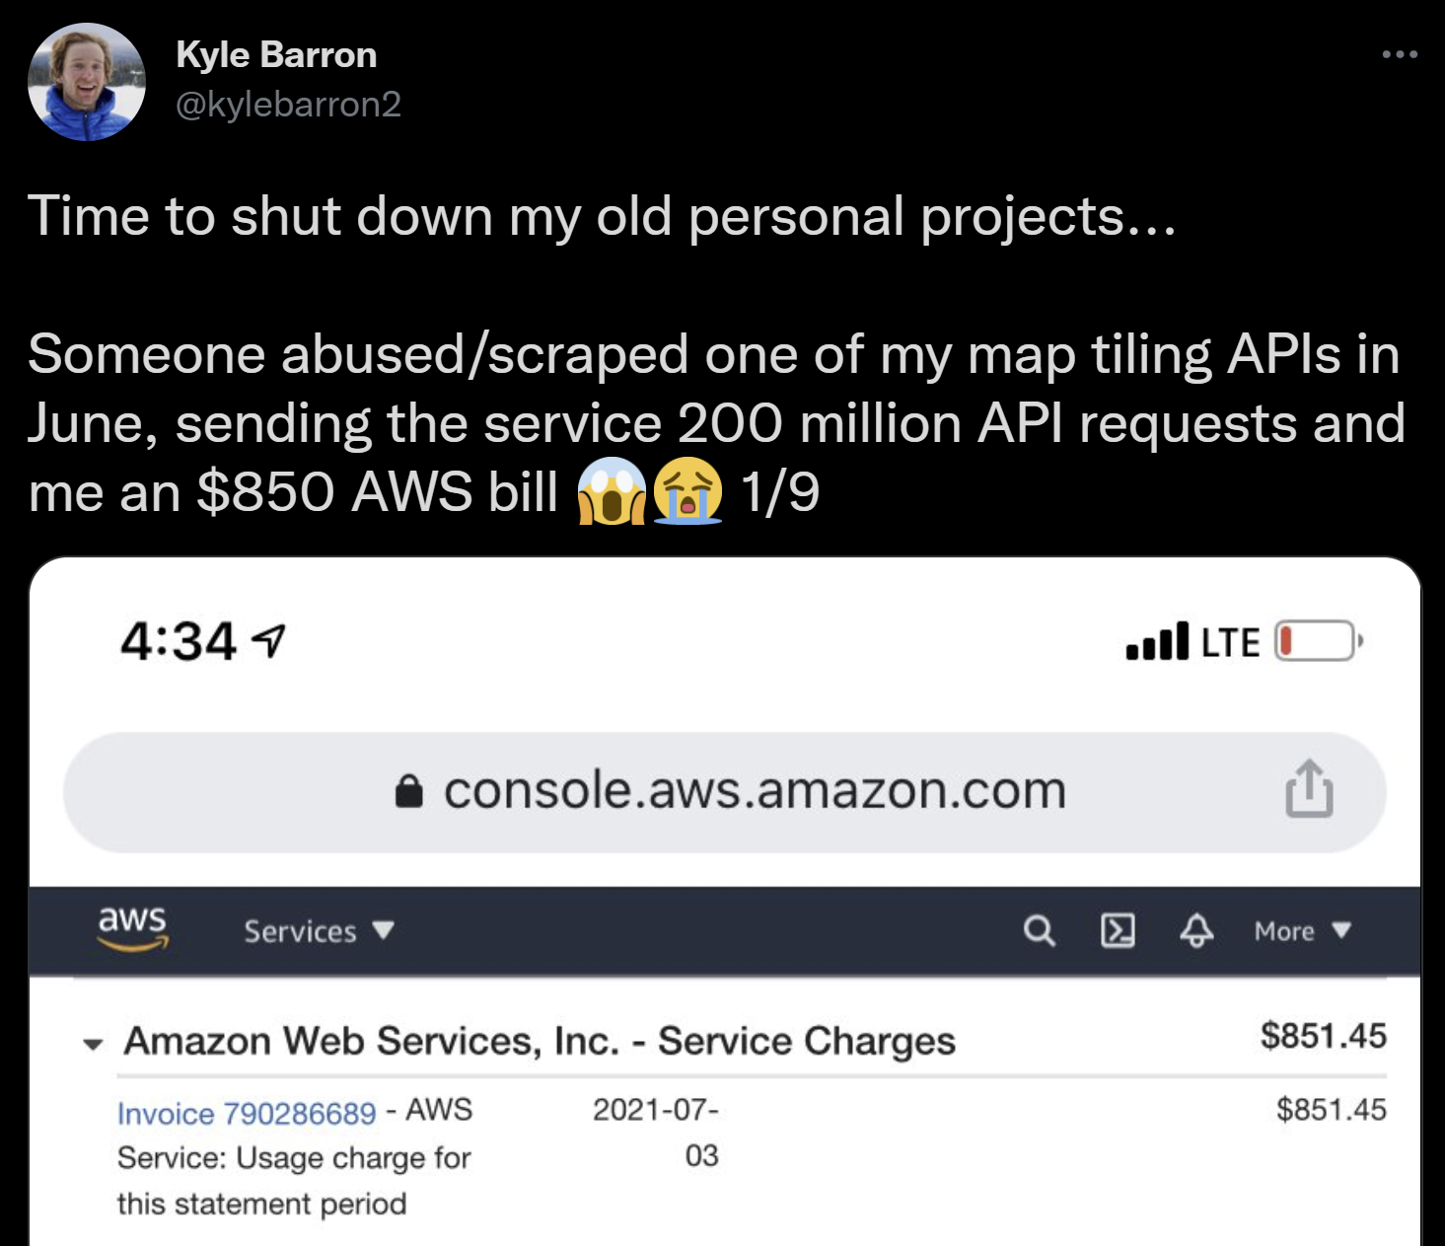
Pricing
All the rules apply even if you do …
…a small pet-project

Slide 19
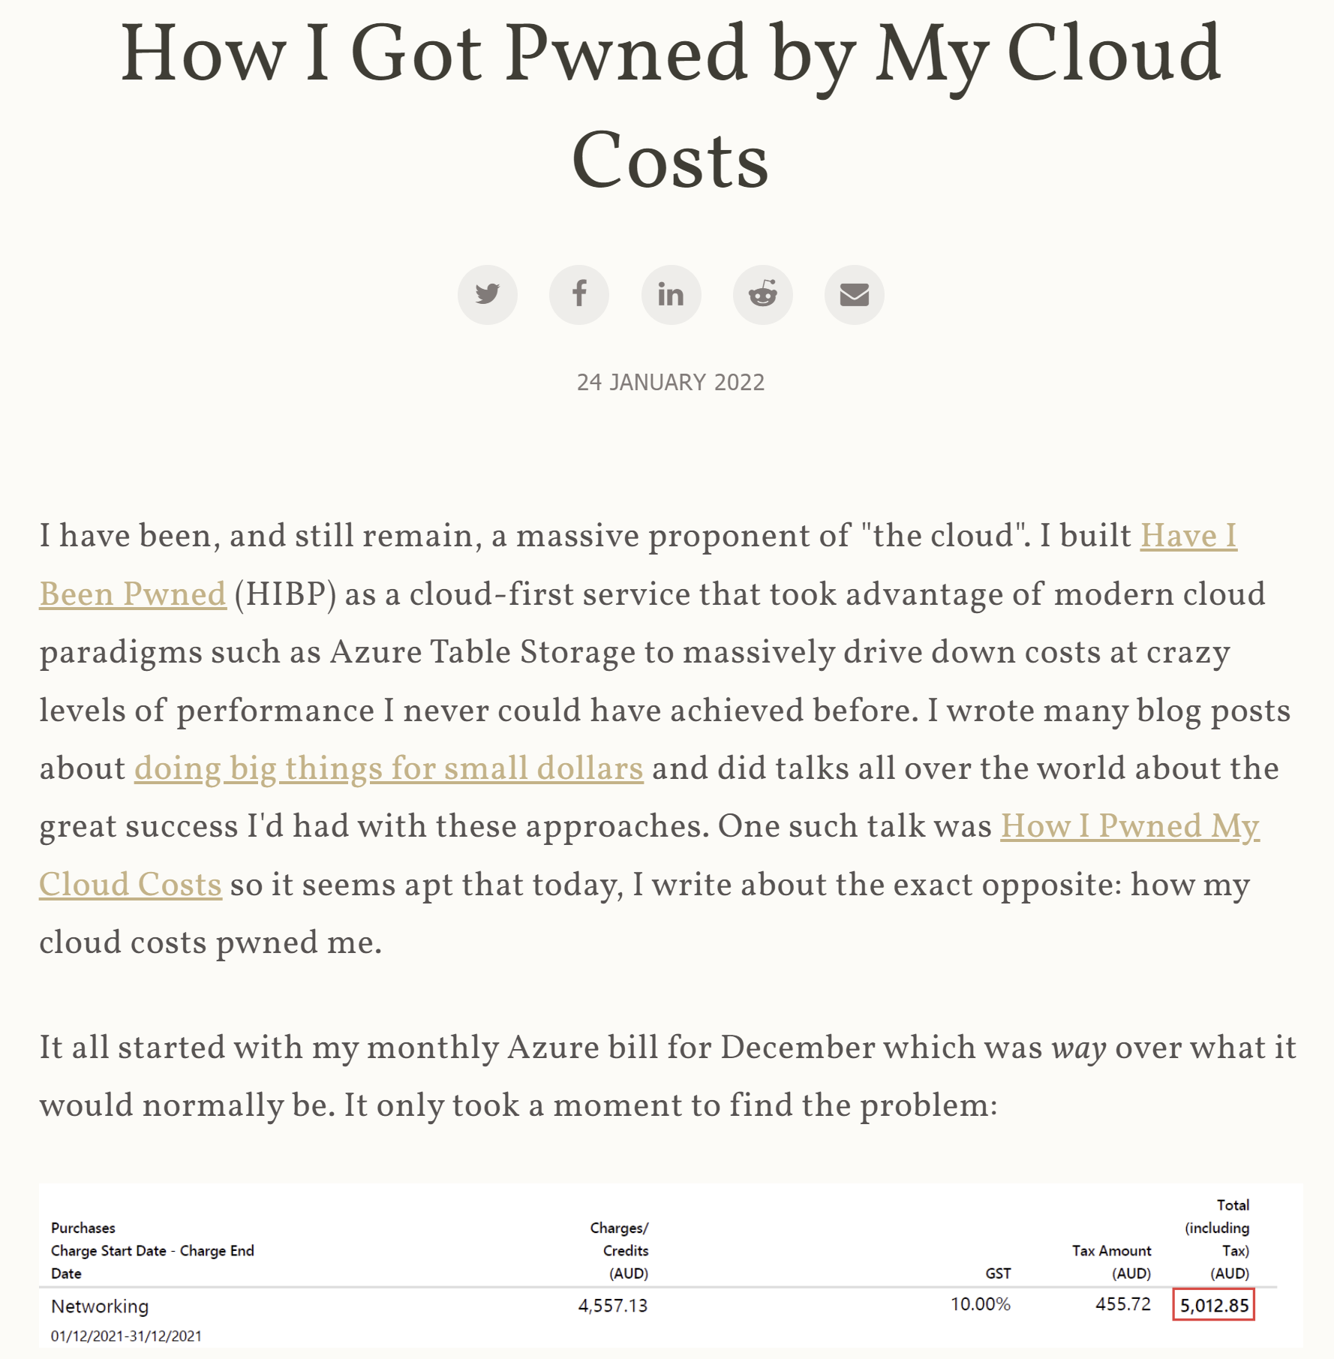
Pricing
All the rules apply even if you do …
…a big non-profit
[ua] translation

Slide 20
Pricing
p.s.
Often engineering team salary is >>> cloud bill
Self-managed service price also includes engineering time

Slide 21
Course plan
Learning session 5
Pricing
Monitoring and Observability

Slide 22
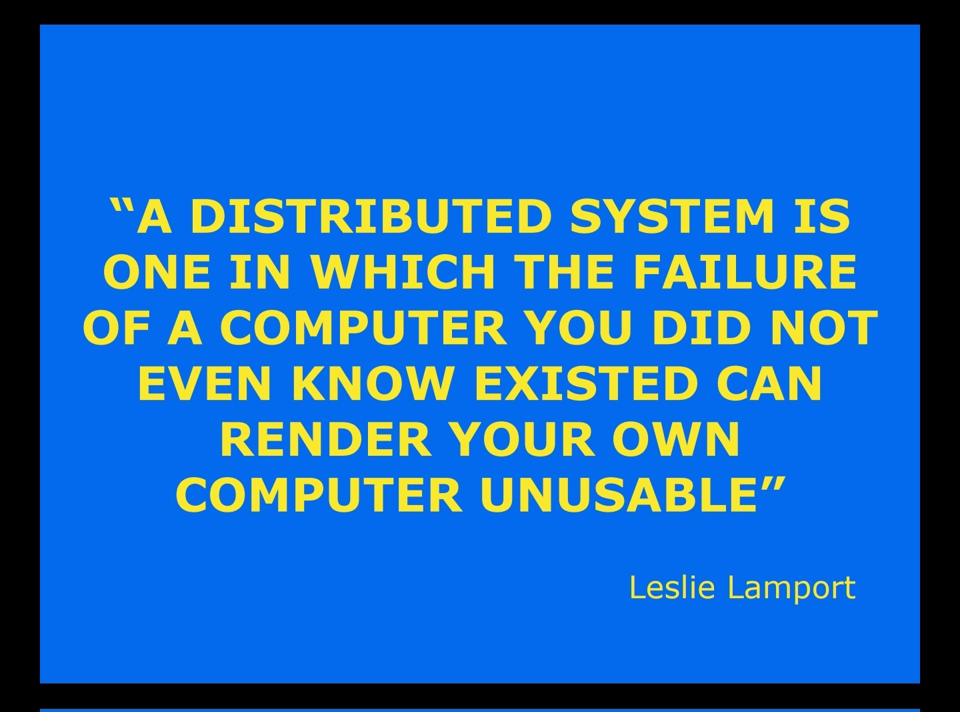
Monitoring and Observability

Slide 23
Monitoring and Observability
What is Monitoring and Observability
Logs
Metrics (and SLI/SLO/SLA)
Traces
Audit
Alerts
Available solutions

Slide 24
Monitoring and Observability
Any system eventually starts misbehaving

Slide 25
Monitoring and Observability
When system misbehaves on my-machine – I can debug it

Slide 26
Monitoring and Observability
When system misbehaves in-production – I can …

Slide 27
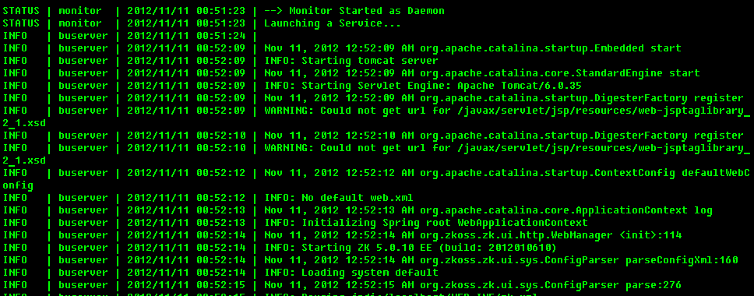
Monitoring and Observability
Logging – process for collecting, storing, retrieving, processing and visualizing log records/events.

Slide 28
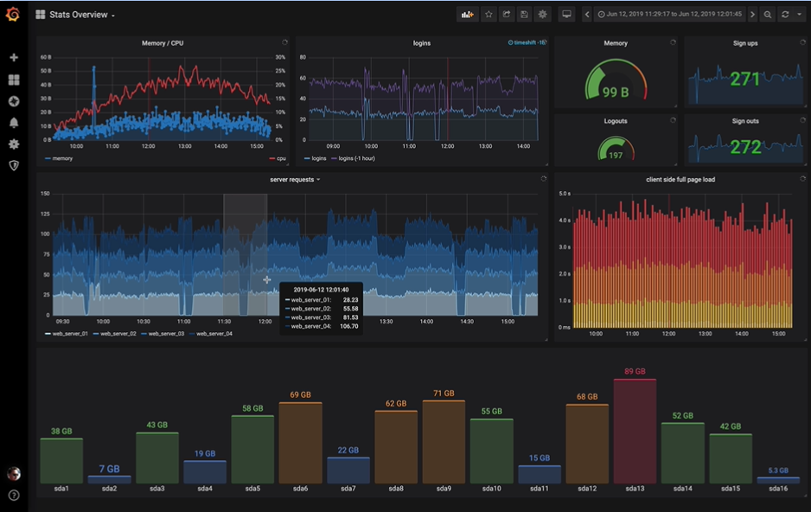
Monitoring and Observability
Monitoring – process for collecting, storing, retrieving, processing and visualizing state data
https://grafana.com/

Slide 29

Monitoring and Observability
Tracing – represents the entire path of a request: which services (or methods) it crosses, how long each step takes
Notes:
https://www.manyworksheets.com/wp-content/uploads/2019/05/Tracing-lines-worksheet-14.jpg
Tracing shapes
Tracing contacts
Tracing bullet

Slide 30
Monitoring and Observability
Observability – a measure of how well internal states of a system can be inferred from knowledge of its external outputs
“Observability is about being able to ask arbitrary questions about your environment without having to know ahead of time what you wanted to ask” © Honeycomb
If you want to look fancy, you can write o11y instead of Observability (or squeeze it into a tweet limit)

Slide 31
Monitoring and Observability: Logging
Logs – events written to a file or storage (almost always time-stamped)

Slide 32
Monitoring and Observability: Logging
Plain-text (unstructured) log: just a string
"2010-01-01 12:34:56.0000 Info: Hello, world"

Slide 33
Monitoring and Observability: Logging
Plain-text log pros
"2010-01-01 12:34:56.0000 Info: Hello, world"
+ easy to read by humans
+ easy to implement
+ cheap to store

Slide 34
Monitoring and Observability: Logging
Plain-text log cons
"2010-01-01 12:34:56.0000 Info: Hello, world"
- limited filtering capabilities
- limited analysis options

Slide 35
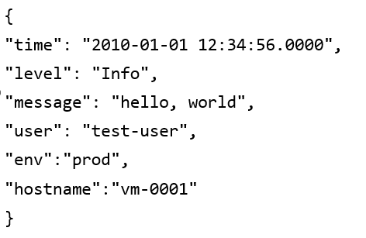
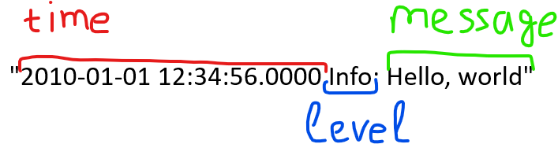
Monitoring and Observability: Logging
Structured logs: all log events follow a defined structure.
Notes:
You can enrich log entry with additional properties: user-id, request-id
Underlying infrastructure can enrich logs too: vm, env, cloud, etc

Slide 36
Monitoring and Observability: Logging
The most popular format for structured logs is json
Big companies often prefer binary encoding, for example, protobuf or avro

Slide 37
Monitoring and Observability: Logging
Structured logs pros:
+ unlimited filtering capabilities
+ unlimited analysis options
+ (could) enforce format
+ (could be) small messages
Notes:
You do not need a master’s degree in regex

Slide 38
Monitoring and Observability: Logging
Structured logs cons:
- hardly readable by humans
- harder to implement
- could be expensive to store
requires infrastructure to process,
aggregate, ingest, index

Slide 39
Monitoring and Observability: Logging
Demo

Slide 40
Monitoring and Observability: Metrics
Metrics – numerical representation of data

Slide 41
Monitoring and Observability: Metrics
Popular metric types:
Counter/Gauge – a number, which goes up or down
Histogram – samples observations into buckets

Slide 42
Monitoring and Observability: Metrics
Often metrics are stored in Time-Series Database (TSDB): software optimized to store ordered by time data-points
But could be also stored as structured records in any other storage type

Slide 43
Monitoring and Observability: Metrics
Often time-series record is identified by name + unique set of dimensions <name>{<label_name>=<label value>, ...}:
api_http_requests_total{method="POST", handler="/messages"}
api_http_requests_total{method="GET", handler="/messages"}

Slide 44
Monitoring and Observability: Metrics
Each unique label generates a new time-series, thus:
Save one more measurement into existing time-series – cheap
Save one more measurement into new time-series – expensive

Slide 45
Monitoring and Observability: Metrics
Querying the same time-series– cheap
Querying multiple time-series – expensive

Slide 46
Monitoring and Observability: Metrics
High-cardinality label – label that could have a lot of unique values
When you use TSDB, better not to use high-cardinality labels

Slide 47
Monitoring and Observability: Metrics
Good label:
HTTP Verb and Status Code
VM id
Bad label:
UserId
RequestId

Slide 48
Monitoring and Observability: Metrics
Service-Level Objective (SLO) – target availability: how long system can be unavailable.
Service-Level Agreement (SLA) – SLO promised to others (users)
Service-Level Indicator (SLI) – units of SLO
sli, sla, slo by Google

Slide 49
Monitoring and Observability: Metrics
Compute AWS Service Level Objective
AWS will use commercially reasonable efforts to make the Included Services each available for each AWS region with a Monthly Uptime Percentage of at least 99.99%

Slide 50
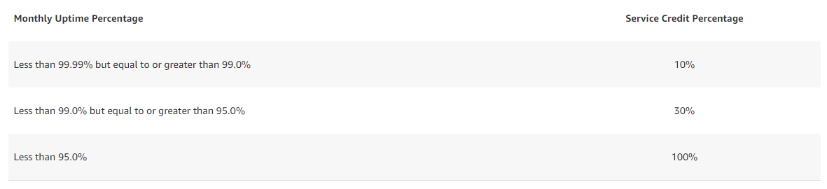
Monitoring and Observability: Metrics
Compute AWS Service Level Agreement

Slide 51
Monitoring and Observability: Metrics
Compute AWS Service Level Indicator
“Monthly Uptime Percentage” is calculated by subtracting from 100% the percentage of minutes during the month in which … [service] was in the state of Unavailability
“Unavailable” and “Unavailability” mean … for Single EC2 Instances, when your Single EC2 Instance has no external connectivity.

Slide 52
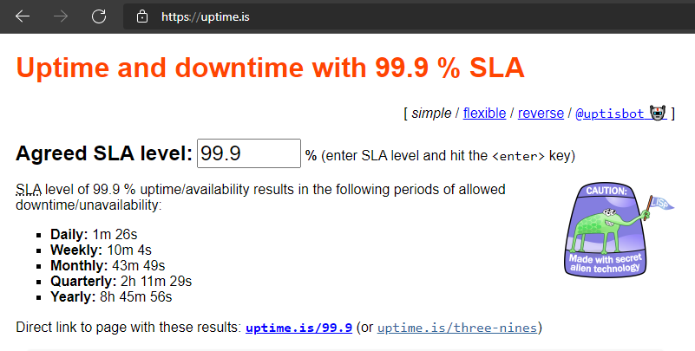
Monitoring and Observability: Metrics
Uptime calculator

Slide 53
Monitoring and Observability: Metrics
p.s.
Internal and External SLO often are different

Slide 54
Monitoring and Observability: Metrics
Demo

Slide 55
Monitoring and Observability: Traces
Finding logs and metrics associated with the same action/request could be tricky in a distributed system.

Slide 56
Monitoring and Observability: Traces
Tracing is an attempt to address this problem.
Trace represents the entire journey of a request/action as it moves through all the nodes/modules of a distributed system.

Slide 57
Monitoring and Observability: Traces
OpenTelemetry proposes vendor-neutral specification for trace model

Slide 58
Monitoring and Observability: Traces
OpenTelemetry introduces data model:
Trace is directed acyclic graph (DAG)
Each edge of this graph is named Span
Spans could have two relation types: ChildOf and FollowsFrom
Spans can have associated Timestamp, Attributes, Links, Context
Notes:
ChildOf – a Parent depends on a Child
FollowsFrom – a Parent does not depend on a Child

Slide 59
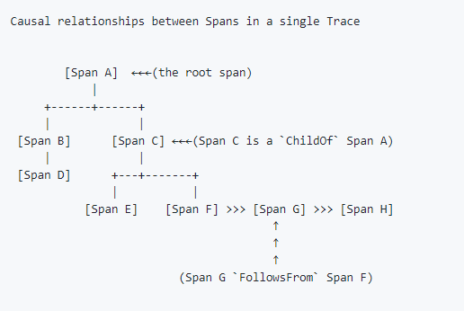
Monitoring and Observability: Traces
https://github.com/opentracing/specification/blob/master/specification.md#the-opentracing-data-model

Slide 60
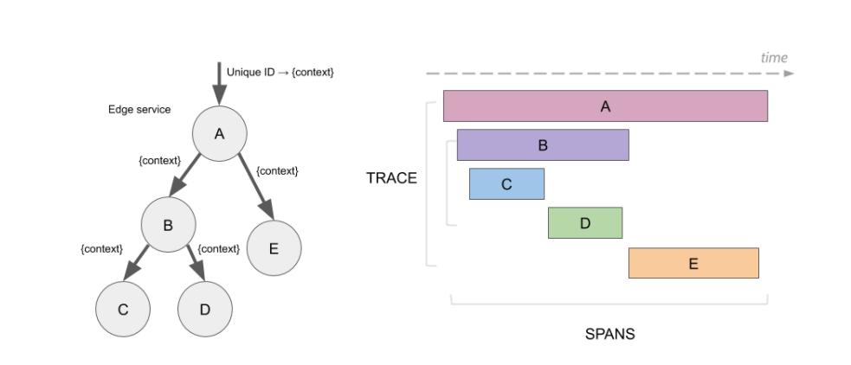
Monitoring and Observability: Traces
https://www.jaegertracing.io/docs/1.22/architecture/

Slide 61
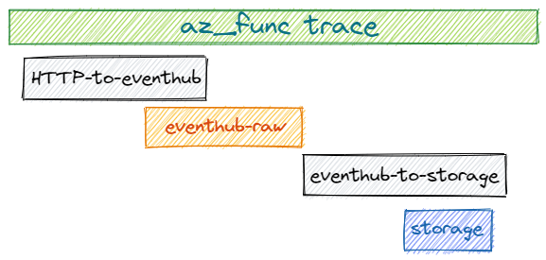
Monitoring and Observability: Traces

Slide 62
Monitoring and Observability: Traces
To build a trace:
Propagate trace-id with each request
Write events with attached trace-id
Aggregate events from all the services into a single storage
Group all events from the storage that have the same trace-id

Slide 63
Monitoring and Observability: Traces
Demo

Slide 64
Monitoring and Observability: Alerts
Alert – action based on a criteria

Slide 65
Monitoring and Observability: Alerts
Alert could be based on
Logs
Metrics
Billing

Slide 66
Monitoring and Observability: Alerts
Alert, often, is a notification: a message sent to a communication channel

Slide 67
Monitoring and Observability: Alerts
But instead of sending a message you can make a request or invoke an API

Slide 68
Monitoring and Observability: Alerts
With alerts you can:
post a warning to messenger (for example, Slack or email)
make a phone call or send SMS
invoke a Lambda function

Slide 69
Monitoring and Observability: Alerts
Demo
Billing alert
Metric alert
Logs alert

Slide 70
Monitoring and Observability
All-in-one solutions:
Azure Monitor; Amazon CloudWatch; Google Stackdriver
Datadog, Splunk, Elastic, New Relic, Dynatrace, Honeycomb
Metrics-only: Prometheus, Graphite, Victoria-Metrics
Traces-only: Jaeger, Zipkin
Logs-only: Elasticsearch (ELK), Grafana Loki
…and many-many-many others
Notes:
If you want to start a new company around an o11y product, you’d better to choose another area unless you 100% SURE what and why are you doing

Slide 71
Monitoring and Observability: Audit
Audit log – records/events answering the question: “who did what and when?”

Slide 72
Monitoring and Observability: Audit
Some audit logs are enabled by default
Some – you must enable explicitly and route to a long-term storage

Slide 73
Monitoring and Observability: Audit
Audit log is crucial in terms of Security

Slide 74
Monitoring and Observability: Audit
Demo

Slide 75
Additional resources
(articles + java samples) Terse logback: github and webpage
(article) SRE fundamentals: SLIs, SLAs and SLOs
(article) Distributed Tracing

Slide 76
Additional resources
(course summary ☺) Serverless to speed-up observability servers
Notes:
honeycomb uses S3 as a long-term storage extension for realtime queries. TL/DR: EC2 instances that use aws-lambdas with S3 to split one query into smaller pieces. The presentation also shows non-obvious limitations of autoscaled Lambdas, inconsistent response time, etc

