Slide 1
Introduction to Kubernetes
Part 1

Slide 2
Course Goal
By the end of the course, you should know:
What is Kubernetes, how access it and install local sandbox
What is Kubernetes architecture, principals, core objects
How to deploy an application to Kubernetes
How to troubleshoot Kubernetes applications
Where to look for further information

Slide 3
Course Plan
What is Kubernetes
What is Container
Kubernetes 10000-foot view
Kubernetes core objects
Daily interactions

Slide 4
Course Plan
What is Kubernetes
What is Container
Kubernetes 10000-foot view
Kubernetes core objects
Daily interactions

Slide 5
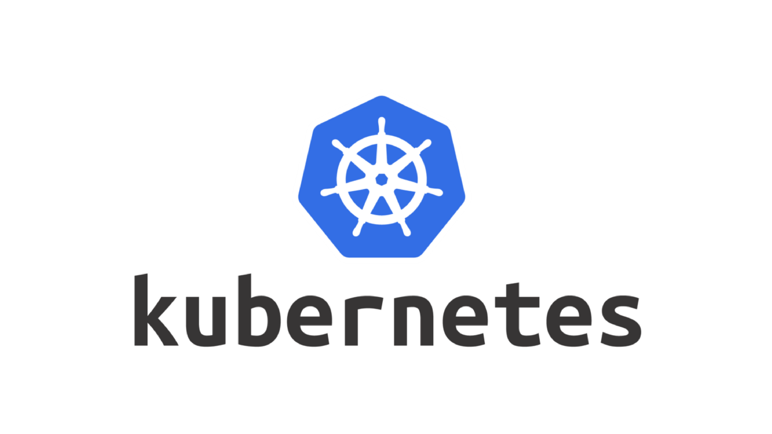
What is Kubernetes
Open-source platform to orchestrate containerized applications
Developed in Google based on Borg
Donated to Cloud Native Computing Foundation (CNCF)

Slide 6
What is Kubernetes
Kubernetes glues compute and storage resources into a single pile and gives an API to schedule workloads on them.
It also gives abstractions to deal with service-discovery, rollouts, self-healing, RBAC, scheduling customization, policies, and leaves extensibility points.

Slide 7
Course Plan
What is Kubernetes
What is Container
Kubernetes 10000-foot view
Kubernetes core objects
Daily interactions

Slide 8
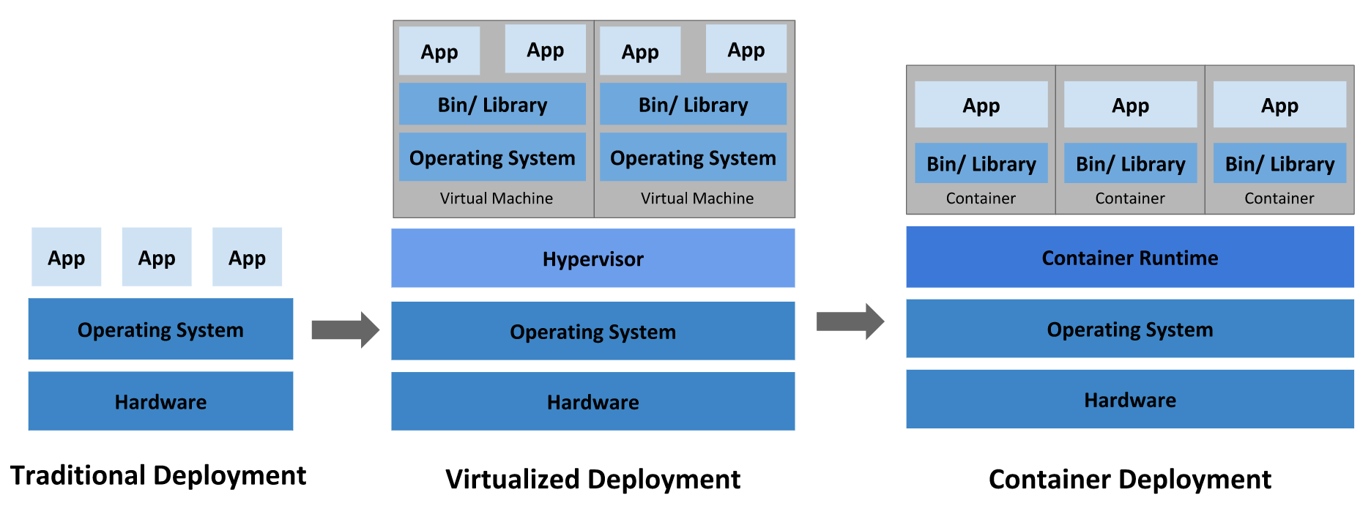
What is Container
Notes:
Image credits: https://kubernetes.io/docs/concepts/overview/what-is-kubernetes/
Problem with “Traditional”: dependencies conflicts, conflicting apps, lack of isolation
Problem with “Virtualized”: resource wasting
Disclaimer: Hypervisor might sit in-between Hardware and OS. It might be named native or bare-metal hypervisor.
Also, the distinction between native and hosted hypervisors sometimes is not clear. For example, Linux KVM (kernel-based VM) is OS module, which allows kernel to behave like a native-hypervisor.

Slide 9
What is Container
Container – 1..N processes that are isolated from the rest of the system

Slide 10
What is Container
Container is based on Linux features:
namespaces (what can see)
cgroups (what can use)

Slide 11
What is Container
Use-cases:
Application (production and local)
Working or Build environment
Instead of installing applications/tools

Slide 12
What is Container
Containers are distributed as Images

Slide 13
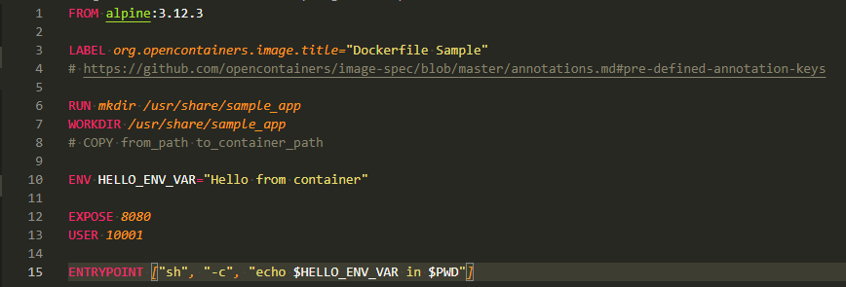
What is Container
De facto standard for container image creation is Dockerfile
Notes:
Sample Dockerfiles:
Used https://gist.github.com/v1r7u/31a4eff2a02792d4c9917b9f2d8d46f6
Kubernetes build-image: https://github.com/kubernetes/kubernetes/blob/master/build/build-image/Dockerfile
Elasticsearch https://github.com/elastic/elasticsearch/blob/master/distribution/docker/src/docker/Dockerfile
Redis: https://github.com/dockerfile/redis/blob/master/Dockerfile
Dockerfile reference: https://docs.docker.com/engine/reference/builder/
docker build -t sample-app:test https://gist.githubusercontent.com/v1r7u/31a4eff2a02792d4c9917b9f2d8d46f6/raw/2df4ddd8603e3d73c100f7a1e53b157050d65886/Dockerfile
docker run -it --rm alpine:3.12.3

Slide 14
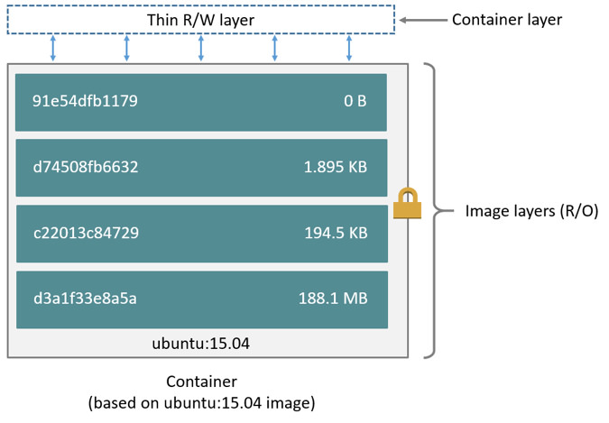
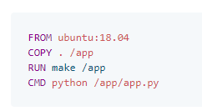
What is Container
Notes:
Image credit: https://docs.docker.com/storage/storagedriver/

Slide 15
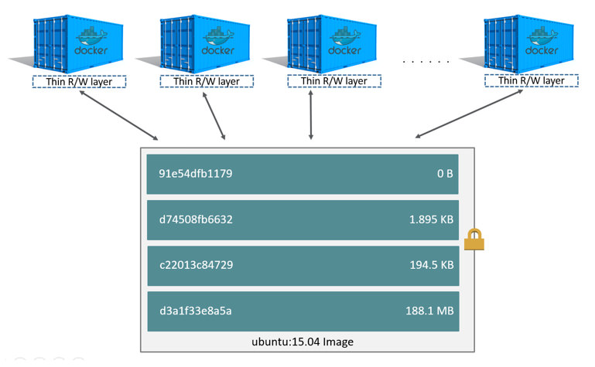
What is Container
container is an instance of an image
Notes:
Image credit: https://docs.docker.com/storage/storagedriver/

Slide 16
What is Container
Container is disposable
When container is gone – created in runtime data fades away
If data should survive – use volume

Slide 17
What is Container
Container Image:
Immutable
Repeatable and portable
Layered
Uses union filesystem with copy-on-write (CoW) strategy

Slide 18
What is Container
Image name format: `{registry:optional}/{image_name}:{tag}`
docker.elastic.co/kibana/kibana-oss:7.2.0
k8s.gcr.io/nginx-slim:0.8
redis:6.0.10-alpine3.12
ubuntu:latest

Slide 19
What is Container
Container Registry – service, that stores and distributes container images

Slide 20
What is Container
Container Runtime – software which runs and manages containers

Slide 21
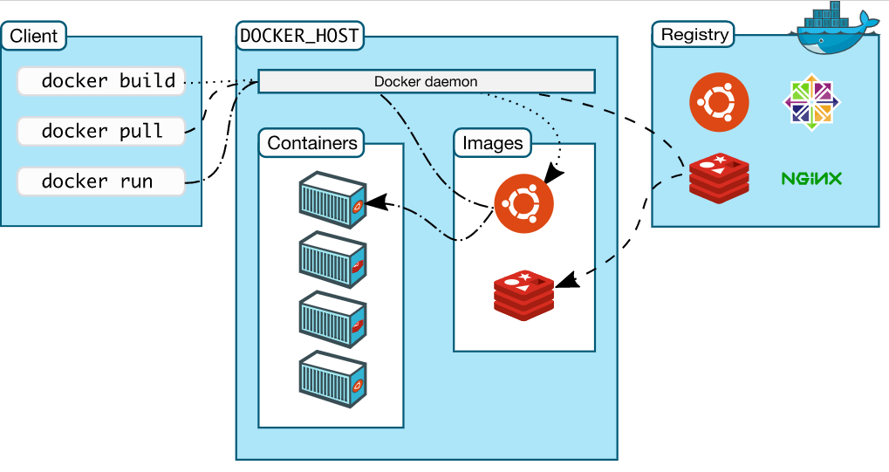
What is Container
Notes:
Image credit https://docs.docker.com/get-started/overview/

Slide 22
What is Container
`docker build -t image:latest .` -> creates image
`docker push image:latest` -> pushes image to the registry
`docker pull image:latest` -> pulls image from the registry
`docker run image:latest` -> creates container from image in a runtime

Slide 23
What is Container
Demo

Slide 24
What is Container
Docker alternatives
buildah + podman + skopeo
Runtimes:
cri-o (based on crun)
Containerd (based on runc)
Notes:
Docker Engine is everything in one product, which could be undesired. Misc parts could be replaced, for example, Red Hat developed several separate tools to cover each particular use-case.
https://www.capitalone.com/tech/cloud/container-runtime/
crun and runc – are low-level runtimes on top of linux primitives.
cri-o and containerd – Container Runtime Interface - higher level abstraction, which also manages images, network, storage, etc

Slide 25
What is Container
Tips & Tricks
tags are mutable
do not use latest tag
use linters/scanners to catch issues at build time
registries could have limits
Notes:
Linters example: https://github.com/hadolint/hadolint
Scanner example: https://github.com/aquasecurity/trivy

Slide 26
Containers additional materials
Alternative containers introduction:
VMware course: video lectures
Beginner-friendly introduction to containers article (what containers are)
Docker-handbook article (how to use docker)

Slide 27
Containers additional materials
Deep-dives:
How Unix Works: article
Docker Layers article
A deep dive into Linux namespaces: part-1 - part-4
How containers work video
Anatomy of Container video
Best-practices for writing dockerfiles: article

Slide 28
Course Plan
What is Kubernetes
What is Container
Kubernetes 10000-foot view
Kubernetes core objects
Daily interactions

Slide 29
Kubernetes 10000-foot view
Kubernetes is a distributed system, which has
Control-plane
Data-plane

Slide 30
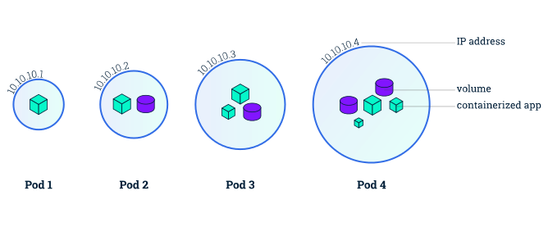
Kubernetes 10000-foot view
Pod – is a core object of Kubernetes
It wraps 1..N containers and 0..M volumes into a single unit
Notes:
Image credit: https://medium.com/developerworld/pod-vs-node-in-kubernetes-26c858988f94

Slide 31
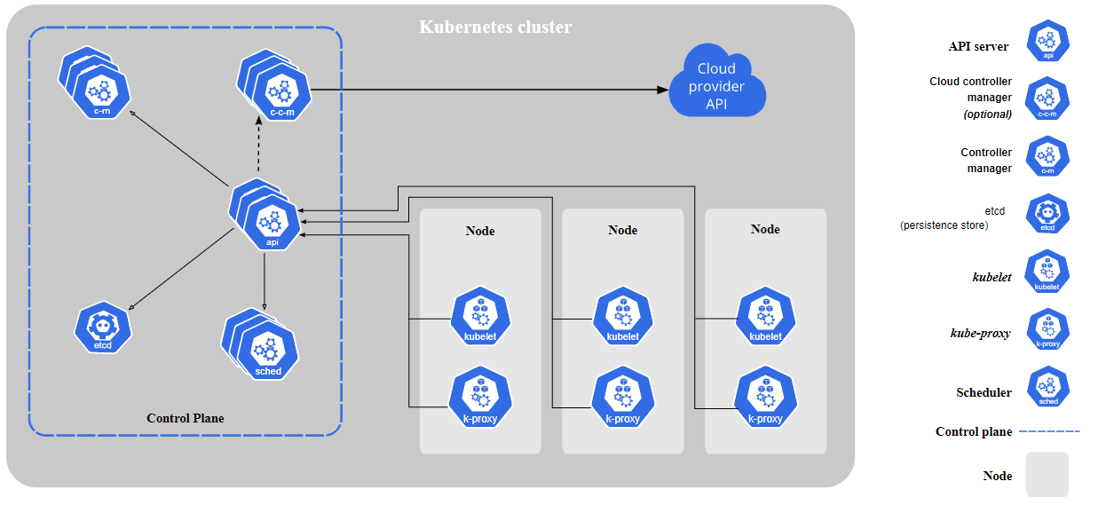
Kubernetes 10000-foot view
Notes:
Image credit https://kubernetes.io/docs/concepts/overview/components/

Slide 32
Kubernetes 10000-foot view

Slide 33
Kubernetes 10000-foot view
Notes:
etcd: stores the entire cluster data

Slide 34
Kubernetes 10000-foot view
Notes:
kube-scheduler: watches for pods with no assigned node and selects a node for them

Slide 35
Kubernetes 10000-foot view
Notes:
kube-controller-manager: runs dozens of controller processes. Each controller process tries to transform current state into desired state (node-controller, replication-controller, endpoints-controller, etc)

Slide 36
Kubernetes 10000-foot view
Notes:
cloud-controller-manager: links k8s to particular cloud

Slide 37
Kubernetes 10000-foot view
Notes:
kubelet: An agent that runs on each node in the cluster. It makes sure that containers are running in a Pod

Slide 38
Kubernetes 10000-foot view
Notes:
kube-proxy: maintains network rules on nodes. These network rules allow network communication to your Pods from network sessions inside or outside of your cluster

Slide 39
Kubernetes 10000-foot view
Notes:
There are also:
- container-runtime: responsible for running containers (docker, containerd, cri-o)
- dns: DNS

Slide 40
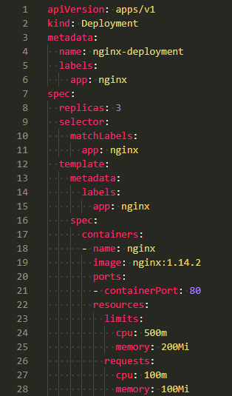
Kubernetes 10000-foot view
Kubernetes is declarative: it stores desired state
Notes:
Sample yaml: https://gist.github.com/v1r7u/19483d1a602645738158377c695c21fe
More details: https://kubernetes.io/docs/concepts/overview/working-with-objects/kubernetes-objects/

Slide 41
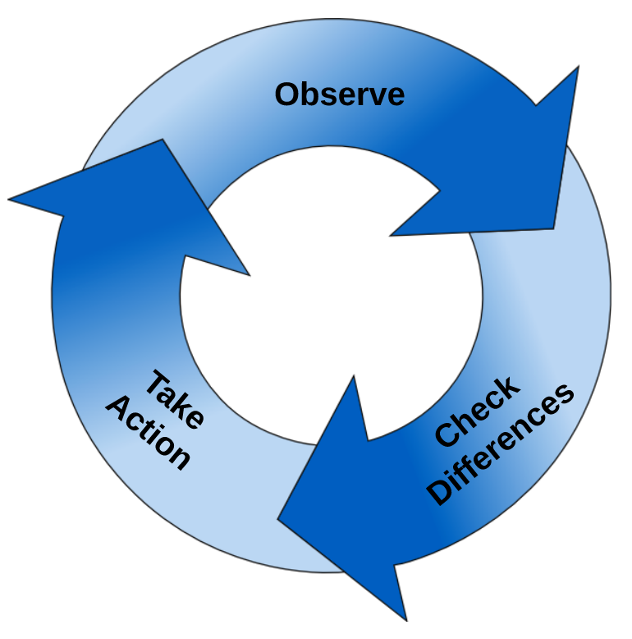
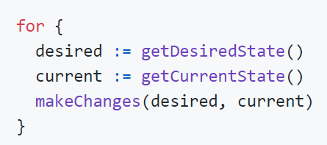
Kubernetes 10000-foot view
Kubernetes controllers try to shape real objects to desired state
Kubernetes heart is control loops
Notes:
https://github.com/kubernetes/community/blob/master/contributors/devel/sig-api-machinery/controllers.md
And
https://kubernetes.io/docs/concepts/architecture/controller/

Slide 42
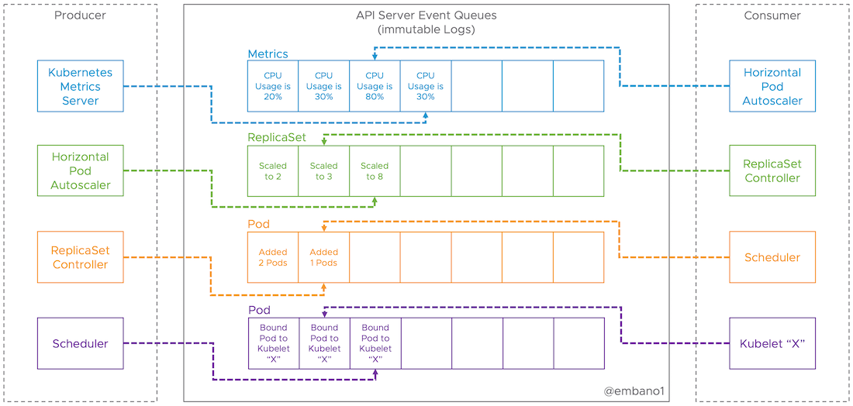
Kubernetes 10000-foot view
There is no central orchestrator
Each k8s component reacts on events
All events are distributed via API service
Notes:
https://www.mgasch.com/2018/08/k8sevents/

Slide 43
Kubernetes 10000-foot view
Labels and Annotations:
Labels are key/value pairs; used to filter/search (both humans and apps)
"release" : "stable"
"environment" : "prod"
"team" : "data-science"
Labels are not unique
Via a label selector, the client/user can identify a set of objects
Annotations – metadata, used by tools/libraries

Slide 44
Kubernetes 10000-foot view
Namespace:
Namespace – virtual cluster inside a physical one
Kubernetes Objects could be namespaced or not
kubectl api-resources --namespaced=true
Namespace enforces scope, policies, limits, roles/permissions
Namespaces use-cases:
per environment
per team
per application
Notes:
More details https://kubernetes.io/docs/concepts/overview/working-with-objects/namespaces/

Slide 45
Kubernetes 10000-foot view
To interact with k8s:
API
kubectl
Config
Commands/parameters: `kubectl {command} {object_type} {object_name} {params}`
Extendible via plugins (you can use plugin manager krew)
k9s, lens, octant
Notes:
Commands:
config: kubectl config get-contexts
get:
kubectl get ns
kubectl get ns default -o yaml
kubectl get pods -o wide
kubectl get pods --all-namespaces -o wide
describe: kubectl describe ns default
apply: kubectl apply -f https://gist.githubusercontent.com/v1r7u/19483d1a602645738158377c695c21fe/raw/236c38da273da8549133fe9594e657c01e884a34/sample_deployment.yaml
watch: kubectl get pods -w
delete: kubectl delete -f https://gist.githubusercontent.com/v1r7u/19483d1a602645738158377c695c21fe/raw/236c38da273da8549133fe9594e657c01e884a34/sample_deployment.yaml

Slide 46
Kubernetes 10000-foot view
Run k8s:
in cloud
Locally
kind
minikube
kubeadm

Slide 47
Kubernetes 10000-foot view
Demo

Slide 48
Kubernetes introduction: additional resources
Alternative Kubernetes introduction:
VMware course: videos
Official docs: What is Kubernetes and Kubernetes Components

Slide 49
Kubernetes introduction: additional resources
Deep dives:
Events, the DNA of Kubernetes: article
Deep-dive into api-server: part-1 (handle request), part-2 (store object), and part-3a (CRD)
Kubernetes plugins and getting started with them article
Official documentation: Working with Kubernetes Objects and Architecture

