Slide 1
Introduction to Kubernetes
Part 2

Slide 2
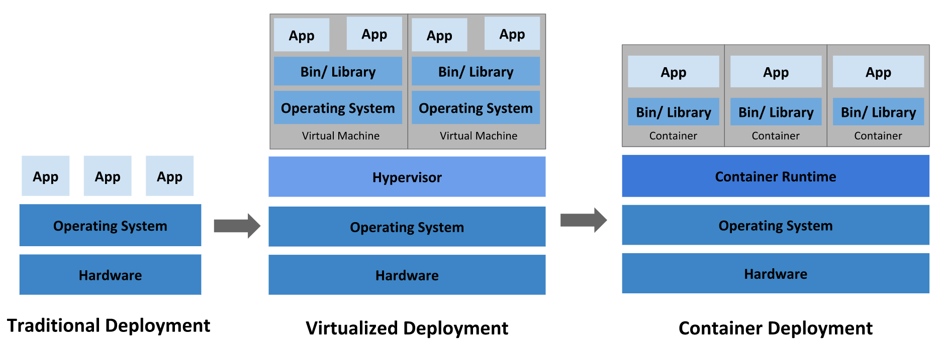
Recap

Slide 3
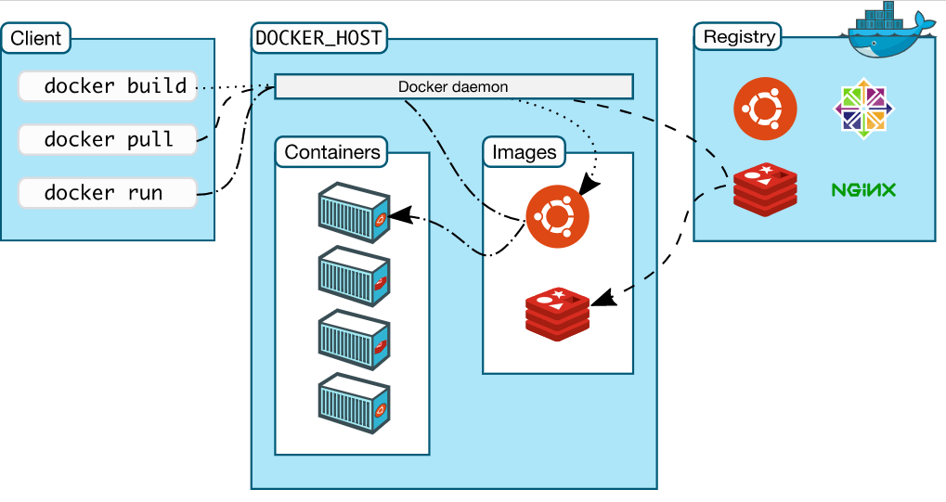
Recap

Slide 4
Recap
Kubernetes
Distributed system to orchestrate containers
Declarative and based on control loops
Core object is Pod, which wraps 1..N containers
Namespace – virtual cluster inside a physical one
Control and Data planes

Slide 5
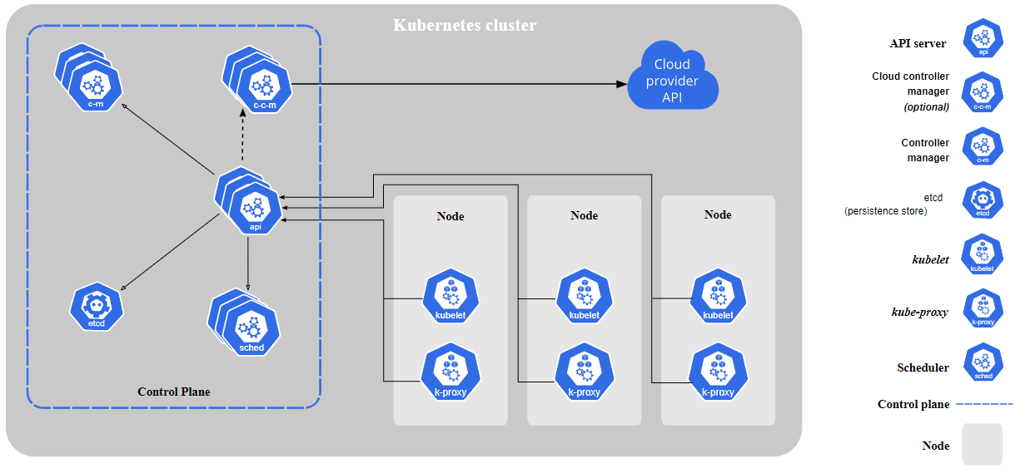
Recap

Slide 6
Course Plan
What is Kubernetes
What is Container
Kubernetes 10000-foot view
Kubernetes core objects
Daily interactions

Slide 7
Kubernetes Core Objects
Pod
Deployment
StatefulSet
Storage
DaemonSet
Job and CronJob
Services and Ingress
ConfigMaps and Secrets
Policies

Slide 8
Kubernetes Core Objects
Pod:
Smallest deployable unit
Can have >=1 containers
Containers could be init-only
All containers in a pod shares the same storage and network
has unique IP
Notes:
Init containers: setting accounts, running setup scripts, configuring databases, prepare file-system

Slide 9
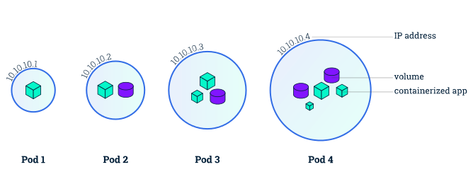
Kubernetes Core Objects
Notes:
Image credit: https://medium.com/developerworld/pod-vs-node-in-kubernetes-26c858988f94

Slide 10
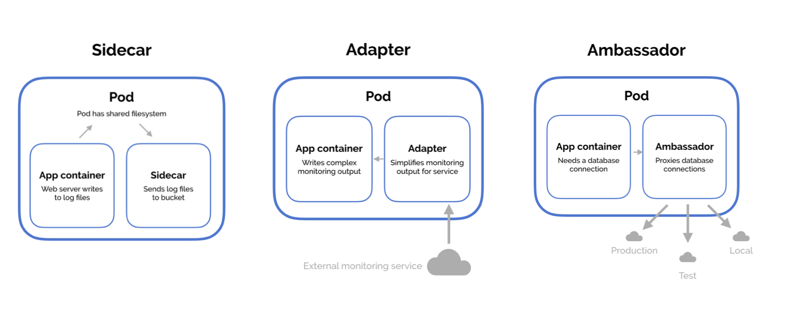
Kubernetes Core Objects
Notes:
sidecar augments and improves the application container (add https, dynamic config, git-puller)
ambassador container brokers interactions between the application container and the rest of the world (shard a service, service broker, request splitting or experimentation)
adapter container is used to modify the interface of the application container (monitoring, logging, health-monitoring)
Image credit: https://devopedia.org/design-patterns-for-microservices-and-containers

Slide 11
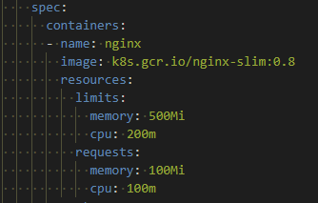
Kubernetes Core Objects
Resource-quotas: requests & limits

Slide 12
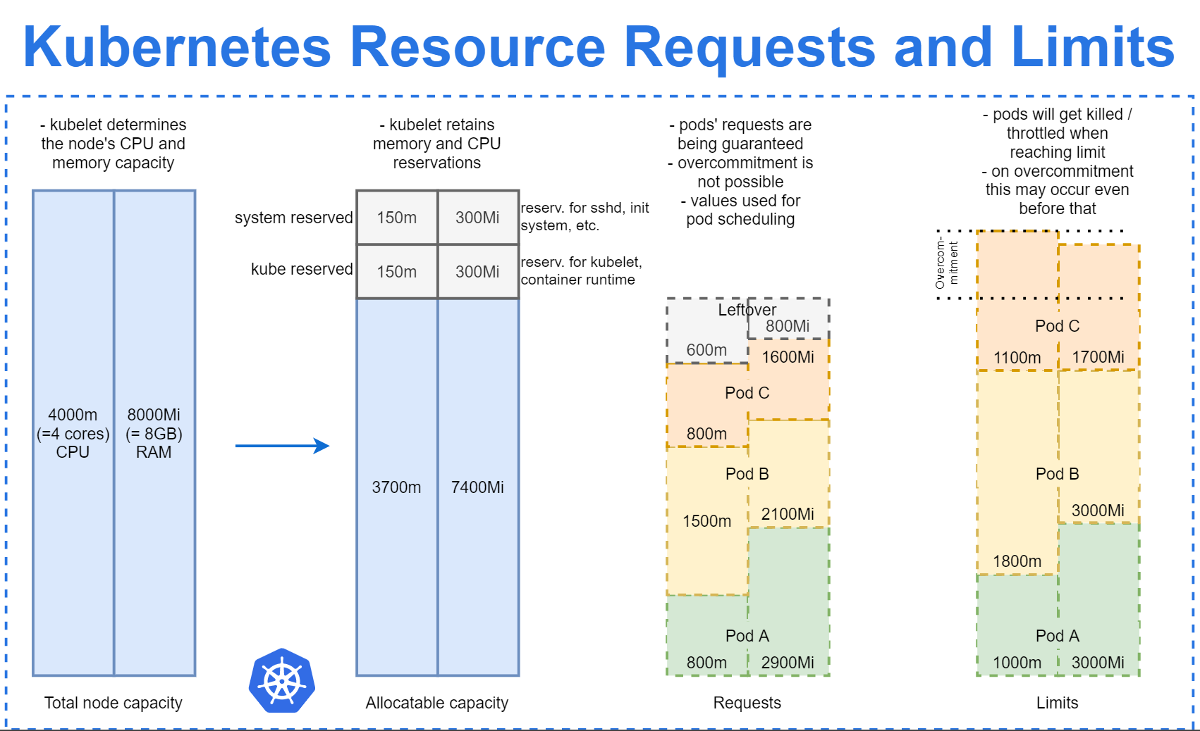
Kubernetes Core Objects
Notes:
Image credit: https://brennerm.github.io/posts/kubernetes-overview-diagrams.html

Slide 13
Kubernetes Core Objects
To pull image images from Container Registry Kubernetes uses
Node configuration
or imagePullSecret property

Slide 14
Kubernetes Core Objects
Pod Lifecycle:
Get scheduled
Remains on the node until completion, termination or deletion
Do not self-heal (kubelet heals)
Probes: startup, readiness, liveness

Slide 15
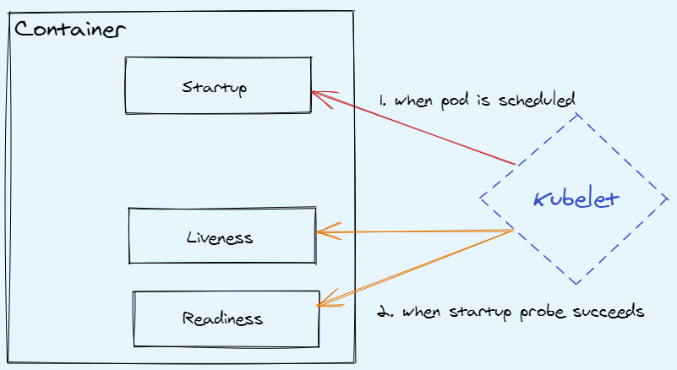
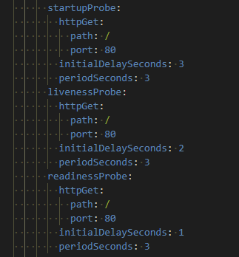
Kubernetes Core Objects

Slide 16
Kubernetes Core Objects
Pod Scheduling:
Available node resources (requests)
Node selectors
Node taints/toleration
Affinity and anti-affinity

Slide 17
Kubernetes Core Objects
Deployment:
a set of containers
defines update-strategy
scales container instances
tools to watch the status and roll-back
wraps ReplicaSets

Slide 18
Kubernetes Core Objects
ReplicaSet sets how many pods of exact specification Kubernetes should run (lower-level object)

Slide 19
Kubernetes Core Objects
Deployment Demo

Slide 20
Kubernetes Core Objects
StatefulSet: like Deployment, but with guarantees about ordering and naming (sticky identity)

Slide 21
Kubernetes Core Objects
Storage:
Volumes - piece of storage available on the node, where pod is running. Volume is mounted into Pods
Persistent Volume (PV) - a piece of storage in the cluster with reference to physical data location
Persistent Volume Claim (PVC) - a storage request by a user. Often used to map StatefulSets to PVs
StorageClass defines parameters of PV: provisioner (AzureDisk, AWSElasticBlockStore, etc), reclaim policy, allows resizing, etc

Slide 22
Kubernetes Core Objects
StatefulSet Demo

Slide 23
Kubernetes Core Objects
DaemonSet defines which Nodes should have an instance of given Pod

Slide 24
Kubernetes Core Objects
Jobs/CronJob run scheduled or one-time tasks

Slide 25
Kubernetes Core Objects
Service:
not an application, but a record in etcd
represents networking rules

Slide 26
Kubernetes Core Objects
Service:
pods are disposable, while a service is long-living
service selects pods based on labels
service might "route" traffic to pods
headless-service - does not route traffic, but registers DNS identity

Slide 27
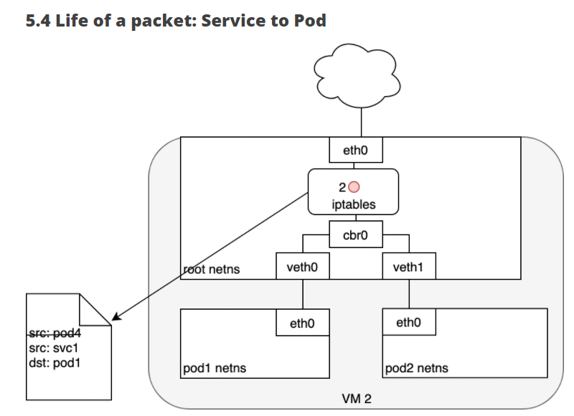
Kubernetes Core Objects
Notes:
Image credit https://sookocheff.com/post/kubernetes/understanding-kubernetes-networking-model/#pod-to-service

Slide 28
Kubernetes Core Objects
Service types:
ClusterIP
NodePort
LoadBalancer

Slide 29
Kubernetes Core Objects
Services Demo

Slide 30
Kubernetes Core Objects
Ingress:
API object (not a real application) to define rules
Exposes HTTP/HTTPS routes from outside the cluster to Services
Real work is done by ingress-controller (nginx, haproxy, envoy, etc)

Slide 31
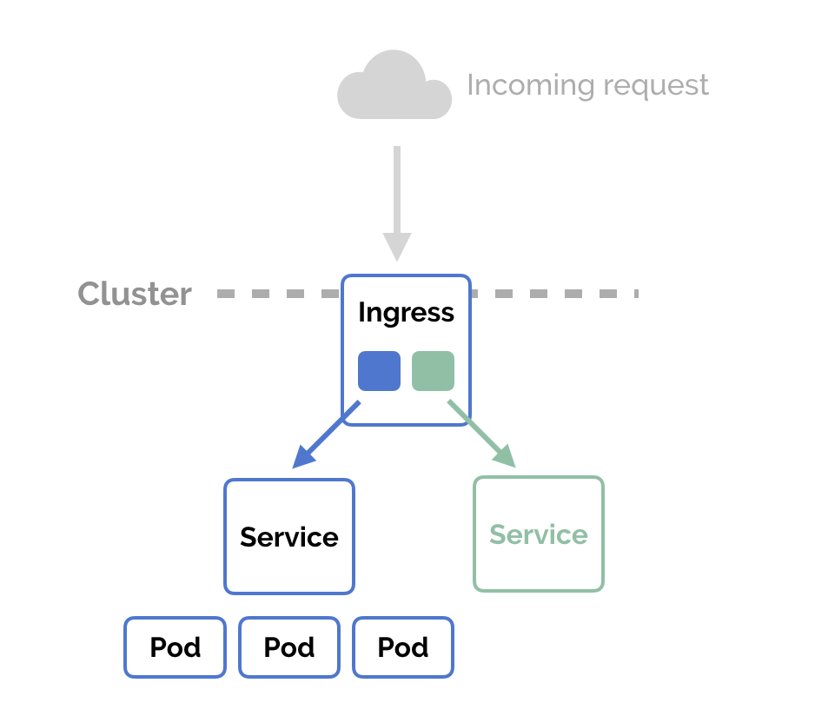
Kubernetes Core Objects
Notes:
Image credit: https://matthewpalmer.net/kubernetes-app-developer/articles/ingress.png

Slide 32
Kubernetes Core Objects
Configuration:
Decouple environment-specific information from application
via environment variables
via ConfigMap (CM) - API object to store non-confidential data. CM could be mapped as env-vars or volumes
via Secret - API object to store confidential data
Secrets are not encrypted and are stored in etcd(!); secrets are encoded in base64, stored in tmpfs (RAM) instead of node-fs, could be encrypted at-rest and in-transit.
Notes:
https://12factor.net/

Slide 33
Kubernetes Core Objects
Policies:
LimitRanges: min, max, default values for cpu/memory
Resource Quotas: how many cpu, memory, storage could be used in a namespace
Pod Security Policy: enforces pod configuration
NetworkPolicies: enforces network boundaries (who can talk to whom); implemented by addons
RBAC: defines identities and their permissions (who can do what)

Slide 34
Kubernetes Core Objects
Requests and Limits
12-factor applications and Sidecar-containers patterns
Stateful Applications in Kubernetes article
Kubernetes Deconstructed video
Understanding Kubernetes Networking article
Official Pods, Workloads, Networking, Storage, Configuration, Scheduling documentation

Slide 35
Course Plan
What is Kubernetes
What is Container
Kubernetes 10000-foot view
Kubernetes core objects
Daily interactions

Slide 36
Daily Interactions
Navigate clusters and namespaces:
`kubectl config get-contexts`
`kubectl config set-context --current --namespace=kube-system`
`kubectl config use-context dev-cluster`
`kubectl get pods -n default`
`kubectl get pods -n default --context second`
If you have a lot of clusters and namespaces: kubectx + kubens tools

Slide 37
Daily Interactions
Basic operations:
get help: `kubectl --help` and `kubectl explain …` and `kubectl api-resources`
apply: `kubectl apply -f sample_deployment.yaml`
get & watch: `kubectl get pods -o wide -w`
describe: `kubectl describe deployment nginx-deployment`
scale: `kubectl scale deployment nginx-deployment --replicas=1`
delete: `kubectl delete -f sample_deployment.yaml` or `kubectl delete deployment sample`
Notes:
https://gist.githubusercontent.com/v1r7u/19483d1a602645738158377c695c21fe/raw/236c38da273da8549133fe9594e657c01e884a34/sample_deployment.yaml

Slide 38
Daily Interactions
Troubleshooting:
get or describe an object
get logs: `kubectl logs pod_name container_name --tail=100`
get events: `kubectl get events -n default`
port-forward to pod/service: `kubectl port-forward svc/service1 port`
run shell in a container: `kubectl exec pod-name -i -t -- bash`
If it is too simple, then welcome to complete troubleshooting deployments guide

Slide 39
Daily Interactions
Sharing, versioning, releasing Kubernetes Objects:
Plain yaml files
kustomize
helm
Argo CD and Flux (GitOps)

Slide 40
Daily Interactions
Additional resources:
Troubleshooting VMware course
Kubernetes Best Practices articles and videos by Google
Tasks section at official docs

Slide 41
Alternative learning materials
Official documentation is very well-written: https://kubernetes.io/docs/concepts/
Full list of VMware courses: https://kube.academy/courses
Azure learn-k8s materials: azure-website + github-repo
Kubernetes Up and Running book. VMware gives it in exchange for your personal data
Designing Distributed Systems book. Microsoft gives it in exchange for your personal data
Learnk8s blog: https://learnk8s.io/blog

