Slide 1
Finding the ideal Neighborhood in Toronto for starting an Indian Restaurant
Coursera Data Science Capstone Project
Vishnuprasad S

Slide 2
Business Problem
The objective of this study is to find an ideal Neighborhood in Toronto to start an Indian Restaurant, based on the location data extracted using Foursquare API, and then their visualization through Folium.
Here, we use the business concept of proximity to competition, to shortlist ideal neighborhoods. Competition can be good, in industries where comparison shopping is popular. (That's why competing retail businesses, such as fast-food restaurants, antique shops and clothing stores tend to cluster together.) You may also catch the overflow from existing businesses, or customers who wish to try a different version of the same product, in our case, a new cuisine of food.

Slide 3
Data Sourcing
1.The Toronto neighborhoods data is obtained from the Wikipedia page: https://en.wikipedia.org/wiki/List_of_postal_codes_of_Canada:_M
2.The latitude and longitude data for the above neighborhoods: http://cocl.us/Geospatial_data
3.Data about the restaurants near these neighborhoods collected via Foursquare API and the explore endpoint

Slide 4
Data Cleaning
The following steps were done to extract the useful data
The data from the Wikipedia page https://en.wikipedia.org/wiki/List_of_postal_codes_of_Canada:_M was read into a pandas dataframe using read_html. Thereafter, the rows having “Not assigned” for Boroughs were removed from the dataset. Multiple neighborhoods having the same postal code were grouped together with a comma separator. For rows which had missing neighborhood field but a non-empty Borough field, the Borough was used as the neighborhood.
The latitude and longitude data for each Neighborhood was read from http://cocl.us/Geospatial_data into a separate dataset, and later merged with the first dataset using the merge function.
We chose to work with only Neighborhoods that were in Toronto, so we selected the Boroughs with the name Toronto in it from the dataframe and marked all of them into a map of Toronto to visualize them.
We then performed a one hot encoding for the venue categories, and then restricted the dataframe to show only the restaurants among the venues. This included a wide list of cuisines all around the world.
We have captured 53 different cuisines of restaurants, which are active around 39 Neighborhoods of Toronto.

Slide 5
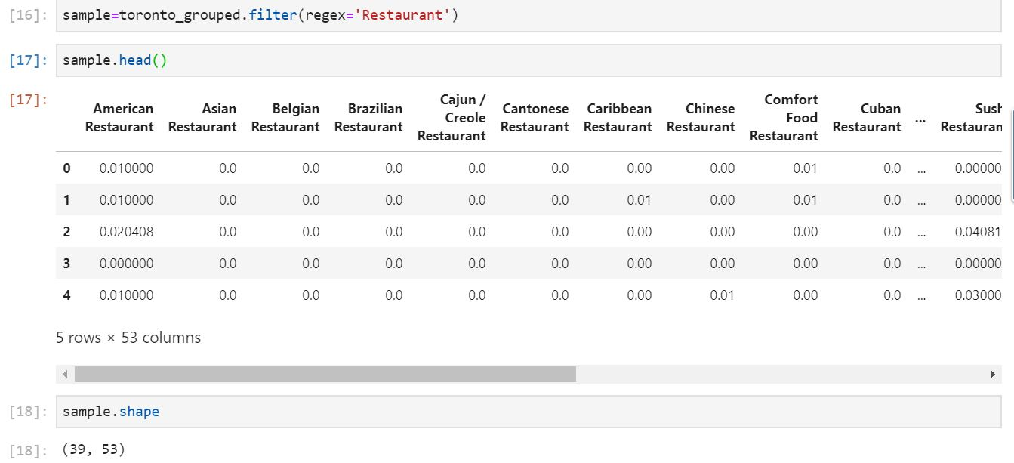
Data Analysis
A one hot encoding for the venue categories, and a condition to show only the restaurants among the venues gave the following output including a wide list of cuisines all around the world.

Slide 6
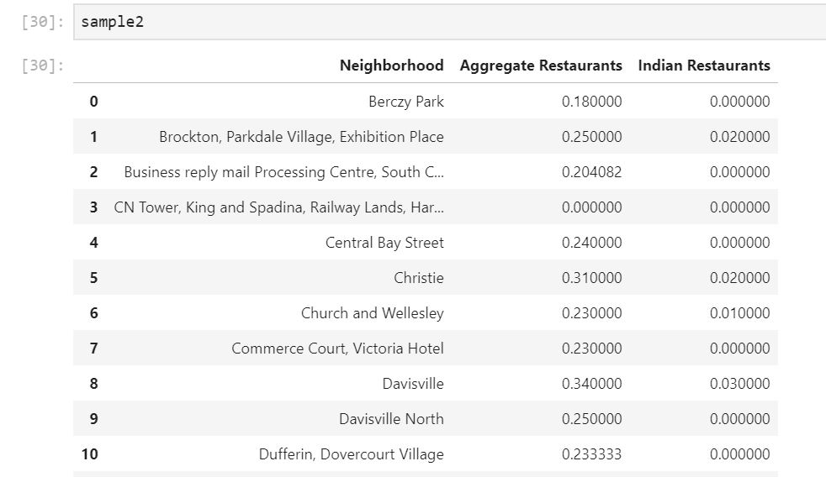
Data Analysis
We have captured 53 different cuisines of restaurants, which are active around 39 Neighborhoods of Toronto. Then, we dropped the column containing the Indian restaurants, did a horizontal sum to get an aggregate value of all other cuisines and then added the Neighborhood column and Indian Restaurant column back to the dataframe to generate the following

Slide 7
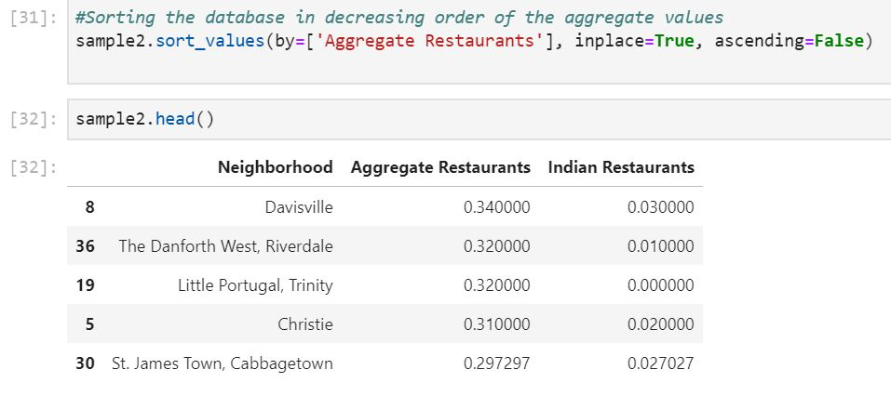
Data Analysis
The next step was to sort the dataframe in the decreasing order of the aggregate Restaurant score, and then look for rows at the top having a 0 value in the Indian restaurant column. This gave us the following result

Slide 8
Results
From the above data frame, let's consider the top 5 rows, we see that that Davisville has the highest clustering of restaurants around, and it also has the highest number of Indian restaurants around. In fact, all neighborhoods in the top 5, except Little Portugal has an Indian restaurant operating nearby.
We can also see that Little Portugal and the Danforth West has the same value for aggregate restaurants, making it a tie for second place, but makes it a better option to start our Indian restaurant. Hence, we can focus more on the Little Portugal neighborhood
Since we have found that Little Portugal has no Indian restaurants nearby, we would like to verify whether the neighborhood is welcoming for restaurants of different cuisine. Unless the neighborhood and the residents are open to try out new cuisines, we won’t benefit much from opening our restaurant in this neighborhood.

Slide 9
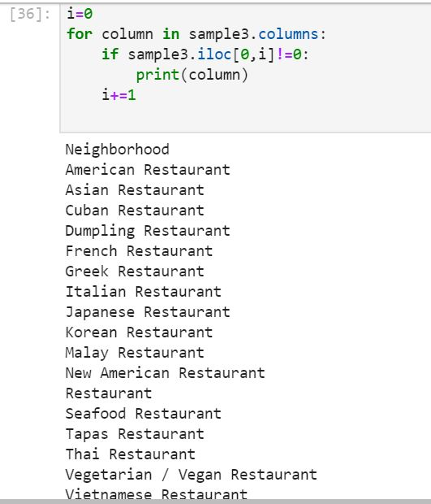
Results
We retrieve every restaurant in Little Portugal region by their cuisine type. This is done by calling the column names of restaurant cuisines of Little Portugal which had a non-zero value. This operation resulted in the following output

Slide 10
Results
We can see that the cuisines around Little Portugal are infact cosmopolitan and we have a good chance of securing business if we select Little Portugal to open our Indian Restaurant.

Slide 11
Discussions and Recommendations
This analysis is purely based on the proximity of other restaurants and their cuisine types. Although this analysis provides a preliminary idea of selection of neighborhood, further study has to be carried out before finalizing. Factors like rent, availability of space, traffic and busy hours can influence the business of a restaurant to a great extent, and these have to be taken into consideration before finalizing. Further analysis can include the population density, spending capacity of residents of each neighborhood etc to take more leverage of the available data. Additionally, the analysis was limited to a radius of 1 km, this can be tweaked for varying the results.

Slide 12
Conclusion
In this project, we utilised the data obtained through Foursquare API to decide a Neighborhood in Toronto for starting an Indian Restaurant. Based on the Analysis, we have selected Little Portugal as a viable option for further analysis and a potential location for the starting of the new Indian Restaurant.

