Slide 1
Databases and Big Data
Lab 1

Slide 2
Today
AWS Basics
MySQL setup
Boto3 (AWS Command Line Interface Wrapper for python)

Slide 3
AWS
Services
EC2, RDS, DynamoDB, API Gateway, Lambda Functions (serverless), AWS Cloudformation

Slide 4
AWS EC2 - Creating a EC2 Instance
Log into https://console.aws.amazon.com or https://www.awseducate.com/signin

Slide 5
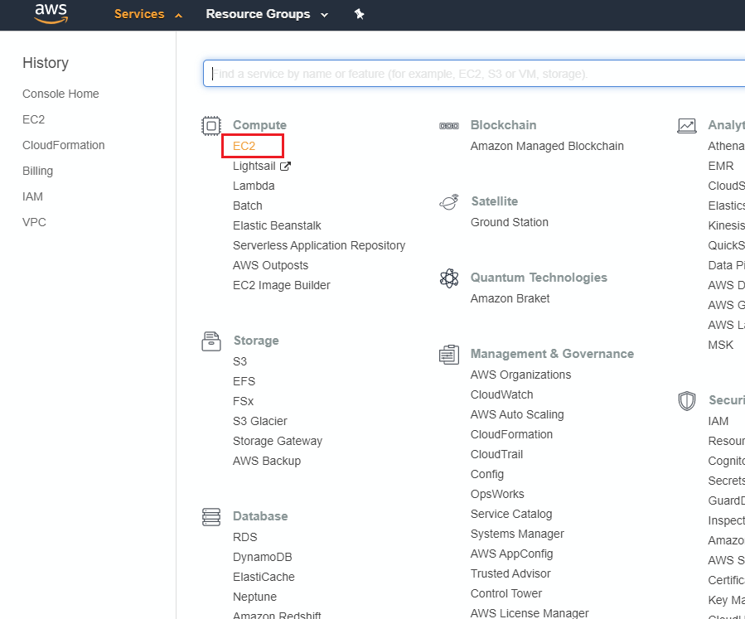
Go to EC2 Service

Slide 6
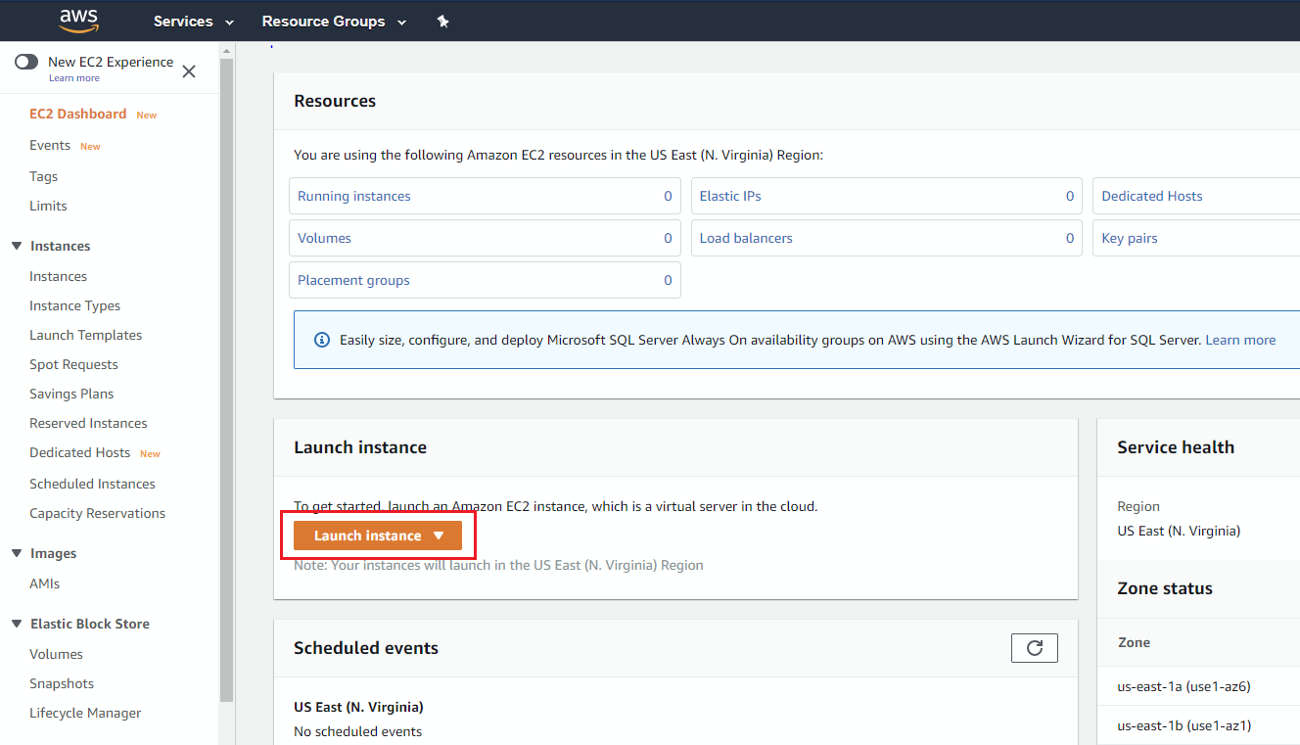
Go to Launch Instance Wizard

Slide 7
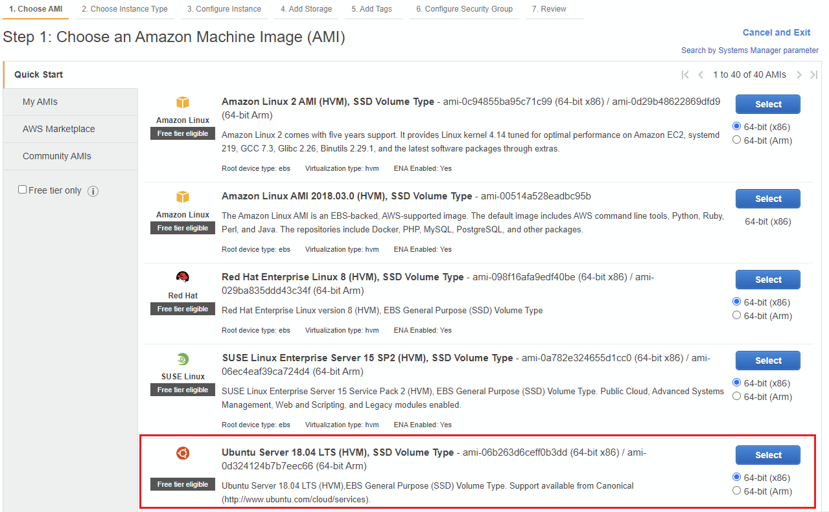
Select an AMI

Slide 8
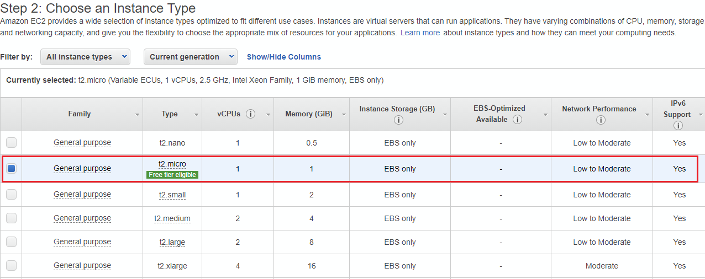
Select an Instance Type

Slide 9
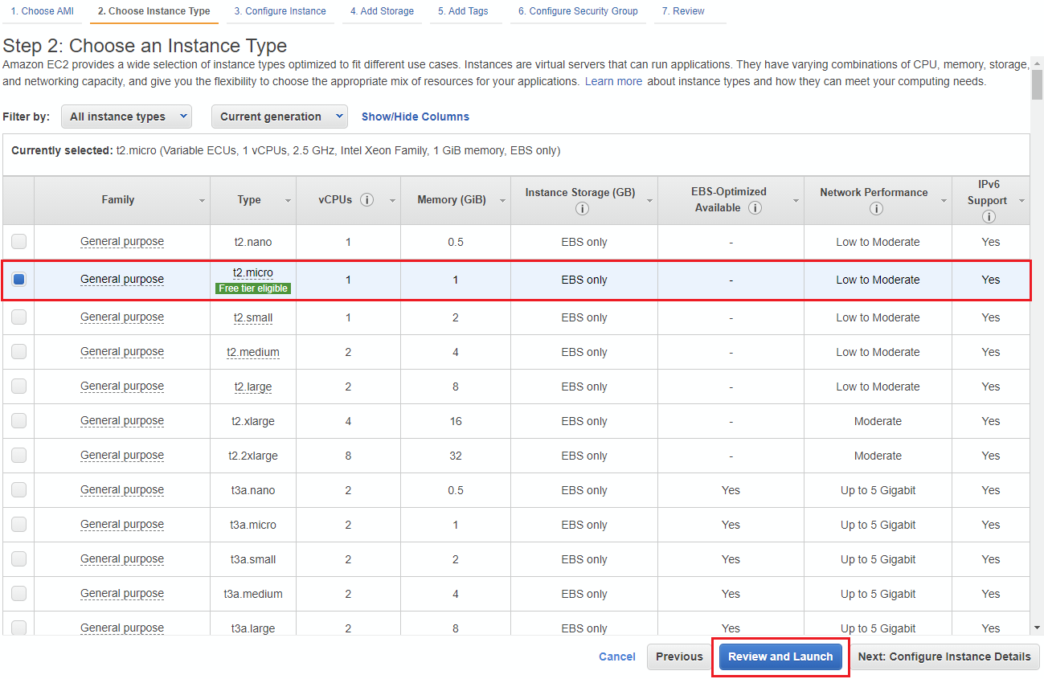
Select an Instance Type and Launch

Slide 10
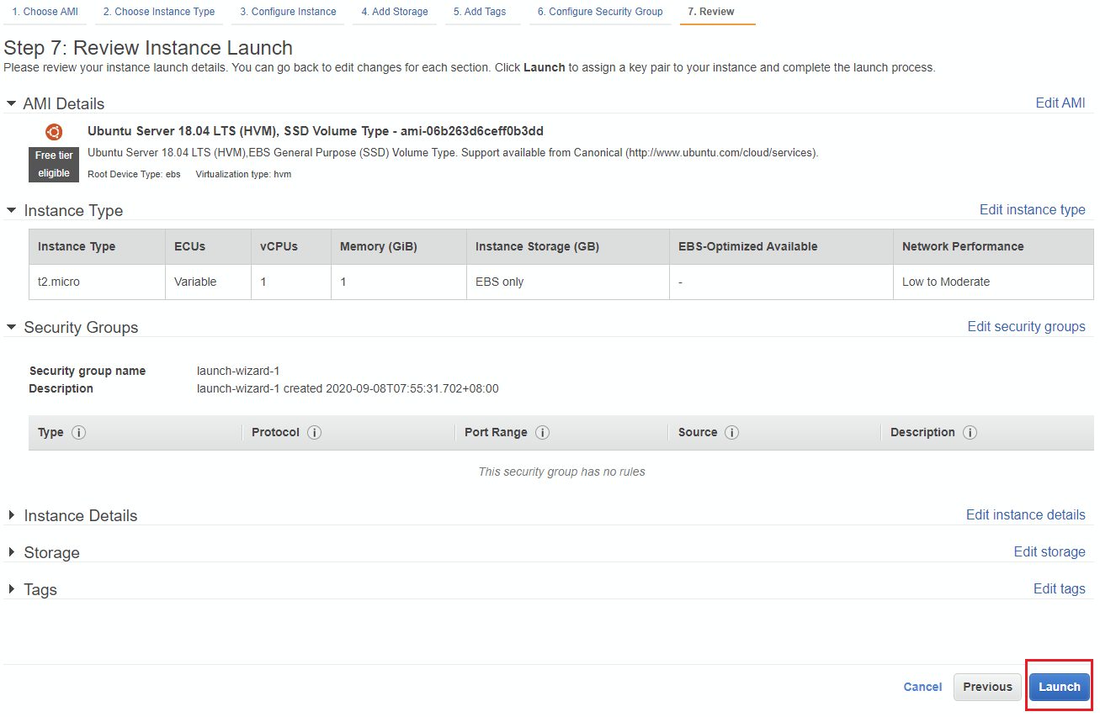
Launch

Slide 11
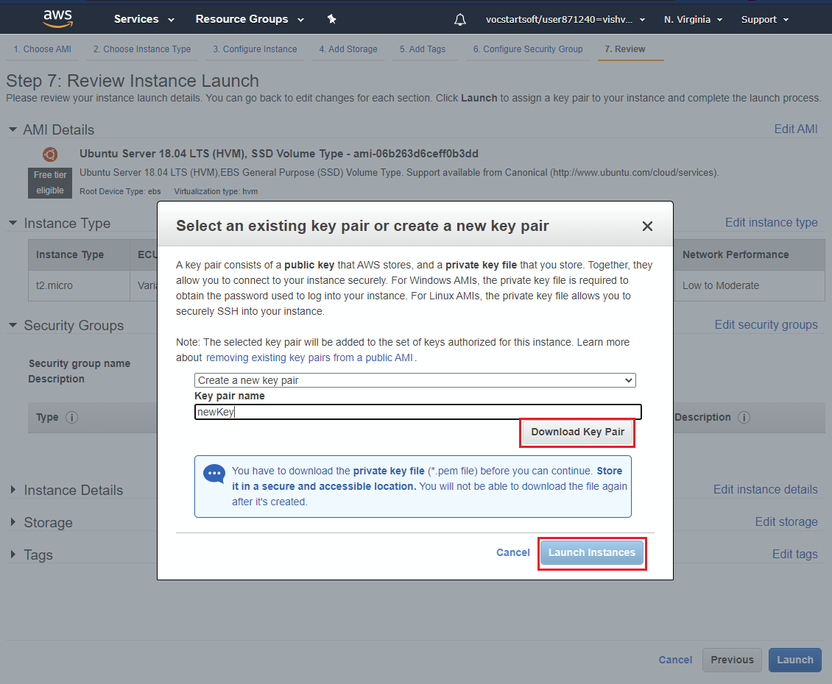
Create Key and Launch

Slide 12
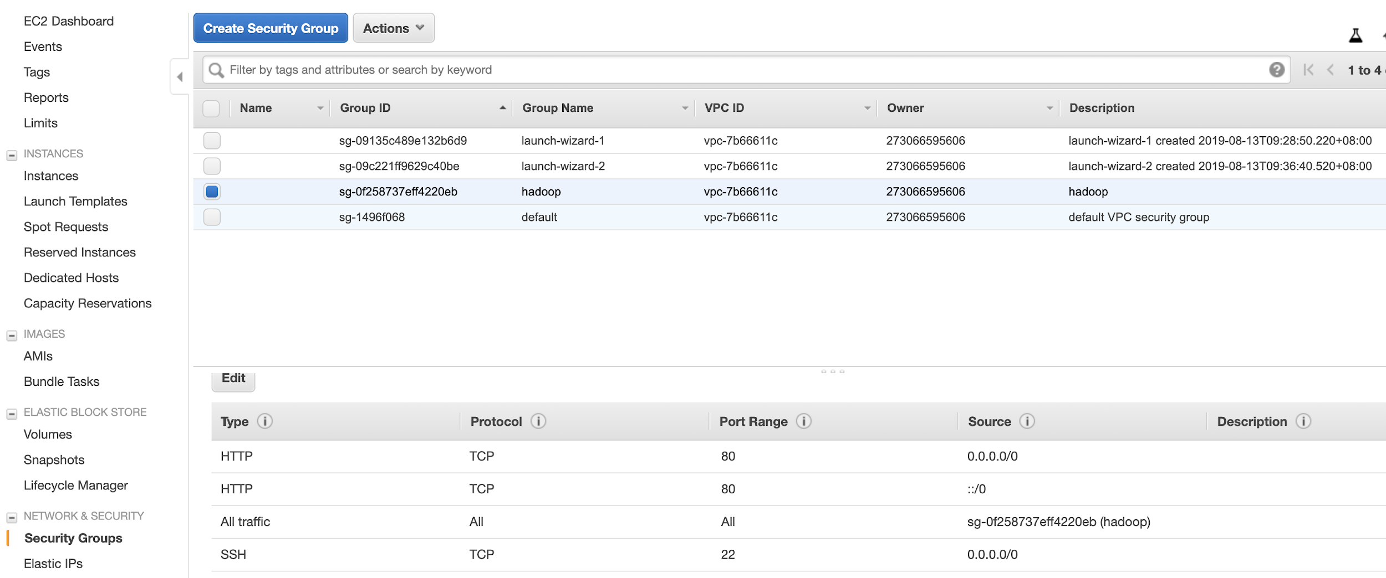
Security Group
Make sure that you allow SSH access

Slide 13
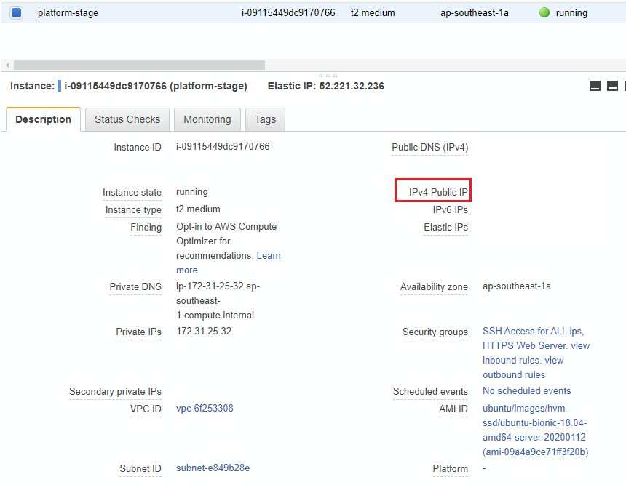
AWS EC2 – Accessing Instance
Locate the public IP of your instance

Slide 14
AWS EC2 – Accessing Instance
Connect using SSH
ssh user@host -i path/to/key.pem
Copy files to server
scp -i path/to/key.pem local/path/file.txt user@host:server/path/file.txt

Slide 15





AWS
2 types of credentials
Access key:
Short, 40-character string
To invoke AWS APIs, must be kept secret.
SSH key:
Standard SSH key
To log-in to the EC2 instances
Root user
IAM user 1
IAM user 2
IAM user N

Slide 16
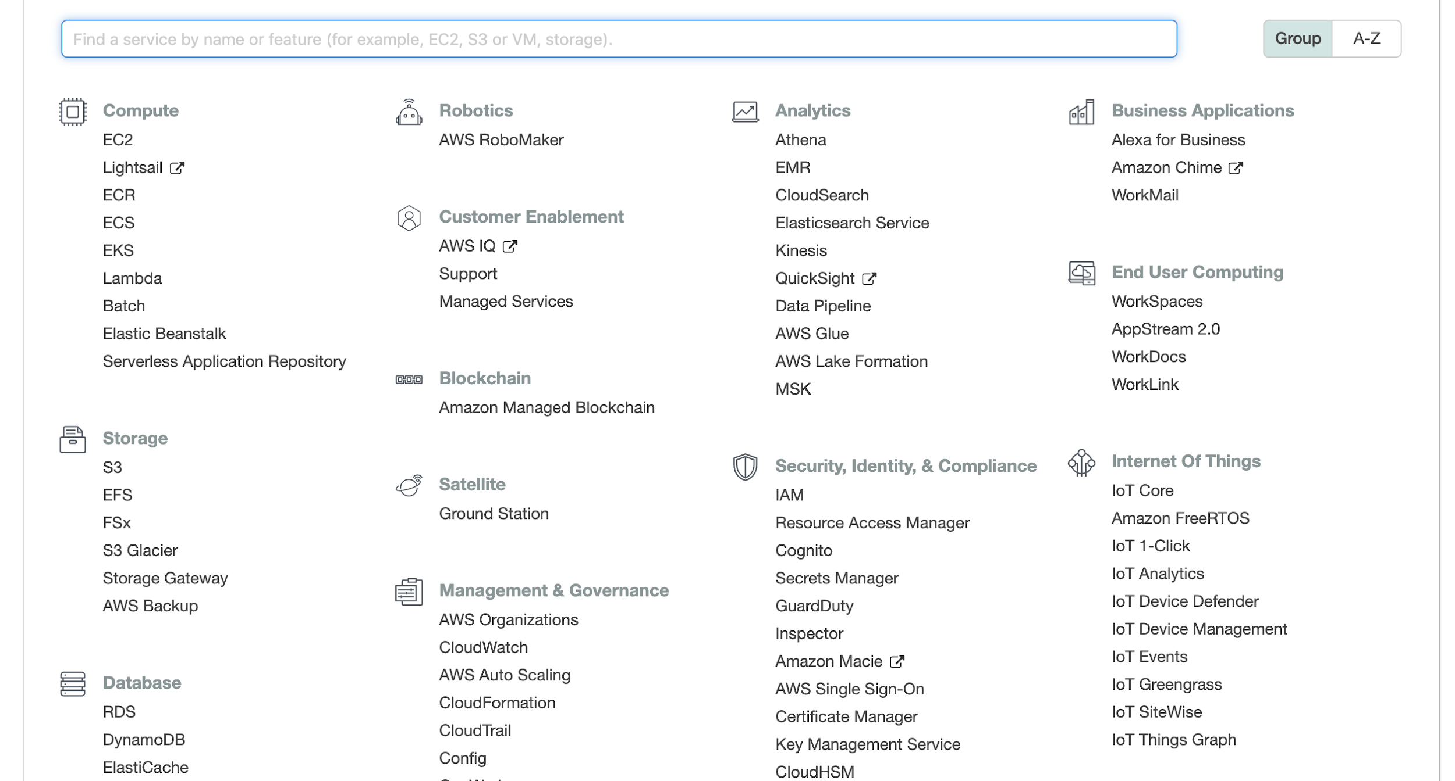
EC2
Access key created via IAM

Slide 17
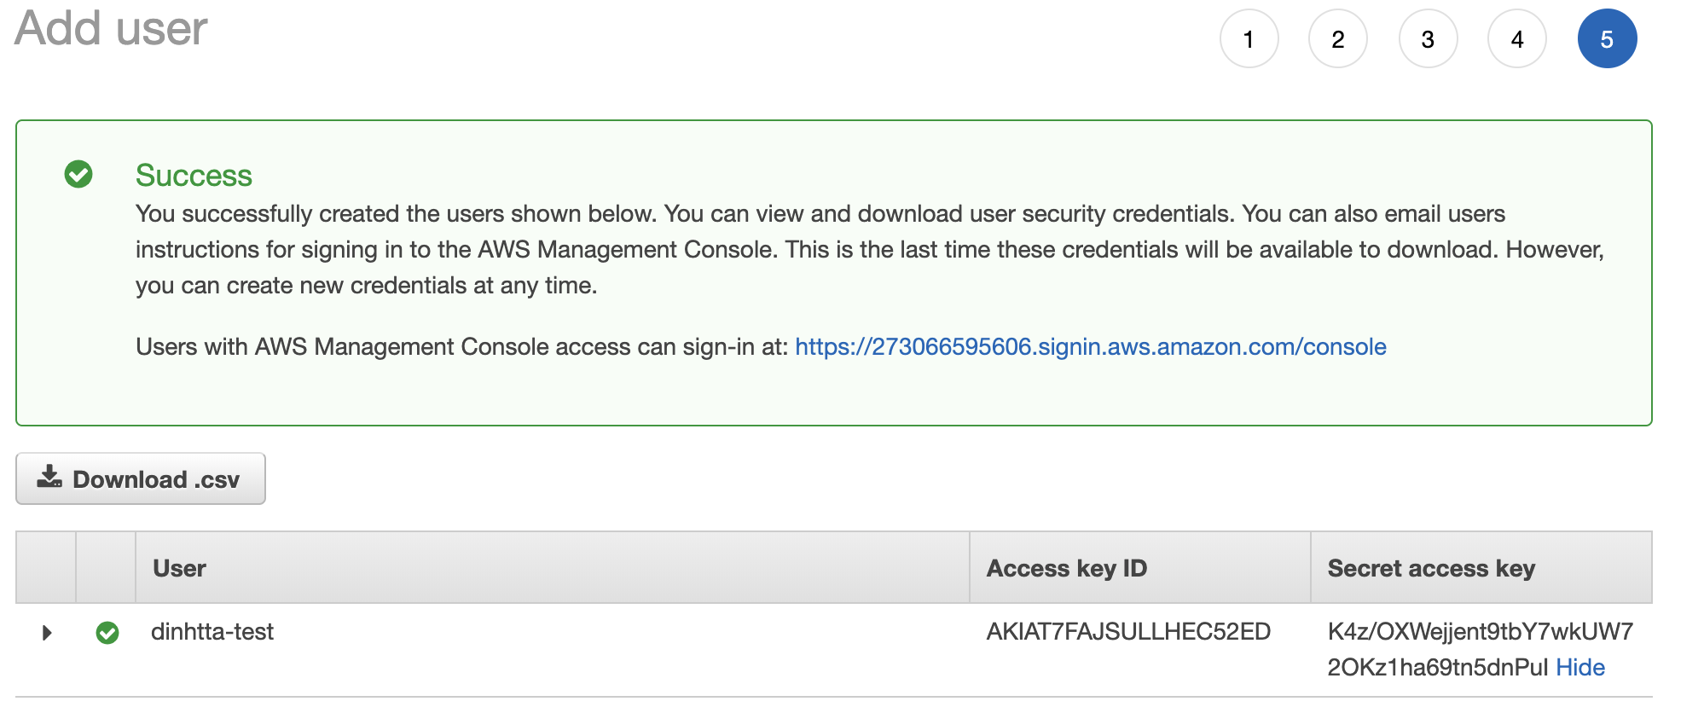
Access Key

Slide 18
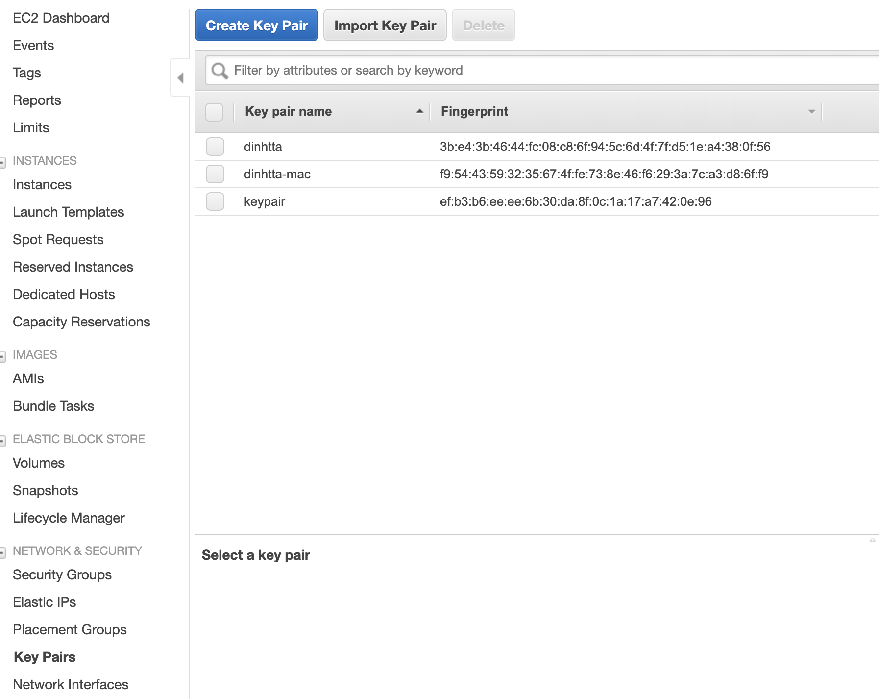
Key Pair
SSH keys
To login to your instances

Slide 19
MySQL Installation
Install mysql-server-5.7 with apt-get
Leave root password blank
mysql -u root
If successful, great!
If not:
Need to explicitly grant access to “root” user
Then restart the server
Now you should see the console
sudo mysql -e 'update mysql.user set plugin = "mysql_native_password" where user="root"' sudo mysql -e 'create user "root"@"%" identified by ""' sudo mysql -e 'grant all privileges on *.* to "root"@"%" with grant option' sudo mysql -e 'flush privileges' sudo service restart

Slide 20
MySQL Hands-on
Show databases
Switch to a database
Configure mysql so it can be accessed remotely.

Slide 21
MySQL remote access config
my.cnf
# The MySQL database server configuration file.
#
# You can copy this to one of:
# - "/etc/mysql/my.cnf" to set global options,
# - "~/.my.cnf" to set user-specific options.
#
# One can use all long options that the program supports.
# Run program with --help to get a list of available options and with
# --print-defaults to see which it would actually understand and use.
#
# For explanations see
# http://dev.mysql.com/doc/mysql/en/server-system-variables.html
#
# * IMPORTANT: Additional settings that can override those from this file!
# The files must end with '.cnf', otherwise they'll be ignored.
#
# mysql config for import access
!includedir /etc/mysql/conf.d/
!includedir /etc/mysql/mysql.conf.d/
[mysqld]
#secure-file-priv=""
#local_infile=1
bind-address = 0.0.0.0

Slide 22

Why not to use default config for mysql
https://www.zdnet.com/article/hackers-are-scanning-for-mysql-servers-to-deploy-gandcrab-ransomware/
Change default port, secure root user, run mysql_secure_installation
Implement granular access for users

Slide 23
MySQL Exercise
Create a flask app with single api CRUD endpoint that connects to mysql db to retrieve data.
Launch it on your pc
Test app API using postman.

Slide 24
MySQL connecting remotely
Install mysql client
sudo apt-get install mysql-client
Connect to server
mysql –u root –p --host=<PublicIP> --port=3306

Slide 25
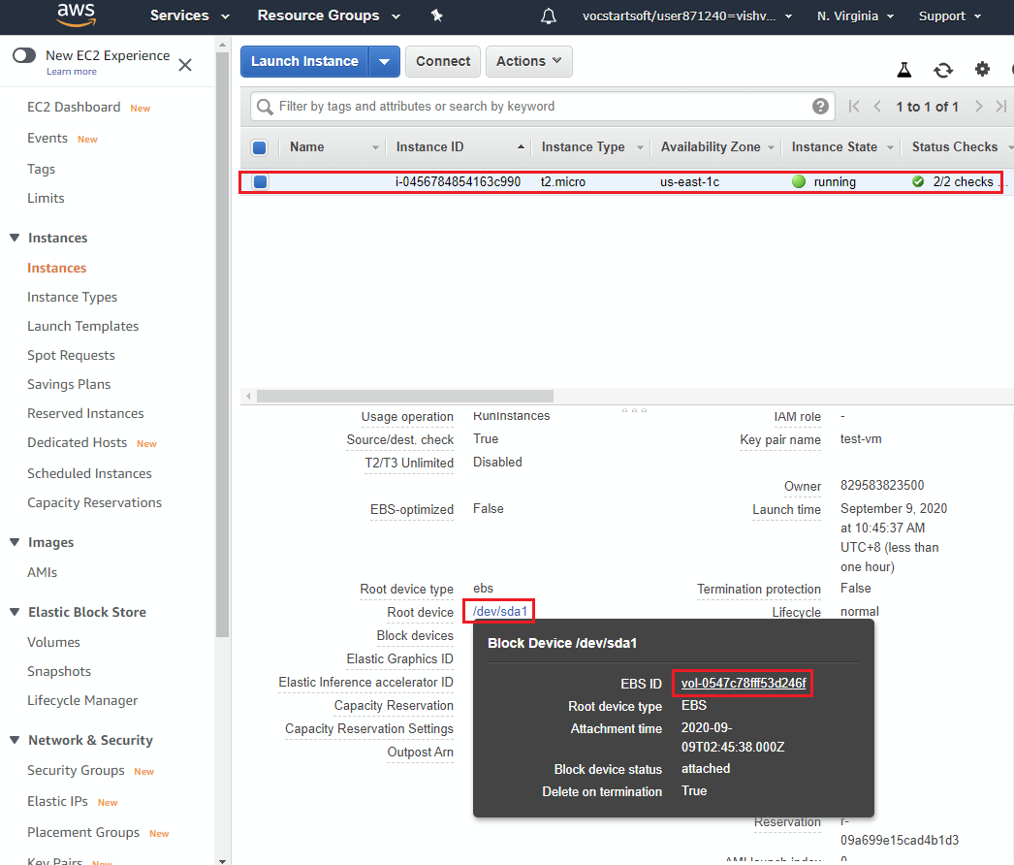
AWS: Creating a Snapshot of MySQL server
Go to EC2 Dashboard and locate VolumeID

Slide 26
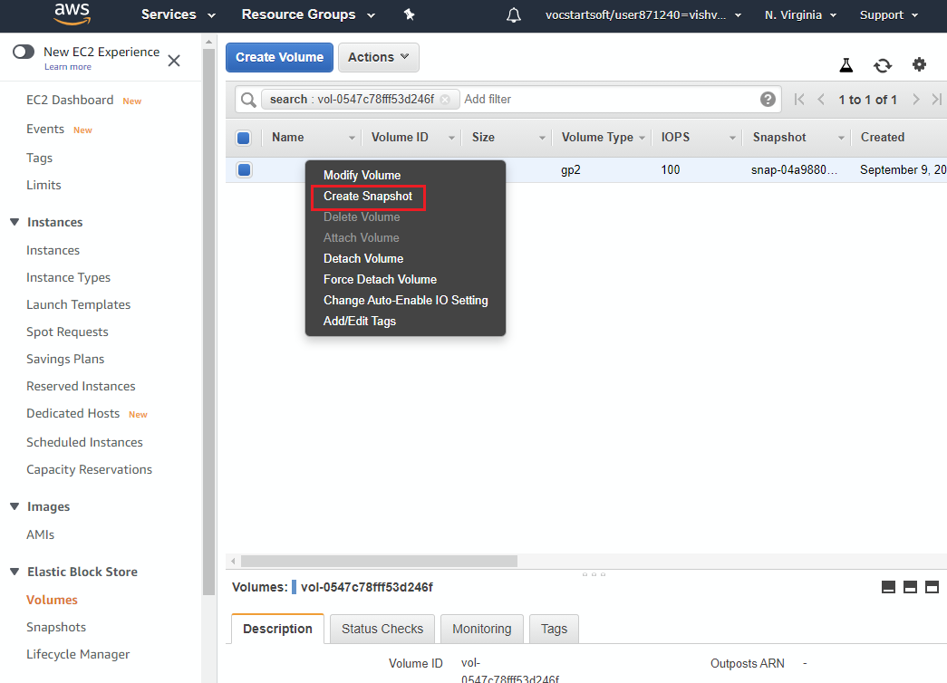
AWS: Creating a Snapshot of MySQL server
Navigate to Volume dashboard and select create Snapshot from context menu.

Slide 27
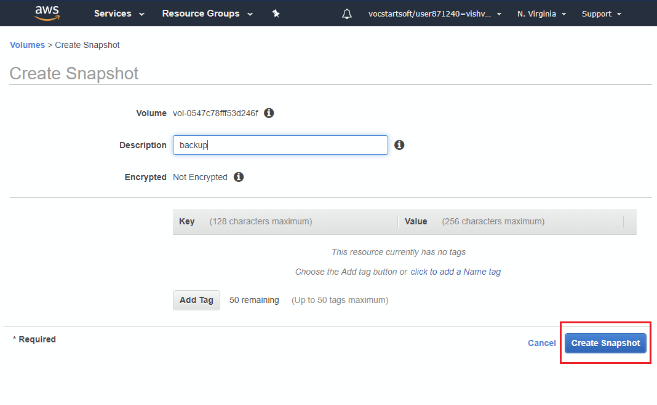
AWS: Creating a Snapshot of MySQL server
Create snapshot

Slide 28
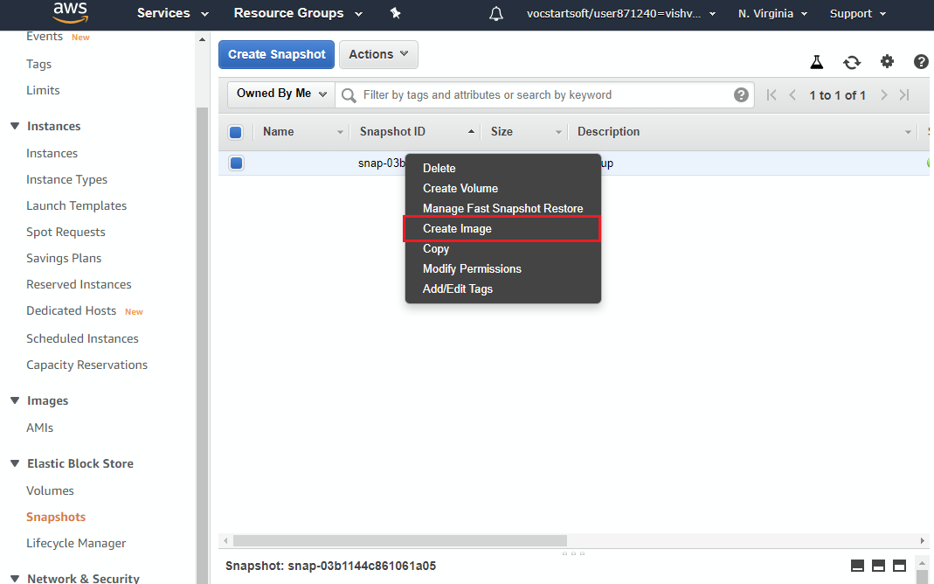
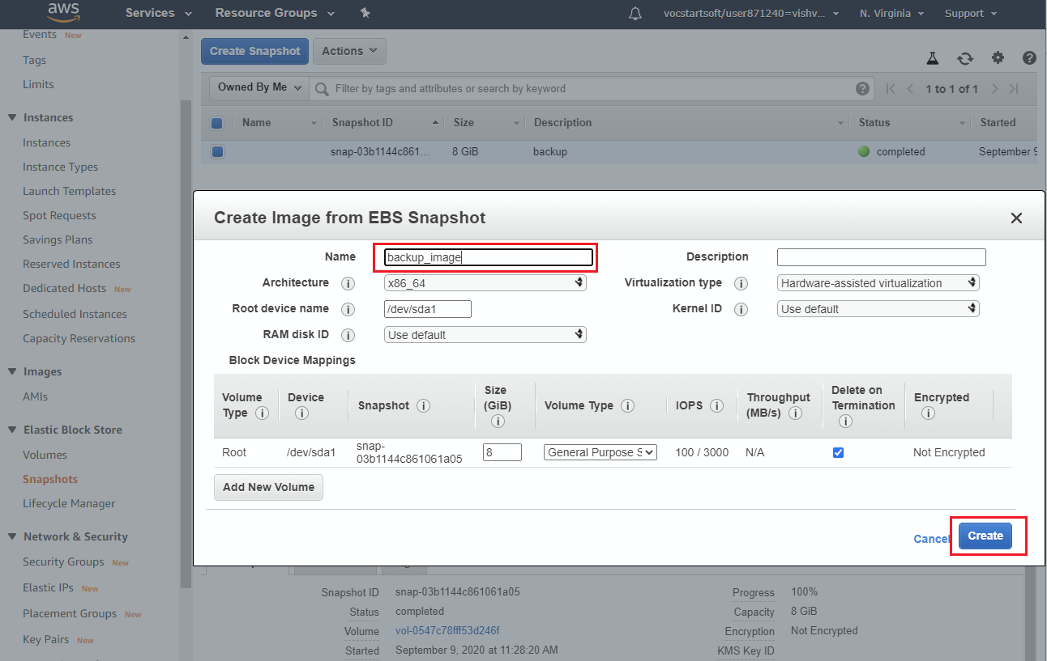
AWS: Launching EC2 using snapshot
Create Image

Slide 29
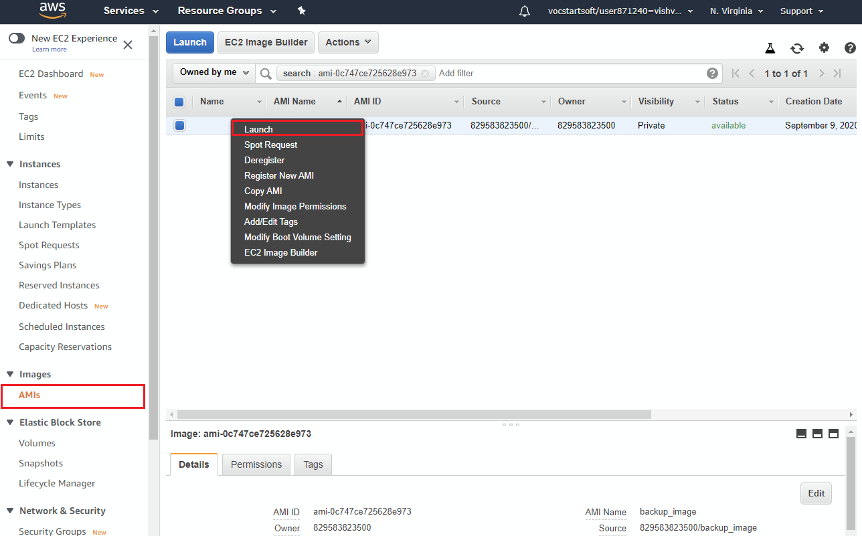
AWS: Launching EC2 using snapshot
Launch Image

Slide 30
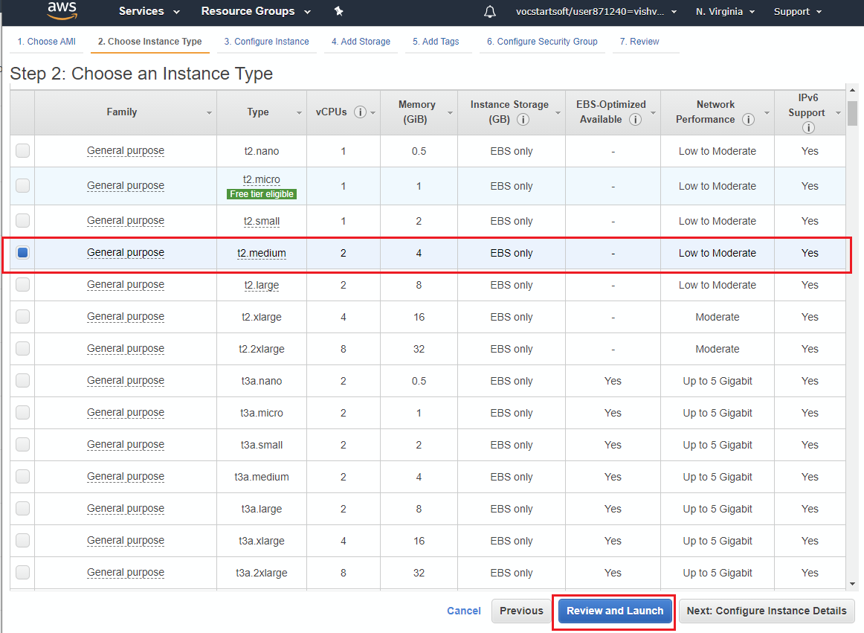
AWS: Launching EC2 using snapshot
Launch a different instance type

Slide 31
Boto3
Python library for accessing AWS services
Your Python application
boto3.client(‘ec2’)
Boto3
boto3.client(‘s3’)
~/.aws

Slide 32

Access key vs. Key pair
Your Python application
boto3.client(‘ec2’)
Boto3
boto3.client(‘ec2’)
Management APIs
~/.aws
Instance
Instance
SSH keys

Slide 33
boto3
Prerequisites
Install aws-cli
https://docs.aws.amazon.com/cli/latest/userguide/install-cliv2-linux.html
Configure aws-cli with access keys
aws configure
Optional – install python pip module if not already installed
sudo apt-get install python3-pip

Slide 34
boto3
Example: start an instance
import boto3
ec2 = boto3.resource('ec2')
# create a new EC2 instance
instances = ec2.create_instances(
ImageId='ami-06b263d6ceff0b3dd',
MinCount=1,
MaxCount=1,
InstanceType='t2.micro',
KeyName='ec2-keypair'
)

