Slide 1
Databases and Big Data
Lab 1

Slide 2
Today
AWS Basics
MySQL setup
Python tools
Basic Web App.
Boto3 (AWS Command Line Interface Wrapper for python)

Slide 3
AWS
Services
EC2, RDS, DynamoDB, API Gateway, Lambda Functions (serverless), AWS Cloudformation

Slide 4
AWS EC2 - Creating a EC2 Instance
Log into https://console.aws.amazon.com or https://www.awseducate.com/signin

Slide 5
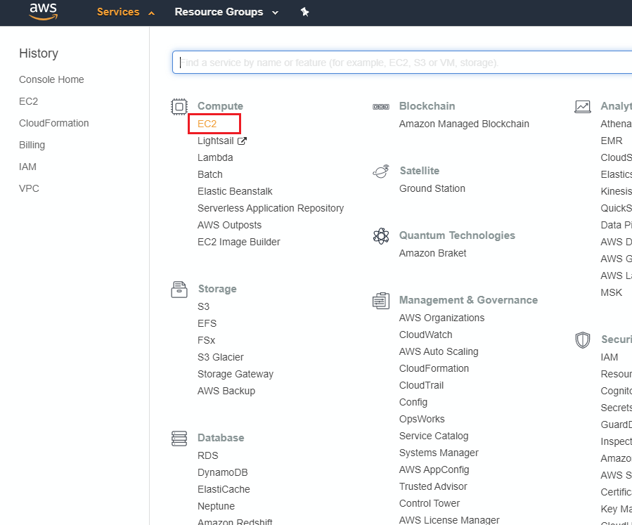
Go to EC2 Service

Slide 6
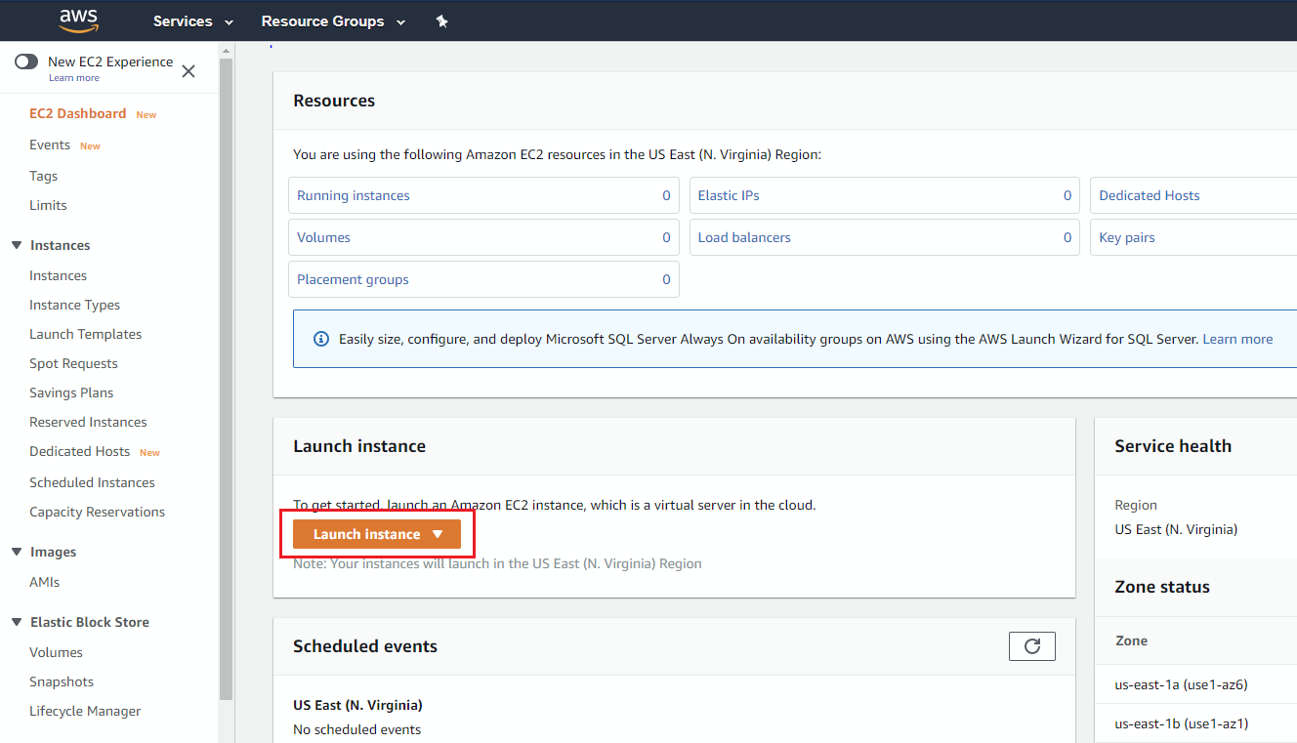
Go to Launch Instance Wizard

Slide 7
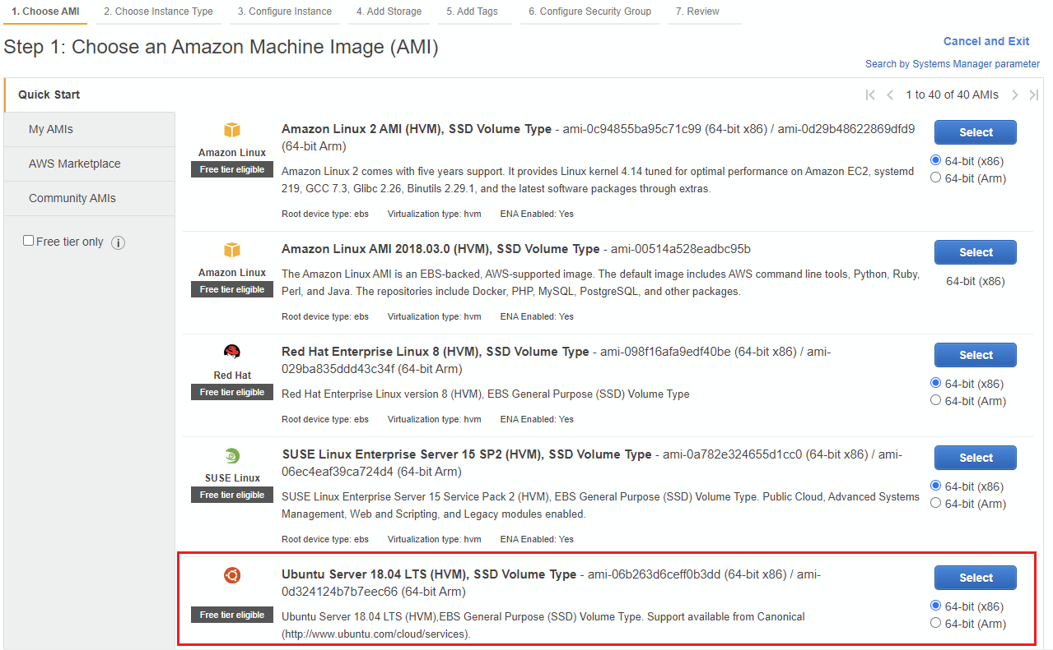
Select an AMI

Slide 8
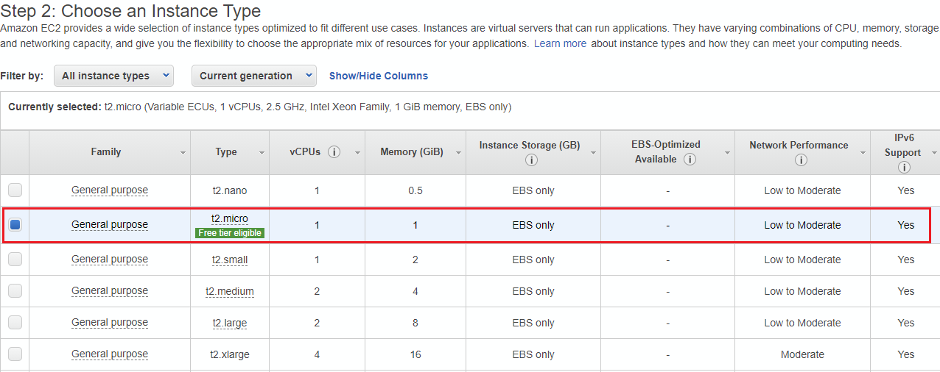
Select an Instance Type

Slide 9
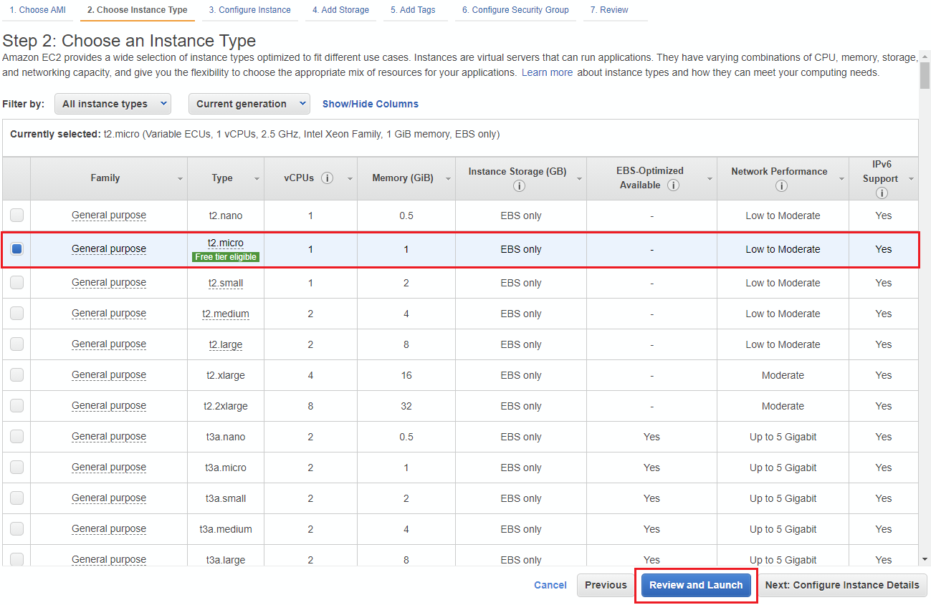
Select an Instance Type and Launch

Slide 10
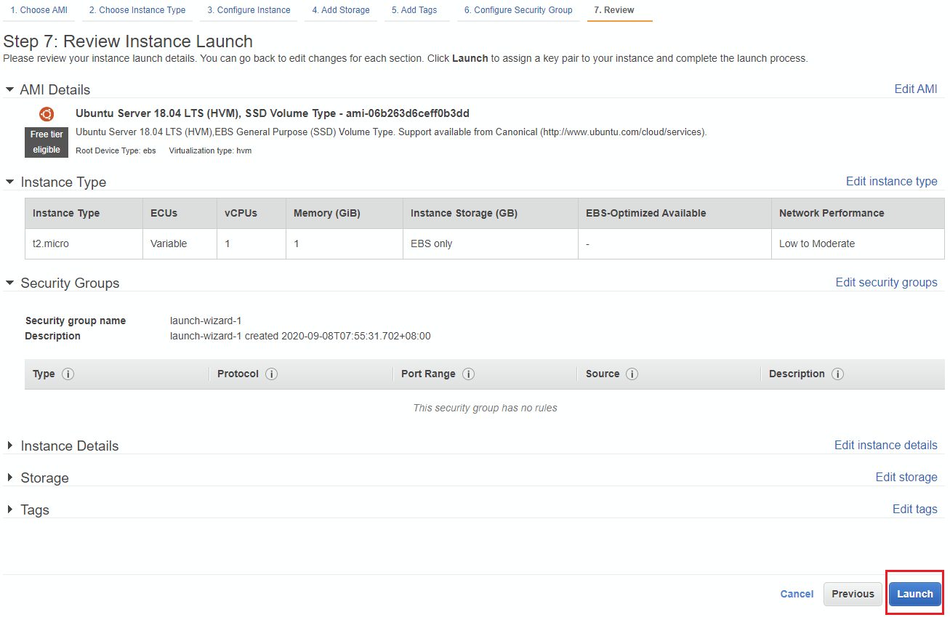
Launch

Slide 11
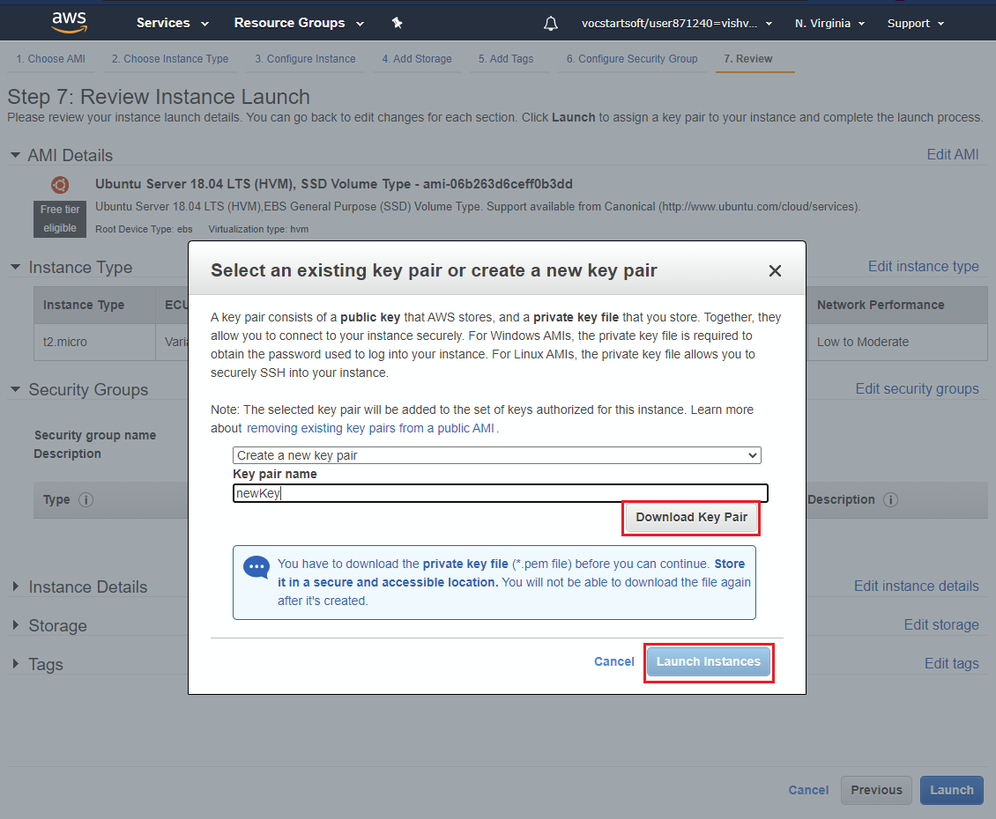
Create Key and Launch

Slide 12
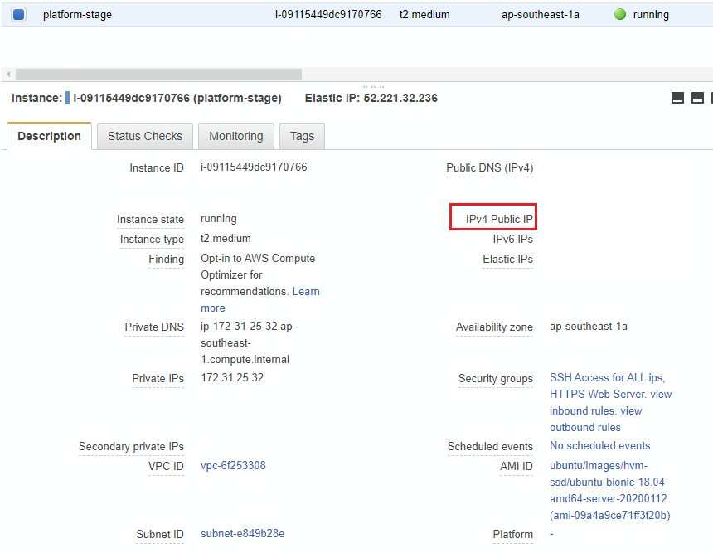
AWS EC2 – Accessing Instance
Locate the public IP of your instance

Slide 13
AWS EC2 – Accessing Instance
Connect using SSH
ssh user@host -i path/to/key.pem
Copy files to server
scp -i path/to/key.pem local/path/file.txt user@host:server/path/file.txt

Slide 14





AWS
2 types of credentials
Access key:
Short, 40-character string
To invoke AWS APIs, must be kept secret.
SSH key:
Standard SSH key
To log-in to the EC2 instances
Root user
IAM user 1
IAM user 2
IAM user N

Slide 15
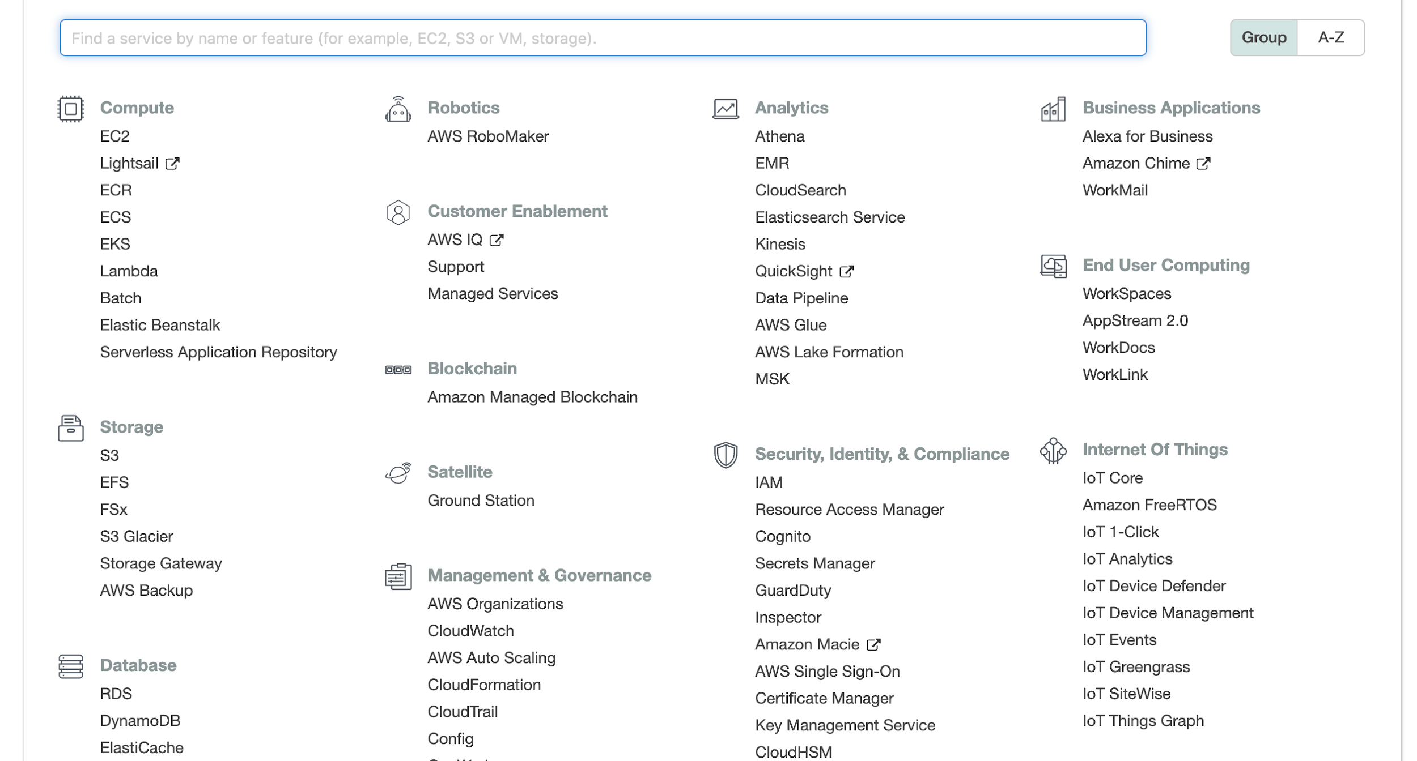
EC2
Access key created via IAM

Slide 16
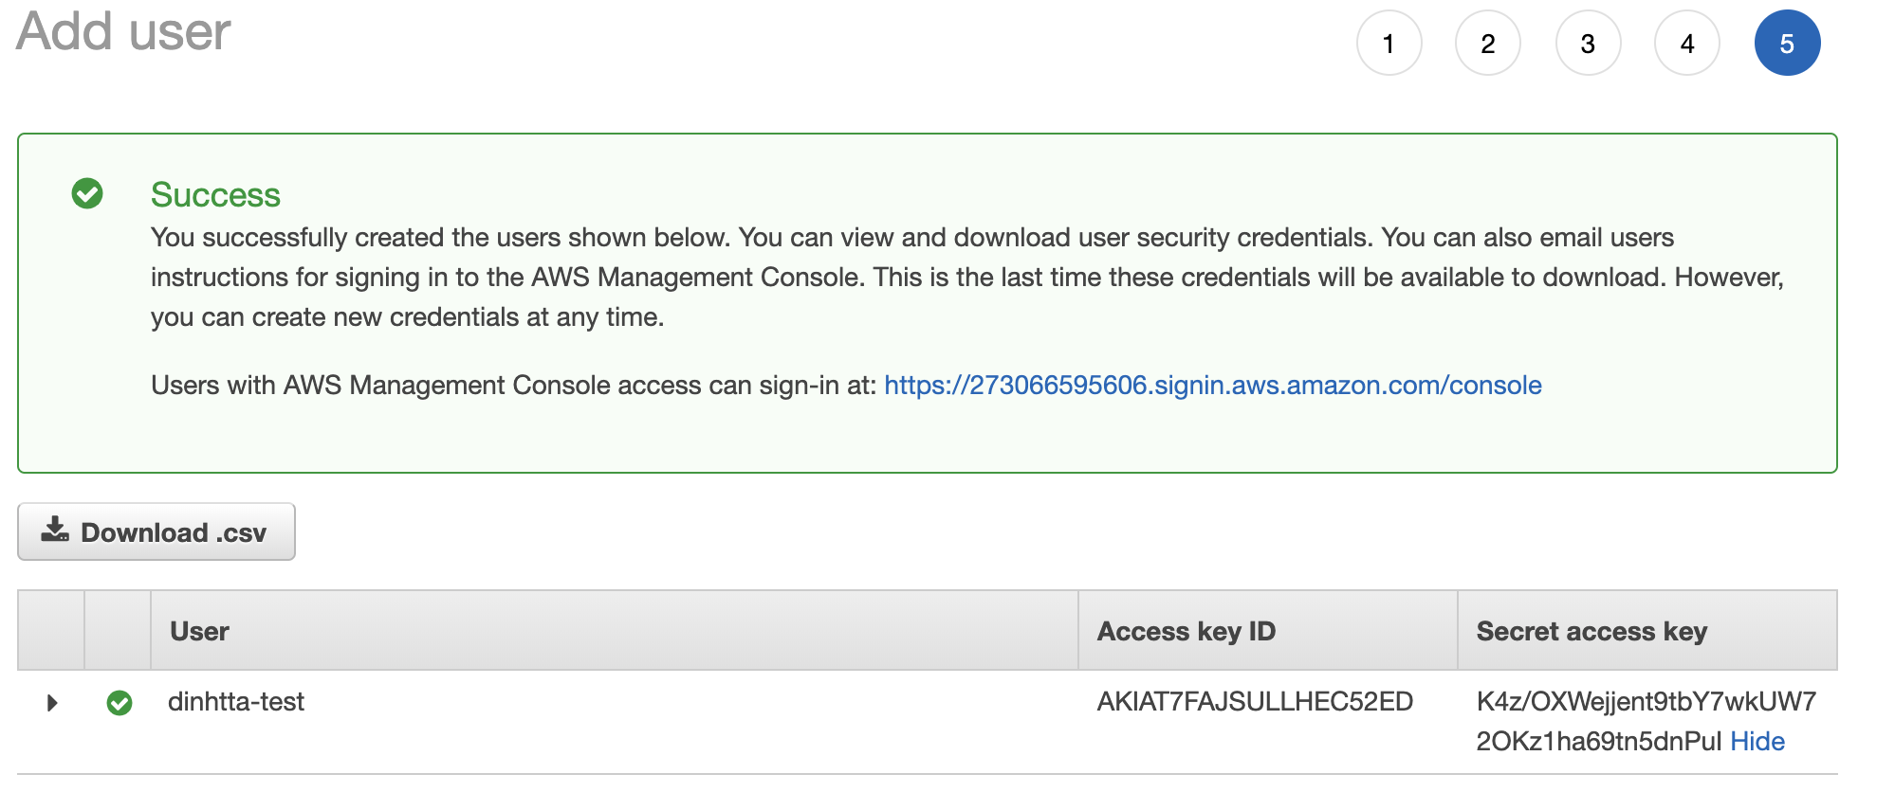
Access Key

Slide 17
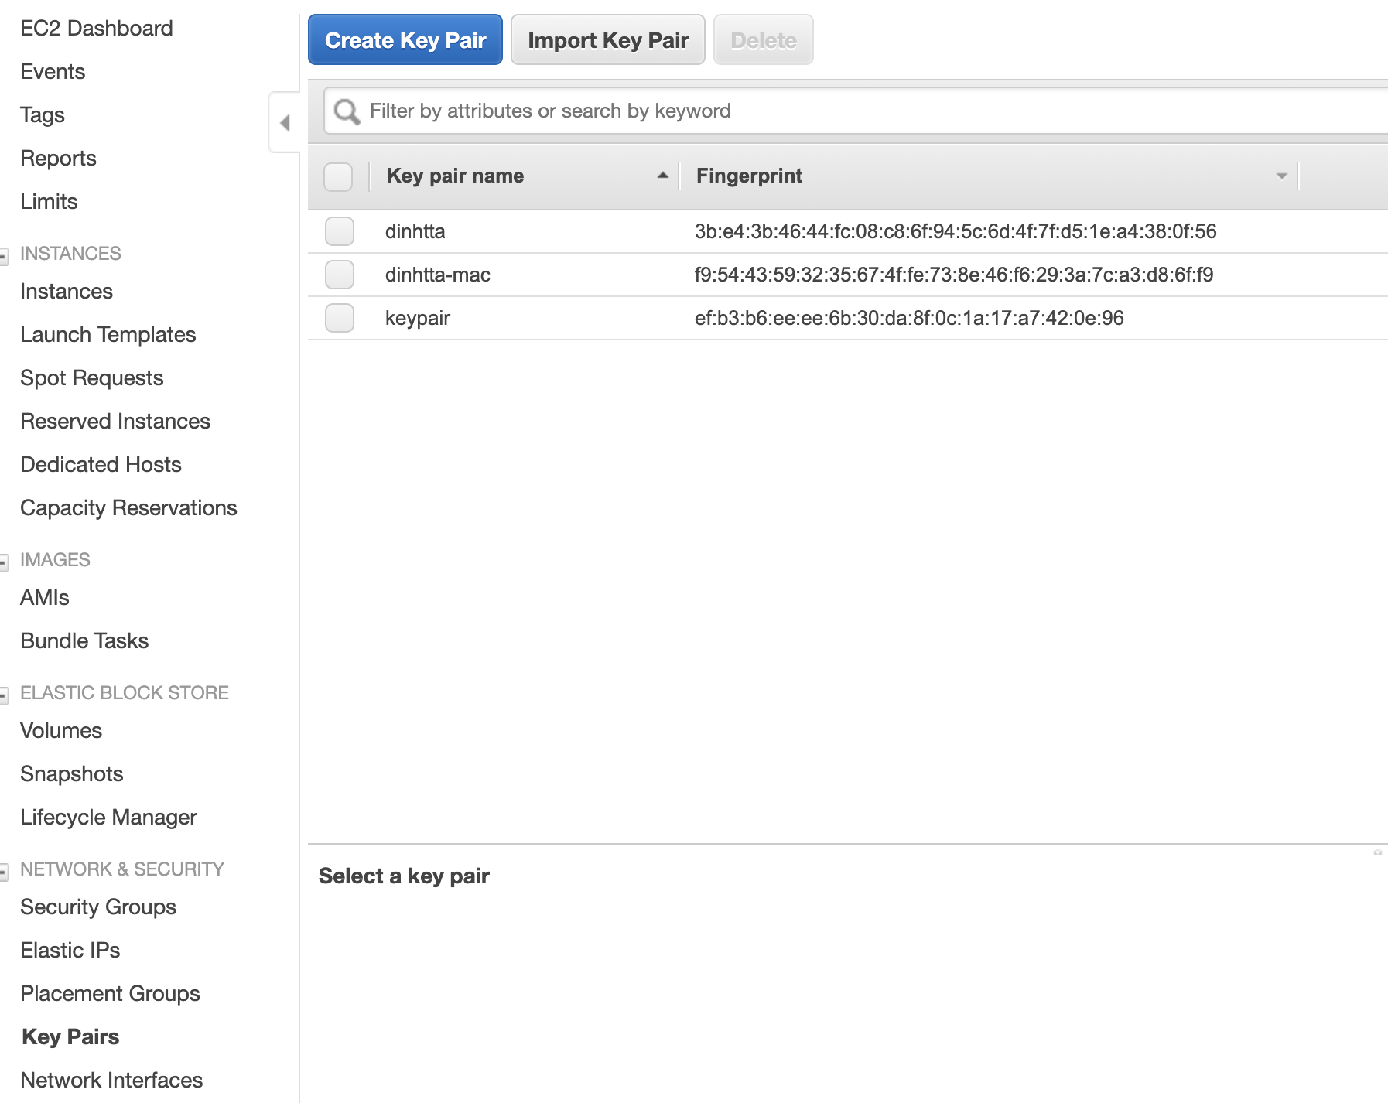
Key Pair
SSH keys
To login to your instances

Slide 18
MySQL Installation
Install mysql-server-5.7 with apt-get
sudo apt-get update
sudo apt-get install -y mysql-server
Login to server
sudo mysql -u root
Now you should see the console

Slide 19
MySQL Hands-on
Show databases
Switch to a database
Create database for flask app
Configure mysql so that flask app can access it from your pc.

Slide 20
Boto3
Python library for accessing AWS services
Your Python application
boto3.client(‘ec2’)
Boto3
boto3.client(‘s3’)
~/.aws

Slide 21

Access key vs. Key pair
Your Python application
boto3.client(‘ec2’)
Boto3
boto3.client(‘ec2’)
Management APIs
~/.aws
Instance
Instance
SSH keys

Slide 22
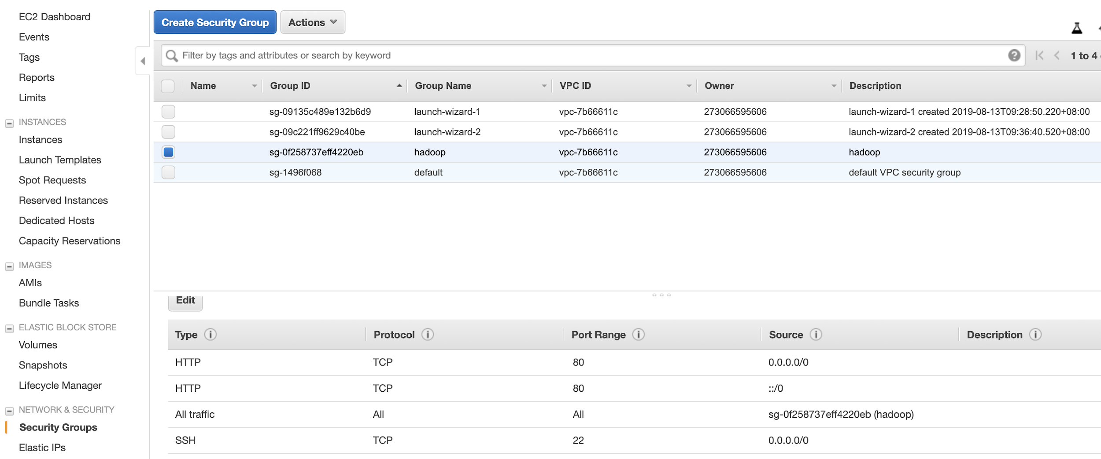
Security Group
Make sure that you allow SSH access

Slide 23
boto3
Example: start an instance
import boto3
ec2 = boto3.resource('ec2')
# create a new EC2 instance
instances = ec2.create_instances(
ImageId='ami-06b263d6ceff0b3dd',
MinCount=1,
MaxCount=1,
InstanceType='t2.micro',
KeyName='ec2-keypair'
)

