Slide 1

2023S AML 3406 AI ML Capstone Project Group 4 :Hotel Assist
Group Members:
Parth Sharma (C0858658)
Vishalkumar Patel (C0857057)
Anirudh Sharma (C0860051)
Jaydeep Mathukiya (C0859793)
Arpit Valand (C0857938)
Resha Soni (C0859047)
Guided By :
Prof. Vahid Hadavi

Slide 2
Introduction
"Hotel Assist," a Toronto-based AI Chatbot, transforms guest interactions, redefining hospitality with personalized service and technology.

Slide 3
Methods
1. Data Collection & Understanding
2. Data Preprocessing
4. Testing & Integration
3. Model Development

Slide 4
Dataset
Data Origins and Collection:
Curated dataset from sources like TripAdvisor, Expedia, Booking.com.
Data from Toronto's known hotels: "Hotel X Toronto," "Marriott," "Hyatt," etc.
Included GPT-generated content for simulated interactions.
Collection Process:
Extracted guest reviews, queries, preferences.
Comprehensive guest experience representation.
Initial dataset: ~27,000 records.
Transformed through purposeful methods to 35,000 records.

Slide 5
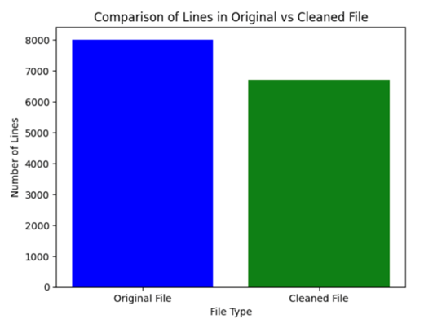
Semantic Data Cleaning

Slide 6
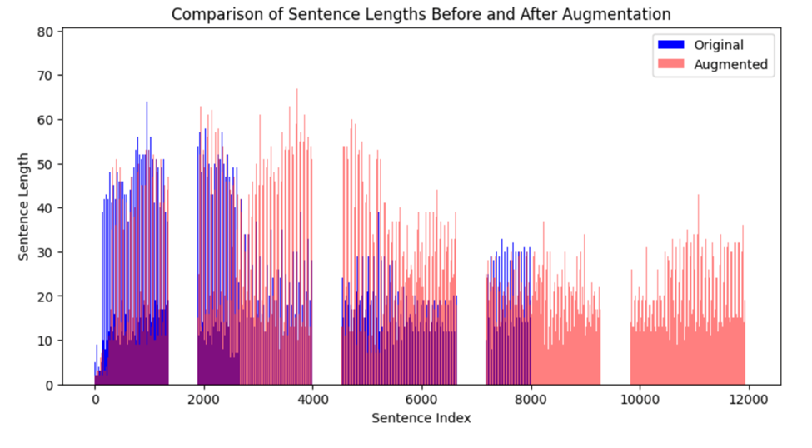
Data Augmentation

Slide 7
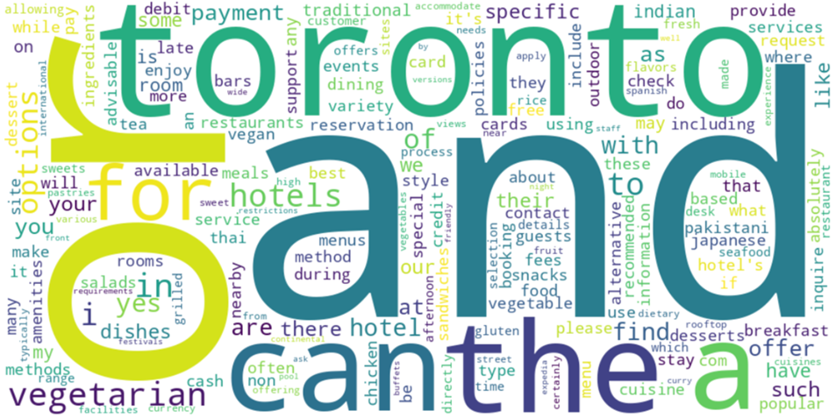
Word Cloud Of Tokens

Slide 8
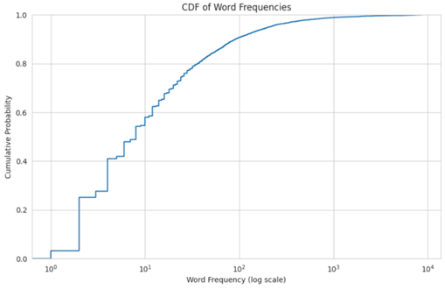
Analysis of Token Frequencies

Slide 9
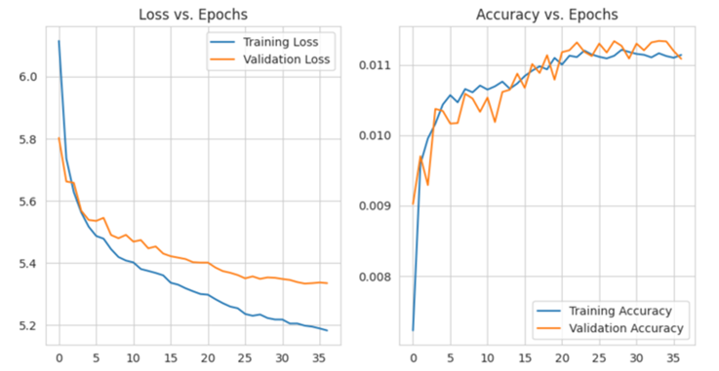
Model
LSTM Model
Seq2Seq
Analysis of Model

Slide 10
Model Development with FLASK
Utilized Flask web framework.
Lightweight for web app development in Python.
Deployed trained Seq2Seq model as Flask app.
Enabled HTTP interface for user interactions.
Accessible through web requests.

Slide 11
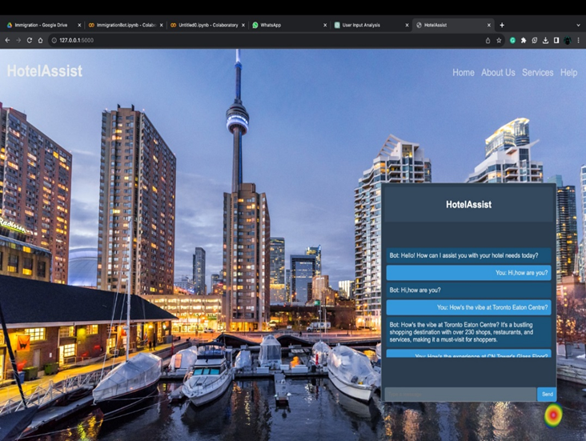
ChatBot Front-End

Slide 12
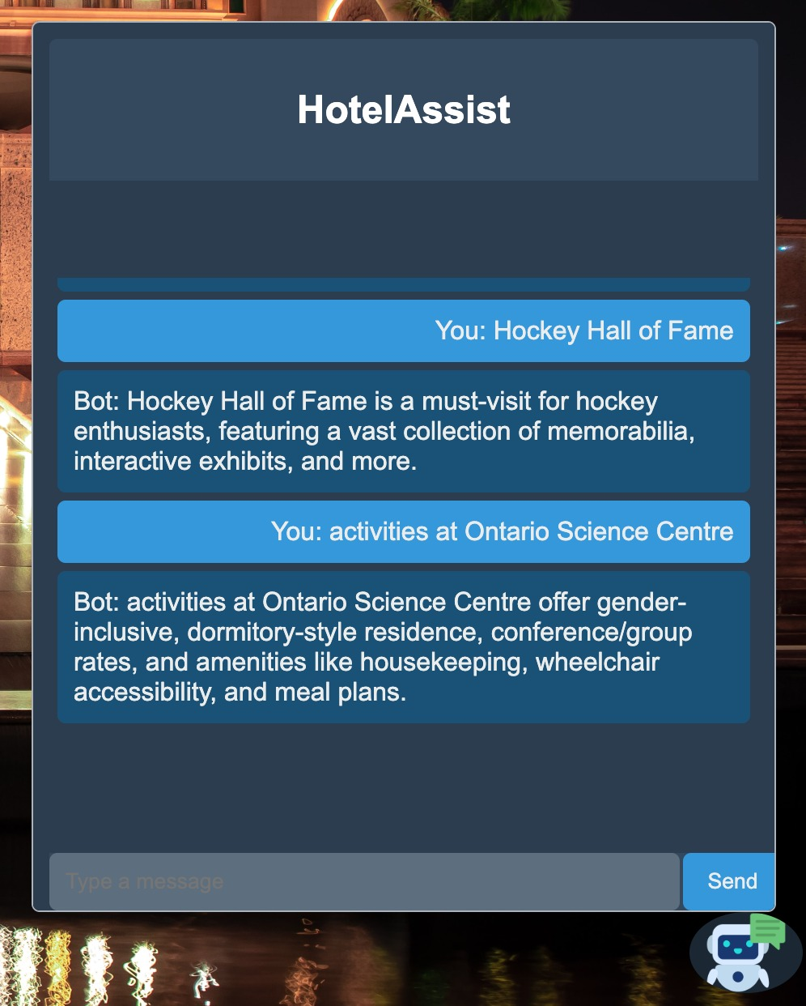
Chatbot Front-End

Slide 13
Conclusion
Explored data augmentation, token analysis, advanced training.
Improved chatbot with algorithms, neural networks.
Deployment via Flask in "HotelAssist" UI.
Prioritized data quality, user friendly chatbots.

Slide 14
References
Goodfellow, I., Bengio, Y., & Courville, A. (2016). Deep Learning. MIT Press.
Vaswani, A., Shazeer, N., Parmar, N., Uszkoreit, J., Jones, L., Gomez, A. N., ... & Polosukhin, I. (2017). Attention is all you need. In Advances in neural information processing systems (pp. 5998-6008).
Brownlee, J. (2020). Deep Learning for Natural Language Processing. Machine Learning Mastery.
Robinson, S. (2020, August 18). Deploying an ML Model as a REST API on Cloud Run. Retrieved from https://sararobinson.dev/2020/08/18/ml-ops-cloud-run.html

Slide 15
Thank You! Any Questions?

