Slide 1
LLM-Guided Grammar-Aware Fuzzing of PostgreSQL
CS-5187 Term Project A3 – Meeting presentation
Venu, Bhuvan, Gowtham

Slide 2
Problem Statement
PostgreSQL ships new optimiser and executor features every year; each one adds code paths that the regression suite covers only partially.
The worst bugs are silent wrong results: no crash, no error, just wrong rows.
Existing SQL fuzzers either produce mostly invalid SQL (grammar-only, type-blind) or use hand-written generators that lag behind new features.
Question: can a typed, editable grammar, extended by an LLM that reads PostgreSQL’s own commits, find more bugs than random mutation and a plain grammar, under the same budget?
Notes:
One sentence: we want to find bugs in new PostgreSQL code automatically, and measure whether an LLM-maintained grammar helps.

Slide 3
Motivation: why PostgreSQL, why now
Used everywhere; a wrong-result bug can corrupt business data silently.
Recent releases changed the planner heavily (to verify per release notes): OR-to-ANY transformation, self-join elimination, B-tree skip scan, virtual generated columns, RETURNING OLD/NEW, MERGE extensions, JSON_TABLE.
master (20devel) gets new commits daily; regressions found there are fixed quickly and credited (“Reported-by”).
LLMs can read commit messages, docs and regression tests – exactly the knowledge a fuzzer lacks about brand-new features.
Notes:
Emphasise: new code = least tested = most bugs. Upstream acts fast on master regressions.

Slide 4
Limits of existing approaches
Approach | Strength | Gap
Random / mutation (AFL-style) | cheap, fast | mostly syntax errors
SQLsmith | type-aware, finds crashes | no wrong-result oracle
SQLancer (TLP, NoREC, PQS) | logic-bug oracles | hand-written generators
Squirrel, SQLRight | coverage-guided IR mutation | fixed grammar, slow to add features
Fuzz4All (LLM) | adapts to new features | LLM on the hot path: slow, costly
Our gap: valid + replayable + extensible by an LLM, with the LLM off the hot path.
(Citations to verify before the paper.)

Slide 5
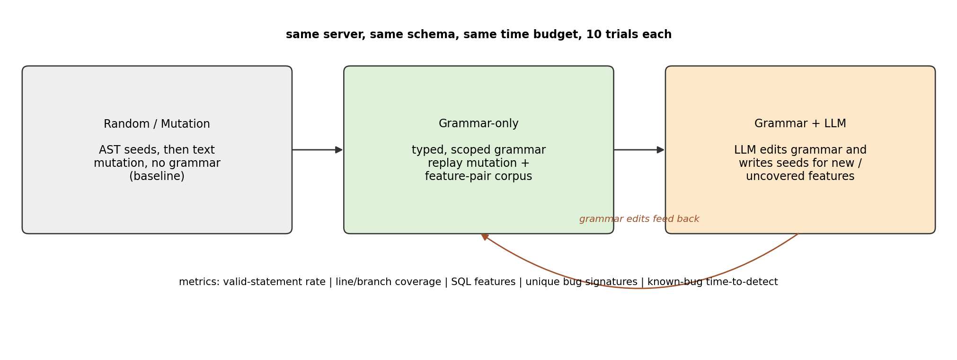
Our idea in one picture
Three arms compared under the same budget, server, schema and oracle
Notes:
Arm 1 is the baseline, arm 2 is our typed grammar, arm 3 adds the LLM that edits the grammar and writes seeds.

Slide 6
Three claims
One tree, four jobs. The derivation tree is how we generate, mutate, rewrite (metamorphic oracle) and reduce. SQL text is only the rendering, so a change cannot break types or scopes.
Soundness we measure. Generator: valid-statement rate. Oracle: a reported mismatch is a real disagreement; triage precision says how often.
The LLM proposes; the server decides. A proposal enters the fuzzer only if it runs and covers changed lines. That coverage is the proof it helped.
The three-arm comparison stays the experiment. These three claims are what is ours.

Slide 7
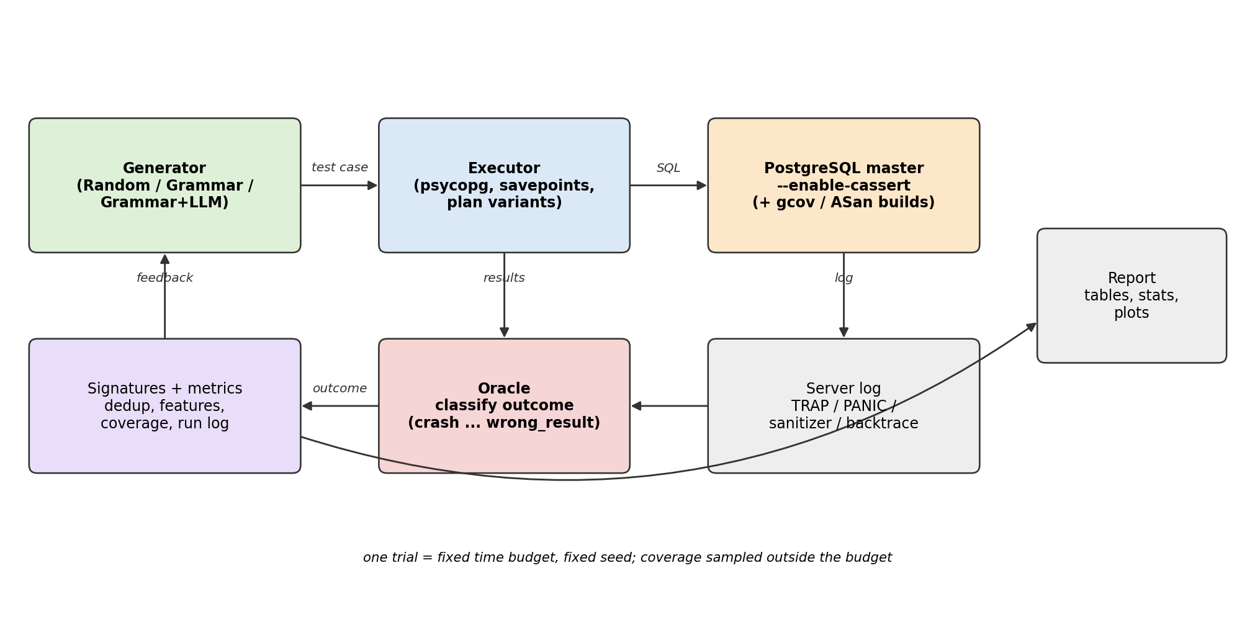
Architecture
Generator, executor, instrumented PostgreSQL, oracle, signatures, report
Notes:
Every arm is a plug-in Generator; everything else (executor, server, oracle, metrics) is shared, which makes the comparison fair.

Slide 8
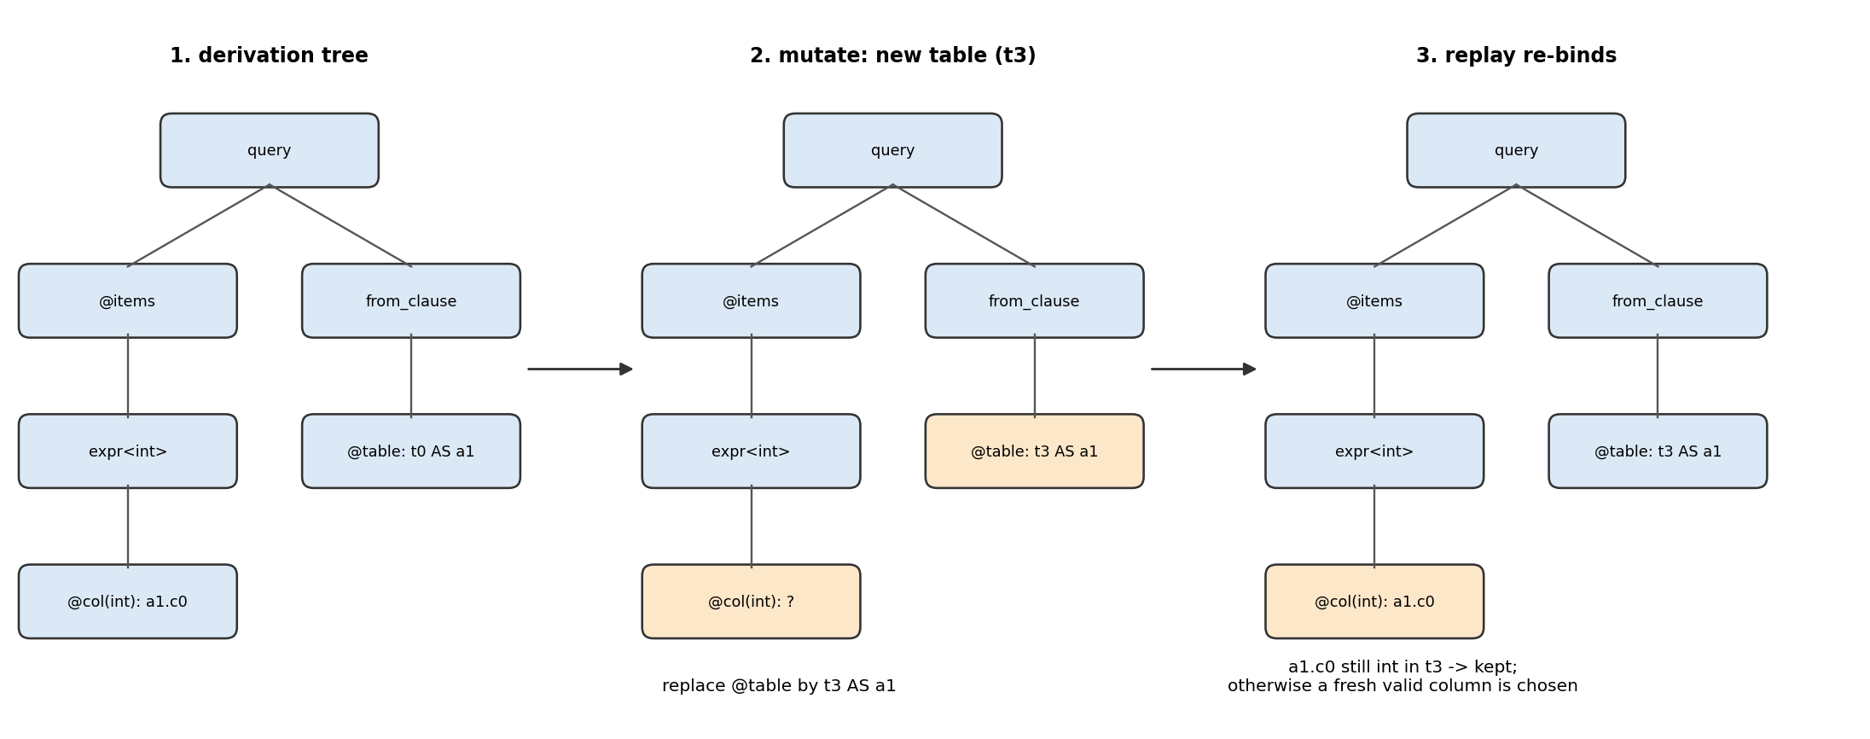
Typed grammar and replay mutation
Our own grammar language .pgg: 13 SQL types, type classes, scopes, SQL grouping rules as context flags (no aggregates in WHERE, group keys only).
Generation = constructing a typing derivation $Γ⊢e:T$ with backtracking – most statements reach the planner.
Each statement keeps its derivation tree; mutation regenerates or splices a subtree, then replay re-binds names and types so the result stays valid.

Slide 9
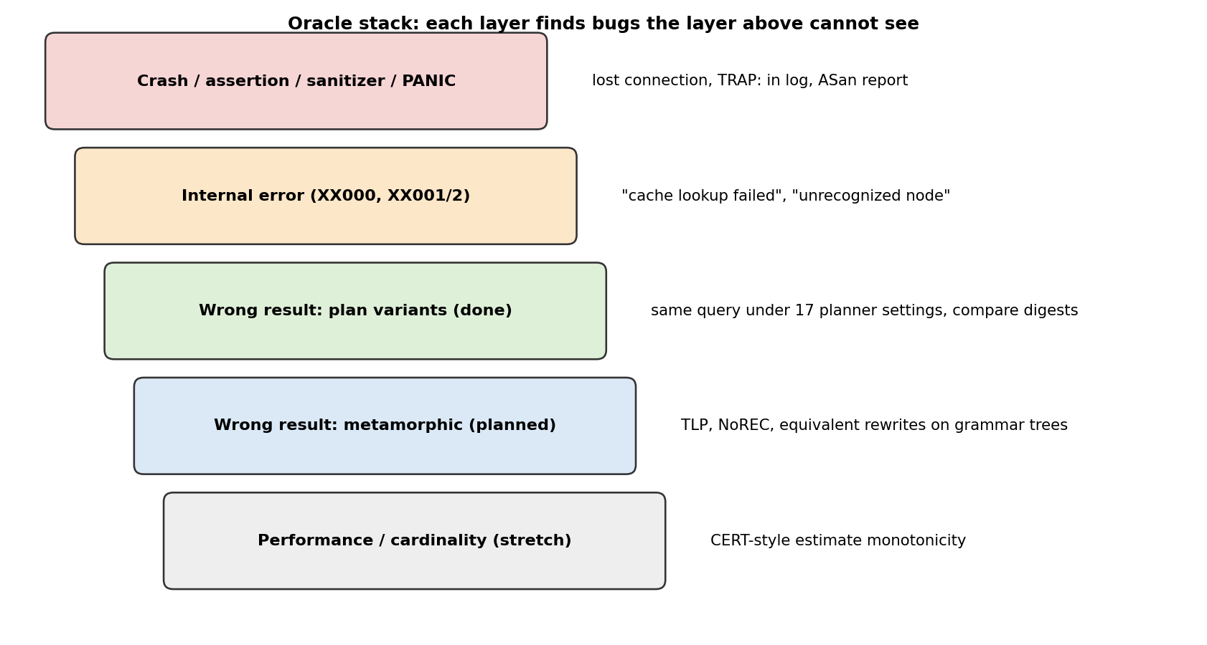
Oracle stack
Crash / assertion, internal error, wrong result
Notes:
Assertions on: TRAP messages from the log. Internal errors XX000. Wrong results: 17 planner variants in savepoints, order-insensitive digests, float masking, determinism filter.

Slide 10
The LLM loop (Stage 3, planned)
Mine commits on master since the last release branch (optimizer, executor, parser).
LLM reads message, diff summary, added regression tests and docs.
Proposes grammar edits and seed test cases.
Validation gate: parses, 200 samples, server validity >= 80 %, new coverage of the changed lines – else rejected with feedback.
Accepted edits enter the Grammar+LLM arm.
LLM is a proposal engine; server and coverage are the judges. Metric: diff coverage = changed lines executed / changed executable lines.

Slide 11
Experimental design
RQ1 Validity and coverage: valid-statement rate, line/branch coverage, plan-shape diversity.
RQ2 Bugs: unique crashes, assertion failures, internal errors, wrong results – and how many are real.
RQ3 Time to detect: 8–12 re-injected historical bugs (revert past fix commits) as ground truth.
RQ4 LLM ablation: grammar edits vs seeds vs both; token cost.
Oracles: crash/assertion, internal error, 17-variant differential, metamorphic (TLP, NoREC, tree-level equivalent rewrites).

Slide 12
Statistics and setup
Same server build (20devel, commit d733fca, assertions + debug), same schema, executor and oracle for all arms.
10 trials per arm, fixed time budget, different seeds.
Medians with 95 % CI; Mann-Whitney U and Vargha-Delaney ${\hat{A}}_{12}$.
Coverage collected on a separate gcov build, excluded from the budget.
Every bug candidate: reproduce, reduce, git bisect, check the release, dedup against pgsql-bugs, report upstream.

Slide 13
Status so far (measured)
Item | Result
PostgreSQL from source | 20devel @ d733fca, assertions, ~13 min on 20 cores
Executor acceptance test | 10/10
Unit and end-to-end tests | 65 at the end of the harness work; 84 after the grammar and the random baseline
Executor speed, 20 test cases | 0.15 s (log read only after a failure) vs 0.99 s
Connection fix on Windows | 131 s (localhost) -> 0.2 s (127.0.0.1)
Grammar | 13 types, about 100 rules, exact replay in tests
Random/mutation arm | In the tree: AST seeds, then text mutation, same schema as the grammar
Next: the first multi-hour campaigns. The server measurement is on the next slide.
Notes:
Only measured numbers. 84 tests is the suite after the random baseline was added; 65 was the count before that. The next slide is the server, not another unit test.

Slide 14
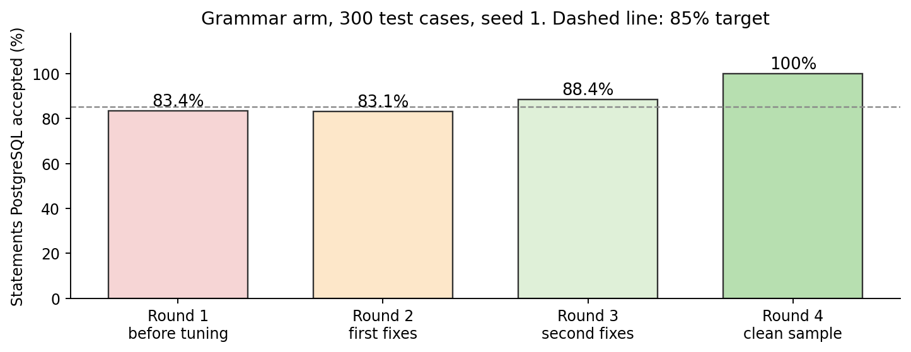
What the server accepted
Rounds 1 to 3 climbed from 83.4% to 88.4%. The misses were scopes, JSON values, partitions, and timeouts.
Round 4: 966 of 966 statements ran (100%), in 22.1 seconds. The error list is empty.
The differential oracle checked 230 queries (460 extra runs). Still no bug candidate.
100% accepted means every statement reached execution. It does not mean the server is bug-free.
Four rounds of 300 grammar test cases on the same server
Notes:
Walk the bars left to right. Round 1 is 83.4 percent, round 2 is 83.1 percent, round 3 is 88.4 percent, round 4 is 100 percent: 966 of 966, 22.1 seconds, no errors. Say out loud that zero bug candidates is still the honest count. Accepted SQL is not a bug. The 4 hour runs are what can still find one.

Slide 15
Who does what
Venu and Bhuvan – recent PostgreSQL code. Read commits since the last release (MERGE, SQL/JSON, generated columns, partitions, new planner rewrites) and aim the grammar at that code.
Bhuvan – also the first person on any bug candidate a run prints: reproduce it, shrink it, decide if it is real.
Gowtham – the rest of the grade: the comparison experiment, the statistics, the LLM arm, and the paper.
The servers keep running while that reading happens. A candidate does not wait for the paper, and the paper does not wait for a candidate.
Notes:
Say the three names. Venu and Bhuvan read new PostgreSQL features and point the grammar at them. Bhuvan also shrinks any candidate a run prints. Gowtham keeps the experiment, the statistics, the LLM arm and the paper. Then hand on to expected outcomes.

Slide 16
Expected outcomes
Either way: RQ1 (validity, coverage), RQ3 (time to detect re-injected bugs) and RQ4 (LLM ablation, token cost) are complete measured results.
Target on top of that: one new bug the developers acknowledge (list reply or fix). We file in week 2 so a reply can arrive before 13 Nov.
If none is confirmed: RQ2 reports zero, plus how many candidates we rejected. The motivating example is a re-injected bug with measured times. We do not call that full marks on the 50 % implementation component.
Artifacts: fuzzer, .pgg grammar, scripts and the run logs behind every number.

Slide 17
Draft paper structure (FSE style)
Graded parts in the template, and where they sit:
Introduction – motivating example (a real query, measured numbers)
Background
Design – workflow (one tree; three arms; validation gate)
Implementation
Evaluation – research questions RQ1 to RQ4
Bugs found – new bugs, or an honest zero plus oracle precision
Threats to validity – internal, external, construct
Related work – each paragraph ends with how we differ
Conclusion

Slide 18
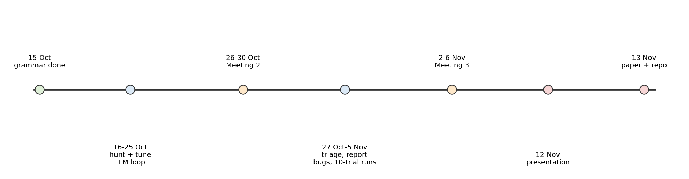
Timeline
From today to the paper deadline (13 Nov)

Slide 19
Risks and asks
Risk | Mitigation
No new bug in time | file in week 2; RQ1, RQ3, RQ4 and the five graded sections still stand
Upstream slow to respond | report early; a list confirmation is already evidence
False positives | determinism filter, re-runs, manual reasoning
LLM proposals invalid | validation gate; acceptance rate is itself a result
Asks: feedback on the RQs; is an upstream confirmation (before a fix commit) acceptable as evidence of a real bug?

Slide 20
Thank you
Questions?

