Slide 1
LLM-Guided Grammar-Aware Fuzzing of PostgreSQL
Progress meeting 2: what we executed, what we found
CS-5187 term project A3 · Venu · Bhuvan · Gowtham · 29 October 2026

Slide 2
RESULT 1
Upstream bug scorecard
Member | Bugs filed | Replied: confirmed a bug | Fixed upstream
Venu | 2 | 0 | 0
Gowtham | 3 | 3 | 2
Bhuvan | 4 | 1 | 0
Team total | 9 | 4 | 2
9
4
2
bugs filed on pgsql-bugs / pgsql-hackers
answered by committers or contributors
already fixed on PostgreSQL master
Bugs were found by our fuzzer, by oracle-guided audits of recent PostgreSQL code, and by reducing campaign findings.
CS-5187 A3 · LLM-guided grammar-aware fuzzing of PostgreSQL · progress meeting 2
2

Slide 3
BUG DETAILS
Venu: 2 filed
Bug | Upstream | What it is (short note) | Status
BUG-01 JSON_TABLE collations | #19768 | JSON_TABLE never assigns collations to its context item and PASSING args. Assertion in execExpr.c on master, silent wrong result on 18.6. Found by the grammar fuzzer; one-line patch + tests. | filed 16 Oct; no reply yet
BUG-02 range containment with NULL | #19793 | Planner support function folds range @> NULL-element to a constant, so a strict operator returns true/false instead of NULL. Silent wrong result in released 17 and 18. Found by our (SELECT e) rewrite oracle. | filed 23 Oct; patch sent; no reply yet
CS-5187 A3 · LLM-guided grammar-aware fuzzing of PostgreSQL · progress meeting 2
3

Slide 4
BUG DETAILS
Gowtham: 3 filed, 3 answered, 2 fixed
Bug | Upstream | What it is (short note) | Status
MERGE: SubPlan with no parent plan | #19802 | MERGE into a partitioned table with a non-pulled-up source and a scalar subquery in UPDATE SET fails with an internal error. Found by the grammar arm. | confirmed by a committer; fix posted
Parallel Append assertion | #19803 | Assertion failure in a parallel Append plan, found through a TLP check by the LLM-fragment arm. | confirmed; fixed on master (abda2a2c)
to_char NaN / NORMALIZE crash | #19771 | to_char on NaN leads to an assertion in NORMALIZE. Reduced by our tool to 27 tokens. | fix committed (776df8a6), authored by Gowtham
CS-5187 A3 · LLM-guided grammar-aware fuzzing of PostgreSQL · progress meeting 2
4

Slide 5
BUG DETAILS
Bhuvan: 4 filed, 1 answered
Bug | Upstream | What it is (short note) | Status
AUDIT-F1 NOT IN anti-join cast | pgsql-bugs | Wrong-result regression from commit 383eb21ebf: NOT IN is turned into an anti-join and ignores an implicit cast on the sub-select side. In 19rc1 and master, not in 18.6. Patch + test. | filed 23 Oct; awaiting reply
AUDIT-F2 IGNORE NULLS hang | pgsql-bugs | Frame scan of window functions with IGNORE NULLS can hang. | filed 23 Oct; Ishii replied 24 Oct
C-01 dependencies.c assertion | pgsql-bugs | Duplicate expression in extended statistics trips an assertion. Reproducer + patch. | filed 27 Oct; awaiting number
Extended stats non-finite MCV | pgsql-hackers | pg_restore_extended_stats accepts non-finite MCV frequencies. Patch submitted. | patch under review
CS-5187 A3 · LLM-guided grammar-aware fuzzing of PostgreSQL · progress meeting 2
5

Slide 6
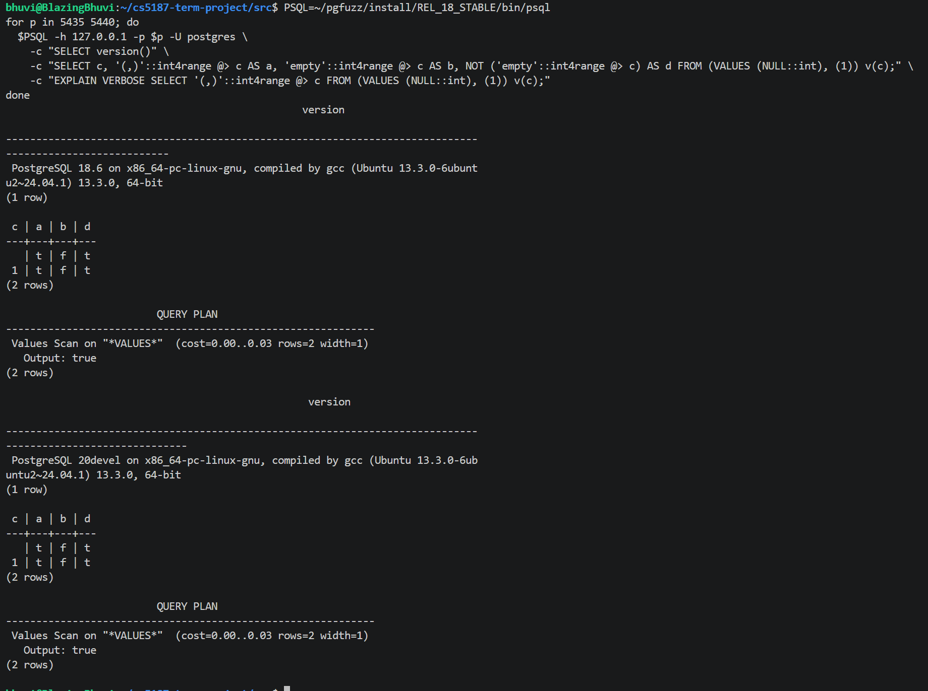
RESULT 1
Evidence: BUG-02 reproduced on 18.6 and master
What you see
NULL row: every column must be NULL
18.6 and master print t / f / t
EXPLAIN shows Output: true, the planner folded it
How we found it
Oracle rewrites e as (SELECT e) on the derivation tree
Found within the first 150 test cases the rewrite ran
Root cause: rangetypes.c support function; patch sent for 17, 18, master
CS-5187 A3 · LLM-guided grammar-aware fuzzing of PostgreSQL · progress meeting 2
6

Slide 7
EXECUTION
Everything planned at meeting 1 is built and run
Plan item | What we executed | Status
Typed grammar | 78 rules, 421 alternatives, 13 types; derivation trees with node spans | done
Metamorphic oracles | 12 kinds: TLP (WHERE, HAVING, aggregates), NoREC, expression/predicate rewrites, RLS leak, CERT | done
Plan + version oracles | 18 plan variants; master vs 18.6 cross-version | done
Triage | reproduce x3, tree + token reduction, localization, upstream report draft | done
LLM extension | commit miner, prompt, validation gate, repair rounds, rewrite gate | done
Benchmark (RQ3) | 23 reverted real fixes; fixed / solo / injected servers | done
Campaigns | 7 arms x 5 trials x 1 h on two machines (RQ1-RQ4) | done
Quality | 148 unit tests; about 10,500 lines of Python | done
CS-5187 A3 · LLM-guided grammar-aware fuzzing of PostgreSQL · progress meeting 2
7

Slide 8
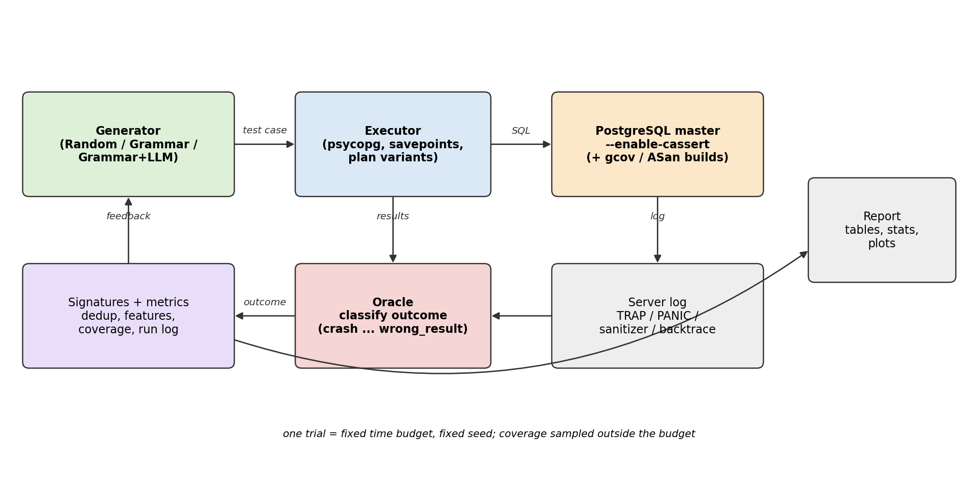
EXECUTION
How it works: one tree, four jobs
The derivation tree
Generation builds it
Mutation re-derives one subtree
Oracles rewrite one typed node
Triage reduces it
Why it matters
Because every node has a type and a position, an oracle can rewrite a single node at any query level, so queries stay valid SQL and the rewrites stay sound.
CS-5187 A3 · LLM-guided grammar-aware fuzzing of PostgreSQL · progress meeting 2
8

Slide 9
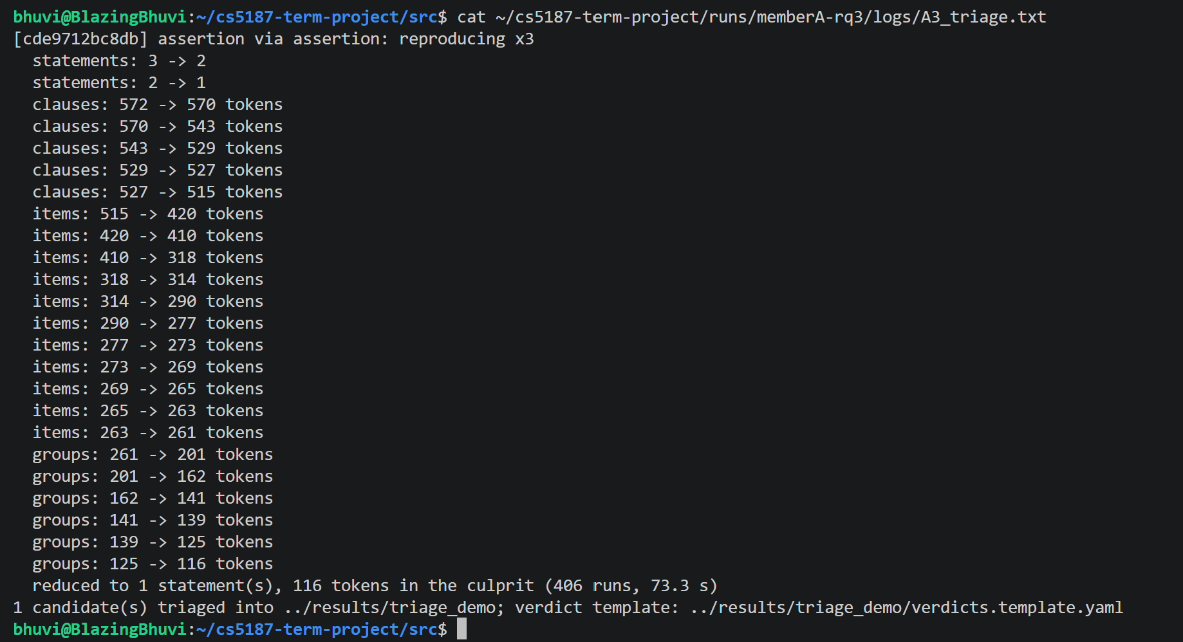
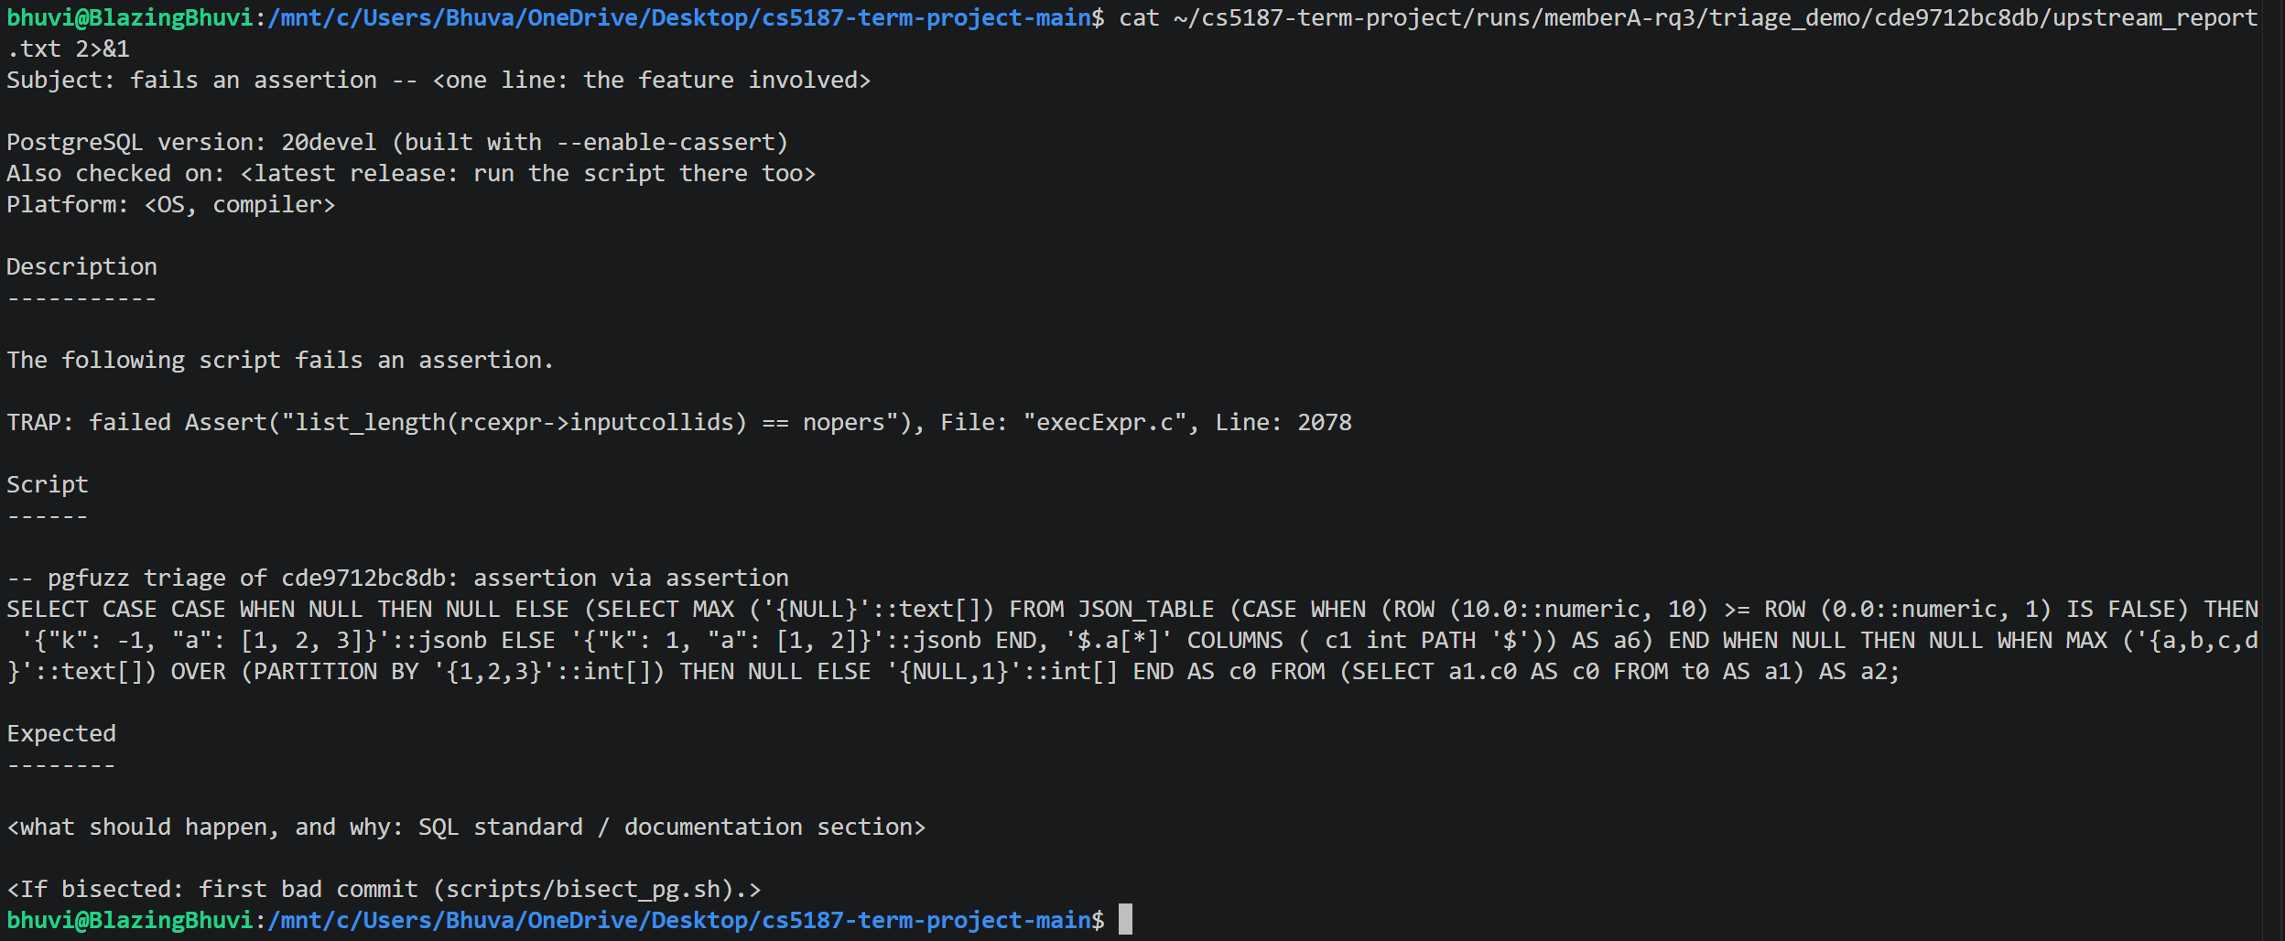
EXECUTION
Evidence: from failure to upstream report
generated upstream report draft
pgfuzz triage on a real candidate
590 → 79
x3
plan x rewrite
tokens after tree + token reduction of a BUG-01 case (tokens alone: 116)
every candidate is reproduced three times on a fresh connection
localization names the planner path or the always-applied rewrite
CS-5187 A3 · LLM-guided grammar-aware fuzzing of PostgreSQL · progress meeting 2
9

Slide 10
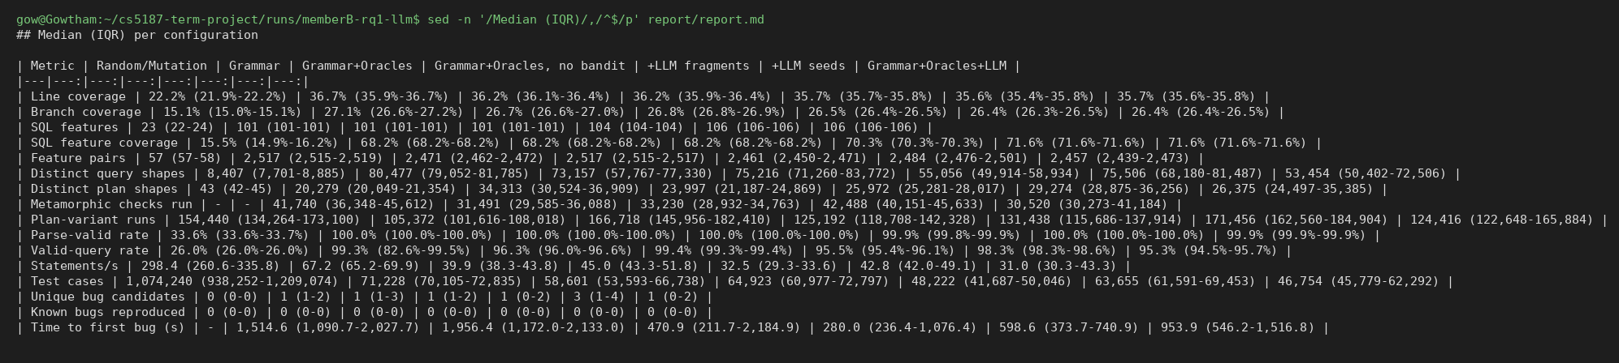
EXECUTION
The campaigns we ran
7 arms
5 x 1 h
2 laptops
26bd08fb
Random, Grammar, +Oracles, no-bandit, +LLM fragments, +LLM seeds, +LLM both
trials per arm, same seeds, 4 workers, assertions on
RQ1/RQ2/RQ4 on one, RQ3 on the other
one PostgreSQL master commit for everything
campaign summary produced by the report tool
Statistics: medians, Mann-Whitney U, Vargha-Delaney A12 (with 5 trials the smallest possible p is 0.008).
CS-5187 A3 · LLM-guided grammar-aware fuzzing of PostgreSQL · progress meeting 2
10

Slide 11
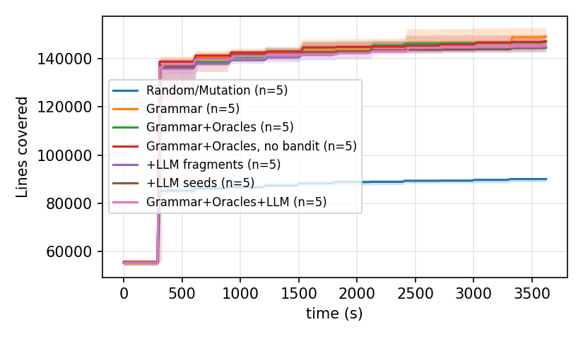
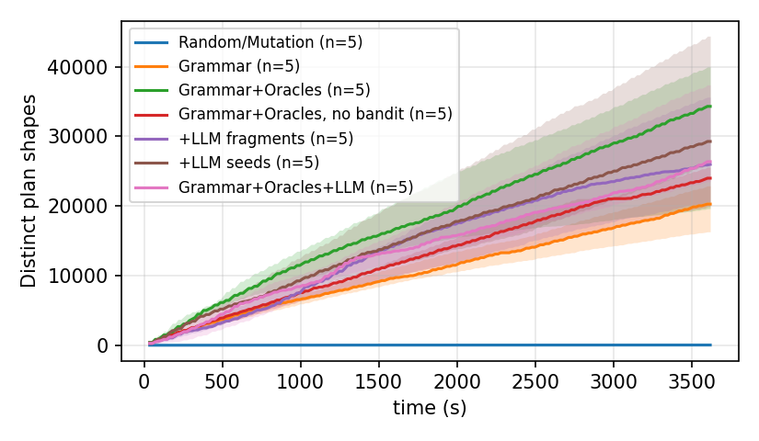
RESULTS
RQ1: the typed grammar reaches far more of PostgreSQL
Arm | Valid | Lines | Features | Plan shapes | Tests
Random / mutation | 26.0% | 22.2% | 23 | 43 | 1,074k
Grammar | 99.3% | 36.7% | 101 | 20,279 | 71k
Grammar + oracles | 96.3% | 36.2% | 101 | 34,313 | 59k
+ LLM (both) | 95.3% | 35.7% | 106 | 26,375 | 47k
Reading
Grammar vs random: A12 = 1.00, p = 0.008
Oracles double plan shapes
LLM adds features, not lines
Cost
Random runs 15x more tests and still reaches less.
backend line coverage over time
distinct plan shapes over time
CS-5187 A3 · LLM-guided grammar-aware fuzzing of PostgreSQL · progress meeting 2
11

Slide 12
RESULTS
RQ2: 93 candidates triaged, every one has a verdict
Verdict | Count
real bugs | 7
duplicates of real upstream bugs | 15
false positives | 37
flaky (did not reproduce x3) | 28
open, to verify | 6
10 false-positive classes, all fixed with tests
6 found during development (ARRAY(SELECT), TLP-HAVING, numeric scale, seed clock, PoC replay, intended corr change)
Equal intervals printed differently: 16 candidates
ORDER BY NULL in ordered aggregates: 2
Cross-version state divergence (IGNORE NULLS): 5
LLM rewrite that changed the collation: 1
Lesson: oracle precision, not generator power, is the bottleneck
0.16
0.37
precision, duplicates not counted
precision if duplicates count
CS-5187 A3 · LLM-guided grammar-aware fuzzing of PostgreSQL · progress meeting 2
12

Slide 13
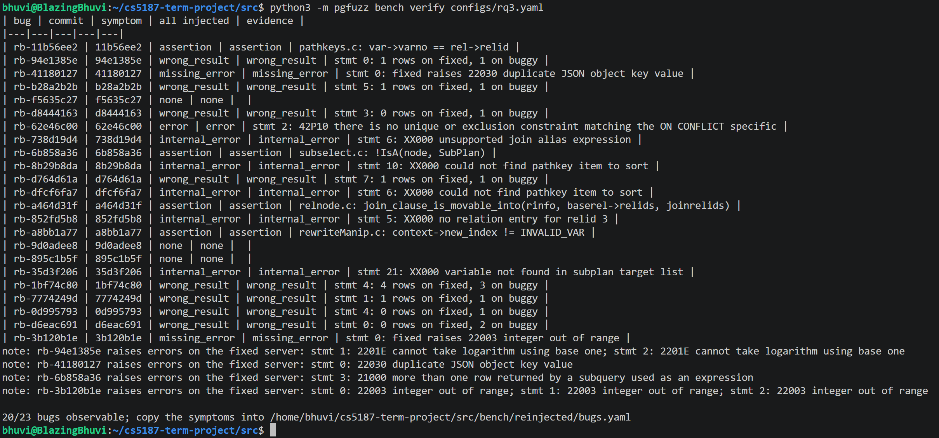
RESULTS
RQ3: 23 real PostgreSQL bugs put back, and what each arm found
Arm | Bugs found (of 20)
Random | 0
Grammar | 1
Grammar + oracles | 2
+ LLM | 2
Honest reading
bench verify: fixed / solo / injected servers
No arm found a wrong-result benchmark bug in 1 h
The oracle advantage is shown by RQ2 (real wrong results found), not by RQ3
The benchmark
Fixes of 31 Jul to 16 Oct 2026, each with a regression test
20 of 23 observable; only 9 visible to a crash-only fuzzer
CS-5187 A3 · LLM-guided grammar-aware fuzzing of PostgreSQL · progress meeting 2
13

Slide 14
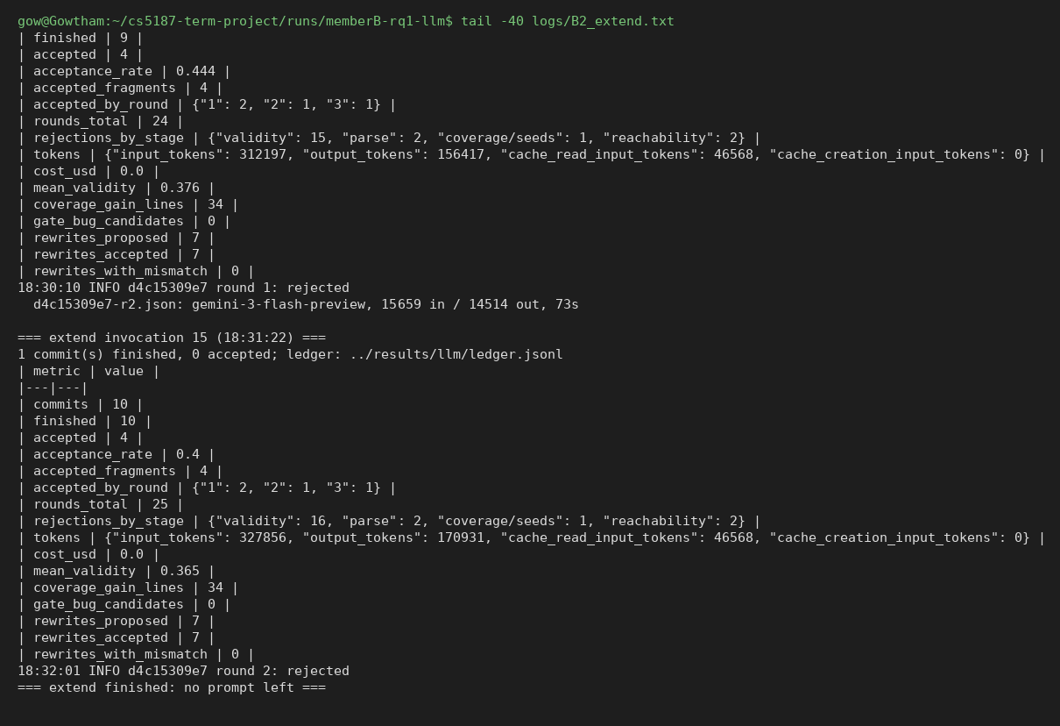
RESULTS
RQ4: the LLM extension
4 / 10
+5
commits accepted by the validation gate
SQL features (p = 0.004), no coverage gain
What happened
Gate rejected 16 of 25 rounds on server validity
Fragments-only arm found upstream bug #19803
One accepted rewrite changed the collation and caused a false positive; the gate now rejects explicit COLLATE
Model: Gemini Flash (free tier); 10 of 25 mined commits used because of the daily quota
commit-directed extension run
Every prompt and response is stored, so the run can be replayed without the model.
CS-5187 A3 · LLM-guided grammar-aware fuzzing of PostgreSQL · progress meeting 2
14

Slide 15
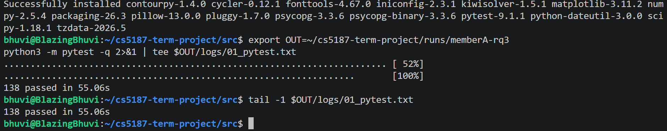
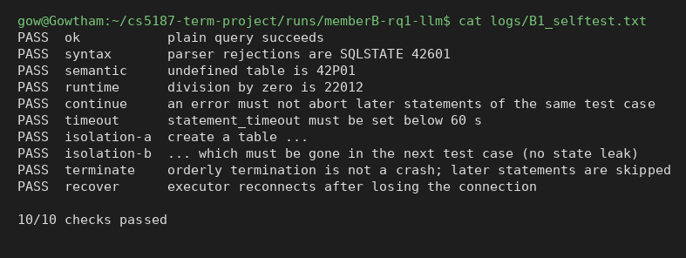
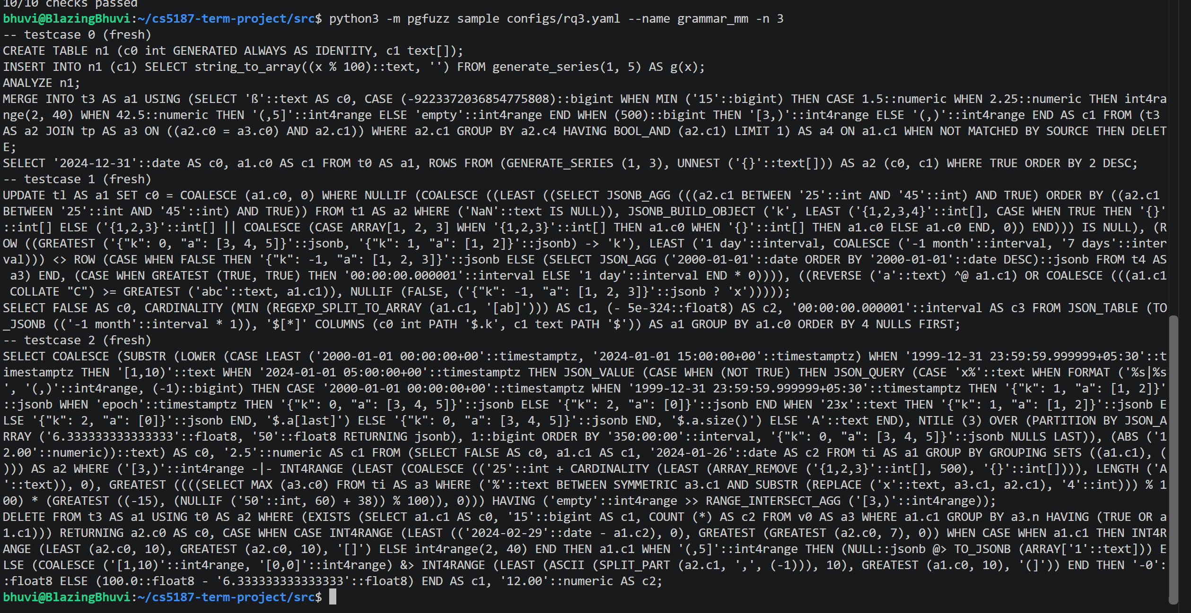
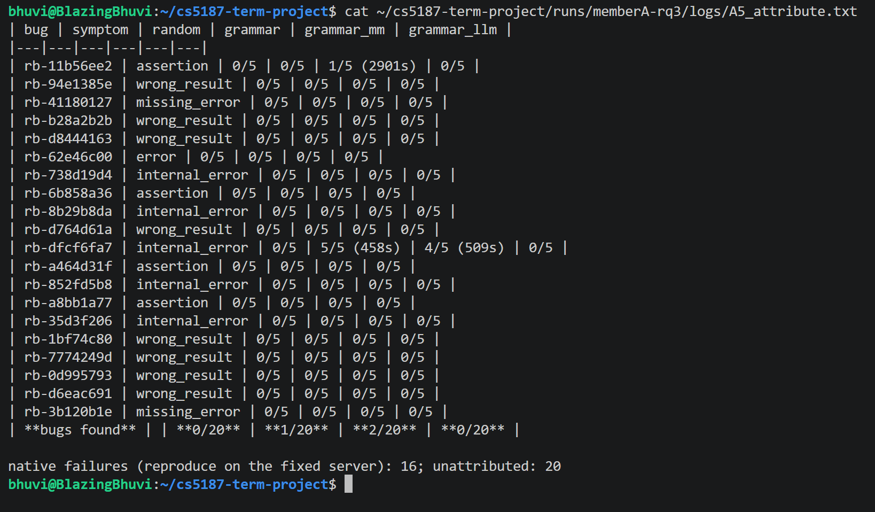
EXECUTION
Evidence wall: runs on the team's machines
unit tests pass
executor self-test
grammar sample: generated SQL, validity
RQ3 attribution by replay on solo servers
CS-5187 A3 · LLM-guided grammar-aware fuzzing of PostgreSQL · progress meeting 2
15

Slide 16
EXECUTION
What went wrong, and how we handled it
Incidents
Substitutions
One worker's server failed crash recovery after an assertion: 14 trials re-run with the same seeds
Laptop sleep during a campaign: trial clocks are monotonic, budget unchanged
LLM arm ran on Gemini Flash (free tier) via the tool's manual mode, no source change
Daily quota: 10 commits instead of 30
False positives
Reported honestly
Four new oracle false-positive classes appeared in the campaigns
Fixed afterwards and tested on stored reproducers; not re-measured
Raw precision 0.16 is logged as measured
RQ3 shows no oracle advantage; we say so
CS-5187 A3 · LLM-guided grammar-aware fuzzing of PostgreSQL · progress meeting 2
16

Slide 17
PLAN
Next steps to 13 November
When | What
30 Oct to 5 Nov | Verify the 6 open candidates (5 RLS, 1 corr); follow up upstream threads; re-run BUG-01/02 reproducers
2 to 6 Nov | Meeting 3: full result tables, paper draft
12 Nov | Presentation
13 Nov | Paper and repository due
Questions for you
Do committer-confirmed bugs (one fixed) meet the top band, even though the benchmark shows no oracle advantage?
CS-5187 A3 · LLM-guided grammar-aware fuzzing of PostgreSQL · progress meeting 2
17

Slide 18
Thank you. Questions?
github.com/v28k/cs5187-term-project

