Slide 1
LLM-Guided Grammar-Aware Fuzzing of PostgreSQL
CS-5187 Term Project A3 · Progress meeting 2
Venu · Bhuvan · Gowtham · 26–30 October 2026
Notes:
Introduce the team and the one-line idea: a typed grammar whose derivation trees drive generation, oracles and reduction, extended from recent commits by a gated LLM.

Slide 2
Status at a glance
4
36.7%
0.16
2 / 20
previously unknown PostgreSQL bugs; 2 confirmed by committers, 1 fixed
of backend lines (random mutation: 22.2%)
oracle precision, 93 candidates (0.37 counting duplicates)
re-injected bugs found by the best arm in 1 h
Done since meeting 1
Next
Every meeting-1 plan item implemented and tested on PostgreSQL master
12 metamorphic oracle kinds on derivation trees, 18 plan variants, cross-version
Campaigns finished: RQ1–RQ4, 5 trials × 1 h per arm, on two machines
LLM arm ran on Gemini Flash (no Claude key): 10 commits, +5 features, no coverage gain
Paper at 12 pages with real numbers; 148 unit tests
Verify the open candidates (5 RLS, 1 corr)
Final slides and artifact package
Upstream follow-up
Notes:
Lead with the four bugs and the honest results. Campaigns are done; remaining work is verification and packaging.

Slide 3
Recap: the problem and our three claims
Problem. PostgreSQL's planner changes every week. The worst bugs are silent wrong results. Crash fuzzers miss them, SQLancer-style oracles use small hand-written generators, and neither knows what changed in yesterday's commit.
1 One tree, four jobs
2 Soundness we measure
3 LLM proposes, server decides
A typed derivation tree generates, mutates, is rewritten by the oracles, and is reduced in triage.
Generator validity, and per-oracle precision before and after each false-positive class is fixed.
Fragments and rewrites enter the fuzzer only through a gate on the real server.
All four in code
Precision ledger
Validation gate
Ladder: Random/Mutation → Grammar → Grammar+Oracles → +LLM, with the same server, oracles, budget and seeds.
Notes:
Silent wrong results are the bugs that matter; crash fuzzers miss them. Our three claims from meeting 1 and where each stands.

Slide 4
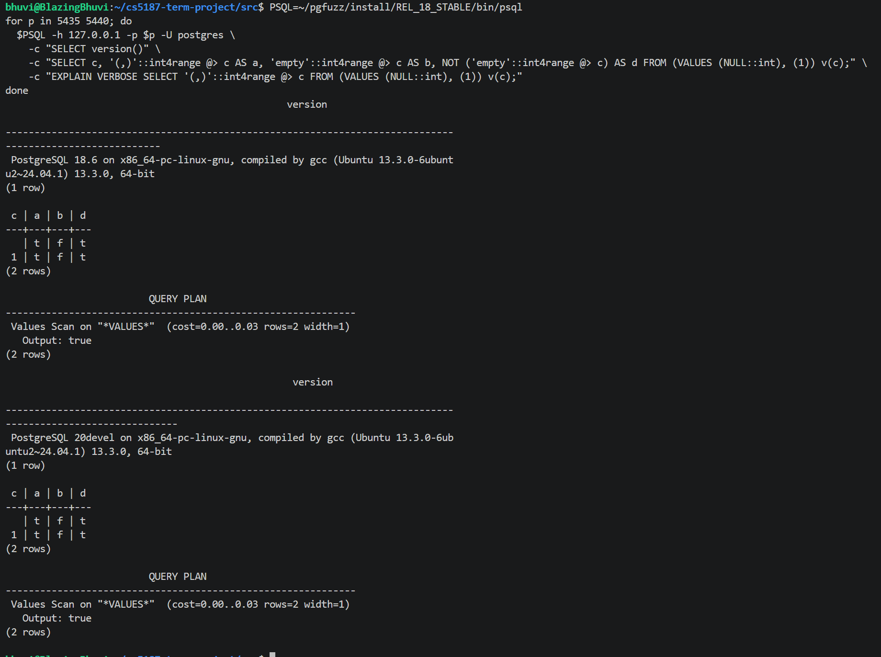
Motivating example: BUG-02, found by our oracle
SELECT c,
'(,)'::int4range @> c AS a, -- want NULL
'empty'::int4range @> c AS b, -- want NULL
NOT ('empty'::int4range @> c) AS d
FROM (VALUES (NULL::int), (1)) v(c);
-- 17, 18.6, master: NULL row -> t | f | t
Strict operator, but a planner support function folds it to true/false (rangetypes.c)
Silent wrong result in released PostgreSQL 17 and 18
Found because the oracle knew '(,)'::int4range is one typed expr<int4range> node, so e ≡ (SELECT e)
Notes:
Run the query live if possible. The NULL row should give NULL in every column; released 17 and 18 give t/f because a planner support function folds the call to a constant.

Slide 5
What changed since meeting 1
Plan item | What we built | Status
Metamorphic oracles | TLP (WHERE, HAVING, aggregates), NoREC, expression, predicate, NOT NULL, ORDER BY, CTE, fence | done
Cross-version | master vs 18.6, per-worker databases, intended-change list | done
Triage | reproduce ×3, tree + token reduction, localization, upstream draft, bisect | done
LLM loop | miner, cached prompt, gate, diff coverage, repair, ledger, rewrite gate | done
Benchmark (RQ3) | 23 reverted fixes; fixed / solo / injected servers; attribution | done
Stretch goals | plan-shape guidance, bandit weights, data profile, RLS and CERT oracles | done
Campaigns | RQ1–RQ4 configs ready; smoke runs pass | running next
Upstream | BUG-01 and BUG-02 patches with regression tests | filing this week
Notes:
Walk the table top to bottom; the last two rows are the work left.

Slide 6
The system

Slide 7
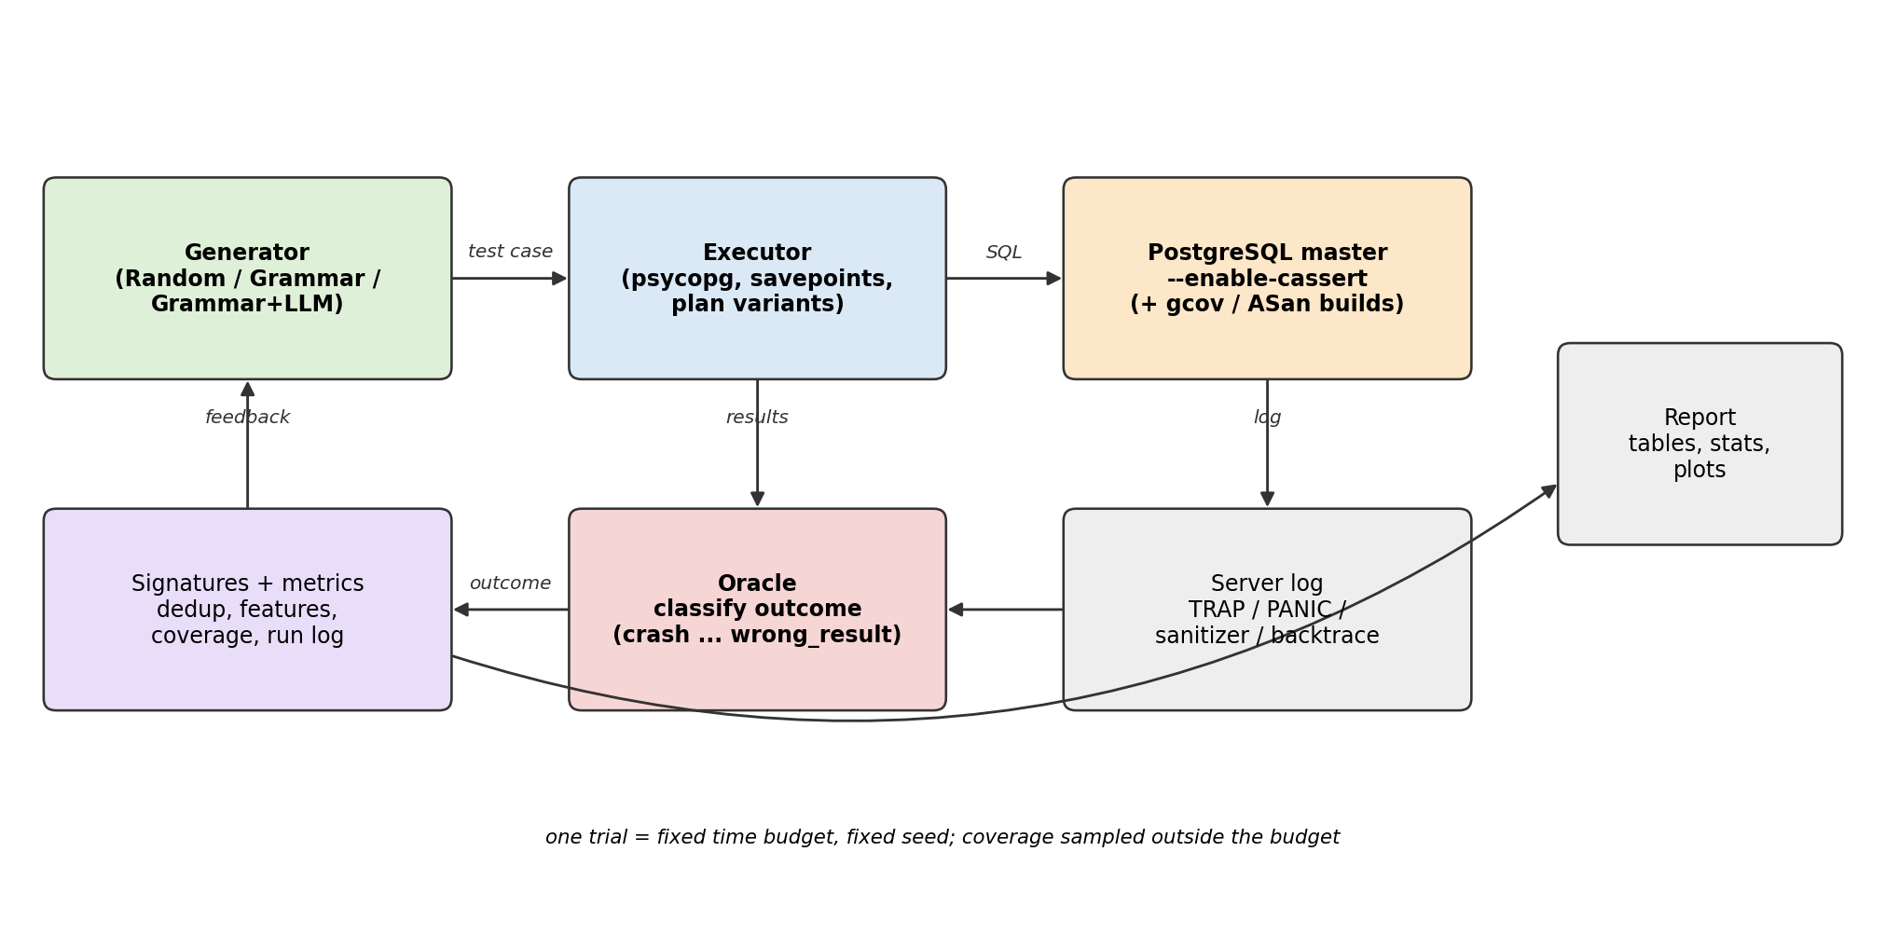
Architecture
Fuzzing loop: derive → attach checks → run several ways → classify / triage. LLM loop: commit → proposal → gate → grammar.
Notes:
Top loop: derive, attach checks, run several ways, classify and triage. Bottom loop: commit, proposal, gate, grammar.

Slide 8
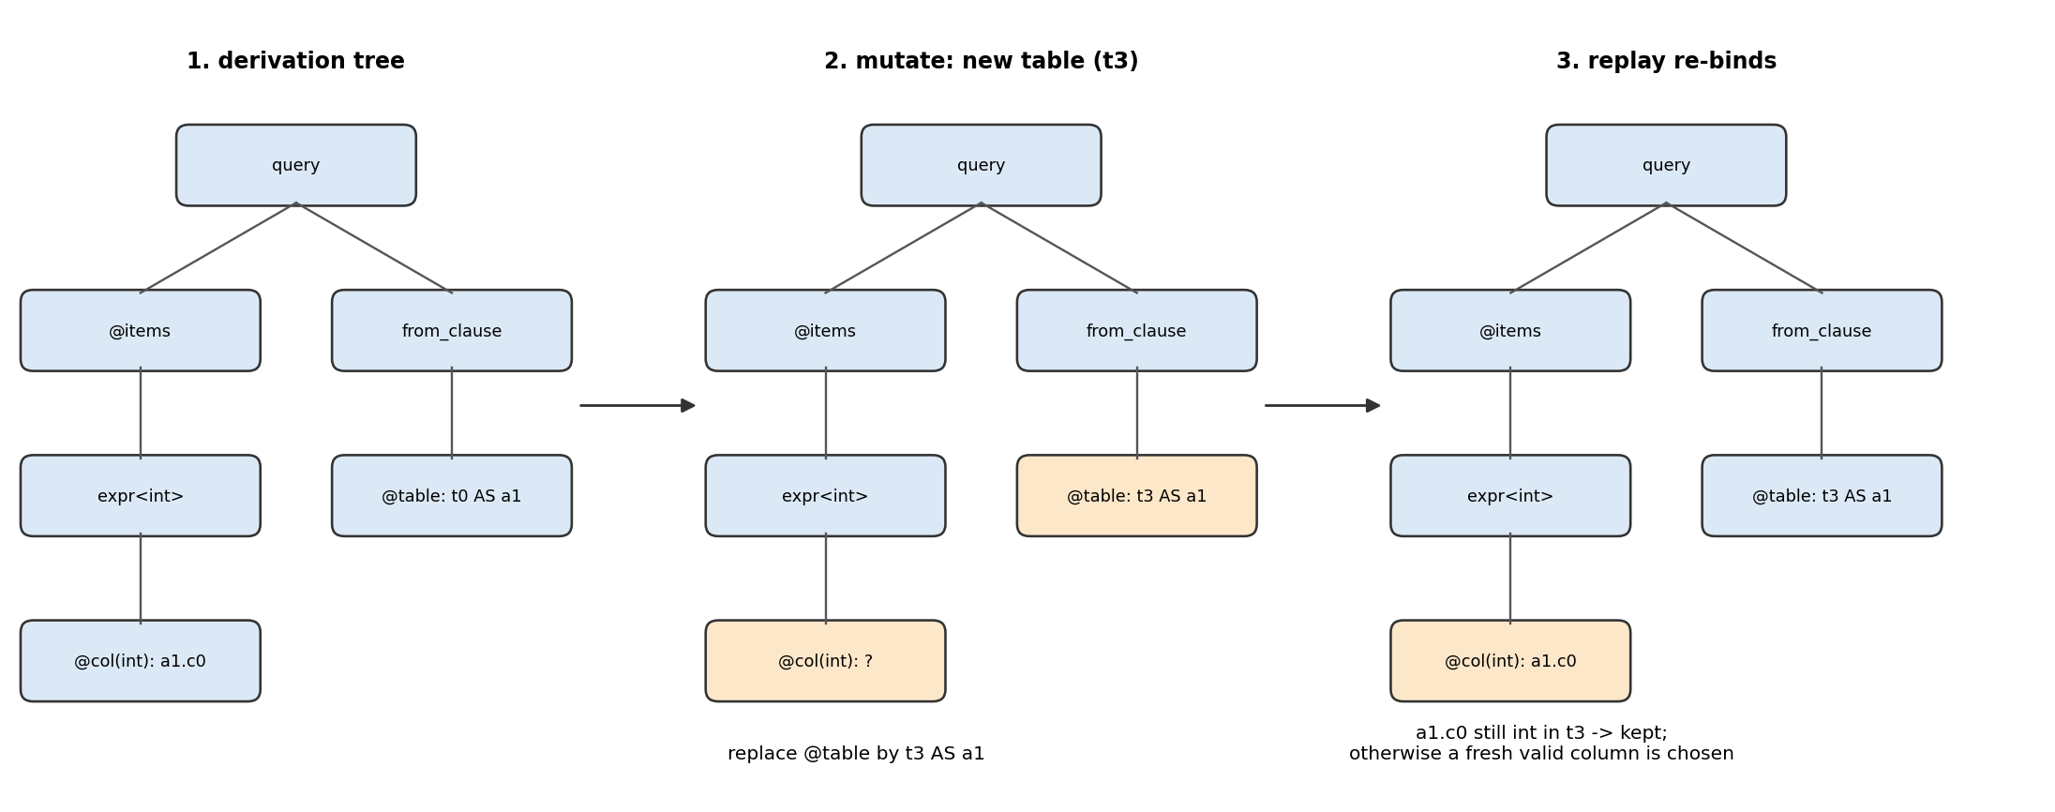
One tree, four jobs
Generate
Mutate
Oracle
Reduce
Typed grammar: 78 rules, 421 alternatives, scopes and type variables
Regenerate, splice, insert or drop subtrees; replay re-binds names and types
Rewrite one typed node or clause span into an equivalent query
Replace subtrees by their smallest derivation; replay keeps the SQL valid
Notes:
The derivation tree is the shared data structure. Replay is what keeps mutated and reduced trees valid.

Slide 9
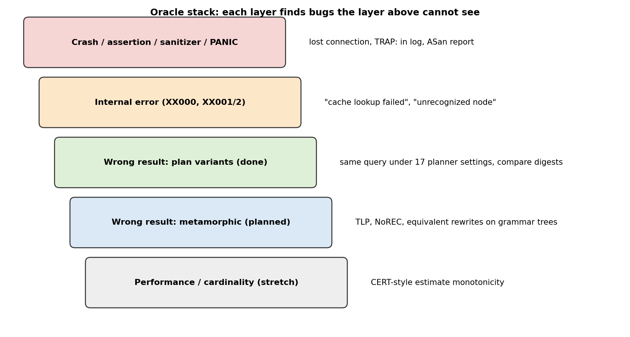
The oracle stack
Crash / assertion / internal error on every statement (cassert build, server log, PID check)
18 plan variants: join methods, hash agg, parallel, partition-wise, tiny work_mem, self-join elimination, eager agg, JIT, …
12 metamorphic kinds on the derivation tree
Cross-version: master vs 18.6
Determinism filter and canonical digests (numeric scale, −0, float classes), confirmation re-run
Notes:
Crash oracles see every statement; the wrong-result oracles see deterministic queries only.

Slide 10
Metamorphic rewrites on derivation trees
TLP-WHERE, generated and rewritten by the tool
Why the tree matters
SELECT t0_1.c0 FROM t0 AS t0_1
==
(SELECT .. WHERE (t0_1.c0 > 5))
UNION ALL (SELECT .. WHERE NOT (t0_1.c0 > 5))
UNION ALL (SELECT .. WHERE (t0_1.c0 > 5) IS NULL)
Knows which WHERE belongs to which SELECT
Knows each node's type, grouped levels, scopes, outer joins
So a rewrite is applied only where sound:
  multiset contexts only
  DISTINCT: unique-text types only
  NOT NULL: never under outer joins
  e+0 on int, not on float8
Also: TLP-HAVING, TLP-aggregates (MIN of MINs, SUM of COUNTs), NoREC, IN ↔ OR, a<b ↔ NOT(a>=b), BETWEEN, NOT NULL conjunct, drop ORDER BY, CTE (not) materialized, OFFSET 0 fence, typed expression identities.
Notes:
TLP partitions rows by p, NOT p, p IS NULL. The tree tells us exactly where each rewrite is sound.

Slide 11
Beyond wrong results: RLS leak oracle and CERT
RLS leak oracle (information flow)
CERT (Ba & Rigger, ICSE'24)
Policies on 5 tables; role pgfuzz_rls sees 131 of 203 rows of t0
Left: the query as the restricted role
Right: the query as superuser, each table replaced by (SELECT * FROM t WHERE policy)
More rows on the left = leak
532 checks, 0 false positives
Adding WHERE must not raise the planner's row estimate
Reported as performance, apart from wrong results; 58 checks, 0 violations
Cross-version
1,155 comparisons, 0 mismatches after fixing clock data and excluding intended changes (corr on master).
Notes:
RLS links to the information-flow lectures: the policy is a label, the check is non-interference on concrete data.

Slide 12
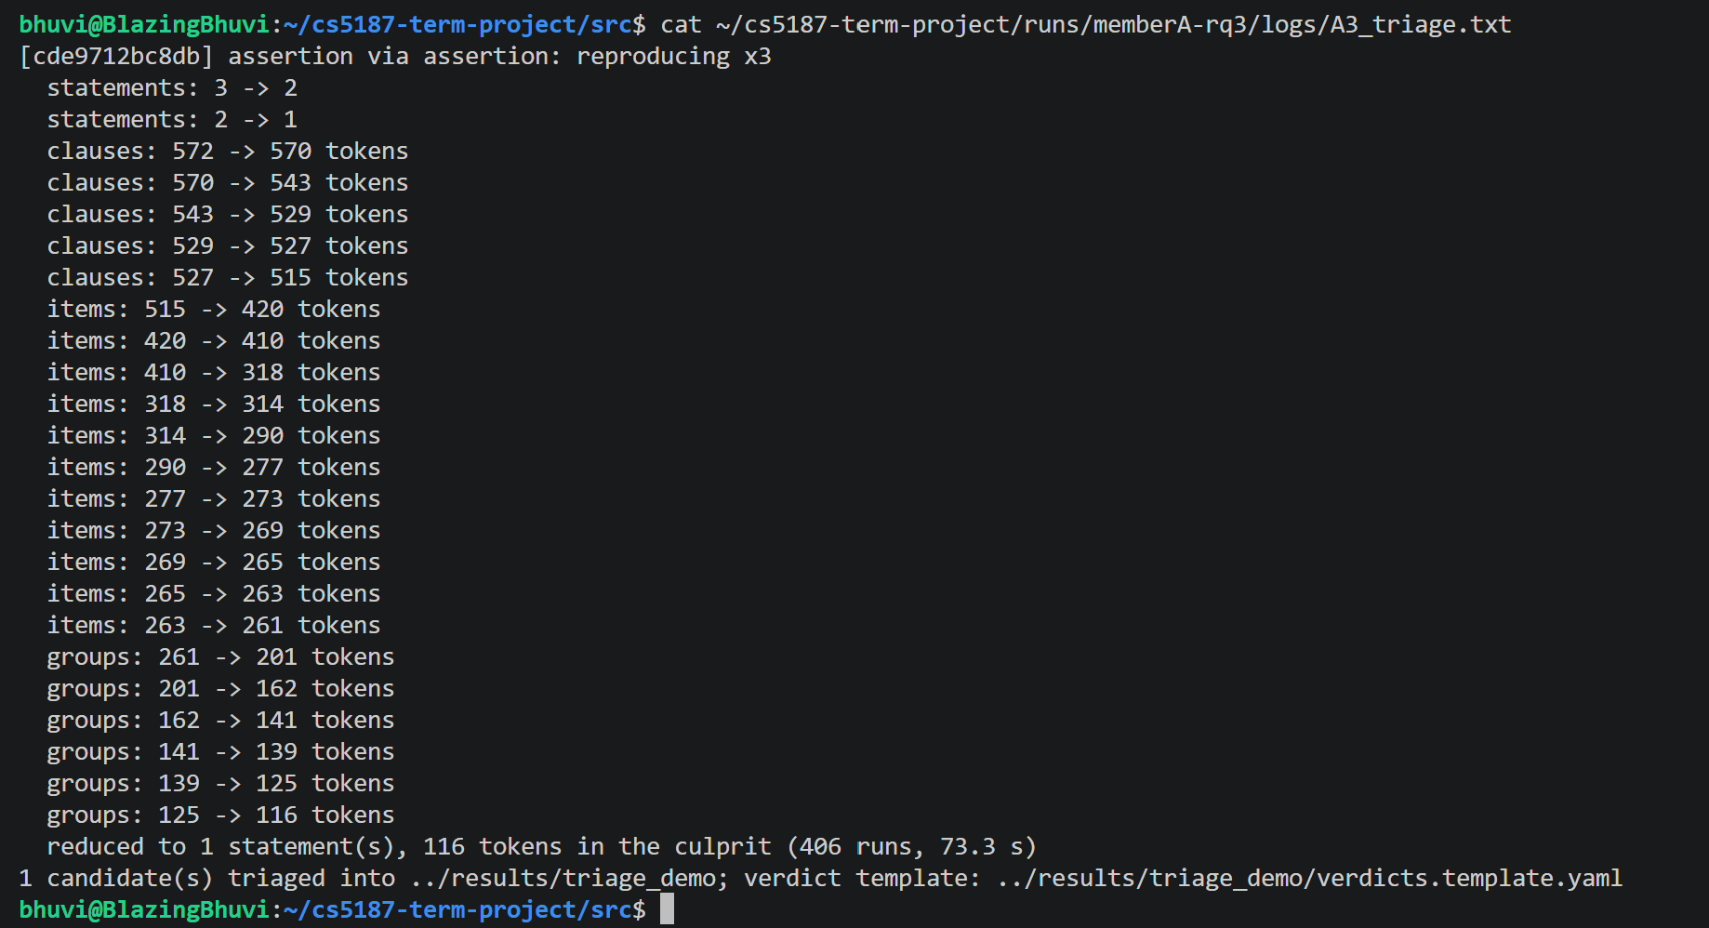
Triage: from a failure to an upstream report
Reproduce ×3
Tree reduction
Statement ddmin
Token HDD (pairs)
Localize (all variants)
Report + upstream draft
BUG-01 case (590 tokens) | Tokens | Server runs
Token reduction only | 116 | 406
Tree first, then tokens | 79 | 555
Localization: BUG-02 → "not toggled by planner settings" → a support function, which is the real cause.
Notes:
Tree reduction finds smaller valid derivations that token deletion cannot reach.

Slide 13
The LLM arm: the LLM proposes, the server decides
Mine master commits (planner, executor, parser), excluding the 23 benchmark fixes
Cached 9k-token prompt + commit digest → fragment, seeds, rewrites (JSON schema)
Gate: parses · derivable (≥5 uses) · ≥60% valid on the server · seeds run · diff coverage up
Repair rounds with the server's errors (max 3); ledger of tokens and cost
Rewrite gate: value probe + 150 live test cases
Proposed rewrite | Result
CASE WHEN e IS NULL THEN NULL ELSE e END | accepted, 90/90
substr(e, 1) | accepted, 88/88
e + 1 | rejected: 12 mismatches
e IS TRUE | rejected: probe at NULL
e IS TRUE passed 109 sampled checks: sampling is not proof.
API or manual mode; stored responses replay for free.
Notes:
e IS TRUE passed 109 sampled checks but is false, not NULL, at NULL: the value probe exists because sampling is not proof.

Slide 14
Evaluation

Slide 15
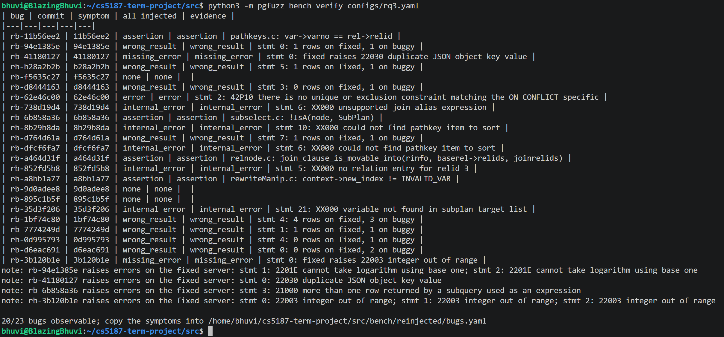
RQ3 benchmark: 23 real bugs put back into PostgreSQL
Fixes from 31 Jul–16 Oct 2026 with regression tests, reverted on base 26bd08fb
Servers: fixed, solo (one bug each), injected (all 23)
bench verify: symptom = the fixed vs solo difference
bench attribute: replay each finding on every solo server
Symptom | Bugs
wrong result | 8
internal error | 5
assertion | 4
missing / wrong error | 3
not observable (excluded) | 3
20 / 23 observable
only 9 of them visible to a crash-only fuzzer
Notes:
Ground truth: real bugs fixed by PostgreSQL developers, reverted on our base commit. 11 of the 20 observable ones need a wrong-result or error oracle.

Slide 16
Component checks on master (single runs)
Component | Measured
Metamorphic oracles (first run) | 907 checks, 0 false positives; BUG-02 in the first 150 test cases
New rewrite kinds | 798 checks, 0 false positives
Full system, 3 min | 3,166 test cases, 99.5% valid, 1,991 checks, 7,956 variant runs, 0 FP
Bandit weights | 533 vs 419 plan shapes per 1,000 test cases, same validity
Data profile (@dlit) | selective predicates (5–95% of rows): 29.3% → 58.6%
Tree replay | 599 / 600 stored trees replay to identical SQL
Token reduction (BUG-02) | 4 statements / 107 tokens → 1 / 36 in 307 runs
LLM fragment gate | valid fragment 251/251 accepted; invalid one rejected with the server's message
Notes:
Each component was measured once on master; the paper has the same table.

Slide 17
Precision ledger (RQ2): 93 triaged candidates
Oracle | Cand. | Real | Dup. | FP | Flaky | Open
assertion | 15 | 3 | 10 | 1 | 1 | 0
cross-version | 25 | 0 | 0 | 7 | 18 | 0
internal error | 4 | 2 | 1 | 0 | 1 | 0
mm: expr | 3 | 1 | 1 | 1 | 0 | 0
mm: rls | 5 | 0 | 0 | 0 | 0 | 5
mm: tlp_having | 4 | 0 | 0 | 4 | 0 | 0
mm: tlp_where | 4 | 1 | 1 | 2 | 0 | 0
plan-variant | 32 | 0 | 2 | 21 | 8 | 1
all (+1 crash) | 93 | 7 | 15 | 37 | 28 | 6
10 false-positive classes, all fixed + tested
6 before the campaigns (ARRAY(SELECT), TLP-HAVING, numeric scale, seed clock, PoC PID, intended corr change)
Equal intervals with different text: 16
ORDER BY NULL in ordered aggregates: 2
Cross-version state divergence (IGNORE NULLS): 5
LLM rewrite that changes the collation: 1
Lesson: oracle precision, not generator power, is the bottleneck.
Notes:
Precision 7/44 = 0.16 without duplicates, 22/59 = 0.37 with. Four new classes were fixed after the campaigns and not re-measured.

Slide 18
Bugs found
Bug | Found by | Upstream | Status
BUG-01 JSON_TABLE collations | grammar (10 signatures) | #19768 | filed
BUG-02 range containment NULL | (SELECT e) rewrite | #19793 | filed, patch
MERGE: SubPlan with no parent plan | grammar | #19802 | confirmed, patch posted
Parallel Append assertion | LLM fragments + TLP | #19803 | confirmed, fixed on master
Rediscovered after others reported them: #19800 (self-join elimination wrong result, plan-variant oracle, present in 18.6), #19772, #19784, #19771 (fixed upstream).
Also filed or reported: C-01 dependencies.c assertion, AUDIT-F1 NOT IN anti-join cast, AUDIT-F2 IGNORE NULLS hang, #19766 shm_toc assertion.
Notes:
Two confirmed by committers, one fixed on master. Four more were found days after others had reported them: the oracles do work.

Slide 19
Experiment design (RQ1–RQ4)
RQ1 reach
RQ2 bugs
RQ3 ground truth
RQ4 LLM
validity, line/branch coverage, features, plan shapes
bugs found and per-oracle precision
re-injected bugs found, time to find
what fragments add (diff coverage, ablation) and what they cost
RQ1: 7 arms (incl. no-bandit and LLM ablations) × 5 trials × 1 h on a gcov build (machine B)
RQ3: 4 arms × 5 trials × 1 h, injected server + 18.6 reference (machine A)
Paired seeds, same oracles and budget; one commit (26bd08fb) for everything
Statistics: medians, IQR, bootstrap 95% CI, Mann–Whitney U, Vargha–Delaney Â12
Notes:
Arms differ only in the generator; everything else is shared and paired by seed.

Slide 20
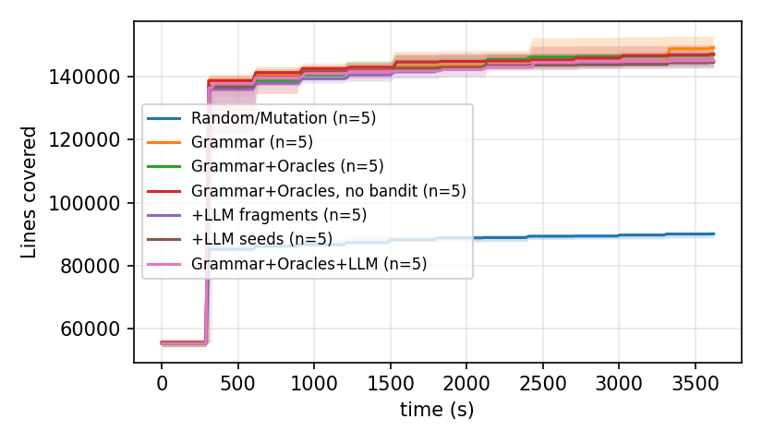
RQ1: reach (median of 5 one-hour trials)
Arm | Valid | Lines | Branches | Features | Plan shapes | Tests
Random | 26.0% | 22.2% | 15.1% | 23 | 43 | 1,074k
Grammar | 99.3% | 36.7% | 27.1% | 101 | 20,279 | 71k
Grammar+Oracles | 96.3% | 36.2% | 26.7% | 101 | 34,313 | 59k
no bandit | 99.4% | 36.2% | 26.8% | 101 | 23,997 | 65k
+LLM fragments | 95.5% | 35.7% | 26.5% | 104 | 25,972 | 48k
+LLM seeds | 98.3% | 35.6% | 26.4% | 106 | 29,274 | 64k
+LLM both | 95.3% | 35.7% | 26.4% | 106 | 26,375 | 47k
Grammar vs random: Â12 = 1.00, p = 0.008, though random runs 15× more tests
Oracles: no line gain (p = 0.42); plan shapes 20k → 34k (Â12 = 0.84, p = 0.095)
Oracles cost throughput: 67 → 40 statements/s
Notes:
Grammar vs random is large on every metric. The oracles do not add coverage but double the plan shapes. The LLM adds features, not coverage.

Slide 21
RQ3 and RQ4
RQ3: bugs found of 20, 5 trials × 1 h
RQ4: LLM (Gemini Flash, free tier)
 | Random | Gram. | +Orac. | +LLM
dfcf6fa7 (internal error) | 0/5 | 5/5 | 4/5 | 5/5
11b56ee2 (assertion) | 0/5 | 0/5 | 1/5 | 1/5
wrong result (8 bugs) | 0 | 0 | 0 | 0
bugs found | 0 | 1 | 2 | 2
10 commits, 4 accepted (40%), 25 rounds; 16 rejected on server validity
+5 SQL features (p = 0.004), no coverage gain
328k in / 171k out tokens, 0 USD
7 of 7 rewrites passed the gate; one changed the collation → false positive; gate now rejects COLLATE
Fragments-only arm found #19803
No wrong-result bug found by any arm
1 h × 5 trials is short for bugs needing feature combinations
Notes:
RQ3 does not show an oracle advantage; that claim rests on RQ2. RQ4: the LLM adds features but no coverage, and one accepted rewrite was not an identity.

Slide 22
Plan

Slide 23
Timeline to the deadline
24–26 Oct
26–28 Oct
29 Oct
30 Oct–5 Nov
2–6 Nov
12 / 13 Nov
builds,
LLM extension
RQ1–RQ4
campaigns done
triage all,
paper numbers
verify open cases,
final slides
meeting 3
presentation /
paper + repo
Open: 5 RLS candidates and one corr() case to verify; authorship of fix 776df8a6
Results and deviations: docs/RESULTS_ANALYSIS.md
Notes:
Machine time is mostly overnight; our time is short. Filing upstream happens right after triage.

Slide 24
Risks, and what we would like feedback on
Risks and fallbacks
Questions for you
Happened: 4 new false-positive classes, fixed after the runs and not re-measured
Happened: no Claude key, LLM arm on Gemini Flash, 10 commits (quota)
5 trials rarely reach p < 0.05 → we report effect sizes
Upstream replies after 13 Nov → report status as of the deadline
Do two committer-confirmed bugs (one fixed) meet the top band although the benchmark shows no oracle advantage?
Is it acceptable that precision after the fixes is argued from reproducers, not a new campaign?
Notes:
End with the questions for the professor.

Slide 25
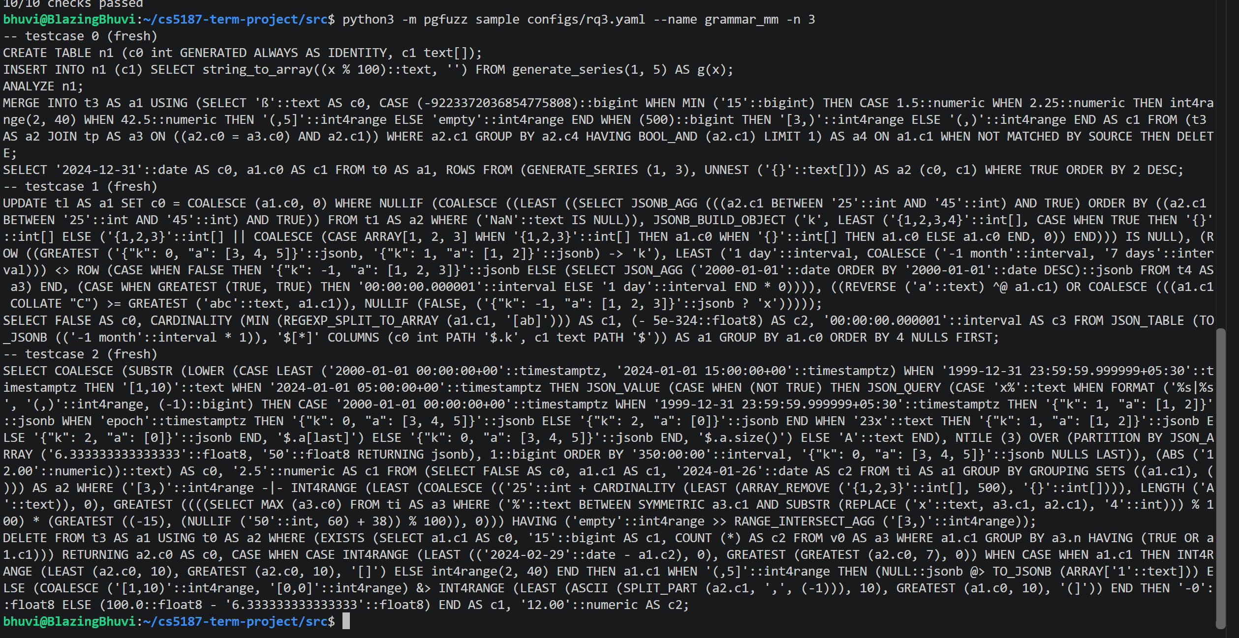
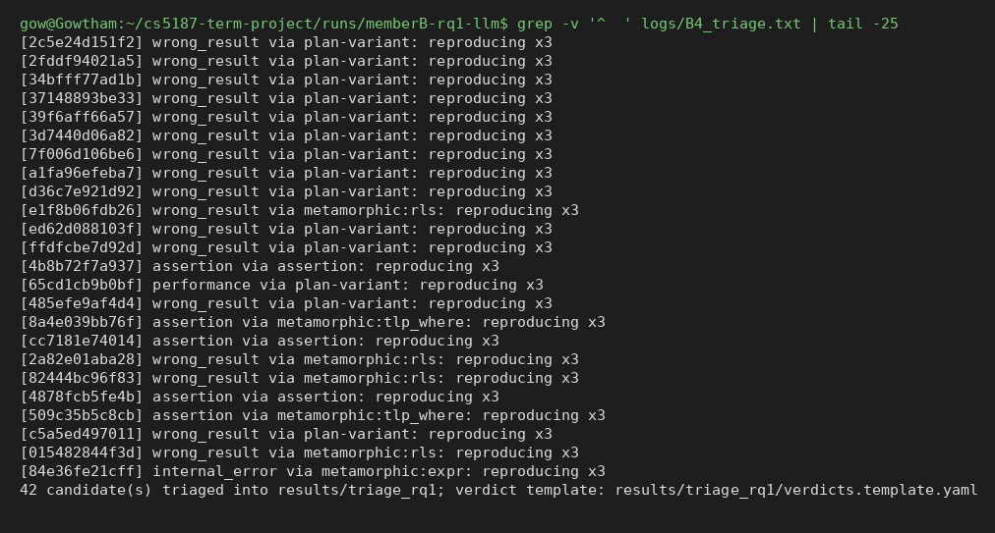
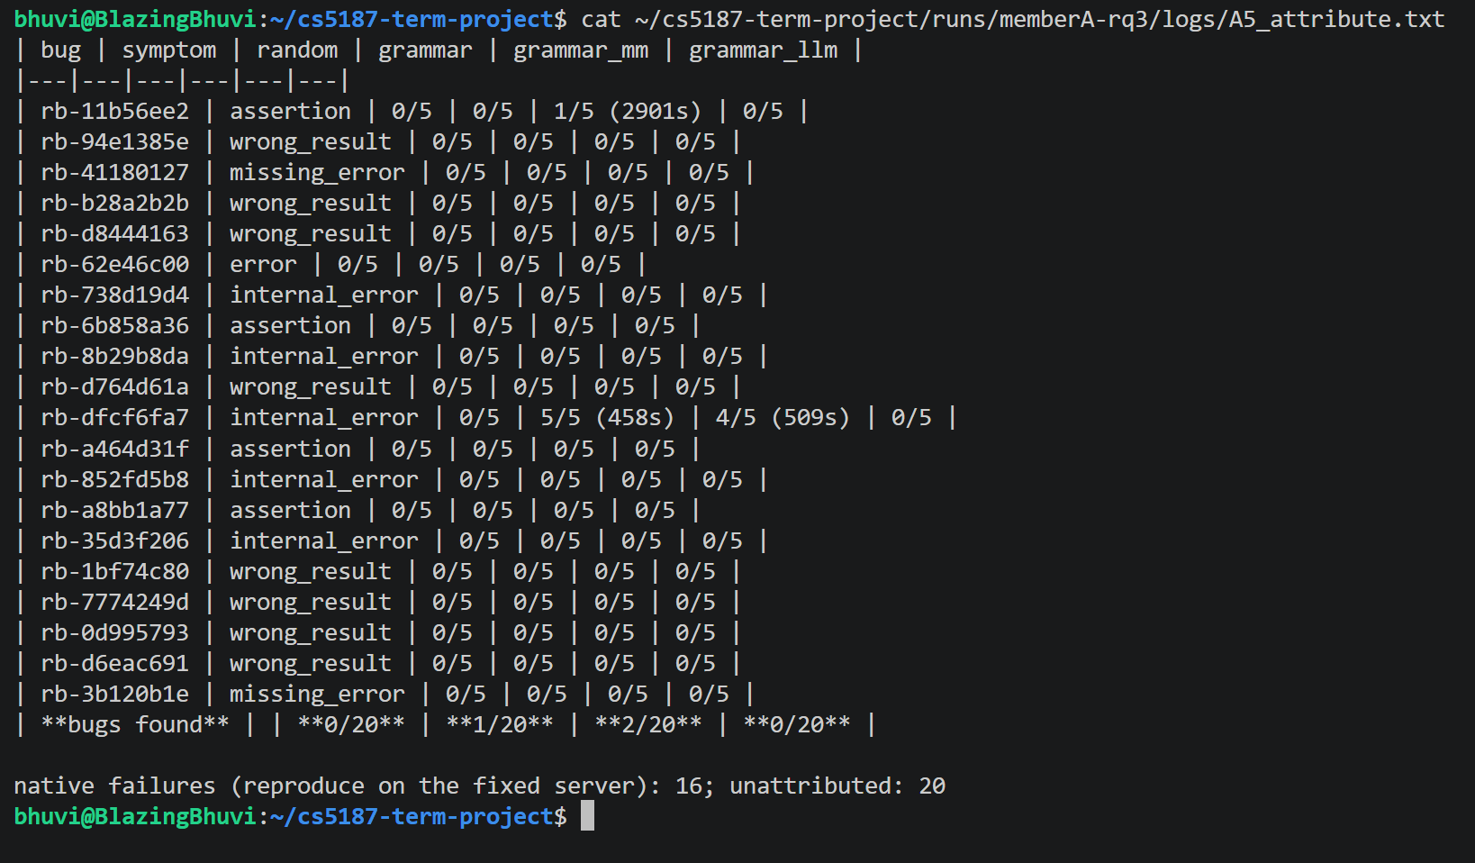
Live demo (backup screenshots)
Notes:
If the live demo fails, show these screenshots instead.

Slide 26
Thank you, questions?
github.com/v28k/cs5187-term-project

