Slide 1
LLM-Guided Grammar-Aware Fuzzing of PostgreSQL
Finding the bugs that do not crash
CS-5187 term project A3 · final presentation · 12 November 2026

Slide 2
The problem: silent wrong results
No crash, no error, no log line: the answer is just wrong.
SELECT c, '(,)'::int4range @> c AS contains
FROM (VALUES (NULL::int), (1)) v(c);
c | contains
NULL | t <- wrong: must be NULL
1 | t
Why it matters
Users cannot notice it
Present in released 17 and 18
Only an oracle that knows the right answer sees it
20 of 23
9 of 20
recent PostgreSQL fixes change a query's result
visible to a crash-only fuzzer

Slide 3
Our idea
Keep every query as a typed tree, and let the server judge every LLM proposal.
Approach | Strength | Gap
Random / mutation | fast | mostly invalid SQL
SQLsmith (grammar) | deep, typed | crashes only
SQLancer (TLP, NoREC) | wrong results | small generator
Fuzz4All (LLM) | new features | LLM on the hot path
Three claims
One tree, four jobs: generate, mutate, rewrite, reduce
Soundness we measure: validity and oracle precision
The LLM proposes, the server decides

Slide 4
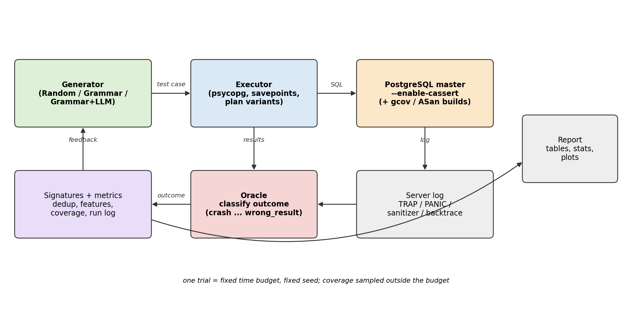
How it works
A fuzzing loop that runs thousands of test cases per minute, and an LLM loop that runs before a campaign.
Pipeline
Generate from a typed grammar
Attach oracle checks to the tree
Run on the server, many ways
Triage: reproduce, reduce, localize
LLM extends the grammar

Slide 5
One tree, four jobs
SQL is generated as a derivation tree whose nodes know their type and scope.
The tree does four jobs
78
13
Generate: derive a typed tree
Mutate: re-derive one subtree
Rewrite: an oracle changes one typed node
Reduce: replace subtrees by their smallest derivation
grammar rules, 421 alternatives
SQL types
99%
590 → 79
of generated statements run
tokens after tree reduction

Slide 6
Oracles that know the right answer
Two queries that must agree, or one query under settings that must not change it.
Example: TLP
Oracle | Detects
Metamorphic rewrites (TLP, NoREC, expression) | wrong results
18 plan variants | plan-dependent results
Cross-version (master vs 18.6) | regressions
Row-level security check | policy leaks
CERT row estimates | estimate anomalies
Crash, assertion, error, hang | everything else
Q = SELECT ... WHERE p
Q must equal Q(p) + Q(NOT p) + Q(p IS NULL)
A difference means a bug

Slide 7
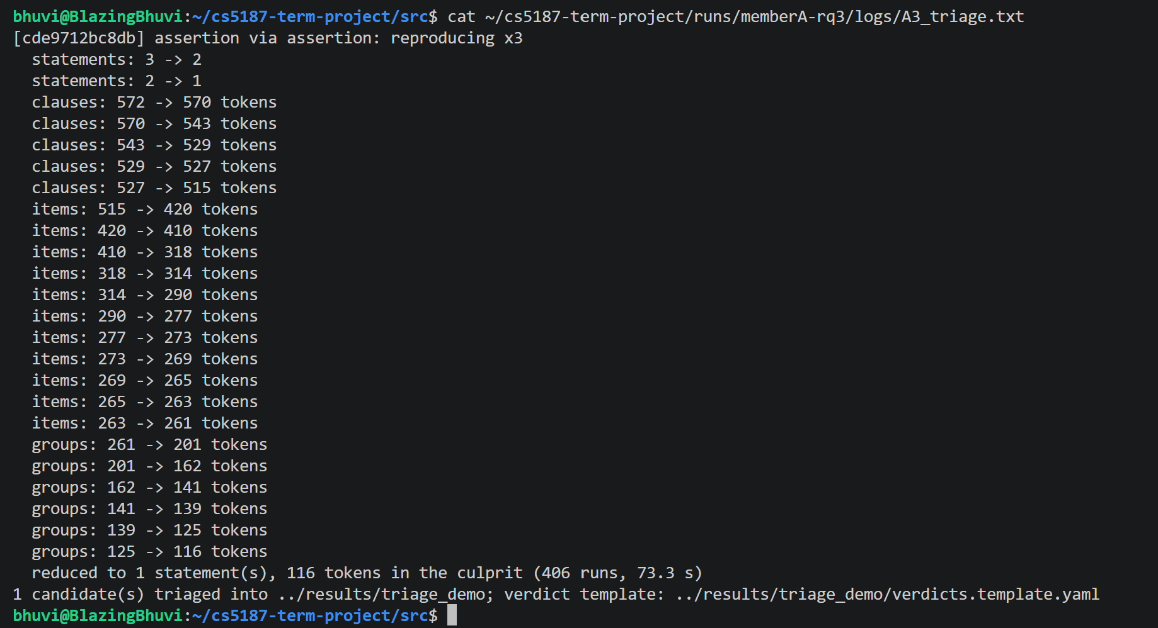
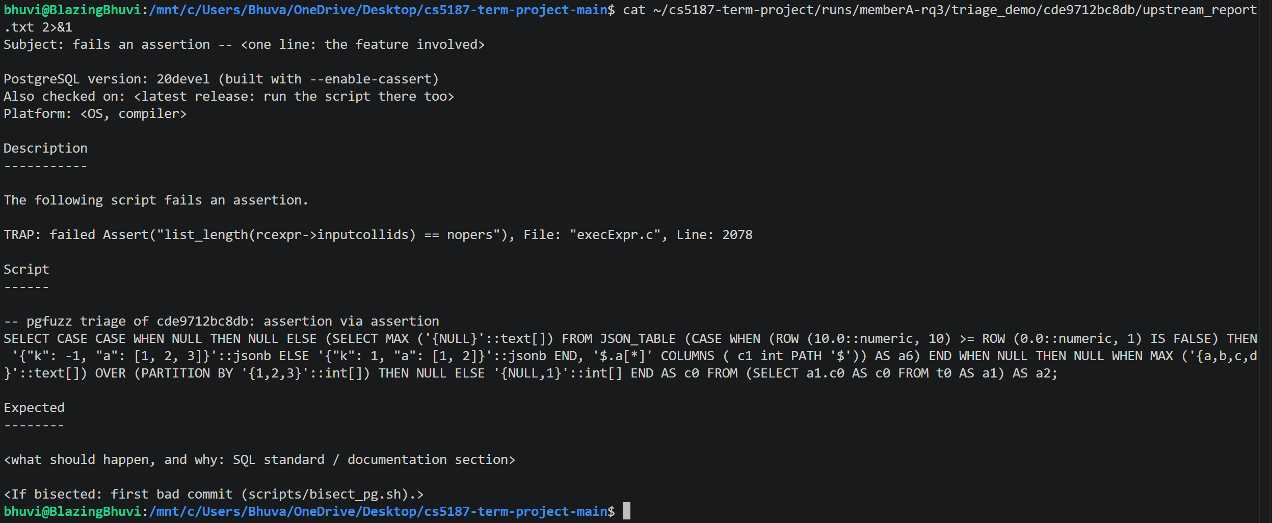
Triage: from failure to upstream report
Every candidate is reproduced three times, reduced, and localized.
x3
590 → 79
localized
reproduced on a fresh connection
tokens, tree then token reduction
planner path or always-applied rewrite

Slide 8
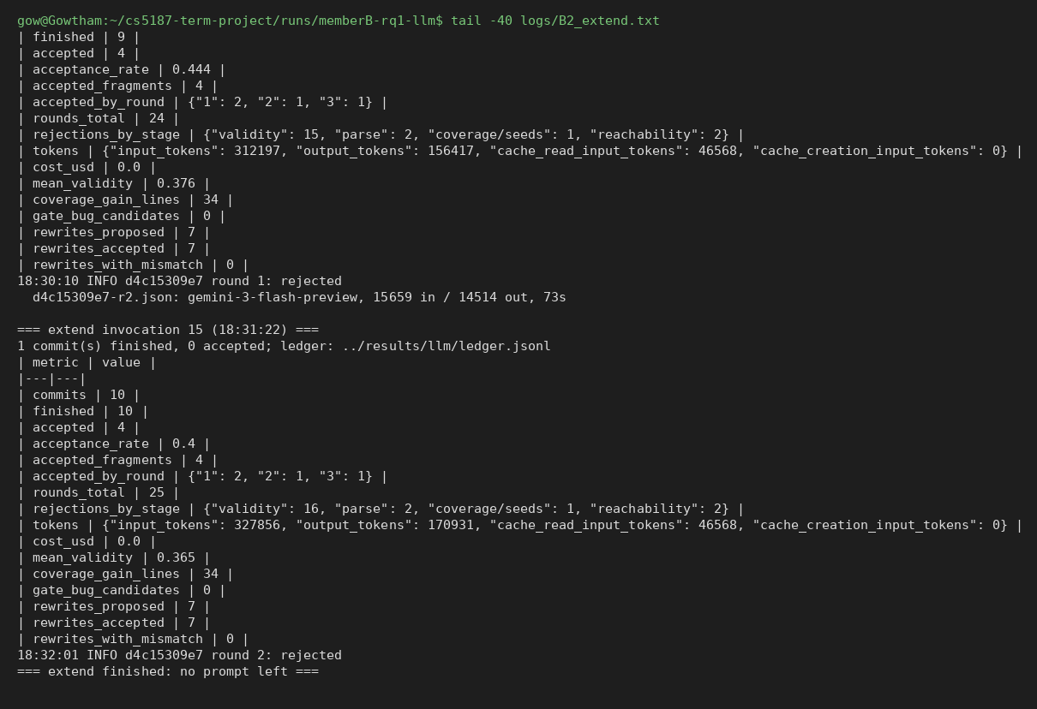
The LLM extension and its gate
The LLM reads a recent commit; a proposal counts only if the server agrees.
Gate checks
Outcome
Parses
Used at least 5 times
60% of statements run
Seeds run
More changed lines covered
10 commits, 4 accepted
+5 SQL features
Found BUG #19803
One rewrite slipped through: now rejected

Slide 9
Evaluation
Four questions, seven configurations, 5 trials of one hour each.
Question | Measure
RQ1 Reach | validity, coverage, SQL features, plan shapes
RQ2 Bugs | bugs found and oracle precision
RQ3 Ground truth | 23 re-injected real bugs found
RQ4 LLM | what the extension adds and costs
Setup
Master 26bd08fb, assertions on
7 arms x 5 trials x 1 h
Two laptops, one per experiment
Same seeds for all arms

Slide 10
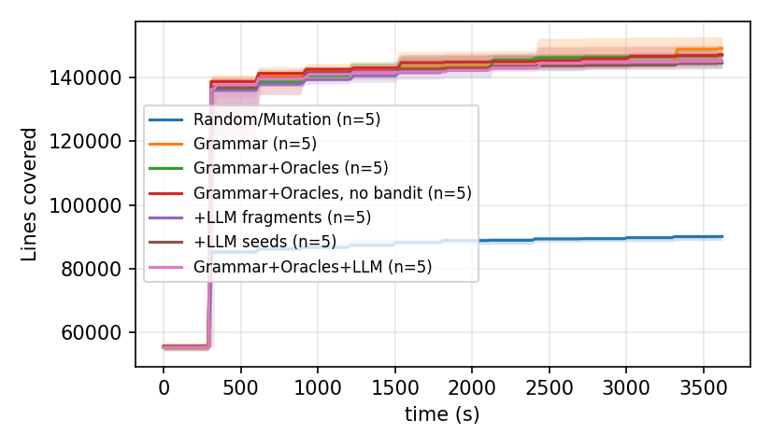
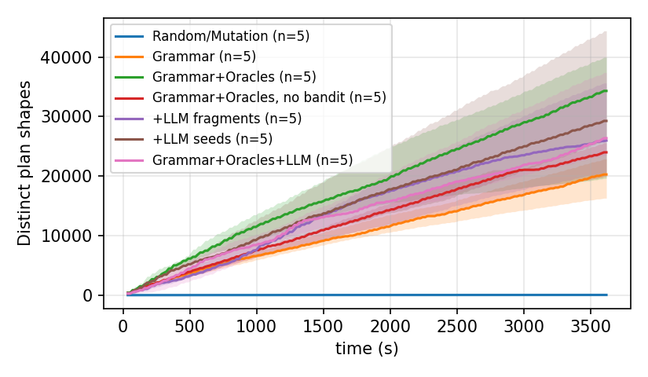
RQ1: the typed grammar reaches much more
Random mutation runs 15 times more tests and still reaches less.
Arm | Valid | Lines | Features | Plan shapes
Random / mutation | 26.0% | 22.2% | 23 | 43
Grammar | 99.3% | 36.7% | 101 | 20,279
Grammar + oracles | 96.3% | 36.2% | 101 | 34,313
+ LLM | 95.3% | 35.7% | 106 | 26,375
Reading
Grammar vs random: A12 = 1.00, p = 0.008
Oracles: plan shapes x1.7
LLM: +5 features, no extra lines

Slide 11
RQ2: nine bugs reported upstream
Two confirmed by committers, two already fixed, one fix written by our team.
Bug | Report | Oracle | State
Parallel Append assertion | #19803 | TLP (LLM arm) | fixed
to_char(NaN) breaks NORMALIZE | #19771 | assertion | fixed
MERGE: SubPlan with no parent | #19802 | internal error | confirmed
IGNORE NULLS frame never returns | pgsql-bugs | hang | answered
range @> NULL folded to a constant | #19793 | (SELECT e) rewrite | reported, patch
JSON_TABLE assigns no collations | #19768 | assertion | reported, patch
NOT IN anti-join ignores a cast | pgsql-bugs | TLP | reported, patch
duplicate statistics expression | pgsql-bugs | assertion | reported, patch
non-finite imported MCV frequencies | pgsql-hackers | CERT estimate | patch

Slide 12
The tool finds every bug we reported
One 150-second run on the base build reports all nine.
9 / 9
150 s
99.3%
reported bugs rediscovered
one trial, base build
validity unchanged
What we added
Seeds that carry their own oracle (the query that must agree)
Grammar: statistics on expressions, statistics import, user-defined casts, IGNORE NULLS frames
A hang oracle: a statement that ignores its timeout is reported, the server restarted

Slide 13
RQ2: precision is the bottleneck
Every one of 93 candidates has a verdict.
Verdict | Count
real, new | 8
real, reported first by others | 15
false positive | 42
flaky | 28
open | 0
Eleven false-positive classes, all fixed
Equal intervals printed differently: 16
RLS rewrite missed a repeated sub-select: 5
Cross-version state divergence: 5
ORDER BY NULL in ordered aggregates: 2
LLM rewrite that changed the collation: 1
Six more found during development
0.16
0.35
precision
if duplicates count

Slide 14
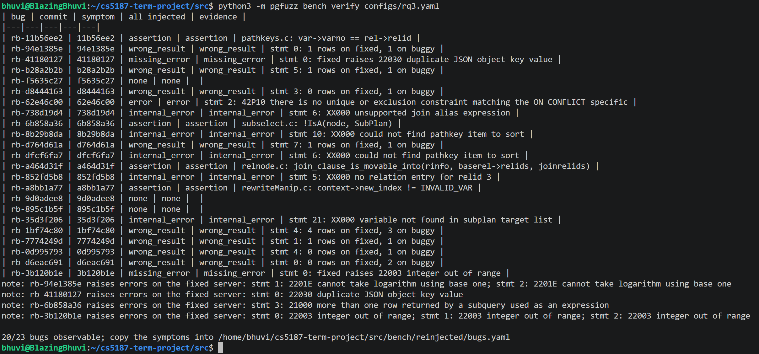
RQ3: re-injected real bugs
One hour finds few of them; we say so.
Arm | Bugs found (of 20)
Random | 0
Grammar | 1
Grammar + oracles | 2
+ LLM | 2
Honest reading
One hour and 5 trials are short for bugs that need feature combinations; the oracle advantage shows in RQ2, not here

Slide 15
What we learned
Three findings.
Typing pays
Precision is the bottleneck
The LLM needs a gate
99% vs 26% valid
36.7% vs 22.2% of lines
random runs 15x more tests
real wrong results in 17 and 18
11 false-positive classes
each needed a soundness fix
+5 features, no extra coverage
4 of 10 commits usable
tested is not proven

Slide 16
Limitations
What our results do not show.
Statistics
Measurement
5 trials per arm: effect sizes, not always significance
False-positive fixes not re-measured by a new campaign
LLM
Scope
Free-tier Gemini Flash, 10 commits
One system, one schema, one commit; rediscovery uses seeds

Slide 17
Conclusion
A fuzzer for the bugs that do not crash.
9
2
36.7%
151
bugs reported upstream
fixed on master
backend lines (random 22.2%)
unit tests
Take-away
Generating valid SQL is the easy part; knowing the right answer is the hard part. Typed trees make sound rewrites possible, and measuring precision tells you where the oracle is still wrong.

Slide 18
Thank you. Questions?
github.com/PASS-IITG/cs5187-term-project-blazing-bhuvi

