Slide 1

Urban Sound Classification
ML-1020 Machine Learning at Scale
Vadim Spirkov, Murlidhar Loka
19/July/2019

Slide 2
Agenda
Challenge Overview
Data Analysis
Approach
Google Cloud Infrastructure
Conclusion
Q & A
Notes:
Cities are significantly noisier than rural areas. Almost a third of Europe’s population lives in areas where noise levels exceed the 55 decibel sound limit recommended by the World Health Organisation.Until recently, urban noise was considered a mere annoyance, a by-product of living in close quarters on busy streets. Yet new research in Denmark funded by the European Research Council demonstrates that it causes stress, disturbed sleep, serious illness, and can even increase the risk of heart attack or stroke.(Ref: Echikson)

Slide 3
Background
Many urban areas exceed the recommended by the World Health Organization sound limit of 55 dB
The latest research shows that constant exposure to the urban noise causes stress, disturbed sleep and serious illness
Accurate categorization of known urban sounds helps to understand and address the sound pollution
Notes:
Objective of this research is to build a robust urban sound classifier. We will be leveraging concepts from transfer learning and deep learning to build the classifier whereby, with any given audio sample belonging to one of our predetermined categories, we should be able to correctly predict the source of this sound.

Slide 4
Objective
Build a robust urban sound classifier leveraging concepts from transfer learning and deep learning.
The model should be able to deal with the sound samples of various duration, number of channels and sample rate.
The model should work fast enough to classify the sound samples in real-time
Notes:
Objective of this research is to build a robust urban sound classifier. We will be leveraging concepts from transfer learning and deep learning to build the classifier whereby, with any given audio sample belonging to one of our predetermined categories, we should be able to correctly predict the source of this sound.

Slide 5
The Dataset
Contains 8732 labeled excerpts of urban sounds from 10 classes
The sound samples are stored in WAV format and are equal to or less than 4 second long
A metadata file maintains the classification of the audio samples
Audio file naming convention: fsID-classID-[occurrenceID]-sliceID.wav
Notes:
8732 audio files of urban sounds (see description above) in WAV format. The sampling rate, bit depth, and number of channels are the same as those of the original file uploaded to Freesound (and hence may vary from file to file).
meta-data information about every audio file in the dataset.This includes:
Slice_file_nameThe name of the audio file. The name takes the following format: fsID-classID-[occurrenceID]-sliceID.wav, where:
sliceID A numeric identifier to distinguish different slices taken from the same occurrence fsID
The Freesound ID of the recording from which this excerpt (slice) is taken

Slide 6
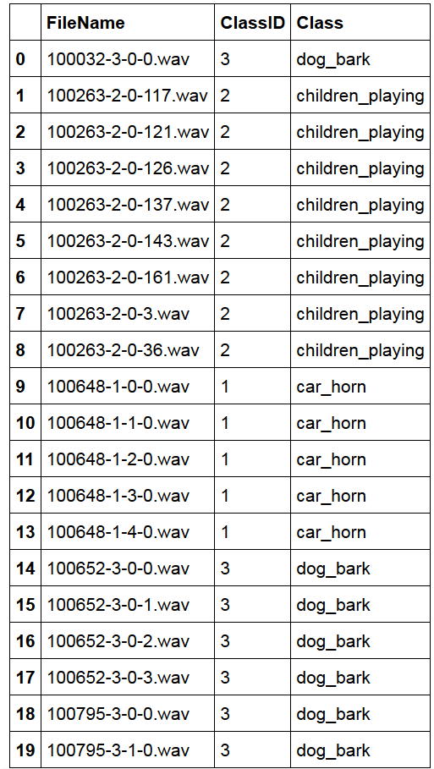
Meta-Data Sample

Slide 7
Ten Sound Categories
0 - Air Conditioner
1 - Car Horn
2 - Children Playing
3 - Dog Bark
4 -Drilling
5 - Engine Idling
6 - Gun Shot
7 - Jackhammer
8 - Siren
9 - Street Music

Slide 8
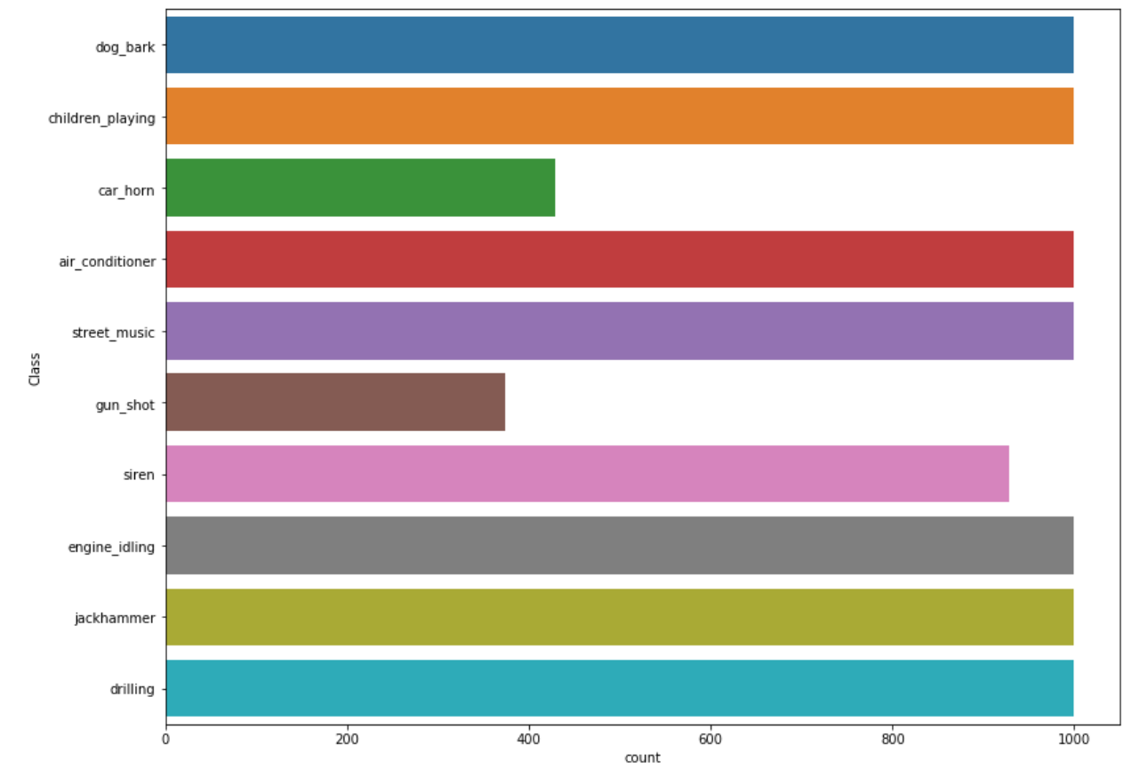
Data Exploration. Category Split
Eight categories have almost equal number of observations
Gun Shot and Car Horn categories are underpopulated
Upsample less populous categories employing sound augmentation technique:
Change pitch
Add noise
Apply time shift

Slide 9
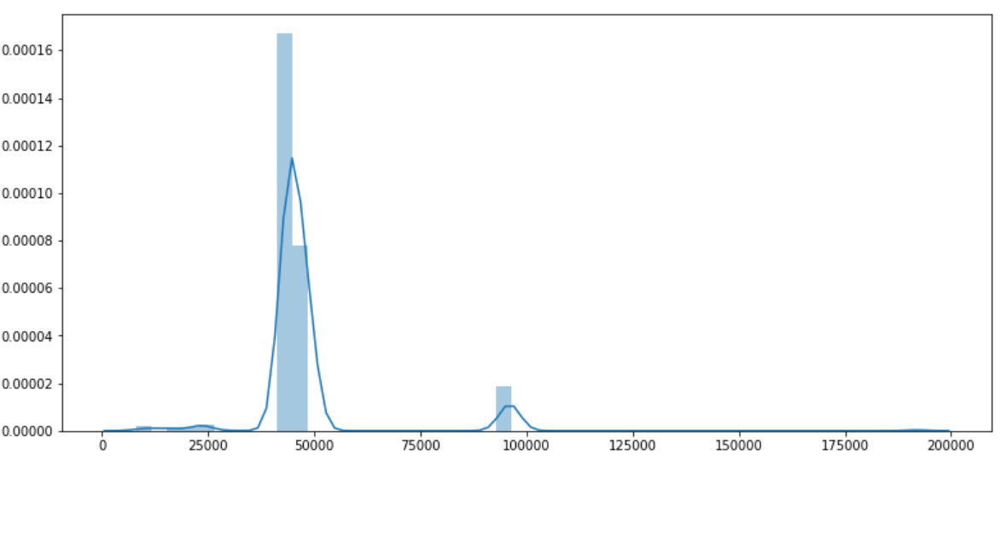
Data Exploration. Sample Rate
The sample rate of the sound files varies. We would have to re-sample the original audio to bring the sample rate to the same standard.

Slide 10
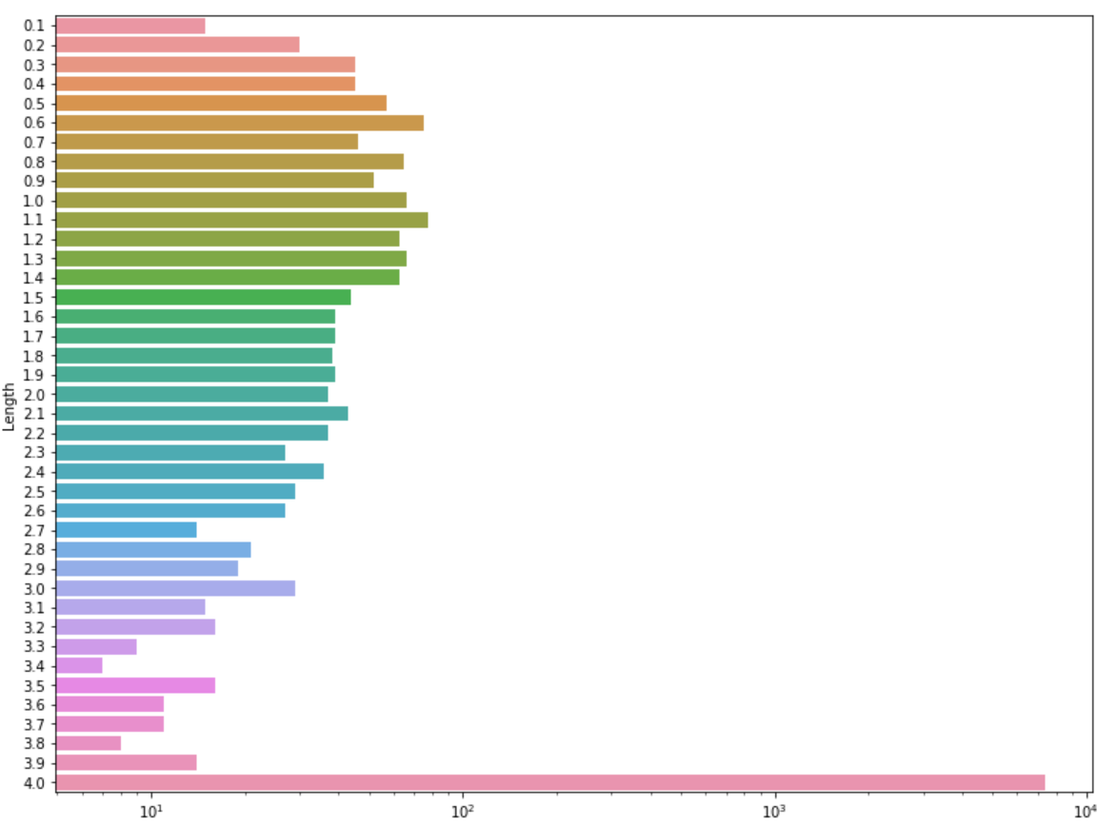
Data Exploration. Sound Length
The majority of the sound files are 4 second long
Some file that are less than a second long.
Discard the samples that are shorter than 500 msec.
Apply sub-sampling technique to deal with the audio of different length.

Slide 11
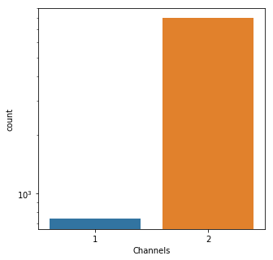
Data Exploration. Number of Channels
Just a few audio files were recorded in mono. Though each stereo channel carries slightly different information for the sake of simplicity we will be converting each audio sample to monophonic

Slide 12
Sound Characteristics by Category
Librosa - audio feature manipulation and extraction library
Each audio category had distinct features
Analyzed one sample from each class to observe the differences
Apply various feature extraction techniques to understand which feature carries the most information and would be the most useful for sound classification

Slide 13
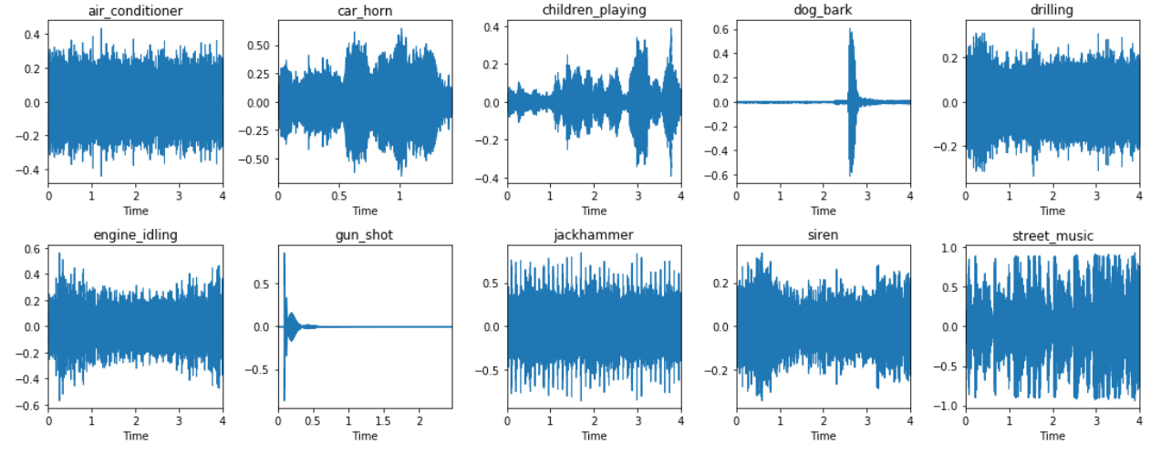
Waveform Amplitude Plots

Slide 14
Mel Spectrogram
Mel scale is a perceptual scale of pitches judged by listeners to be equal in distance from one another.
Lossless representation of signal
Gives acoustic time-frequency representation of sound: the power spectral density
Audio is sampled into number of points around equally spaced time and frequency (on a Mel frequency scale)

Slide 15
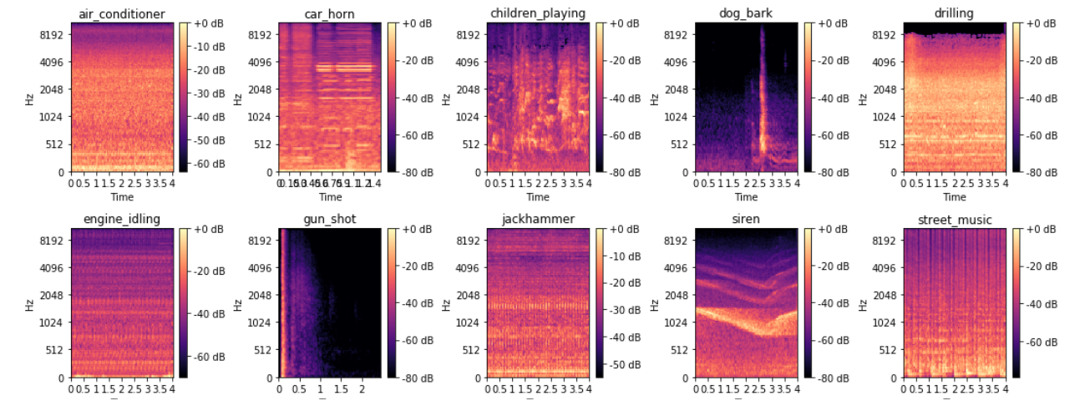
Mel Spectrograms

Slide 16
Data Preparation
Balanced the dataset applying sound augmentation
Re-sample all audio files using the sample rate of 22050 Hz
Convert all sound samples to mono
To deal with audio file of various length and preserve as much data as possible apply a sub-sampling technique known as a sliding window approach

Slide 17
Sliding Window Sub-sampling Technique
Select window of 0.5 secs, for each audio sample to slice it into 0.5s long audio segments
The window will move from start of the audio file to the end with overlap of 0.25 seconds
Most of the times the sliding window will not cut the audio file precisely. Thus the last slice will be taken from the end of the audio sample
This approach will result in getting multiple overlapping samples from each audio file

Slide 18
Feature Extraction
Long before the neural networks gained their popularity the scientist had already come up with pretty accurate methods to classify the sound. The star feature of the time was Mel-frequency cepstral coefficients (MFCCs)
With the expansion of the Neural Networks multiple research works demonstrate that log-scaled Mel spectrogram is superior to the other features extraction techniques in the context of deep learning models

Slide 19
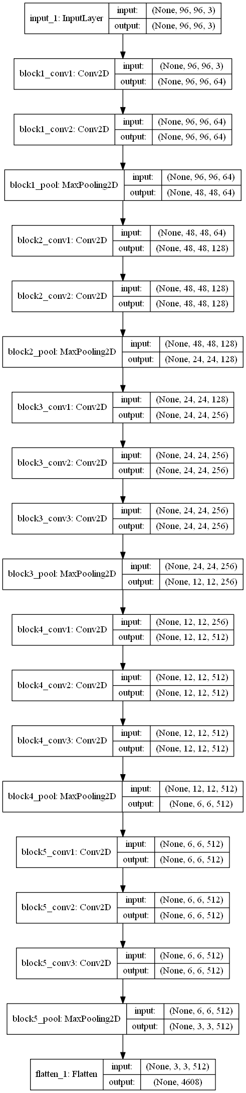
Feature Learning
Employ the power of transfer learning to learn the features of Mel spectrograms
Our choice is VGG-16 - a convolutional neural network trained on millions of images from “imagenet”
Reshape the input layer, drop the output layer and flatten the last layer

Slide 20
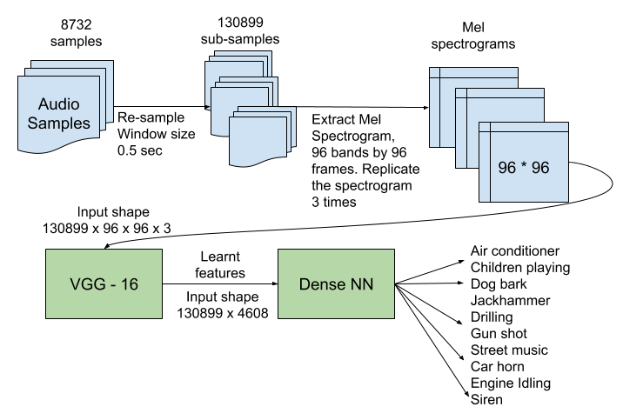
Production Pipeline

Slide 21
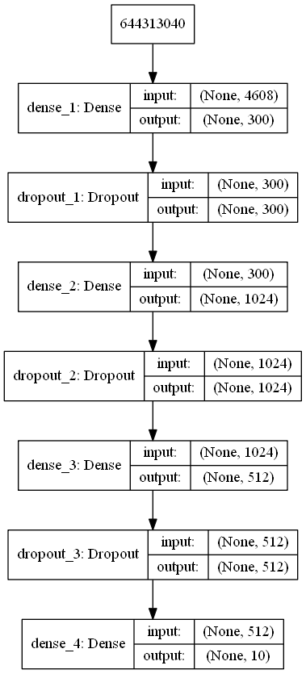
Classification Model
Simple Dense Neural Network that benefits from the transfer learning
A few dropout layers to fight the overfitting
The output layer of the classifier has softmax activation function with ten outputs - one for each sound category

Slide 22
Model Training on GCP. Grand Design
Upload original audio file to a GCP bucket.
Run data normalization and feature extraction job on GCP AI Platform.
Save the output of the job as a pickle file in a temporary folder of the bucket.
Develop a serverless GCP function to learn the features employing VGG-16. The pickle files produced by the AI job would be used as input for VGG-16. The function would be triggered by the storage event in reaction to the creation of the feature pickle file. Dump the pickle file with the learned features

Slide 23
Grand Design (Continued)
5. Develop a serverless function to train the classification model. Similarly to step 4 trigger the function execution propagating a storage event. Use the pickle file with learnt features produced at step # 4 as input.

Slide 24
Model Training on GCP. Reality
As it turned out it was a formidable task to implement the proposed above design. It could have taken weeks to develop such pipeline even for experienced GCP developers. Thus, considering the time constraints and luck of experience dealing with GCP we have come up with a hybrid approach.

Slide 25
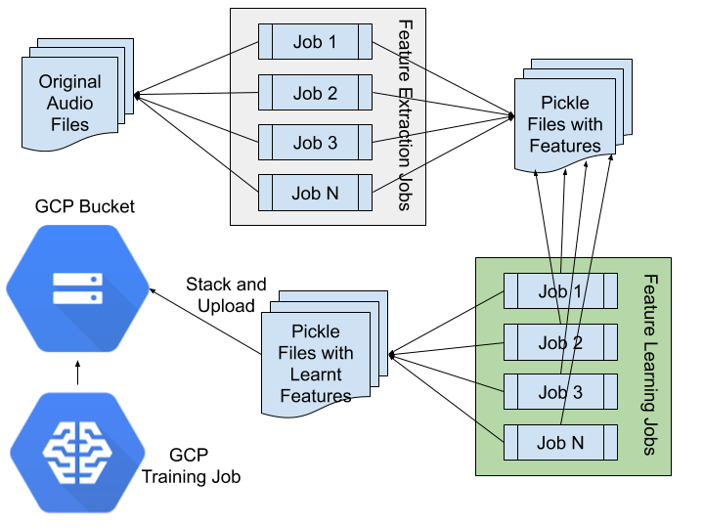
Hybrid Approach

Slide 26
GCP AI Platform Configuration
PREMIUM_1 scale tier
One master instance
19 workers
11 parameter servers
Compute Engine machine name, master: n1-highcpu-16, workers: n1-highcpu-16, parameter servers: n1-highmem-8
The model training parameters:
50 epochs, batch size of 256
Validation set size - 25% of the training dataset
Adam optimizer
Learning rate decay

Slide 27
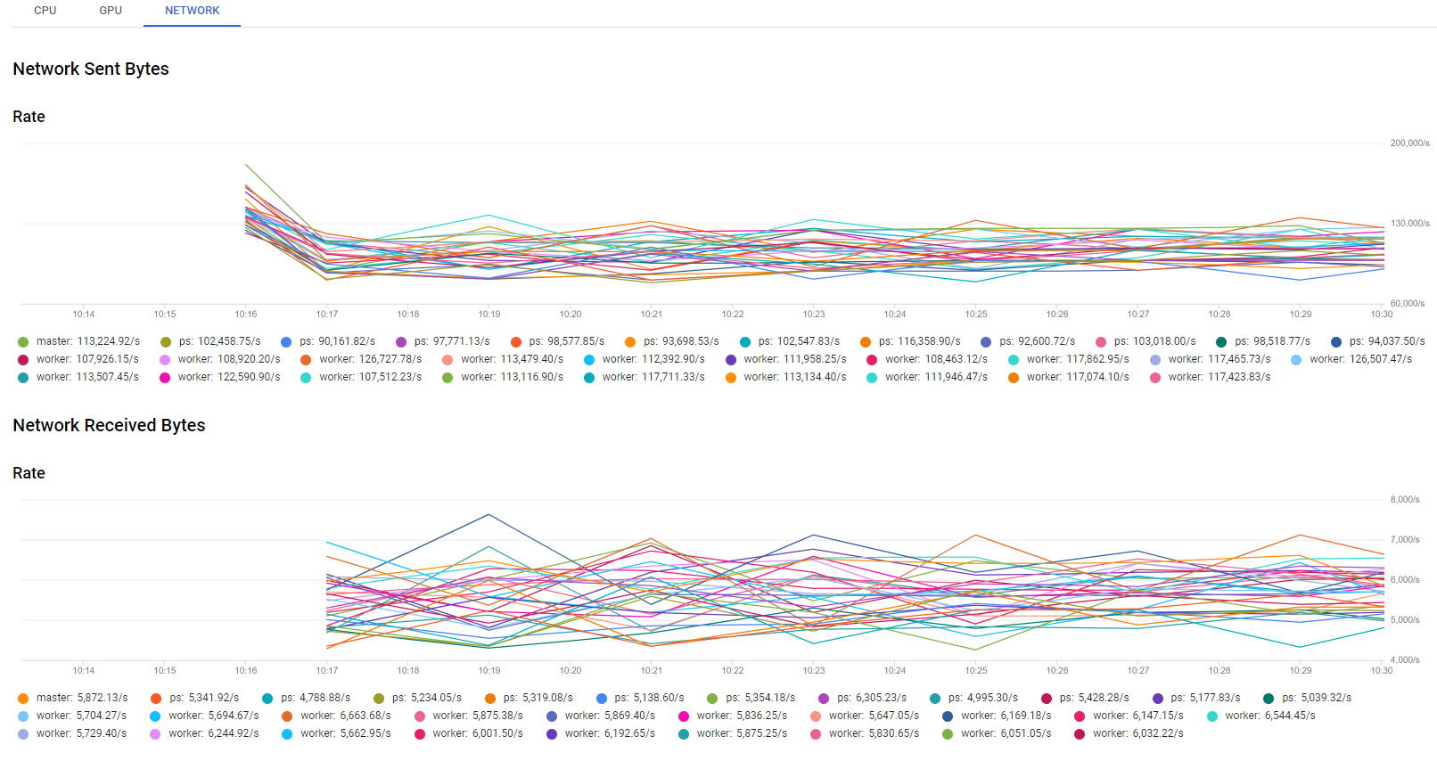
GCP Job Statistics. Network Traffic

Slide 28
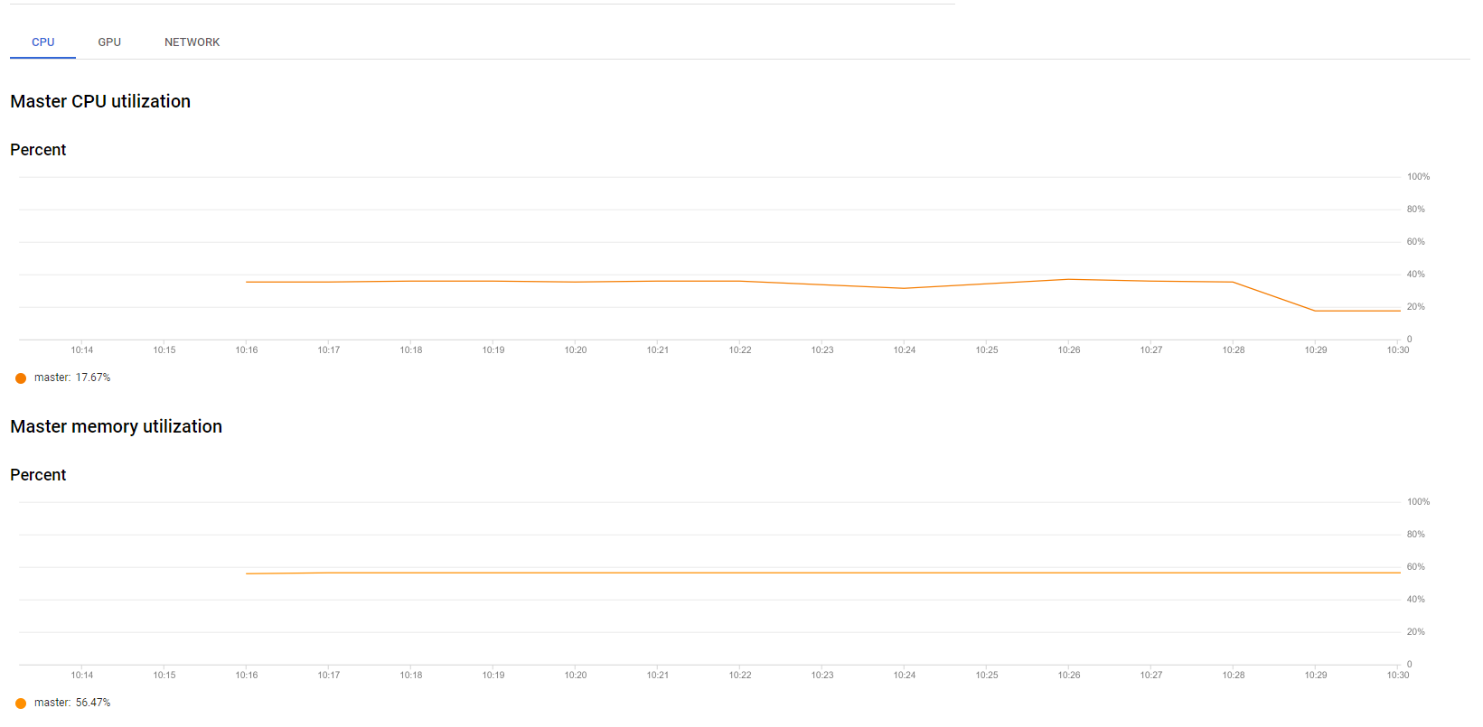
GCP Job Statistics. Master Server CPU & Mem

Slide 29
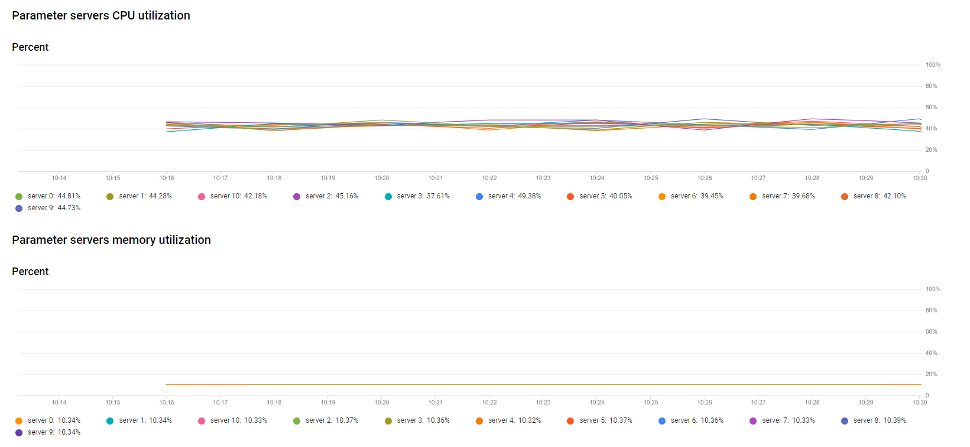
GCP Job Statistics. Parameter Servers CPU

Slide 30
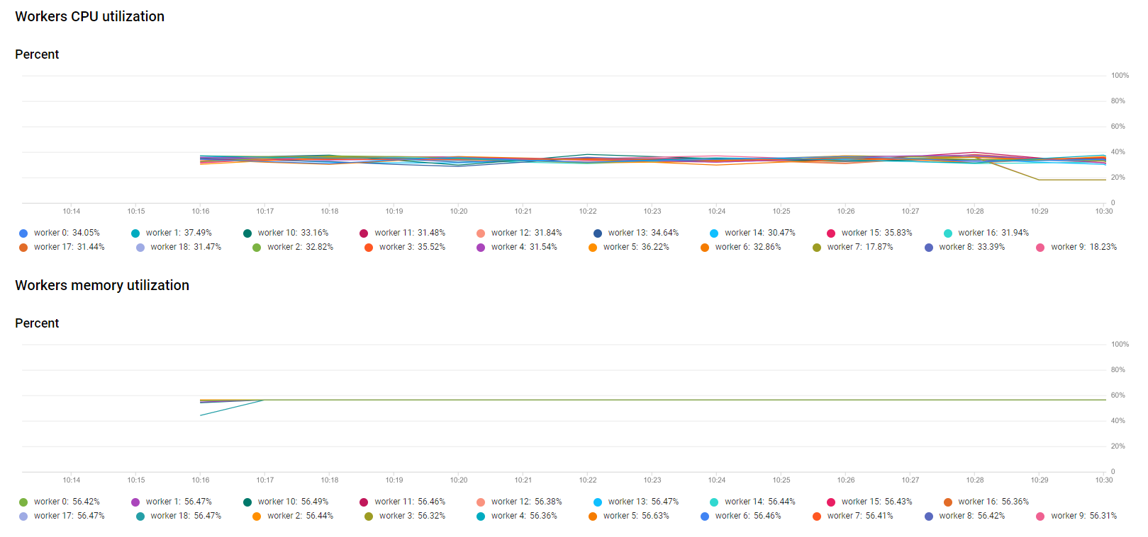
GCP Job Statistics. Workers CPU & Memory

Slide 31
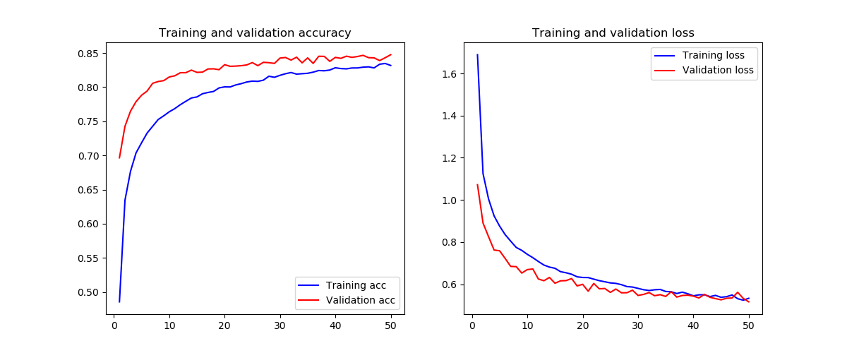

Slide 32
Review Model Training
Training and Validation accuracy nicely converged - the model learnt the data well
Both curves lay in close proximity and follow each other - training and validation are represented - they contain all the features of original dataset
The training and validation curves on the right hand side have plateaued - further training might lead to overfitting

Slide 33
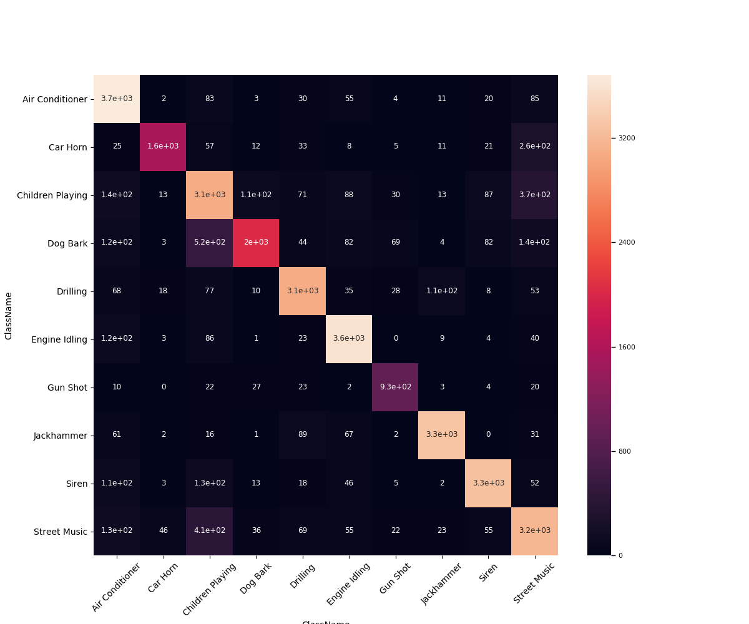
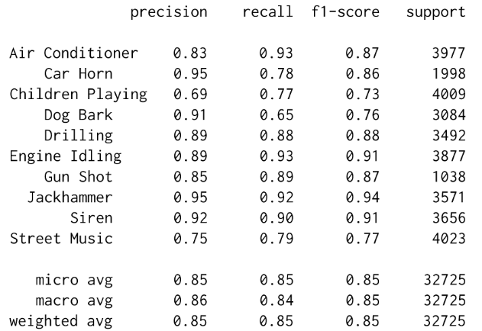
Model Confusion Matrix

Slide 34
Model Training Outcome
All averaged F1 scores show 85% accuracy on training set!
The least successful categories are Children Playing, Dog Bark and Street Music (all scored mid to high 70’s)
The lower score to classify Children Playing and Street Music could be explained by the complexity of the sound
Not sure why Dog Bark had a low score
We believe more samples of the underperforming classes would help to improve the classifier

Slide 35
Conclusion
Our research proves that having even modest computational resources it is possible to classify urban sounds with the high degree of accuracy.
We have confirmed that the data augmentation is an excellent tool to balance the unbalanced datasets or even boost the size of the small dataset.
We have demonstrated the power of the transfer learning, which makes training of the high accuracy models with limited resources possible.

Slide 36
Q & A

