Slide 1
NAAN MUDHALVAN PROJECT KEY LOGGERS
Presented by
A . VEERAMANI
III B.E CSE
SURYA ENGINEERING COLLEGE
ERODE

Slide 2
OVERVIEW
Problem statement
Proposed system
System Development Approach
Algorithm
Deployment
Result
Conclusion
Future Scope
References

Slide 3
PROBLEM STATEMENT Credential theft refers to stealing someone’s login credentials, such as usernames and passwords. Cybercriminals use the compromised credentials to gain access to valuable data and accounts, enabling identity theft and financial fraud . Once cybercriminals have access to compromised credentials, they can log into accounts and try to move laterally across an organization’s environment. For organizations, credential theft can lead to compromised business accounts, stolen intellectual property, and damaged reputations.

Slide 4
PROPOSED SYSTEM Credential theft in a proposed system is a serious concern. It can lead to unauthorized access, data breaches, and various security vulnerabilities. To mitigate this risk, ensure robust authentication mechanisms, encrypt sensitive data, regularly update security protocols, and conduct thorough testing for vulnerabilities before implementation. Additionally, educating users about the importance of strong passwords and phishing awareness can also help prevent credential theft.

Slide 5
SYSTEM DELEVPMENT APPROACH 1. *Threat Modeling*: Identify potential threats and vulnerabilities in the system early in the development process. 2. *Secure Design*: Design the system with security in mind, incorporating principles like least privilege, defense in depth, and secure default configurations. 3. *Authentication Mechanisms*: Implement strong authentication methods such as multi-factor authentication (MFA), biometrics, or token-based authentication to prevent unauthorized access. 4. *Encryption*: Encrypt sensitive data, both in transit and at rest, using strong encryption algorithms to protect it from unauthorized access. 5. *Access Controls*: Enforce proper access controls to ensure that users only have access to the resources and information they need to perform their tasks.

Slide 6
ALGORITHM Credential theft in algorithms typically refers to the exploitation of vulnerabilities within algorithms or cryptographic protocols to steal sensitive information such as usernames, passwords, or cryptographic keys. This can occur through various means such as brute-force attacks, man-in-the-middle attacks, or exploiting weaknesses in encryption algorithms. Preventing credential theft often involves using secure cryptographic algorithms, implementing strong authentication mechanisms, and regularly updating systems to patch any known vulnerabilities.

Slide 7
DEPLOYMENT Deployment in credential theft refers to the method or technique used by attackers to obtain and exploit usernames, passwords, or other authentication credentials from individuals or organizations. It can involve various tactics such as phishing emails, social engineering, malware (like keyloggers or credential stealers), or exploiting vulnerabilities in software or systems. Once obtained, these credentials can be used for unauthorized access to accounts, data theft, financial fraud, or further exploitation of the target's network or resources. Deployments can range from sophisticated, targeted attacks to more opportunistic, automated campaigns.

Slide 8
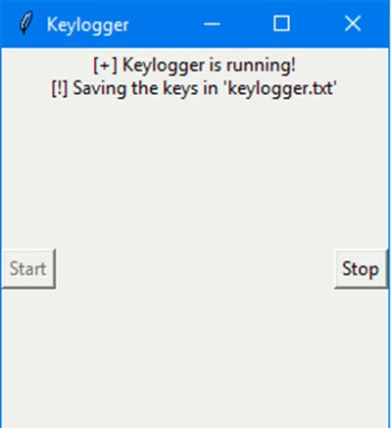
RESULT
Keylogger was project successfully captures and logs keystrokes, providing insight into user activity on the system. By recording keystrokes, the is project helps identify potential security breaches and unauthorized access to sensitive information. Additionally, the keylogger can serve as a valuable tool for forensic analysis and monitoring user behavior, aiding in the prevention and detection of data leakage incidents within the organization.

Slide 9
CONCLUSION In conclusion, credential theft is a serious cybersecurity threat that can have significant consequences for individuals and organizations. Attackers deploy various tactics, including phishing, social engineering, malware, and exploiting vulnerabilities, to obtain usernames, passwords, and other authentication credentials. Once stolen, these credentials can be used for unauthorized access, data theft, financial fraud, and further exploitation. It's crucial for individuals and organizations to implement robust security measures, such as multifactor authentication, employee training, and regular software updates, to mitigate the risk of credential theft and protect sensitive information.

Slide 10
FUTURE SCOPE The future scope of credential theft is concerning due to advancements in technology and cybercriminal tactics. As more services move online and adopt digital authentication methods, attackers will likely continue to develop sophisticated methods to steal credentials, including exploiting vulnerabilities in software, social engineering, and utilizing AI-driven attacks. Additionally, emerging technologies like quantum computing could potentially pose new challenges for encryption methods used to secure credentials.

Slide 11
REFERENCES Guryanov, Konstantin V. "THE PROJECT "GUNMAN": FIRST KEYLOGGER." Basis, no. 2 (2020): 79 http://dx.doi.org/10.51962/2587-8042_2020_8_79. K.S, Jayalekshmi. "Foiling Keylogger Attacks using Virtual Onscreen Keyboard." International Journal of Computer Sciences and Engineering 7, no. 2 (February 28, 2019): 635–39. http://dx.doi.org/10.26438/ijcse/v7i2.635639. Aron, Jacob. "Touchscreen keylogger captures details from your taps." New Scientist 211, no. 2825 (August 2011): 21. http://dx.doi.org/10.1016/s0262-4079(11)61950-7.

Slide 12
THANK YOU!!

