Slide 1
Asynchronous JavaScript
Notes:
Notes:

Slide 2
Asynchronous JS
What is Asynchronous JS ?
Revisiting Callback Functions
  setTimeout(), setInterval()
Async JS
Promise
  Create a Promise
  Using a Promise
    then().catch() and finally()
    async and await keywords
Reading File Asynchronously – an example
Notes:
Notes:

Slide 3
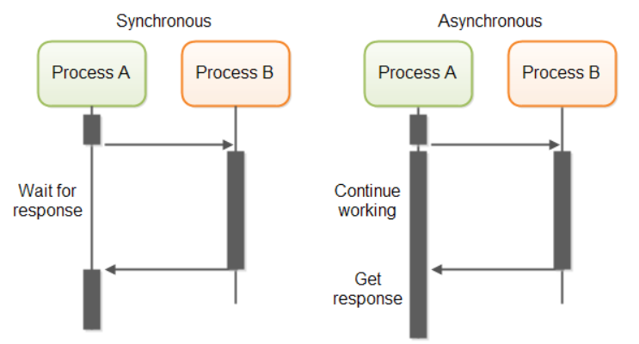
Synchronous vs Asynchronous
Synchronous
  Can only execute one thing at a time
Asynchronous
  Can execute multiple things at a time and you don't have to finish executing the current thing in order to move on to next one
Notes:
JavaScript engine is single threaded, it can only process one statement at a time
Using asynchronous JavaScript (such as callbacks, promises, and async/await), you can perform long network requests without blocking the main thread

Slide 4
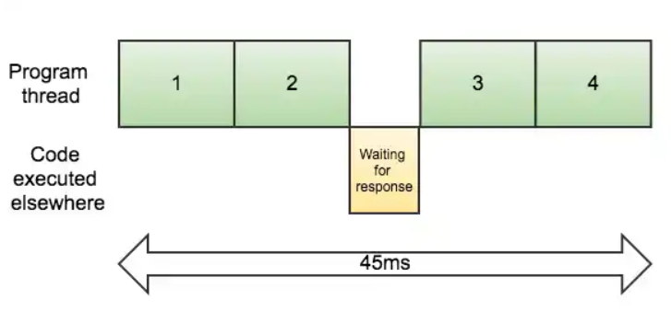
Synchronous Execution
Notes:
https://www.sohamkamani.com/blog/2016/03/14/wrapping-your-head-around-async-programming/

Slide 5
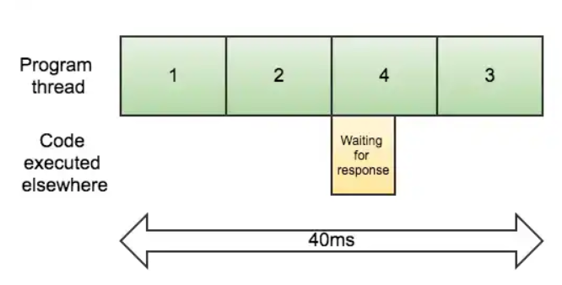
Asynchronous Execution
Notes:
https://www.sohamkamani.com/blog/2016/03/14/wrapping-your-head-around-async-programming/

Slide 6
Revisiting setTimeout() Method
Built in window function
  Calls a function or evaluates an expression after a specified number of milliseconds
    The argument function is a callback function
How to use setTimeout()
  Define an anonymous function inside the setTimeout
  Define a function and pass an argument
  Use the arrow function (most compact way)
setTimeout(function, milliseconds, param1, param...)
Notes:
Notes:
Notes:

Slide 7
Callback Function – Another Example
setTimeout(
function() {
console.log("hello anonymous function")
}, 1000
);
function displayHello() {
console.log('displayHello function');
}
setTimeout(displayHello, 1000);
setTimeout(() => console.log('hello arrow') , 1000);
console.log('This will be displayed first');
1 asynchronous callback
2 asynchronous callback
3 asynchronous
callback
Notes:
Code snippet in 11_async/snippets/asynchronous.js
Output:
This will be displayed first
Hello anonymous function
displayHello function
hello arrow
Define an anonymous function within the setTimeout() function. Take note that it is the callback function in the first argument as setTimeout() function
Define a function called displayHello(). Then pass displayHello as the first argument to setTimeout function()
Use the arrow function to implement the first argument of setTimeout

Slide 8
Promise
Graceful asynchronous programming
Based on ECMA Committee, promise is
  An object that is used as a placeholder for the eventual results of a deferred (and possibly asynchronous) computation
    A JavaScript Object
    Always returns a value
state : “fulfilled”
new Promise()
resolved(value)
result : value
state : “pending”
reject(error)
state : “rejected”
result : undefined
result : error
Notes:
A promise is an object which can be returned synchronously from an asynchronous function. It will be in one of 3 possible states:
Fulfilled: onFulfilled() will be called (e.g., resolve() was called)
Rejected: onRejected() will be called (e.g., reject() was called)
Pending: not yet fulfilled or rejected

Slide 9
Creating a Promise Object
resolved(value)
state : “pending”
new Promise()
result : undefined
state : “pending”
result : undefined
reject(error)
state : “pending”
result : undefined
let promise$ = new Promise(function (resolve, reject) {
let number = 12;
if (number == 2) {
resolve("Your promise is resolved.");
} else {
reject('Your promise is rejected.');
}
});
Notes:
Code snippet in 11_async/snippets/createPromise.js – Do not run.
When new Promise is created, the executor runs automatically. It contains the producing code which should eventually produce the result. The arguments resolve and reject are callbacks provided by JavaScript itself.
When the executor obtains the result, be it soon or late, It calls one of these callbacks:
resolve(value) — if the job finished successfully, with result value.
reject(error) — if an error occurred, error is the error object.
So to summarize: the executor runs automatically and attempts to perform a job. When it is finished with the attempt it calls resolve if it was successful or reject if there was an error.
The promise object returned by the new Promise constructor has these internal properties
state — initially "pending", then changes to either "fulfilled" when resolve is called or "rejected" when reject is called.
result — initially undefined, then changes to value when resolve(value) called or error when reject(error) is called.

Slide 10
Handling a Promise Object Using then()
Promise can be consumed by the use of the following functions
  then( resolved, rejected)
Invoked when promise is resolved or rejected
promise$.then(function (msg) {
console.log(`First argument function - ${msg}`);
}, function (msg) {
console.log(`Second argument function - ${msg}`);
});
Invoked when promise is resolved
Invoked when promise is rejected or an error occurs
Notes:
Code snippet in 11_async/snippets/usingThenPromise.js
Output:
Second argument function – Your promise is rejected.
The then() method of promise is invoked when promise is either resolved or rejected. The then() methods takes two functions as parameters:
The first function is executed if the promise is resolved and a result is received.
The second function is executed if the promise is rejected and any kind of error is received. (It is optional a parameter and there is a better way to handle error using .catch() method
promise.then(function(msg) {
// handles when promise is resolved
}, function(msg) {
// handles when promise is not resolved (better to use the catch method)
});

Slide 11
Handling a Promise Object Using then()/catch()
Promise can be consumed by the use of the following functions
  then( resolved, rejected)
  catch() – better way to handle when promise is rejected
promise$.
then(function (msg){
console.log(`${msg}`);
}).
catch(function () {
console.log('There some error has occurred');
})
Invoked when promise is resolved or rejected
resolved
Note: The second function is removed.
Invoked when promise is rejected or an error occurs
Notes:
Code snippet in 11_async/snippets/usingThenCatchPromise.js
Output:
Inside the catch() method – Your promise is rejected.
The then() method of promise is invoked when promise is either resolved or rejected. The then() methods takes two functions as parameters:
The first function is executed if the promise is resolved and a result is received.
The second function is executed if the promise is rejected and any kind of error is received. (It is optional a parameter and there is a better way to handle error using .catch() method
// Handles the first argument only
promise.then(function(msg) {
// handles when promise is resolved
}).catch( function () {
// The catch() method of promise is invoked when a promise is either rejected or some error has occurred within the execution
)};
The promise#catch() function in JavaScript is a convenient shorthand for .then(). Calling .catch(onRejected) is syntactic sugar for .then(null, onRejected).

Slide 12
Two Code Behaves the Same !
Using then()
Using then().catch()
promise$.then(function (msg) {
console.log(`First argument function - resolved ${msg}`);
}, function (msg) {
console.log(`Second argument function - rejected ${msg}`);
});
promise$.then(function () {
console.log(`First argument function - ${msg}`);
}).
catch(function () {
console.log('There Some error has occurred');
})
PREFERRED WAY !
Notes:
Using catch() for error handling is more readable.

Slide 13
Handling a Promise Object – Fat Arrows
Using the then() method
Using then() and catch()
promise$.then(
msg => console.log(msg),
error => console.log(error)
);
promise$.then(
msg => console.log(msg)
). catch(
error => console.log(error)
);
PREFERRED WAY !
Notes:
Code snippet in 11_async/snippets/usingFatArrowPromise01.js
Code snippet in 11_async/snippets/usingFatArrowPromise02.js
Output:
Your promise is rejected.

Slide 14
Function Returning a Promise
function chainedPromise(number) {
let promise$ = new Promise(function (resolve, reject) {
if (number == 2) {
console.log(`Value of number is ${number}
console.log(`Your promise is resolved.`);
else {
reject(‘Your promise is rejected.');
}
});
return promise$;
}
Promise created
Promise as return value
Notes:
Code snippet in 11_async/snippets/promiseFunction.js - Do not run.

Slide 15
Chained Promise – Scenario 1
console.log(`Scenario 1 output`);
chainedPromise(2).then(() => {
    console.log("first then");
    return chainedPromise(2)}).
  then(() => {
    console.log("second then");
    return chainedPromise(2)
}).
  catch( error => console.log(error));
Invoke a function that returns a Promise
Promise handler
When the function is resolved, the return keyword will call chainedPromise function
Any reject or
error occurs
Promise handler
When the function is resolved, the return keyword will call chainedFunction
Notes:
Code snippet in 11_async/snippets/chainedPromise01.js
Output:
Scenario 1 output
Value of number is 2
first then
Value of number is 2
second then
Value of number is 2
To chain promise,
Scenario 1 - Chain then()s to run async actions in sequence. Return something from a then() callback
If you return a value, the next then() is called with that value
However, if you return something promise-like, the next then() waits on it, and is only called when that promise settles (succeeds/fails)
Scenario 2 - Do not need to catch errors in each individual then()
Put the catch() at the end of your promise chain, any errors in the promise chain will bypass the rest of the promise chain and go straight to your catch() error handler

Slide 16
Chained Promise – Scenario 2
console.log(`Scenario 2 output`);
chainedPromise(2).then(() => {
    console.log("first then");
    return chainedPromise(8)}).
then(() => {
    console.log("second then");
    return chainedPromise(2)
}).
  catch( error => console.log(error));
Invoke a function that returns a Promise
Promise handler
When the function is resolved, the return keyword will call chainedPromise function
Any reject or
error occurs
Bypass
Notes:
Code snippet in 11_async/snippets/chainedPromise02.js
Output:
Scenario 2 output
Value of number is 2
first then
Your promise is rejected.
To chain promise,
Scenario 1 - Chain then()s to run async actions in sequence. Return something from a then() callback.
If you return a value, the next then() is called with that value
However, if you return something promise-like, the next then() waits on it, and is only called when that promise settles (succeeds/fails)
Scenario 2 - Do not need to catch errors in each individual then().
Put the catch() at the end of your promise chain, any errors in the promise chain will bypass the rest of the promise chain and go straight to your catch() error handler

Slide 17
Async Function in JavaScript
It enables asynchronous, promised-based behavior written in cleaner style, avoiding the need to explicitly configure promise chain
  A functions declared with async keyword
  The await keyword is permitted within them
The return values are guaranteed to be converted into promises
Coroutine that allows to work with Promises by using JavaScript language syntax and allow to implement nonlinear control flow in JavaScript
  Currently async control flow in JavaScript can be expressed with several features: event, callback, streams, promises and with async generator
Notes:
Notes:

Slide 18
Async Function in JavaScript
  Syntax
    Any async function declaration should start with async keyword
    The await operator is used to resolve the value of the function call returning a promise
async function nameOfFunction(param list) {
try {
. . . .
let result = await functionCall();
} catch(error) {
} finally {
// housekeeping. . . .
}
}
Notes:
The await operator
Used to resolve the value of the function call
It will cause the execution the async function to pause
When the return value of the method call is a Promise
The await returns resolved value
if Promise is rejected the await throw exception with rejected value
When the return value of the method call is not Promise
The await operator returns the same value
The execution of function is suspended for short period of time
It will resolve it as a promise
It can be used only within async function

Slide 19
Async Function in JS – An Example
async function handlePromise() {
try {
let result = await doSomething();
console.log(result)
} catch (error) {
console.log(error.message)
} finally {
console.log(`Finally block is called’);
}
}
// invoke the function
handlePromise();
console.log('hello');
async keyword
await operator must be within try/catch block
await operator
Function that returns a promise object
Note: The implementation of doSomething() is on the notes below.
Notes:
Code snippet in 11_async/snippets/usingAsync.js
Output:
Hello
Resolved from doSomething()
The finally block is called
Implementation of doSomething() function:
function doSomething() {
let promise = new Promise(function (resolve, reject) {
let number = 2;
if (number == 2) {
resolve("Resolved from doSomething()");
} else {
reject('Your Promise Rejected');
}
});
return promise;
}

Slide 20
Reading a File in Node.js Asynchronously
A practical example ~
async
keyword
const fs = require('fs').promises;
async function readTxtFile() {
let data;
try {
data = await fs.readFile("hello.txt", "binary");
console.log(data);
} catch(error) {
console.log(error);
}
}
readTxtFile();
4
2
await
operator
await operator
must be within try/catch block
1
Function that returns a promise object
3
5
Invoke readTxtFile() async function
Notes:
Code snippet in 11_async/snippets/readingFile.js
Hello.txt
Hello World
JavaScript
Output:
Hello World
JavaScript
Based on Node.js’ documentation: https://nodejs.org/api/fs.html#fs_fs_readfile_path_options_callback
The fs.readFile() is a promise based function
Use the await operator is used to pause the code on that line until the promise fulfils, then return the resulting value
The await operator should within a try and catch block
The function should use the async keyword so the await keyword will work

