Slide 1

STOCK LENS ~Unveiling Corporate Dynamics
Team members:
Peter Ly (5502)
Vijay Kumar Poloju (5502)
Andrew Connell (4502)
Harrison Fagan (4502)

Slide 2
Introduction
Problem statements
Goals

Slide 3
Introduction
Focus
Data mining and analysis using SEC reports and stock market trend of the company
Key technologies
Natural Language Processing (NLP) and Statistical Analysis
Objective
Analyze how company decisions affect stock prices
Notes:
Good [morning/afternoon], everyone! Today, I’m excited to present "StockLens," our data mining project focused on uncovering insights from company earnings reports using Natural Language Processing (NLP) and advanced statistical analysis.
In the world of finance, companies release earnings reports each year, which can significantly impact their stock prices. Our project aims to analyze these reports to understand how specific business decisions influence stock movements. By applying NLP, we extract key insights from the language used in these reports, identifying patterns and trends that might not be immediately obvious.
But we’re not stopping there. We also investigate potential correlations between companies. By comparing their earnings reports and financial movements, we aim to detect abnormal correlations that might signal hidden partnerships or collaborations between organizations.
Our approach includes both time-series analysis and predictive modeling to give a comprehensive view of corporate behavior. With this project, we hope to shine a light on how companies shape the stock market and offer new ways to understand their interrelations.

Slide 4

Goals
Understand the impact of business decisions on stock performance
Identify patterns and trends across multiple companies
Explore correlations between companies to identify potential partnerships
Provide predictive insights for future stock movements

Slide 5
Methodology
What data are we using
How are we managing the data
How are we processing the data
How do we know our results are reasonable

Slide 6
Data Source
SEC public filings
Stock prices

Slide 7
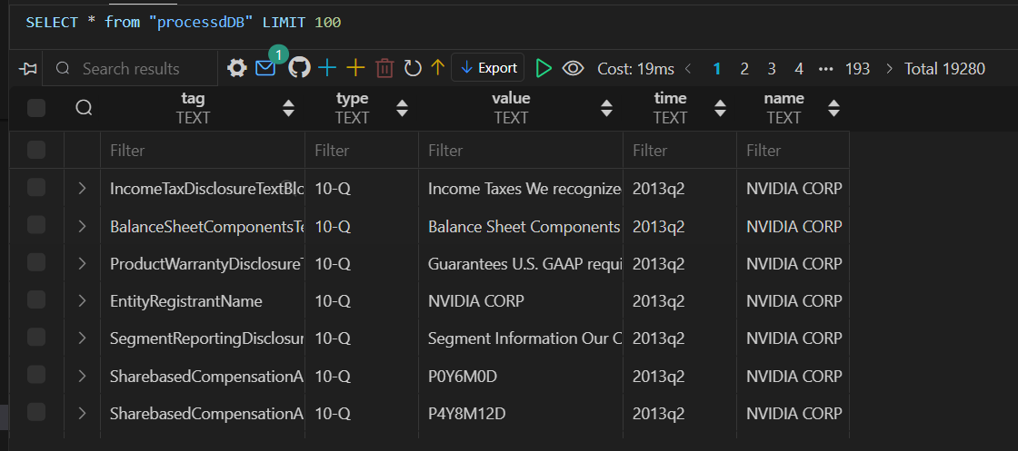
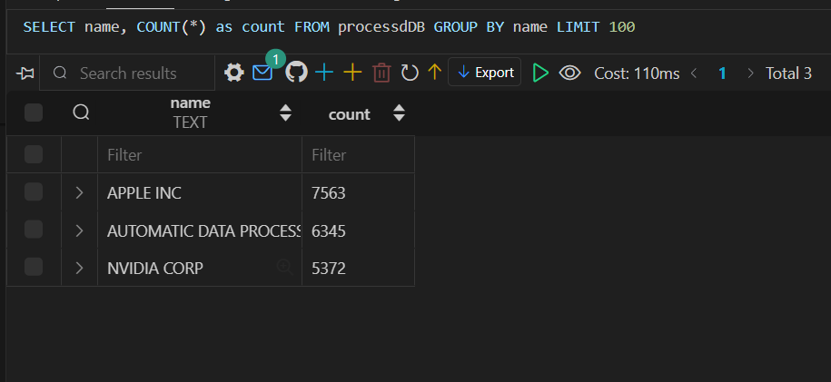
Data management
Relational Database with extracted key value pairs that’s been processed.
Structured as:
ID: primary unique key
Tag (key)
Type – (type of report 10-Q or 8K)
Value – (value of key)
Time –(report time)
Name – (Company Name)

Slide 8
Data processing
Keyword analysis
Semantic analysis
Correlation analysis

Slide 9
Insights
Explanation of what is done
Visualization of the computed patterns
Specific examples in computed patterns
Explanation for general pattern

Slide 10
Discussion/Future work
Using yfinance recent articles regarding companies
Better parsing for 10-K report
Instead of yearly data, use daily data
Accounting for overall market performance

Slide 11
Challenges
Dataset Limitations
Difficulty in confirming existing partnerships
Limited data for certain companies or industries
Accuracy in Correlations
Distinguish correlation from causation
Handle industry-specific trends that may skew results
Change of partnerships
Partnerships between companies may not last very long and may change

