Slide 1

STOCK LENS ~Unveiling Corporate Dynamics
Team members:
Peter Ly (5502)
Vijay Kumar Poloju (5502)
Andrew Connell (4502)
Harrison Fagan (4502)

Slide 2
Introduction
Focus
Data mining and analysis using SEC reports and stock market trend of the company
Key technologies
Natural Language Processing (NLP) and Statistical Analysis
Objective
Analyze how company decisions affect stock prices
[Reach] Detect potential partnerships or correlations between companies
Notes:
Good [morning/afternoon], everyone! Today, I’m excited to present "StockLens," our data mining project focused on uncovering insights from company earnings reports using Natural Language Processing (NLP) and advanced statistical analysis.
In the world of finance, companies release earnings reports each year, which can significantly impact their stock prices. Our project aims to analyze these reports to understand how specific business decisions influence stock movements. By applying NLP, we extract key insights from the language used in these reports, identifying patterns and trends that might not be immediately obvious.
But we’re not stopping there. We also investigate potential correlations between companies. By comparing their earnings reports and financial movements, we aim to detect abnormal correlations that might signal hidden partnerships or collaborations between organizations.
Our approach includes both time-series analysis and predictive modeling to give a comprehensive view of corporate behavior. With this project, we hope to shine a light on how companies shape the stock market and offer new ways to understand their interrelations.

Slide 3

Goals
Understand the impact of business decisions on stock performance
Identify patterns and trends across multiple companies
Explore correlations between companies to identify potential partnerships
Provide predictive insights for future stock movements

Slide 4
Completed work
Extraction of data from SEC website
Data cleaning
Began to identify redundant tags in SEC reports
Data acquisition
Aggregated by company
Data integration
Extraction of daily historical pricing
Notes:
Notes

Slide 5
Changes to initially proposed work
Data Gathering
Collect company earnings reports and time-series stock data
[Moved to reach] Expand data to include industry benchmarks and market factors
NLP Analysis
Extract insights from earnings reports
Run sentiment analysis to gauge company outlook
Correlation Analysis
Investigate unusual correlations between companies
[Moved to reach] Control for industry and sub-industry factors

Slide 6
Specifics in collection and pre-processing
Data Collection:
Retrieved the required data from the SEC website.
Data Preprocessing:
Automated and developed code to extract data from ZIP files into a useful format (capable of processing 126GB of data).
Created a SQLite database to store extracted data chunks organized by company.
Currently working on various models to analyze which approach yields meaningful insights.

Slide 7
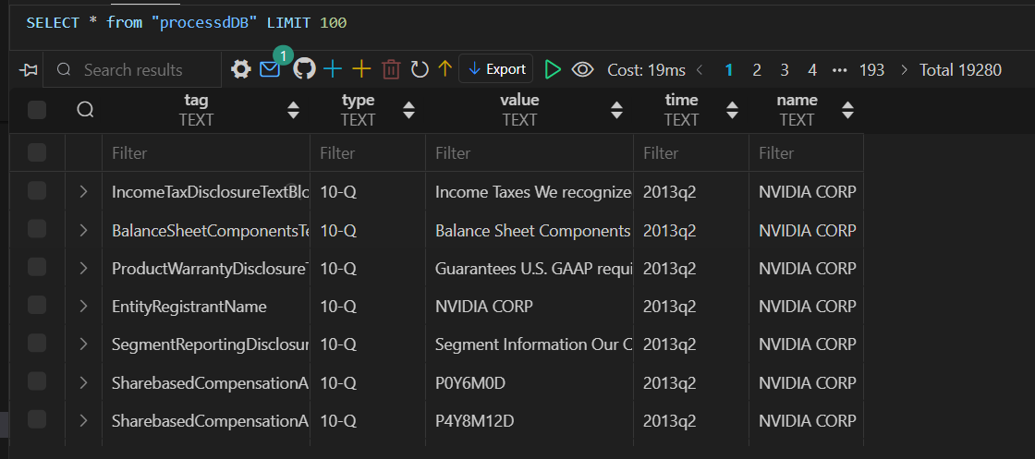
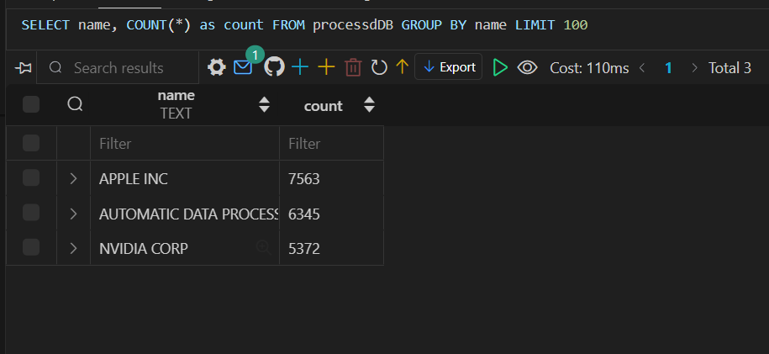
processdDB
Relational Database with extracted key value pairs that’s been processed.
Structured as:
ID: primary unique key
Tag (key)
Type – (type of report 10-Q or 8K)
Value – (value of key)
Time –(report time)
Name – (Company Name)

Slide 8
Remaining work
Extract meaningful insights from text DB
Modeling
Analysis
Test the first batch of companies and find some relation
Testing
Build model for small batch (at least 3 companies)
Scaling
Apply the models for a larger set of companies

Slide 9
Extracting insights from the text
Semantic document grouping
Document embedding via BERT
K-means clustering
Keyword/topic extraction
Term-frequency Inverse document frequency
Latent Dirichlet allocation/NMF
Sentiment analysis
FinBERT/VADER

Slide 10
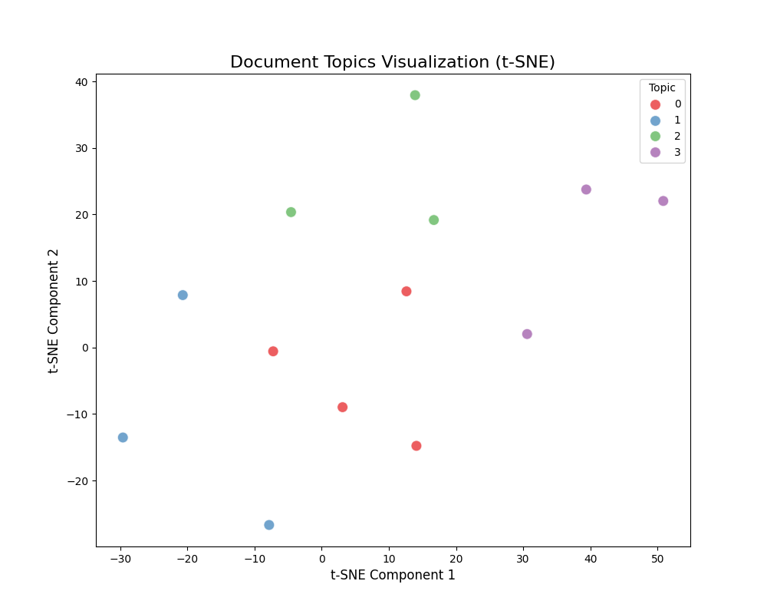
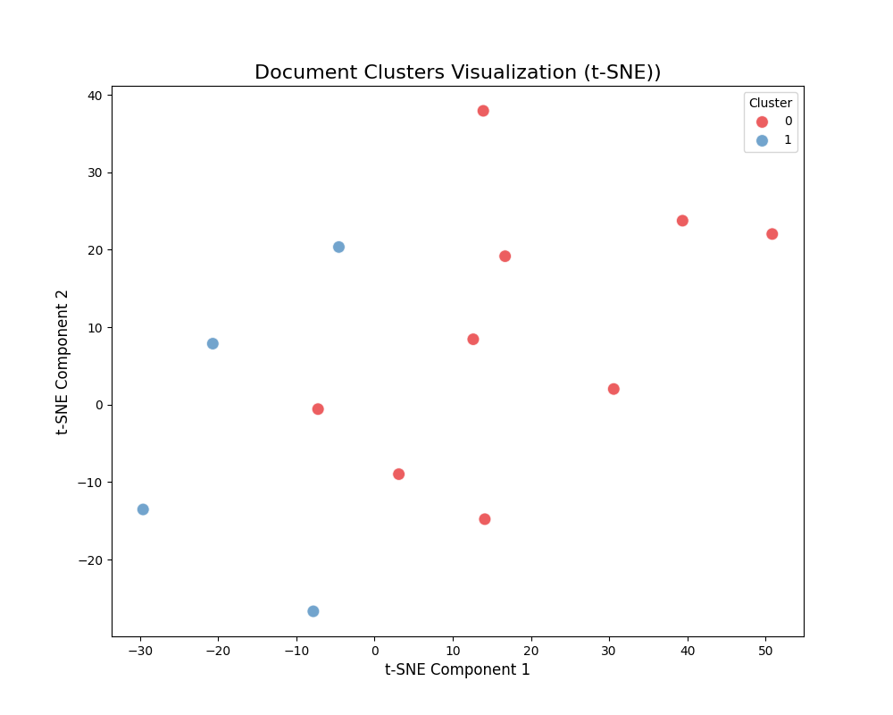
Text insights
Given a collection of documents, we can cluster them based on their BERT encodings or identify what topics are relevant to them

Slide 11
Tentative models
Understand the impact of business decisions on stock performance
Decision tree, random forests, LSTM
Identify patterns and trends across multiple companies
Keyword analysis with clustering techniques
Explore correlations between companies to identify potential partnerships
Cross-correlation between stock returns and clustering of company direction
Provide insights for future stock movements
Decision trees, SVM, LSTM
Notes:
Decision trees are easy to interpret, random forests are less easy to interpret, but less prone to overfitting LSTM are less easy to interpret, but inherently work nicely with sequential data
The clustering will probably be k-means or EM after mapping keywords (company direction) to embeddings
Cross-correlation can be used to detect similar movement between stock returns we could also use clustering algorithms based on correlation matrix
As before decision trees are easy to interpret, SVM is good with high dimensional data, LSTM is good for sequential data

Slide 12
Measuring accuracy of model?
Understand the impact of business decisions on stock performance
Evaluate on a test set
Identify patterns and trends across multiple companies
Comparison to classical industry clusters
Explore correlations between companies to identify potential partnerships
Testing on a small number of companies to determine number of accurate predictions
Provide insights for future stock movements
Evaluate on a test set

Slide 13
Challenges
Dataset Limitations
Difficulty in confirming existing partnerships
Limited data for certain companies or industries
Accuracy in Correlations
Distinguish correlation from causation
Handle industry-specific trends that may skew results
Change of partnerships
Partnerships between companies may not last very long and may change

Slide 14
Expected Outcomes
Clear identification of business decisions impacting stock performance
Potential indicators for undisclosed partnerships or alliances
Enhanced predictive models for stock movement forecasting

Slide 15

Evaluation
Understanding business decision's effect on stock performance
Compare business direction and stock performance to industry average
Finding patterns and trends across multiple companies
Compare to standard trends among industries
Identifying possible partnerships between companies
Model with past data and verify with publicly available news
Predicting future stock prices
Model with past data and verify on later past data

Slide 16
Milestones
Data collection
Stock price data
Shareholder letters
Data cleaning
Identify missing information
Data integration
Join data sets by company
Small batch testing
Verify method on a few companies
Modelling
Run analysis on complete data set

