Slide 1
Eco-Loop Building Agents
Problem Statement Title- Eco-Loop Building Agents: Safe LLM-Supervised EnergyPlus Control
Theme- Smart Buildings / Energy Optimization / Physical AI
PS Category- Software
Student Name: Vasanth Krishna V
Student ID: 127157059

Slide 2
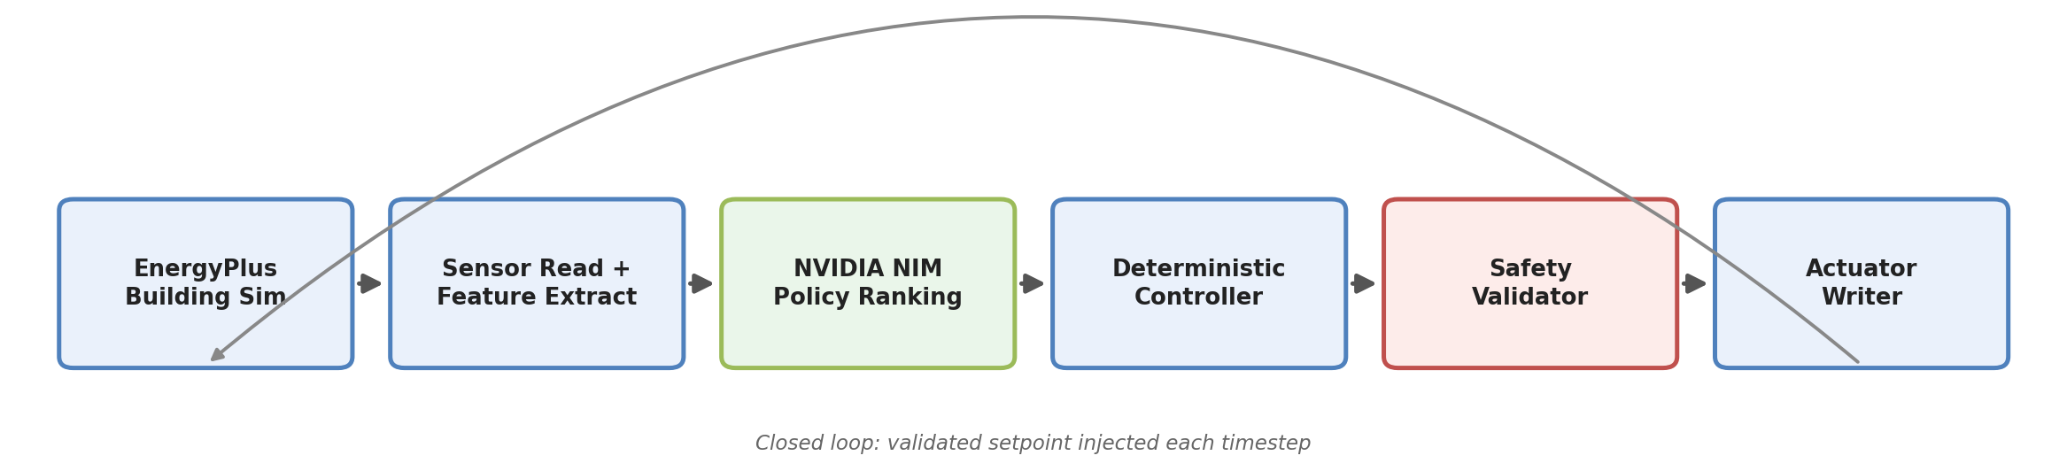
Eco-Loop Building Agents
Proposed Solution
AI-supervised closed-loop EnergyPlus controller
EnergyPlus acts as the digital building sandbox
NVIDIA NIM (Llama 3 Nemotron) ranks safe supervisory policies
Deterministic controller converts selected policy into actuator command
Safety layer prevents unsafe setpoints

Slide 3
Detailed Explanation & Innovation
EnergyPlus Runtime API used for live sensor feedback and actuator injection
Proven actuator: System Node Setpoint / Temperature Setpoint / MAIN COOLING COIL 1 OUTLET NODE
LLM does not directly control the actuator
LLM ranks safe candidates generated by deterministic logic
Invalid or unsafe model output falls back to the deterministic recommendation
Streamlit dashboard explains the full loop
What makes this unique
Safe LLM supervision + physics simulation + validation-first closed loop

Slide 4
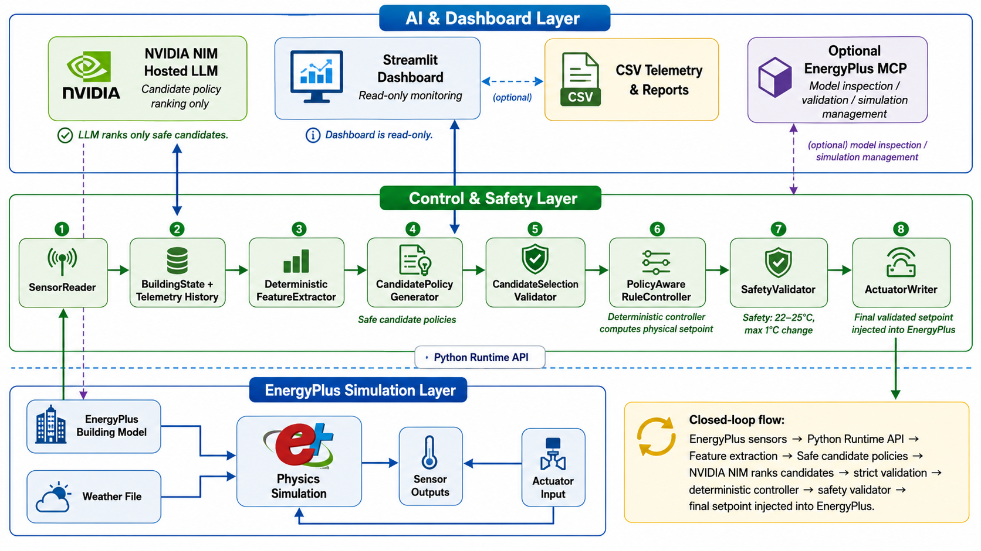
TECHNICAL APPROACH
Pipeline: EnergyPlus → SensorReader → FeatureExtractor → CandidatePolicyGenerator → NVIDIA NIM → CandidateValidator → PolicyAwareRuleController → SafetyValidator → ActuatorWriter → EnergyPlus
Technologies: Python, EnergyPlus Runtime API, NVIDIA NIM, Streamlit, pandas, Docker/MCP (optional), CSV telemetry

Slide 5
FEASIBILITY AND VIABILITY
Feasibility
Risks
Mitigation
Mature EnergyPlus simulation platform for building digital twins
Open-source LLM enables intelligent supervisory decision-making
Real-time Python Runtime API supports closed-loop control
Scalable architecture for commercial smart buildings
Modular design allows easy deployment and future extensions
Readily deployable using existing cloud and edge infrastructure
Unsafe AI-generated control decisions
High energy consumption during peak demand periods
Real-time response latency affecting control quality
Model adaptation across different building configurations
Maintaining occupant comfort while reducing energy usage
Deterministic safety validation before every actuator command
Bounded candidate-policy selection instead of unrestricted AI control
Rule-based fallback for invalid or delayed AI responses
Continuous feedback loop using live EnergyPlus sensor data
Modular architecture supporting easy adaptation to different buildings

Slide 6
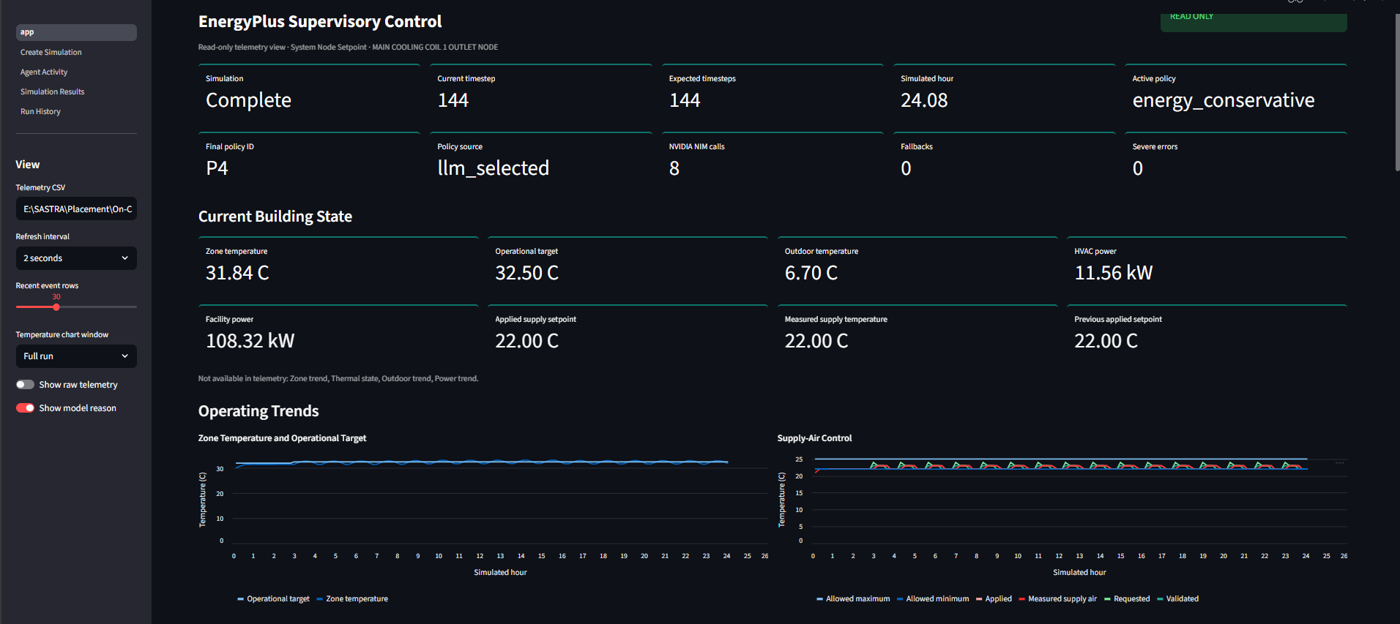
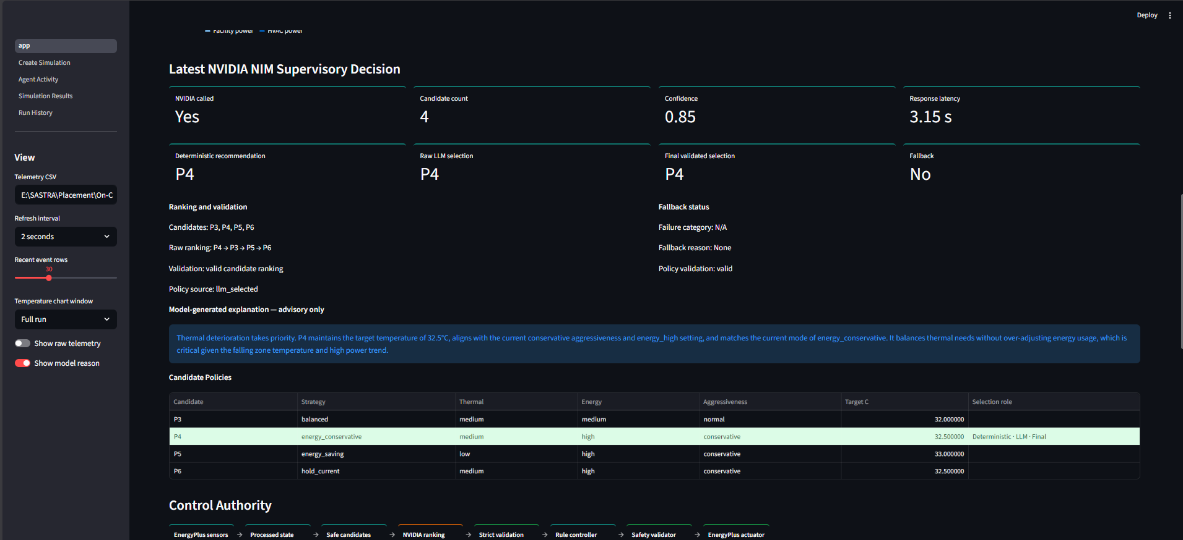
Artifacts & References
Artifacts
GitHub repository (placeholder link)
Streamlit dashboard
Telemetry CSV
One-day smoke-test report
Architecture diagram
EnergyPlus simulation outputs
References
EnergyPlus Runtime API
NVIDIA NIM hosted inference
LBNL EnergyPlus MCP repository
Model Context Protocol

