Slide 1
MEGATHON 2023
AMPED UP
HARSHVARDHAN PANDEY , VAISHNAVI SHIVKUMAR , ANIRUTH SURESH , KUSHANG AGARWAL , MEET GERA

Slide 2
Machine Learning In agriculture

Slide 3
Problem
Estimating health of the prospective paddy crop purchase with least human involvement.

Slide 4
Source
Image of the crop taken locally with geotagging
Notes:
Consider talking about:
Machine learning tasks

Slide 5
RESNET90
Dataset used Source : https://www.kaggle.com/datasets/shayanriyaz/riceleafs/
3385 .jpg files with 4 categories : Brown Spot , Healthy , Hispa, LeafBlast.
BrownSpot , LeafBlast and Hispa are combined to form unhealthy.
Thus, 2 Categories : Healthy , Unhealthy.
Notes:
Consider talking about:
Relation to data mining
Relation to optimization
Relation to statistics

Slide 6

MODEL Theory
Image to RGB array
Data augmentation using existing data.
Normalize Image Array for Stable and fast Processing.
Global Average Pooling
maps whole Image to probability of feature.
ReLU (Reactified
Linear unit) as activation function.
F(x) = max(0,x).
Conv2D layer
With 64 filters,
3*3 kernel.

Slide 7
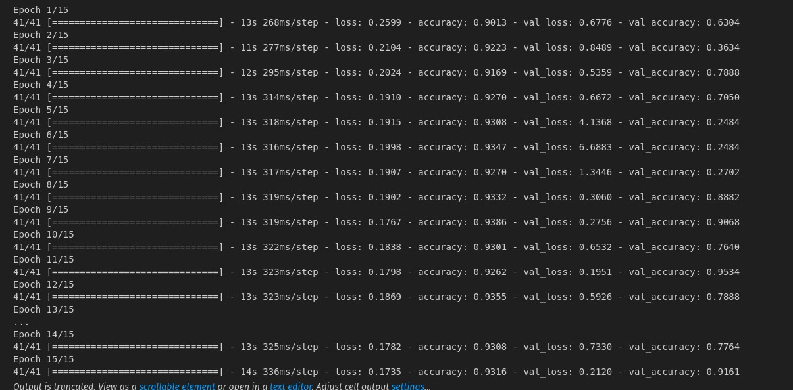
ACCURACY
Accuracy over Epochs, average Accuracy above 66%
Notes:
Consider talking about:
Types of learning algorithms
Models
Training models

Slide 8
Application
Government token which :
Maps crop to harvested location.
Mark for health reliability for sale.

Slide 9
Limitations
Lower Accuracy than 50%
Only 1 image taken for analysis.
Notes:
Consider talking about:
Bias

Slide 10
ONLINE Procurement MANAGEMENT system
Easy to Access, Lightweight website.
Basic Personal Information Required.
Healthy estimated crop are eligible for a token.
Farmer can call for human intervention for unhealthy estimated crop
Notes:
Consider talking about:
Bias

Slide 11
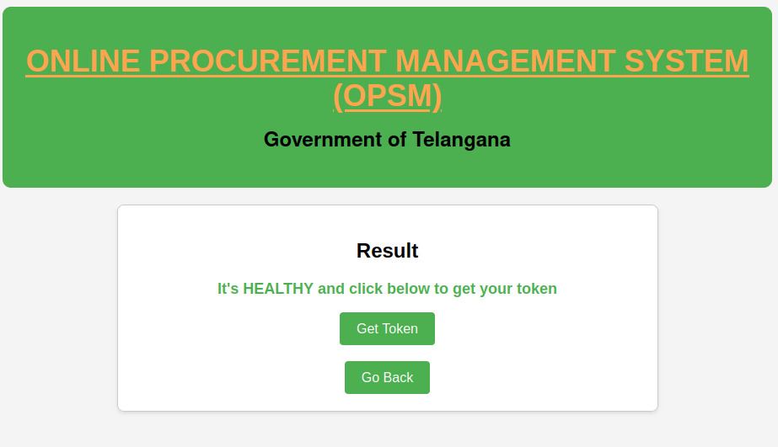
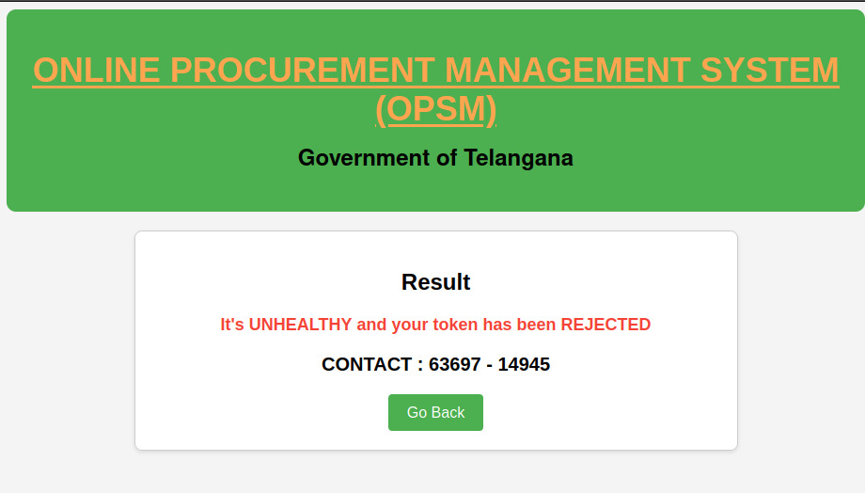
ONLINE Procurement MANAGEMENT system
Notes:
Consider talking about:
Bias

Slide 12
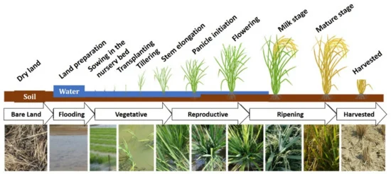
SATELLITE MODEL
NDVI parameter would be measured across the time frame of 119 Days.
Initially it will be near zero because there is only water.
Value increases till MilkStage and then suddenly decreases as crop changes colour on maturation.
Unable to do due to lack of data set.
Notes:
Consider talking about:
Bias

Slide 13
References
https://www.kaggle.com/code/itsmegood/rice-leaf-disease
https://www.kaggle.com/code/swastikkulkarni/rice-crop-detection
Notes:
Consider talking about:
Bias

