Slide 1
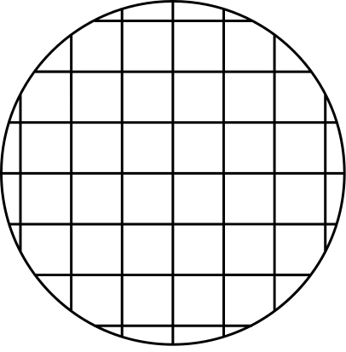




Precog Task
BERTSCORE:
paper analysis
Vaishnavi Shivkumar

Slide 2
Thorough analysis of different text generating scenarios using different models, and analyzing different metrics alongside BERTSCORE
Quantitative, Representative and Robustness analysis, along with examples of further future analysis tasks.
Adequate examples of BERTSCORE being the most similar to human judgement out of all possible models (SOTA.)
Strengths

Slide 3
BERTSCORE doesn't seem to show better results with importance weighting consistently.
There is no one metric of BERTSCORE (either precision, recall, or F1 score) which is consistently the best measure of human judgement, despite BERTSCORE metrics being relatively the most close to human judgement.
BERTSCORE doesn't have very stable performance on low resource languages, and doesn't perform too well on abstractive text compression.
Weaknesses

Slide 4
The paper could have done further analysis on why BERTSCORE doesn't show better/more consistent results with importance weighting
The paper could have covered BERTSCORE metric analysis for summarizing as well.
Improvement

