Slide 1

Wrapper for additional packages
PostCSS — парсер, и работает с текстом похожим на CSS.
PostCSS is a powerful CSS Processing tool which can enhance any front-end developers workflow.
PostCSS is a tool for transforming CSS with JS plugins.

Slide 2
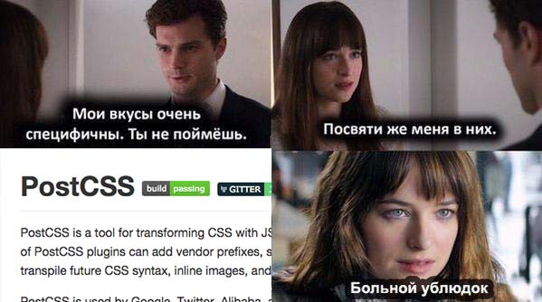

Slide 4
Linters
Critical css
css-modules
https://blog.gospodarets.com/css_apply_rule
Sprites
Inlining - postcss-url

Slide 5
http://davidtheclark.com/its-time-for-everyone-to-learn-about-postcss/
http://slides.com/ai/postcss-intro#/
http://webdesign.tutsplus.com/series/postcss-deep-dive--cms-889
https://www.youtube.com/playlist?list=PLLnpHn493BHFvjZzyYrQP0RTsG-Al7j9m

