Slide 1
Multiplayer Game of Life
Dzmitry Fitsner, James Liu, Kenny Ho, Myron Yao

Slide 2
Conway’s Game of Life
Cellular automaton devised by British mathematician John Horton Conway in 1970
Zero player game – result determined by initial state with no further user input

Slide 3
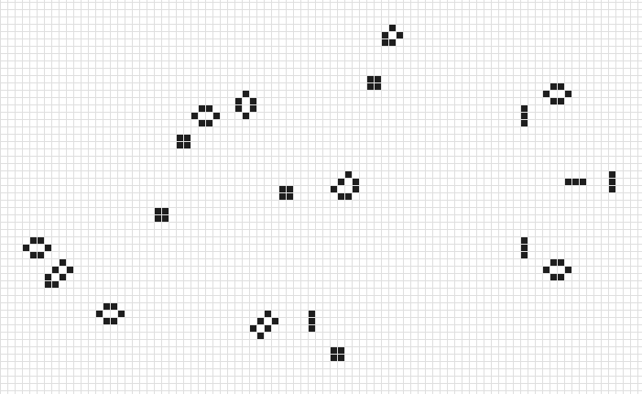
Universe consists of 2D grid of “cells”
Each cell has only two states: Alive or Dead
Universe’s evolution is governed by 4 rules:
Any live cell with fewer than two live neighbors dies, as if by underpopulation.
Any live cell with two or three live neighbors lives on to the next generation.
Any live cell with more than three live neighbors dies, as if by overpopulation.
Any dead cell with exactly three live neighbors becomes a live cell, as if by reproduction.

Slide 4


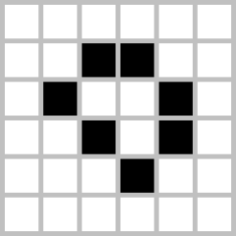
Patterns
Blinker
Toad
Pulsar
Block
Boat
Loaf
Glider
Lightweight spaceship

