Slide 1
September 2024
Analysis results
Predicting Control Energy Volumes for
Grid Stability
Notes:
B.

Slide 2
Agenda
Reminder of the objectives
Approach adopted
Analysis of variables
Benchmarks
Notes:
B.

Slide 3
Reminder of the objective
Hackathon Objective
Develop a model that predicts the daily total volume of mFRR+ and mFRR- for day-ahead (by 10 a.m. today for the following day).
Long-Term Goal
Develop a model that predicts the daily total volume of mFRR+ and mFRR- over the long term (several months ahead).
Assumptions
If we are unable to predict accurately in the very short term, it will be challenging to predict over the long term.
Notes:
B.

Slide 4
Approach
Analysis of relevant available variables
Calendar analysis
Weather analysis
Price analysis
Analysis of other variables (conso/prod/border/etc.)
Selection of the variables most correlated with the target
Development of different models in a real backtested situation (data used = data actually available at time t → stability + NO overfitting)
Simple average over the period
Benchmark on calendar data
Use of all the most relevant data
Notes:
B.

Slide 5
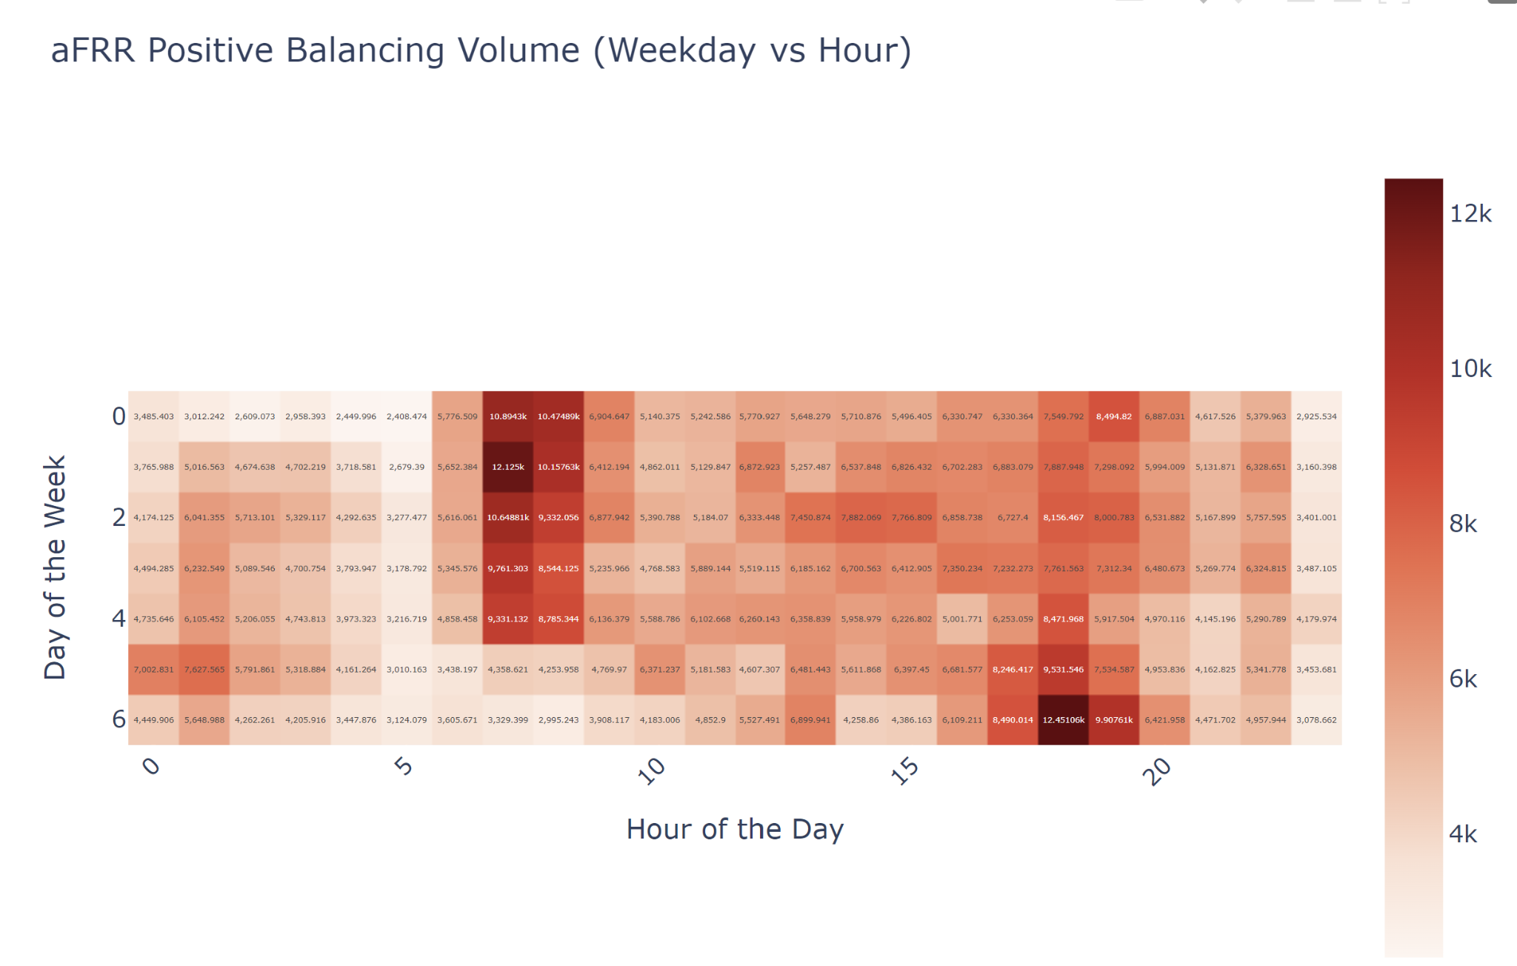
Calendar features
The time of day and the day of the week are very informative about the volume activated
Peaks are between 6-8am on weekdays and between 5pm and 7pm every day.
Nights are less busy
Notes:
B.

Slide 6
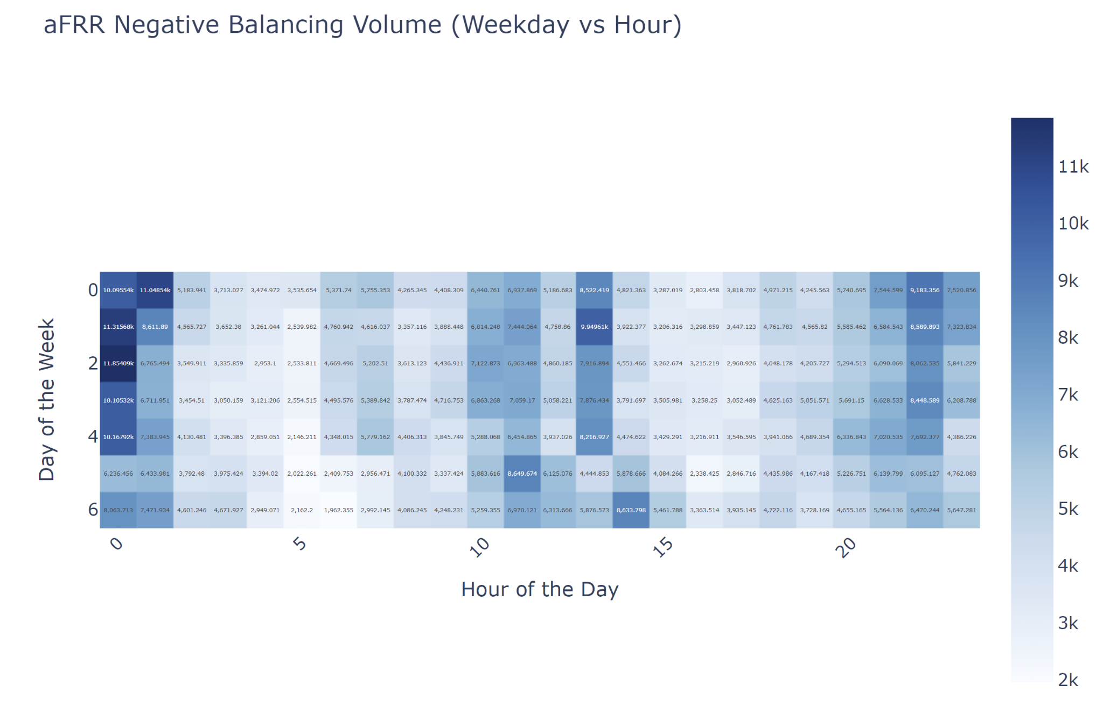
Calendar features
The time of day and the day of the week have a major influence on the volume activated
Peaks tend to occur at night and in the middle of the afternoon
Notes:
B.

Slide 7
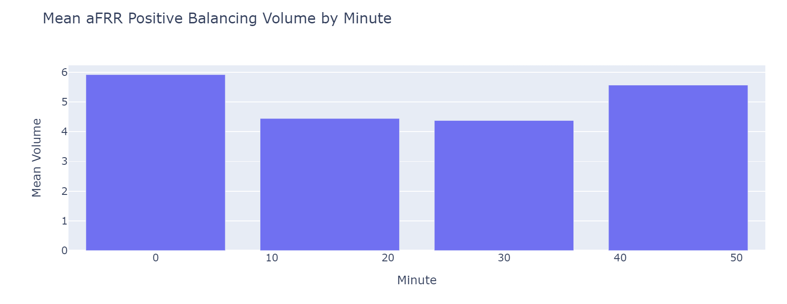
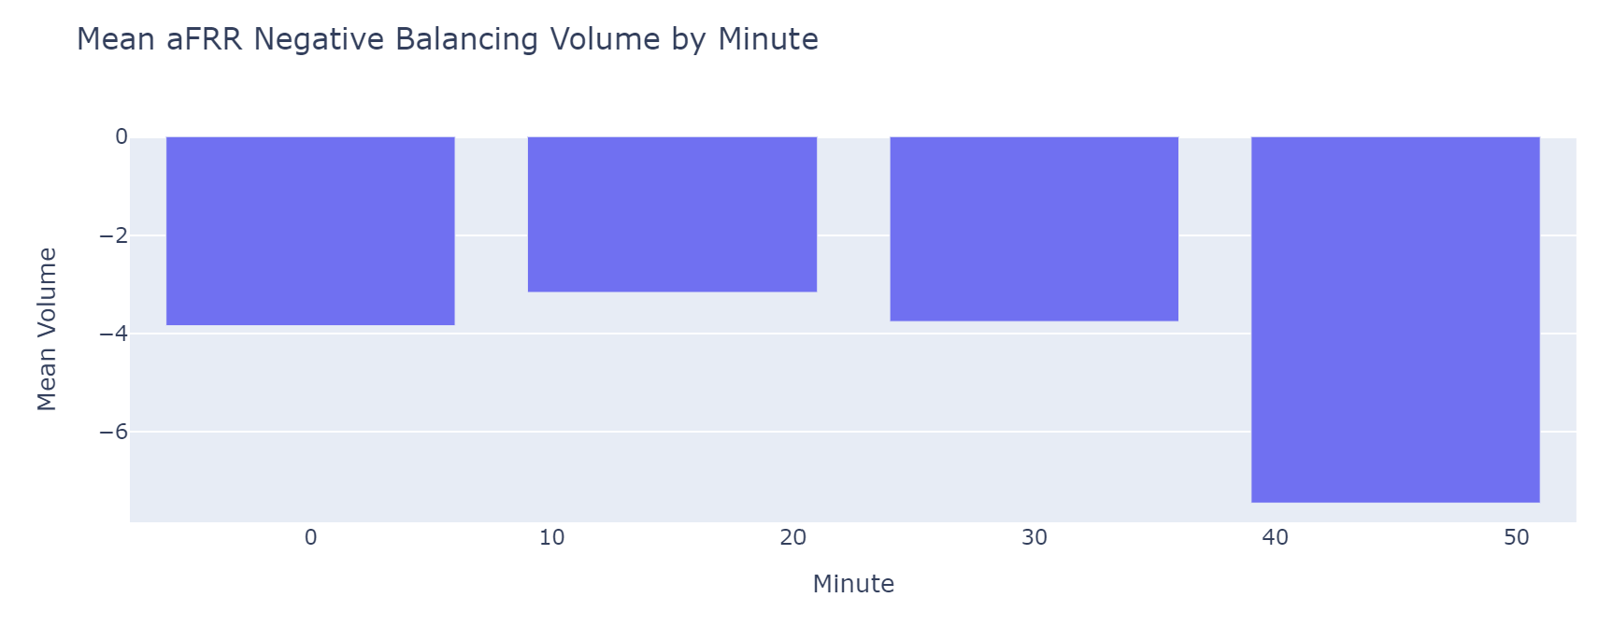
Calendar features
The position of the quarter-hour within the hour seems to be informative
Notes:
B.

Slide 8
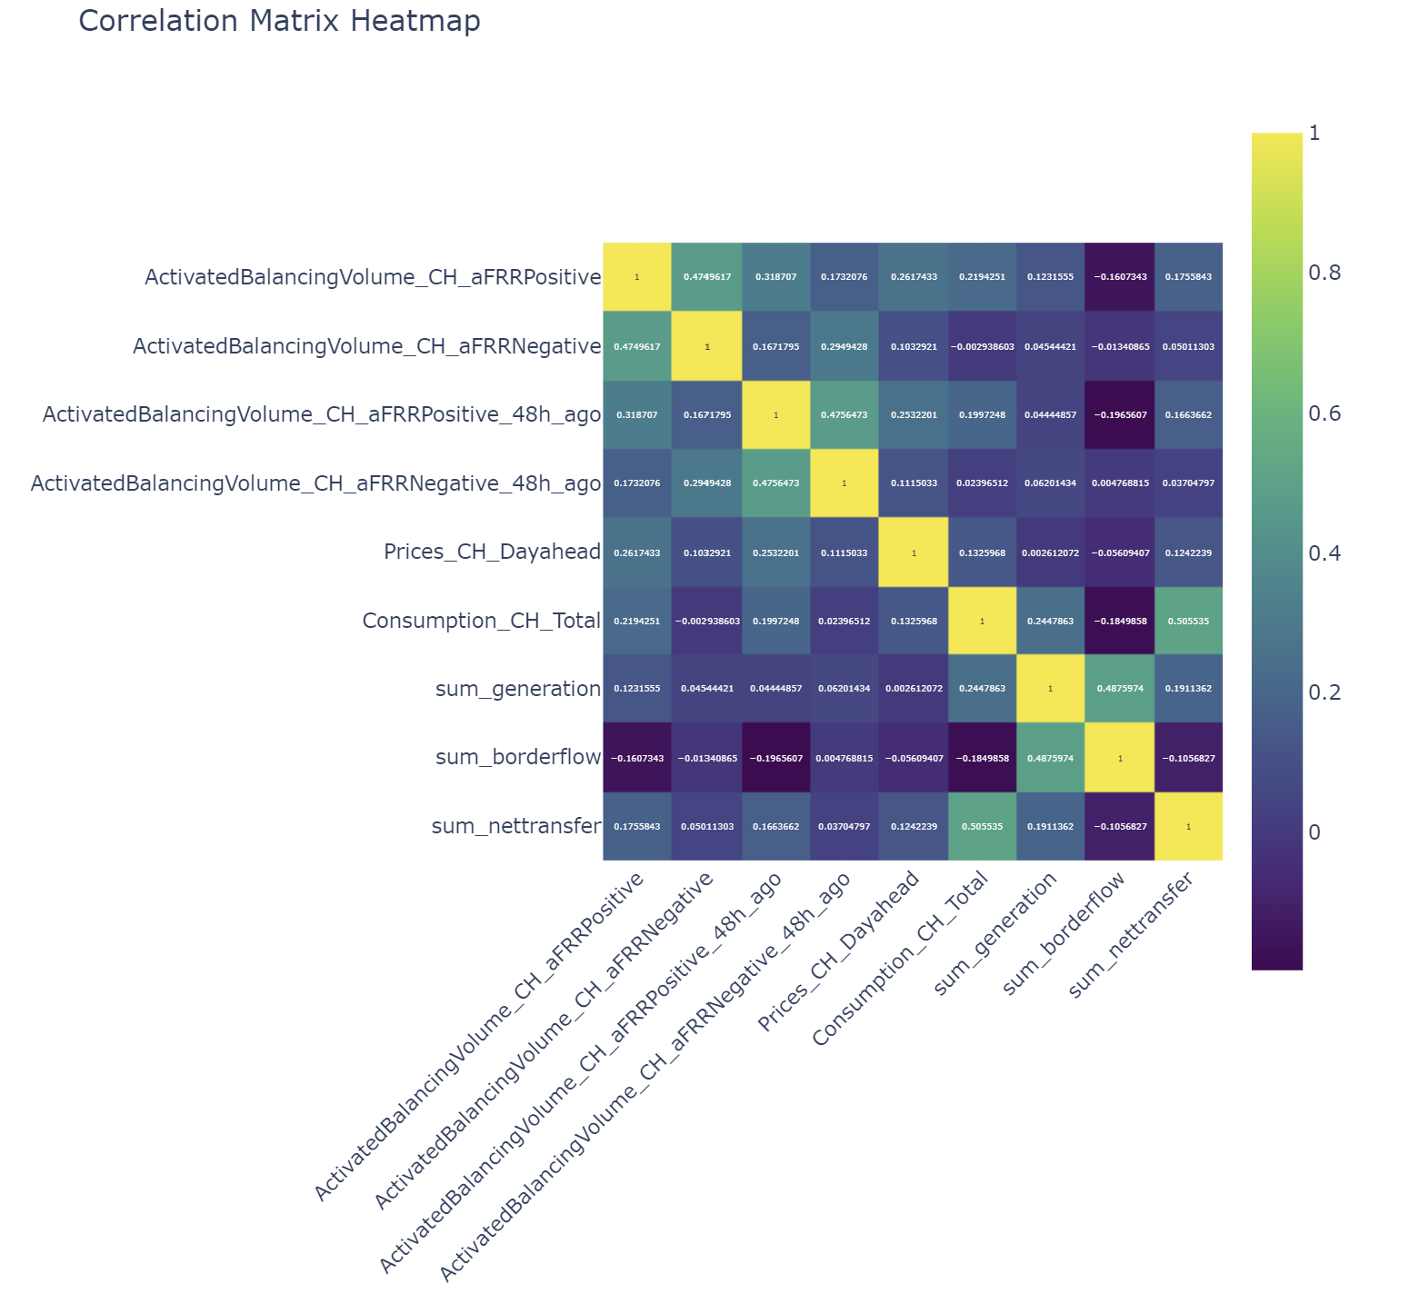
Other features
Price and consumption seem to be slightly correlated, but... is this intrinsically due to the time of day?
The most correlated variable is activation in the previous days
Notes:
B.

Slide 9
Benchmarks: set up
Test carried out in a real-life situation over the period 1.1.2024-6.15.2024:
Only the data available at 10am on the previous day is used to predict the following day.
The model is re-trained each day and predicts the following day.
This approach guarantees the usability of the live solution
It also guarantees the stability of the solution
Notes:
B.

Slide 10
Benchmarks
Model 1:
Naive average over the period
RMSE:
Model 2: Best
Trained only on calendar data
RMSE:
Model 3:
Trained on variables assumed to be most relevant
RMSE:
Notes:
B.

Slide 11
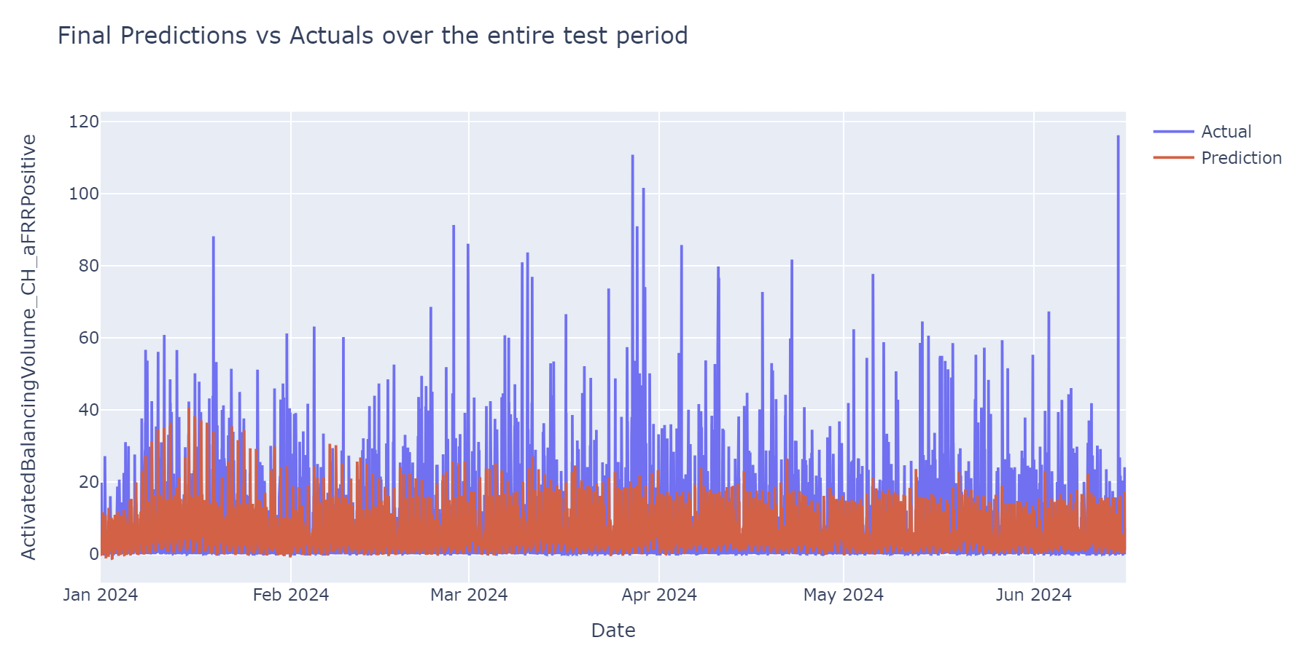
Best fitting and ongoing development
Facts:
Calendar variables capture much of the information
Next steps:
Integrate short-term variations (variations in weather forecasts / production / consumption / market stability)
Notes:
B.

