Slide 1
Assignment 1

Slide 2
Assignment problems in IPP given on April 23rd, 2020
Write all the programs using C language.
1. WACP to find the sum of Fibonacci series
2. WACP to find the sum of even numbers of n numbers
3.WACP to find the sum of odd numbers of n numbers
4. WACP to print
a. Hello World
b. Hello world
c. hello world
d. HELLO WORLD
5. WACP to implement string methods

Slide 3
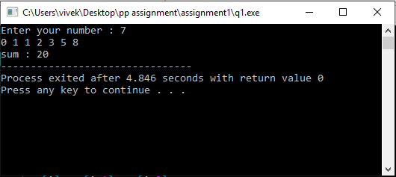
1. WACP to find the sum of Fibonacci series
#include <stdio.h>
int main()
{
int n,i,arr[100],sum;
printf("Enter your number : ");
scanf("%d",&n);
arr[0]=0;
arr[1]=1;
sum=arr[0]+arr[1];
for(i=2;i<n;i++)
{
arr[i]=arr[i-1]+arr[i-2];
sum+=arr[i];
}
for(i=0;i<n;i++)
{
printf("%d ",arr[i]);
}
printf("\nsum : %d",sum);
return 0;
}
Output:

Slide 4
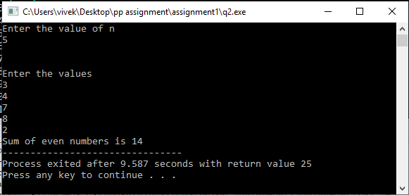
2. WACP to find the sum of even numbers of n numbers
#include <stdio.h>
int main()
{
int i,n,arr[100],sum=0;
printf("Enter the value of n\n");
scanf("%d",&n);
for(i=0;i<n;i++)
{
scanf("%d",&arr[i]);
}
for(i=0;i<n;i++)
{
if(arr[i]%2==0)
{
sum+=arr[i];
}
}
printf("Sum of even numbers is %d",sum);
}
Output:

Slide 5
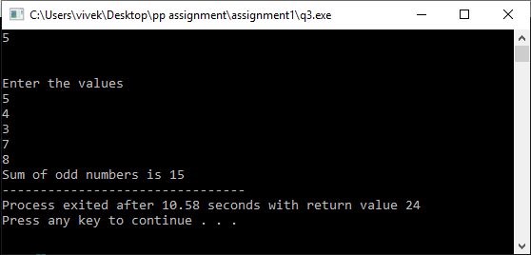
3. WACP to find the sum of odd numbers of n numbers
#include <stdio.h>
int main()
{
int i,n,arr[100],sum=0;
printf("Enter the value of n\n");
scanf("%d",&n);
printf("\n\nEnter the values\n");
for(i=0;i<n;i++)
{
scanf("%d",&arr[i]);
}
for(i=0;i<n;i++)
{
if(arr[i]%2!=0)
{
sum+=arr[i];
}
}
printf("Sum of odd numbers is %d",sum);
}
Output:

Slide 6
4. WACP to print.
a. Hello World, b. Hello world, c. hello world, d. HELLO WORLD
#include<stdio.h>
#include<string.h>
void main()
{
char str[20],temp1[20],temp2[20],temp3[20],temp4[20];
int n,i;
printf("Enter your word ");
gets(str);
n=strlen(str);
strcpy(temp1,str);
strcpy(temp2,str);
strcpy(temp3,str);
strcpy(temp4,str);
for(i=0;i<n;i++)
{
if(i==0 && temp1[i] !=' ' || temp1[i]!=' ' && temp1[i-1]==' ')
{
if(temp1[i]>='a' && temp1[i]<='z')
{
temp1[i]-=32;
}
}
}
printf("\n\n String 1 :%s",temp1);
for(i=0;i<n;i++)
{
if(i==0 && temp2[i] !=' ')
{
if(temp2[i]>='a' && temp2[i]<='z')
{
temp2[i]-=32;
}
}
}
printf("\n String 2 :%s",temp2);
printf("\n String 3 :%s",temp3);
for(i=0;i<n;i++)
{
if(temp4[i]>='a' && temp4[i]<='z')
{
temp4[i]-=32;
}
else if(temp4[i]>='A' && temp4[i]<='Z')
{
temp4[i]+=32;
}
}
printf("\n String 4 :%s",temp4);
}

Slide 7
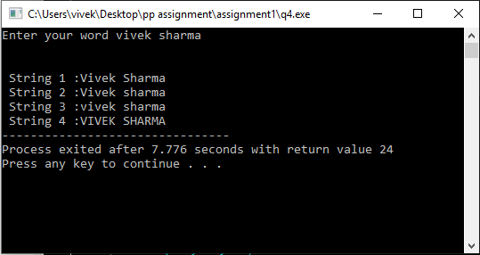
Output:

Slide 8
5. WACP to implement string methods
#include<stdio.h>
#include<string.h>
void main()
{
char str1[20]="hello world of c";
char str2[20]="hello world";
char temp1[20],temp2[20],temp3[20],temp4[20];
printf("String 1 : %s \n",str1);
printf("String 1 : %s \n",str2);
/*C String function – strlen
strlen-It returns the length of the string without including end character*/
printf("length of the 1st string %d:\n",strlen(str1));
printf("length of the 1st string %d:\n",strlen(str2));
/*C String function – strcmp
It compares the two strings and returns an integer value.
If both the strings are same (equal) then this function would return 0 otherwise
it may return a negative or positive value based on the comparison.*/
if (strcmp(str1, str2) ==0)
{
printf("\nstring 1 and string 2 are equal\n");
}
else
{
printf("\nstring 1 and 2 are different\n");
}
/*C String function – strncmp
It compares both the string till n characters or
in other words it compares first n characters of both the strings.*/
if (strncmp(str1, str2, 8) ==0)
{
printf("\nstring 1 and string 2 are equal\n");
}
else
{
printf("\nstring 1 and 2 are different\n");
}
/*C String function – strcpy
It copies the string str2 into string str1,
including the end character (terminator char ‘\0’).*/
strcpy(temp1,str1);
strcpy(temp2,str2);
/*C String function – strcat
It concatenates two strings and returns the concatenated string.*/
strcat(temp1,temp2);
printf("\nOutput string after concatenation: %s\n", temp1);
/*C String function – strchr
It searches string for any character */
printf ("\n%s\n", strchr(str1,'w'));
/*C String function – strstr
It is similar to strchr,
except that it searches for string srch_term instead of a single char.*/
printf ("\nOutput string is: %s\n", strstr(str1, str2));
}

Slide 9
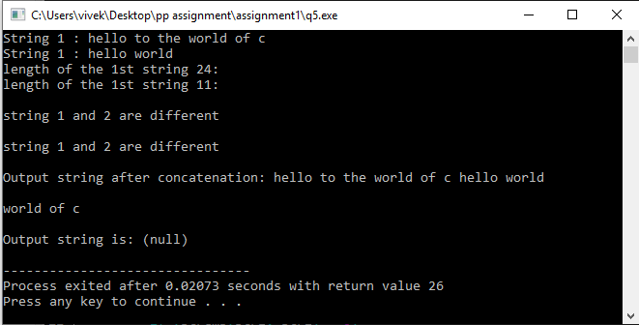
Output:

