Slide 1



Pet Adoption Platform
Team 13
2024/12/18
Chen Letian 2330026013
Chen Tingxuan 2330026020
Yun Haoyi 2230026199
Xu Shuhan 2330026181
Xu Yilang 2330026184

Slide 2

CONTENTS
01.Introduction
02.Front-End
03.Back-End
04.Database
05.Conclusion
→ Live Demo

Slide 3

Introduction
01.

Slide 4
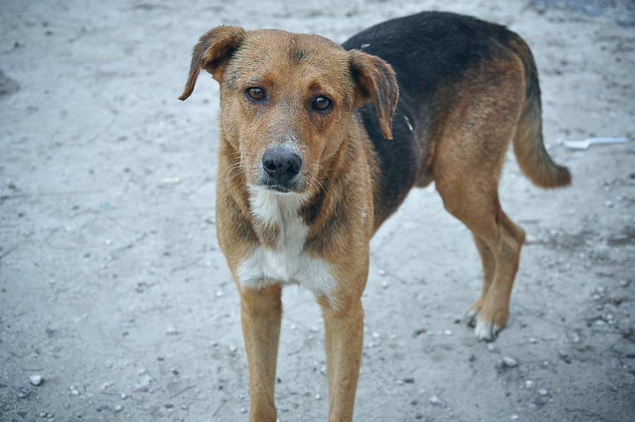
Introduction
Background - The growing issue of
stray animals in modern society.
Goal - Offer users a platform where they can view available animals, apply for adoption, and donate to help improve the lives of animals.

Slide 5
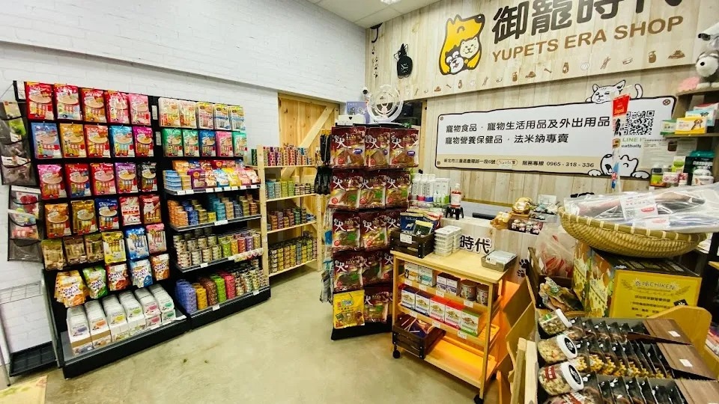
Introduction
Data Collection - Based
on our own experience and
pet-related websites.
We manually created some
of the data, while the rest was randomly generated through the provided program.
Our Website is primarily built using PHP, MySQL, and JavaScript.

Slide 6
We will focus on it later in Live Demo
Front-End
02.

Slide 7
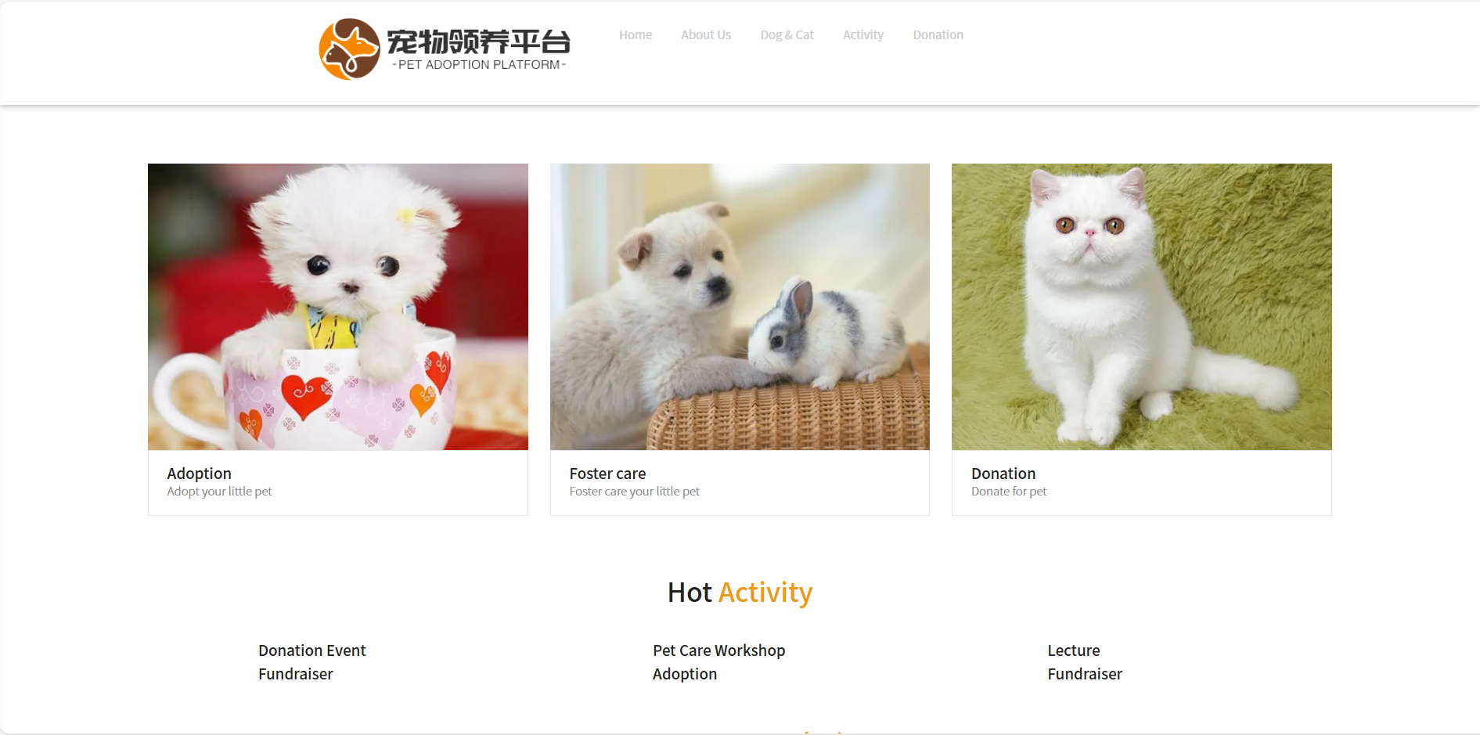
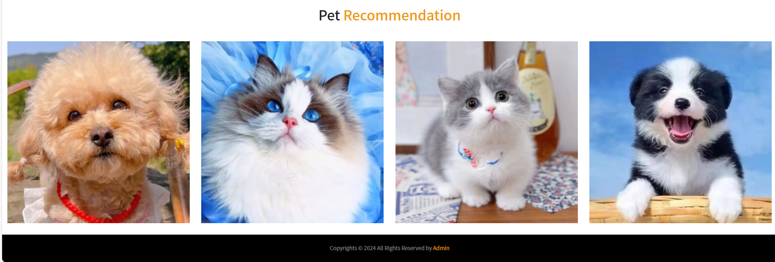
Front-End
Homepage

Slide 8
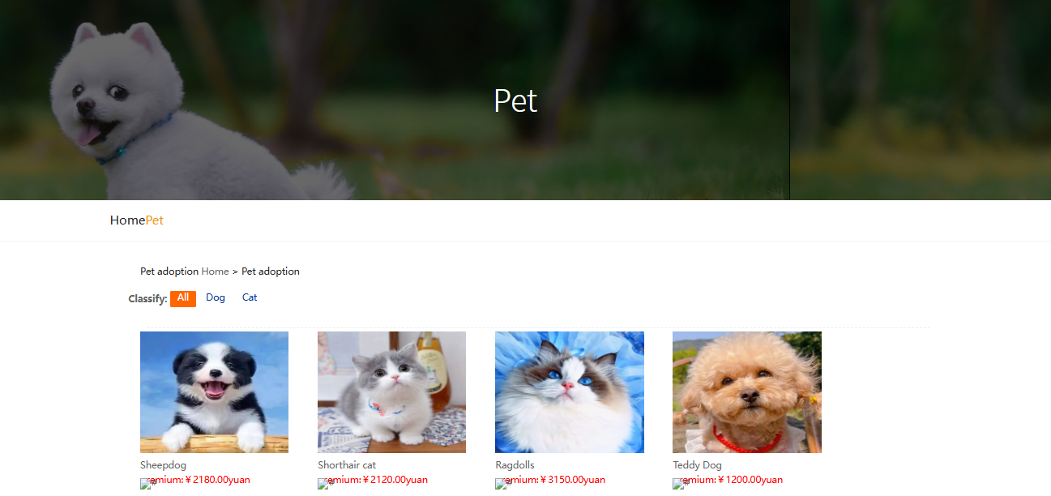
Front-End
Pet

Slide 9
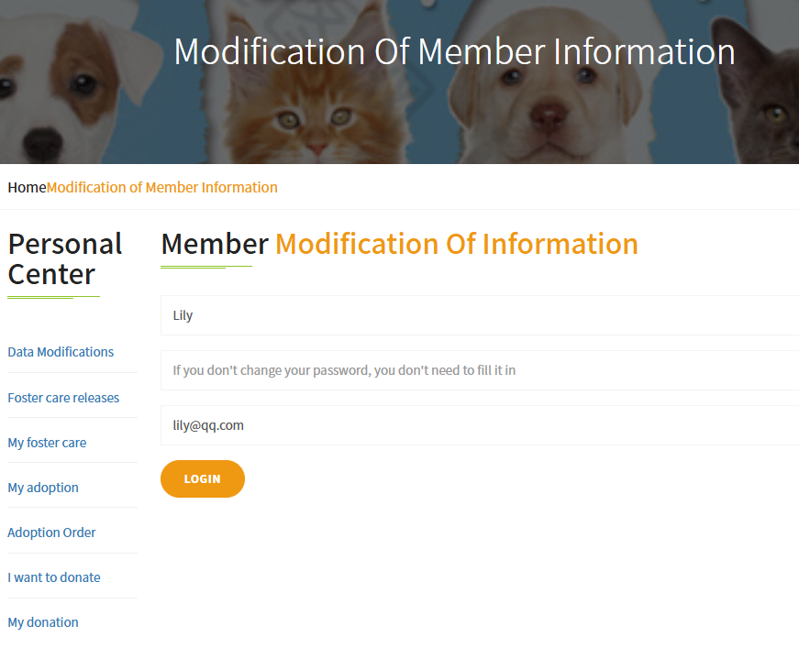
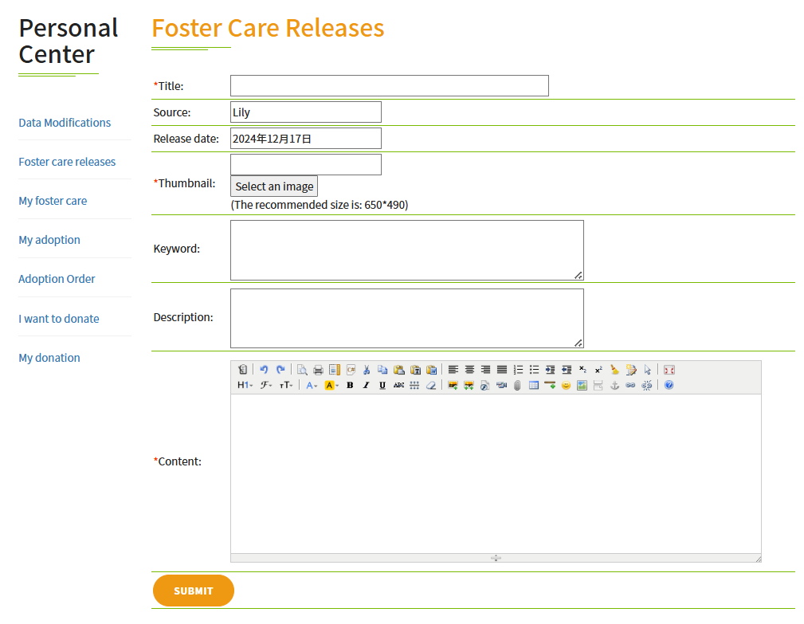
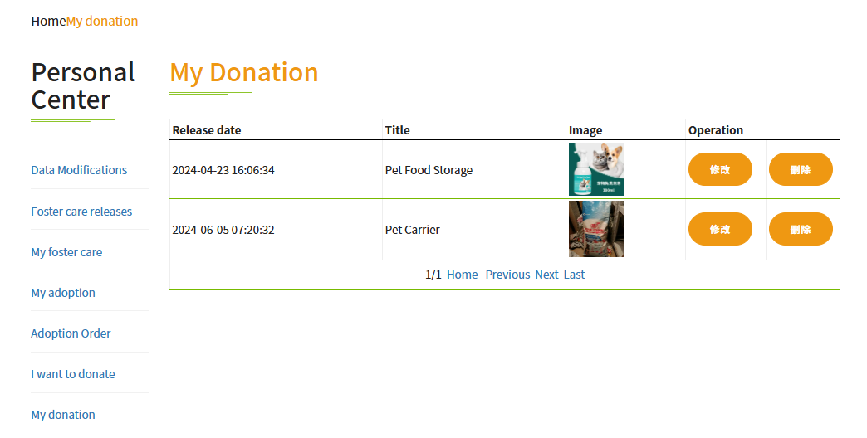
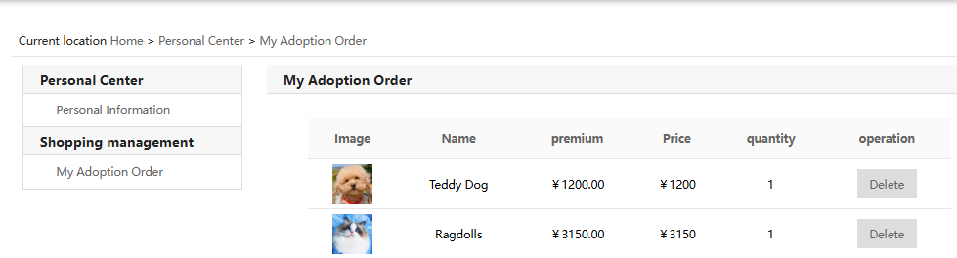
Front-End
Personal Center

Slide 10
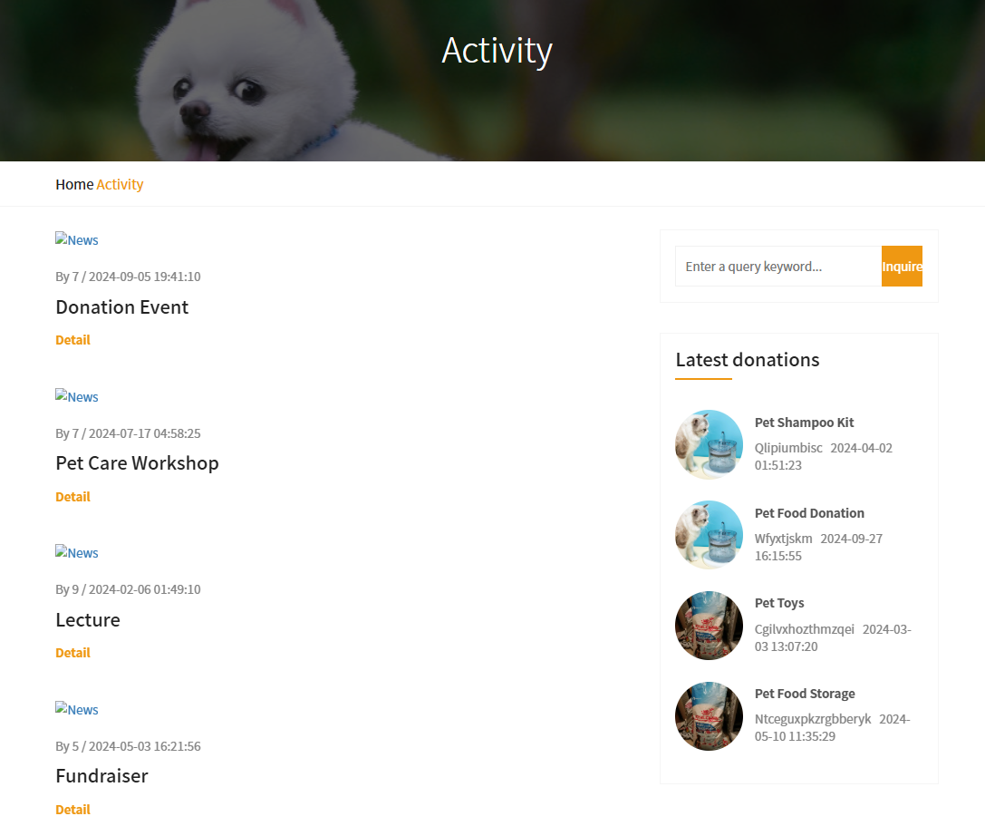
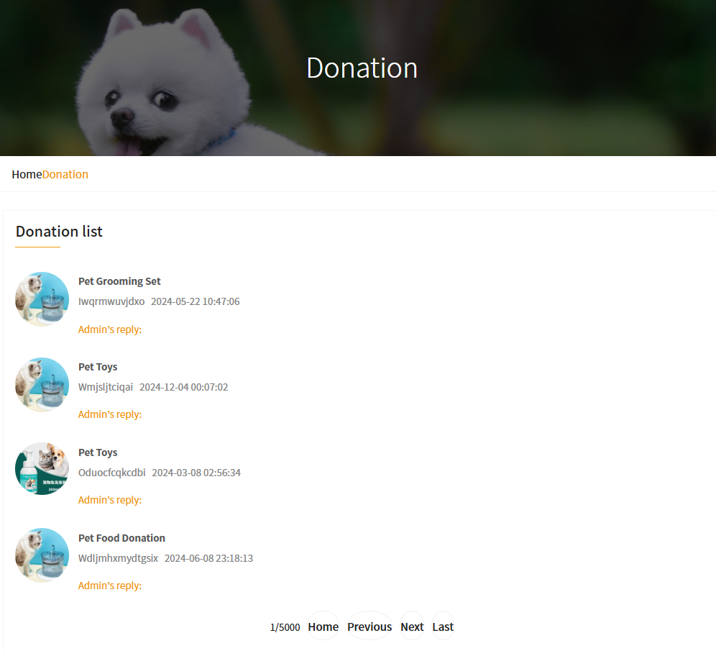
Front-End
Activity and Donation

Slide 11
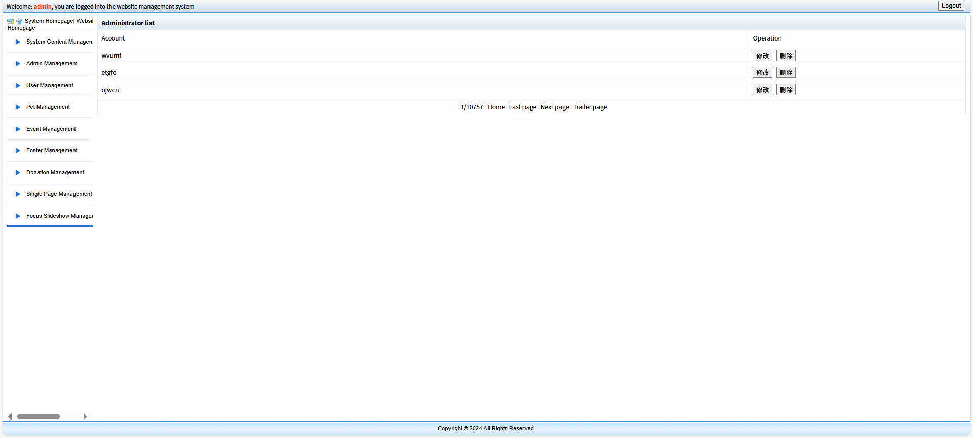
Front-End
Homepage (for admin)

Slide 12
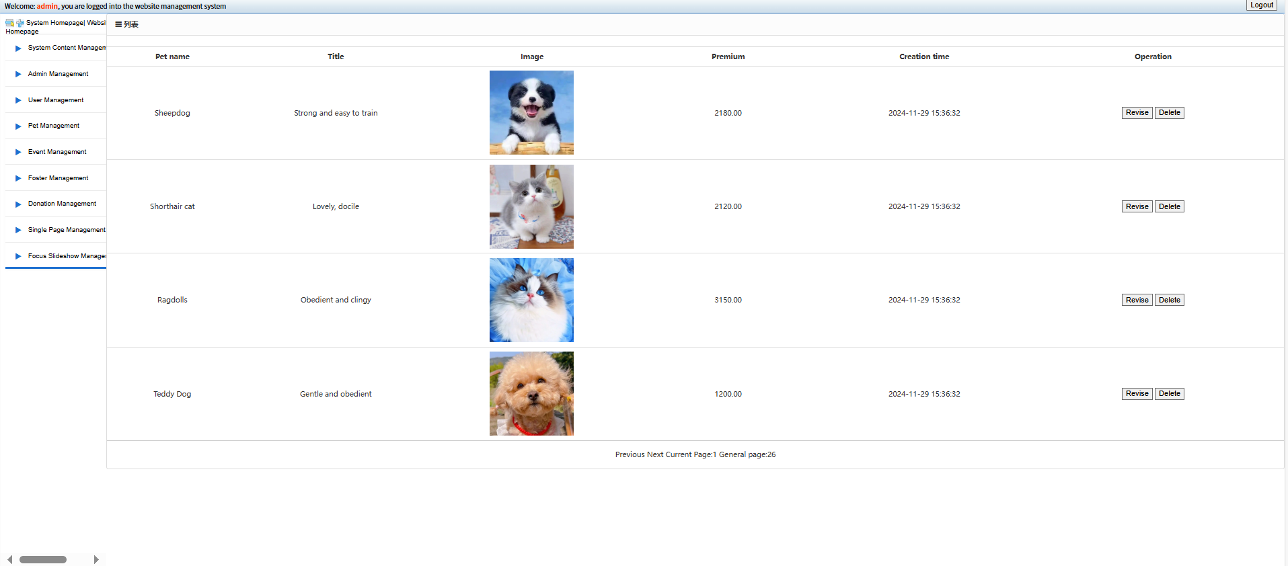
Front-End
Pet Management (for admin)

Slide 13
Back-End
03.

Slide 14
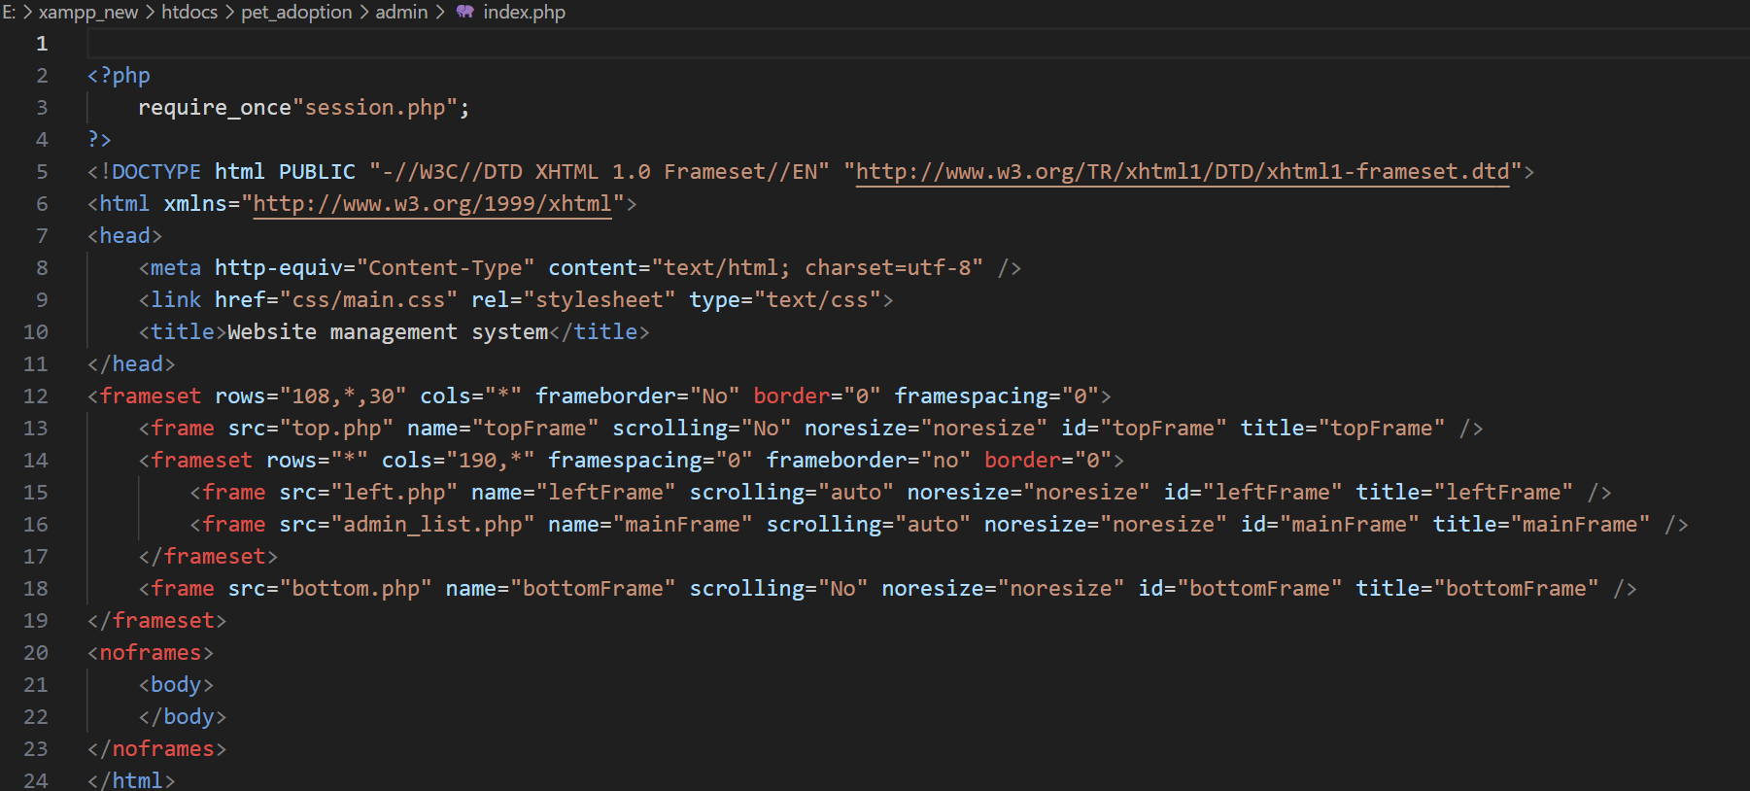
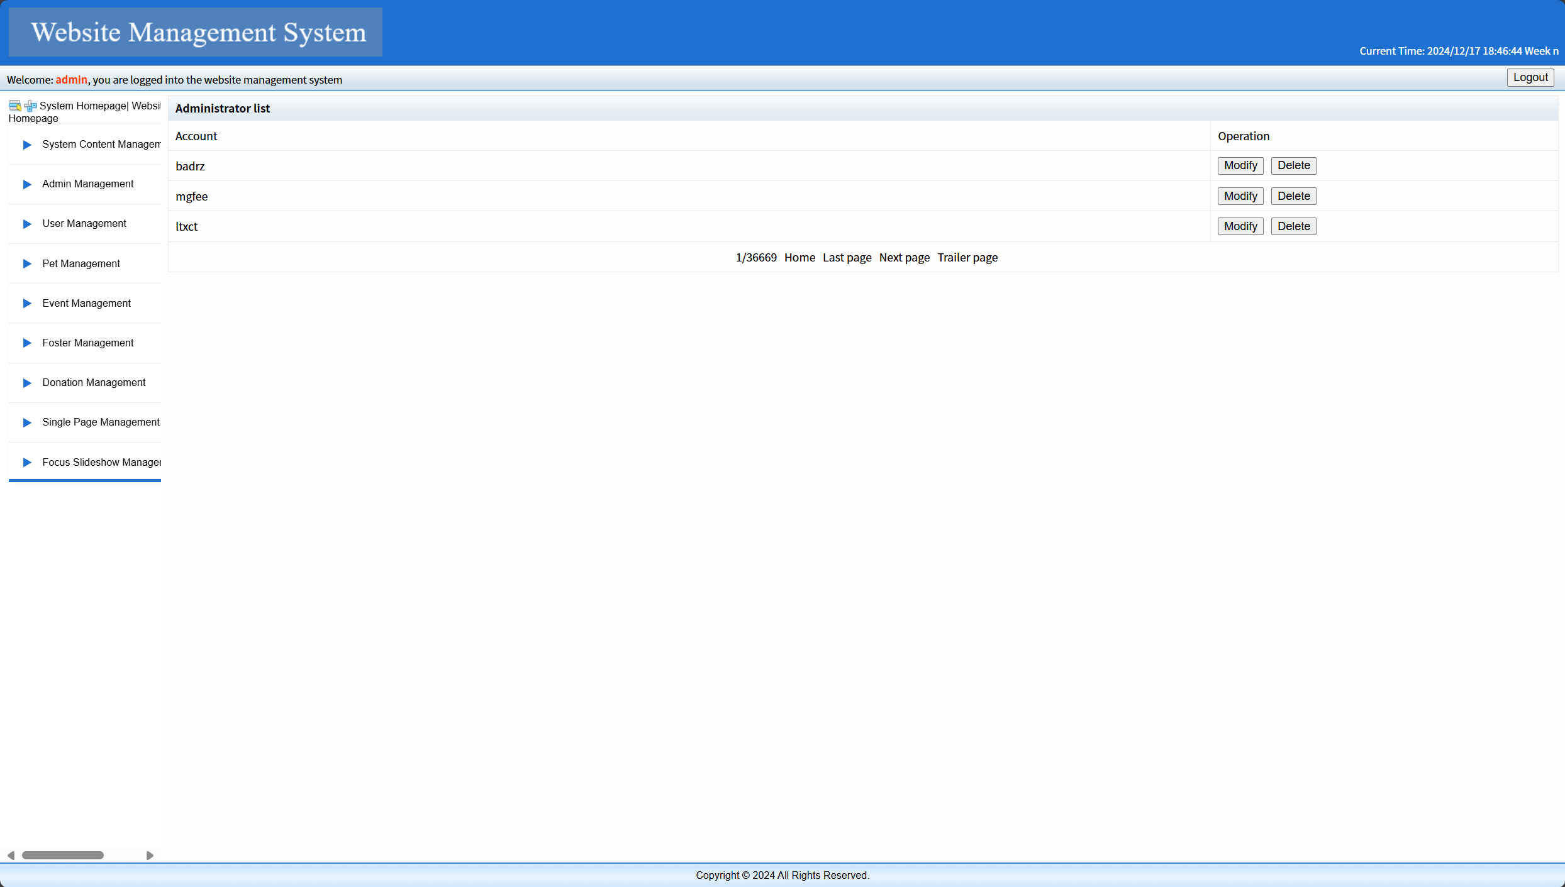

Slide 15

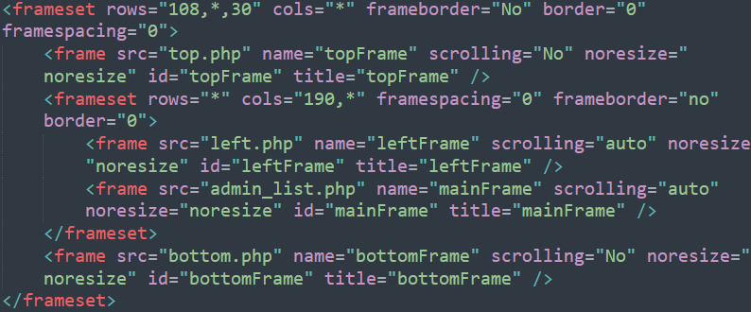
Frame Layout
The use of the `<frameset>` tag divides the page into distinct sections (top, left, main content area, and bottom). This separation helps organize the content into functional areas, which is of benefit in:
1. Clear Page Structure
2. Independent Section Management
3. Faster Page Load
4. Ideal for Admin Dashboards
5. Ease of Maintenance

Slide 16
Database
04.

Slide 17
Production Process
SQL
ER Diagram
Database Implementation
Create a database
Define the table structure: CREATE TABLE
Set the index: primary key, foreign key
Database Test
Generate initial data & large amounts
of virtual test data
Demand analysis
Conceptual Design
Logical Design

Slide 18
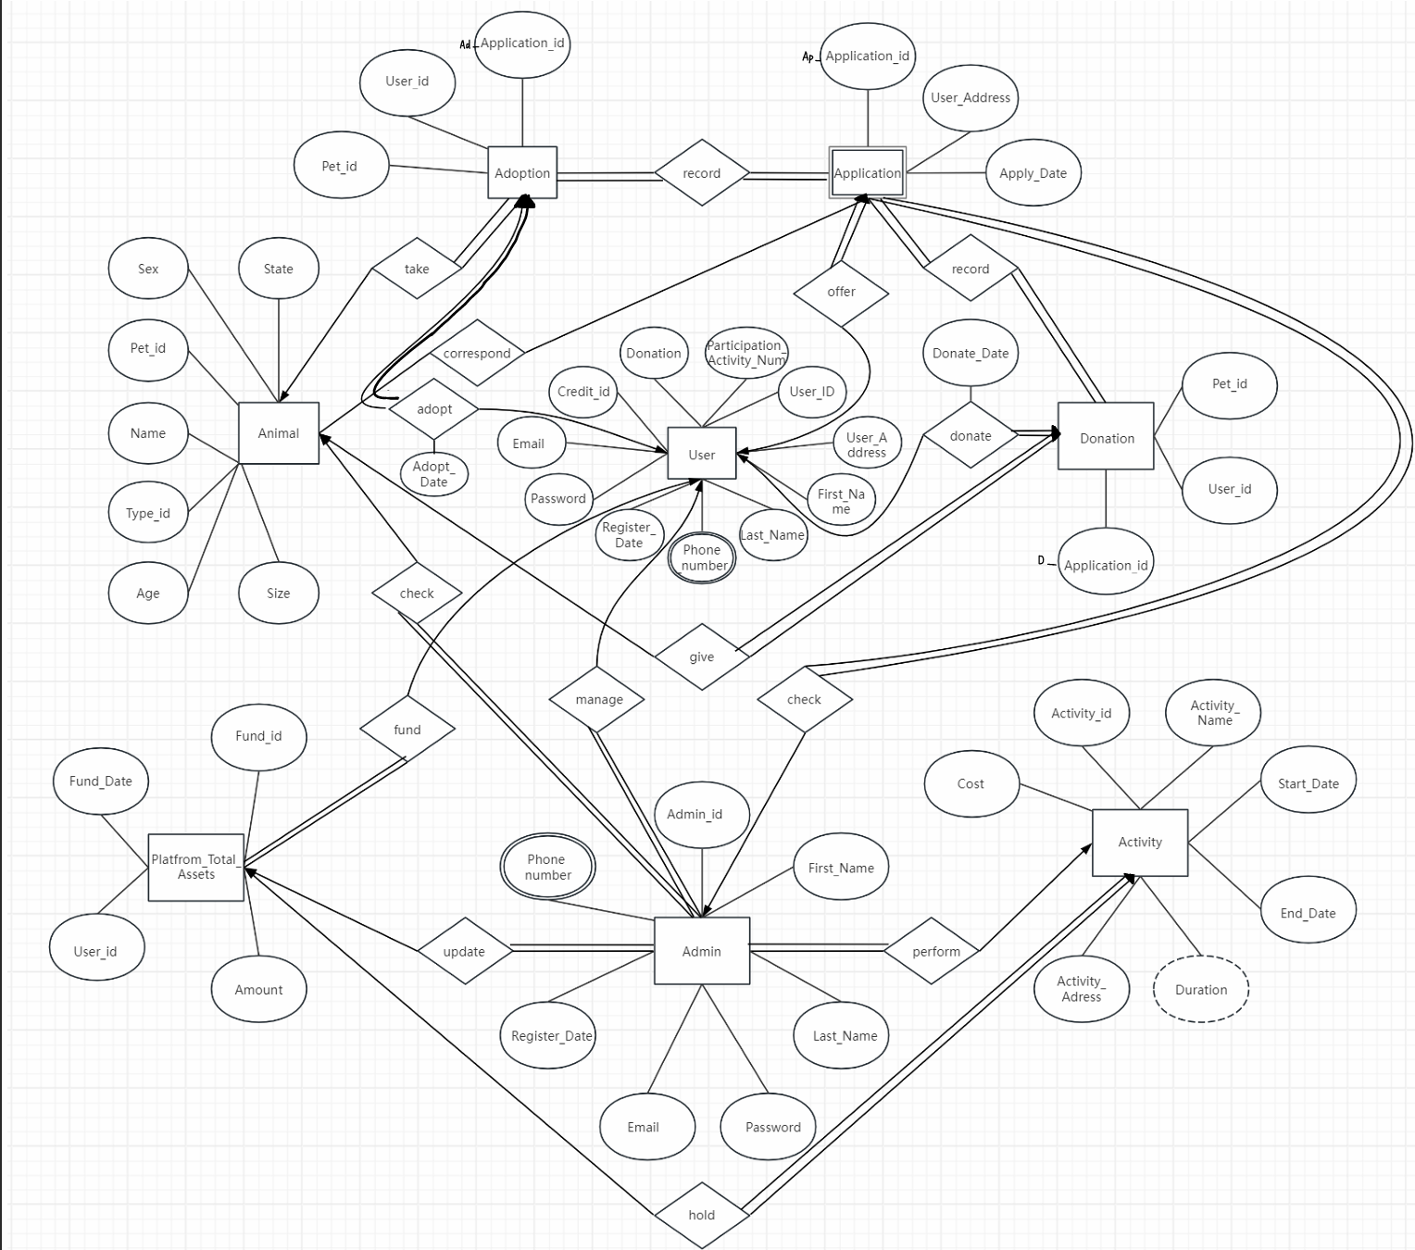
ER Diagram
8 entities & 15 relationships
(not included definition
the set of entities in the
Admin System [E.g. config,
slide, single etc.])

Slide 19
Entity and Relationship
User: User_id, User_address, First_name, Last_name, Phone_num, Register_date, Password, Email, Credit_id, Donation, Participation_Activity_num;
Donation: Pet_id, User_id, Application_id;
Application: Application_id, User_address, Apply_data;
Adoption: Pet_id, User_id, Application_id;
Animal: Pet_id, Type_id, Name, Age, Sex, State, Size;
Platfrom TotalAssets: User_id, Found_Date, Fund_id;
Admin: Admin_id, First_name, Last_name, Password, Email, Register_date, Phone_num
Activity: Activity_id, Activity_name, Start_date, End_date, Duration, Activity_address, cost
Take: one to many relationship
Record: many to many relationship
Offer: one to one relationship
Check: one to many relationship
Fund: one to many relationship
Give: one to one relationship
Preform: one to many relationship
Hold: one to one relationship
Donate: one to one relationship

Slide 20
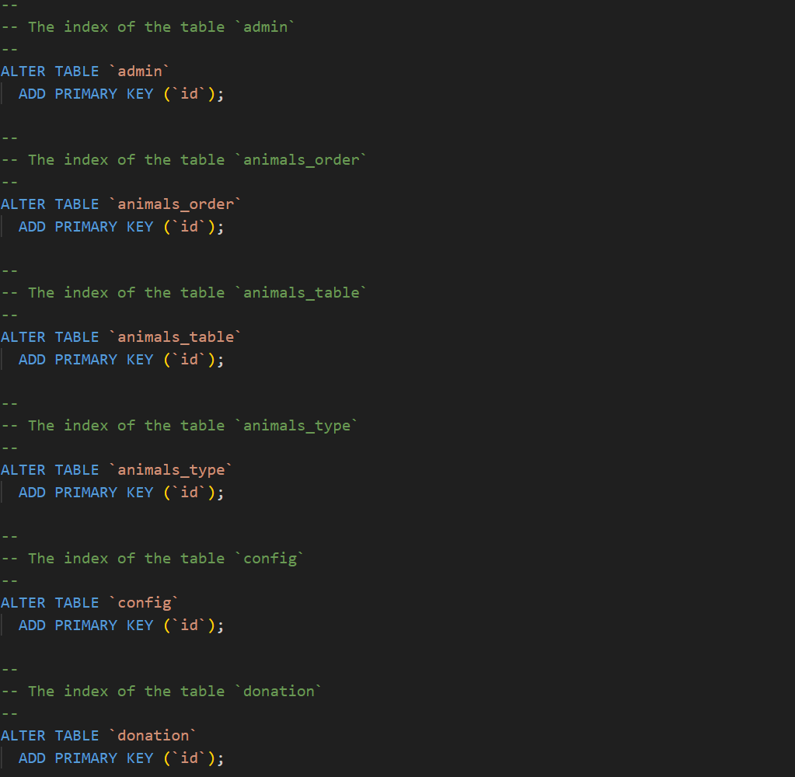
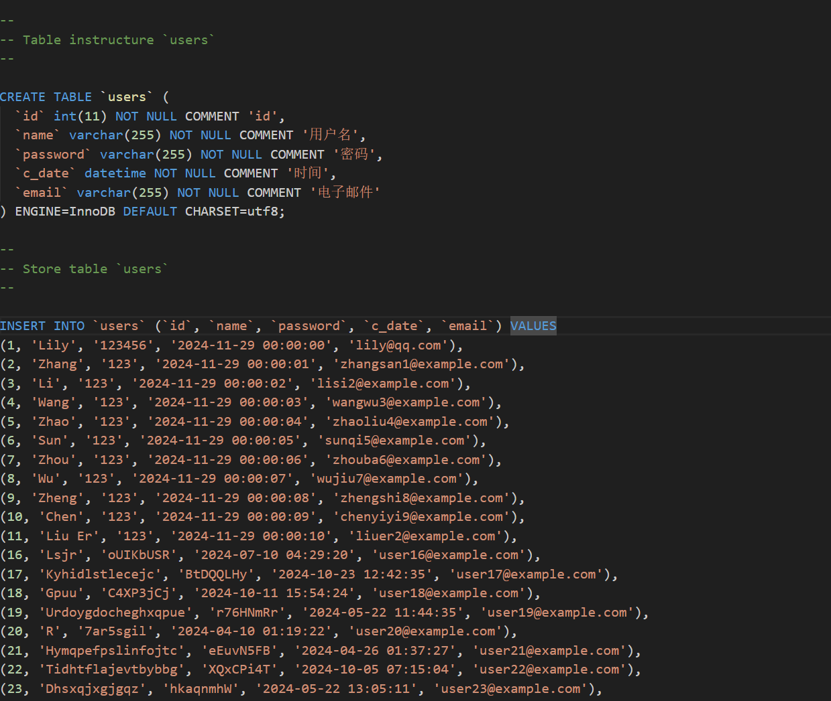
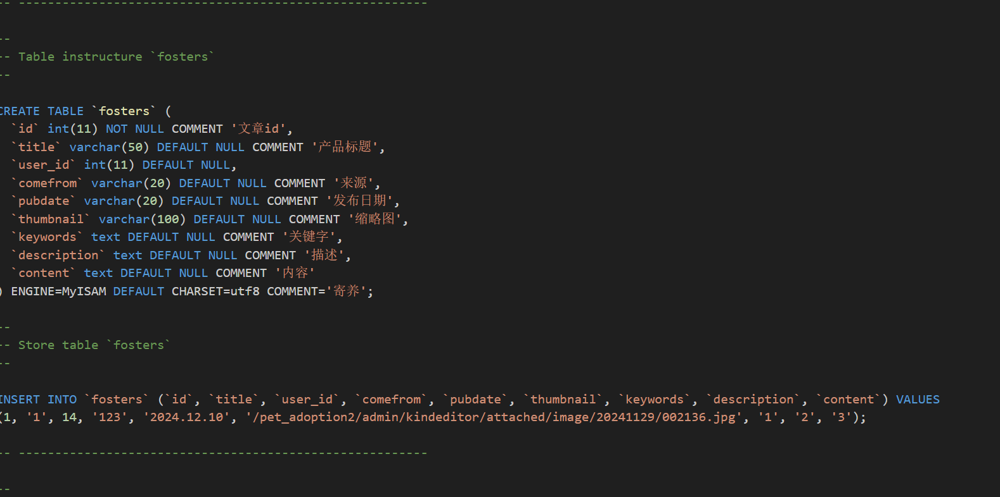
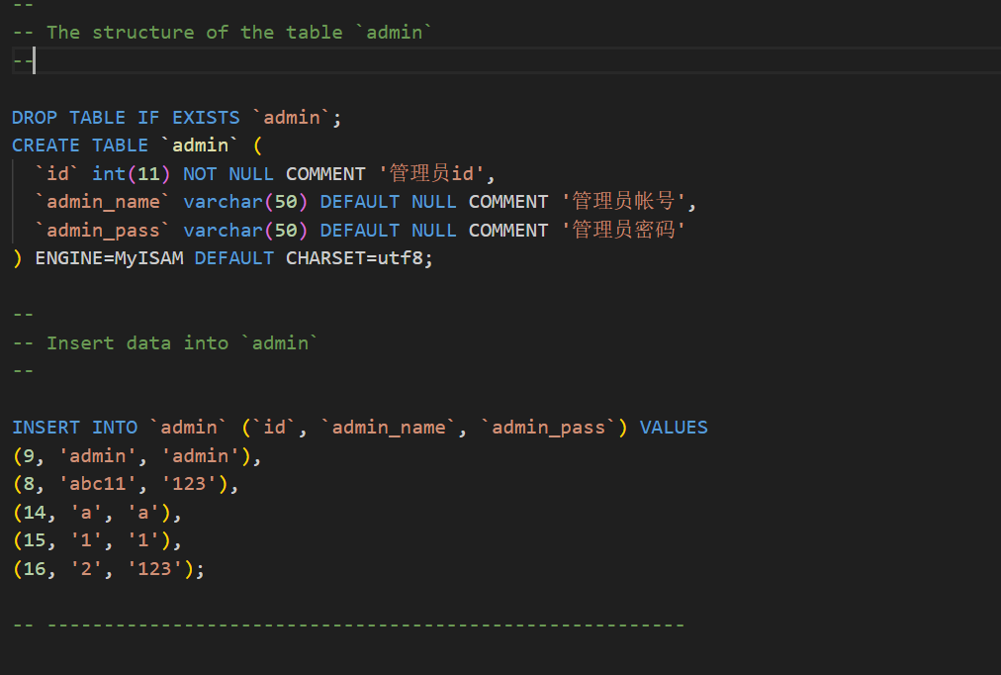
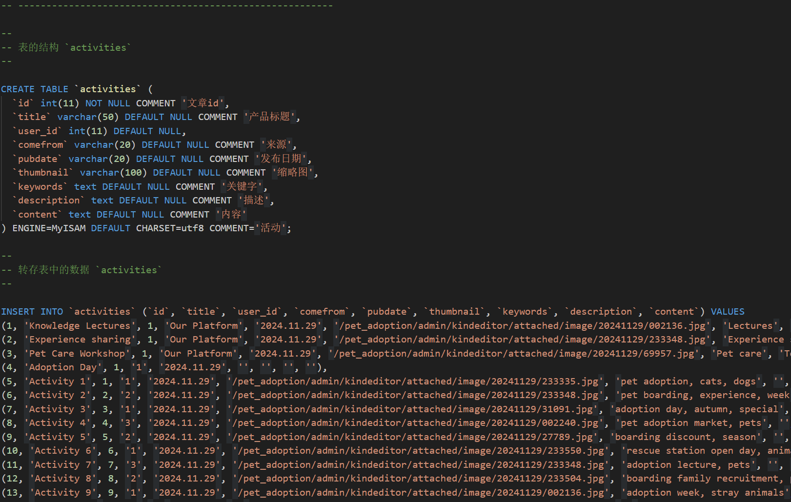
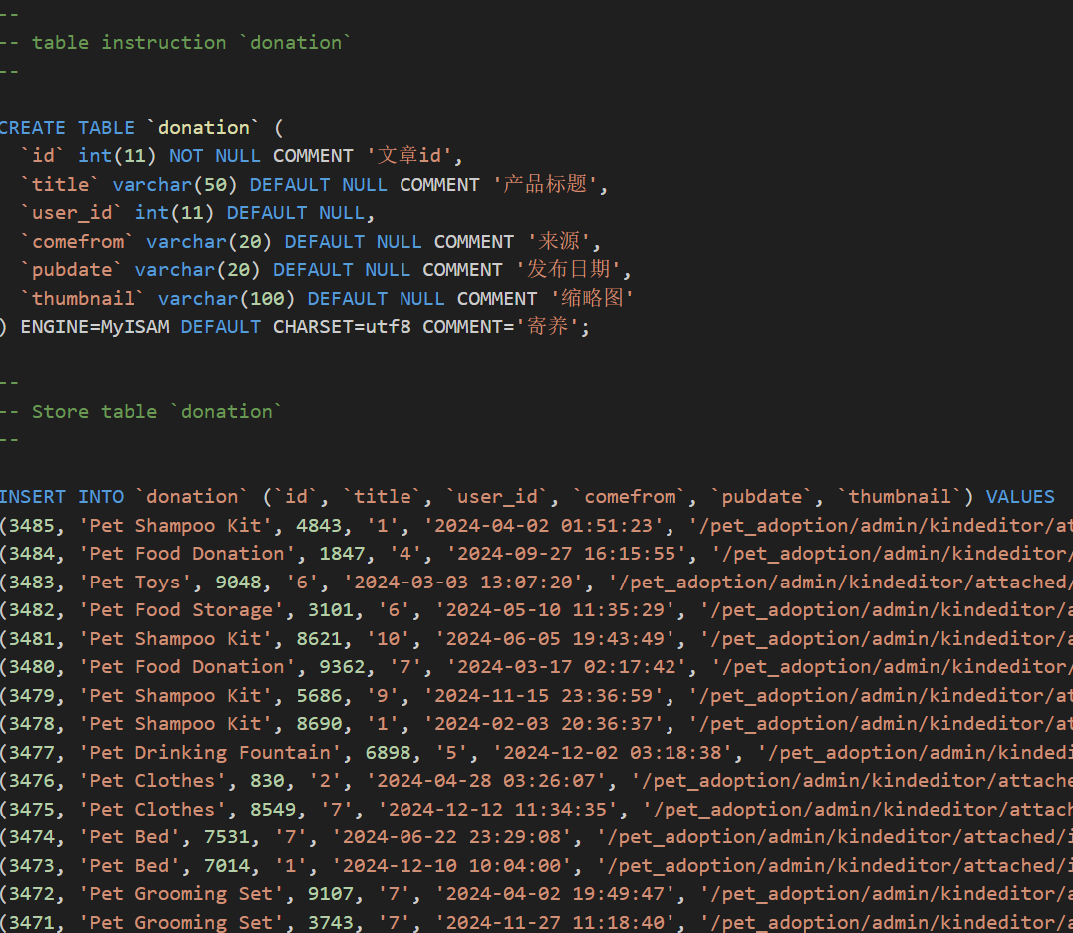
Basic SQL
Sample program：
CREATE TABLE ALTER TABLE
PRIMARY KEY

Slide 21
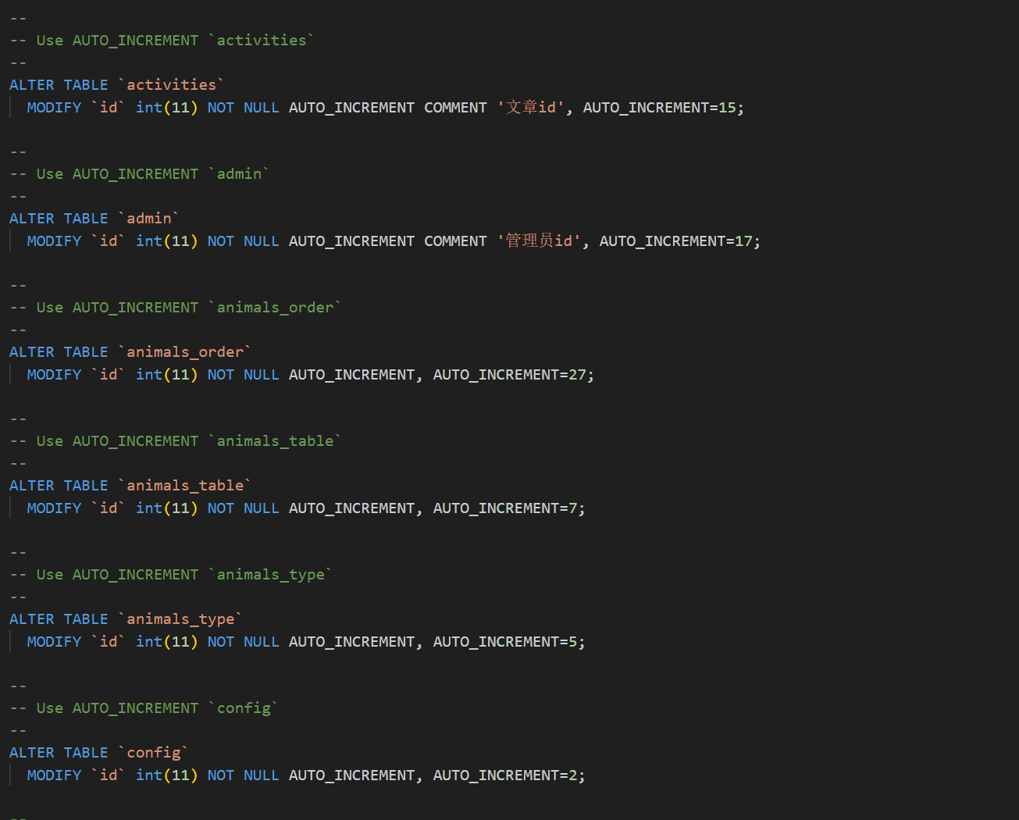
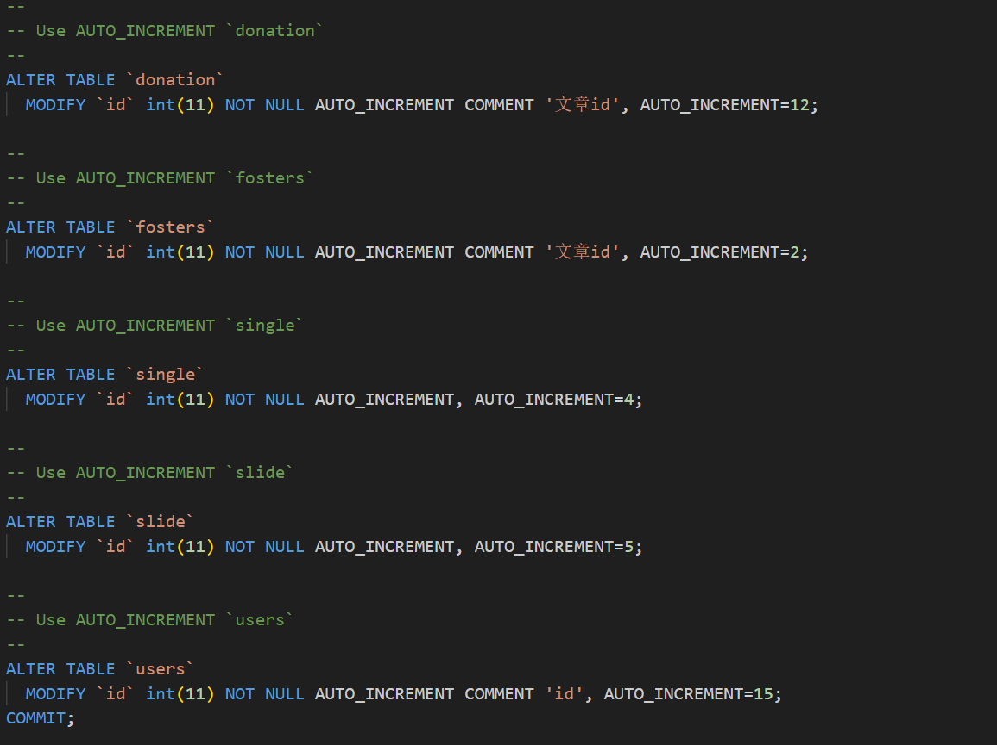
Auto Increment
Simplify the process of generating primary key values.
Suitable for scenarios where the uniqueness of primary keys is required.

Slide 22
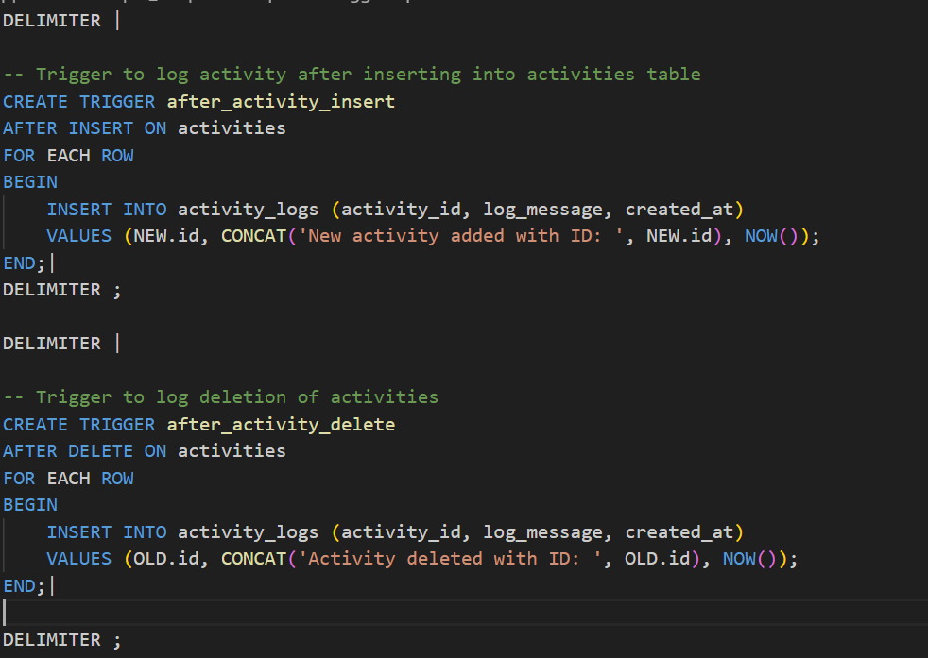
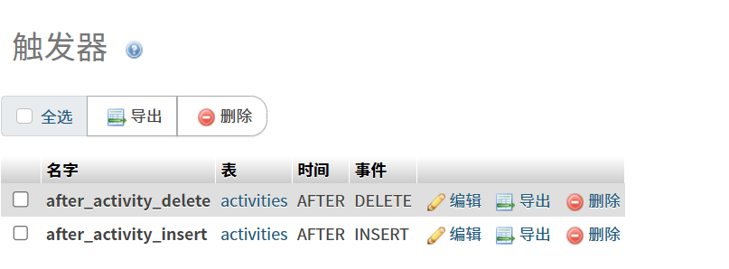
Trigger
When a new record is inserted into the activities table or deleted from the table, the trigger is triggered

Slide 23
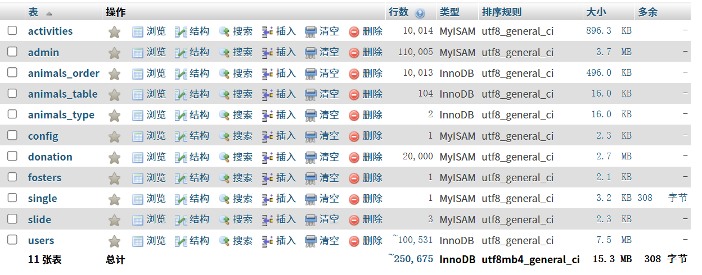
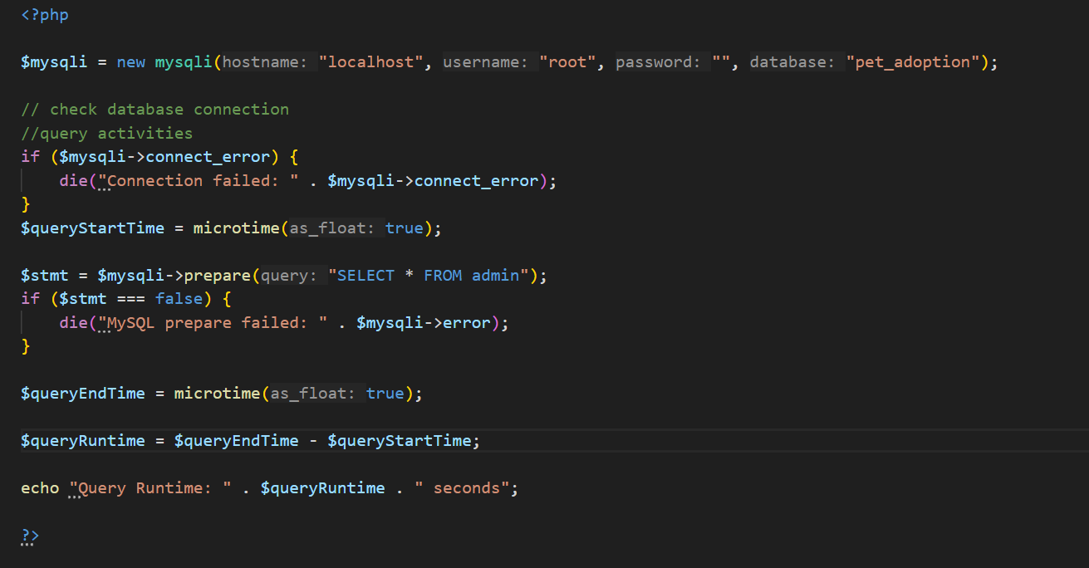
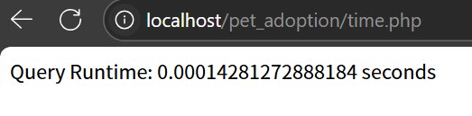
Basic Requirement
1.The average data is more than 1w and at least two tables are more than 5w
2.Find out all the candidate keys in the relationship pattern, and list all function dependencies satisfy the BCNF
3.Calculate the query time to ensure performance
(E.g. admin: own 11w+ data)

Slide 24
Conclusion
05.

Slide 25


Conclusion
In summary, we’ve built this pet adoption
platform through front-end, back-end,
and database architecture.
Through this platform, we aim to help more animals find loving homes and encourage greater public involvement in animal welfare and donations, making a tangible contribution.
Currently, our website still has many areas for improvement, including but not limited to a more user-friendly UI design, more features, more transparent information, and a faster, more stable browsing experience. In the future, we plan to upgrade the platform in these areas.

Slide 26
Reference and Resources
http://www.w3.org/TR/xhtml1/DTD/xhtml1-transitional.dtd
http://www.w3.org/1999/xhtml

Slide 27
Next - Live Demo
Thanks For Your Watching and Advice
Team 13
2024/12/18
Chen Letian 2330026013
Chen Tingxuan 2330026020
Yun Haoyi 2230026199
Xu Shuhan 2330026181
Xu Yilang 2330026184

