Slide 1
Mentor Caring System
Product Promotion + Software Engineering
Chen Letian 2330026013 Zeng Qikai 2330013039
Liu Bochen 2330026096 Yue Kaiqi 2330026204
Yu Yicong 2330026201 Yang Jingtian 2330026187
B07

Slide 2
Part 1
Introduction
From Manual Mentoring Management to a Centralized Role-Based System
Member 1 · Chen Letian

Slide 3
From Design to Product
2.1 SRS
3.1 Purposes & Positioning
Requirement scope, use cases, representative flows
Purposes Design, product positioning & target users
2.2 Architecture Design
1. Introduction
3.2 Feature & Advantages
Layered/MVC design, system architecture, subsystems
From Manual Mentoring Management to a Centralized Role-Based System
Main features, advantages, user-friendliness, & code-related work
2.3 Detailed Design
3.3 Live Demo
Class diagram, representative classes, traceability
Mentor-centered workflow; show code runs as stated

Slide 4
Part 2.1
SE Part 1: SRS
Requirements, use cases, representative flows, and classes
Member 2 · YANG Jingtian

Slide 5
SRS Logic
SRS
Context Model → Use Case Diagram → State Transition (3.6 Communicate) → Build Classes → Class + Sequence Diagram.
1
Context
Model
2
Use Case
Diagram
3
State Transition
Communicate
4
Classes identification
5
Class + Sequence
Diagram
System boundary
external dependencies
Actors + goals
role permissions
Page states
events + warnings
Nouns → objects
attributes/operations
Static structure
scenario interaction
Why 3.6 Communicate is the main state example
Why the class model is explained in detail
It contains both communication and appointment behavior: send/receive/reply messages, mentor time-slot setup, student slot selection, and warning paths.
Class construction shows how SRS nouns become domain objects, how attributes and operations are selected, and how relationships support the whole MCS workflow.

Slide 6
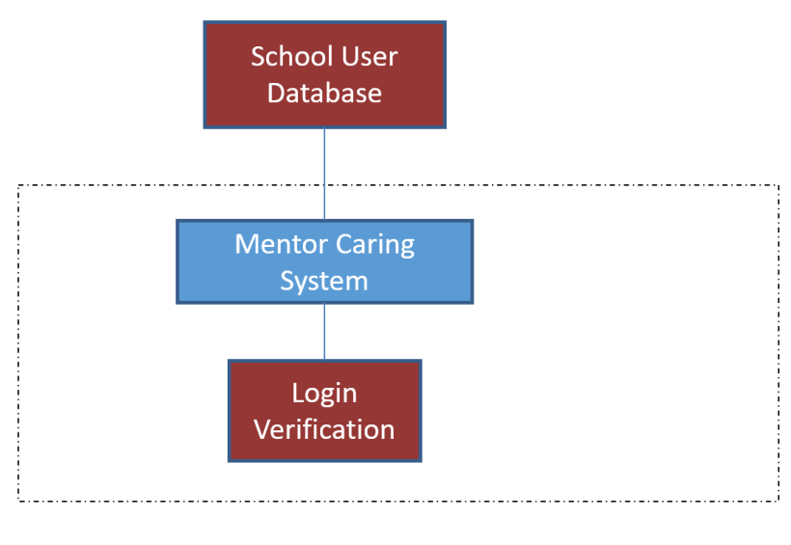
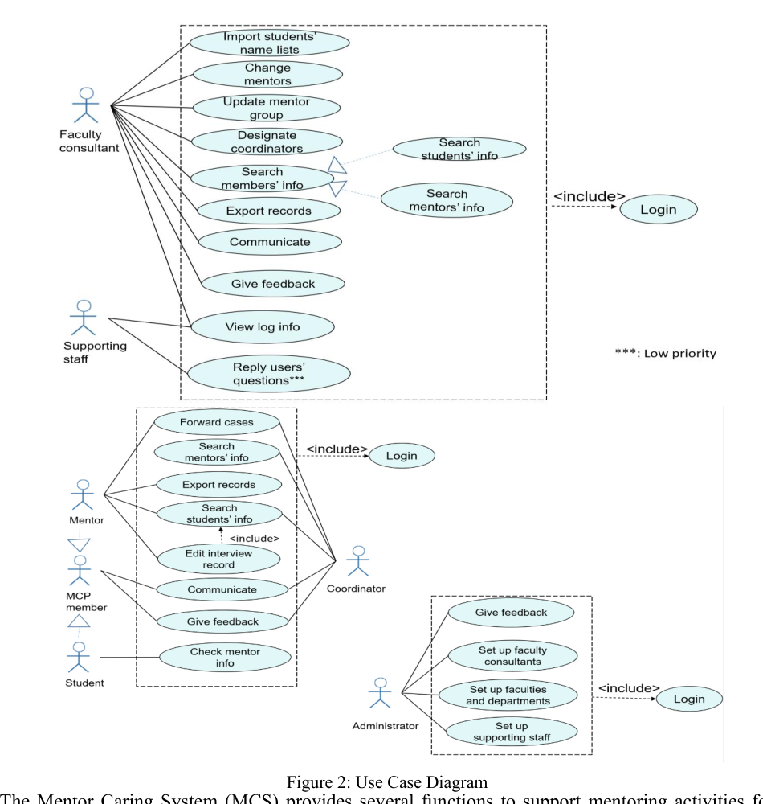
Context Model + Use Case Diagram
These two models define the system boundary and the role-based goals before behavior modeling.
Context model: what is inside MCS?
Actors
Use case overview: who uses which service?
Faculty Consultant, Mentor, Student, Coordinator, Administrator, Supporting Staff.
Representative use case
Communicate is chosen because it covers both message exchange and appointment arrangement.
Scope decision
MCS handles mentoring activities. Login verification and school user data are external dependencies, not the main product logic.
Transition
Use cases say what users want; state transition diagrams show how the UI/system behaves.

Slide 7
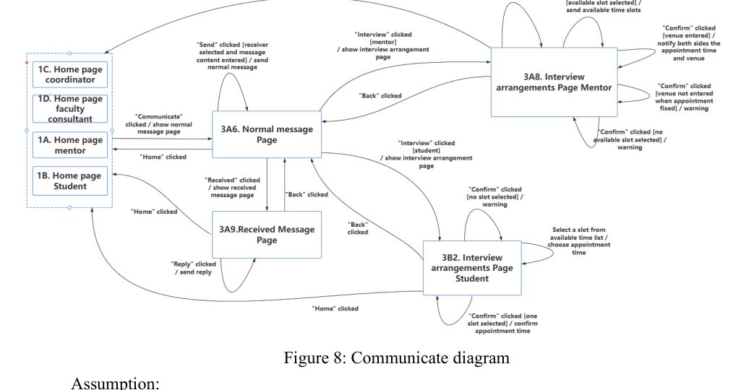
State Transition Diagram: Communicate
This part shows behavior states, events, guards and exception paths for message and appointment communication.
Normal message path
Home -> Normal Message
-> Send / Received / Reply.
Mentor appointment path
Mentor enters available slots and venue, then confirms.
Student appointment path
Student selects one available slot and confirms appointment time.
Alternative paths
Warnings are produced when receiver/content, slot or venue is missing.

Slide 8
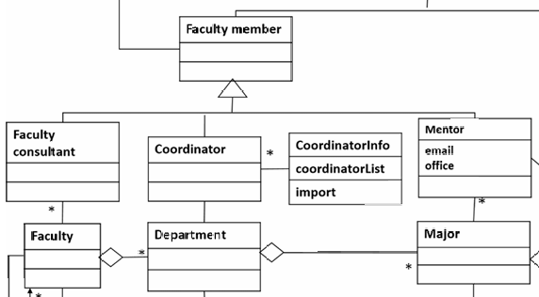
Building Classes from Requirements
Extract nouns from the description and construct classes (attributes, operations) and relationships based on the use case diagram.
1. Identify superclass
Repeated staff roles are abstracted as Faculty member.
2. Specialize roles
Faculty consultant, Coordinator and Mentor inherit from Faculty member because they share staff identity but own different duties.
3. Add support classes
CoordinatorInfo stores coordinatorList and import(), supporting the designation/import requirement.
4. Connect organization units
Faculty, Department and Major form the university structure; their associations explain allocation and group management.

Slide 9
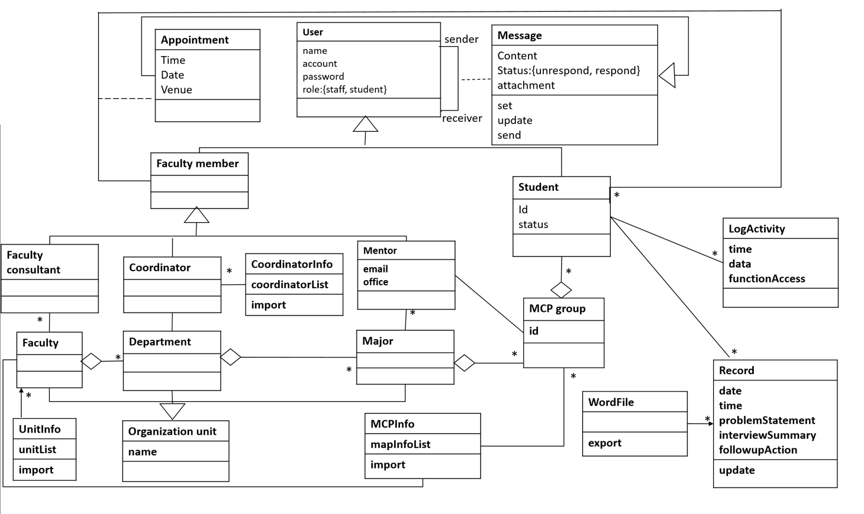
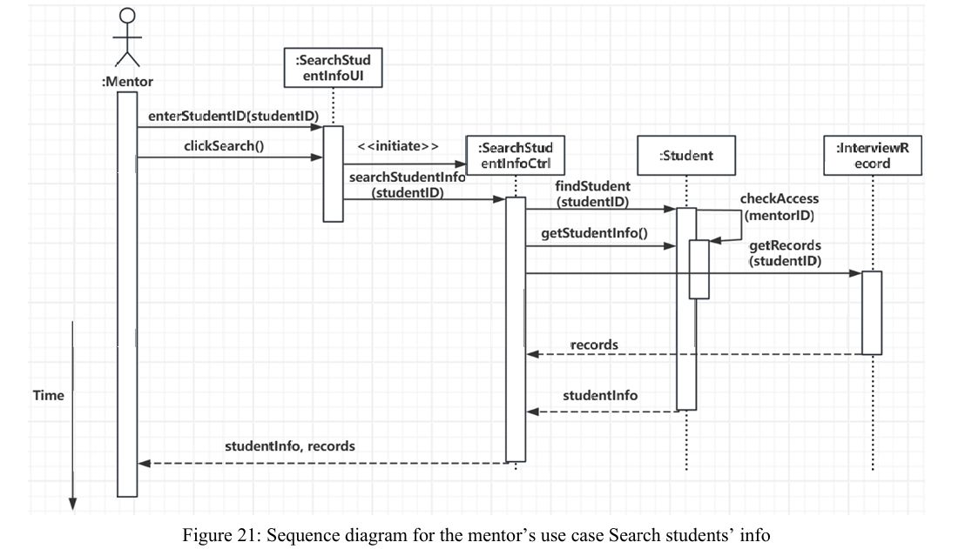
Class + Sequence Diagram
The final overall class and sequence diagram is as follows.

Slide 10
Part 2.2
SE Part 2: Architecture Design
Architecture model, subsystem decomposition, and database support for MCS
Member 4 · Liu Bochen

Slide 11
Architecture Design Logic
Show how requirements become a maintainable system structure.
Design model
System architecture
Layered architecture + MVC
Four major subsystems
Core claim
Organization & Member
Communication & Appointment
Record & Reporting
Audit & Support subsystems
Divide into
Database support
Subsystem design
Tables support core data and associations
Boundary / control / entity / mapper responsibilities
Keep UI, workflow logic, and data operations independent.

Slide 12
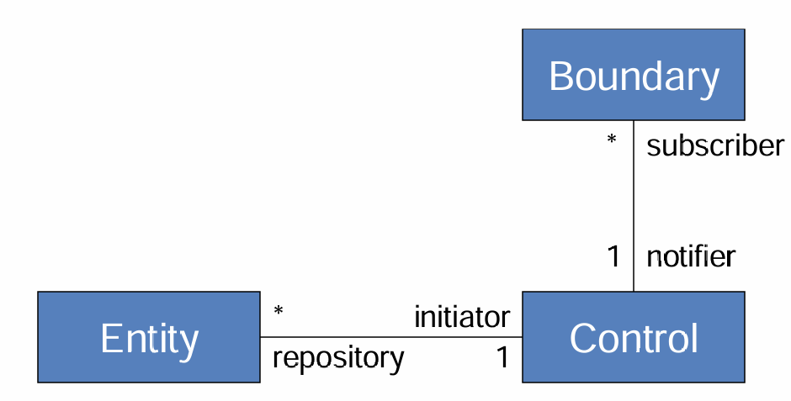
Design Model: Layered Architecture + MVC
Explain the architecture model.
Interface
User interfaces and Flask boundary blueprints
Application Logic
Control classes handle workflows and rules
MVC in MCS
Boundary works as the View
Control works as the Controller
Entity works as the data access part.
This separation keeps each parts independently
Storage
Mappers and ORM entities persist system data

Slide 13
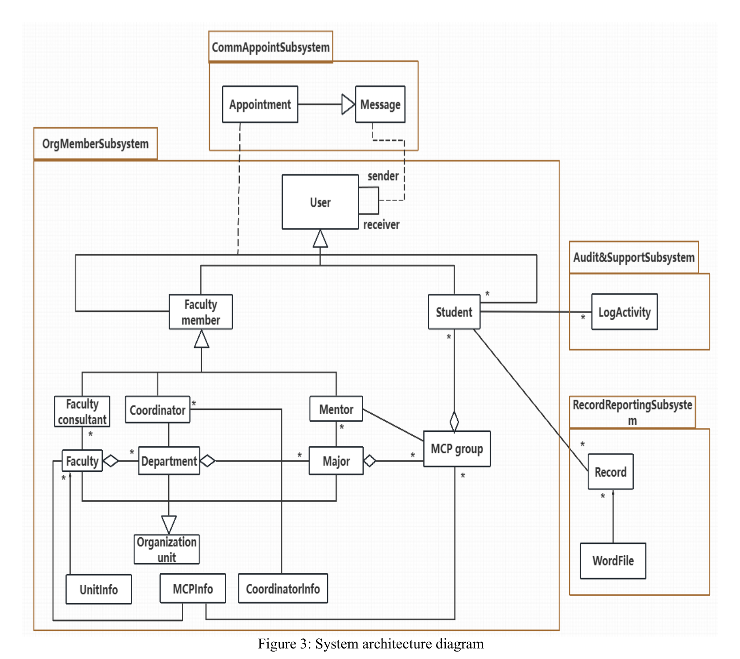
System Architecture Diagram
Overall architecture diagram explain.
.
How to explain
1.Member, role, and group data are the core.
2.Four subsystems map to the main feature groups.
3.Communication and records reuse shared member data.
4.Audit/support improves traceability.
Why it matters
High cohesion
Low coupling

Slide 14
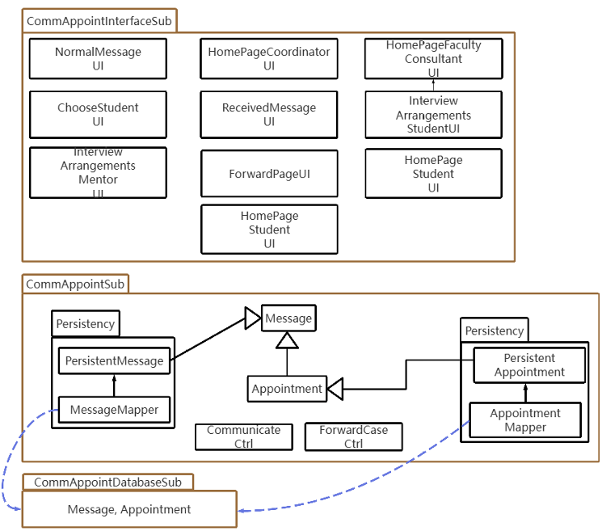
Subsystem Design Overview
Subsystem are divided into four subsystems with four main functions
Role-based Interface
Core Business Objects
Different UI pages are provided for different users,.
Four major subsystems
Controller
Persistence & Database
Tables support core data and associations
Store Message and Appointment data.

Slide 15
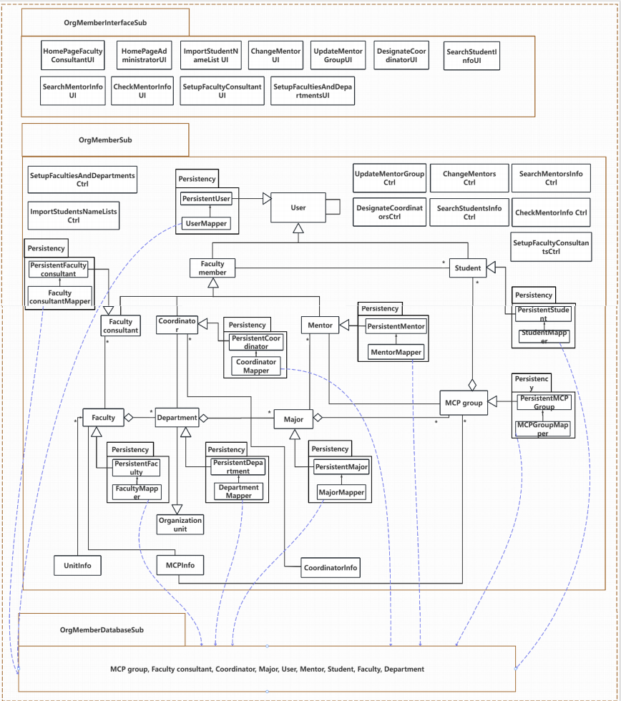
Subsystem Design Overview
Subsystem are divided into four subsystems with four main functions
Organization& Member
Manages students, mentors, coordinators.
Defines department, major, and group relationships
Supports member import, role update, and group assignment

Slide 16
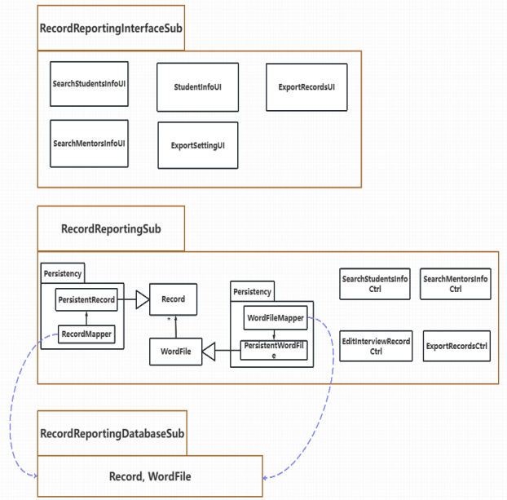
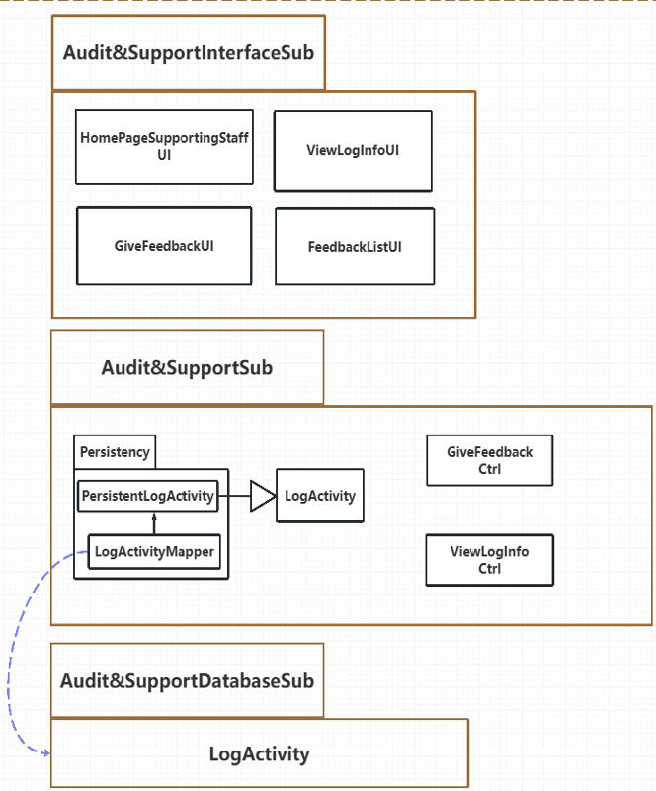
Subsystem Design Overview
Subsystem are divided into four subsystems with four main functions
Record & Reporting
Audit & Support
Interview records and export
Logs and feedback/support

Slide 17
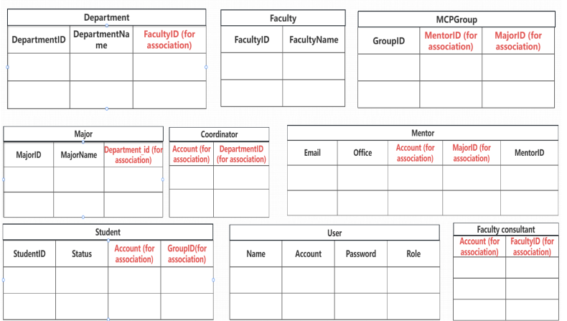
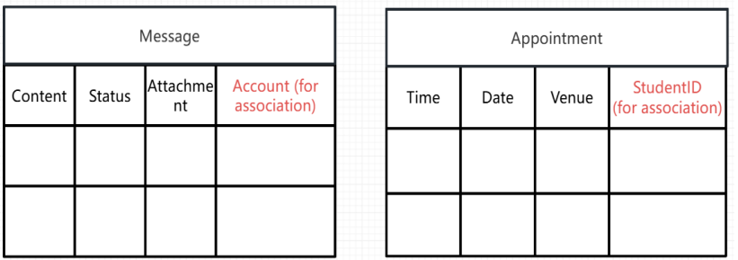
Database Support
Database support for architecture.
Member&Organization DB
Core member and organization data for users, roles,
mentors, students, and groups.
Message & Appointment DB
Communication messages and appointment records

Slide 18
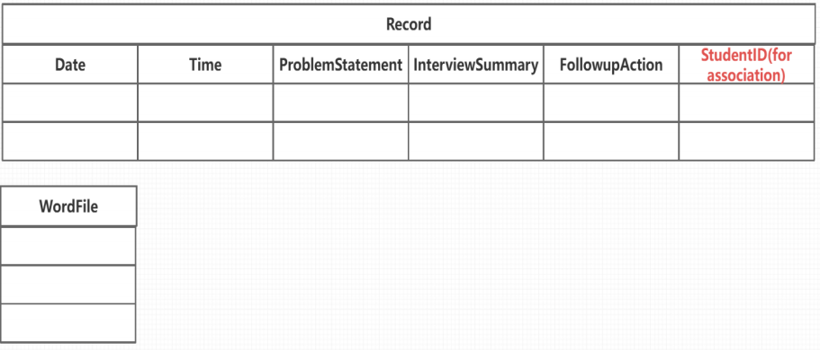
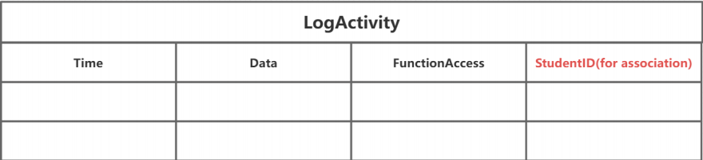
Database Support
Four Database support for architecture.
Record & WordFile DB
Interview records and exported report files
Audit&Surpport DB
Operation logs and feedback data
Database tables provide persistent storage for core entities and cross-subsystem data associations.

Slide 19
Part 2.3
SE Part 3: Detailed Design + Testing
Class diagram, representative classes, design-to-code traceability and software testing
Member 4 · Zeng Qikai

Slide 20
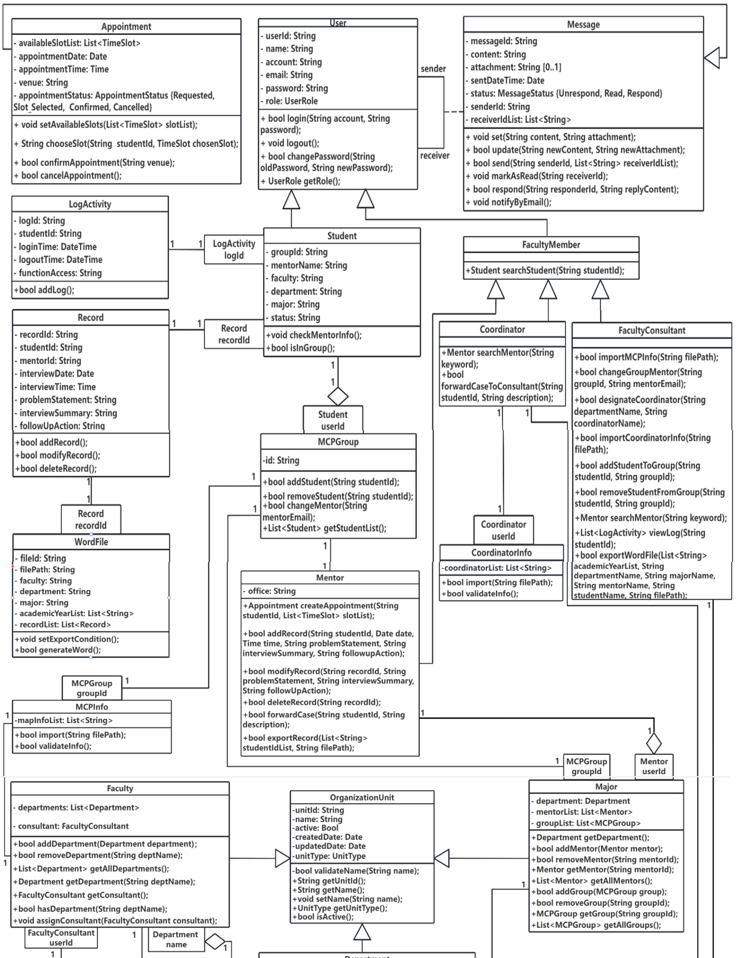
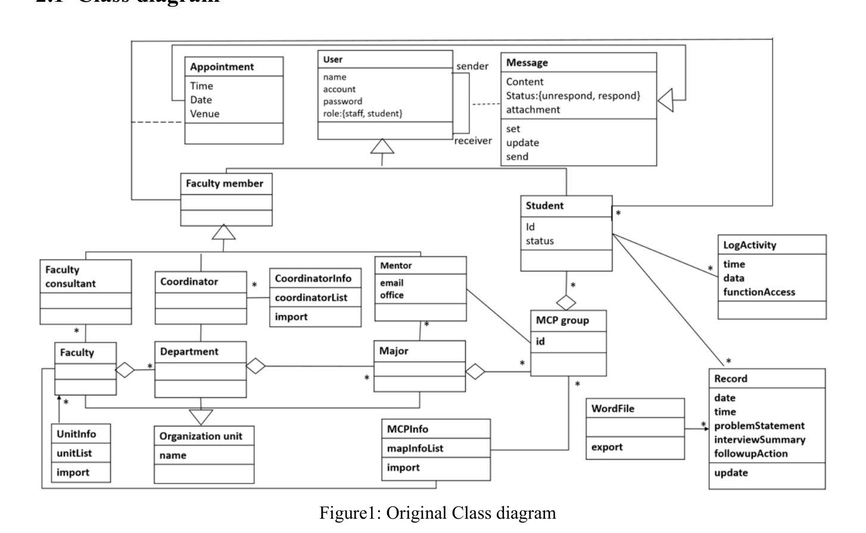
Class Diagram Evolution to Detailed Design
The detailed design refines classes, attributes, operations and relationships.
Analysis point
The updated class diagram refines the original model by clarifying user roles, adding detailed attributes and operations, and improving relationships among users, groups, messages, appointments, records, and exported files. This makes the design closer to implementation.

Slide 21
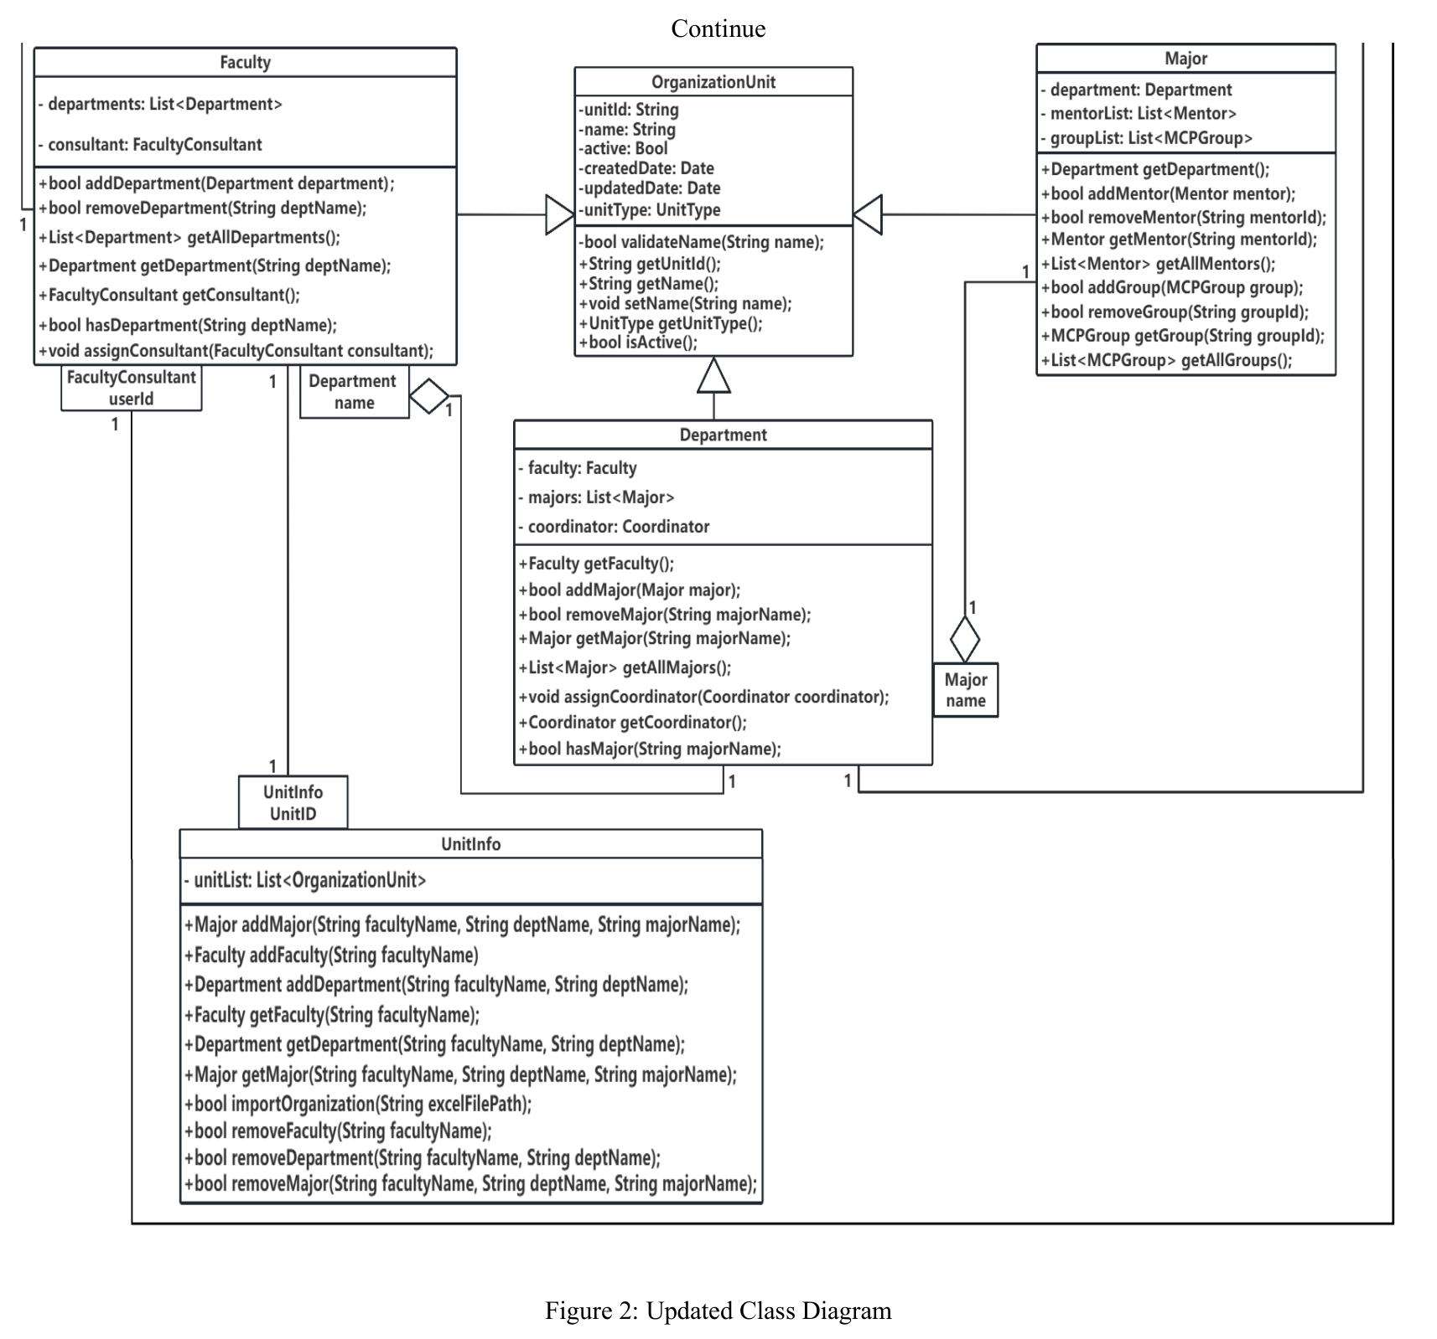
Updated Detailed Design Class Diagram
This diagram presents the final class-level structure of MCS after refinement

Slide 22
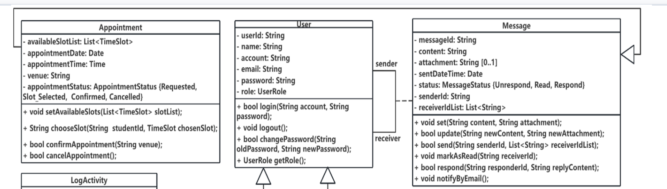
Representative Classes: Communication & Appointment
Use one representative part to explain detailed design clearly.
Appointment
Message
Manages available interview slots
Supports slot selection and confirmation
Handles appointment status changes
Stores message content and participants
Supports sending, replying, and reading
Enables mentor-student communication
Why this pair matters
Message and Appointment, together with User relationships, support the mentor-student workflow for communication and appointment arrangement.

Slide 23
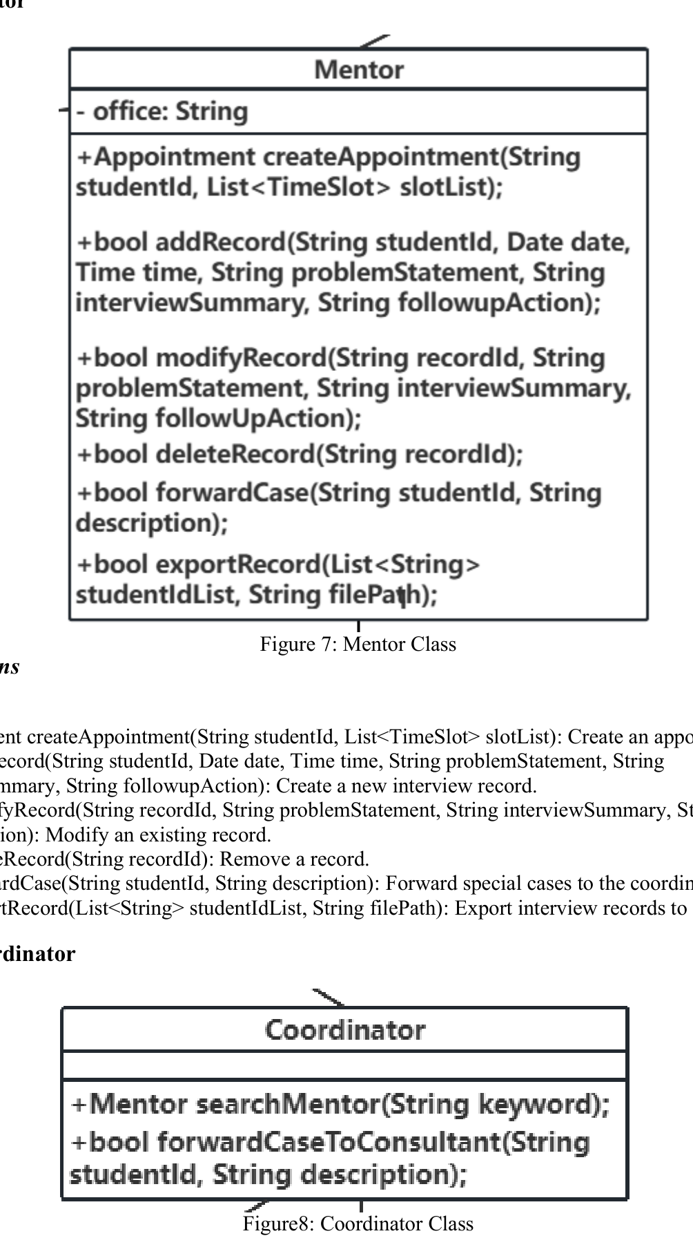
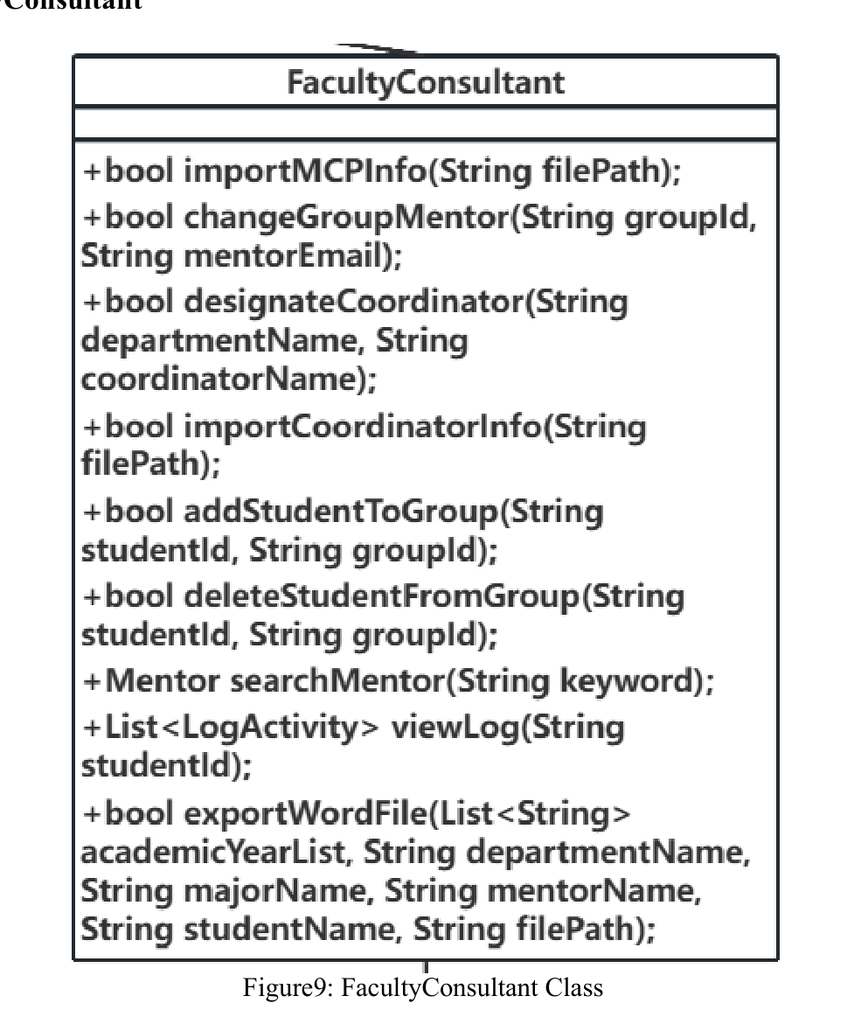
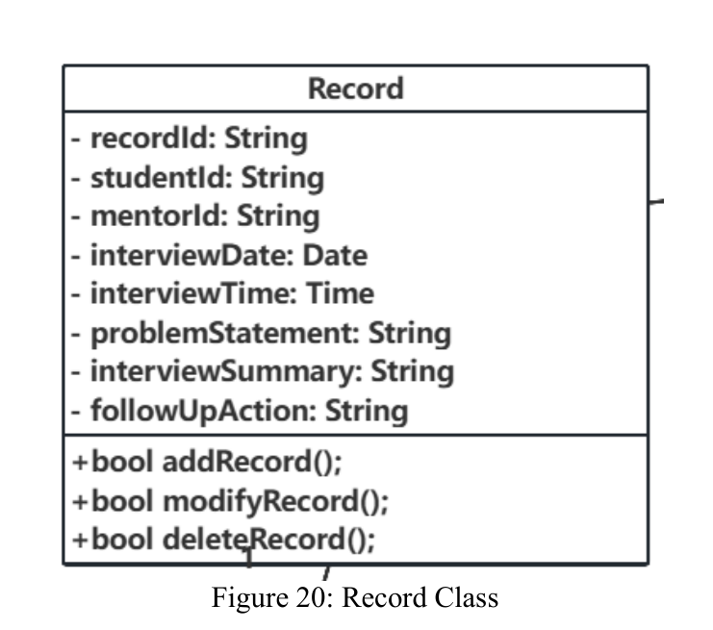
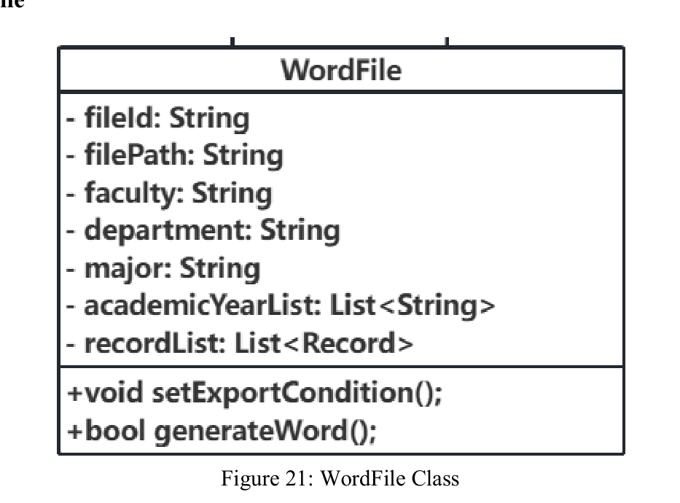
Supporting Classes: Records, Roles and Export
These classes support interview record management, responsibility control, and report gengeration
Mentor / Coordinator
FacultyConsultant
Mentor manages interview records.
Coordinator handles forwarded cases and supports follow-up.
Manages MCP groups, changes mentors, designates coordinators, and exports selected records.
Record
WordFile
Stores interview information, including student, mentor, problem statement, interview summary, and follow-up action.
Uses selected conditions and records to generate the final Word report.

Slide 24
Testing Verification
We tested three core use cases with black-box tests and tools.
Test Plan
Execution
Test Report
Scope, methods,
test cases
TestComplete +
LoadRunner practice
Pass/fail result
and error report
Modules Under Test
Testing Methods
Tool Evidence
Result Summary
Search Student's Info
Edit Interview Record
Search Mentor's Info
System testing from user perspective
Equivalence class + boundary value
Functional testing
Load testing
TestComplete: recorded GUI test for Search Student's Info
Checkpoints: valid ID shows info; invalid/empty ID shows warning
LoadRunner: used for Edit Interview Record use case
Most test cases worked as expected
Edit Interview Record: no unexpected result
Search Mentor's Info: no unexpected result
One permission issue found in Search Student's Info

Slide 25
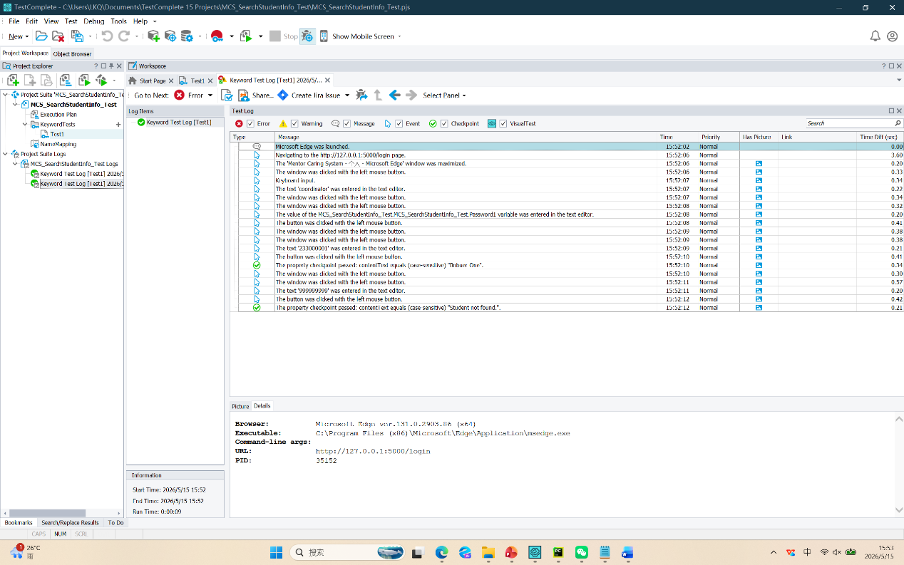
Test Result
A concrete result selected from the Search Student Info testing evidence.
Selected Result: SSI-EC-06
Tool Evidence: TestComplete Test Log
Test case
Mentor searches for a student outside his/her permission scope.
Expected Result
A mentor should not access a student outside his/her permission scope.
Actual Result
The mentor could enter the Student Detail Page, but was blocked only when opening interview records.

Slide 26
Traceability: Requirements -> Design -> Code
This slide links SE documents with the implementation.
SRS
Defines the user requirement
Detailed Design
Refines it into classes and operations
Code
Implements it with routes, logic, entities, and database access
Demo
Shows the workflow running in the real system
Architecture
Places it into a subsystem
Example trace
Requirement → subsystem → User / Message / Appointment classes → message & appointment code modules → live demo workflow
Member 5 · 0:25 · traceability
10-minute oral + 2-minute demo

Slide 27
Part 3.1
ASDW: Purposes & Positioning
Purposes Design, product positioning & target users
Member 1 · Chen Letian

Slide 28
Purposes Design
Why is a dedicated system needed?
Mentor Caring System
Before MCS
After MCS
One platform for the complete mentoring workflow
Scattered information
Manual coordination
Inconsistent records
Repeated report
preparation
Centralized platform
Role-based workflow
Traceable records
Faster report export
CENTRALIZED
ROLE-BASED
TRACEABLE
One platform for mentoring groups, records, communication, appointments, and reports.
MCS

Slide 29
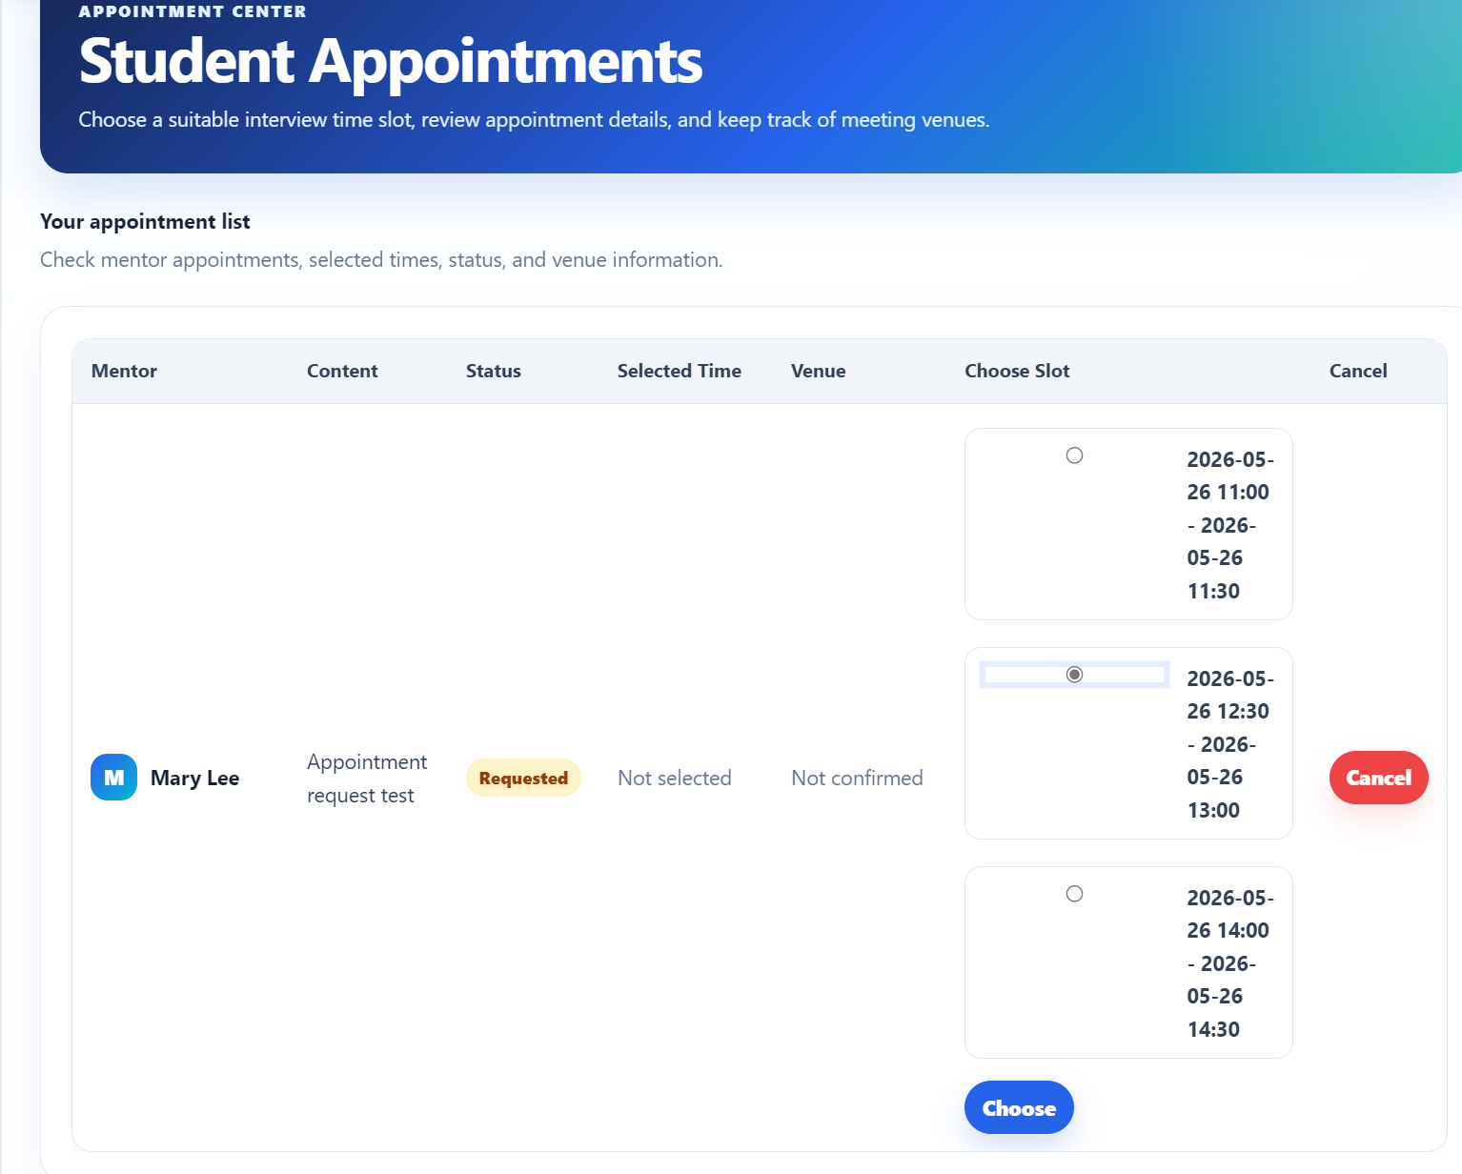
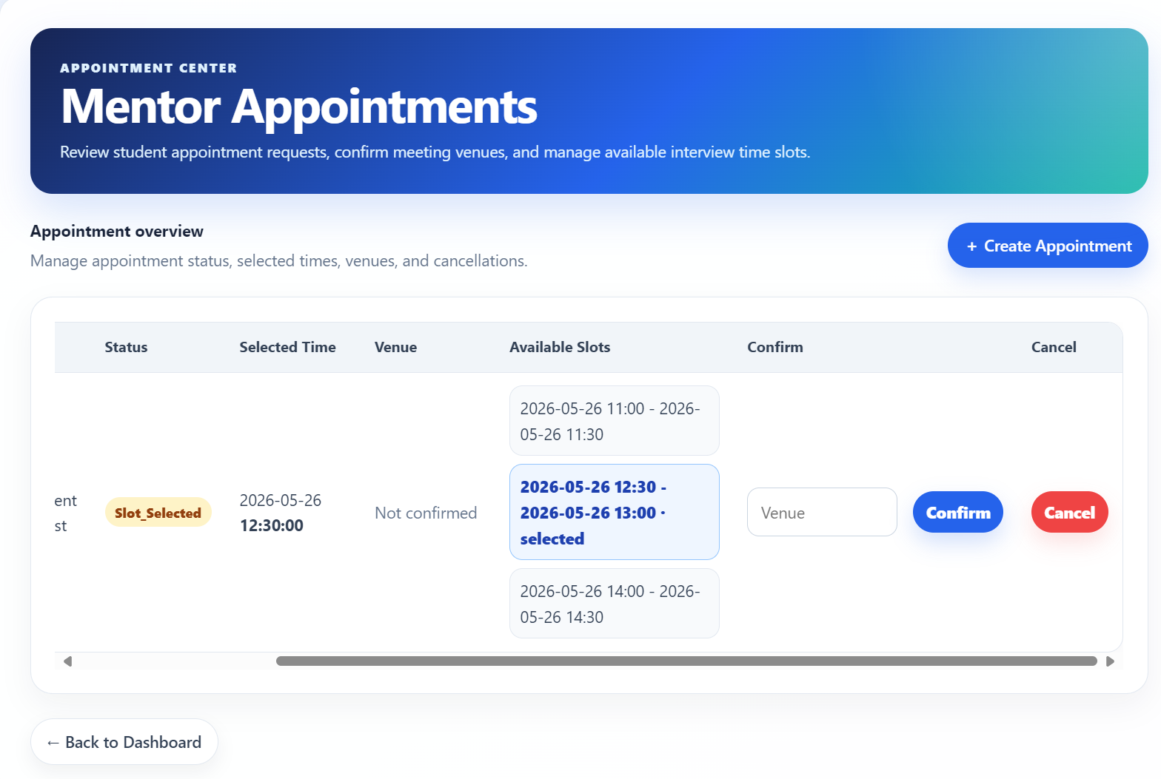
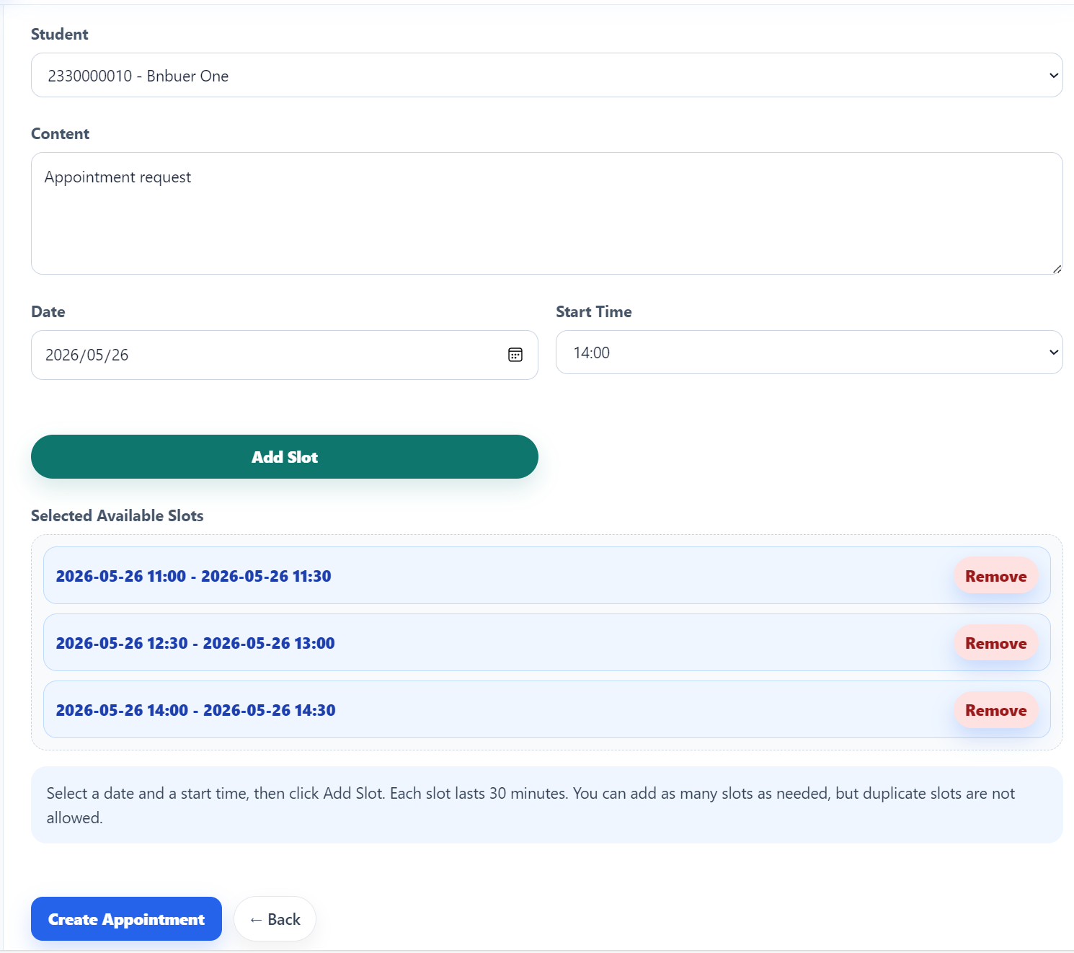
Showcase
A centralized, role-based, and user-friendly web system for BNBU Mentor Caring Programme.
Student view
Appointment workflow
Mentor view

Slide 30
Product Positioning & Target Users
MCS is a centralized role-based platform for managing mentoring activities.
Product positioning
Faculty Consultant
Mentor
Import student lists
Manage mentor groups
Change mentors
Export records
Search students
Edit interview records
Communicate with students
Arrange appointments
Web-based centralized platform
Connect group management, mentor allocation student records, communication, appointment arrangement, & report export
Help different roles work on the same mentoring workflow
Student
Coordinator
Check mentor information
Receive & Reply messages
Choose appointment slots
View student / mentor information
Communicate with users
Handle forwarded cases
Administrator
Supporting Staff
Main speaking focus: Faculty Consultant, Mentor, & Student
Set up faculties, departments, consultants & supporting staff
View logs
Reply to feedback
Support system operation
These three roles best represent the main mentoring workflow.

Slide 31
Part 3.2
ASDW: Feature & Advantages
Main features, advantages, user-friendliness, and code-related work
Member 5 · Yue Kaiqi

Slide 32
Product Advantages
1
2
3
Centralized
Role-based
Easy actions
No more scattered files and messages.
Different users get focused tasks.
Buttons, tables, and forms make next steps obvious.
4
5
Traceable
Report-ready
Logs and status support supervision.
Export selected records to Word output.

Slide 33
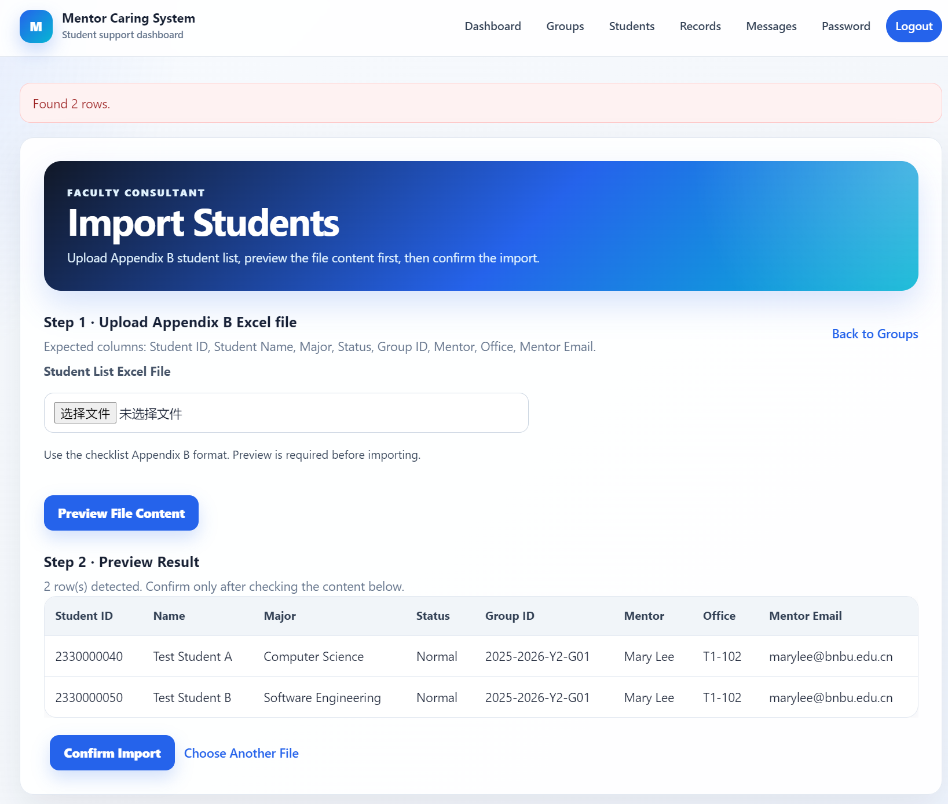
Feature 1 · Centralized Data
Import students once and build a reliable student database
BENEFIT
Less repeated input
• Bulk import reduces manual typing.
• A preview table helps users check the data before activation.
• The system becomes the starting point for later records and appointments.
Student Import

Slide 34
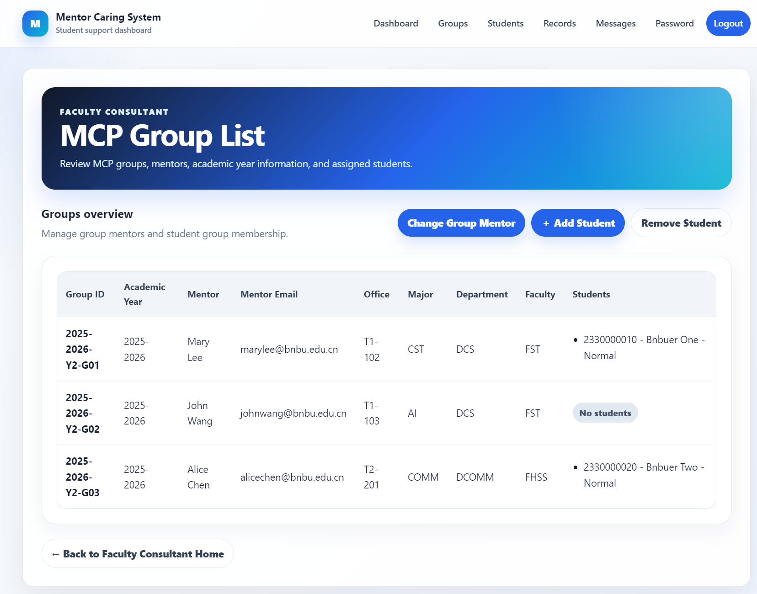
Feature 2 · Group Management
Maintain MCP groups and mentor ownership in one place
BENEFIT
Clear ownership
• Groups show academic year, faculty, mentor, and student count.
• Coordinators can update group members systematically.
• Mentoring responsibilities are easier to supervise.
MCP Group List

Slide 35
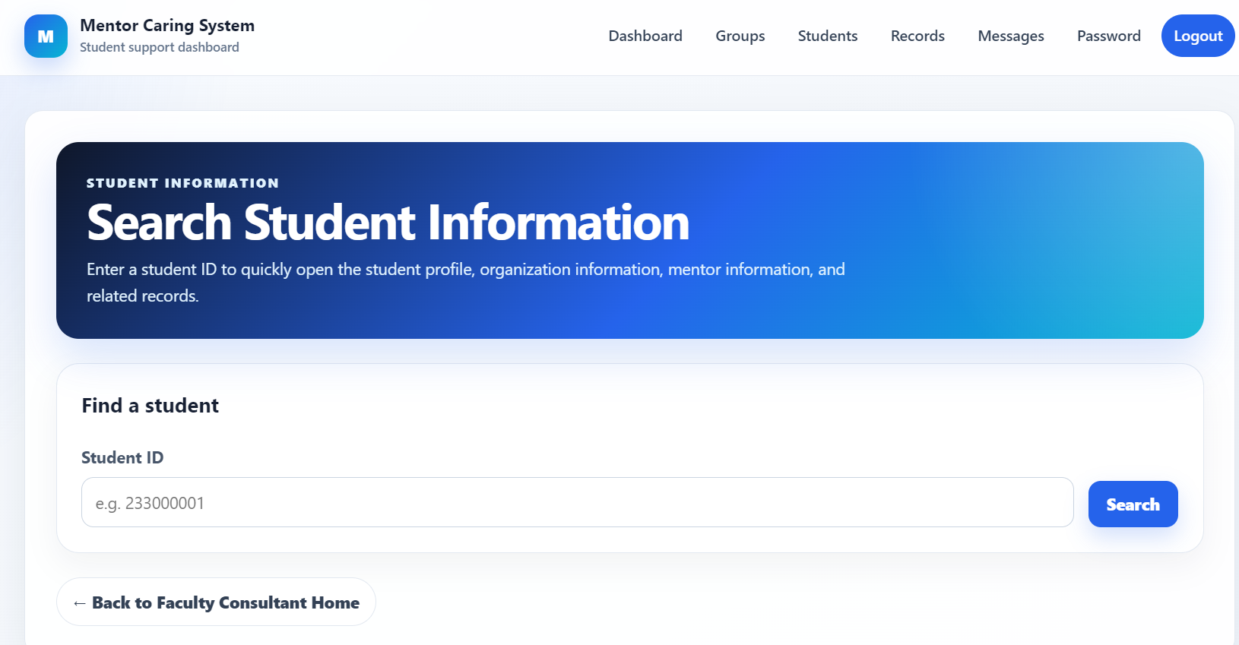
Feature 3 · Fast Search
Search first, then act on student information
BENEFIT
Faster access
• Users can locate a student quickly by ID.
• The search page reduces time spent checking external files.
• Follow-up actions become easier after the right student is found.
Search Student

Slide 36
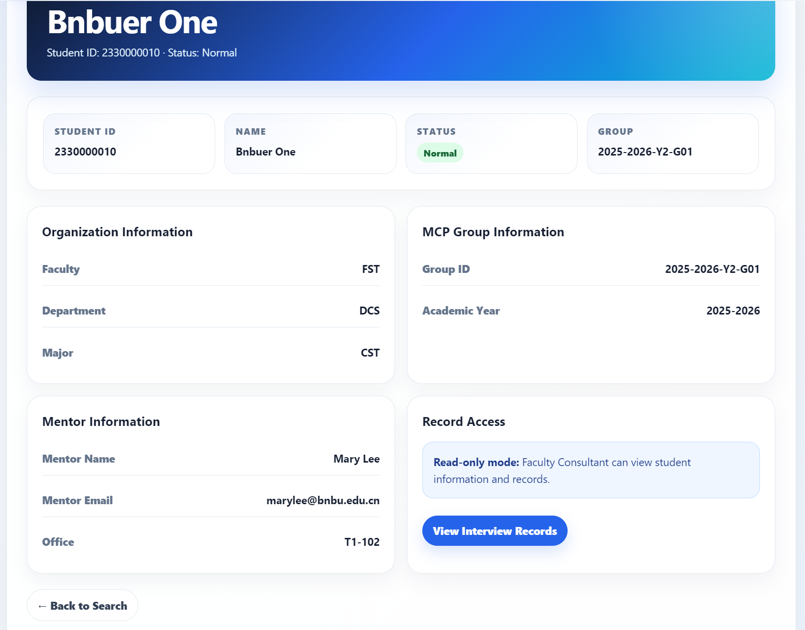
Feature 4 · Student Profile
Connect profile information with mentoring records
BENEFIT
Better decisions
• Student, organization, MCP group, and mentor information are visible together.
• Record access links support smoother follow-up.
• Mentors get context before taking action.
Student Profile + Records

Slide 37
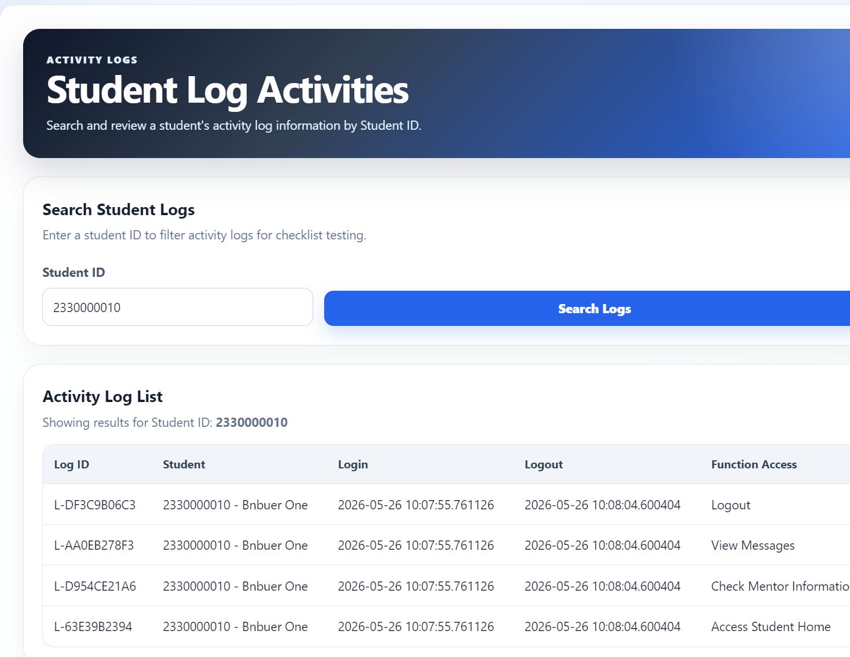
Feature 5 · Activity Logs
Make key user actions visible for supervision
BENEFIT
Traceable workflow
• Logs show important actions and timestamps.
• Supervisors can check progress without asking every user manually.
• Accountability becomes part of the product experience.
Activity Logs

Slide 38
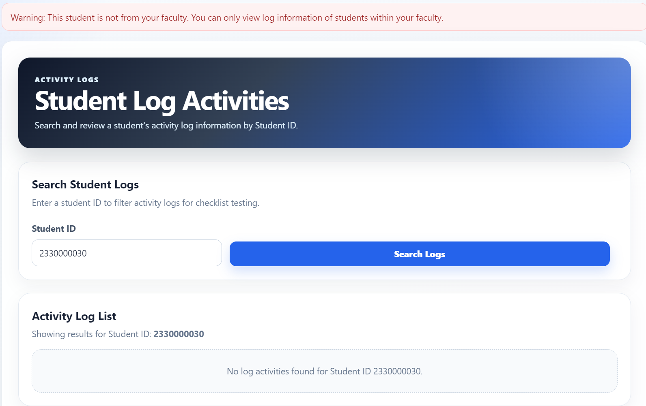
Feature 6 · Permission Protection
Warn users when information is outside their scope
BENEFIT
Safer access
• The system signals access boundaries clearly.
• Users understand why some information cannot be viewed.
• This supports safer data handling in role-based work.
Permission Warning

Slide 39
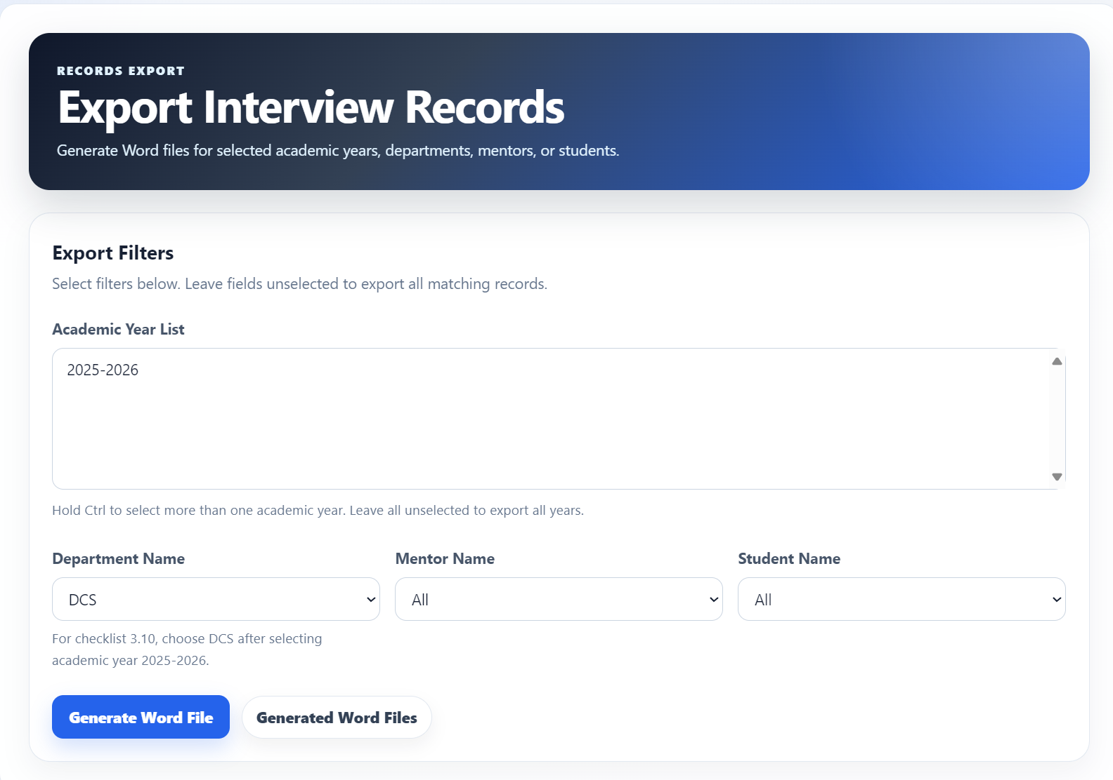
Feature 7 · Fast Reporting
Export selected interview records directly from system data
BENEFIT
Report-ready output
• Filters help select the right academic year, mentor, or student.
• Word generation reduces copying and formatting work.
• Faculty-level reports become faster and more consistent.
Word Export

Slide 40
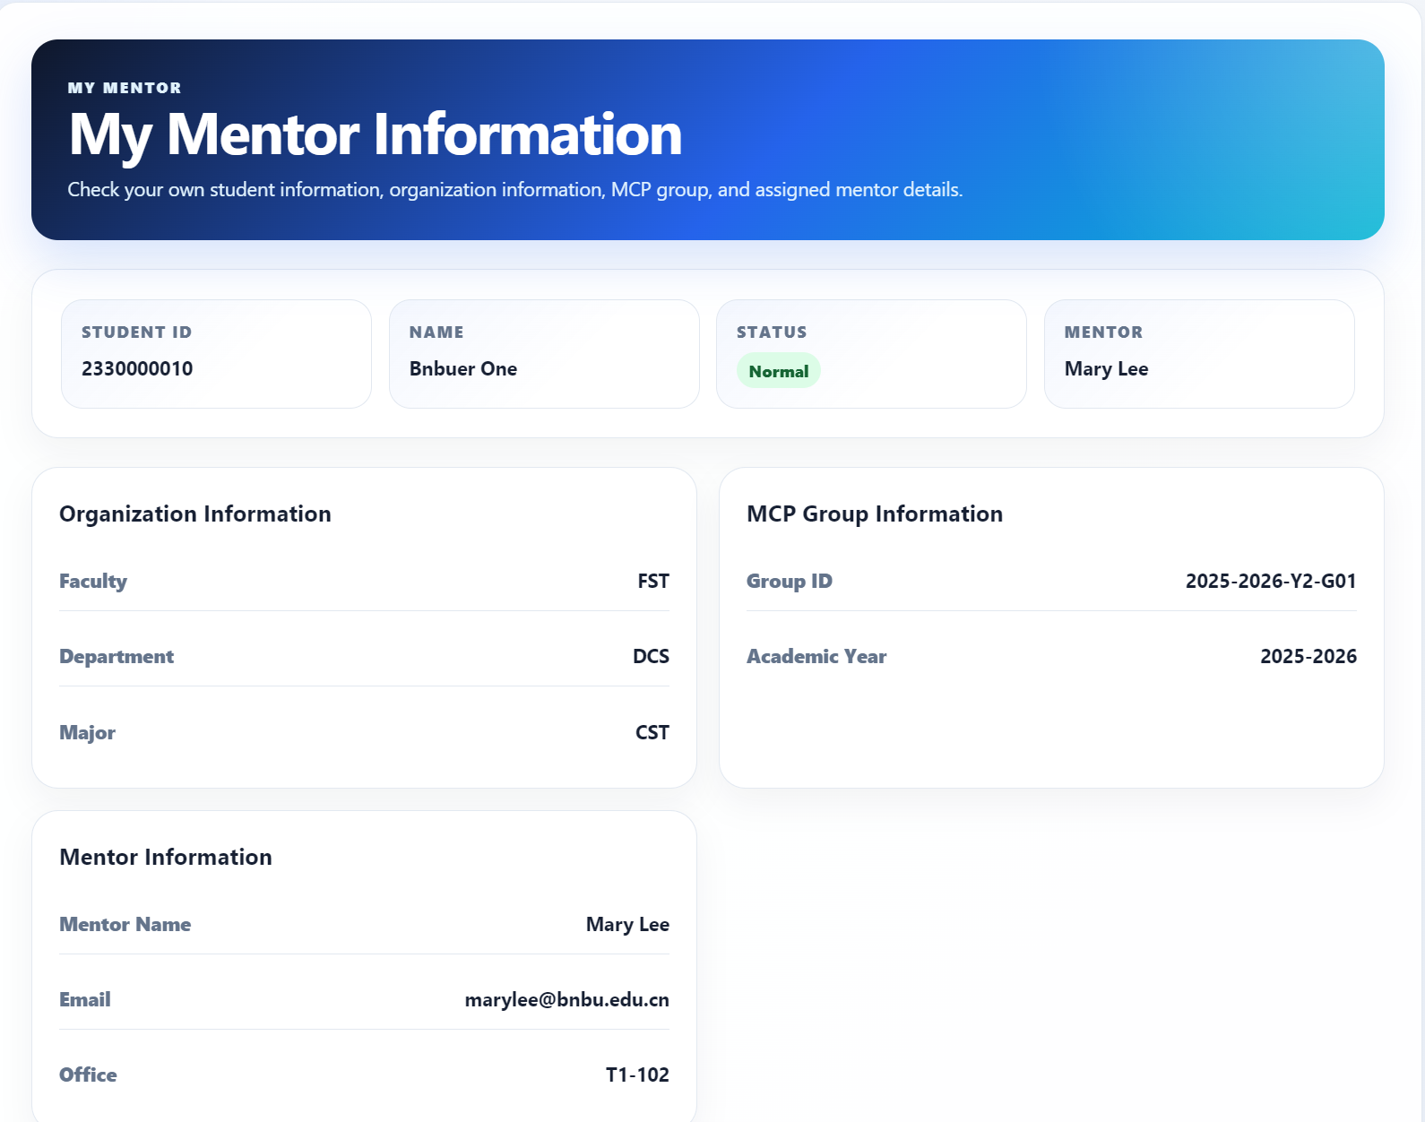
Student-Friendly Experience
Students can check mentor information inside the same platform
BENEFIT
No channel switching
• Students see mentor information and group details in one page.
• This reduces uncertainty about whom to contact.
• The product feels direct and student-centered.
My Mentor Information
MCS Software Promotion · 12

Slide 41
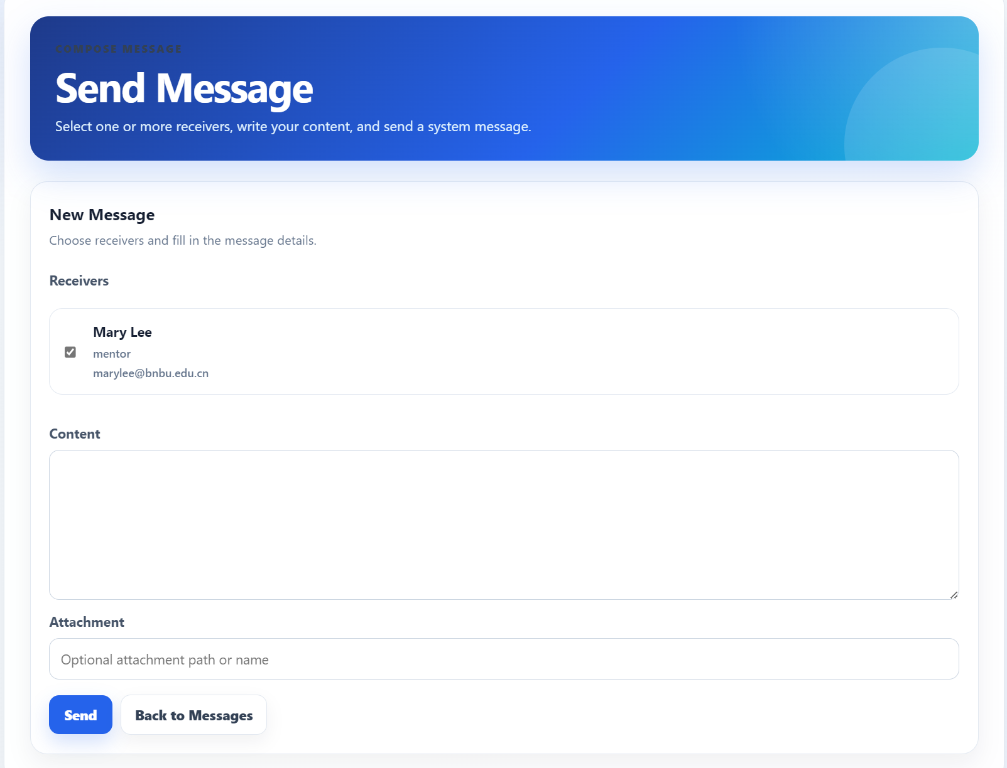
Student-Friendly Communication
Send messages without leaving the system
BENEFIT
Lower friction
• Receiver information is visible before sending.
• Message content and attachments are handled in one form.
• Communication becomes part of the mentoring workflow.
Send Message
MCS Software Promotion · 13

Slide 42
User-Friendliness Showcase
Mentor creates request
Student chooses time
Mentor confirms venue
1
2
3
Select student, add content, provide available slots.
Radio buttons make the selection direct and visible.
Selected time and venue are confirmed on the same page.
Mentor
Student
Confirm
User-friendliness is shown by the workflow: each role sees the exact action it needs next.

Slide 43
Showcase 1 · Mentor Creates Appointment
One clear form for one clear task
WHY IT WORKS
Fewer repeated messages
• The mentor selects a student and writes the appointment request.
• Several available slots can be added in the same form.
• Students receive structured choices instead of open-ended chat.
Create Appointment

Slide 44
Showcase 2 · Student Chooses Time
The student can select a suitable slot directly
WHY IT WORKS
Easy decision
• Appointment status and available slots are shown together.
• Radio buttons make the choice simple.
• The student sees what to do next without asking the mentor again.
Student Appointments

Slide 45
Showcase 3 · Mentor Confirms Venue
The mentor reviews the selected slot and finalizes the meeting
BENEFIT
• Clearer appointment coordination
• Fewer confirmation mistakes
• Faster final decision
WHY IT WORKS
• Step-by-step confirmation flow
• Visible selected time and venue
• Simple role-specific actions
Mentor Appointments

Slide 46
Code-Related Work
Mention only what supports the product and SE design.
Framework & tools
Code structure
SE connection
Python Flask web app
SQLAlchemy + SQLite
Flask-Login
Jinja templates + CSS
Word export support
Role-based Flask Blueprints
Templates + CSS for pages
Models for users, records,
messages, appointments
Mappers for database operations
Export module for Word reports
Implements MVC + Three-tier Architecture
Boundary: pages and forms
Control: workflow coordination
Entity: core system data
Mapper: database persistence

Slide 47
Part 3.3
ASDW: Live Demo
Show that the code behaves
Member 6 · Yu Yicong

Slide 48
Thanks

