Slide 1


Implementing Commands
Notes:
We will play a game.
Do not worry if you can’t complete a section on time, there are many questions.
But before there are some materials left to cover.

Slide 2


Task
clarusway
materials
lms.txt
pre-class
try-it.txt
post-class
lessons
linux.txt
“I love linux”
html.txt
“I can create a website”
Notes:
The structural pattern is similar to what we have in Windows.

Slide 3
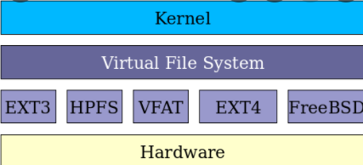
Linux file systems
Notes:
Explain what is a file system, what is FAT.
A FAT file system has four different sections, each as a structure in the FAT partition. The four sections are:
Boot Sector: This is also known as the reserved sector; it is located on the first part of the disc.
It contains: the OS's necessary boot loader code to start a PC system,
the partition table known as the master boot record (MRB) that describes how the drive is organized,
and the BIOS parameter block (BPB) which describes the physical outline of the data storage volume.
FAT Region: This region generally encompasses two copies of the File Allocation Table which is for
redundancy checking and specifies how the clusters are assigned.
Data Region: This is where the directory data and existing files are stored.
It uses up the majority of the partition.
Root Directory Region: This region is a directory table that contains the information about the directories and files.
It is used with FAT16 and FAT12 but not with other FAT file systems.
It has a fixed maximum size that is configured when created.
FAT32 usually stores the root directory in the data region so it can be expanded if needed.
Types of File systems used in Linux:
ext is an extension of the minix filesystem. It has been completely
superseded by the second version of the extended filesystem (ext2) and has been
removed from the kernel (in 2.1.21).
ext2 is the high performance disk filesystem used by Linux for fixed disks as well as
removable media. The second extended filesystem was designed as an extension of
the extended filesystem (ext). See ext2 (5).
ext3 is a journaling version of the ext2 filesystem. It is easy to switch back and
forth between ext2 and ext3. See ext3 (5).
ext4 is a set of upgrades to ext3 including substantial performance and reliability
enhancements, plus large increases in volume, file, and directory size limits.
See ext4 (5).
hpfs is the High Performance Filesystem, used in OS/2. This filesystem is read-only
under Linux due to the lack of available documentation.
Which one is UBUNTU? Ext4 is the default.
You may find the great details here about the file systems .
https://manpages.ubuntu.com/manpages/xenial/man5/fs.5.html

Slide 4
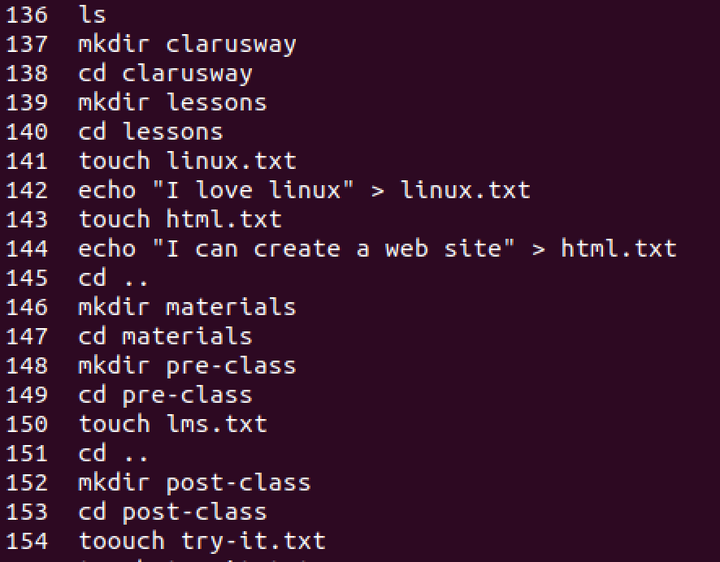
Solution

Slide 5


Slide 6
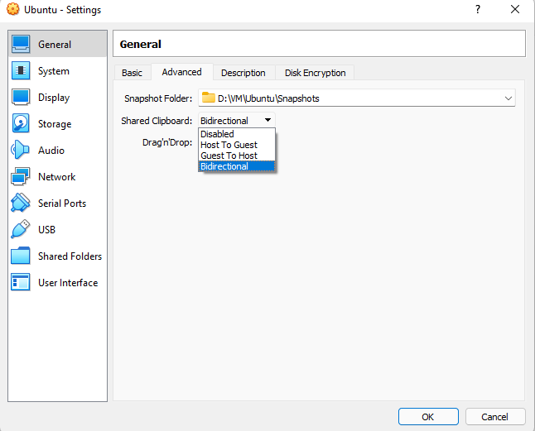
Preparation
If not open; Boot-up Ubuntu in VBox, login.
Select and find Devices\Insert Guest Additions CD image.
Open up a terminal and execute the command “Reboot”
After reboot login to VBox, open terminal.
cd /
sudo rmdir ~/Projects
mkdir under ~/Projects, these folders : Common DB Docs Output Test Web Worklog
clear
Notes:
General\Advanced\Shared Clipboard and Drag&Drop

Slide 7
Session 14 : 5pts
Timeout : 5 min
Investigation of Linux directory Structure :
/ this is the root directory cd /
/bin : Essential user binaries
/sbin : Essential system administration binaries.
/boot : Files needed to boot the system.
/cdrom: Temporary location for the cd-rom content (not standard)
/dev : Device files, linux treats devices as files. for ex (sda : sata drive), dev/null is special, no input-output, can be ignored.
/etc : configuration files exist here.
/home: Home folder for each user exists here. Every user contains a folder in.
/lib : Shared libraries, all applications use this folder as a common share folder.
/lost+found : if a system crash happens, linux saves the content here if possible, next boot it should be checked if needed.
/media : Removable media treated as file again.
/tmp : Temporary mount points. For instance if you mount a windows partition, it would be /mnt/windows.
/opt : The optional packages for apps that do not obey the standart file hierarchy.
/proc : Similar to dev, but more specific to running processes in memory, files created by those processes.
/root : It is the home directory for the current user. which is distinct from the / system root directory.
/run : it is a fairly new standard. it gives the apps to store transient storage area, like sockets and process ID’s.
/srv : Service data, just like IIS in windows Apache HTTP Server’s data can be stored here.
/usr : User binaries, read-only data. Non-essential applications, user specific applications.
/var : This is a writable counterpart of /usr directory. /var/logs are pretty much used to check application logs.
Filesystem Hierarchy Standard (FHS) defines this structure, but it doesn’t mean that non-standard folders can’t exist.
Notes:
env command displays the environment parameters
export PATH=${PATH}:/home/vivek/bin

Slide 8
Review :
cd / takes us to the root folder
cd ~/ takes us to the home folder of the user
cd .. One directory up
cd [Path] takes us the the desired directory
man find
user@host:/$
pwd
ls -a (all items including . and ..)
ls -l (long listing)
mkdir dir1 dir2 dir3 dir4 dir5
rm -r dir1
touch filename
rm filename
cp filename -n (With or without interaction switches i and n)
mv filename
echo ‘2022 Log File contents’ > SystemLog.log
cat filename
sudo find -name ‘*.log’
sudo find ~/ /var/ -name ‘*.log’
open 1.html
alias ll=’ls -al’
alias mytop=’top -u root’ // IF another user needed than set the name.
tail -f /var/log/auth.log // -f monitors follows the file for changes
grep pam_unix /var/log/auth.log // displays if pam_unix exists in the file.

Slide 9
New Commands:
dmesg : displays the boot messages, this is just like to loggers in programming languages.
cat /proc/cpuinfo : see the CPU information in detail.
free -h : display the free memory in detail
lshw : hardware configuration
lsblk : some information about block devices
lspci -tv : PCI devices in tree structure
lsusb -tv : USB devices in tree structure
dmidecode : hardware information in BIOS
hdparm -i /dev/disk : display disk data
hdparm -tT /dev/[device] : read speed test
badblocks -s /dev/[device] : display bad blocks on disk
: badblocks -s /dev/disk/by-id/ata xxx choose the disk.
fsck [disk-or-partition-location] : run a disk check

Slide 10
Create file, folder, modify and save using NANO editor
cd /
mkdir ~/Projects
touch ~/Projects/data.json
nano ~/Projects/data.json
write “This is data.json file. It will contain json elements” and save the contents.
cat data.json to display the output.

Slide 11
Create file, folder, modify and save in VIM Editor
cd /
touch ~/Projects/config.json
vi ~/Projects/config.json
write “This is config.json file. It will contain configuration elements” and save the contents.
cat ~/Projects/config.json to display the output.
Notes:
use :q to quit , :w to write

Slide 12
By using an editor in GUI environment
modify the contents of data.json.
Write “This is from GUI Editor” inside it an save it please.
Notes:
GUI Editor can be Kate in Kubuntu, GEdit or any other tool as you prefer.
Find a way to open this editor with sudo.

Slide 13
cd /
w (display the logged in users)
whoami (display the current user)

Slide 14
Find how to display date time values in Terminal in Ubuntu.
You may check web, or man pages.
Notes:
date command displays the date time settings of the host

Slide 15
Find your local IPv4 address in Ubuntu Terminal
Find your local IPv4 address in Settings\Network
Notes:
apt install net-tools
In UI it may not show the actual IP address in Virtual environments

Slide 16
date
!!
type in !! 5 times to see what it does.
ip a
tell where is your local IP address in the figure.
!!
Notes:
!! command executes the last command that was executed.

Slide 17
Your linux environment has some issues, you can’t figure out what’s wrong with it. You decided to investigate the boot-up logs, how do you do that?
dmesg displays the list of logs, please find an error message
(Red one’s are the error logs)
Notes:
!! command executes the last command that was executed.

Slide 18
Your python application crashes several times while working, you need to check if it’s because no free RAM space available in your PC.
How do you do that from Terminal easily?
Notes:
free -h
total - Total installed memory
used - Memory currently in use by running processes (used= total – free – buff/cache)
free - Unused memory (free= total – used – buff/cache)
shared - Memory shared by multiple processes
buffers - Memory reserved by the OS to allocate as buffers when process need them
cached - Recently used files stored in RAM
buff/cache - Buffers + Cache
available - Estimation of how much memory is available for starting new applications, without swapping.

Slide 19
There is a utility called htop in Linux. It displays the running processes and corresponding consumed memory and details.
Install this application by using
sudo apt-get install htop
Find the name of the process that has the highest CPU usage
Check the memory and CPU usage percentages.
Notes:
free -h

Slide 20
cd /
We had created data.json under /Projects folder.
Stay in root, do the actions below ;
rm /Projects/ data.json, config.json
mkdir in /Projects Worklog Output
touch /Projects data.json config.json
edit contents in VI editor and NANO editor, save
cp data.json to Worklog
mv config. json to Output
try to remove rmdir, rm Worklog and Output from root directory.
Notes:
cp and mv commands demonstration.
If you face any problems please check the man pages.

Slide 21
Install bashtop yourself and see the free memory in your system.
You know it already that sudo apt-get install bashtop will do it.
After installing find how to open-up the bashtop tool.

Slide 22
cd /
ls
lspci
lshw
lsblk
lsusb
Observe the outputs of each command above.
After observing the outputs please find the model of your PCI Ethernet Controller by using one of the commands above.

Slide 23
Find a way to display the environment variables
Notes:
env command displays the environment parameters

Slide 24
Find KDE partition manager, observe your disks partitions, which one is the major partition?
Notes:
Explain that EXT4 is the main partition.

Slide 25
Investigate these commands id, last, w, who and take notes to explain them.
Notes:
See details about the active users: id
Show last system logins: last
Display who is currently logged into the system with the who command: who
Show which users are logged in and their activity: w

Slide 26
Investigate the difference between info and man, drop me some lines about it. You may check “cp“ command in both
documentation and tell the difference.

Slide 27
File Permissions

Slide 28
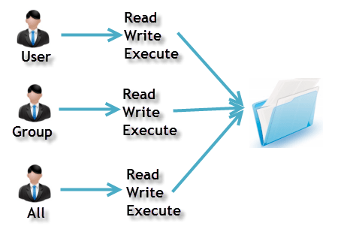
File Permission
Ownership
Permission
A user is the owner of the file.
This permission give you the authority to open and read a file.
User
Read
A user- group can contain multiple users.
The write permission gives you the authority to modify the contents of a file.
Group
Write
Any other user who has access to a file.
you cannot run a program unless the execute permission is set.
Other
Execute
‹#›
Notes:
Display these information in the UI.

Slide 29
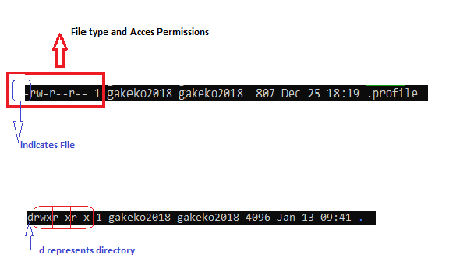
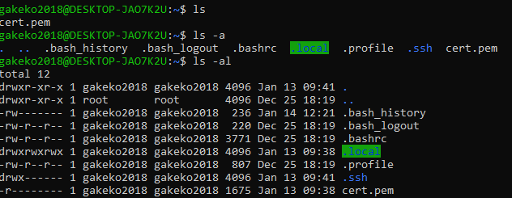
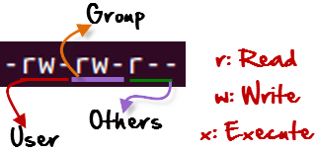

File Permission
r = read permission
w = write permission
x = execute permission
- = no permission
‹#›

Slide 30
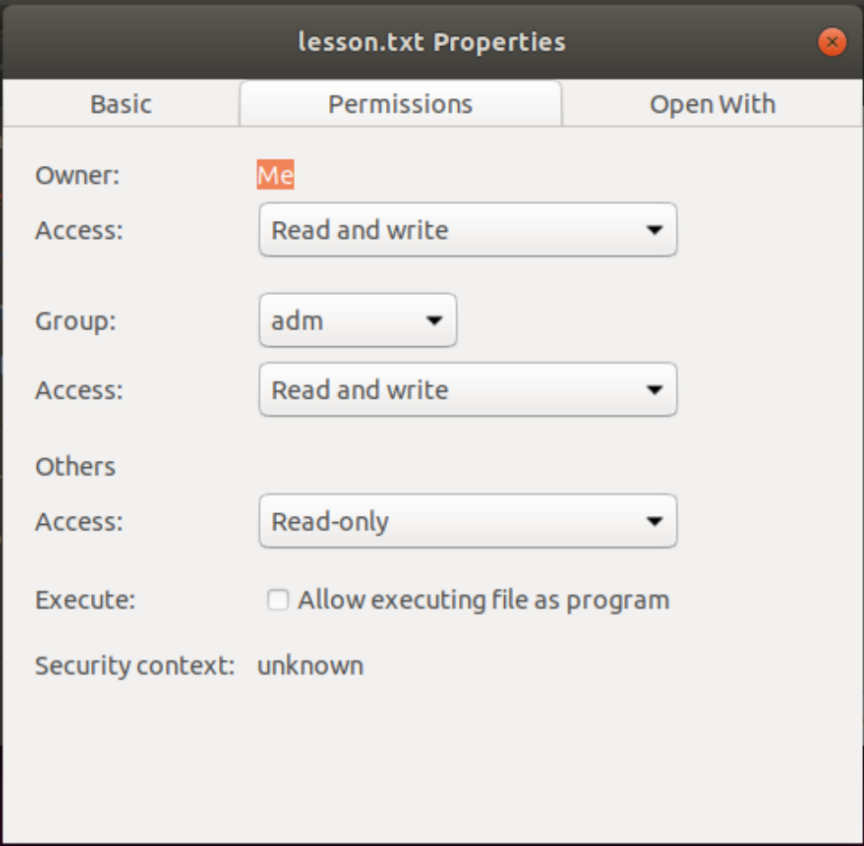
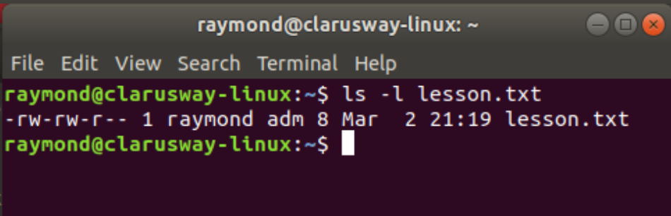
File Permission
Please find data.json and investigate the permission details in
UI and Terminal interface, make a comparison, does it match?
‹#›

Slide 31
File Permission
Changing Permission with chmod Command
We can use the chmod command which stands for change mode.
we can set permissions (read, write, execute) on a file/directory for the owner, group and the world.
Symbol | Permission Type
--- | No Permission
--x | Execute
-w- | Write
-wx | Execute+Write
r-- | Read
r-x | Read+Execute
rw- | Read+Write
rwx | Read+Write+Execute
chmod permissions filename
chmod u=rwx,g=rx,o=r data.json

Slide 32
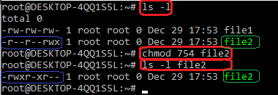
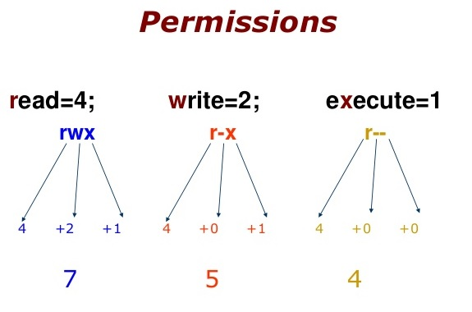
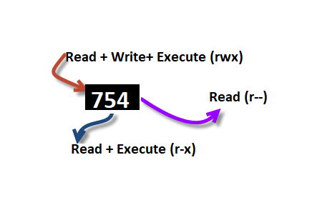
File Permission
754 code says;
Owner can read, write and execute
User’s group can read and execute
Other can only read
chmod u=rwx,g=rx,o=r myfile
chmod 754 myfile
Notes:
Does that look like a BCD encoding?

Slide 33
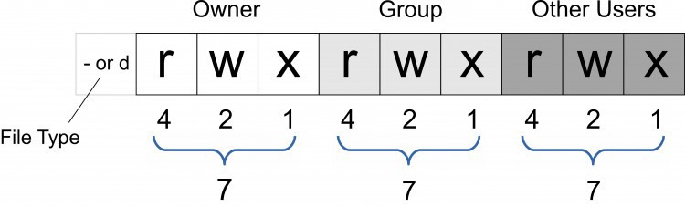
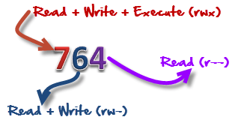
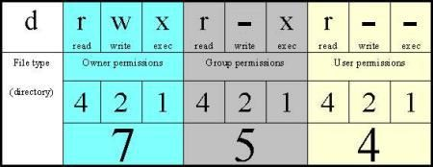
File Permission

Slide 34
Set permissions of data.json to;
owner : full access
group : read and execute
others : no access
Notes:
🍐 This is a Pear Deck Text Slide
🍐 To edit the type of question, go back to the "Ask Students a Question" in the Pear Deck sidebar.

Slide 35
Ping & SSH Command

Slide 36
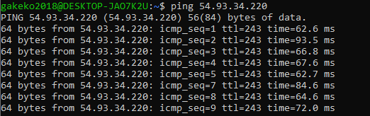
Ping Command
Ping or Packet Internet Groper is a network administration utility used to check the connectivity status between a source and a destination device.
ping host-name/IP
ping 54.93.34.220

Slide 37
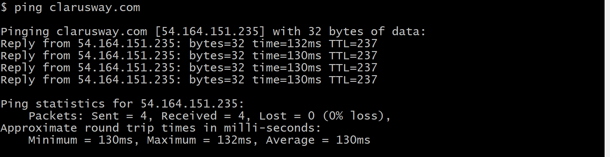
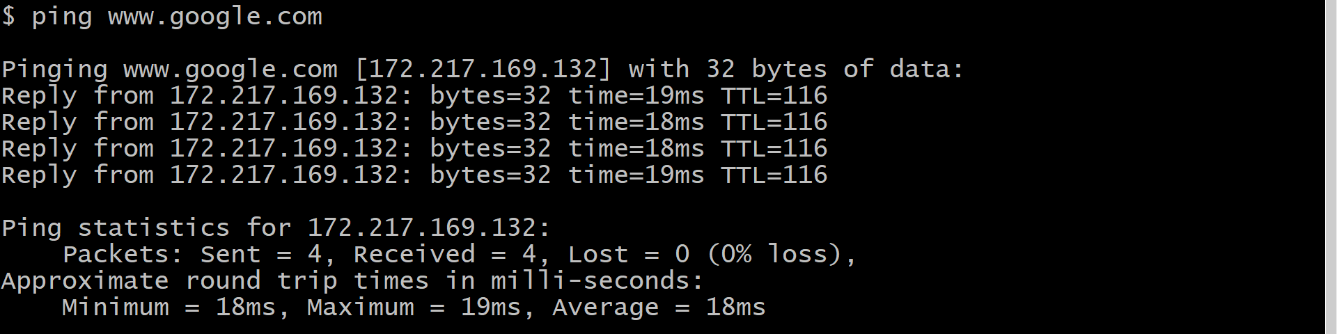
Ping Command

Slide 38
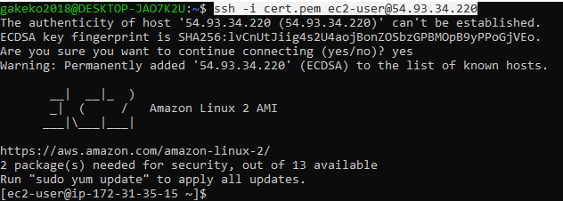
SSH Command
* ssh stands for “Secure Shell”.
* It is a protocol used to securely connect to a remote server/system.
ssh user@host(IP/Domain_name)
ssh -i cert.pem ec2-user@54.93.34.220

Slide 39
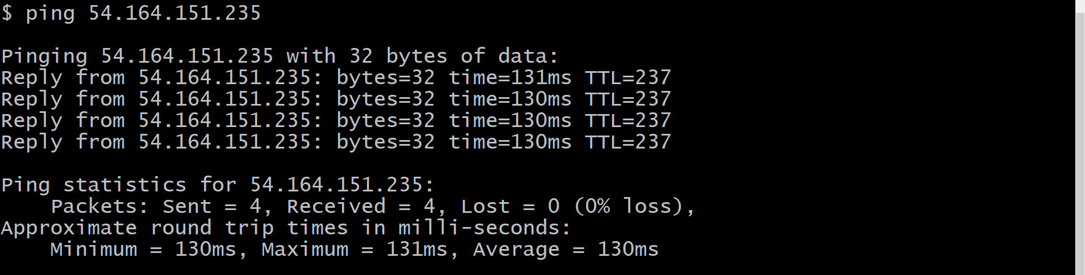
Ping Command

Slide 40
THANK YOU
Any questions?

