Slide 1

Quick review and new materials
Notes:
Preparation : Bi-directional copy/paste ability for this session is needed for VBox.

Slide 2
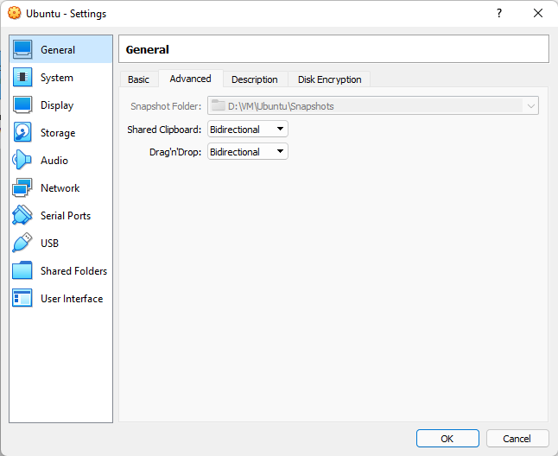
Notes:
Preparation : Bi-directional copy/paste ability for this session is needed for VBox.

Slide 3
Quick review
cd / changes directory to physical root
mkdir xxx creates a directory
rm -r xxx directory recursively removes the file/folder
lspci, lshw, lsusb
pwd Displays the working directory
!! re-execute the latest command, use up/down keys
tabKey Using tab key finds the alternatives
touch creates a file.
cp copies a file with default or updated name
mv moves a file
cat display contents of a file
echo mainly used in scripts, also displays environment variables
.sh is an executable script file
dmesg investigate the startup logs
cat /proc/cpuinfo : details of CPU
/proc folder contains useful information
free -h or free : details of ram usage
nano and vi are the text editors
ip a : displays the IP configuration
env : displays the environment variables
chmod 777 file : assign the access permissions
ping xxx : check if there is a problem with physical access
ssh : open up a secure shell connection
host : host www.sybex.com
Notes:
Lets make a quick review for the commands that require applicable parameters

Slide 4
What defines a Linux OS?
Command line shells
Graphical User Interfaces (Ease of use for command line shells)
Utility Programs (Calculators, disk managers etc)
Libraries (Collections of functions)
Productivity Programs (web browsers, word processors, graphic editors)

Slide 5
Optional : Install Blender in Ubuntu
sudo apt-get update
sudo apt-get install Blender
blender
Installation can take around 10 min with ~900Mb space
Notes:
The installation process can be as simple as 2 lines of commands
Where for other tools the installation process can be quite complicated.
You must follow the individual steps of each installation.
sudo apt-get install net-tools

Slide 6
Using tar archive extractor
tar –help
Create a new archive file
tar -cf backup.tar /home/volkan
tar -C /home/volkan/installers -xvf backup.tar
Its also possible to use zip/unzip
Notes:
-v verbose
-x extract
-c create
-C change to directory
-f use archive file or device to extract

Slide 7
Choosing a desktop environment
KDE
GNOME
LXDE
Unity
Xfce
Build Your Own
Notes:
echo $XDG_CURRENT_DESKTOP displays the current desktop environment
It is possible to get it from : sudo apt install screenfetch (do the installation)
KDE :
The K Desktop Environment, or KDE (www.kde.org), is a popular desktop environment for Linux. It’s the default desktop environment for Mandriva and openSUSE. It includes many powerful tools that integrate together well. It’s built using the Qt widget set.
https://itsfoss.com/install-kde-on-ubuntu/
GNOME :
(www.gnome.org) is also popular in the Linux desktop environment arena. It is the default desktop environment for the Fedora and Debian distributions. GNOME is built atop the GIMP Toolkit (GTK+) widget set. Like KDE, GNOME includes many powerful tools that work together. GNOME aims to provide an easy-to-use desktop environment.
https://linuxconfig.org/how-to-install-gnome-on-ubuntu-20-04-lts-focal-fossa
XLDE :
The Lightweight X11 Desktop Environment, or LXDE (http://lxde.org), is, as its full name suggests, intended to consume few resources and therefore works well on old or modest computers. It is also built on the GTK+ widget set. LXDE is typically the default desktop environment on Linux distributions whose primary goal is to consume as few resources as possible, while still being fully functional, such as Lubuntu.
https://www.howtogeek.com/107368/how-to-install-the-lightweight-lxde-desktop-on-ubuntu/
UNITY :
Canonical, publisher of the Ubuntu distribution, released the Unity desktop environment (http://ubuntu.unity.com) back in 2010. It became Ubuntu’s default desktop environment in 2011. Unity aims for simplicity and to provide a consistent desktop environment across various desktop and mobile platforms.
https://linuxconfig.org/ubuntu-20-04-unity-desktop
XfCE :
This popular desktop environment can be found at www.xfce.org. It was originally modeled on a commercial desktop environment known as CDE, but it is built using the GTK+ widget set. Xfce provides more configurability than GNOME or Unity, and it aims to consume fewer system resources than most other desktop environments.
https://linuxconfig.org/install-xfce-xubuntu-desktop-on-ubuntu-20-04-focal-fossa-linux
Build Your Own : (Do the test in your local)
It’s possible to build a desktop environment of your own from components that you like. Because this can be a rather complex task, it’s best to start with detailed guidance. Open your favorite web search engine, and type in how to create your own Linux desktop environment to find specific information on building your custom desktop.
https://www.makeuseof.com/how-to-build-a-linux-desktop-environment/

Slide 8
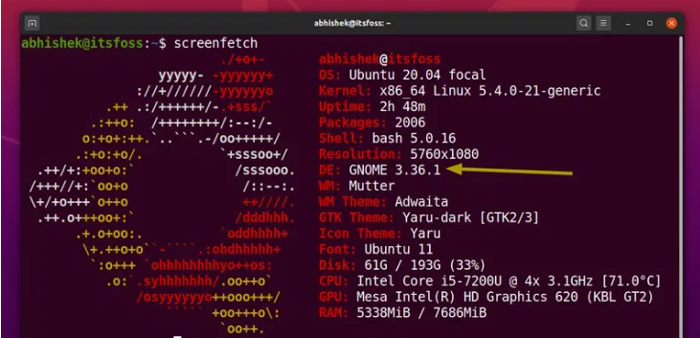
Choosing a desktop environment
Notes:
echo $XDG_CURRENT_DESKTOP displays the current desktop environment, but it may not work.
It is possible to get it from : sudo apt install screenfetch (do the installation),this may not work due to VM
KDE :
The K Desktop Environment, or KDE (www.kde.org), is a popular desktop environment for Linux. It’s the default desktop environment for Mandriva and openSUSE. It includes many powerful tools that integrate together well. It’s built using the Qt widget set.
https://itsfoss.com/install-kde-on-ubuntu/
GNOME :
(www.gnome.org) is also popular in the Linux desktop environment arena. It is the default desktop environment for the Fedora and Debian distributions. GNOME is built atop the GIMP Toolkit (GTK+) widget set. Like KDE, GNOME includes many powerful tools that work together. GNOME aims to provide an easy-to-use desktop environment.
https://linuxconfig.org/how-to-install-gnome-on-ubuntu-20-04-lts-focal-fossa
XLDE :
The Lightweight X11 Desktop Environment, or LXDE (http://lxde.org), is, as its full name suggests, intended to consume few resources and therefore works well on old or modest computers. It is also built on the GTK+ widget set. LXDE is typically the default desktop environment on Linux distributions whose primary goal is to consume as few resources as possible, while still being fully functional, such as Lubuntu.
https://www.howtogeek.com/107368/how-to-install-the-lightweight-lxde-desktop-on-ubuntu/
UNITY :
Canonical, publisher of the Ubuntu distribution, released the Unity desktop environment (http://ubuntu.unity.com) back in 2010. It became Ubuntu’s default desktop environment in 2011. Unity aims for simplicity and to provide a consistent desktop environment across various desktop and mobile platforms.
https://linuxconfig.org/ubuntu-20-04-unity-desktop
XfCE :
This popular desktop environment can be found at www.xfce.org. It was originally modeled on a commercial desktop environment known as CDE, but it is built using the GTK+ widget set. Xfce provides more configurability than GNOME or Unity, and it aims to consume fewer system resources than most other desktop environments.
https://linuxconfig.org/install-xfce-xubuntu-desktop-on-ubuntu-20-04-focal-fossa-linux
Build Your Own :
It’s possible to build a desktop environment of your own from components that you like. Because this can be a rather complex task, it’s best to start with detailed guidance. Open your favorite web search engine, and type in how to create your own Linux desktop environment to find specific information on building your custom desktop.
https://www.makeuseof.com/how-to-build-a-linux-desktop-environment/

Slide 9
Common used package tools
dpkg
rpm
apt-get
yum
Notes:
dpkg :
A low-level package tool used as the foundation of Debian-based family of PMS tools. It can be used directly to install, manage, and remove software packages. However, it is limited in function. For example, the dpkg tool cannot download software packages from the repositories.
rpm :
The rpm tool is also a low-level package tool similar in function to the dpkg utility. However, it is used as the foundation of the Red Hat Linux package management system. Though you can use rpm to manage packages, it’s best to use a higher-level PMS utility.
apt-get
This is a text-mode tool for the Debian PMS. With apt-get, you can install from repositories and remove software packages from your local Linux system. In addition, you can perform package upgrades for individual packages, all of the packages on your system, or your entire distribution. However, you will need to use the apt-cache text-mode tool for determining various pieces of information concerning software packages.
yum
This is a text-mode tool for the Red Hat PMS. It is used on distributions, such as Red Hat Enterprise Linux (RHEL), Fedora, and CentOS. With yum, you can install from repositories, remove software packages from your local Linux system, upgrade packages, and so on. In addition, you can use yum for determining various pieces of information concerning packages and their management, such as displaying a list of the PMS’s configured repositories.

Slide 10
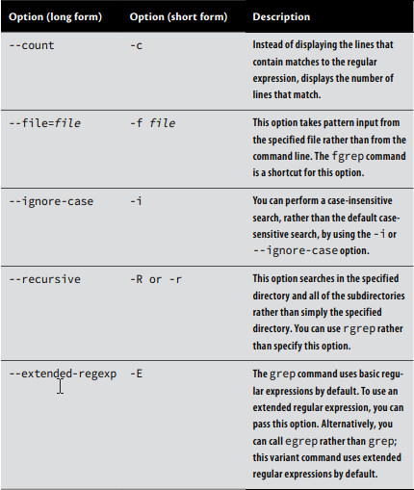
Using grep command
The grep command searches for files that contain a specified string and returns the name of the file and (if it’s a text file) the line containing that string.
You can also use grep to search a specified file for a specified string.
To use grep , you type the command’s name, an optional set of options, a regular expression, and an optional filename specification.
The grep command supports a large number of options

Slide 11
Using grep command
sudo grep -r eth0 /etc/*
This example finds all of the files in /etc that contain the string eth0
(the identifier for the first Ethernet device on most distributions).
Because the example includes the -r option, it searches recursively, so grep searches files in subdirectories of /etc as well as those in /etc itself.
For each matching text file, the line that contains the string is printed.
Suppose that you want to locate all of the files in /etc that contain the string eth0 or eth1 .
You can enter the following command, which uses a bracket regular expression to specify both variant devices:
sudo grep eth[01] /etc/*

Slide 12
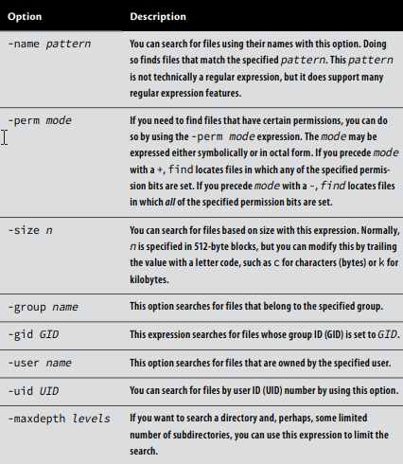
Using find command
This utility application finds files by searching through the specified directory tree, checking filenames, file creation dates, and so on to locate the files that match the specified criteria.
Because of this operation method, find tends to be slow. It’s flexible, however, and likely to succeed, assuming that the file for which you’re searching exists.
sudo find /home -name "*.c"
Notes:
Please try to find some specific files in your environment

Slide 13
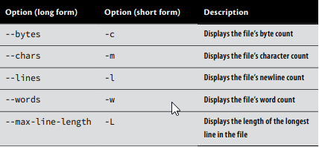
Using wc command
A file’s size in bytes, as revealed by ls or searched for using find , can be a useful metric. This size value isn’t always the most useful one for text files, though. You might need to know how many words or lines are in a text file—say, because you want to know how many pages a text document will consume when printed at 52 lines per page.
The wc utility provides this information. For instance, to discover the information for a newly created file named newfile .txt in your present working directory:
$ wc newfile.txt 37 59 1990 newfile.txt
Notes:
Please try to find some specific files in your environment
Lets keep this command as Word Count in our minds not wc :)

Slide 14
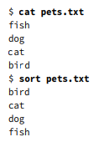
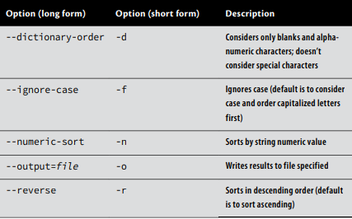
Using sort command
When dealing with a large amount of data, being able to sort it is often useful. The sort command does just that. However, you need to be aware of its features in order to achieve the desired results.
Please create a file named pets.txt and sort the internal elements by sort.
Notes:
Do this exercise to sort out all the values in txt file.

Slide 15
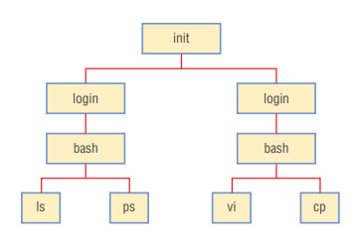
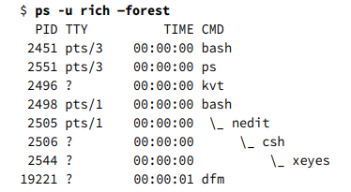
Linux Processes
Before we can manage processes, we must be able to identify them. The ps and top, bashtop utilities can help you identify processes. In either case, you can search for processes in various ways, such as by name or by resource use. You may also want to identify how much memory your processes are consuming, which you can do with the free command.
Notes:
Important to read all sections :
The Linux kernel is the core of a Linux installation.
The kernel manages memory, provides software with a way to access the hard disk, distributes the CPU time, and performs other critical low-level tasks.
The kernel is loaded early in the boot process, and it’s the kernel that’s responsible for managing every other piece of software on a running Linux computer.
One of the many ways that the kernel imposes order on the potentially chaotic set of running software is to create a sort of hierarchy.
When it boots, the kernel runs just one program—normally /sbin/init.
The init process is then responsible for starting all the other basic programs that Linux must run, such as the programs that manage logins and always-up servers.
Such programs, if launched directly by init, are called its children. The children of init can in turn launch their own children.
This happens when you log into Linux.
The process that launched a given process is called its parent. The result of this system is a treelike hierarchy of processes, as illustrated in Figure (“Trees” in computer science are often depicted upside down.)
Figure shows a small subset of the many processes that run on a typical Linux installation: just a few processes associated with a text-mode login, including the login tool that manages logins, a couple of bash shells, and a few user programs.
A working Linux system will likely have dozens or hundreds of running processes.

Slide 16
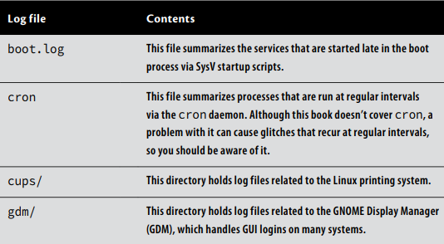
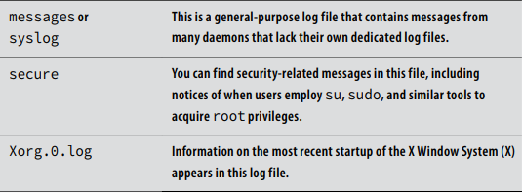
Using Log files
Linux stores most log files in the /var/log directory tree. Table 9.2 summarizes some common log files on many Linux systems. In addition, many server programs not described in this book add their own log files or subdirectories of /var/log . If you experience problems with such a server, checking its log files can be a good place to start troubleshooting.
Notes:
Many programs that run in the background (daemons) write information about their normal operations to log files , which record such notes. Consulting log files can therefore be an important part of diagnosing problems with daemons. The first step in doing this is to locate your log files. In some cases, you may need to tell the program to produce more-verbose output to help track down the problem. In this section, you’ll learn some pointers on how to do that. Finally, this section describes the kernel ring buffer, which isn’t technically a log file but can fill a similar role for kernel information.

Slide 17
Creating scripts and using them in Linux
A script is a program written in an interpreted language, typically associated with a shell or a compiled program.
In Linux, many scripts are shell scripts , which are associated with Bash or another shell. (If you’re familiar with batch files in Windows, scripts serve a similar purpose.)
You can write shell scripts to help automate tedious, repetitive tasks or to perform new and complex tasks. Scripts perform many of Linux’s startup functions, so mastering scripting will help you manage the startup process.
We will check the Bash shell scripts, beginning with the task of creating a new script file.
We then describe several important scripting features that help you to perform progressively more complex scripting tasks
The scripts begin with
#!/bin/bash
chmod a+x my-script
Notes:
The main idea is to create a script and change it’s attribute to executable.
I distributed the script file in pieces but it’s better that we use a single file.

Slide 18
Creating scripts and using them in Linux
Echo and Printf commands
#!/bin/bash
echo This is a demonstration of a simple script
#!/bin/bash
printf “This is a demonstration of a simple script\n”

Slide 19
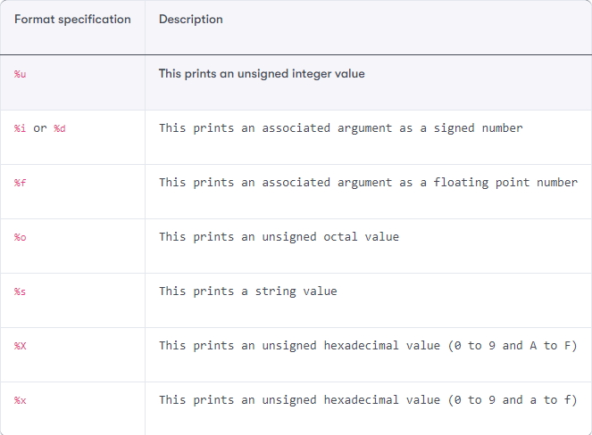
Creating scripts and using them in Linux
printf FORMAT [ARGUMENTS]
#!/bin/bash
printf "%d mul %f = %f\n" 6 6.0 36.0
The output would be :
6 mul 6.000000 = 36.000000
Another example :
printf "%d mul %.2f = %.2f\n" 6 6.0 36.0
The output would be :
6 mul 6.00 = 36.00

Slide 20

Creating scripts and using them in Linux
#!/bin/bash
#Filename: print.sh
#Description: print and echo
echo "Basic mathematics"
printf "%-7d %-7s %-7.2f =\t%-7.2f\n" 23 plus 5.5 28.5
printf "%-7.2f %-7s %-7d =\t%-7.2f\n" 50.50 minus 20 30.50
printf "%-7d %-7s %-7d =\t%-7d\n" 10 mul 5 50
printf "%-7d %-7s %-7d =\t%-7.2f\n" 27 div 4 6.75
The output would be :

Slide 21
Creating scripts and using them in Linux
A simple script that starts 3 applications :
#!/bin/bash
gnome-terminal & // will work
/usr/bin/xterm & // won’t work if not exist
/usr/bin/kmail & // won’t work if not installed
The scripts may go complicated :
#!/bin/bash ip=`route -n | grep UG | tr -s “ “ | cut -f 2 -d “ “`
ping=”/bin/ping”
echo “Checking to see if $ip is up...”
$ping -c 5 $ip
Here the dollar sign indicates a variable
Notes:
$ping -c 5 $ip ping 192.168.80.56 for 5 times

Slide 22
Creating scripts and using them in Linux
Using variables :
book="Linux Shell Scripting" # Stores string value
book = "Linux Shell Scripting" # Wrong, spaces around = operator
total_chapters=8 # Stores integer value
number_of_pages=210 # Stores integer value
average_pages_per_chapter=26.25 # Stores float value
echo average_pages_per_chapter
Notes:
printf average_pages_per_chapter

Slide 23
Creating scripts and using them in Linux
Accessing variables :
#!/bin/bash
#Filename: variables.sh
#Description: Basic variable definition and accessing them
echo Basic variable definition and accessing them
book="Linux Shell Scripting"
total_chapters=8
number_of_pages=210
average_pages_per_chapter=26.25
echo "Book name - $book"
echo "Number of Chapters - $total_chapters"
printf "Total number of pages in book - $number_of_pages\n"
printf "Average pages in each chapter - %-.2f\n" $average_pages_per_chapter

Slide 24
Creating scripts and using them in Linux
The unset script command
#!/bin/bash
#Filename: unset.sh
#Description: removing value of a variable
fruit="Apple"
quantity=6
echo "Fruit = $fruit , Quantity = $quantity"
unset fruit
echo "Fruit = $fruit , Quantity = $quantity"
The output would be :
Fruit = Apple , Quantity = 6
Fruit = , Quantity = 6

Slide 25
Creating scripts and using them in Linux
Definition and usage of constant variables
#!/bin/bash
#Filename: constant.sh
#Description: constant variables in shell
readonly text="Welcome to Linux Shell Scripting"
echo $text
declare -r number=27
echo $number
text="Welcome"
The output would be :
Welcome to Linux Shell Scripting
27
constant.sh: line 9: text: readonly variable
Notes:
When you try to change a constant value you’ll get an error message from the interpreter.

Slide 26
Creating scripts and using them in Linux
Reading variables from user input and using them
#!/bin/bash
#Filename: inputs.sh
#Description: Reading the user input
read name loginname password
echo $name $loginname $password
The output would be : just check it on VBox :)

Slide 27
Creating scripts and using them in Linux
Reading variables from user input and using them
#!/bin/bash
#Filename: inputs.sh
#Description: Reading the user input
read -p "What is your name? " # -p allows to prompt user a message
What is your name? Foo
$ echo $REPLY
Foo
The output would be as displayed above

Slide 28
Creating scripts and using them in Linux
Reading variables from user input and using them
#!/bin/bash
#Filename: inputs.sh
#Description: Reading the user input but in hidden form
read -s -p "Enter your secret key:" # -s doesn't echo input in console
Enter your secret key:$ #Pressing enter key brings command prompt $
echo $REPLY
foo
The output would be as displayed above

Slide 29
Creating scripts and using them in Linux
A sample script that searches a file
#!/bin/bash
#Filename: read.sh
#Description: Find a file in a path entered by user
read -p "Enter filename to be searched:"
filename=$REPLY
read -p "Enter path for search:" path
echo "File $filename search matches to"
find $path -name $filename
The output would be as:
Enter filename to be searched:read
Enter path for search:/usr/bin
File read search matches to
/usr/bin/read

Slide 30
Creating scripts and using them in Linux
The if / fi usage
#!/bin/sh
a=10
b=20
if [ $a == $b ]
then
echo "a is equal to b"
else
echo "a is not equal to b"
fi
The output would be as:
a is not equal to b

Slide 31
Creating scripts and using them in Linux
The while do done
#!/bin/bash
x=1
while [ $x -le 5 ]
do
echo "Welcome $x times"
x=$(( $x + 1 ))
done
The output would be on your local
Notes:
Define lg, lt, le

Slide 32
Creating scripts and using them in Linux
The if / fi usage
#!/bin/sh
a=0
while [ "$a" -lt 10 ] # this is loop1
do
b="$a"
while [ "$b" -ge 0 ] # this is loop2
do
echo -n "$b "
b=`expr $b - 1`
done
echo
a=`expr $a + 1`
done
The output would be as:
0
1 0
2 1 0
3 2 1 0
4 3 2 1 0
5 4 3 2 1 0
6 5 4 3 2 1 0
7 6 5 4 3 2 1 0
8 7 6 5 4 3 2 1 0
9 8 7 6 5 4 3 2 1 0

Slide 33
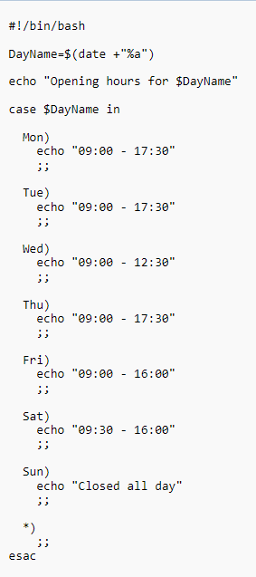
Creating scripts
if [ -s /tmp/tempstuff ]
then echo “/tmp/tempstuff found; aborting!”
exit fi
case word in pattern1)
command(s);;
pattern2)
command(s);; ...
esac
Notes:
Just like writing an application the scripts may contain conditions.

Slide 34
Creating scripts
How to define functions in scripts
#!/bin/sh
# Define your function here
Hello () {
echo "Hello World"
}
# Invoke your function
Hello
The output would be
$./test.sh
Hello World
Notes:
Just like writing an application the scripts may contain conditions.

Slide 35
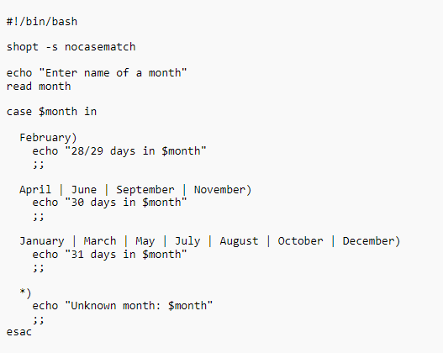
Creating scripts
Notes:
Just like writing an application the scripts may contain conditions.
Shopt : (Scripting Options)
On Unix-like operating systems, shopt is a builtin command of the Bash shell that enables or disables options for the current shell session

Slide 36
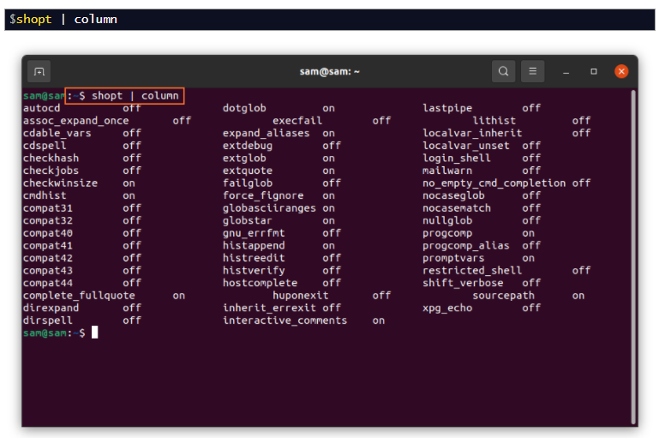
Creating scripts

Slide 37
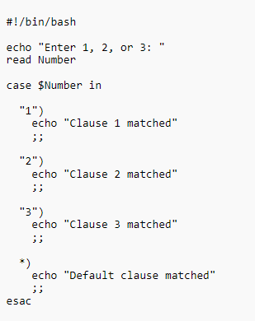
Creating scripts
Notes:
Using digits in case statements, digit values can be stored in variables as well.

Slide 38
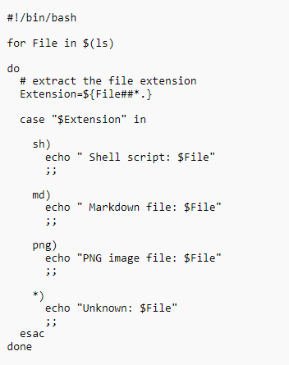
Using for statement in scripts
Notes:
Using for loop in shell scripts

Slide 39
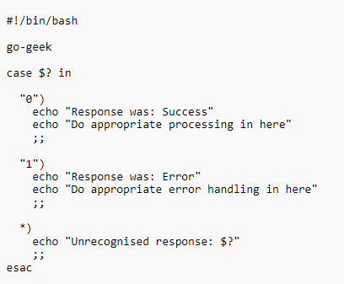
Using exit code in scripts
Notes:
Using exit in shell scripts
Here we can use another application that exists in our OS.

Slide 40
THANK YOU
Any questions?

