Slide 1
Intro to Crypto and Cryptocurrencies
Slides by Arvind Narayanan et al.

Slide 2
Hash Pointers and Data Structures

Slide 3
hash pointer is:
* pointer to where some info is stored, and
* (cryptographic) hash of the info
if we have a hash pointer, we can
* ask to get the info back, and
* verify that it hasn’t changed

Slide 4
H( )
(data)
will draw hash pointers like this

Slide 5
key idea:
build data structures with hash pointers

Slide 6
linked list with hash pointers = “block chain”
H( )
prev: H( )
prev: H( )
prev: H( )
data
data
data
use case: tamper-evident log

Slide 7
detecting tampering
H( )
prev: H( )
prev: H( )
prev: H( )
data
data
data
use case: tamper-evident log

Slide 8
binary tree with hash pointers = “Merkle tree”
H( ) H( )
H( ) H( )
H( ) H( )
H( ) H( )
H( ) H( )
H( ) H( )
H( ) H( )
(data)
(data)
(data)
(data)
(data)
(data)
(data)
(data)

Slide 9
proving membership in a Merkle tree
show O(log n) items
H( ) H( )
H( ) H( )
H( ) H( )
(data)

Slide 10
Advantages of Merkle trees
Tree holds many items
but just need to remember the root hash
Can verify membership in O(log n) time/space
Variant: sorted Merkle tree
can verify non-membership in O(log n)
(show items before, after the missing one)

Slide 11
More generally ...
can use hash pointers in any pointer-based
data structure that has no cycles

Slide 12

GoofyCoin

Slide 13
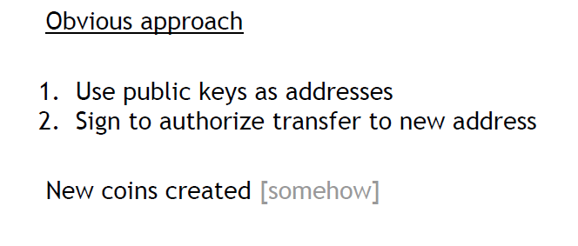
Simple Cryptocurrencies

Slide 14
Goofy can create new coins
New coins belong to me.
signed by pk_{Goofy}
CreateCoin [uniqueCoinID]

Slide 15
A coin’s owner can spend it.
Alice owns it now.
signed by pk_{Goofy}
Pay to pk_{Alice} : H( )
signed by pk_{Goofy}
CreateCoin [uniqueCoinID]

Slide 16

The recipient can pass on the coin again.
signed by pk_{Alice}
Bob owns it now.
Pay to pk_{Bob} : H( )
signed by pk_{Goofy}
Pay to pk_{Alice} : H( )
signed by pk_{Goofy}
CreateCoin [uniqueCoinID]

Slide 17
double-spending attack
signed by pk_{Alice}
signed by pk_{Alice}
Pay to pk_{Bob} : H( )
Pay to pk_{Chuck} : H( )
signed by pk_{Goofy}
Pay to pk_{Alice} : H( )
signed by pk_{Goofy}
CreateCoin [uniqueCoinID]

Slide 18
double-spending attack
the main design challenge in digital currency

Slide 19
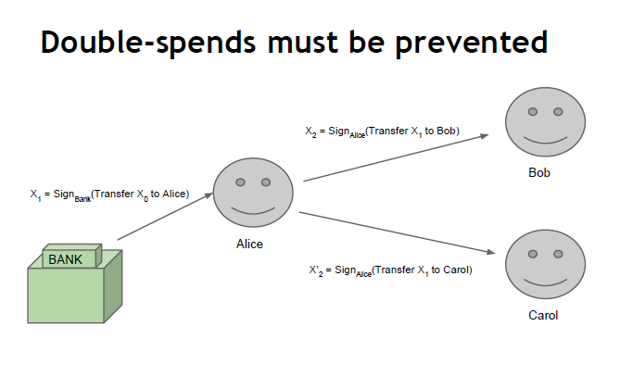

Slide 20
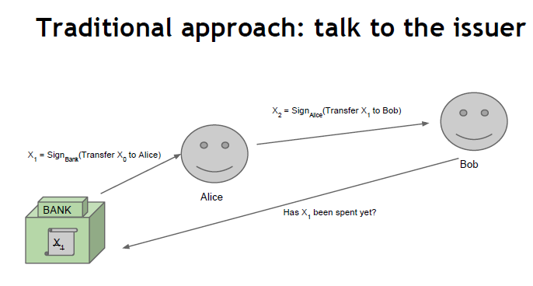

Slide 21

ScroogeCoin

Slide 22

Scrooge publishes a history of all transactions
(a block chain, signed by Scrooge)
H( )
prev: H( )
prev: H( )
prev: H( )
transID: 71
transID: 72
transID: 73
trans
trans
trans
optimization: put multiple transactions in the same block

Slide 23
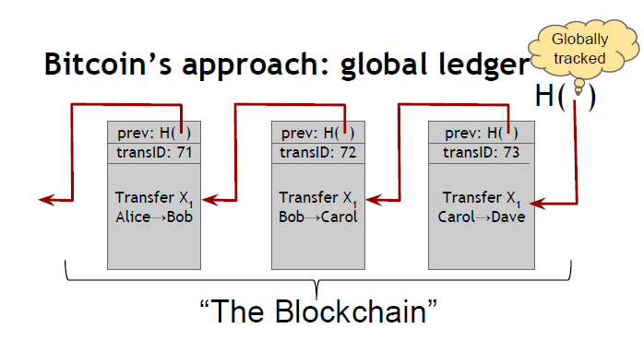

Slide 24
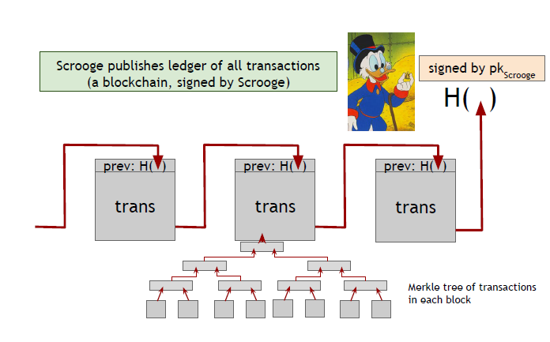

Slide 25
CreateCoins transaction creates new coins
Valid, because I said so.
transID: 73 type:CreateCoins
coins created
num | value | recipient
0 | 3.2 | 0x...
1 | 1.4 | 0x...
2 | 7.1 | 0x...
coinID 73(0)
coinID 73(1)
coinID 73(2)

Slide 26
PayCoins transaction consumes (and destroys) some coins,
and creates new coins of the same total value
transID: 73 type:PayCoins
consumed coinIDs:
68(1), 42(0), 72(3)
Valid if:
-- consumed coins valid,
-- not already consumed,
-- total value out = total value in, and
-- signed by owners of all consumed coins
coins created
num | value | recipient
0 | 3.2 | 0x...
1 | 1.4 | 0x...
2 | 7.1 | 0x...
signatures

Slide 27
Immutable coins
Coins can’t be transferred, subdivided, or combined.
But: you can get the same effect by using transactions
to subdivide: create new trans
consume your coin
pay out two new coins to yourself

Slide 29
Don’t worry, I’m honest.

Slide 30
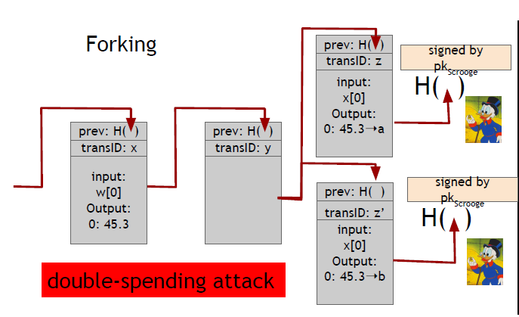
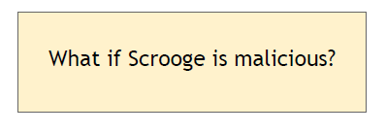

Slide 31
Don’t worry, I’m honest.
Crucial question:
Can we descroogify the currency, and operate without any central, trusted party?

Slide 32
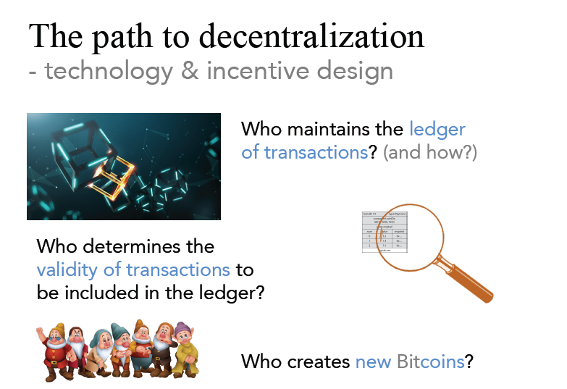

Slide 33
Mechanics of Bitcoin

Slide 34
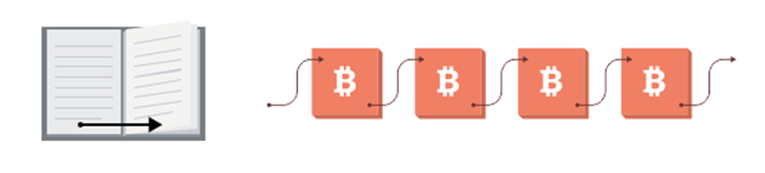
What is blockchain, and why does it matter?
A blockchain is a historical record of transactions, much like a database
Blocks in a chain = pages in a book.
Each page in a book contains:
The text: the story
Equivalent to transactions in case of blockchain
Each page has information about itself (metadata): title of the book, chapter title, page number, etc.
A header which contains the data about the block: e.g. technical information, a reference to the previous block, and a digital fingerprint (aka “hash”) of the data contained in this block, among other things.
“Bits on Blocks”, Blog by Antony Lewis, https://bitsonblocks.net/

Slide 35
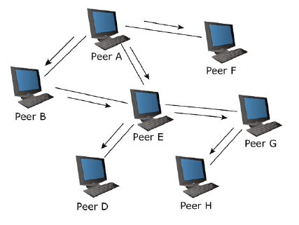
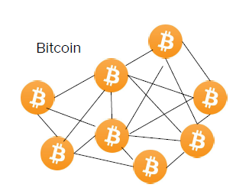
Peer to Peer Network

Slide 36
Peer to Peer Network
A distributed network architecture may be called a Peer-to-Peer (P-to-P, P2P,.) network, if the participants share a part of their own hardware resources (processing power, storage capacity, network link capacity, printers,.). These shared resources are necessary to provide the Service and content offered by the network (e.g. file sharing or shared workspaces for collaboration). They are accessible by other peers directly, without passing intermediary entities. The participants of such a network are thus resource (Service and content) providers as well as resource (Service and content) requestors (Servent-concept).
- Rüdiger Schollmeier, 2002

Slide 37
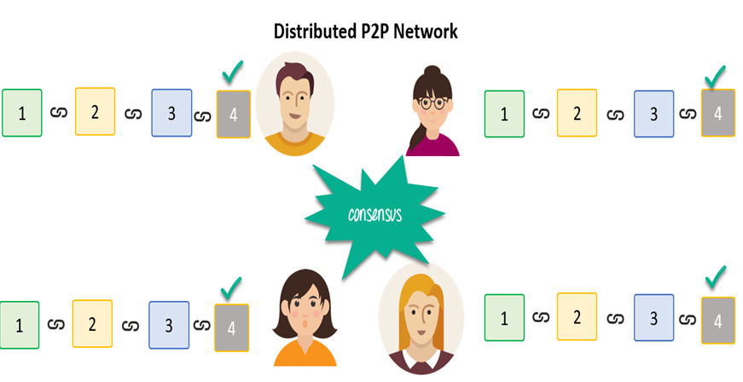
How to achieve consistency?

Slide 38
Public Keys as Identities

Slide 39
Why don’t Bitcoin nodes have identities?
No Central Authority

Slide 40
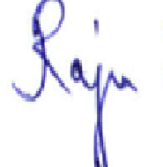
Useful trick: public key == an identity
if you see sig such that verify(pk, msg, sig)==true,
think of it as
pk says, “[msg]”.
to “speak for” pk, you must know matching secret key sk

Slide 41
How to make a new identity
create a new, random key-pair (sk, pk)
pk is the public “name” you can use
[usually better to use Hash(pk)]
sk lets you “speak for” the identity
you control the identity, because only you know sk
if pk “looks random”, nobody needs to know who you are

Slide 42
Decentralized identity management
Public Key as Idenitity!
anybody can make a new identity at any time - make as many as you want!
These identities are called “addresses” in Bitcoin.
Pseudonymity is a goal of Bitcoin
Identity is hard in a P2P system — Sybil attack

Slide 43
Privacy
Addresses not directly connected to real-world identity.
But observer can link together an address’s activity over time, make inferences.

Slide 44
Bitcoin transactions

Slide 45
An account-based ledger (not Bitcoin)
time
might need to scan backwards until genesis!
Create 25 coins and credit to Alice_{ASSERTED BY MINERS}
Transfer 17 coins from Alice to Bob_{SIGNED(Alice)}
Transfer 8 coins from Bob to Carol_{SIGNED(Bob)}
Transfer 5 coins from Carol to Alice_{SIGNED(Carol)}
is this valid?
Transfer 15 coins from Alice to David_{SIGNED(Alice)}
SIMPLIFICATION: only one transaction per block

Slide 46
A transaction-based ledger (Bitcoin)
Inputs: Ø
Outputs: 25.0→Alice
1
time
we implement this with hash pointers
change address
Inputs: 1[0]
Outputs: 17.0→Bob, 8.0→Alice
SIGNED(Alice)
2
Inputs: 2[0]
Outputs: 8.0→Carol, 9.0→Bob
SIGNED(Bob)
finite scan to check for validity
3
Inputs: 2[1]
Outputs: 6.0→David, 2.0→Alice
SIGNED(Alice)
4
is this valid?
SIMPLIFICATION: only one transaction per block
Notes:
This is called a “change address”

Slide 47
Merging value
time
Inputs: ...
Outputs: 17.0→Bob, 8.0→Alice
SIGNED(Alice)
1
...
Inputs: 1[1]
Outputs: 6.0→Carol, 2.0→Bob
SIGNED(Carol)
2
...
Inputs: 1[0], 2[1]
Outputs: 19.0→Bob
SIGNED(Bob)
3
SIMPLIFICATION: only one transaction per block

Slide 48
Joint payments
time
Inputs: ...
Outputs: 17.0→Bob, 8.0→Alice
SIGNED(Alice)
1
...
Inputs: 1[1]
Outputs: 6.0→Carol, 2.0→Bob
SIGNED(Carol)
2
...
Inputs: 2[0], 2[1]
Outputs: 8.0→David
SIGNED(Carol), SIGNED(Bob)
3
two signatures!
SIMPLIFICATION: only one transaction per block

Slide 49
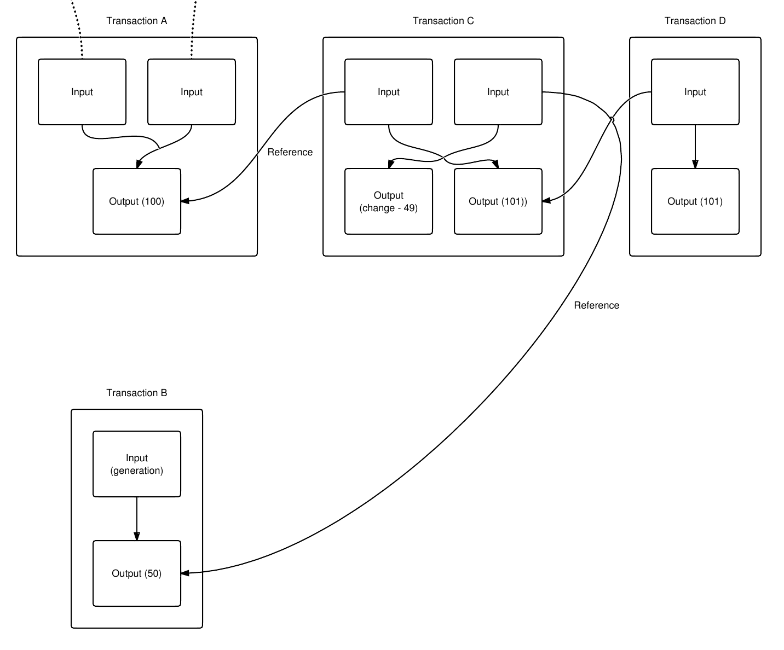

Slide 50
The real deal: a Bitcoin transaction
{ "hash":"5a42590fbe0a90ee8e8747244d6c84f0db1a3a24e8f1b95b10c9e050990b8b6b", "ver":1, "vin_sz":2, "vout_sz":1, "lock_time":0, "size":404, "in":[ { "prev_out":{ "hash":"3be4ac9728a0823cf5e2deb2e86fc0bd2aa503a91d307b42ba76117d79280260", "n":0 },
"scriptSig":"30440..." }, { "prev_out":{ "hash":"7508e6ab259b4df0fd5147bab0c949d81473db4518f81afc5c3f52f91ff6b34e", "n":0 }, "scriptSig":"3f3a4ce81...." } ], "out":[ { "value":"10.12287097", "scriptPubKey":"OP_DUP OP_HASH160 69e02e18b5705a05dd6b28ed517716c894b3d42e OP_EQUALVERIFY OP_CHECKSIG" } ]
}
metadata
input(s)
output(s)

Slide 51
The real deal: transaction metadata
{ "hash":"5a42590...b8b6b", "ver":1, "vin_sz":2, "vout_sz":1, "lock_time":0, "size":404,
...
}
transaction hash
housekeeping
“not valid before”
housekeeping

Slide 52
The real deal: transaction inputs
"in":[ { "prev_out":{ "hash":"3be4...80260", "n":0 },
"scriptSig":"30440....3f3a4ce81" }, ...
],
previous
transaction
signature
(more inputs)

Slide 53
The real deal: transaction outputs
"out":[
{
"value":"10.12287097",
"scriptPubKey":"OP_DUP OP_HASH160 69e...3d42e OP_EQUALVERIFY OP_CHECKSIG"
},
...
]
output value
recipient address??
more on this soon...
(more outputs)

Slide 54
Bitcoin scripts

Slide 55
Output “addresses” are really scripts
OP_DUP
OP_HASH160
69e02e18...
OP_EQUALVERIFY OP_CHECKSIG

Slide 56
Input “addresses” are also scripts
30440220...
0467d2c9...
scriptSig
OP_DUP
OP_HASH160
69e02e18...
OP_EQUALVERIFY OP_CHECKSIG
scriptPubKey
TO VERIFY: Concatenated script must execute completely with no errors

Slide 57
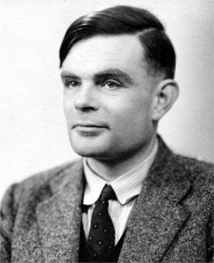
Bitcoin scripting language (“Script”)
Design goals
Built for Bitcoin (inspired by Forth)
Simple, compact
Support for cryptography
Stack-based
Limits on time/memory
No looping
I am not impressed

Slide 58
Bitcoin script execution example
✓
<pubKeyHash?>
<pubKey>
<pubKeyHash>
<pubKey>
<sig>
true
<sig> <pubKey> OP_DUP OP_HASH160 <pubKeyHash?> OP_EQUALVERIFY OP_CHECKSIG

Slide 59
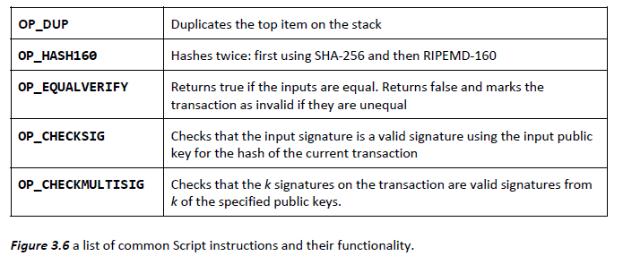

Slide 60
Bitcoin script instructions
256 opcodes total (15 disabled, 75 reserved)
Arithmetic
If/then
Logic/data handling
Crypto!
Hashes
Signature verification
Multi-signature verification

Slide 61

OP_CHECKMULTISIG
Built-in support for joint signatures
Specify n public keys
Specify t
Verification requires t signatures
BUG ALERT: Extra data value popped from the stack and ignored

Slide 62
Bitcoin scripts in practice (as of 2014)
Most nodes whitelist known scripts
99.9% are simple signature checks
~0.01% are MULTISIG
~0.01% are Pay-to-Script-Hash
Remainder are errors, proof-of-burn

Slide 63
Proof-of-burn
nothing’s going to redeem that ☹
OP_RETURN
<arbitrary data>
Notes:
Uses: spam/griefing. Transfer to another cryptocurrency. Fidelity bond

Slide 64
Should senders specify scripts?
?
Big Box
I’m ready to pay for my purchases!
Cool! Well we’re using MULTISIG now, so include a script requiring 2 of our 3 account managers to approve. Don’t get any of those details wrong. Thanks for shopping at Big Box!

Slide 65
Idea: use the hash of redemption script
<signature>
<<pubkey> OP_CHECKSIG>
<signature>
<pubkey>
OP_CHECKSIG
OP_HASH160
<hash of redemption script>
OP_EQUAL
“Pay to Script Hash”

Slide 66
Pay to script hash
Big Box
I’m ready to pay for my purchases!
Great! Here’s our address: 0x3454

Slide 67
Applications of Bitcoin scripts

Slide 68

Example 1: Escrow transactions
(disputed case)
(normal case)
Pay x to Bob
SIGNED(ALICE, BOB)
Pay x to Alice
SIGNED(ALICE, JUDY)
Judy
To: Alice
From: Bob
PROBLEM: Alice wants to buy online from Bob. Alice doesn’t want to pay until after Bob ships.
Bob doesn’t want to ship until after Alice pays.
Alice
Pay x to 2-of-3 of Alice, Bob, Judy (MULTISIG)
SIGNED(ALICE)
Bob
Notes:
Gavel from OpenClipArt.com

Slide 69
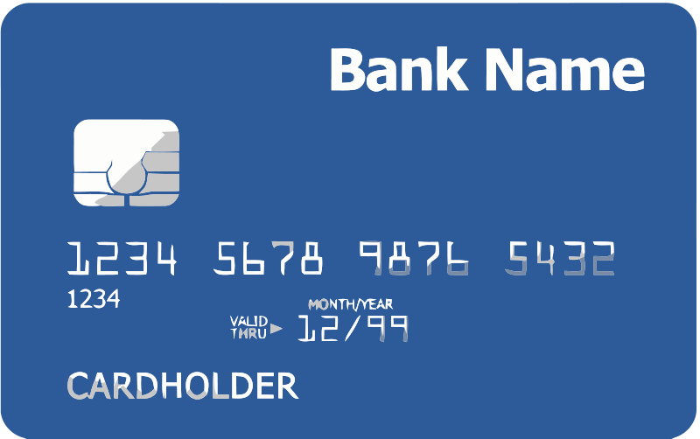

Example 2: Green addresses
InstaWallet, Mt. Gox
Collapsed!
You may Trust me. We do not do double spend!
It’s me, Alice! Could you make out a green payment to Bob?
Bank
Pay x to Bob, y to Bank
SIGNED(BANK)
No double spend
Alice
PROBLEM: Alice wants to pay Bob.
Bob can’t wait 6 verifications to guard against double-spends, or is offline completely.
Bob
Notes:
These are mostly dead thanks to Mt. Gox, Instawallet

Slide 70
Example 3: Efficient micro-payments
What if Bob never signs??
Input: x; Pay 42 to Bob, 58 to Alice
SIGNED(ALICE) SIGNED(BOB)
all of these could be double-spends!
Input: x; Pay 42 to Bob, 58 to Alice
SIGNED(ALICE)___________
...
Alice demands a timed refund transaction before starting
Input: x; Pay 04 to Bob, 96 to Alice
SIGNED(ALICE)___________
Input: x; Pay 100 to Alice, LOCK until time t
SIGNED(ALICE) SIGNED(BOB)
I’m done!
I’ll publish!
Input: x; Pay 03 to Bob, 97 to Alice
SIGNED(ALICE)___________
Input: x; Pay 02 to Bob, 98 to Alice
SIGNED(ALICE)___________
Input: x; Pay 01 to Bob, 99 to Alice
SIGNED(ALICE)___________
PROBLEM: Alice wants to pay Bob for each minute of phone service. She doesn’t want to incur a transaction fee every minute.
Bob
Alice
Input: y; Pay 100 to Bob/Alice (MULTISIG)
SIGNED(ALICE)
Notes:
What if Bob never paid?

Slide 71
lock_time
{ "hash":"5a42590...b8b6b", "ver":1, "vin_sz":2, "vout_sz":1, "lock_time":315415, "size":404,
...
}
Block index or real-world timestamp before which this transaction can’t be published

Slide 72
More advanced scripts
Multiplayer lotteries
Hash pre-image challenges
Coin-swapping protocols
“Smart contracts”

Slide 73
The Bitcoin network

Slide 74
Bitcoin P2P network
Ad-hoc protocol (runs on TCP port 8333)
Ad-hoc network with random topology
All nodes are equal
New nodes can join at any time
Network Changes over time - dynamic
No explict way to leave network
Forget non-responding nodes after 3 hr

Slide 75
Joining the Bitcoin P2P network
5
1
Hello World! I’m ready to Bitcoin!
7
8
getaddr()
getaddr()
1, 7
getaddr()
3
6
2
4
Notes:
No geographic topology
Seed nodes
No formal way of leaving

Slide 76
Transaction propagation (flooding)
Already heard that!
5
1
7
8
A→B
A→B
A→B
New tx!
A→B
3
6
A→B
2
A→B
A→B
A→B
4
A→B
A→B
A→B
Notes:
Transactions are propagated in the “pending transaction pool”

Slide 77
Should I relay a proposed transaction?
Transaction valid with current block chain
(default) script matches a whitelist
Avoid unusual scripts
Haven’t seen before
Avoid infinite loops
Doesn’t conflict with others I’ve relayed
Avoid double-spends
Sanity checks only...
Some nodes may ignore them!

Slide 78
Nodes may differ on transaction pool
New tx!
A→C
5
1
A→C
A→B
A→C
7
A→C
A→C
8
A→C
A→B
A→B
A→B
3
6
2
A→B
A→B
A→B
4
A→B

Slide 79
Race conditions
Transactions or blocks may conflict
Default behavior: accept what you hear first
Network position matters
Miners may implement other logic!

