Slide 1
Intro to Crypto and Cryptocurrencies
Slides by Arvind Narayanan et al.

Slide 2
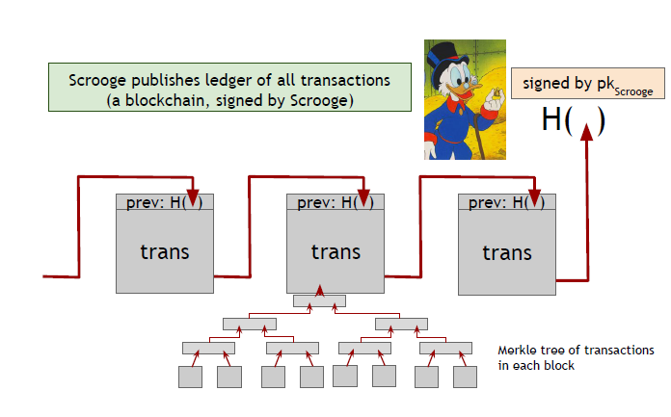

Slide 3

Don’t worry, I’m honest.

Slide 4
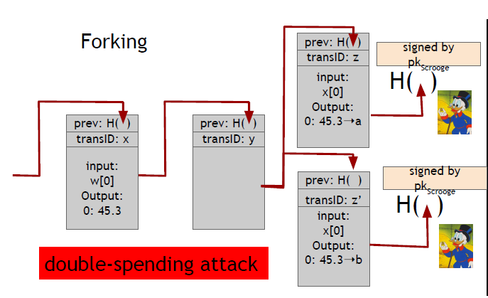
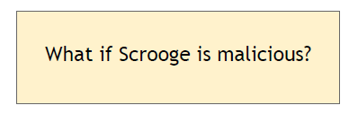

Slide 5
Don’t worry, I’m honest.
Crucial question:
Can we descroogify the currency, and operate without any central, trusted party?

Slide 6
Centralization vs. decentralization

Slide 7
Centralization vs. decentralization
Competing paradigms that underlie many digital technologies

Slide 8
Decentralization is not all-or-nothing
E-mail: decentralized protocol, but dominated by centralized webmail services

Slide 9
Bitcoin Consensus

Slide 10
Consensus algorithm (simplified)
New transactions are broadcast to all nodes
Follow Flooding/Gossip Protocol to broadcast
Some nodes collect new transactions into a block
In each round a random node gets to broadcast its block
Other nodes accept the block only if all transactions in it are valid (unspent, valid signatures)
Nodes express their acceptance of the block by including its hash in the next block they create
Mining Process
Consensus Agreement

Slide 11
Why consensus is hard
Nodes may crash
Nodes may be malicious
Network is imperfect
Not all pairs of nodes connected
Faults in network
Latency
No notion of global time
Notes:
Analogy of talking on the phone and having a lag

Slide 12
Many impossibility results
Fischer-Lynch-Paterson (deterministic nodes): consensus impossible with a single faulty node

Slide 13
Some well-known protocols
Example: Paxos, Raft, ….
Makes certain compromises
Never produces inconsistent result, but can (rarely) get stuck

Slide 14
Bitcoin consensus: theory & practice
Bitcoin consensus works better in practice than in theory
Theory is still catching up
BUT theory is important, can help predict unforeseen attacks

Slide 15
Some things Bitcoin does differently
Introduces incentives
Possible only because it’s a currency!
Embraces randomness
Does away with the notion of a specific start and end-point
Consensus happens over long time scales — about 1 hour

Slide 16
Hashcash: Proof of work
Based on the idea of HashCash, a Proof of Work concept invented by Adam Back in 1997 (http://www.hashcash.org/papers/hashcash.pdf)
Originally proposed as an anti-spam throttling mechanism
The core idea is that before accepting a transaction, the sender must first demonstrate a “cost” via a computationally “hard” problem that can simultaneously be easily verified.
This generally referred to as a “Proof of Work”

Slide 17

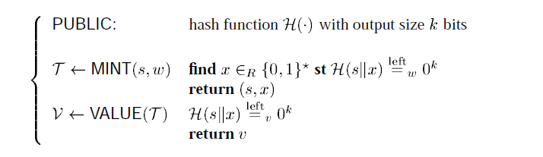
Hashcash: Proof of work
HashCash Cost Function: Interactive Vs. Non-interactive
s: service name

Slide 18
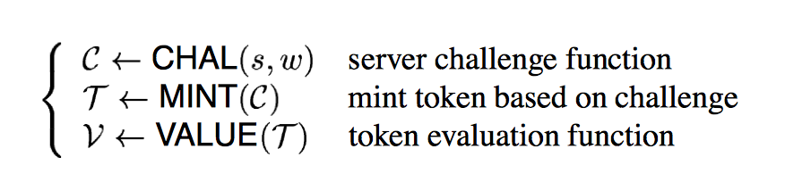
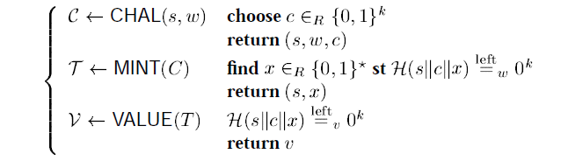
Hashcash: Proof of work
Hashcash Cost Function: Interactive Vs. Non-interactive
Prevents DOS motivated attack or pre-computation attacks

Slide 19
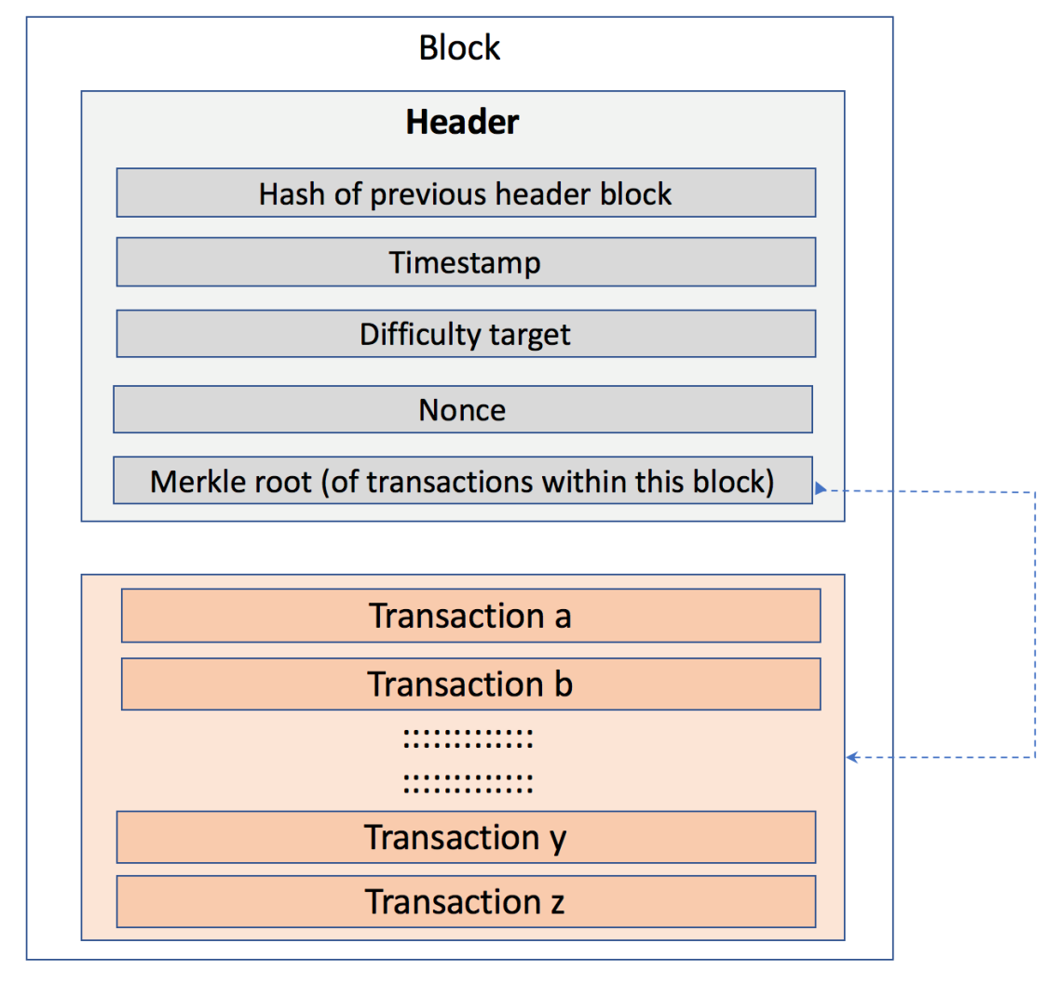
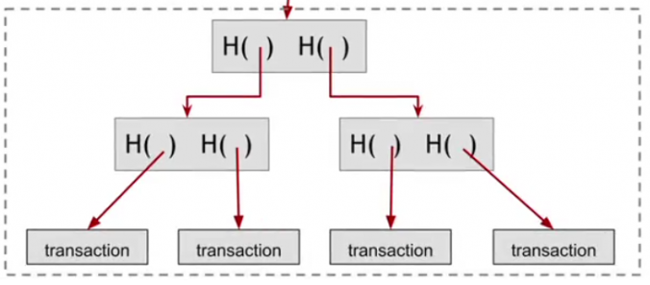

The real deal: a Bitcoin block
{
"hash":"00000000000000001aad2...",
"ver":2,
"prev_block":"00000000000000003043...",
"time":1391279636,
"bits":419558700,
"nonce":459459841,
"mrkl_root":"89776...",
"n_tx":354,
"size":181520,
"tx":[
...
],
"mrkl_tree":[
"6bd5eb25...",
...
"89776cdb..."
]
}
block header
transaction data

Slide 20
Bitcoin blocks
Why bundle transactions together?
Single unit of work for miners
Limit length of hash-chain of blocks
Faster to verify history

Slide 21

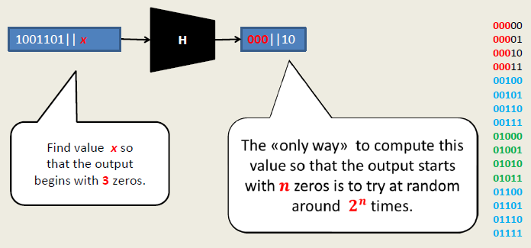
The real deal: a Bitcoin block
{
"hash":"00000000000000001aad2...",
"ver":2,
"prev_block":"00000000000000003043...",
"time":1391279636,
"bits":419558700,
"nonce":459459841,
"mrkl_root":"89776...",
"n_tx":354,
"size":181520,
"tx":[
...
],
"mrkl_tree":[
"6bd5eb25...",
...
"89776cdb..."
]
}
block header
transaction data

Slide 22
Finding a valid block: Proof-of-Work
prev: H( )
prev: H( )
mrkl_root: H( )
mrkl_root: H( )
nonce: 0x0001...
nonce: 0xffff...
nonce: 0x0000...
nonce: 0x0001...
nonce: 0x0002...
nonce: 0xf77e...
nonce: 0x7a83
nonce: 0x0000...
hash: 0xd0c7...
hash: 0x6a1f...
hash: 0x300c...
hash:
hash: 0x0224...
hash: 0xc9c8...
hash: 0x0000...
hash: 0x3485...
hash: 0x0000
hash:
All changed
H( ) H( )
H( ) H( )
H( ) H( )
25.0→A
coinbase:
0x0000...00
25.0→A
coinbase:
0x0000...01
25.0→A
coinbase:
0x3df5...65
transaction
transaction
transaction
Notes:
Make sure to point out-coinbase is why miners aren’t all solving the exact same problem

Slide 23
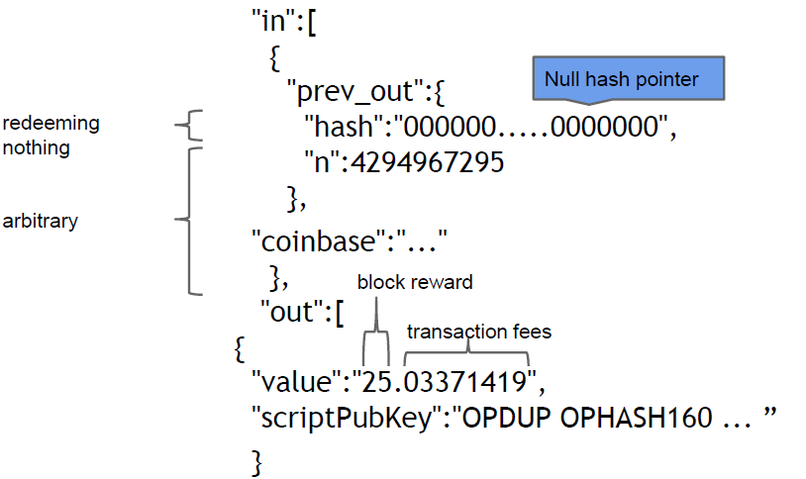
Coinbase

Slide 24
Hash puzzles: Bitcoin Proof-of-Work
nonce
To create block, find nonce s.t.
H(nonce ‖ prev_hash ‖ tx ‖ … ‖ tx) is very small
prev_h
Tx
Tx
Output space of hash
Target
space
If hash function is secure:
only way to succeed is to try enough nonces until you get lucky
Target space is 1% of overall output space, You would have to try 100 nonces before you are likely to get valid result.
Notes:
If Alice has 100x more computing power than Bob it doesn’t mean she always wins the race. It means she has about a 99% chance of wining. In the long run Bob will create 1% of the blocks

Slide 25
PoW property 1: difficult to compute
Other words, the size of the target space is less than 1/ 10²⁰ of the size of the overall space
As of Aug 2014: about 10²⁰ hashes/block
Only some nodes bother to compete — miners

Slide 26
PoW property 2: parameterizable cost
Nodes automatically re-calculate the target every two weeks
Goal: average time between blocks = 10 minutes
Prob (Alice wins next block) =
fraction of global hash power she controls
Alice with 0.1% of total hash power will find roughly one in every 1000 blocks.
Notes:
what happens if time b/w blocks is too low or too high

Slide 27
Key security assumption
Attacks infeasible if majority of miners weighted by hash power follow the protocol

Slide 28
PoW property 3: trivial to verify
Nonce must be published as part of block
Other miners simply verify that
H(nonce ‖ prev_hash ‖ tx ‖ … ‖ tx) < target

Slide 29
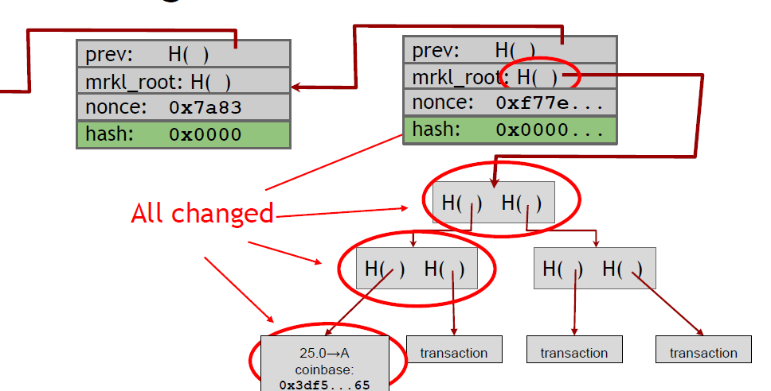
The real deal: a Bitcoin block
{
"hash":"00000000000000001aad2...",
"ver":2,
"prev_block":"00000000000000003043...",
"time":1391279636,
"bits":419558700,
"nonce":459459841,
"mrkl_root":"89776...",
"n_tx":354,
"size":181520,
"tx":[
...
],
"mrkl_tree":[
"6bd5eb25...",
...
"89776cdb..."
]
}
block header
transaction data

Slide 30
Block propagation nearly identical
Relay a new block when you hear it if:
Block meets the hash target
Block has all valid transactions
Run all scripts, even if you wouldn’t relay
Block builds on current longest chain
Avoid forks
Bitcoin Mining
Sanity check
Also may be ignored...

Slide 31

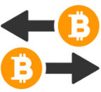




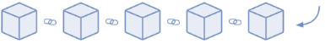




BLOCKCHAIN WORKING PRINCIPLE
Transactions
Miners
Block
How the BlockChain Works?
Process starts over
Block Puzzle
The new block is added to existing blockchain
Proof of work
Miners
Verification
Broadcasting Proof of work in network
Proof of work

Slide 32
Mining Bitcoins in 6 easy steps
Join the network, listen for transactions
Validate all proposed transactions
Listen for new blocks, maintain block chain
When a new block is proposed, validate it
Assemble a new valid block
Find the nonce to make your block valid
Hope everybody accepts your new block
Profit!
Useful to Bitcoin network
Notes:
Image is public domain (Wikimedia commons)

Slide 33
Incentives in proof of work

Slide 34
What can a malicious node do?
Double-spending attack
signed by A
C_{A} → B
Pay to pk_{B} : H( )
signed by A
C_{A} → A’
Pay to pk_{A’} : H( )
Honest nodes will extend the longest valid branch
Notes:
Can’t create new transactions from someone else’s address, or modify them.
Suppressing tx’s is only a minor annoyance.

Slide 35
From Bob the merchant’s point of view
1 confirmation
3 confirmations
C_{A} → B
Double-spend probability decreases exponentially with # of confirmations
Most common heuristic: 6 confirmations
C_{A} → A’
double-spend attempt
Hear about C_{A} → B transaction
0 confirmations

Slide 36
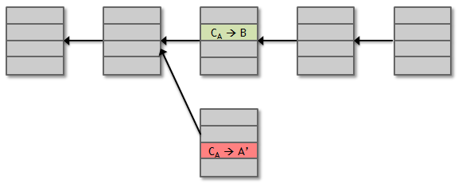
Security
Protection against invalid transactions is cryptographic, but enforced by consensus
Denial of Service
Protection against double-spending is purely by consensus
You’re never 100% sure a transaction is in consensus branch. Guarantee is probabilistic

Slide 37
Assumption of honesty is problematic
Can we give nodes incentives for behaving honestly?
Everything so far is just a distributed consensus protocol
But now we utilize the fact that the currency has value
Can we reward nodes that created these blocks?
Can we penalize the node that created this block?

Slide 38
Incentive 1: block reward
Creator of block gets to
include special coin-creation transaction in the block
choose recipient address of this transaction
Value is fixed: currently 12.5 BTC, halves every 4 years
Block creator gets to “collect” the reward only if the block ends up on long-term consensus branch!

Slide 39
Finding a valid block: Proof-of-Work
prev: H( )
prev: H( )
mrkl_root: H( )
mrkl_root: H( )
nonce: 0x0001...
nonce: 0xffff...
nonce: 0x0000...
nonce: 0x0001...
nonce: 0x0002...
nonce: 0xf77e...
nonce: 0x7a83
nonce: 0x0000...
hash: 0xd0c7...
hash: 0x6a1f...
hash: 0x300c...
hash:
hash: 0x0224...
hash: 0xc9c8...
hash: 0x0000...
hash: 0x3485...
hash: 0x0000
hash:
All changed
H( ) H( )
H( ) H( )
H( ) H( )
25.0→A
coinbase:
0x0000...00
25.0→A
coinbase:
0x0000...01
25.0→A
coinbase:
0x3df5...65
transaction
transaction
transaction
Notes:
Make sure to point out-coinbase is why miners aren’t all solving the exact same problem

Slide 40
Coinbase

Slide 41
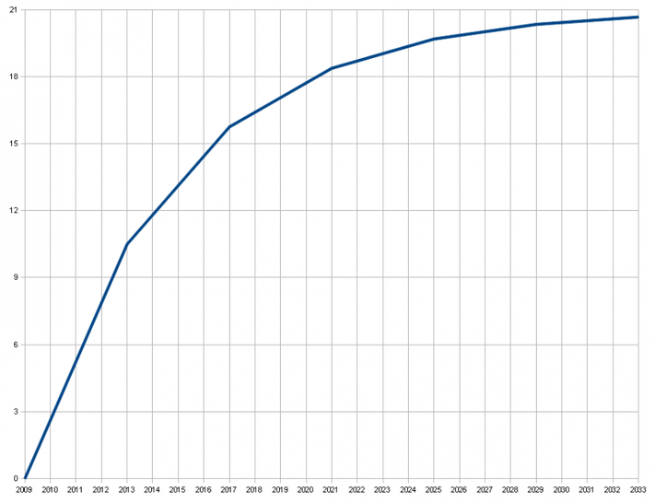
There’s a finite supply of bitcoins
Total supply: 21 million
Block reward is how new bitcoins are created
Runs out in 2040. No new bitcoins unless rules change
Total bitcoins in circulation
First inflection point: reward halved from 50BTC to 25BTC
Year

Slide 42
Incentive 2: transaction fees
Creator of transaction can choose to make
output value less than input value
Remainder is a transaction fee and goes to block creator
Purely voluntary, like a tip

Slide 43
The real deal: coinbase transaction
"in":[ { "prev_out":{ "hash":"000000.....0000000", "n":4294967295 },
"coinbase":"..." }, "out":[ { "value":"25.03371419", "scriptPubKey":"OPDUP OPHASH160 ... ”
}
block reward
transaction fees

Slide 44
Current consensus fees:
No fee if
tx less than 1000 bytes in size,
all outputs are 0.01 BTC or larger, and
priority is large enough
Priority = (sum of inputAge*inputValue) / (trans size)
Otherwise fee is 0.0001 BTC per 1000 bytes
Approx transaction size: 148 N_{inputs}+ 34 N_{outputs} + 10
Notes:
Transaction threshold is 4 BTC-days per 1000 bytes.

Slide 45
Most miners enforce the consensus fee structure.
If you don’t pay the consensus fee, your transaction will
take longer to be recorded.
Generally, higher fee means transaction will be forwarded and recorded faster.
Miners prioritize transactions based on fees and the priority formula.
Notes:
Transaction threshold is 4 BTC-days per 1000 bytes.

Slide 46
Mining economics
Complications:
fixed vs. variable costs
reward depends on global hash rate
If mining reward (block reward + Tx fees) | > | hardware + electricity cost | → | Profit

Slide 47
Putting it all together

Slide 48
Recap
Identities
Transactions
P2P network
Block chain & consensus
Hash puzzles & mining

Slide 49
Bitcoin is bootstrapped
security of block chain
health of mining ecosystem
value of currency

Slide 50
What can a “51% attacker” do?
Steal coins from existing address?
Suppress some transactions?
From the block chain
From the P2P network
Change the block reward?
Destroy confidence in Bitcoin?
✗
✓
✗
✗
✓✓

Slide 51
The real deal: a Bitcoin block
{
"hash":"00000000000000001aad2...",
"ver":2,
"prev_block":"00000000000000003043...",
"time":1391279636,
"bits":419558700,
"nonce":459459841,
"mrkl_root":"89776...",
"n_tx":354,
"size":181520,
"tx":[
...
],
"mrkl_tree":[
"6bd5eb25...",
...
"89776cdb..."
]
}
block header
transaction data

Slide 52
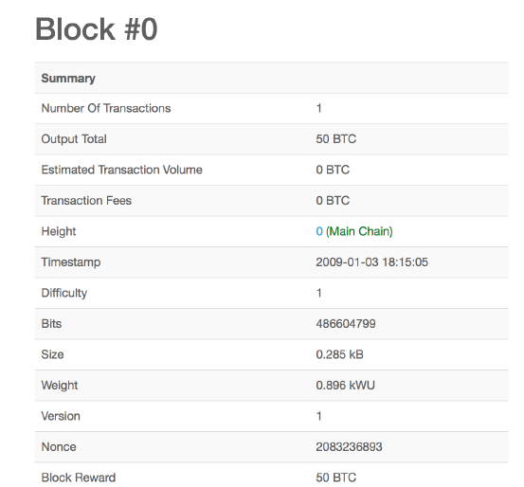
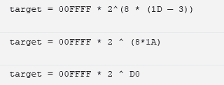
Mining Difficulty (Max Target)
Bits: 486604799 = 1D00FFFF

Slide 53
Mining difficulty “target” (as of March 2015)
256 bit hash output
Huge Number!
Greater than the Human Population of earth squared
64+ leading zeroes required
Less than 1 in about 2⁶⁴ nonecs that you try will work

Slide 54
Finding a valid block: Proof-of-Work
prev: H( )
prev: H( )
mrkl_root: H( )
mrkl_root: H( )
nonce: 0x0001...
nonce: 0xffff...
nonce: 0x0000...
nonce: 0x0001...
nonce: 0x0002...
nonce: 0xf77e...
nonce: 0x7a83
nonce: 0x0000...
hash: 0xd0c7...
hash: 0x6a1f...
hash: 0x300c...
hash:
hash: 0x0224...
hash: 0xc9c8...
hash: 0x0000...
hash: 0x3485...
hash: 0x0000
hash:
All changed
H( ) H( )
H( ) H( )
H( ) H( )
25.0→A
coinbase:
0x0000...00
25.0→A
coinbase:
0x0000...01
25.0→A
coinbase:
0x3df5...65
transaction
transaction
transaction
Notes:
Make sure to point out-coinbase is why miners aren’t all solving the exact same problem

Slide 55
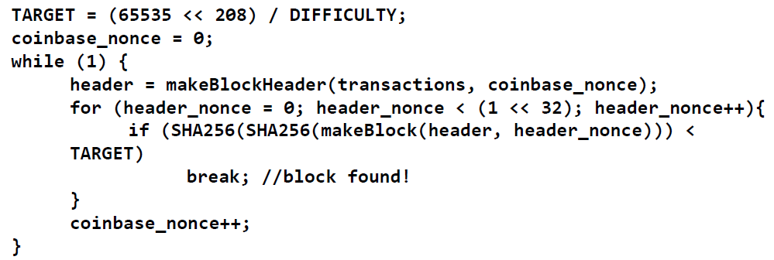
Mining Pseudocode
More Info: https://en.bitcoin.it/wiki/Difficulty
Max Target: An application-defined constant, which sets the target hash corresponding to the lowest possible difficulty, 1

Slide 56
CPU mining
while (1){
HDR[kNoncePos]++;
IF (SHA256(SHA256(HDR)) < (65535 << 208)/ DIFFICULTY)
return;
}
two hashes
Throughput on a high-end PC = 10-20 MHz ≈ 2²⁴ Hashes/Sec
139,461 years to find a block today!

Slide 57
Global Hash Rate & Difficulty
while (1){
HDR[kNoncePos]++;
IF (SHA256(SHA256(HDR)) < (65535 << 208)/ DIFFICULTY)
return;
}
Hashes are 256-bit integers. So, TOTAL output size: 2^256.
The current TARGET is “max_target/difficulty”, where max_target is (65535 * 2^208).
Therefore, fraction of output space is is TARGET/TOTAL. Therefore, TOTAL/TARGET=(2^256*difficulty/max_target) no. of hashes are needed on average to find a block.
This is done over 600 sec, considering previous 2016 blocks.
Global Hashrate:
(2^256 * difficulty/max_target)/600
= (2^256 * difficulty/65535 * 2^208)/600
= (2^48 * difficulty/65535 )/600
= difficulty * 7158388.055

Slide 58
Setting the mining difficulty
Every two weeks, compute:
next_difficulty= currennt_difficulty *
(2 weeks)/(time to mine last 2016 blocks)
Expected number of blocks in 2 weeks at 10 minutes/block

Slide 59
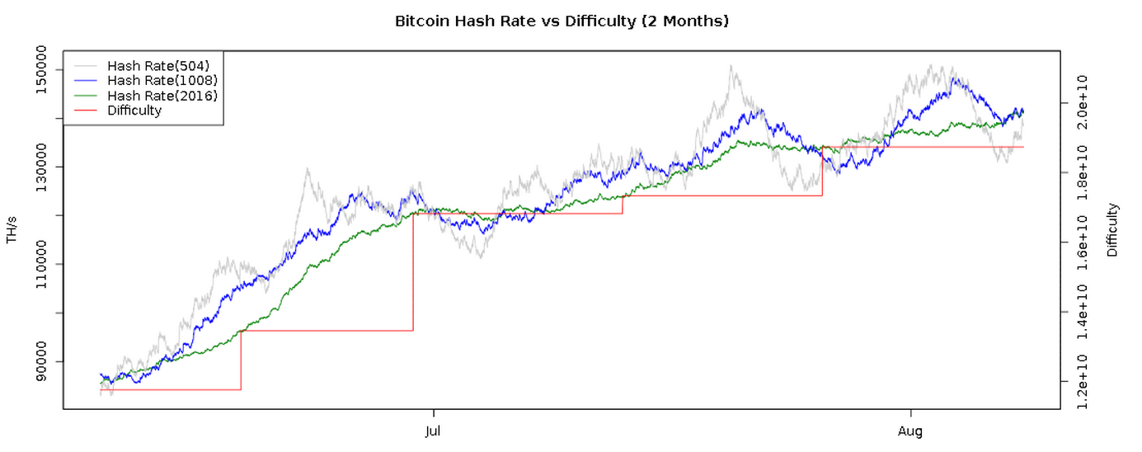
Mining difficulty over time
Note that the y‐axis begins at 80,000 TeraHashes/s. The hash rate is averaged over 2016/1008/504 blocks
bitcoinwisdom.com

Slide 60
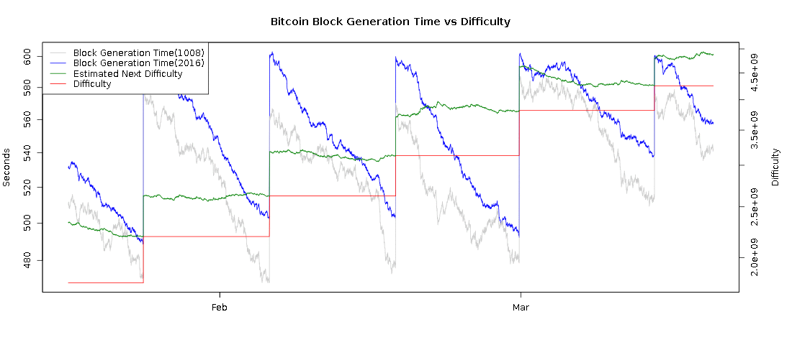
Time to find a block
10 minutes
2 weeks
bitcoinwisdom.com

Slide 61
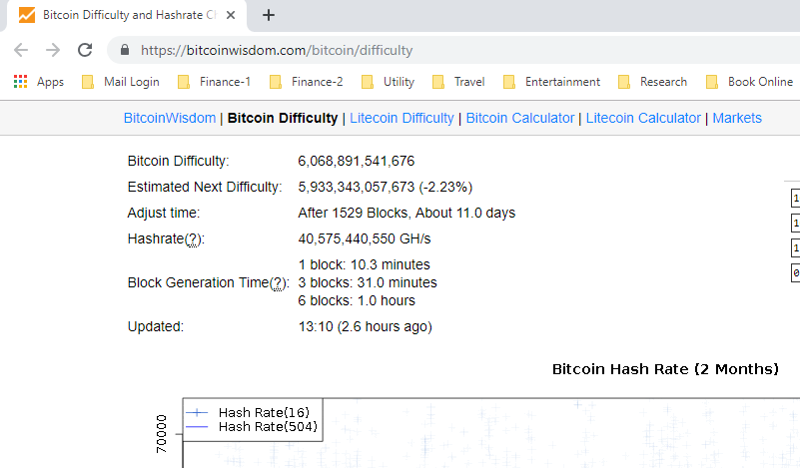

Slide 62
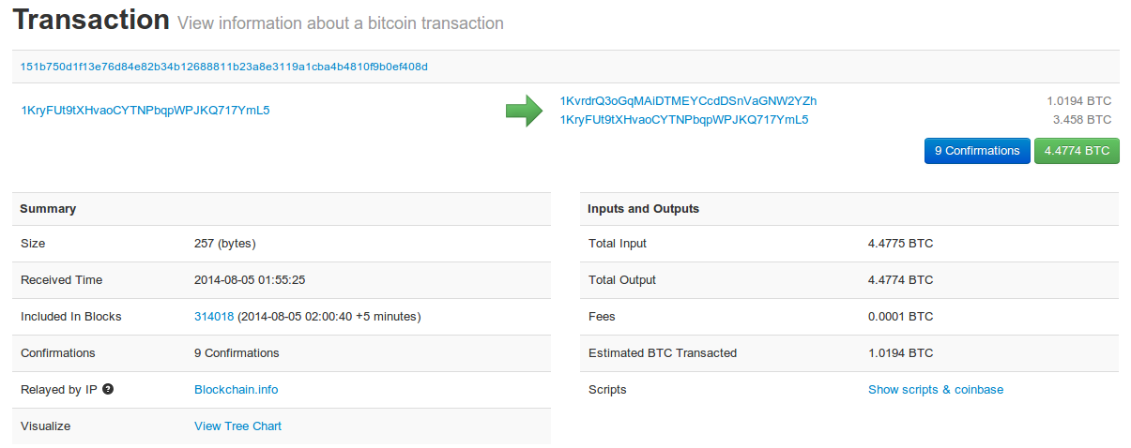
See for yourself!
blockchain.info (and many other sites)

Slide 63
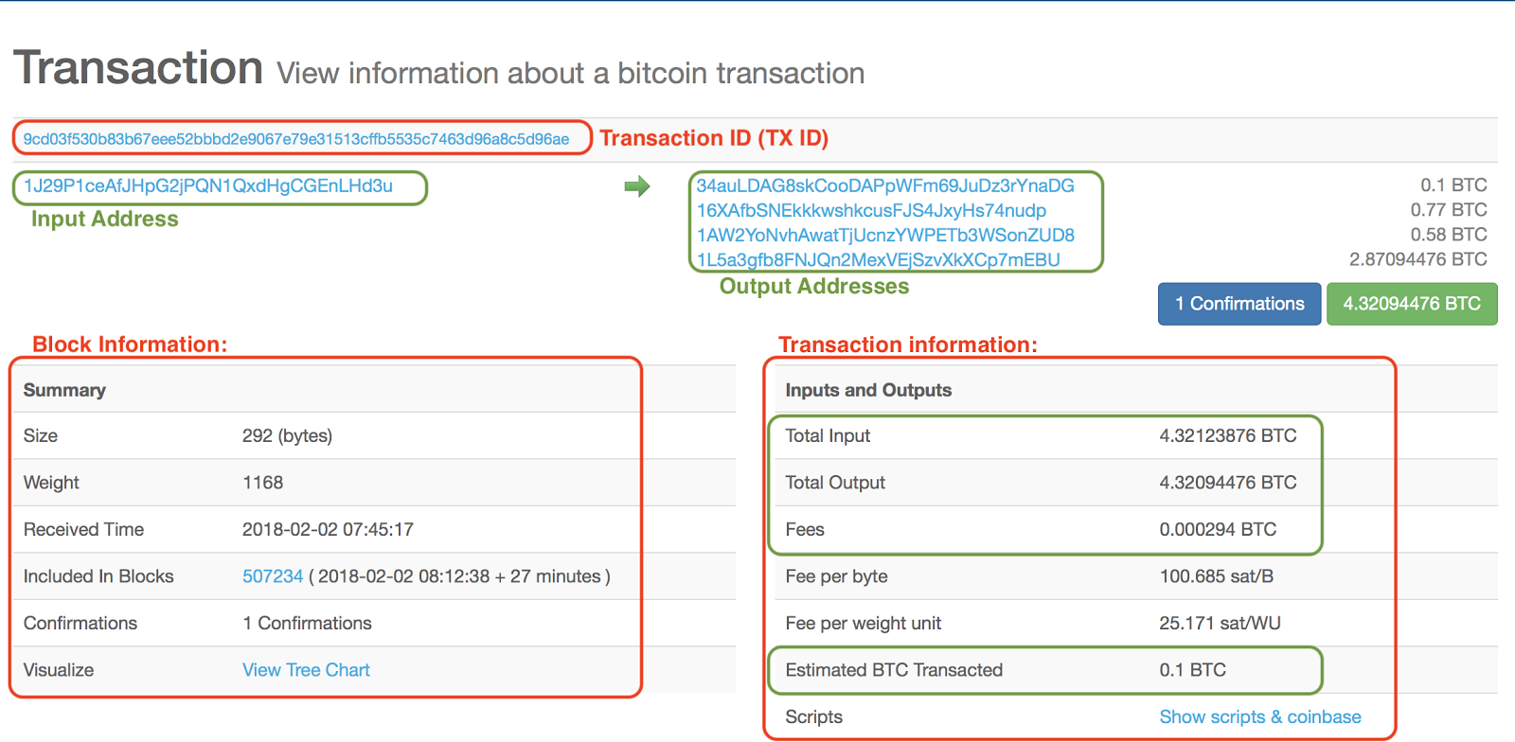

Slide 64
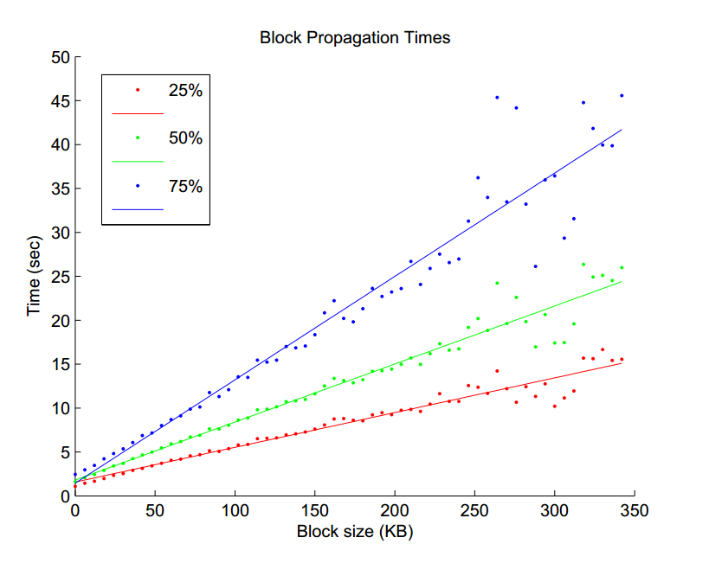
The relation between the block size and the time it took to reach 25% (red), 50% (green), and 75% (blue) of monitored nodes
Source: Yonatan Sompolinsky and Aviv Zohar: “Accelerating Bitcoin’s Transaction Processing” 2014

