Slide 1
Intro to Crypto and Cryptocurrencies
Slides by Arvind Narayanan et al.

Slide 2
How big is the network?
Impossible to measure exactly
Estimates-up to 1M IP addresses/month
Only about 5-10k “full nodes”
Permanently connected
Fully-validate
This number may be dropping!

Slide 3
Fully-validating nodes
Permanently connected
Store entire block chain
Hear and forward every node/transaction

Slide 4
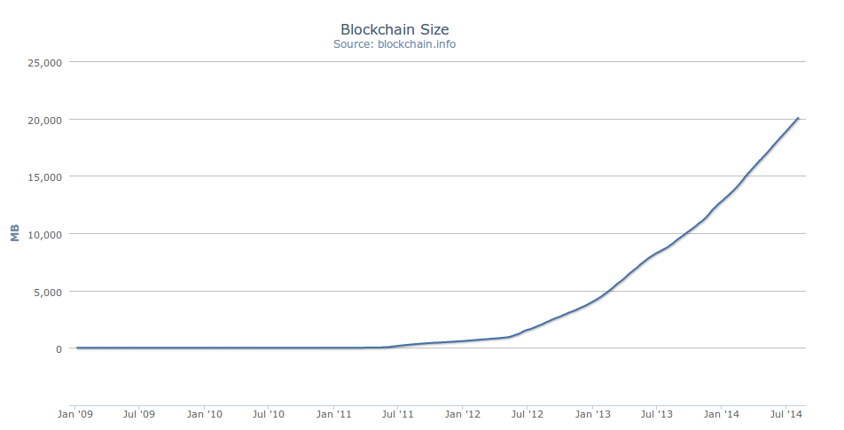
Storage costs (Size of Blckchain)
20 GB

Slide 5
Tracking the UTXO set
Unspent Transaction Output
Everything else can be stored on disk
Currently ~12 M UTXOs
Out of 44 M transactions
Can easily fit into RAM

Slide 6
Thin/SPV clients (not fully-validating)
Idea: don’t store everything
Store block headers only
Request transactions as needed
To verify incoming payment
Trust fully-validating nodes
1000x cost savings! (20 GB -> 23MB)
Notes:
Also called “lightweight nodes”

Slide 7
Software diversity
About 90% of nodes run “Core Bitcoin” (C++)
Some are out of date versions
Other implementations running successfully
BitcoinJ (Java)
Libbitcoin (C++)
btcd (Go)
“Original Satoshi client”
Notes:
Core Bitcoin == “Satoshi “client
Original Satoshi client=historical only

Slide 8
Limitations & improvements

Slide 9
Hard-coded limits in Bitcoin
10 min. average creation time per block
1 M bytes in a block
20,000 signature operations per block
100 M satoshis per bitcoin
23M total bitcoins maximum
50,25,12.5... bitcoin mining reward
These affect economic balance of power too much to change now

Slide 10
Throughput limits in Bitcoin
1 M bytes/block (10 min)
>250 bytes/transaction
7 transactions/sec ☹
Compare to:
VISA: 2,000-10,000 transactions/sec
PayPal: 50-100 transaction/sec

Slide 11
Cryptographic limits in Bitcoin
Only 1 signature algorithm (ECDSA/P256)
Hard-coded hash functions (SHA-256, RIPEMD-160)
Crypto primitives might break by 2040...

Slide 12
“Hard-forking” changes to Bitcoin
5
1
Block 23
Block 24
Block 23
7
8
Block 24
That’s crazy talk!!
Block 23
That’s crazy talk!!
Block 24
Block 23
24
I found a nifty new block!
3
6
24
2
Block 23
Block 24
Block 23
Block 23
24
4
24
Block 23
PROBLEM: Old nodes will never catch up
Block 24

Slide 13
Hard forks
New op codes
Changes to size limits (increasing)
Changes to mining rate
Many small bug fixes
Currently seem very unlikely to happen

Slide 14
Soft forks
Observation: we can add new features which only limit the set of valid transactions
Need majority of nodes to enforce new rules
Old nodes will approve
RISK: Old nodes might mine now-invalid blocks

Slide 15
Soft fork example: pay to script hash
<signature>
<<pubkey> OP_CHECKSIG>
OP_HASH160
<hash of redemption script>
OP_EQUAL
Old nodes will just approve the hash, not run the embedded script

Slide 16
Soft fork possibilities
New signature schemes
Changes to size limits (decreasing)
Extra per-block metadata
Shove in the coinbase parameter
Commit to UTXO tree in each block

