Slide 1
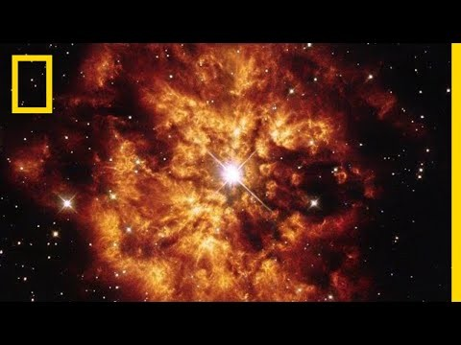
PRESENTATION BY
VIANNY
STARRING
John k
Isaac y
john doe
SOURCES
Chatgpt

