Slide 1
Moco: Building projects and making custom goals in C++

Slide 2
Things you need
Opensim 4.0 or more recent, preferably 4.3
https://simtk.org/frs/?group_id=91
Cmake 3.2 or more recent
https://cmake.org/download/
Visual Studio (community) 16 or more recent
https://visualstudio.microsoft.com/downloads/
A github account (optional), github desktop is also a nice addition.
https://github.com/

Slide 3

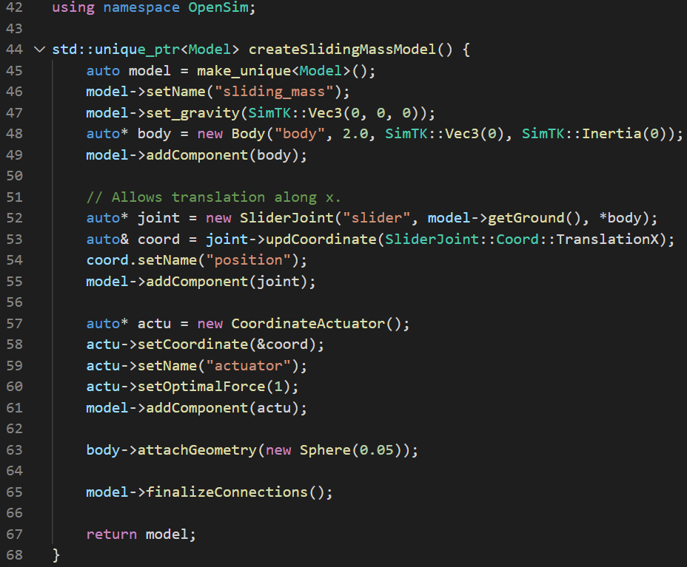
Example Moco C++ code
exampleSlidingMass.cpp
Libraries
Model setup
A mass slides along the X-axis
with some force F pushing it.

Slide 4
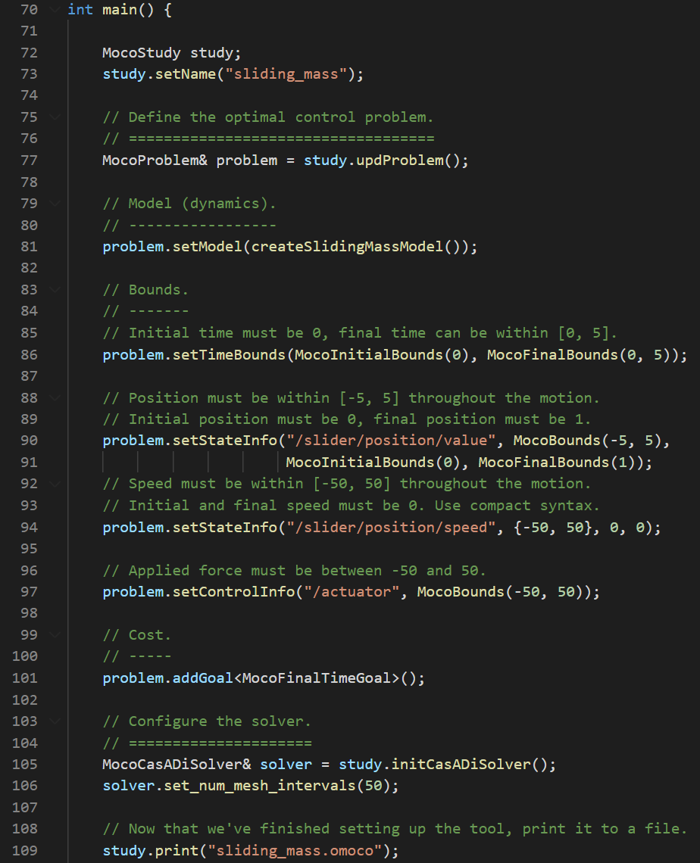
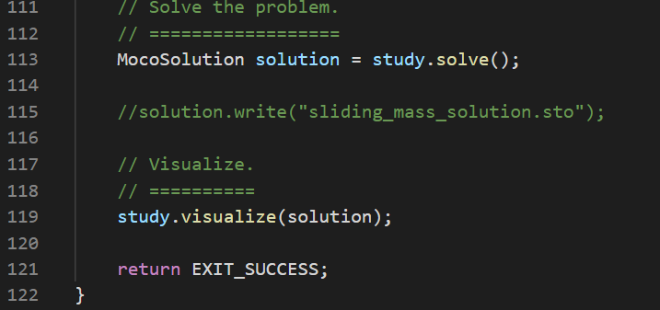
Example Moco code
Problem setup
Problem solve
Solve for the force, states and time,
such that –
The final time is minimized
Subject to:
Initial position is 0, Final position is 1
Initial speed is 0, Final speed is 0
Initial time is 0, Final time < 5
-5 < Position < 5
-50 < Speed < 50
-50 < Force < 50

Slide 5
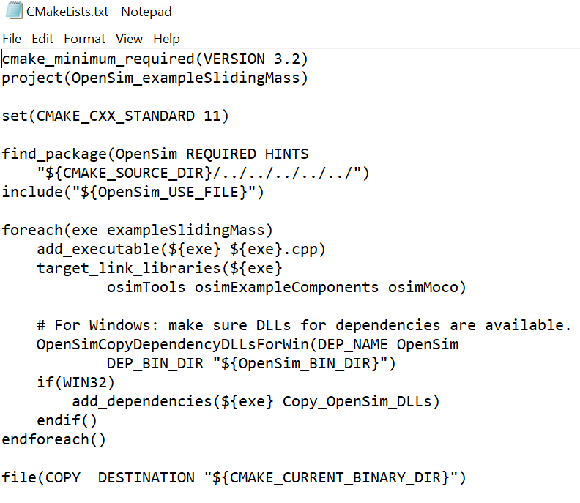
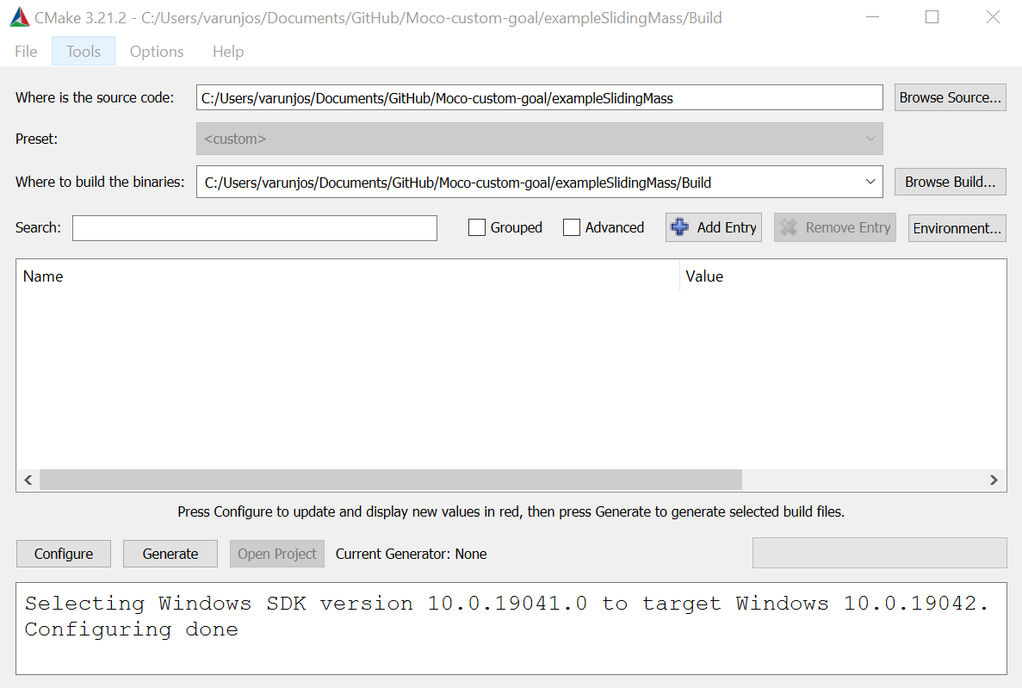
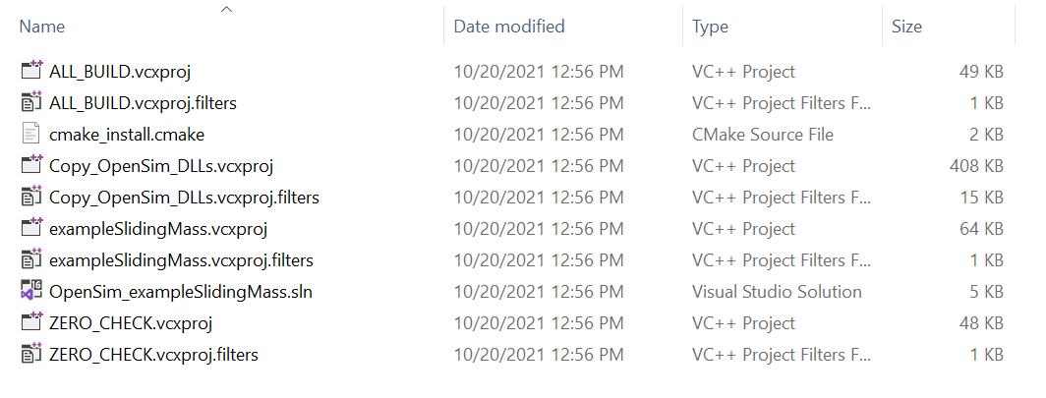
How do you build C++ code?
Unlike Matlab or python, you can’t just run C++ code. It needs to be compiled into an executable.
We use cmake to compile dependencies/header files.
+
=

Slide 6
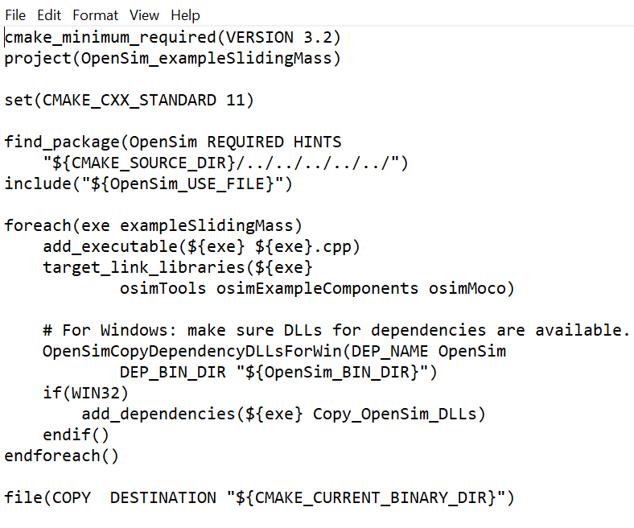
Moco example make file
For most Moco projects you want to build,
this is most likely the only thing you need to change

Slide 7
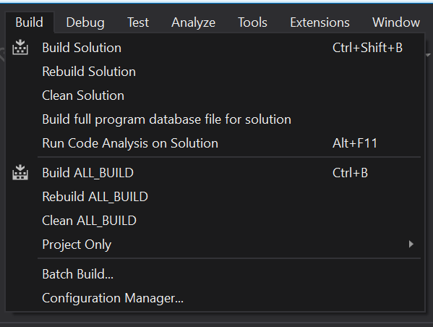
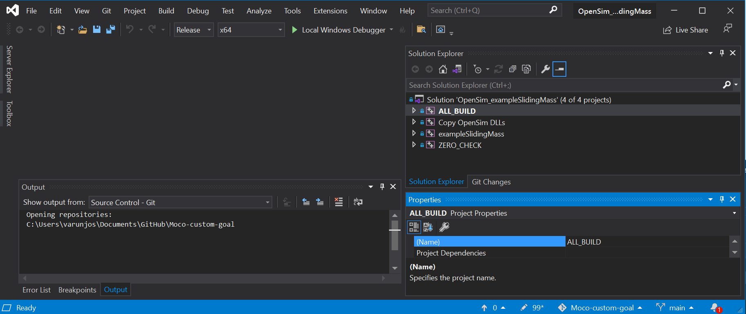
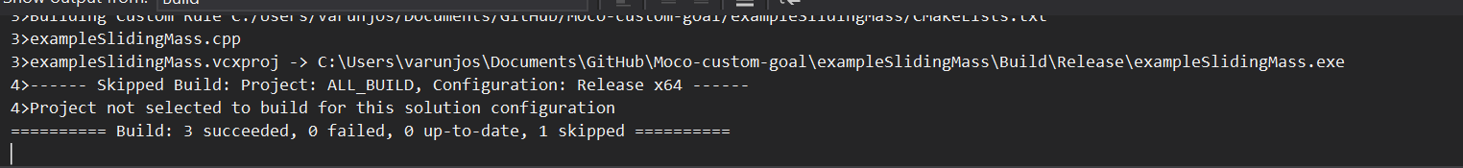
Open the solution file and build it

Slide 8
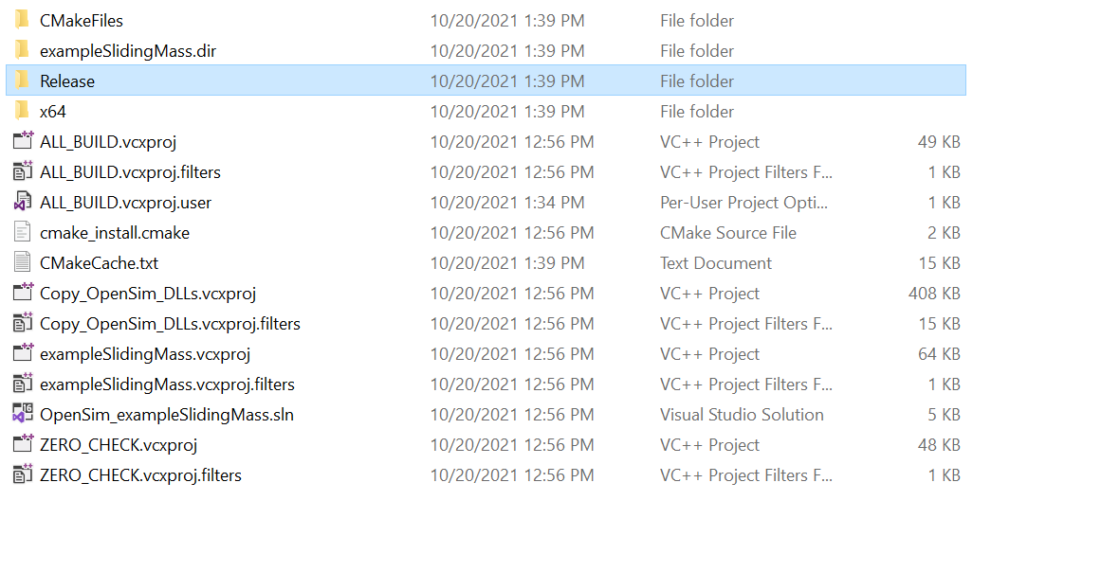
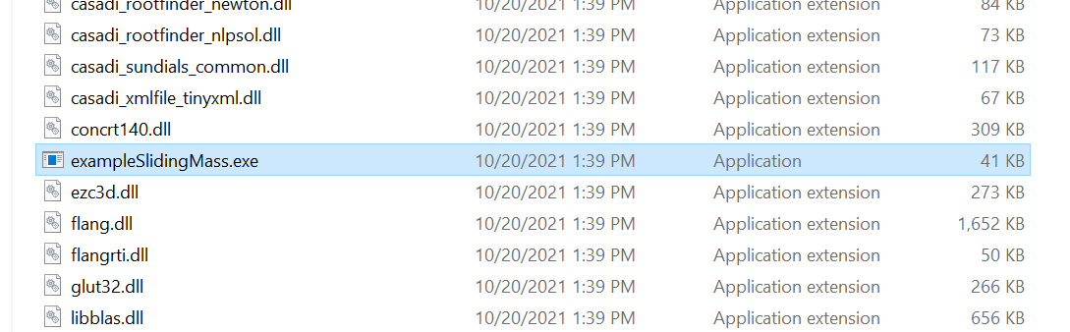
Run the executable

Slide 9
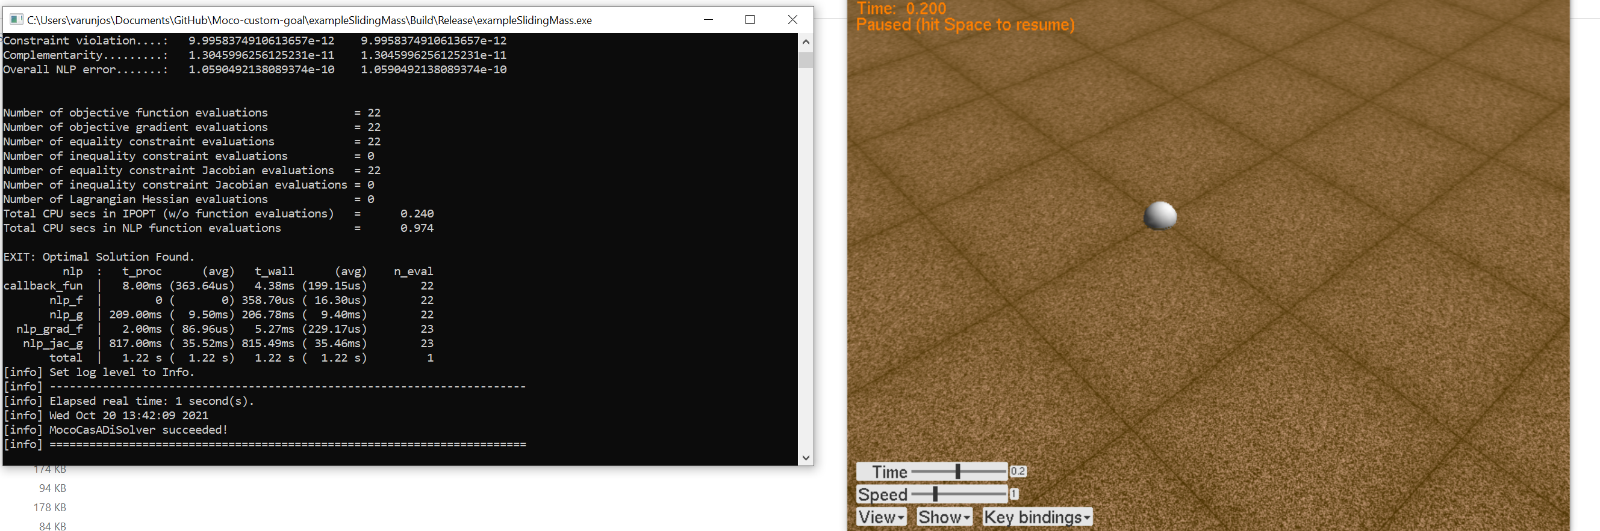
Success?

Slide 10
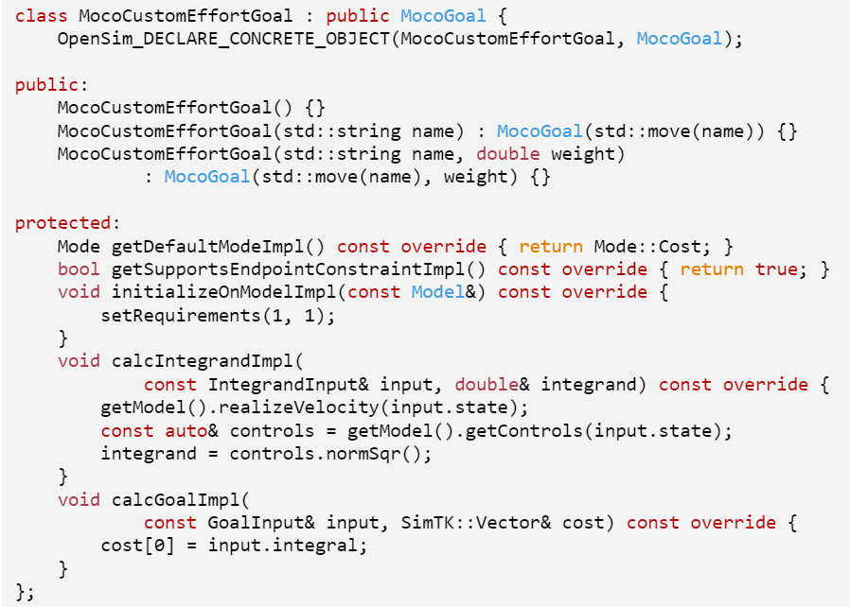
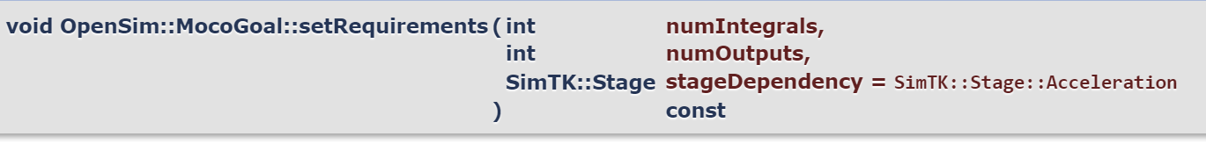
Custom goals
exampleSlidingMassAdvanced.cpp
These parts are REQUIRED
Constructors: Make sure to use the right name.
numIntegrals is either 0 or 1
This tells the code to expect one integrand
and to produce 1 integral as a result.

Slide 11
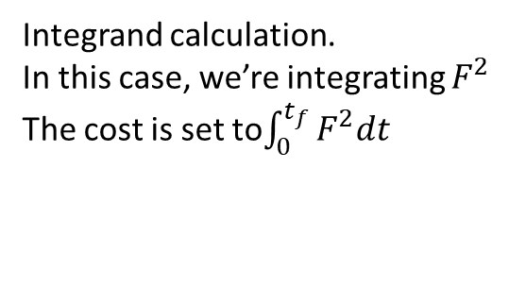
Custom goals
exampleSlidingMassAdvanced.cpp
These parts are OPTIONAL
Integrand calculation.
In this case, we’re integrating $F^{2}$
The cost is set to$\int_{0}^{t_{f}}{F^{2}dt}$

Slide 12
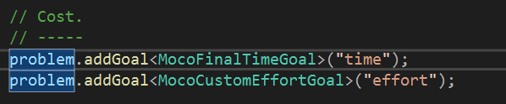
Using the custom goal
Now the optimizer is trying to balance between two goals –
Take the minimum time
Use the smallest forces

Slide 13
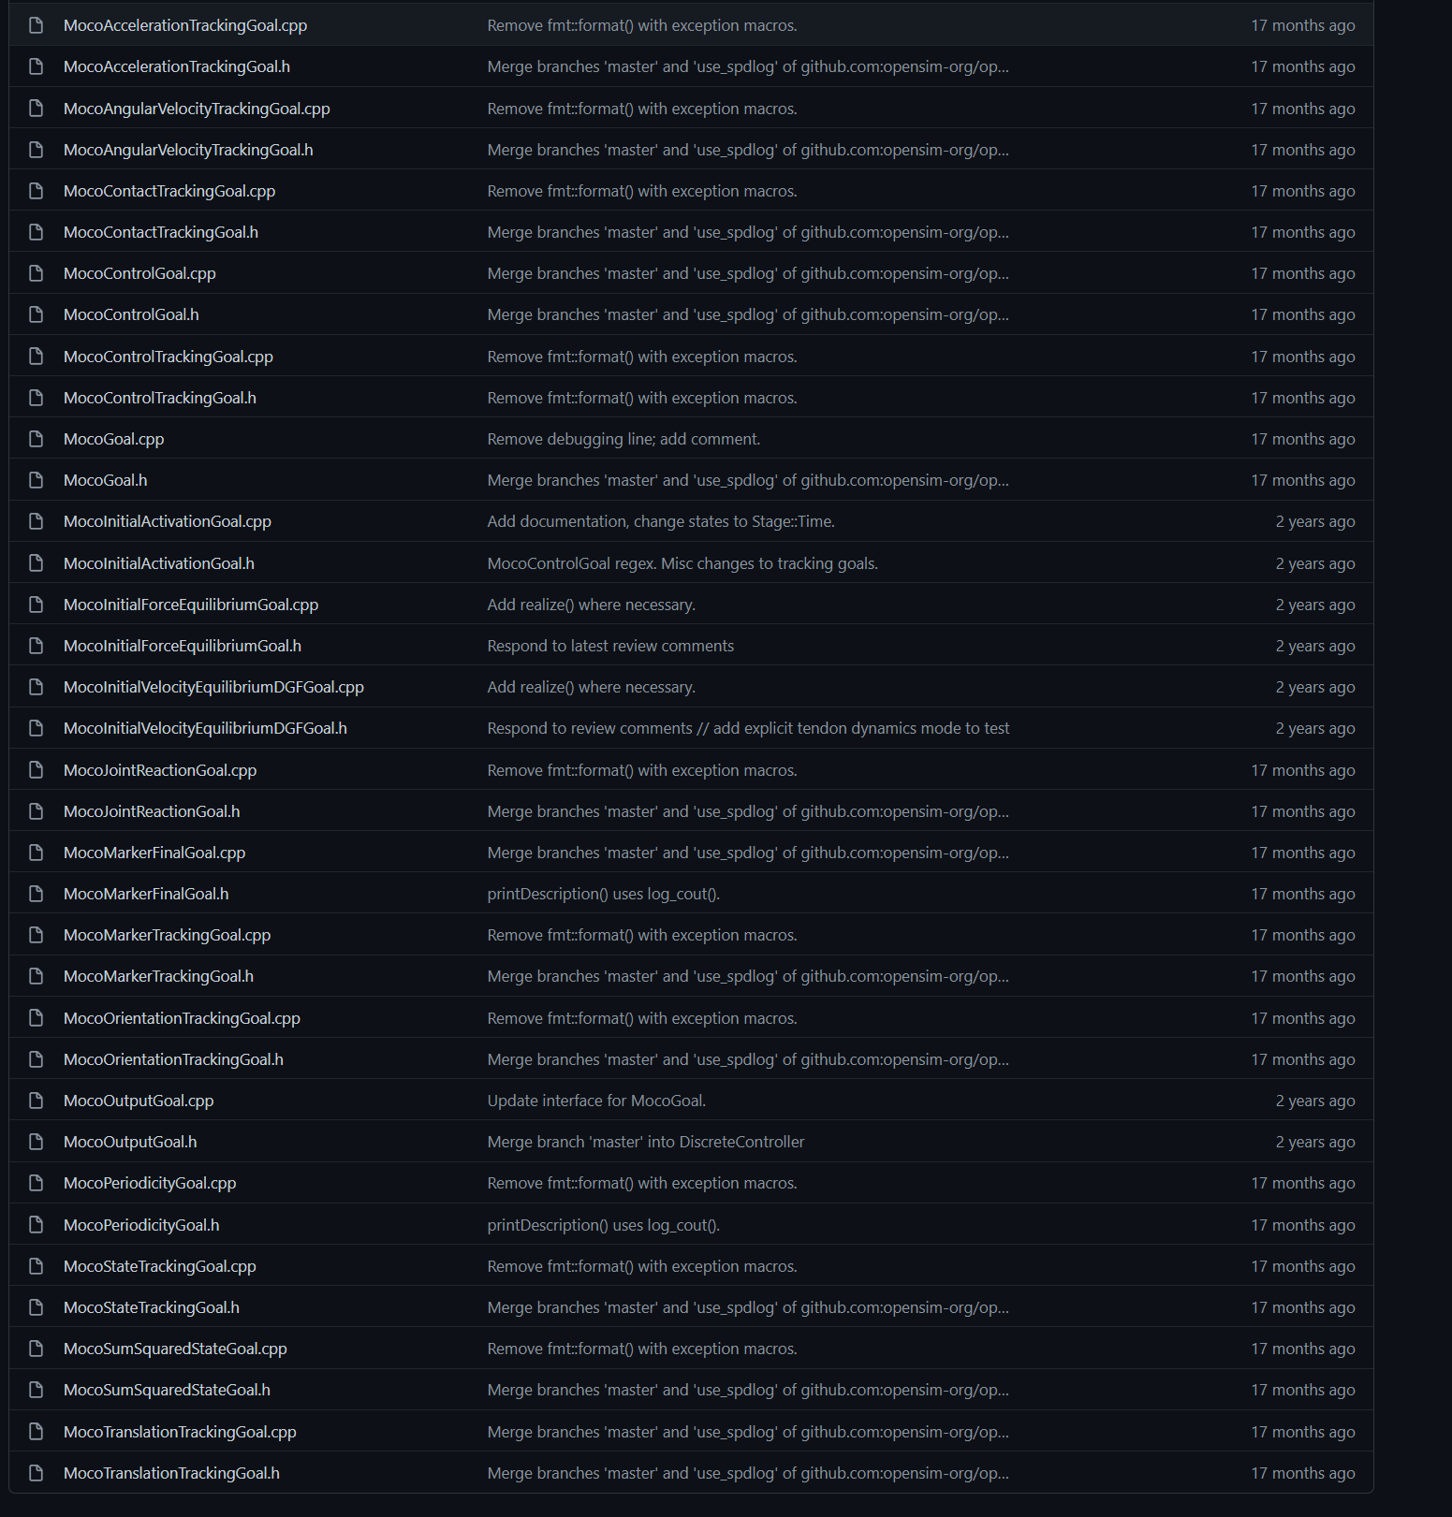
Most typically used goals are available

Slide 14
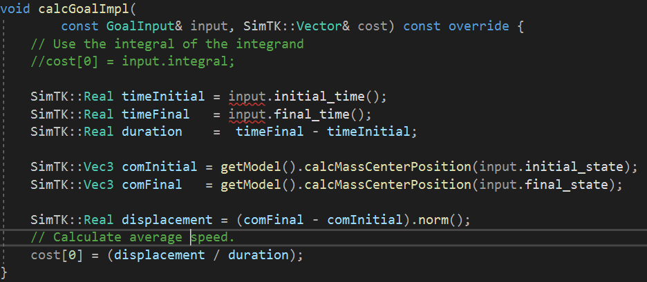
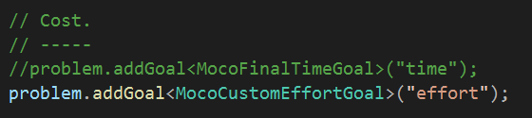
Other options
Minimize the speed of the block (this is the same as maximizing the time).
Note: we aren’t using the integrator for this.

Slide 15
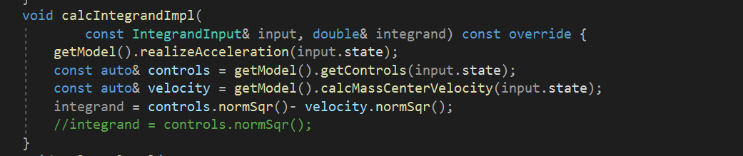
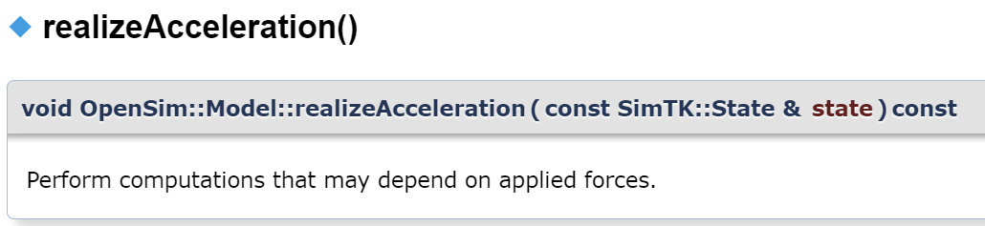
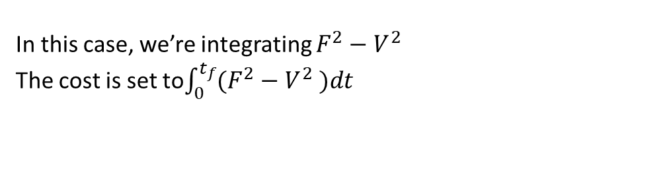
Other options
Something made up without any physical significance -
In this case, we’re integrating $F^{2}−V^{2}$
The cost is set to$\int_{0}^{t_{f}}{(F^{2}−V^{2} )dt}$

