Slide 1
Moco: Building projects and making custom goals in C++

Slide 2
Things you need
Opensim 4.0 or more recent, preferably 4.3
https://simtk.org/frs/?group_id=91
Cmake 3.2 or more recent
https://cmake.org/download/
Visual Studio (community) 16 or more recent
https://visualstudio.microsoft.com/downloads/
A github account (optional), github desktop is also a nice addition.
https://github.com/

Slide 3

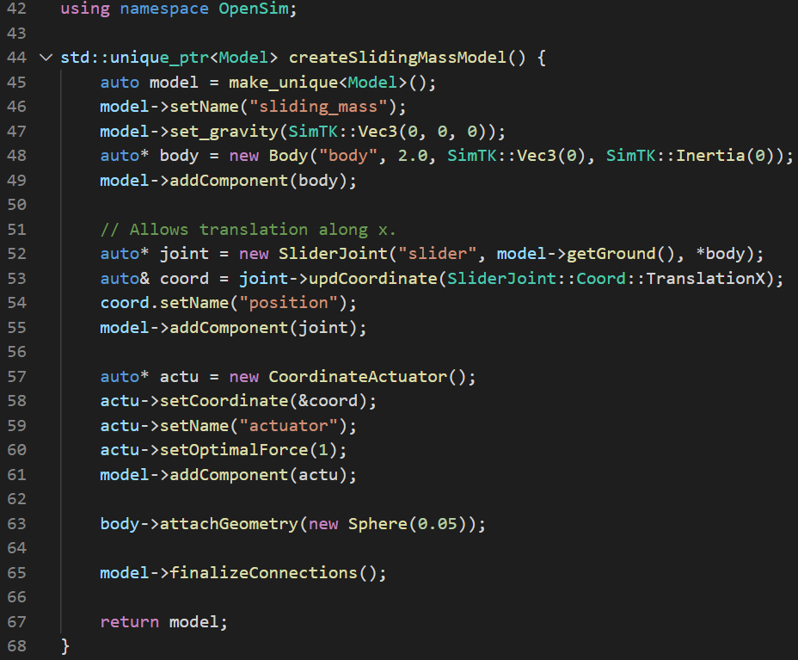
Example Moco C++ code
exampleSlidingMass.cpp
Libraries
Model setup
A mass slides along the X-axis
with some force F pushing it.

Slide 4
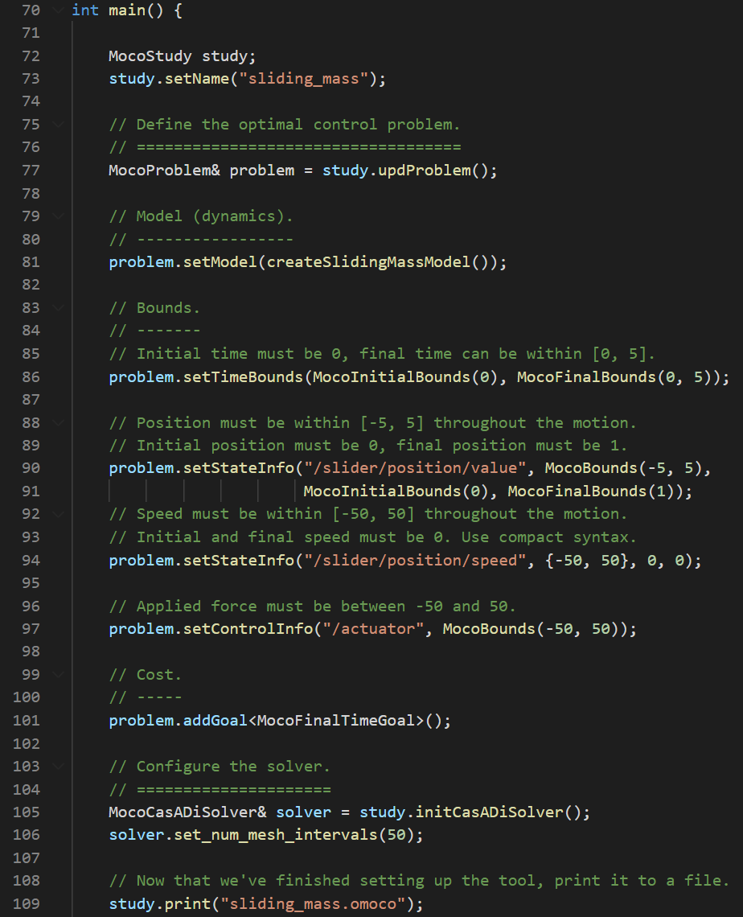
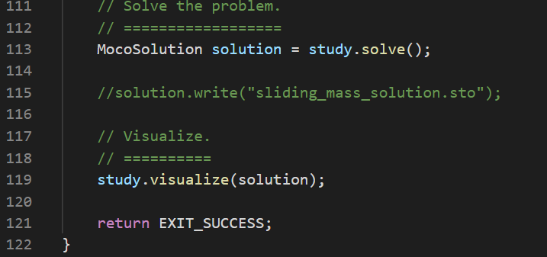
Example Moco code
Problem setup
Problem solve
Solve for the force, states and time,
such that –
The final time is minimized
Subject to:
Initial position is 0, Final position is 1
Initial speed is 0, Final speed is 0
Initial time is 0, Final time < 5
-5 < Position < 5
-50 < Speed < 50
-50 < Force < 50

Slide 5
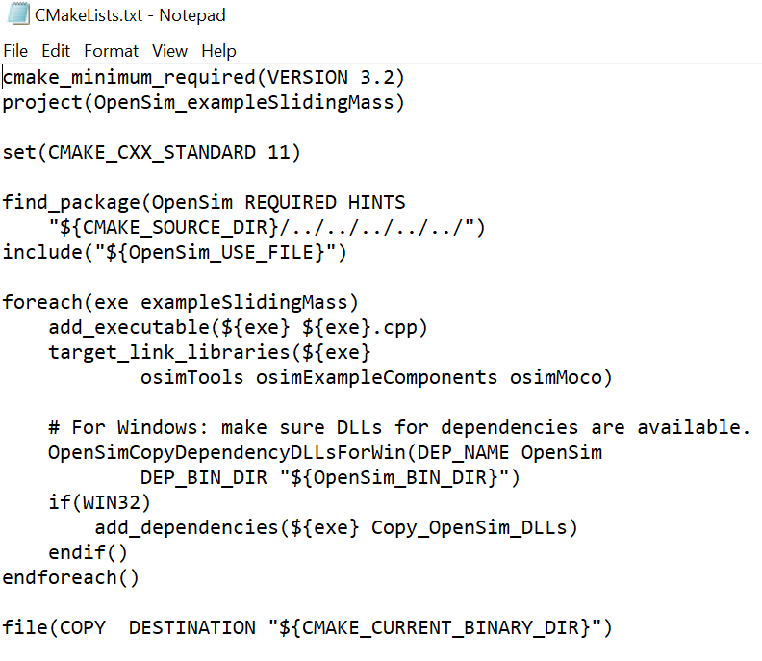
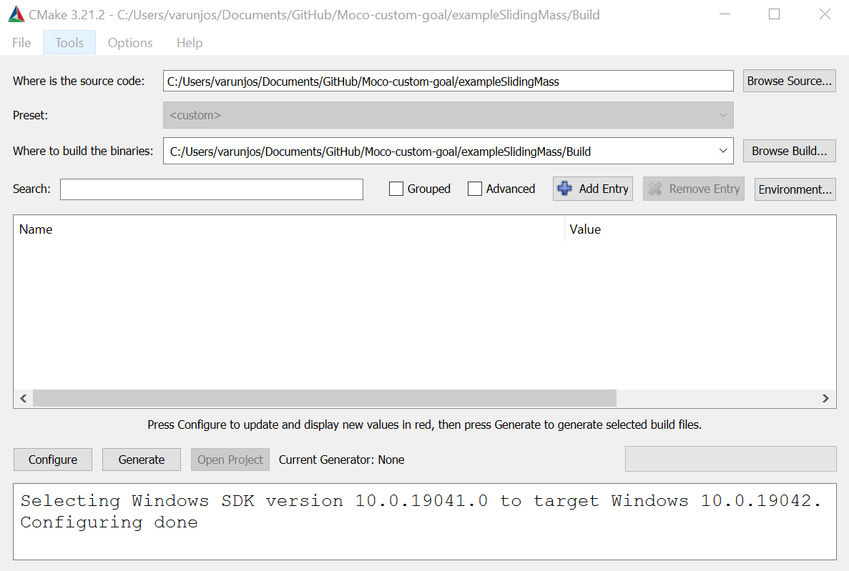
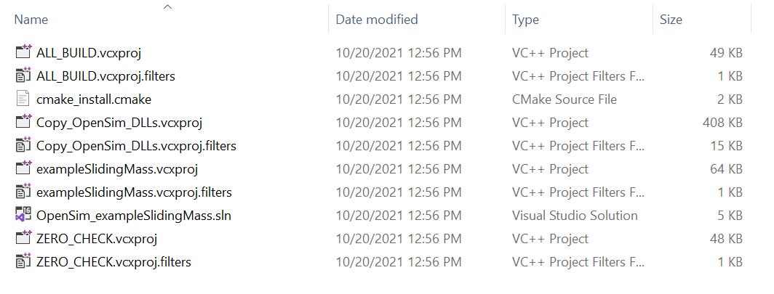
How do you build C++ code?
Unlike Matlab or python, you can’t just run C++ code. It needs to be compiled into an executable.
We use cmake to generate a “makefile”.
+
=

Slide 6
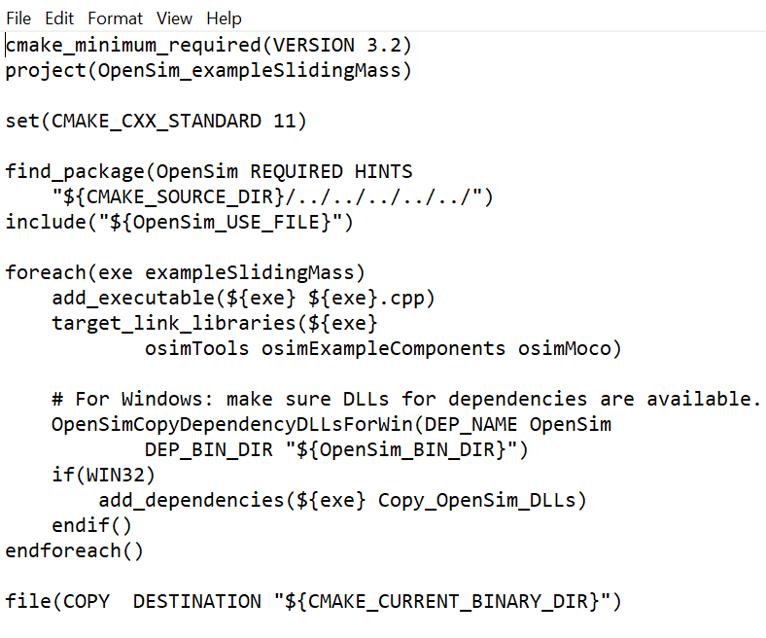
Moco example make list
For most Moco projects you want to build,
this is most likely the only thing you need to change

Slide 7
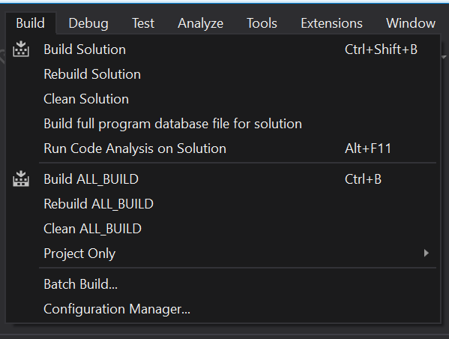
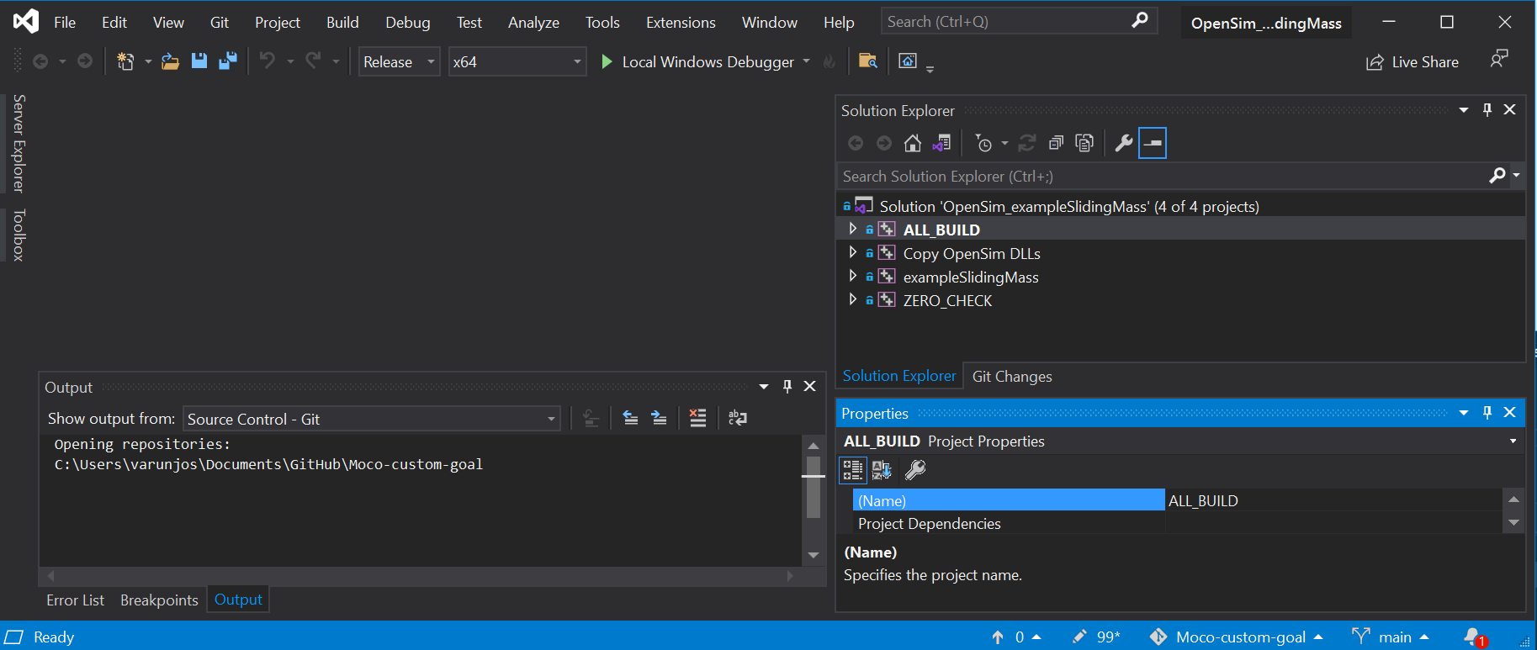
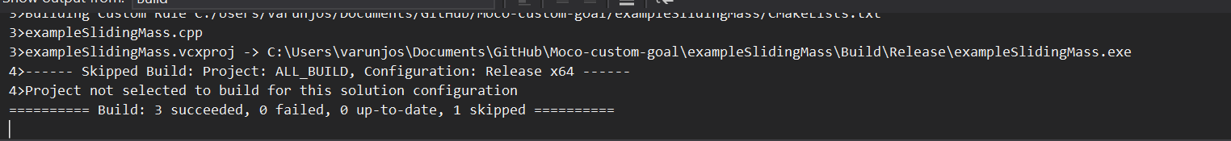
Open the solution file and build it

Slide 8
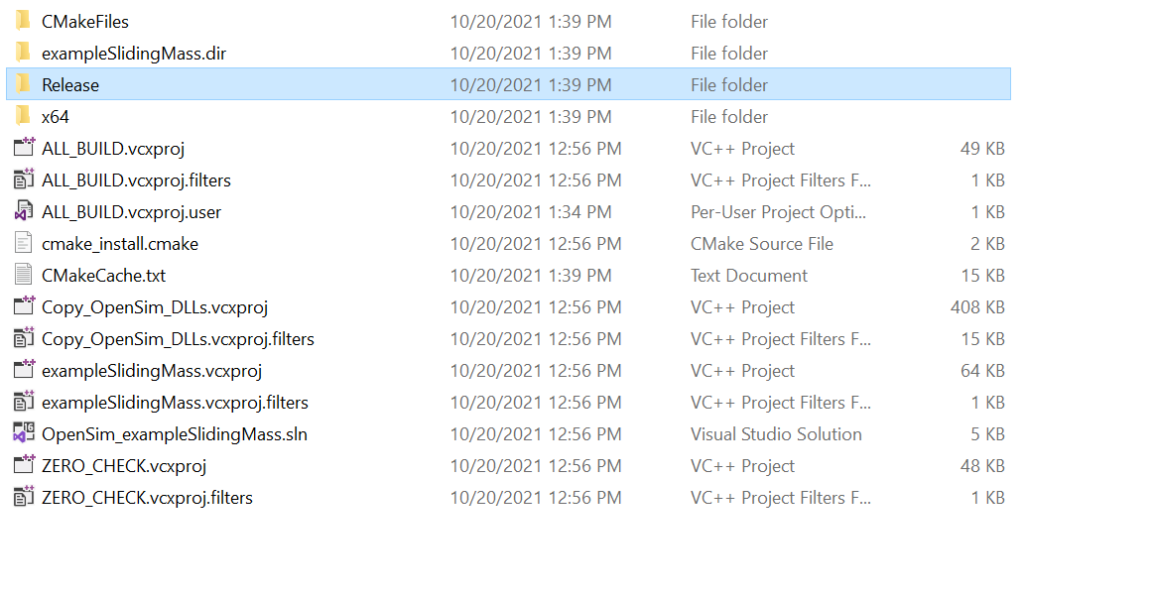
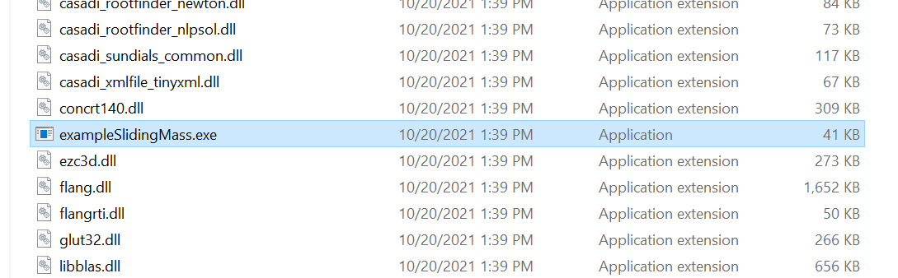
Run the executable

Slide 9
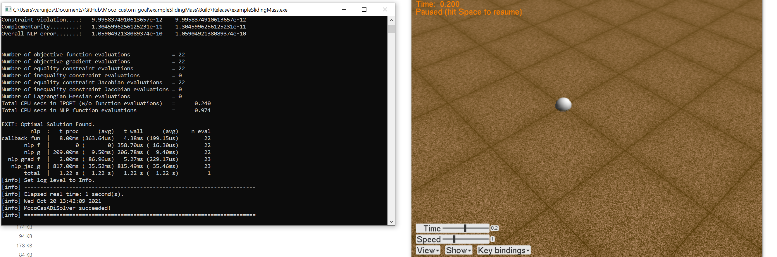
Success?

Slide 10
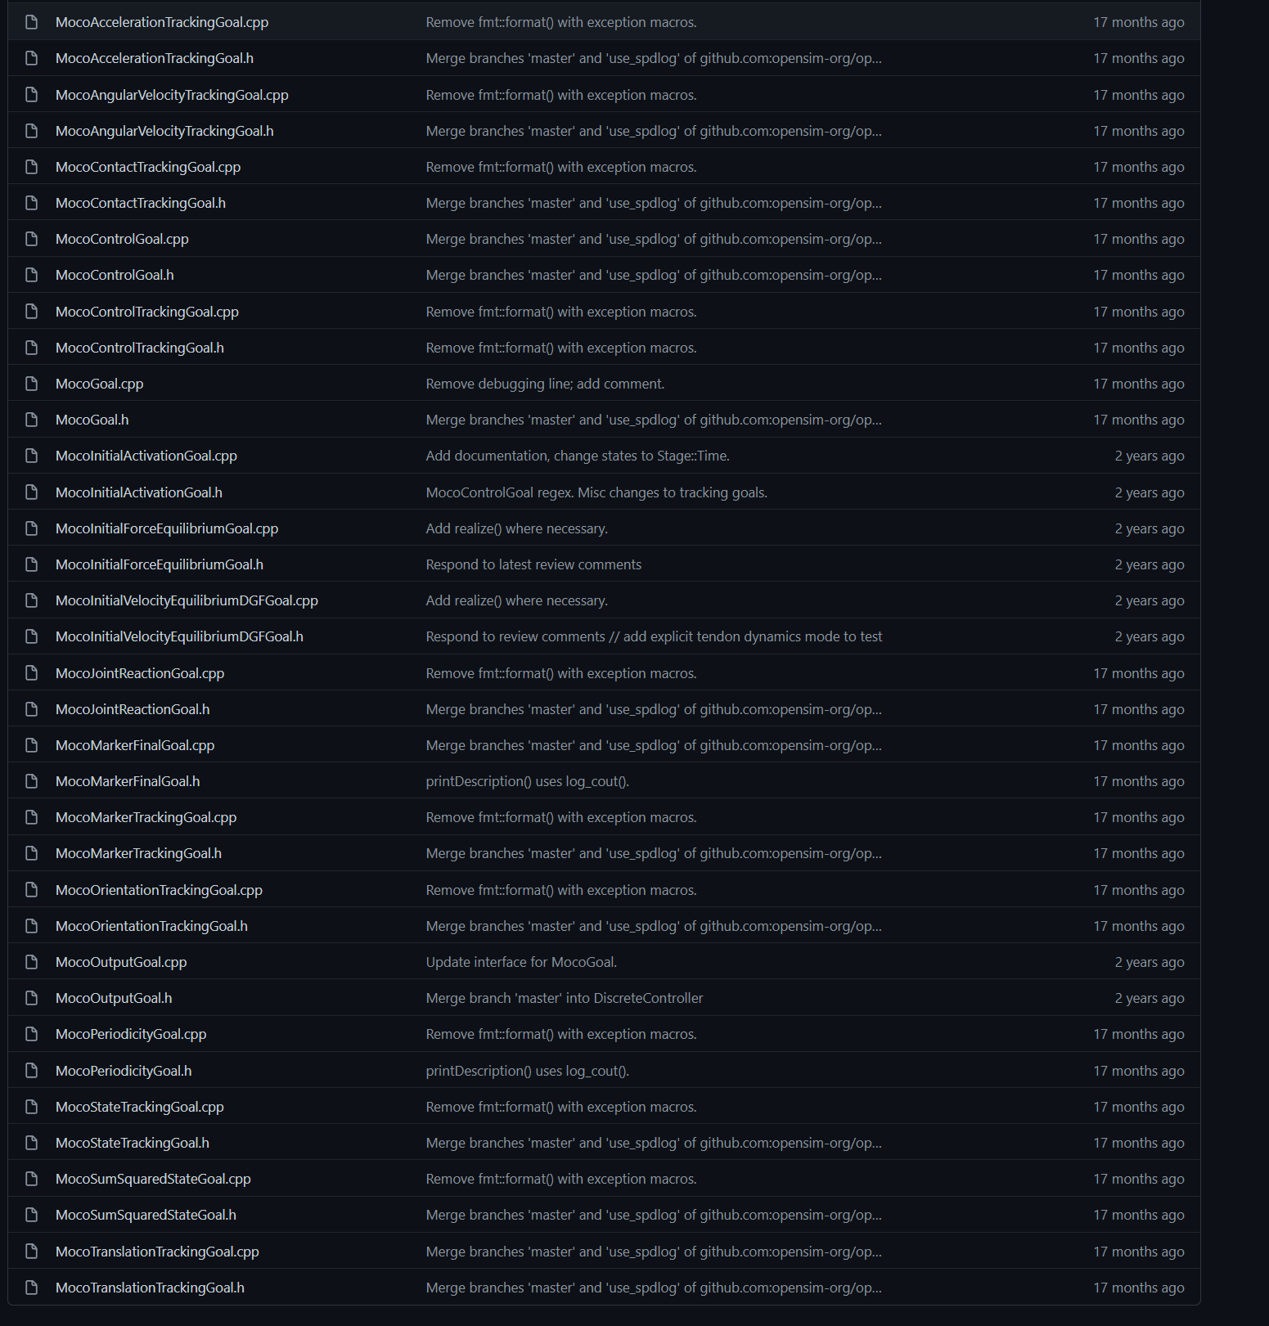
Most typically used goals are available
These files contain a lot more information than the opensim documentation.
Including variables that allow you to access lower level information about objects.

Slide 11
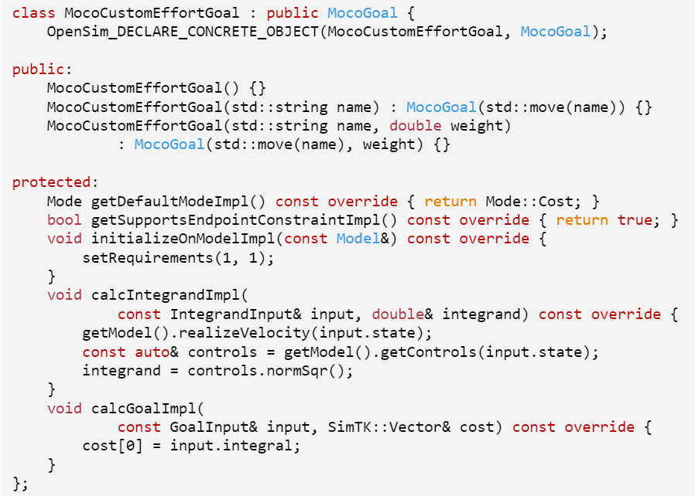
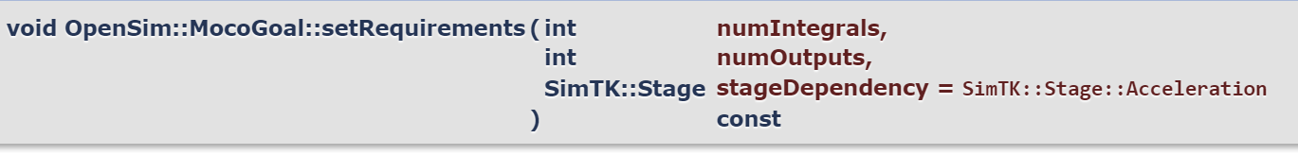
Custom goals
exampleSlidingMassAdvanced.cpp
These parts are REQUIRED
Constructors: Make sure to use the right name.
numIntegrals is either 0 or 1
This tells the code to expect one integrand
and to produce 1 integral as a result.

Slide 12
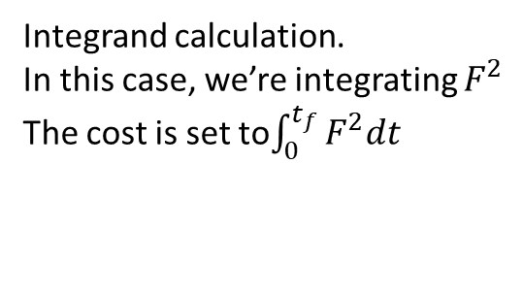
Custom goals
exampleSlidingMassAdvanced.cpp
These parts are OPTIONAL
Integrand calculation.
In this case, we’re integrating $F^{2}$
The cost is set to$\int_{0}^{t_{f}}{F^{2}dt}$

Slide 13
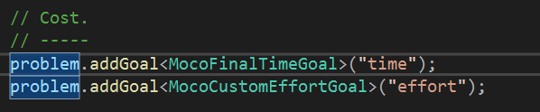
Using the custom goal
Now the optimizer is trying to balance between two goals –
Take the minimum time
Use the smallest forces

Slide 14
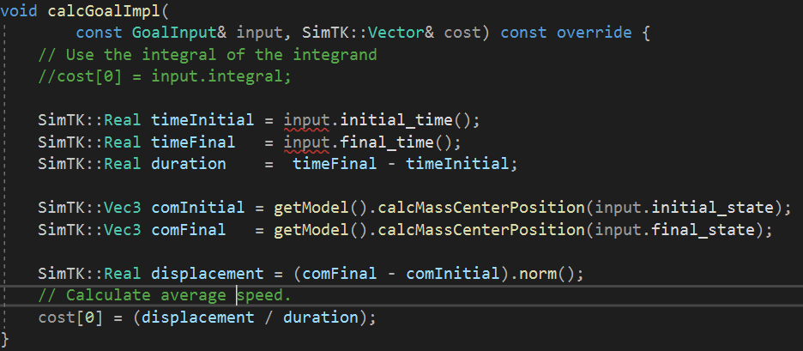
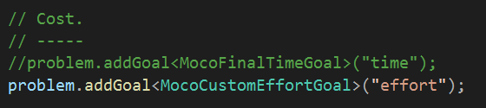
Other options
Minimize the speed of the block (this is the same as maximizing the time).
Note: we aren’t using the integrator for this.

Slide 15
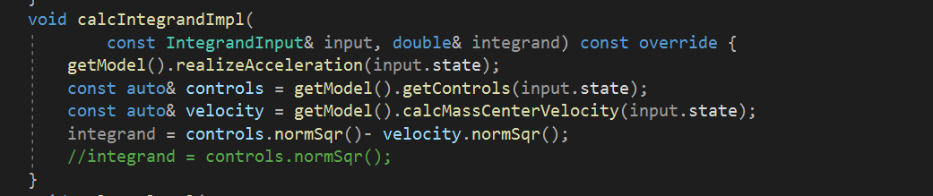
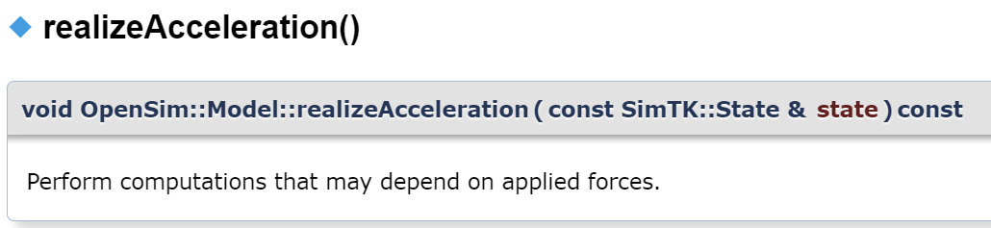
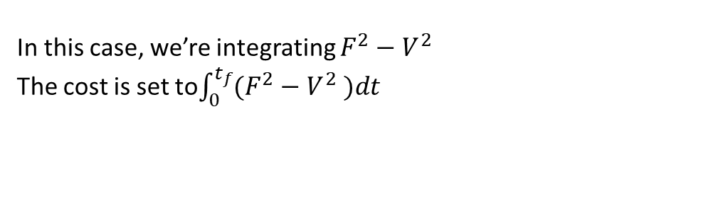
Other options
Something made up without any physical significance -
In this case, we’re integrating $F^{2}−V^{2}$
The cost is set to$\int_{0}^{t_{f}}{(F^{2}−V^{2} )dt}$

Slide 16
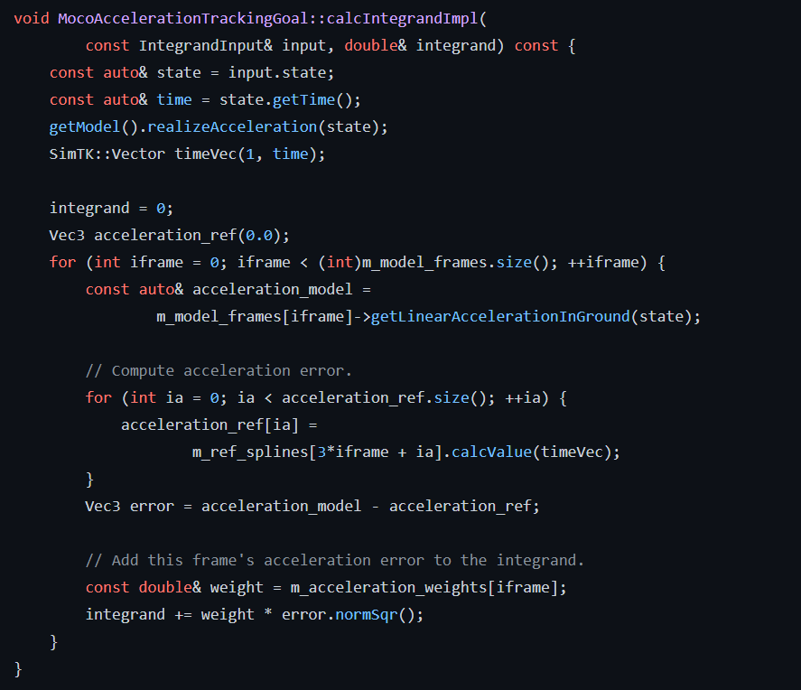
How do you access state information?
These files contain a lot more information than the opensim documentation.
Including variables that allow you to access lower level information about objects.

