Slide 1
Moco: Building projects and making custom goals in C++

Slide 2
Things you need
Opensim 4.0 or more recent, preferably 4.3
https://simtk.org/frs/?group_id=91
Cmake 3.2 or more recent
https://cmake.org/download/
Visual Studio (community) 16 or more recent.
https://visualstudio.microsoft.com/downloads/
Make sure you get the Desktop development tools for c++
A github account (optional), github desktop is also a nice addition.
https://github.com/

Slide 3

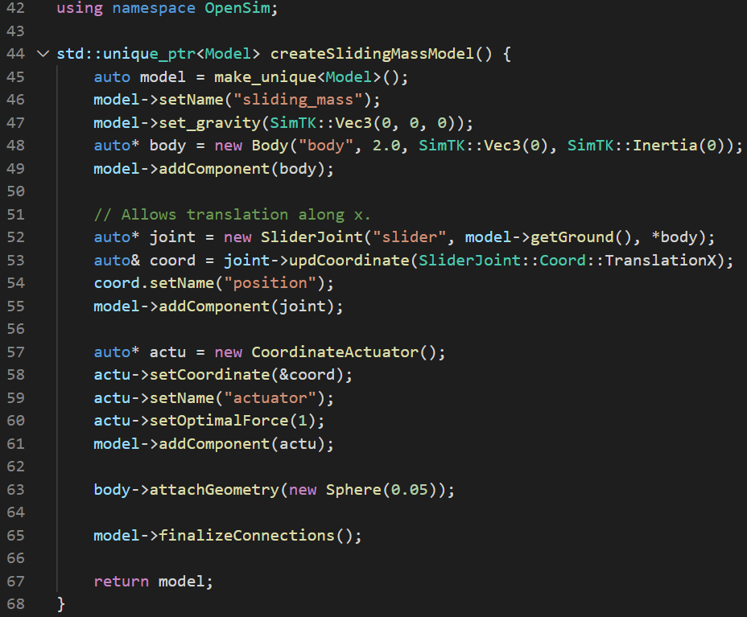
Example Moco C++ code
exampleSlidingMass.cpp
Libraries
Model setup
A mass slides along the X-axis
with some force F pushing it.

Slide 4
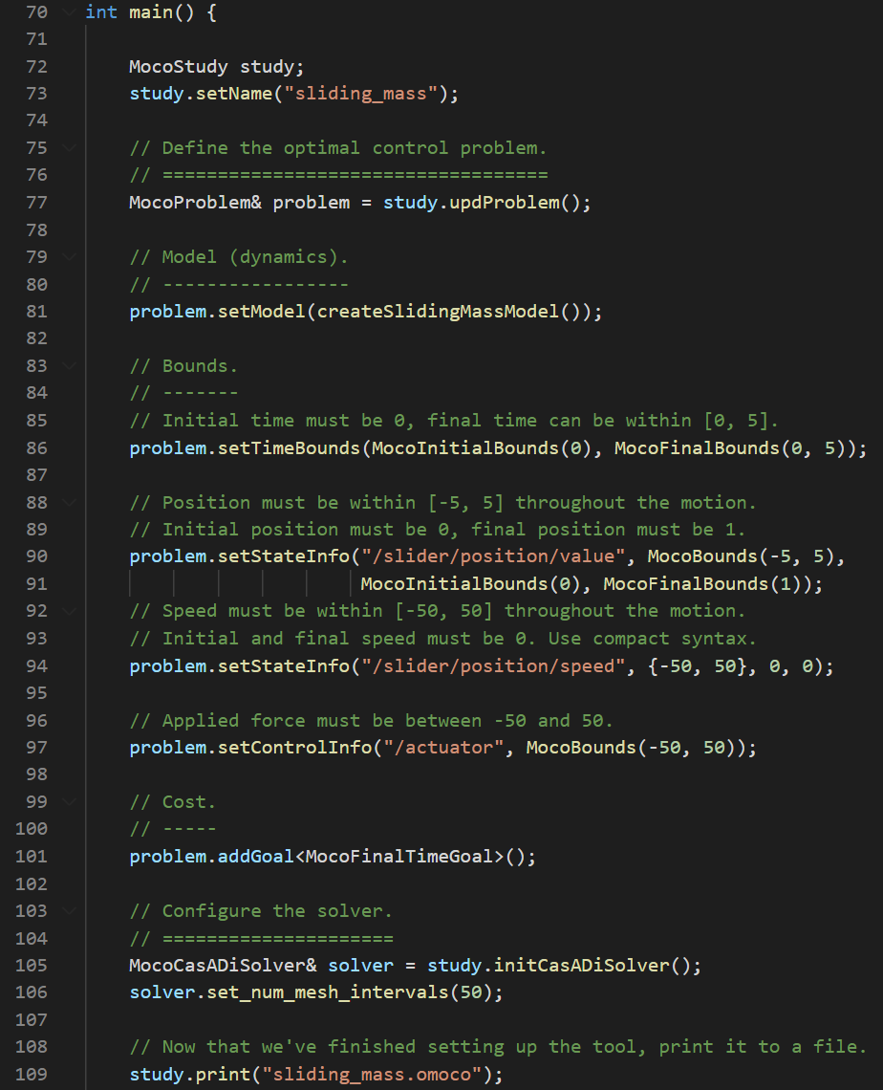
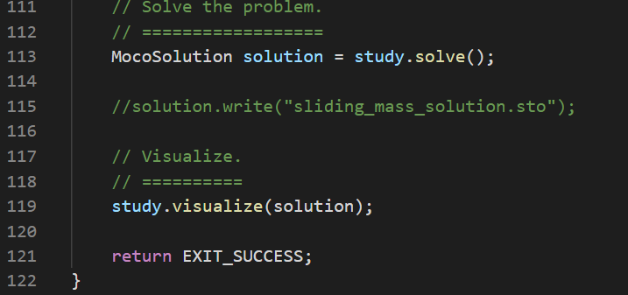
Example Moco code
Problem setup
Problem solve
Solve for the force, states and time,
such that –
The final time is minimized
Subject to:
Initial position is 0, Final position is 1
Initial speed is 0, Final speed is 0
Initial time is 0, Final time < 5
-5 < Position < 5
-50 < Speed < 50
-50 < Force < 50

Slide 5
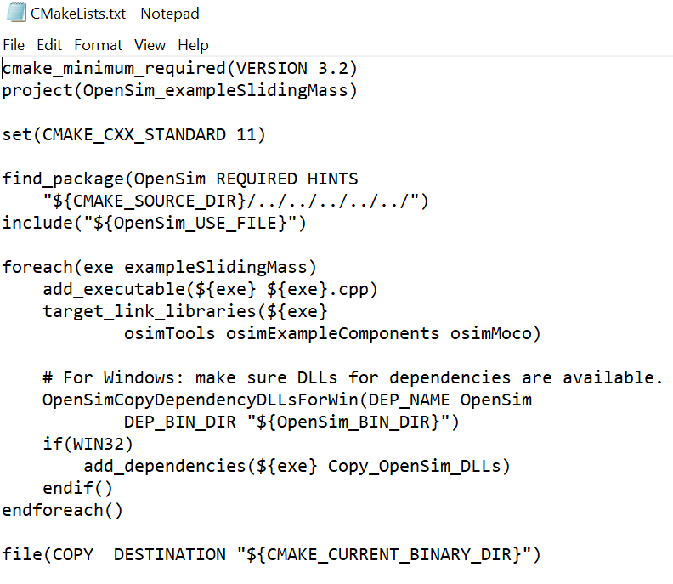
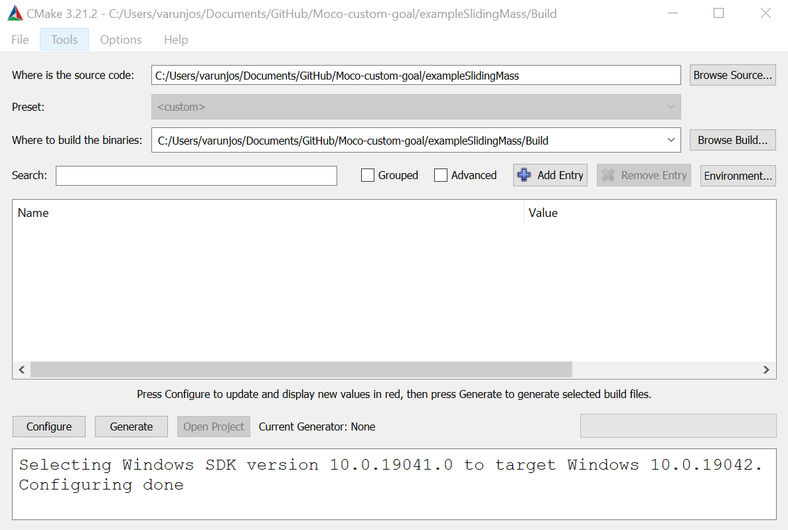
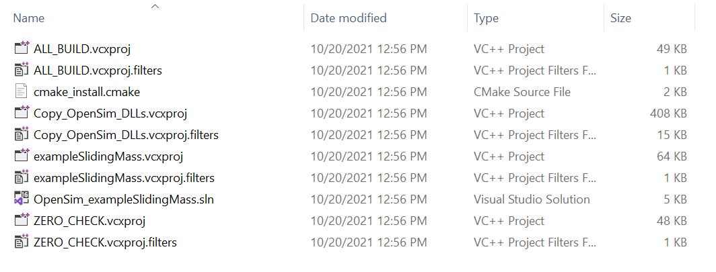
How do you build C++ code?
Unlike Matlab or python, you can’t just run C++ code. It needs to be compiled into an executable.
We use cmake to generate a “makefile”.
+
=

Slide 6
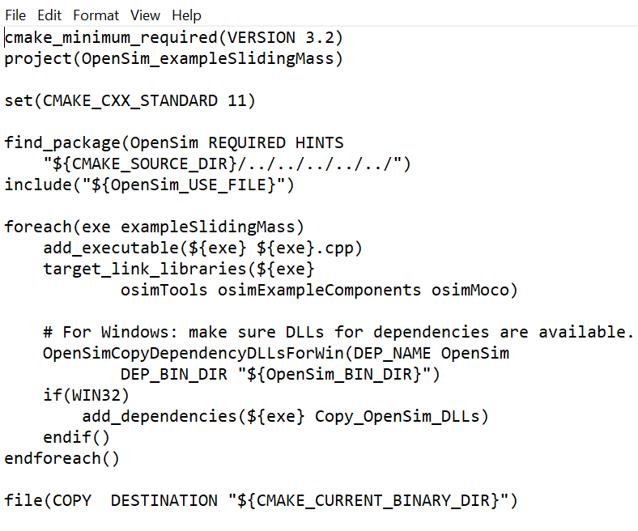
Moco example make list
For most Moco projects you want to build,
this is most likely the only thing you need to change

Slide 7
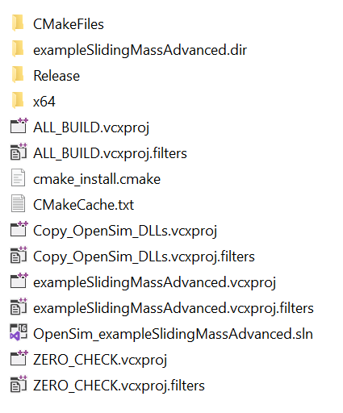
Once you’ve edited your make list
Configure and generate your makefile.
Common problems – folder names, visual studio version.
This will generate a solution file for visual studio

Slide 8
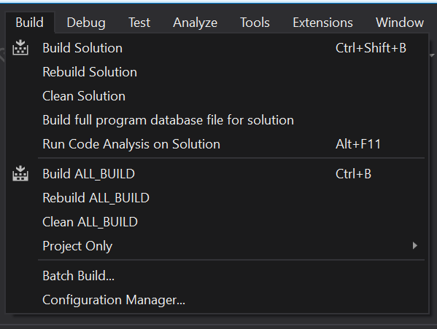
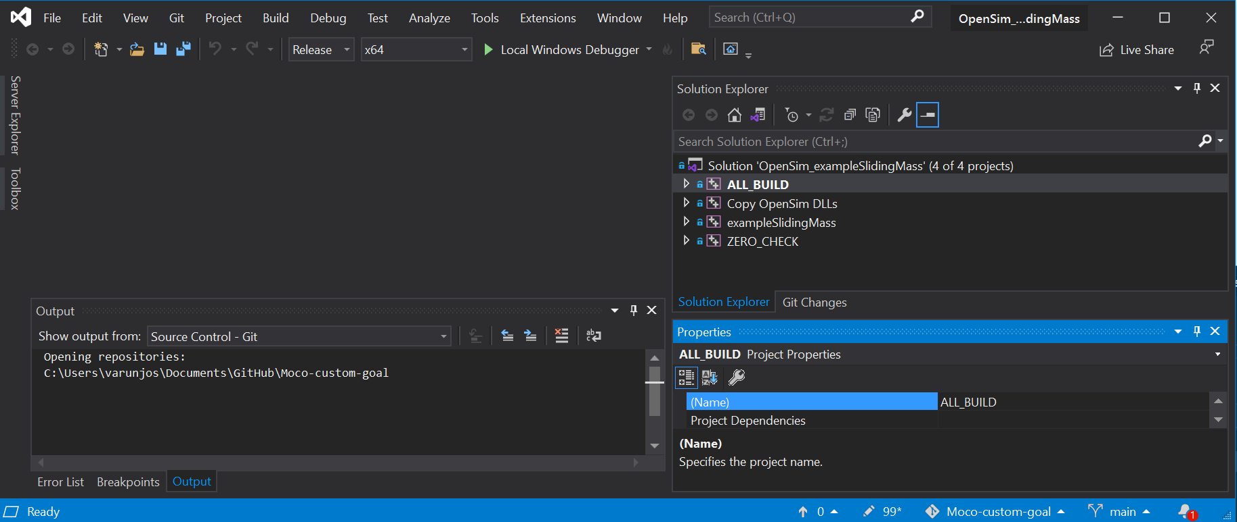
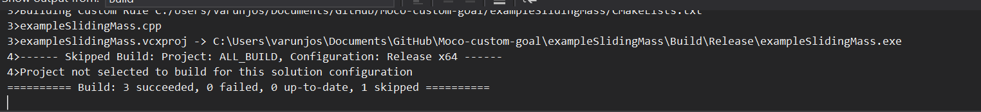
Open the solution file and build it

Slide 9
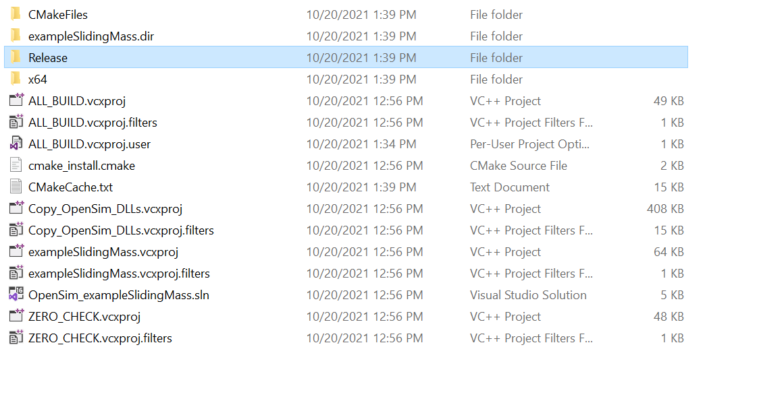
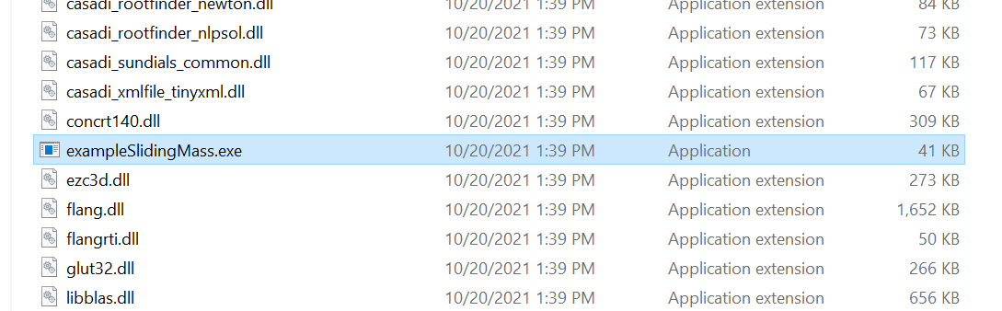
Run the executable

Slide 10
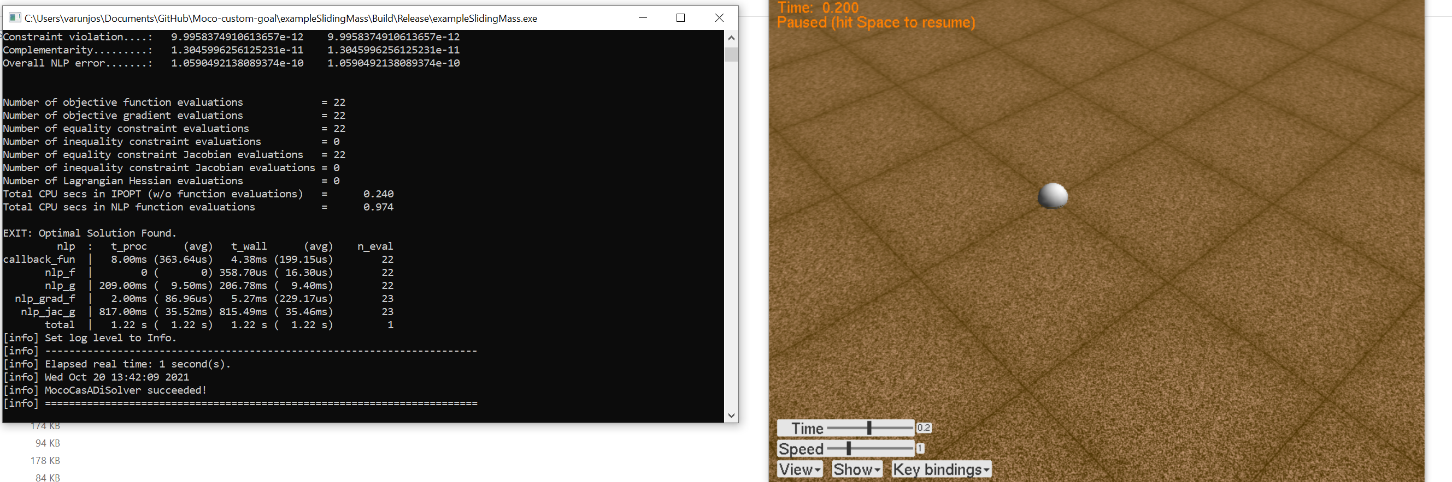
Success?

Slide 11
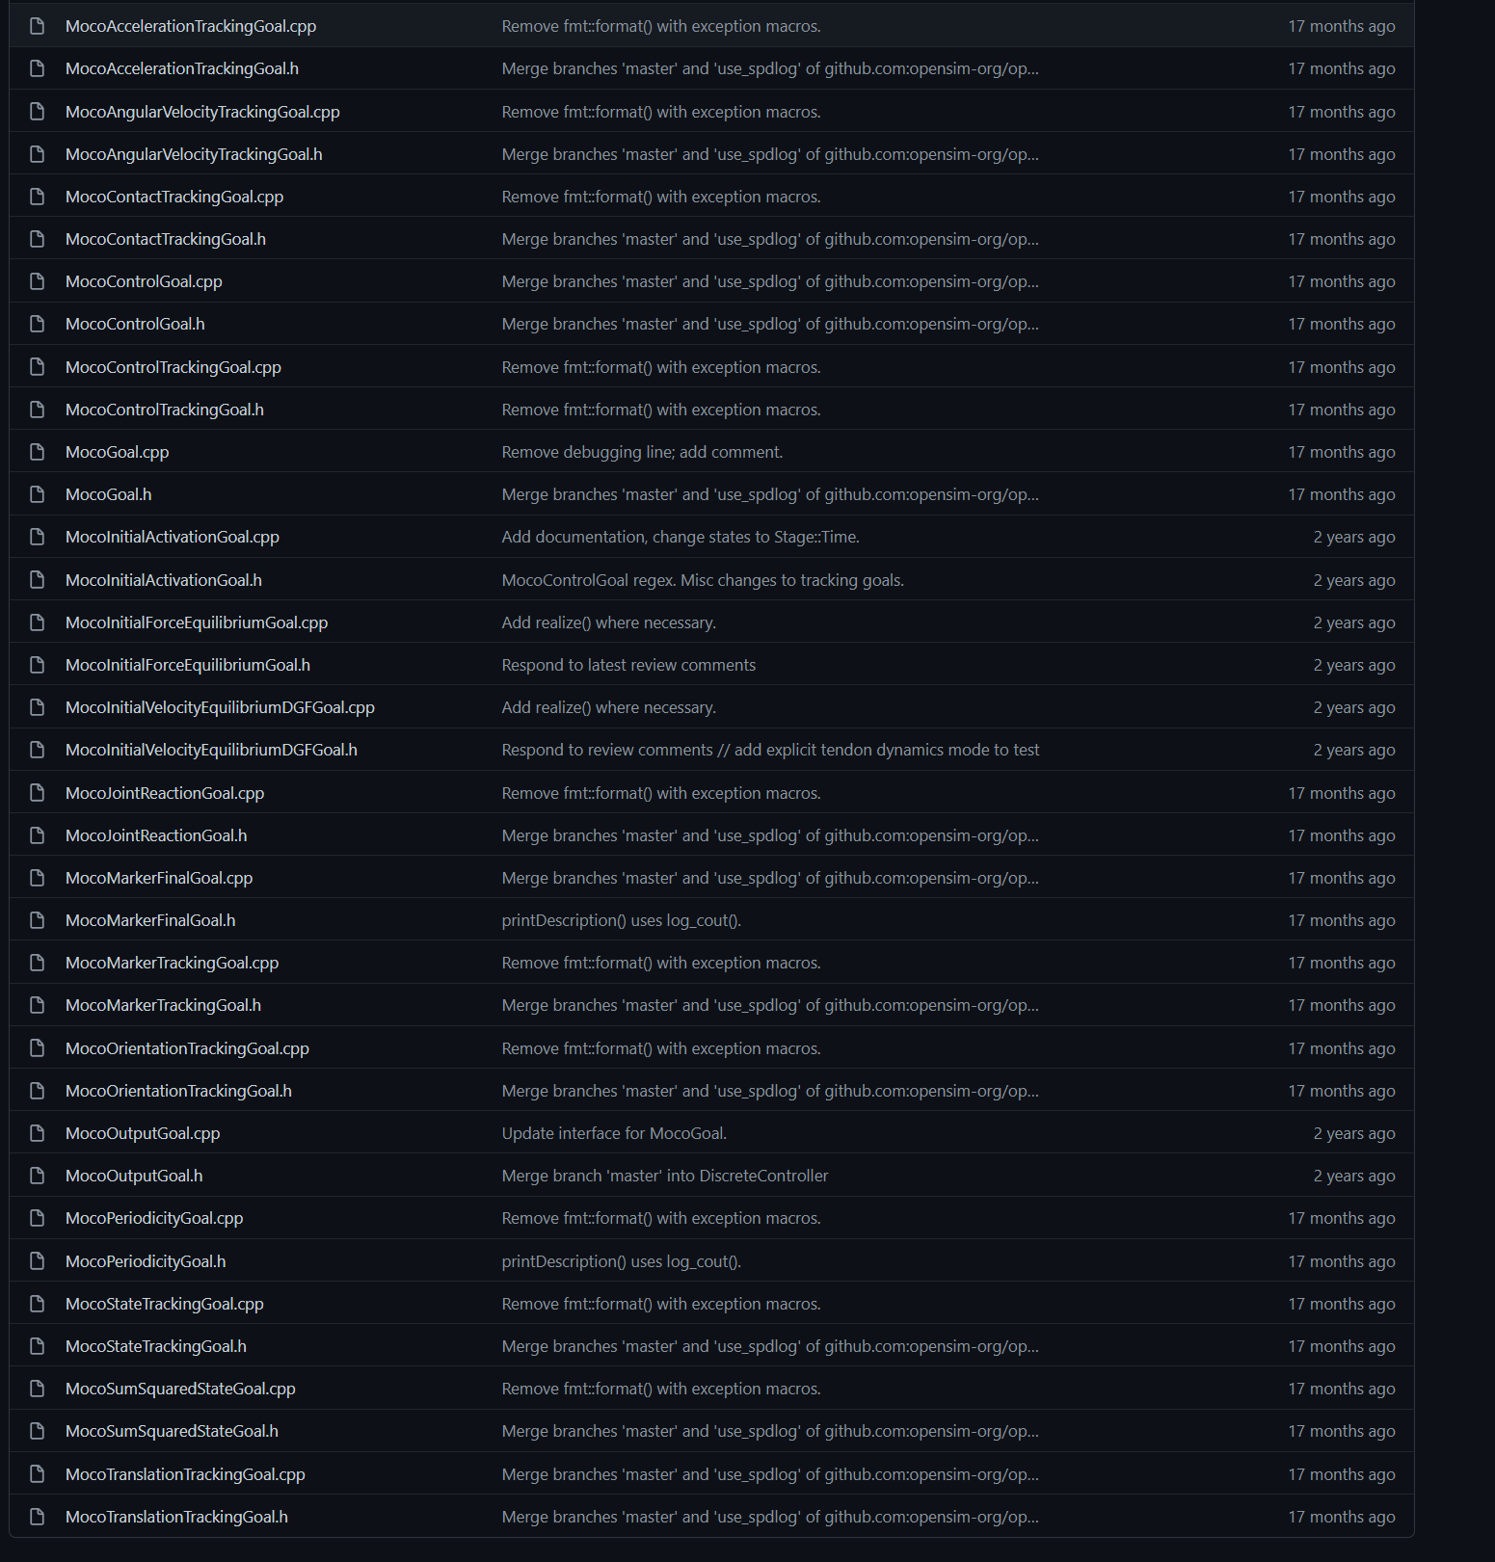
Most typically used goals are available
These files contain a lot more information than the opensim documentation.
Including variables that allow you to access lower level information about objects.

Slide 12
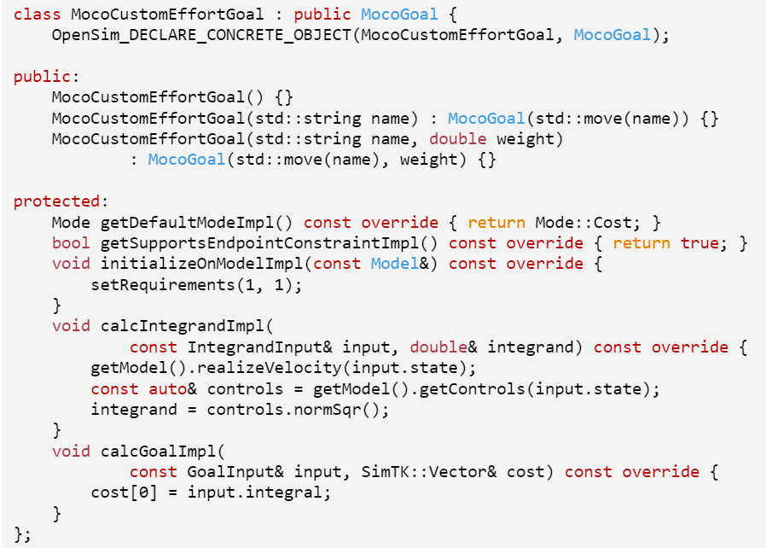
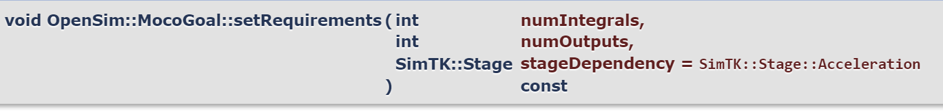
Custom goals
exampleSlidingMassAdvanced.cpp
These parts are REQUIRED
Constructors: Make sure to use the right name.
numIntegrals is either 0 or 1
This tells the code to expect one integrand
and to produce 1 integral as a result.

Slide 13
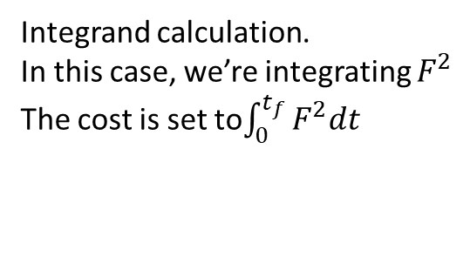
Custom goals
exampleSlidingMassAdvanced.cpp
These parts are OPTIONAL
Integrand calculation.
In this case, we’re integrating $F^{2}$
The cost is set to$\int_{0}^{t_{f}}{F^{2}dt}$

Slide 14
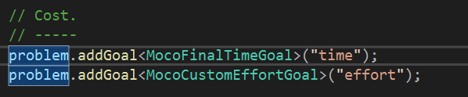
Using the custom goal
Now the optimizer is trying to balance between two goals –
Take the minimum time
Use the smallest forces

Slide 15
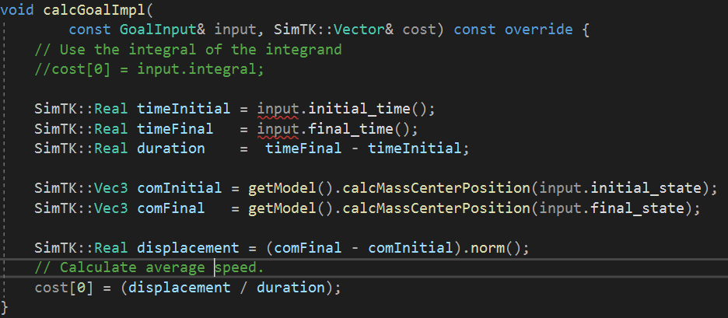
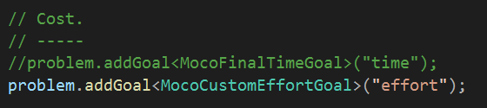
Other options
Minimize the speed of the block (this is the same as maximizing the time).
Note: we aren’t using the integrator for this.

Slide 16
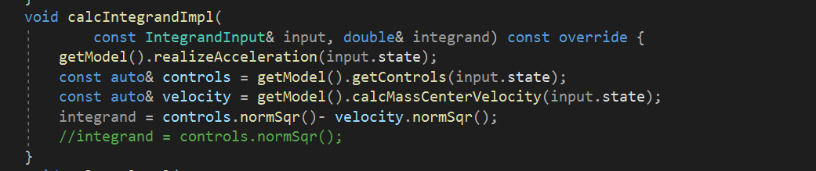
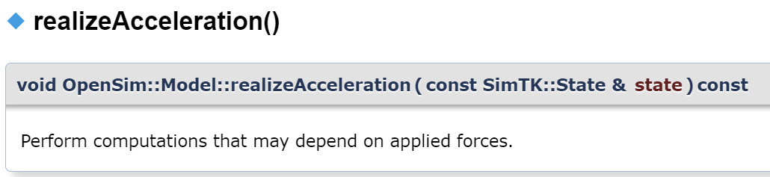
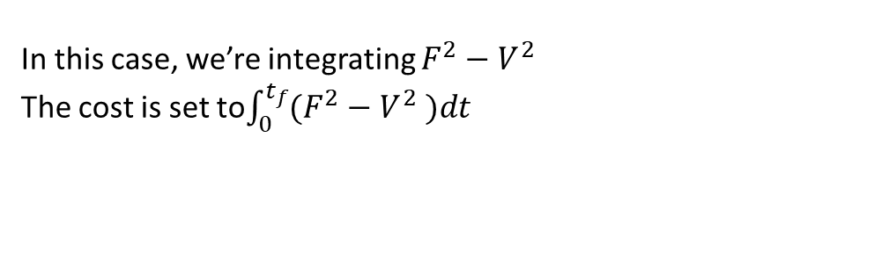
Other options
Something made up without any physical significance -
In this case, we’re integrating $F^{2}−V^{2}$
The cost is set to$\int_{0}^{t_{f}}{(F^{2}−V^{2} )dt}$

Slide 17
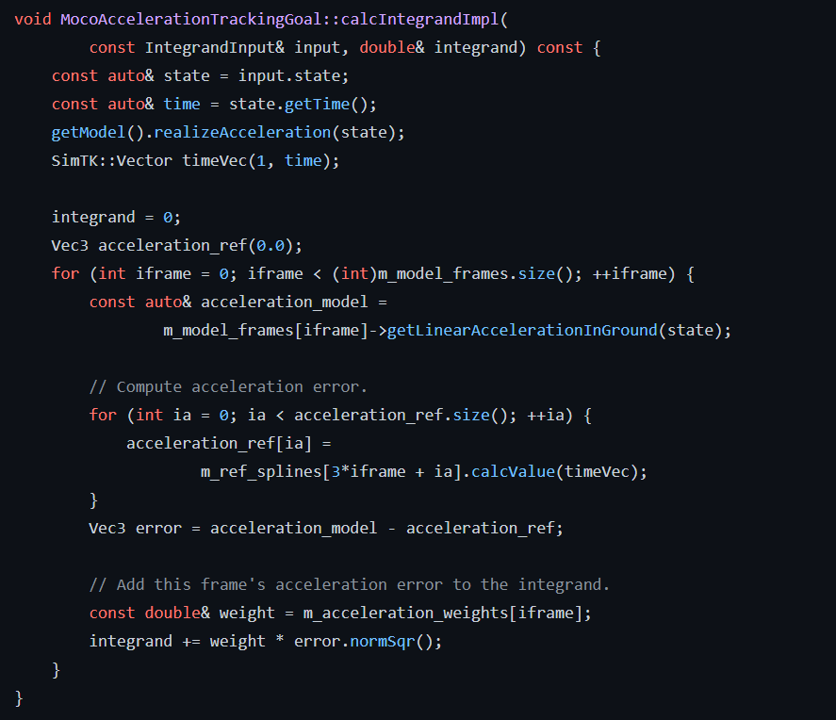
How do you access state information?
These files contain a lot more information than the opensim documentation.
Including variables that allow you to access lower level information about objects.

Slide 18
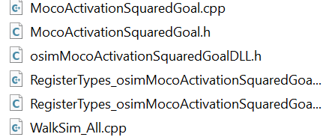
Making libraries
Goal: Making a library that could be used in Matlab (maybe, possibly, in the future?)
We need some new files

Slide 19
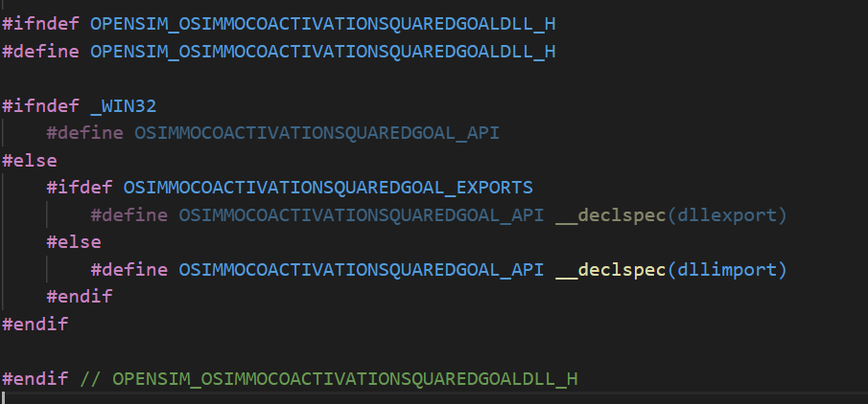
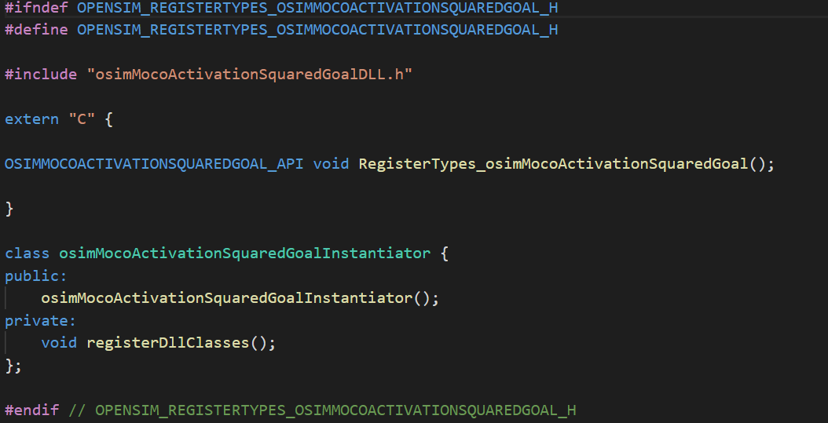
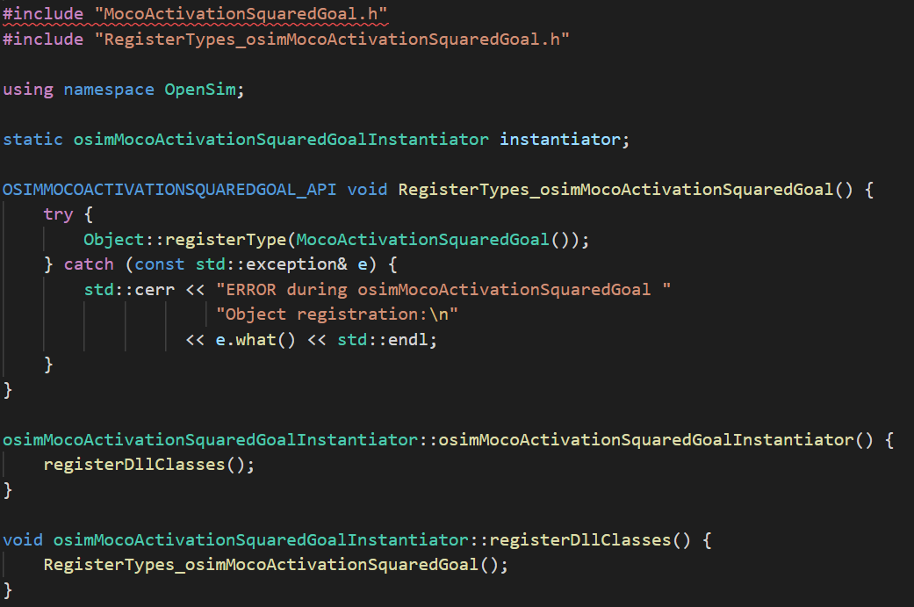
What’s in the new files?
Mostly bookkeeping
All you have to do is change the names according to your new custom goal file a few times.

Slide 20
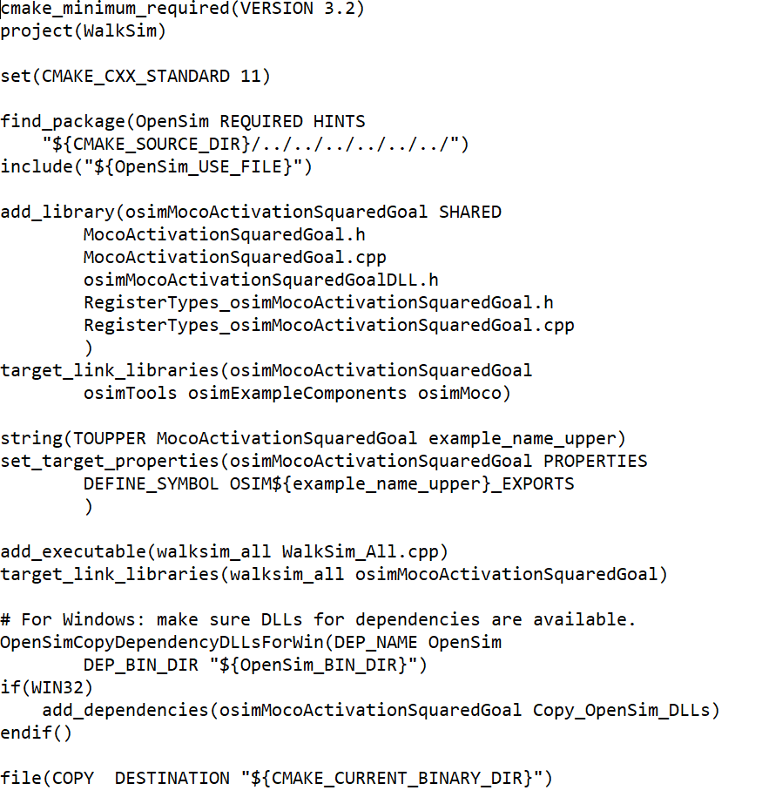
Make lists get more complicated

Slide 21
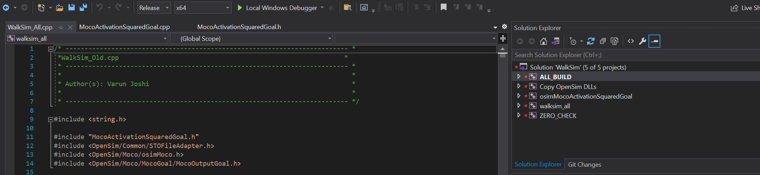
The rest is still the same

Slide 22
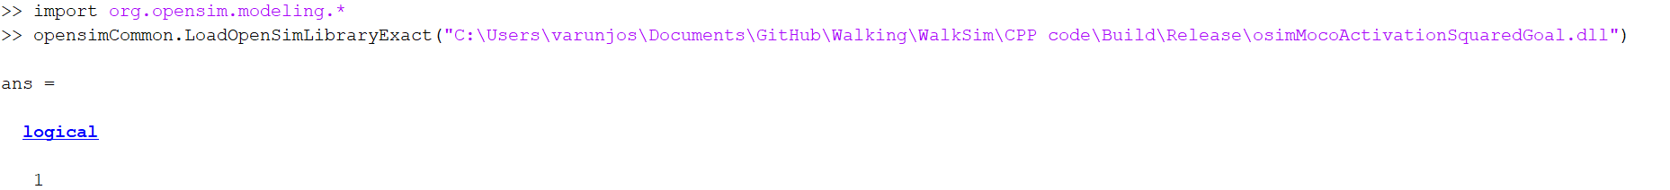
What’s the benefit?
Not much right now – Matlab needs java wrappers for dlls to use them.
However, you can now run a pre-made study (.omoco) using Matlab.
First load your library into Matlab –
Then run your study.
Without the dll -

