Slide 1

vAPI Trust Network
Paid human review for ERC-8183 jobs on Arc
Arc Testnet · Agentic Economy
Notes:
[Sources]
- https://github.com/vAPI-Network/vapi-arc
- https://github.com/vAPI-Network/vapi-arc/blob/main/docs/specs/2026-07-28-paid-human-review-exchange.md
- vAPI wordmark from the vAPI Hairline brand kit in the local vapi-app repository.
[/Sources]

Slide 2
02 / 05
AI reviews routine jobs. Auditors review the rest.
AIAllowed
The router checks the verdict against the job and policy.
Agent funds job
Freelancer submits work
Escrow settles
USDC enters the ERC-8183 escrow.
Arc stores a hash of the work.
Funds go to the freelancer or back to the client.
Human review
HumanOnly and escalated jobs wait for a reviewer.
AI never signs transactions. The router checks its verdict before the oracle submits it.
Notes:
[Sources]
- https://github.com/vAPI-Network/vapi-arc/blob/main/contracts/src/EvaluationRouter.sol
- https://github.com/vAPI-Network/vapi-arc/blob/main/core/README.md
[/Sources]

Slide 3
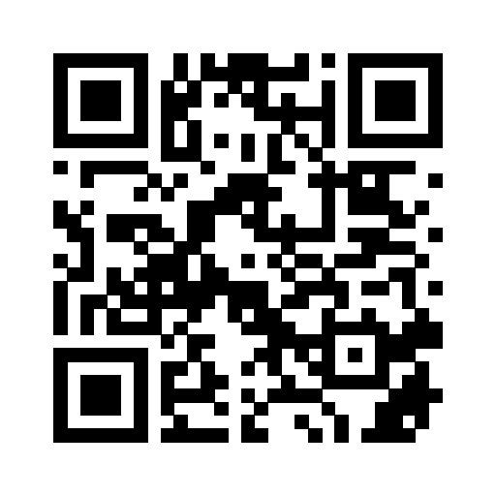
03 / 05
The agent pays 0.25 USDC. The auditor receives 0.20.
The agent pays through Circle Gateway
The service stores the review order.
Review in Telegram
Telegram sends the job to approved auditors
Claim, decide, and reply with a reason.
The first eligible claim wins.
The auditor approves or rejects
They must write a reason.
Circle Wallet pays the auditor
The service records the verdict and settles the escrow on Arc.
The reward is the same for approve and reject.
Notes:
[Sources]
- https://developers.circle.com/gateway/nanopayments/quickstarts/seller
- https://github.com/vAPI-Network/vapi-arc/blob/main/docs/specs/2026-07-28-paid-human-review-exchange.md
- https://github.com/vAPI-Network/vapi-arc/blob/main/contracts/src/EvaluationRouter.sol
- Telegram QR generated from https://t.me/vAPITrustCouncilBot.
[/Sources]

Slide 4
04 / 05
The router is live on Arc Testnet.
EvaluationRouter v3
Test jobs on Arc
Source verified
#159668
AI completed
0x44A51C365eB3eC703534ebb56394E7015930533D
#159669
Injection detected and escalated
AgenticCommerce
0x0747EEf0706327138c69792bF28Cd525089e4583
#159670
Human review selected and escalated
37 contract tests · 108 service tests · 14 browser tests
Notes:
[Sources]
- https://testnet.arcscan.app/address/0x44A51C365eB3eC703534ebb56394E7015930533D
- https://testnet.arcscan.app/address/0x0747EEf0706327138c69792bF28Cd525089e4583
- https://github.com/vAPI-Network/vapi-arc/blob/main/README.md
- https://github.com/vAPI-Network/vapi-arc/blob/main/contracts/test/EvaluationRouter.t.sol
- https://github.com/vAPI-Network/vapi-arc/tree/main/core/src
- https://github.com/vAPI-Network/vapi-arc/tree/main/app/tests
[/Sources]

Slide 5
05 / 05
The next live run must reach payout and settlement.
Job 159917
Next run
Escrow created and funded
01
Reply with a reason in Telegram
0.25 USDC x402 payment accepted
02
Confirm the 0.20 USDC payout
Telegram review expired before a verdict
03
Confirm the escrow result on Arc
04
Open the public run record
github.com/vAPI-Network/vapi-arc
vapi-web-production.up.railway.app
Notes:
[Sources]
- https://github.com/vAPI-Network/vapi-arc/blob/main/README.md
- https://vapi-web-production.up.railway.app
- https://github.com/vAPI-Network/vapi-arc/blob/main/docs/deployment/railway.md
[/Sources]

