Slide 1

DWDM TECHNOLOGY PALTEL TOPLOGY FOR PALESTINE
Prepared by:
Nermeen Saleh ,Salma Soufan ,Dima Khalil
Under Supervision of : Dr.Yousef Dama

Slide 2

DWDM Technology PALTEL Topology
1

Slide 3
1
REVIEW
TABLE
OF
CONTENTS
2
DWDM network design
3
Running out of bandwidth
4
Software implementation
2

Slide 4
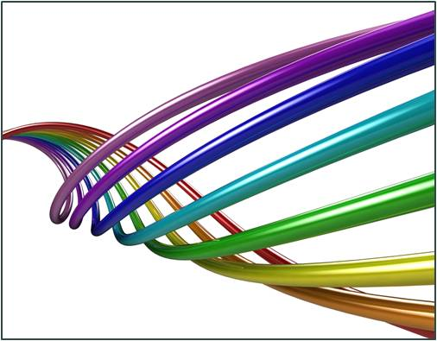
REVIEW
WHY DWDM ?!
WHAT is DWDM?!
DWDM
Equipments
The world of telecomm-unication networking is changing rapidly. Where once we had kilobits, we now demand megabit and gigabits. And soon the world will start using terabits.
is a technology which multiplexes a number of optical carrier signals onto a single optical fiber by using different wavelengths of laser light. This technique enables bidirectional communications over one strand of fiber, as well as increasing the capacity of the system.
1-Transponder/Muxponder Transceivers
2-MUX/DEMUX
3-Amplifiers
4- ROADM(Optical Add Drop Multiplexer).
3

Slide 5
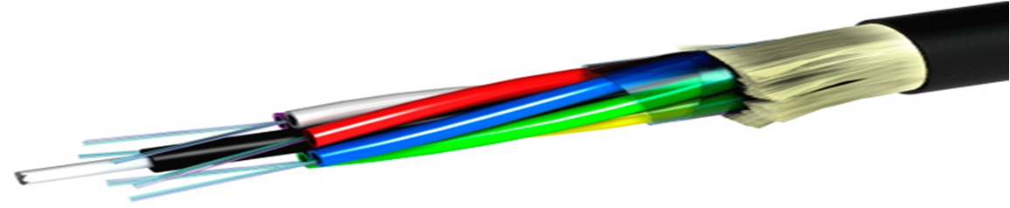

DWDM Network Design
and
Numerical Calculations
INTRODUCTION
Designing a DWDM point to point link or a ring requires some specifications that needs to defined before starting implementation
TARGET DESIGN SPECIFICATIONS
Total Capacity | 440Gbps
Number of channels | 44
Data rate of each channel | 10Gbps
Target BER
Target OSNR at the receiver | 20-30 dB
4
Notes:
89

Slide 6





DETERMINE THE DISPERSION LIMITATION OF THE SYSTEM
.
The first step is to measure the distance that a signal can pass without the need for dispersion compensation according to the following equations that find the spectral line width then use it to find the maximum distance
Where:
is the wavelength and it is 1550 nm
C is the speed of light 3*10^8
D is the dispersion coefficient 17 ps/nm.km
Bo is the data rate of each channel
λ
This means that the signal can pass 18.5km without the need for dispersion compensation and so in our case since the distances are larger than 18.5 a card called DCM(dispersion compensation module) must be used
(
5

Slide 7

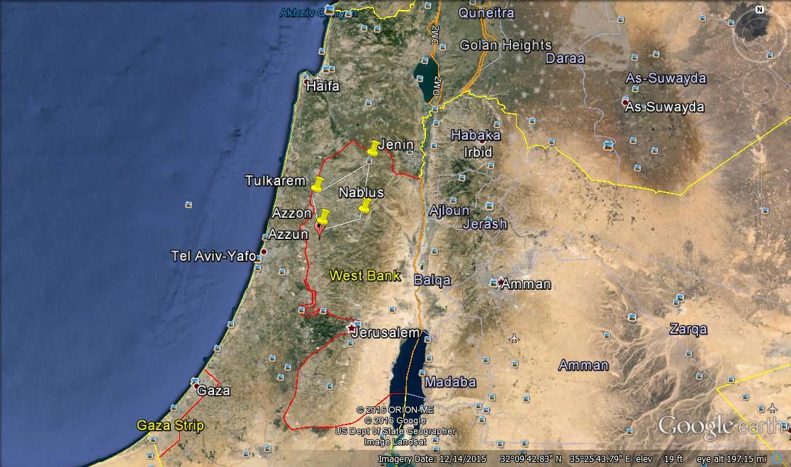
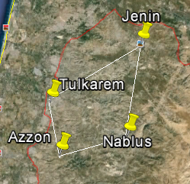
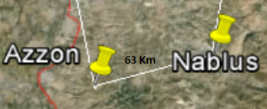
NORTH RING DESIGN

Slide 8


NABLUS-AZZON NUMERICAL CALCULATIONS
Since the total distance is 63(small) the amplifier span= 63Km
Find the received Power
System needs Amplification
Total Distance=63 Km
Find Number of Segments (N)
Now, find min input power of the amplifier
Find the span loss to find the gain of the amplifier
Calculate the OSNR
6

Slide 9
North Ring Design Results
Link Name | = |  | Estimated Loss | OSNR
Nablus-Jenin | 59.5km | -22.95 | 23.875 | 30
Jenin-Tolkarem | 60km | -22.95 | 24 | 30
Tolkarem-Azzon | 31km | -14 | ----- | -----
Azzon-Nablus | 63km | -23.8 | 24.85 | 29.15
For Tolkarem- Azzon link, it was found that the signal can reach it’s distention without the need for optical amplifier since the distance is 31 Km
7

Slide 10


WE
ARE
RUNNING
OUT OF
BANDWIDTH
INTRODUCTION
In a world where mobile device network additions are growing faster than the population, and machine2mchime device network additions are also growing faster than mobile device additions. The problem of bandwidth is clearly becoming highly important and requires a good solution. So not only does the network needs to grow, but it also needs to grow more cost effectively.
8

Slide 11

Data granularity:
which cost less to deploy
There are two solutions available for providing higher bandwidth and so solve the problem of higher bandwidth.
Replace the 44 wavelength with 88 wavelengths
Replace the 10g cards with 100g cards
10

Slide 12


Solution number 1
Despite the adavntages mentioned before , it is not very recommended because changing the whole infrastructure is not an easy task and costly.
Replace the 44 wavelength with 88 wavelengths
PROS
CONS
more robust to channel impairments
new equipment installations
requires low OSNR
planning and deployment costs
more flexible
11

Slide 13


Solution number 2
10gig signal VS. 100gig signal
Replace the 10g cards with 100g cards
The spectral width of a 100G OOK signal is ten times larger than 10G OOK signal, making it too wide to pass through DWDM filters without excessive penalties
The necessary modulator, driver and receiver electronics to attempt 100G OOK transmission are difficult to fabricate, making them hard to source and prohibitively expensive
chromatic dispersion limits transmission reach to a few kilometers before regeneration is required
This solution requires multiplexing ten 10gig wavelengths to produces 1 100gig wavelength by using a 100G muxponder cards.
Deploying a 100gig signal requirements:
the OSNR must be improved
more resilience to chromatic dispersion
the signal must be squeezed in to the 100 Gig spacing
HOW TO SLOVE THE ABOVE PROBLEMS?
deploy a DP-QPSK modulation scheme.
12

Slide 14

PROS
the service provider has effectively extended the life of the existing network and remaining bandwidth by up to 10 times
After solving the problems mentioned above we must decide whether to use the 100gig signal or change to 10gig with 50GHz spacing(44 wavelengths)
13

Slide 15
Feasibility study for the 100g deployment in DWDM network
In the 10G system, each 11 STAR card costs 7,000$. So to establish a link between two points, the cards will cost 14,000$.
in 100G system each port on the costs 1500$.
In our network, Med1-Swaimeh link carries 25 wavelengths. Such link will cost 25*14,000=350,000$.these 350,000 are not wasted since they can be reused in another node in case the demand increased.
To carry 25 wavelengths, two ports will be fully utilized ,and the third one will be half filled, the total cost will be
(2*10*1500+5*1500)*2= 75,000$
This solution will save 312,500$. In this way, we have stayed in budget and scaled the network to meet the increasing demands at the same time
14

Slide 16
TO BE HAPPY
JUST MOVE TO THE 100gig SIGNAL SOLUTION
15

Slide 17

APPLICATION IMPLEMENTATION
INTRODUCTION
This application is implemented based on JAVA language for the purpose of monitoring the DWDM network it supports five different modules that are shown below
NEW ROUTE
FIBER CUT
CONTROL PANEL
UTILIZATION
LINK DESIGN
16

Slide 18
Design Steps For The Software
Planning the network and determine the services
Implementing the database
Choosing a routing algorithm
Lamda and path assignment
17

Slide 19
The Functionalities and the modules of the software are shown in the following demo
18

Slide 20
Conclusion
In this project we have achieved the following
We have completed the third phase of PALTEL PLAN for DWDM network design in Palestine
We have improved the network and founded a solution for enhancing the capacity of the network
We have implemented a software for the purpose of monitoring and managing the DWDM network
19

