Slide 1

Machine Learning Project
Covid-19 Mortality Prediction
Gkatsis Vasileios
MTN 2004

Slide 2
Overview
Create machine learning models capable of predicting the number of people dying from covid-19 in a country during a month.
Gather and process data. (Our World In Data)
Extract the more explanatory features.
Create and tune models.
Evaluate the models.

Slide 3
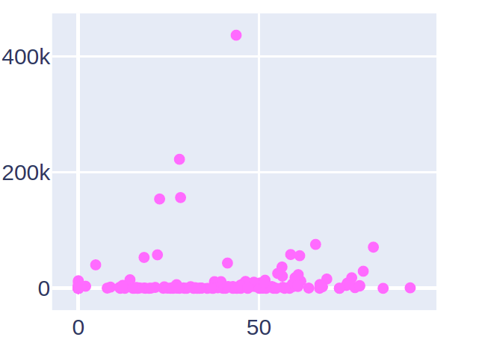
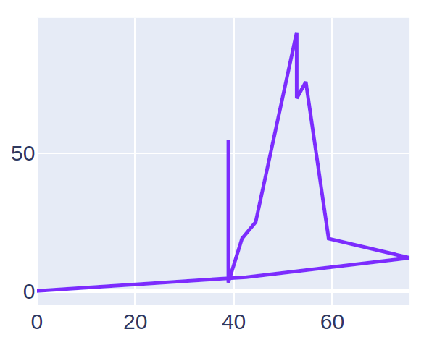
Feature Extraction
Choose the features that explain better the data using simple graphs.
Total Deaths - Smokers
Total Deaths – Stringency Index

Slide 4
Create Models
Linear Regression
Lasso Regression
Ridge Regression
K-NN Regression
Elastic-Net
Decision Trees
Support Vector Machines
Python library: scikit-learn
(SGD, and Tweedie Regression
Where also tested but left out due to very bad results)

Slide 5
Tune Models
Split data on train and validation.
Perform k-fold on train data and find average MAE.
Find MAE of validation dataset.
Keep the combination of parameter values that minimize both MAE scores

Slide 6
Test
Make predictions for the test dataset.
Count performance using the following metrics:
R²
Mean Average Error (MAE)
Mean Squared Error (MSE)
Rooted Mean Squared Error (RMSE)

Slide 7
Results
 | Linear Regression | Lasso Regression | Ridge Regression | kNN Regression | Elastic Net | Decision Trees | SVM
R2 | 0.79 | 0.78 | 0.69 | 0.2 | 0.78 | 0.92 | -0.15
MAE | 2326.4 | 2360 | 2438.9 | 4643.7 | 2419.1 | 1599 | 5232.1
MSE | 18312097 | 19008276 | 27148578 | 69774062.2 | 19427773 | 7362844 | 100242603
RMSE | 4279.26 | 4359.8 | 5210 | 8353 | 4407.7 | 2713.46 | 10012

Slide 8
Final Thoughts
Not a feasible project.
Not with simple machine learning tools.
Not without including more data (epidemiological, cultural etc.)
Maybe deep learning methods can produce more stable models.

