Slide 1
Internal Assessment 1
Gopalakrishnan
Employee_ID : 4361

Slide 2
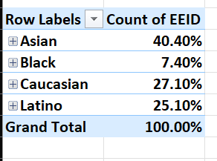
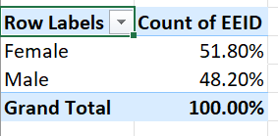
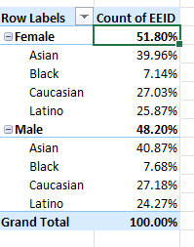
Q1.
Observation:
The employees are divided into 4 ethnicity Asian, Black, Caucasian and Latino with 40.40%, 7.40%, 27.10%, 25.10% of the total number of employees respectively
The employees are divided into 2 genders male and female with 51.80% and 48.20% of the total number of employees respectively

Slide 3


Q2.
Observation:-
- On average an employee stays in the company for ~1801 days

Slide 4
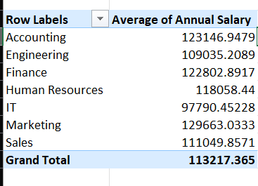
Q3.
Observation:
- Every department has average salary around 1,10,000 and there is no significant difference between them

Slide 5

Q4.
Observation:
- The United States country has the highest number of employees

Slide 6
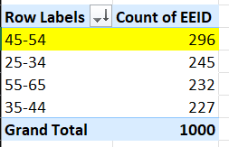
Q5.
Observation:-
The most common age range among employees are 45-54 with 296 employees

Slide 7


Q6.
Observation:-
- The average bonus % given to employees is 8.87%

Slide 8
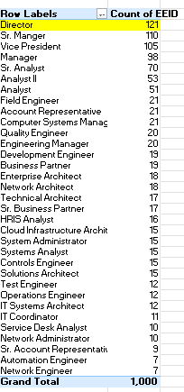
Q7
Observation:-
- The Director job title occurs the most frequently in the dataset

Slide 9
Q8.

Slide 10
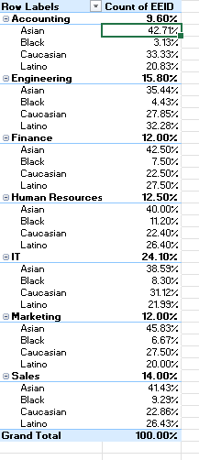
Q9
Observation:-
All department have highest % of employees from Asian ethnicity and lowest as black
Some departments have more Caucasian than latino and vice-versa, but does not have a major difference
Hence all the departments seem to be similarly diverse based on ethnicity

Slide 11
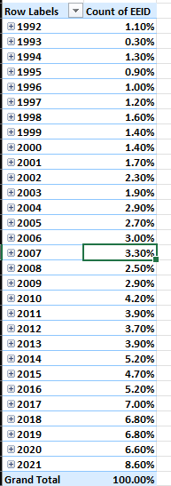
Q10.
Observation:-
Yes, there has been an increase in the number of hires over the years from 1992 to 2021 with a slight drop in the years 1993, 1995, 1999, 2003, 2005, 2008, 2011, 2012, 2015, 2018, 2020
Decrease in 2 consecutive years 2011 and 2012
Major increase in 2021, 2017, 2014, 2010, 2004

