Slide 1
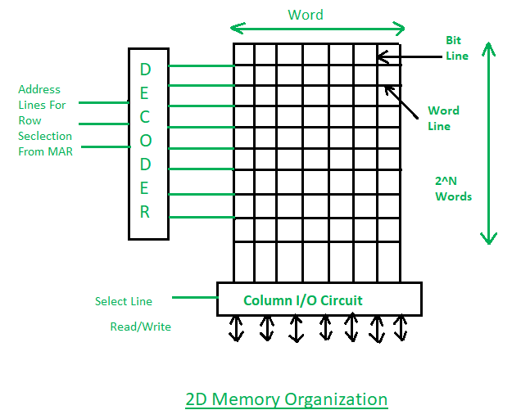

Data Representation
How are the values of the different data types stored in the computer ?
  In memory , in files, in a database, on the network
1010100011101010101001010101010100001010101010010
memory
file
database
network
"Hello World"
"你好世界" "
"வணக்கம் உலகம்"
😁🙏➡️➡️👥🙌
1234
12.345
True/False
con.execute(f"INSERT INTO DB VALUES {message}")
socket.send(
message.encode())
message = input()
f.write(message)
{"name":"John",
"age": 24,
"hobbies": [
"chess"
]
}

Slide 2
Encoding and Decoding
Encoding is the process of converting data from one format to another for storage, transmission and processing efficiency.
Decoding is the reverse process, converting encoded data back into its original format.
Please do not confuse these with the concepts of Encrypting and Decrypting. They have different objectives.
Encoding and Decoding is NEVER used for the purpose of obfuscation.

Slide 3
Unicode
every symbol used in human written communication is represented by a non-negative integer known as a code point
Each code point can be encoded into 3 different encoding scheme:
  UTF-8 (Default in Python and most operating systems)
  UTF-16
  UTF-32

Slide 4
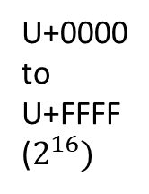
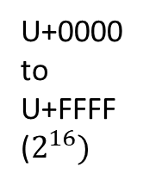

A
https://unicode-table.com/en/
Unicode
plane
Unicode
plane
U+0041
Unicode
plane
glyph
U+0000
to
U+FFFF
($2^{16})$
😀
U+1F600
glyph
U+0000
to
U+FFFF
($2^{16})$
U+5B57
Basic Multilingual Plane
字
U+0000-U+FFFF
U+110000-U+11FFFF
U+10000-U+1FFFF
glyph
17
Total no. of Code Points = $2^{16}×17=1,114,112$
Number of bytes to represent Unicode codepoints = 3 bytes
16 bits + 5 bits(17 ) = 21 bits

Slide 5
Python Code Points
Unicode Code Points are written as U+XXXXXX, where X is a hexadecimal digit
In Python, code points are written as "\uXXXX", if the code point is between 0000 and FFFF and "\UXXXXXXXX" if the code point value is > FFFF
In Python using string literals
  print("\u4e50"), print("\U0001F600")
In Python using the chr() function
  print( chr(0x4e50) )

Slide 6
Encoding a Code Point
storing an integer ranging from 0 to 1 114 112₁₀ in memory or file
00000000 to 00010000 11111111 11111111₂
UTF-8, UTF-16, UTF-32 can be used to encode all UNICODE Code points

Slide 7
UTF-8
UTF-16
UTF-32
8-bit
8-bit
8-bit
8-bit
8-bit
8-bit
8-bit
8-bit
8-bit
8-bit
16-bit
16-bit
16-bit
32-bit

Slide 8
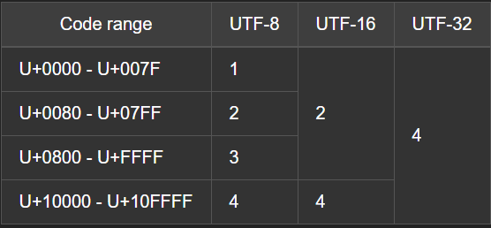
UTF-8 vs UTF-16 vs UTF-32
ASCII
Cyrillic,Hebrew,Arabic
Thai,CJK Ideographs
Emoji
UTF-8 is compatible with ASCII
UTF-16 can be used for most languages with just 2 bytes instead of 3 bytes for UTF-8
UTF-32 seldom used
BOM, Byte Order Marker is used for UTF-16 and UTF-32 to indicate Endianness
  0xFF 0xFE ,Little Endian ( Least Significant Byte First)
  0xFE 0xFF ,Big Endian (Most Significant Byte First)

Slide 9
Integer Representation

Slide 10
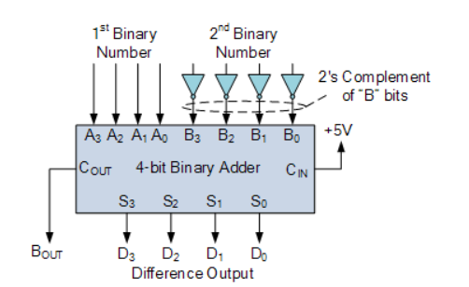
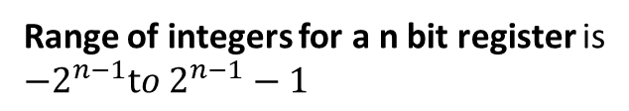
3-BIT COMPUTER
Bit pattern | Sign Magnitude | 1's complement | 2's complement
000 | 0 | 0 | 0
001 | 1 | 1 | 1
010 | 2 | 2 | 2
011 | 3 | 3 | 3
100 | -0 | -3 | -4
101 | -1 | -2 | -3
110 | -2 | -1 | -2
111 | -3 | -0 | -1
in 2's complement Overflow occurs when:
both operands with same sign results in different sign
carry-in to the most significant bit is different from the carry out
Range of integers for a n bit register is
$$−2^{n−1}to 2^{n−1}−1$$
When the msb is 1, it means –ve,
flip the bits to get its abs value
When the msb is 1, it means –ve,
flip the bits and + 1 to get its abs value

Slide 11
3-BIT COMPUTER 2's complement arithmetic
Bit pattern | 2's complement
000 | 0
001 | 1
010 | 2
011 | 3
100 | -4
101 | -3
110 | -2
111 | -1
3
-1
2
0 | 1 | 1
1 | 1 | 1
0 | 1 | 0
2
-4
-2
0 | 1 | 0
1 | 0 | 0
1 | 1 | 0
-1
-4
-5
1 | 1 | 1
1 | 0 | 0
0 | 1 | 1
3
1
4
0 | 1 | 1
0 | 0 | 1
1 | 0 | 0
in 2's complement Overflow occurs when:
both operands with same sign results in different sign
carry-in to the most significant bit is different from the carry out

Slide 12
Real Number Representation

Slide 13
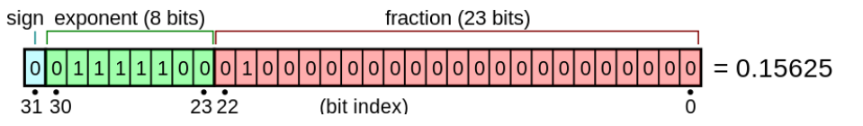
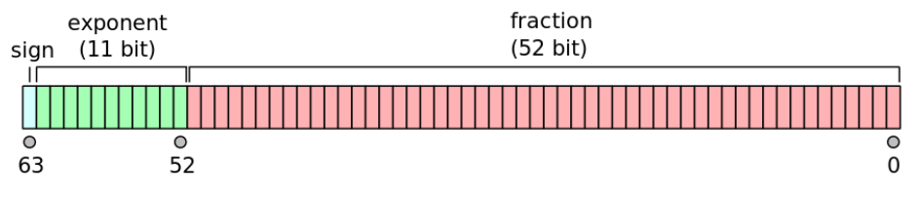
IEEE 754
32 bit single precision
64 bit double precision
mantissa
significand
mantissa
significand

Slide 14
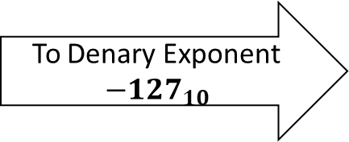
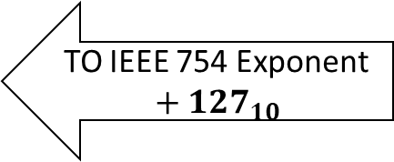
Exponent Bias: mapping a range of signed integers to unsigned integer
IEEE 754 32 BIT
EXPONENT RANGE with 8 bit exponent
Denary
EXPONENT RANGE
255
128
TO IEEE 754 Exponent
$$+ {127}_{10}$$
To Denary Exponent
$$−{127}_{10}$$
0
-127
* in actual implementation 255 (11111111₂) is used to represent infinity, so denary range is actually -127 to 127

Slide 15
Convert Decimal to IEEE 754 representation
sign | exponent | mantissa
Convert 8.625 to
Convert the integer part and the fractional part separately, such that 8.625 = 8 + 0.625.
The integer part can be directly converted to binary using base conversion: 8₁₀ = 1000₂
Convert the fractional part as follows:
    multiply the fraction by 2
    take the integer part, as the binary digit
    repeat step i) but without the integer part, until the fraction is zero or 23 fraction digits have been found
    Example:
    0.625 × 2 = 1.25 (1) leftmost binary digit after the bicimal point
    0.25 × 2 = 0.5 (0)
    0.5 × 2 = 1.0 (1)
    Since the fractional part of 1.0 is 0, the process is terminated, and we reach a value of 101. Hence, 0.625₁₀ = 0.101₂.
    Summing the two parts, 8.62510 = 1000₂ + 0.101₂ = 1000.101₂.
Normalise the sum such that the only integer before the binary point is 1.
Normalising 111.101₂, we get 1.000101 × 2³. [mantissa × 2 ^{exponent.}]
Sign bit = 0, since 8.625 is a positive number
  Biased exponent = 3 + 127 = 130 = 10000010₂
  Dropping the 1, fractional part of mantissa= 000101_{2,}
0 1000001 00001010 00000000 00000000

